Slide 1
April 4th 2023
Mini Argus Timex Sensitivity Analysis: Image Correlation with Mask (10 minute benchmark)

Slide 2
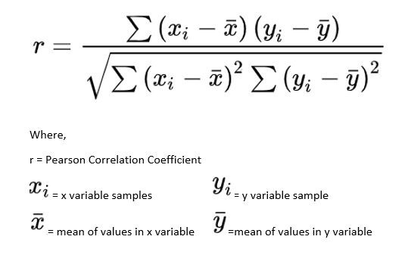
Tabular Wave Data and Methodology
An Image Correlation analysis using the numpy.corrcoef function was conducted for each Mini Argus collect listed on the table below.
The function returns the Pearson correlation coefficient (r), which describes the strength and direction of the linear relationship between two images.
To conduct the test, 7 Timex sampling schemes, ranging between 1.5 and 15.0 minutes (1.5, 3.0, 4.5, 6.0, 7.5, 9.0, 15.0min), were masked to remove the foreground and sky, leaving only the surf zone, then compared to an Argus Style benchmark Timex (10 minutes @ 2Hz).
The sampling scheme with the highest correlation for each set of wave conditions is highlighted in red.
Collect | UTC Time | Wave Height (m) | Dominant Period (s) | Average Period (s) | Direction (deg)
1663005397544 | Mon 12 Sept 2022 9:32 | 1.44 | 14.29 | 9.45 | 73
1663080831409 | Tue 13 Sept 2022 6:30 | 1.38 | 14.29 | 10.38 | 86
1663869541385 | Thu 22 Sept 2022 9:29 | 0.8 | 11.76 | 7.54 | 125
1663948741409 | Fri 23 Sept 2022 7:29 | 2.3 | 6.67 | 5.45 | 20
1664117941403 | Sun 25 Sept 2022 6:29 | 0.64 | 9.09 | 5.88 | 83
1664395141403 | Wed 28 Sept 2022 11:29 | 1.49 | 5.56 | 4.5 | 12

Slide 3
Mask Example
Example of Masked Image used in Correlation Analysis. 10 minute @ 2hz Timex w/ foreground and sky removed.
Note: A buffer in the foreground was left for image collects that had significant runup.

Slide 4
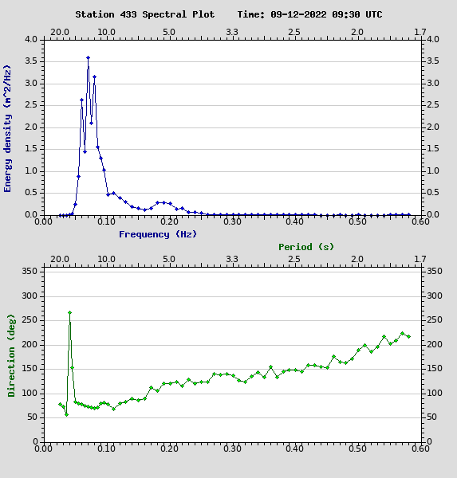
1) Collect 1663005397544
Collect | UTC Time | Wave Height (m) | Dominant Period (s) | Average Period (s) | Direction (deg)
1663005397544 | Mon 12 Sept 2022 9:32 | 1.44 | 14.29 | 9.45 | 73
1663080831409 | Tue 13 Sept 2022 6:30 | 1.38 | 14.29 | 10.38 | 86
1663869541385 | Thu 22 Sept 2022 9:29 | 0.8 | 11.76 | 7.54 | 125
1663948741409 | Fri 23 Sept 2022 7:29 | 2.3 | 6.67 | 5.45 | 20
1664117941403 | Sun 25 Sept 2022 6:29 | 0.64 | 9.09 | 5.88 | 83
1664395141403 | Wed 28 Sept 2022 11:29 | 1.49 | 5.56 | 4.5 | 12

Slide 5
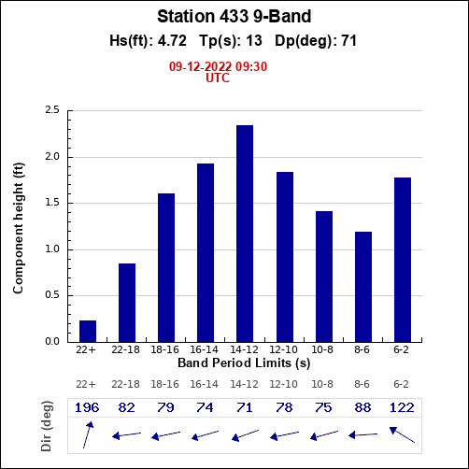
2) Collect 1663080831409
Collect | UTC Time | Wave Height (m) | Dominant Period (s) | Average Period (s) | Direction (deg)
1663005397544 | Mon 12 Sept 2022 9:32 | 1.44 | 14.29 | 9.45 | 73
1663080831409 | Tue 13 Sept 2022 6:30 | 1.38 | 14.29 | 10.38 | 86
1663869541385 | Thu 22 Sept 2022 9:29 | 0.8 | 11.76 | 7.54 | 125
1663948741409 | Fri 23 Sept 2022 7:29 | 2.3 | 6.67 | 5.45 | 20
1664117941403 | Sun 25 Sept 2022 6:29 | 0.64 | 9.09 | 5.88 | 83
1664395141403 | Wed 28 Sept 2022 11:29 | 1.49 | 5.56 | 4.5 | 12

Slide 6
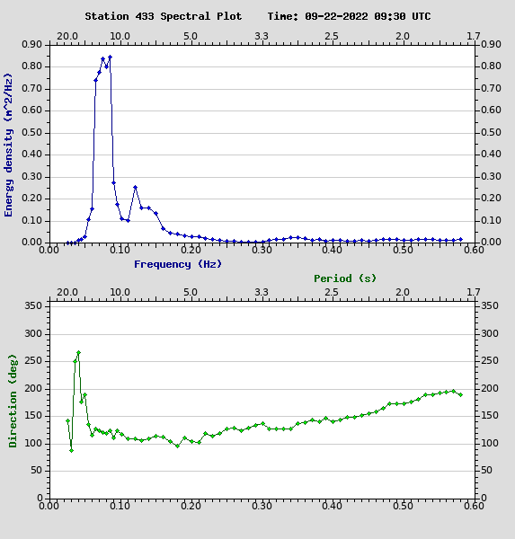
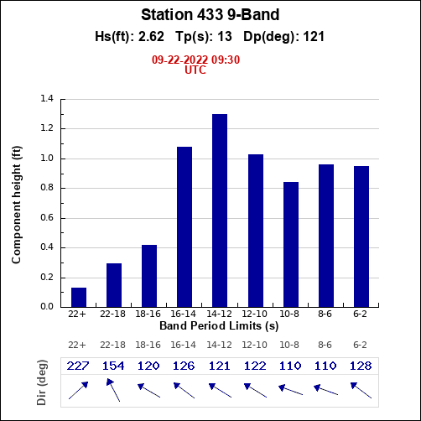
3) Collect 1663869541385
Collect | UTC Time | Wave Height (m) | Dominant Period (s) | Average Period (s) | Direction (deg)
1663005397544 | Mon 12 Sept 2022 9:32 | 1.44 | 14.29 | 9.45 | 73
1663080831409 | Tue 13 Sept 2022 6:30 | 1.38 | 14.29 | 10.38 | 86
1663869541385 | Thu 22 Sept 2022 9:29 | 0.8 | 11.76 | 7.54 | 125
1663948741409 | Fri 23 Sept 2022 7:29 | 2.3 | 6.67 | 5.45 | 20
1664117941403 | Sun 25 Sept 2022 6:29 | 0.64 | 9.09 | 5.88 | 83
1664395141403 | Wed 28 Sept 2022 11:29 | 1.49 | 5.56 | 4.5 | 12

Slide 7
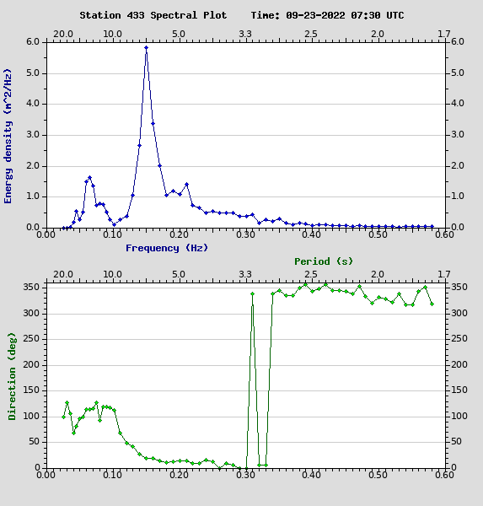
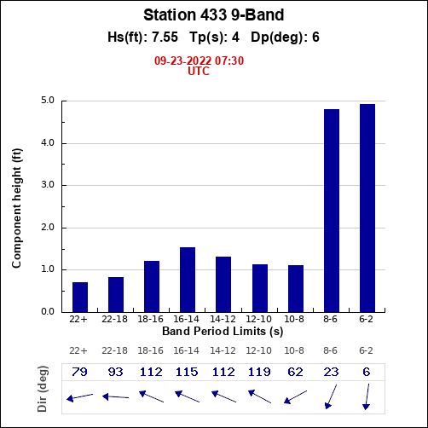
4) Collect 1663948741409
Collect | UTC Time | Wave Height (m) | Dominant Period (s) | Average Period (s) | Direction (deg)
1663005397544 | Mon 12 Sept 2022 9:32 | 1.44 | 14.29 | 9.45 | 73
1663080831409 | Tue 13 Sept 2022 6:30 | 1.38 | 14.29 | 10.38 | 86
1663869541385 | Thu 22 Sept 2022 9:29 | 0.8 | 11.76 | 7.54 | 125
1663948741409 | Fri 23 Sept 2022 7:29 | 2.3 | 6.67 | 5.45 | 20
1664117941403 | Sun 25 Sept 2022 6:29 | 0.64 | 9.09 | 5.88 | 83
1664395141403 | Wed 28 Sept 2022 11:29 | 1.49 | 5.56 | 4.5 | 12

Slide 8
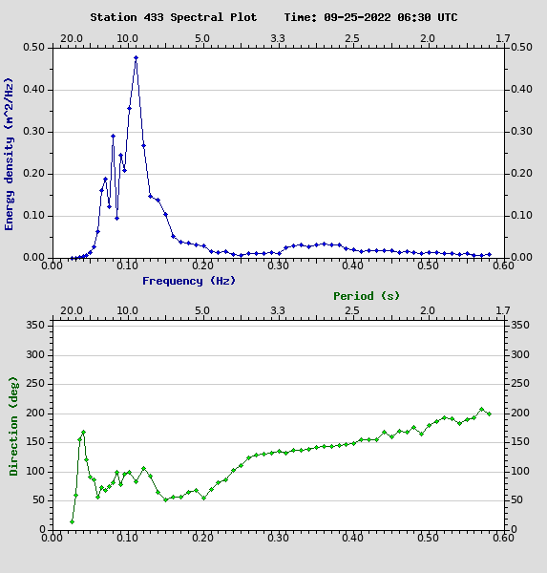
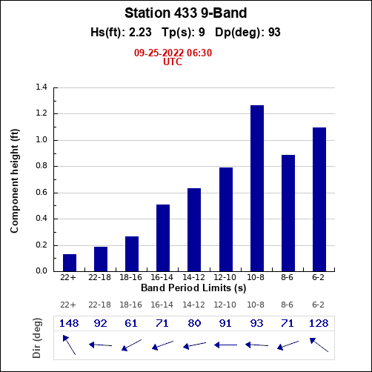
5) Collect 1664117941403
Collect | UTC Time | Wave Height (m) | Dominant Period (s) | Average Period (s) | Direction (deg)
1663005397544 | Mon 12 Sept 2022 9:32 | 1.44 | 14.29 | 9.45 | 73
1663080831409 | Tue 13 Sept 2022 6:30 | 1.38 | 14.29 | 10.38 | 86
1663869541385 | Thu 22 Sept 2022 9:29 | 0.8 | 11.76 | 7.54 | 125
1663948741409 | Fri 23 Sept 2022 7:29 | 2.3 | 6.67 | 5.45 | 20
1664117941403 | Sun 25 Sept 2022 6:29 | 0.64 | 9.09 | 5.88 | 83
1664395141403 | Wed 28 Sept 2022 11:29 | 1.49 | 5.56 | 4.5 | 12

Slide 9
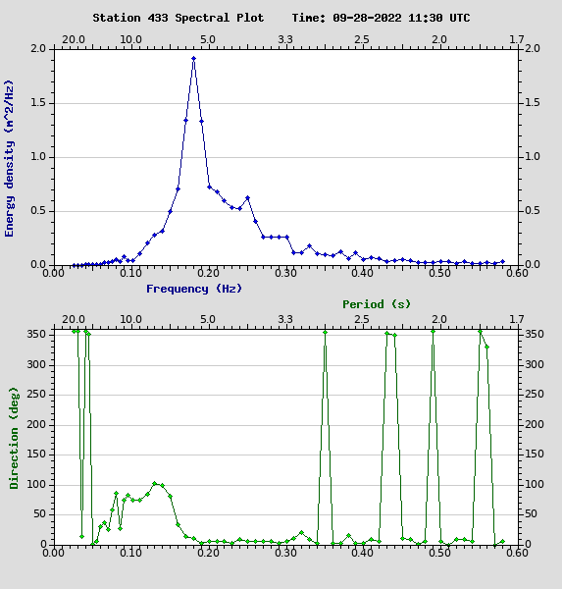
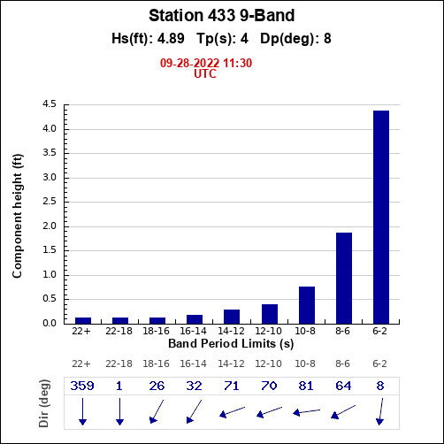
6) Collect 1664395141403
Collect | UTC Time | Wave Height (m) | Dominant Period (s) | Average Period (s) | Direction (deg)
1663005397544 | Mon 12 Sept 2022 9:32 | 1.44 | 14.29 | 9.45 | 73
1663080831409 | Tue 13 Sept 2022 6:30 | 1.38 | 14.29 | 10.38 | 86
1663869541385 | Thu 22 Sept 2022 9:29 | 0.8 | 11.76 | 7.54 | 125
1663948741409 | Fri 23 Sept 2022 7:29 | 2.3 | 6.67 | 5.45 | 20
1664117941403 | Sun 25 Sept 2022 6:29 | 0.64 | 9.09 | 5.88 | 83
1664395141403 | Wed 28 Sept 2022 11:29 | 1.49 | 5.56 | 4.5 | 12

Slide 10
Conclusions
This slide deck documents a statistical comparison of downsampled imagery (90 frames) and the total imagery record (1200 frames) for a given amount of time (10 minutes).
Under each of the 6 wave scenarios studied, the downsampled 10 minute duration scored highest (above 99.9%. A Pearson Correlation Coefficient of 1.0 is perfect).
This leads me to believe the implementation of the mask, reduced image noise in unimportant parts of the frame.
Image noise includes but is not limited to, changes in cloud patterns, variations in incident light striking the sand and dune grass, and motion of the dune grass.
This work demonstrates that a downsampled Timex created using 7.5% of the image record is 99.9% as good as using the full collect, if the duration of time of the two images are collected over is the same.
Same analysis using other statistical image products? Depending on results, downsampling may have implications for CorpsCam systems, sampling techniques, and data storage/processing, from trailcams to Big Argus.

