Slide 1
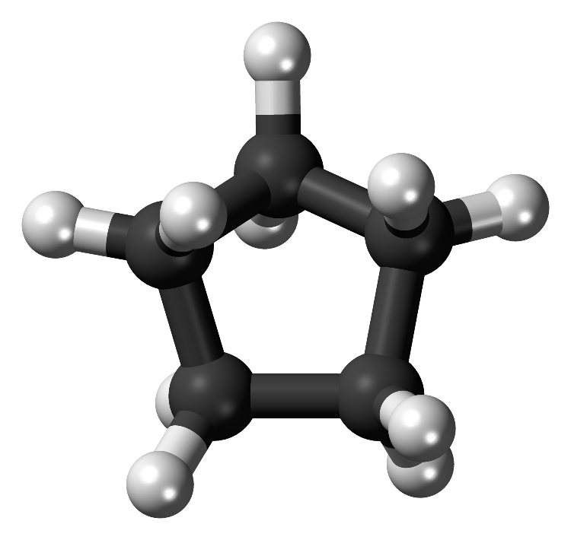
Cyclopentane
Uses: Cyclopentane is commonly used as a blowing agent for insulation, a plasticizer, a solvent, and a fuel additive.
Formula: C₅H₁₀
Physical Properties: Colourless liquid with a mild, sweet odour, with a boiling point of 49.2 degrees Celsius and a melting point of -94 degrees celsius. It is approximately 0.75 g/cu cm at room temperature

