Slide 1

STRENGTHENING CYBERSECURITY IN THE FINANCIAL INDUSTRY USING THREE COMPUTATIONAL STATISTICS TECHNIQUES
Autumn Chen, Kara Conway, and Connor Boos

Slide 2
Introduction to Cybersecurity in the Financial Industry
Cybersecurity- “any technology, measure, or practice for preventing cyber attacks or mitigating their impact” (from What is Cybersecurity?, IBM)
The financial sector today relies heavily on technology, making it increasingly susceptible to cyber attacks and fraudulent transactions
Many financial institutions need big data in order to increase market share
The financial industry is a prime target for cyber attacks and fraud due to the desire for financial gain
Cyberattacks and fraud against the financial industry can impact the economy and disrupt markets

Slide 3



Cybersecurity Challenges in the Financial Industry
Third-party companies make up a big part of the financial sector
Customers want to have the ability to send and receive funds electronically, which requires vetting, auditing, and managing these companies, which sometimes is not done correctly
Example of third parties: Venmo and PayPal
Technology rapidly increases, and hackers can benefit from new technologies that make it simpler for them to hack legacy systems
Example: many financial institutions don’t use two-factor authentication because customers find it inconvenient
Instead, they employ the latest applications in technology, which are under pressure to please customers and may lack the necessary security
Human behavior is often a weak link
Phishing emails
Social media platforms have been used to groom financial employees

Slide 4
Roadmap
Data Exploration – Credit Card Transaction Dataset (1 million record)
We will use 3 different computational techniques to detect fraudulent credit card transactions and compare model performance
1st Technique – Logistic Regression with Fisher Scoring
2nd Technique - Monte Carlo
3rd Technique – Kernel Density Estimate

Slide 5
Credit Card Fraud DATA Exploration Variable Explanation
fraud - Is the transaction fraudulent (binary)? This is our response or y variable.
distance_from_home - the distance from home where the transaction happened (continuous).
distance_from_last_transaction - the distance from last transaction happened (continuous).
ratio_to_median_purchase_price - Ratio of purchased price transaction to median purchase price (continuous).
repeat_retailer - Is the transaction happened from same retailer (binary)?
used_chip - Is the transaction through a chip credit card (binary)?
used_pin_number - Is the transaction happened by using PIN number (binary)?
online_order - Is the transaction an online order (binary)?
Data Source- https://www.kaggle.com/datasets/dhanushnarayananr/credit-card-fraud

Slide 6
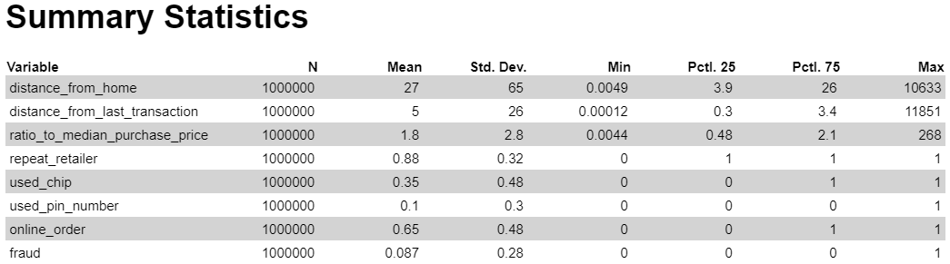
Credit Card Fraud - Data Summary
Data Source- https://www.kaggle.com/datasets/dhanushnarayananr/credit-card-fraud

Slide 7
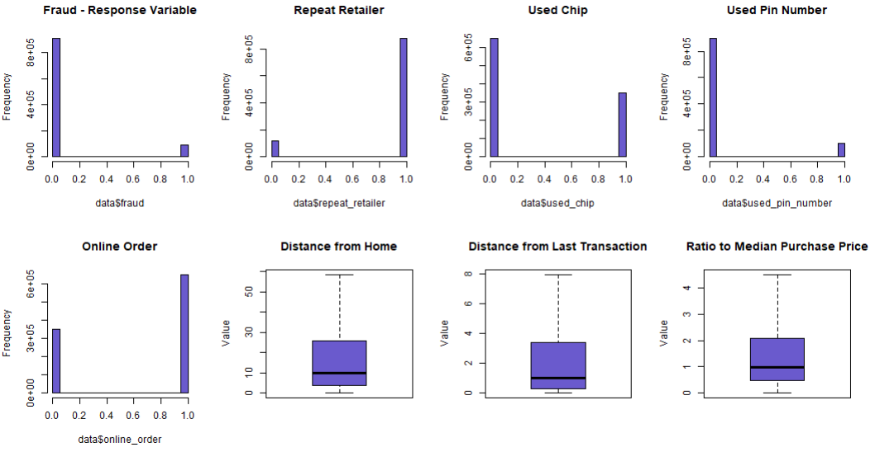
Credit Card Fraud - Data Plot
Data Source- https://www.kaggle.com/datasets/dhanushnarayananr/credit-card-fraud

Slide 8
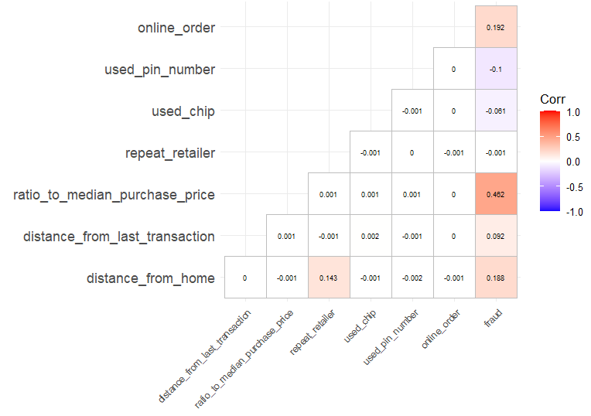
Credit Card Fraud - Correlation Plot
Data Source- https://www.kaggle.com/datasets/dhanushnarayananr/credit-card-fraud

Slide 9
Computational Statistics Technique #1 Fisher Scoring
The Fisher Scoring method is an optimization method used in maximum likelihood estimation problems
It is iterative and starts with an initial guess for the parameters and then updates the estimate to move closer to maximum likelihood estimates
Fisher Scoring can be utilized in cybersecurity to detect fraudulent transactions, especially when the response variable is binary

Slide 10
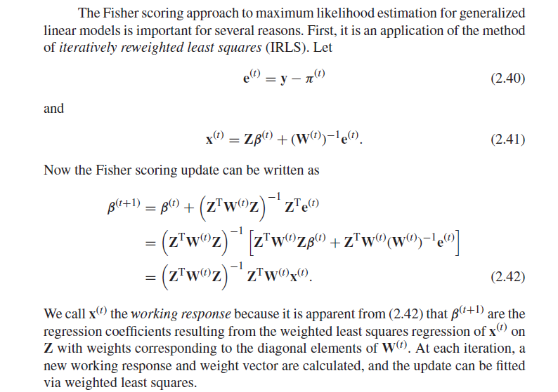
Fisher Scoring – Calculate optimal coefficient
Source: Computational Statistics, by G. H. Givens and J. A. Hoeting, 2013, p38.

Slide 11
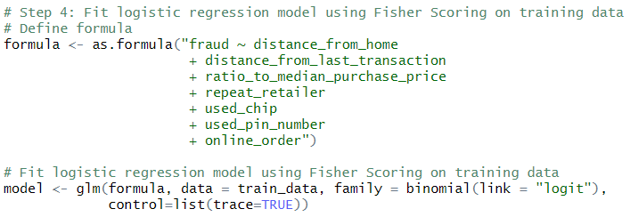
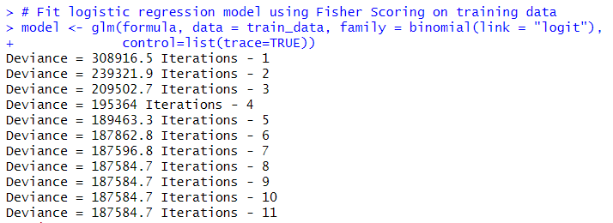
Logistic Model with Fisher Scoring on training data
Fisher Scoring is used to optimize parameters/coefficients of models to fit the observed data, which leads to more accurate predictions.

Slide 12
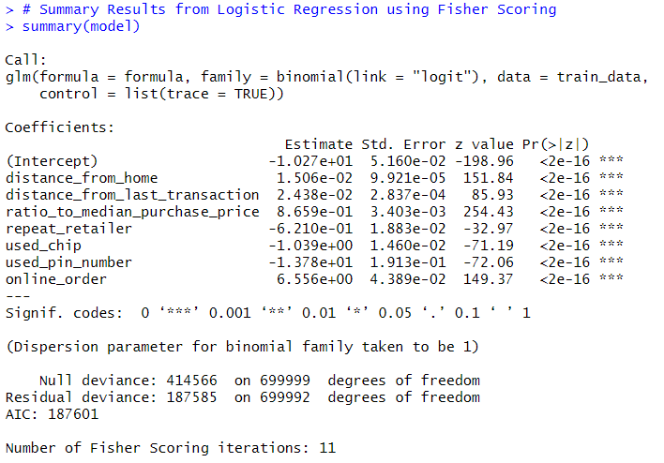
Logistic Model Summary with Fisher Scoring
*** All significant p-values with results showing final parameter/coefficients after steady state has reached using Fisher Scoring

Slide 13
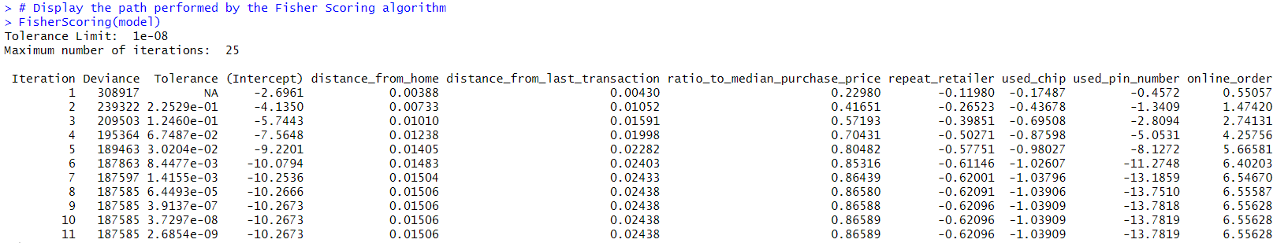
Fisher Scoring Iteration Results
It took 25 iterations for the Fisher Scoring method to adjust the coefficients until the algorithm found values that make the model's predictions as close to the actual outcome as possible, arriving at convergence or steady state for the parameter estimates. Note, only the first 11 iterations are listed above.

Slide 14
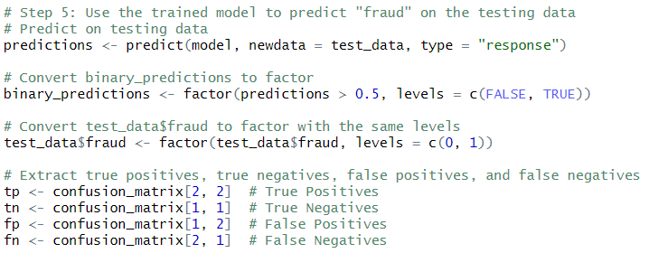
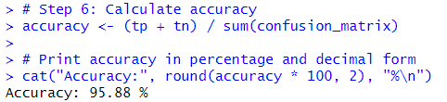
Cross Validation - Fisher Scoring Performance Results
Using test data that the training data has never seen before, ~96% accuracy was attained using Fisher Scoring to calculate coefficient estimates for our Logistic Regression to detect credit card fraud.

Slide 15
Computational Statistics Technique #2 Monte Carlo Simulation
Monte Carlo simulation generates random samples from a distribution and then approximates the probability of the outcomes
A large number of random samples are generated from probability distributions that represent the uncertainty in a model, and results are used to analyze the system
It is beneficial in situations where there is uncertainty in the model

Slide 16
Monte Carlo and Cybersecurity
Monte Carlo simulations can be used to model cyber threats
Analyze potential impacts of these threats through simulation
Simulate cyber attacks to uncover security gaps in infrastructure

Slide 17
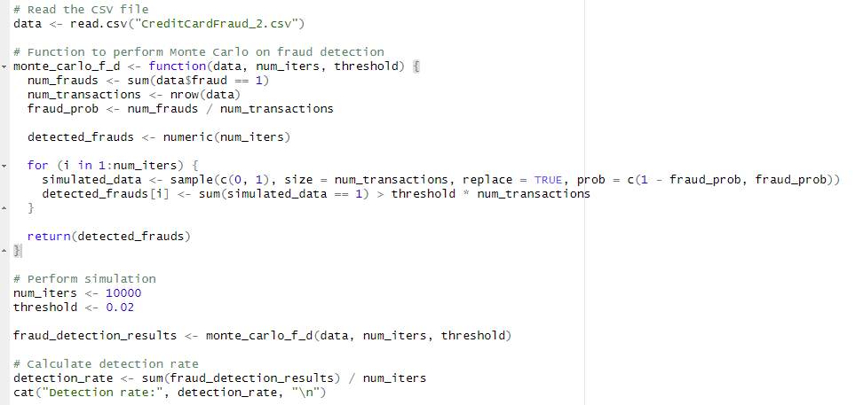
Monte Carlo
This code uses Monte Carlo to generate sets of data and then evaluate if fraud is detected

Slide 18
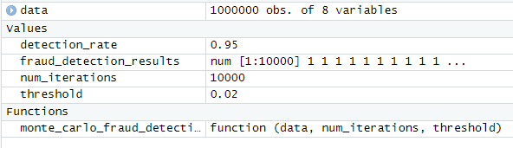
Monte Carlo Results
We get a detection rate of 95%, which is very good and shows us that our algorithm is effective at detecting fraud

Slide 19
Computational Statistics Technique #3 Kernel Density Estimation
This is a non-parametric method that estimates the PDF of a continuous variable based on observed data without making assumptions about the form of the distribution

Slide 20
Kernel Density Estimation and Cybersecurity
Anomaly Detection
KDE can also be used in anomaly detection by modeling the normal behavior of a system and then comparing this with the estimated data to identify patterns

Slide 21
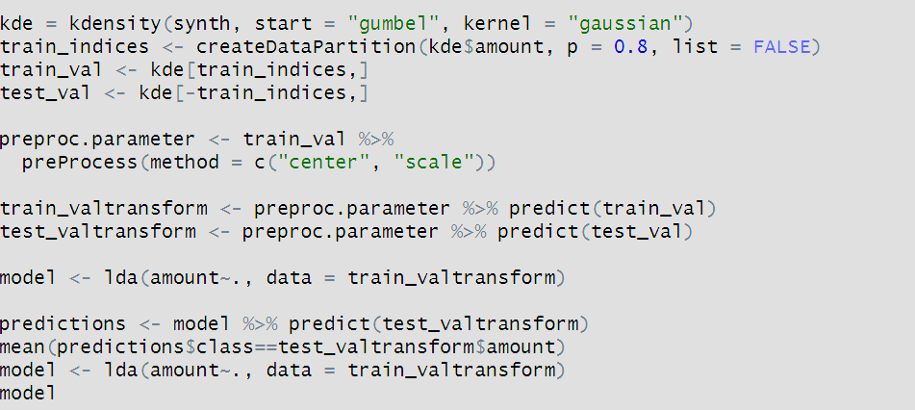
Kernel Density Estimation and Linear Discriminant Analysis
This code uses KDE and LDA to determine fraud.

Slide 22
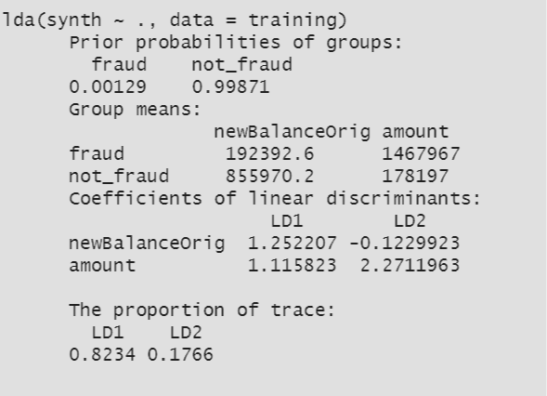
Kernel Density Estimation & Linear Discriminant Analysis Results
KDE can accurately predict fraudulent behavior 82% of the time.

Slide 23
Conclusion
All 3 computational methods offer a different approach to the same problem in detecting fraudulent credit card transactions
Fisher Scoring performed the best with 96% accuracy rate
Monte Carlo method performed the second-best with 95% accuracy rate
Kernel Density Estimate method performed the third-best with 82% accuracy rate
Real-world financial analysts often use a combination of models to optimize accuracy in fraud detections, such as the ones shown in this project
By leveraging these computational statistics techniques, financial institutions can mitigate the risk of fraudulent transactions, stolen identity, and cyber-attacks to protect sensitive and valuable digital assets

Slide 24
Sources
Computational Statistics, by G. H. Givens and J. A. Hoeting, 2013.
Financial Industry Cybersecurity: Safeguarding Assets and Data (cybersecurityguide.org)
https://www.kaggle.com/datasets/dhanushnarayananr/credit-card-fraud
https://www.stat.cmu.edu/~cshalizi/uADA/12/lectures/ch12.pdf
Kernel Density Estimation step by step | Medium | Towards Data Science
What is Cybersecurity? | IBM
What Is Monte Carlo Simulation? | IBM

