Slide 1
Forecasting DC Pavement Condition Using HPMS Data
Connor Bruce
DATA 606

Slide 2
Project Purpose
Help DDOT predict pavement condition into the future based on traffic trends, road designation, and pavement type.
Allows for data-informed decisions on where to allocate funding for pavement improvements
Provides insight on what pavements last longer under certain circumstances
DDOT: District Department of Transportation

Slide 3
Questions to Answer
 | What is the effect of traffic on pavement condition over time?
 | What will DC’s pavement network look like in the future?
 | Is HPMS data adequate for developing pavement models or is additional data needed?
HPMS: Highway Performance Monitoring System

Slide 4


Data Source
Highway Performance Monitoring System (HPMS) DDOT Submittals 2015-2024
284.8 MB Geodatabase File
1,727,332 Rows x 40 Columns
Each record contains road designation, condition, and traffic information of a given section for a given year

Slide 5
Data Dictionary
Column Name | Data Type | Definition | Potential Values
ROUTE_ID | Character | Route Designation Identifier | Any alphanumeric combination
BEGIN_POINT | Numeric | Mile marker of starting point for section | Any real number >= 0 and less than END_POINT
END_POINT | Numeric | Mile marker of ending point for section | Any real number > 0 and greater than BEGIN_POINT
YEAR_RECORD | Integer | Year of given observation | Integer between 2015 and 2024, inclusive
AADT | Integer | Average Annual Daily Traffic. Average number of cars that drove on given section of road per day for given year | Integer >= 0
IRI | Integer | Internation Roughness Index (IRI) value for given section. In units of in/mi | Integer >= 0
F_SYSTEM | Integer | Code for functional system of given section. (e.g. Interstate, Major Arterial, Minor Arterial) | Integer between 0 and 7, inclusive
NHS | Integer | Indicates whether the road is part of the National Highway System (NHS) | Integer between 0 and 7, inclusive
SURFACE_TYPE | Integer | Code for material of given section's pavement surface | Integer between 0 and 11, inclusive
IRI_DELTA | Integer | Year-over-year change in IRI, in in/mi | Integer >= 0
AADT_DELTA | Integer | Year-over-year change in AADT | Integer >= 0

Slide 6
Model
Target: IRI Delta
AADT Pavement deteriorates differently under varying traffic loads | AADT Delta Year-over-year changes in traffic can impact pavement condition | Functional System Different road classes have different types of traffic (e.g. truck vs car) and are given varying funding | NHS Designation Highways have different types of traffic and receive special funding for preservation | Surface Type Type of pavement (e.g. Asphalt vs. Concrete) behave differently | IRI Current pavement condition can affect further changes in pavement condition
IRI: International Roughness Index

Slide 7
Preliminary Data –
Missing IRI Delta Data
Year | Number Missing Values | Number Non-Missing Values | Percentage Missing
2015 | 105244 | 0 | 1.000
2016 | 2393 | 104976 | 0.022
2017 | 34196 | 46877 | 0.422
2018 | 6731 | 88831 | 0.070
2019 | 3760 | 144374 | 0.025
2020 | 1343 | 148440 | 0.009
2021 | 4041 | 145221 | 0.027
2022 | 52379 | 156463 | 0.251
2023 | 3424 | 208835 | 0.016
2024 | 9347 | 213511 | 0.042
Doesn’t have prior year’s data to compute delta
High, but acceptable

Slide 8
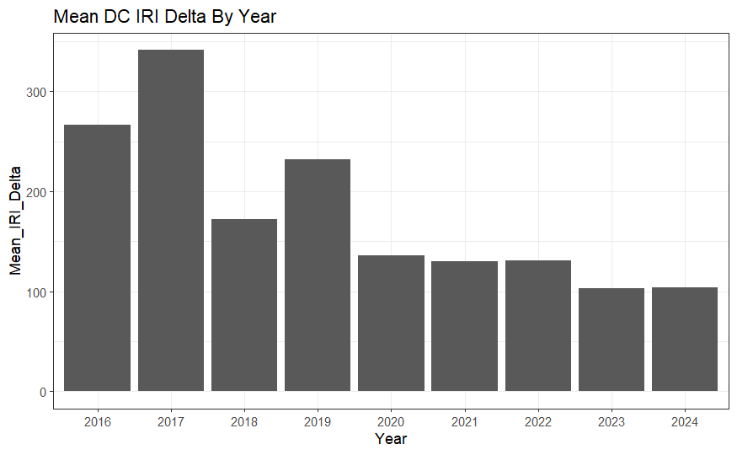
Preliminary EDA:
IRI Delta Distribution
Slight decrease over time
Spikes in 2016, 2017, and 2019 may be due to outliers

Slide 9
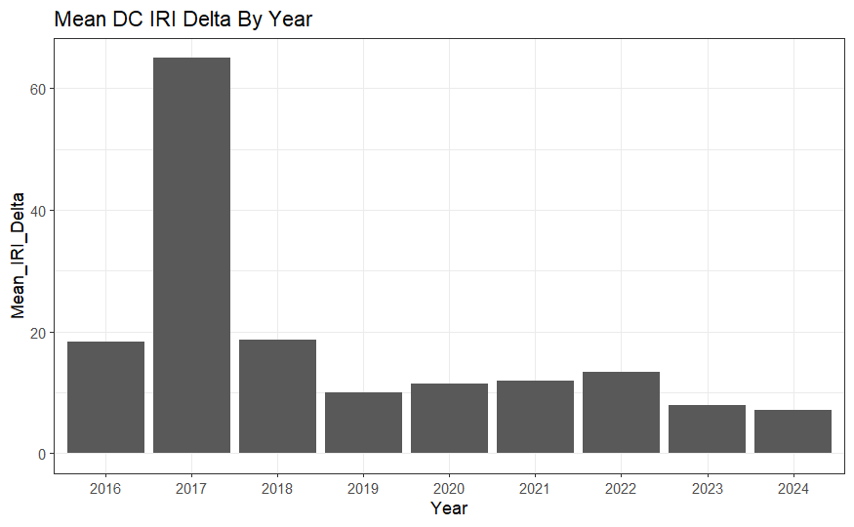
Preliminary EDA:
IRI Delta Distribution (No Outliers)
Removed changes over 100 in/mi per year
2017 still heavy outlier
Trend in middle years flips
Still lower in recent years

Slide 10
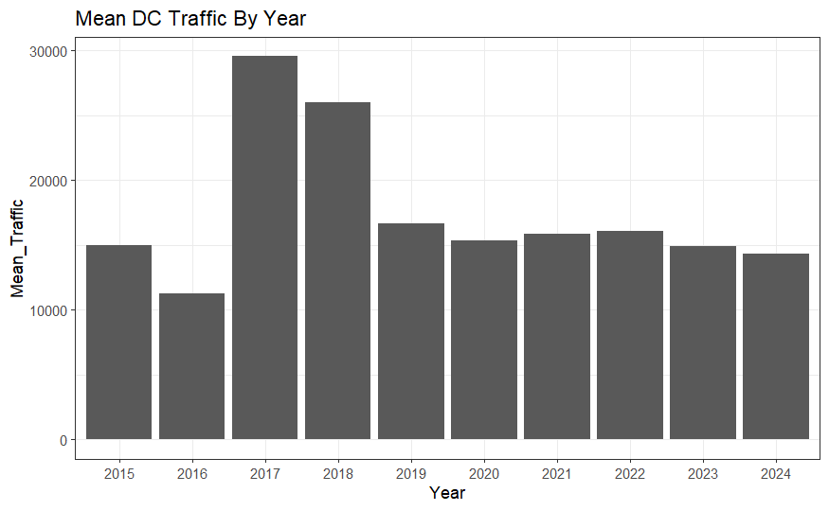
Preliminary EDA:
Traffic Distribution
Traffic spikes in 2017 and 2018
Sharp decrease then remains consistent after 2019 – could be COVID effect
2015 lower than other years

Slide 11
Planned EDA
Exploring 2017 outliers
Correlation analysis for features
Distribution for categorical features (Functional Class, Surface Type, NHS)
Exploring general linear trends

Slide 12
Questions?

