Slide 1
Forecasting DC Pavement Condition Using HPMS Data
EDA
Connor Bruce
DATA 606

Slide 2
Simplifying Features
Feature | New Value | Database Coded Values*
NHS | NHS – 1 | 1-7
 | Non-NHS – 0 | 0
Surface Type | Unpaved – 1 | 1
 | Asphalt/Composite – 2 | 2,6,7,8
 | Concrete – 3 | 3,4,5,9,10
Functional System | Interstate – 1 | 1
 | Non-Interstate – 0 | 2-7
* From FHWA’s HPMS Field Manual

Slide 3
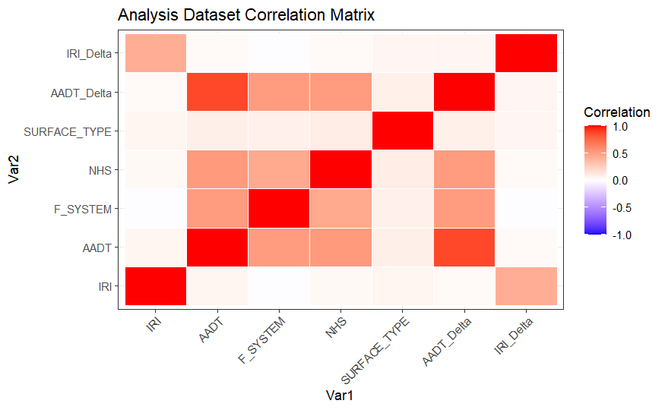
Correlation Analysis
Target Variable (IRI_Delta) does not have strong correlation with any feature aside from IRI.
Interstates and NHS roads typically have higher traffic, but do not seem to have a large effect on IRI or IRI Delta.
Surface Type is fairly agnostic of road designation

Slide 4
Records by Road Designation
 | Interstate | Non-Interstate | Total
NHS | 64,168 | 192,582 | 256,750
Non-NHS | 2,295 | 891,547 | 893,842
Total | 66463 | 1,084,129 | 1,150,592

Slide 5
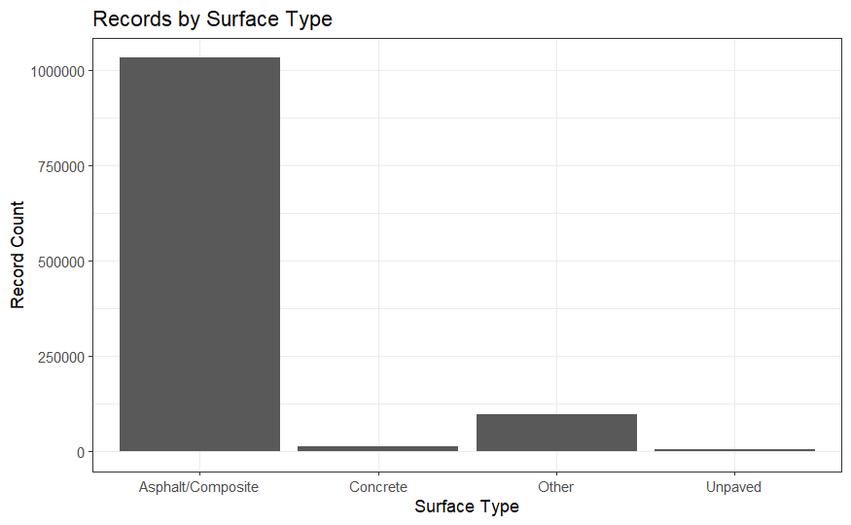
Records by Surface Type

Slide 6
Mapping Interstates vs Non-Interstates

Slide 7
Mapping NHS vs. Non-NHS

Slide 8
Map of Most Recent IRI Data

