Slide 1

Predicting Washington DC’s Pavement Performance
Connor Bruce
DATA 606 – Fall 2026

Slide 2
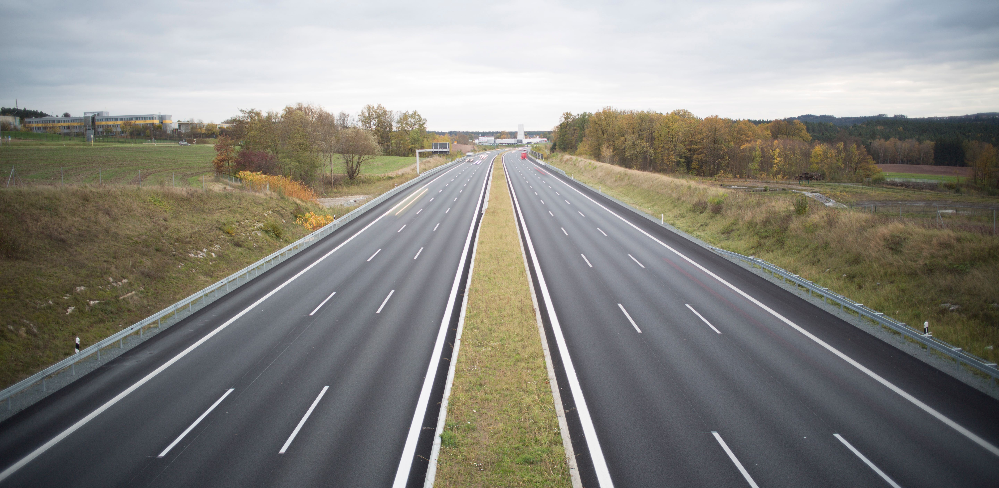
The Vision
Use existing DDOT pavement condition data to predict future condition data
Consolidate the results in an easy to analyze tool

Slide 3

The Why
Allow transportation planners to make data-driven decisions about their network
Process and join messy pavement data
Identify non-surface level trends in the data

Slide 4

Analysis Dataset Overview
DDOT Highway Performance Monitoring System (HPMS) Data Submittals (2015-2024)
Raw: 1.7 million rows
Processed: 20,000 rows
Each record represents pavement designation and condition for a ~0.1mi section for a given year

Slide 5
Analysis Dataset – Features
Column Name | Data Type | Definition | Potential Values
ROUTE_ID | Character | Route Designation Identifier | Any alphanumeric combination
BEGIN_POINT | Numeric | Mile marker of starting point for section | Any real number >= 0 and less than END_POINT
END_POINT | Numeric | Mile marker of ending point for section | Any real number > 0 and greater than BEGIN_POINT
YEAR_RECORD | Integer | Year of given observation | Integer between 2015 and 2024, inclusive
AADT | Integer | Average Annual Daily Traffic. Average number of cars that drove on given section of road per day for given year | Integer >= 0
IRI | Integer | Internation Roughness Index (IRI) value for given section. In units of in/mi | Integer >= 0
F_SYSTEM | Integer | Code for functional system of given section. (e.g. Interstate, Major Arterial, Minor Arterial) | Integer between 0 and 7, inclusive
NHS | Integer | Indicates whether the road is part of the National Highway System (NHS) | Integer between 0 and 7, inclusive
SURFACE_TYPE | Integer | Code for material of given section's pavement surface | Integer between 0 and 11, inclusive
AADT_DELTA | Integer | Year-over-year change in AADT | Integer >= 0
IRI_DELTA | Integer | Year-over-year change in IRI, in in/mi | Integer >= 0

Slide 6

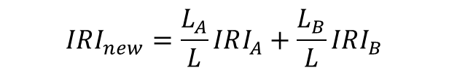


Data Processing
$$IRI_{new}=\frac{L_{A}}{L}IRI_{A}+\frac{L_{B}}{L}IRI_{B}$$
Section A
Section B
$$L_{A}$$
$$L_{B}$$
Base Section
$$L$$
Records did not match 1-to-1 between years – sectioning (mileposts) were different
Used most recent year (2024) as base sectioning
Broken into cases and used weighted averages to recalculate values

Slide 7
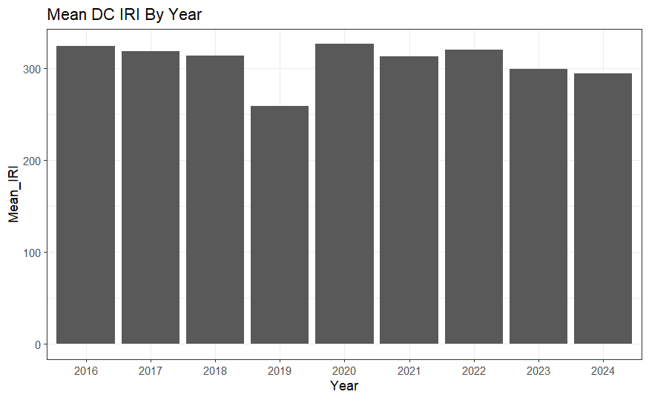
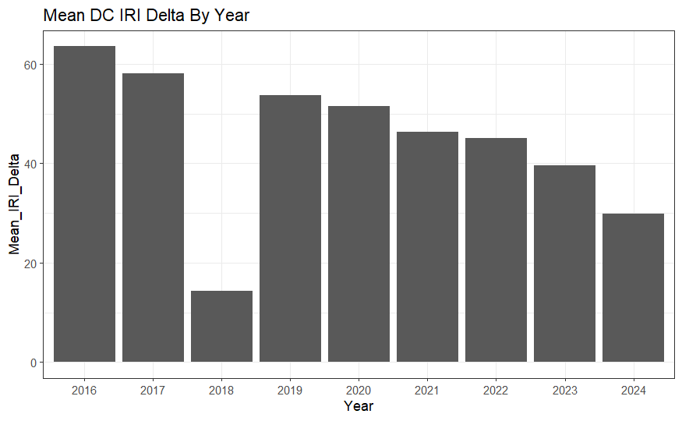
EDA – Mean Distributions
Dip in 2018 average delta IRI was noted, but upon investigation, values were legitimate – likely due to rehabilitation projects/differences in data collection
Mean IRI Distribution
Mean Delta IRI Distribution

Slide 8
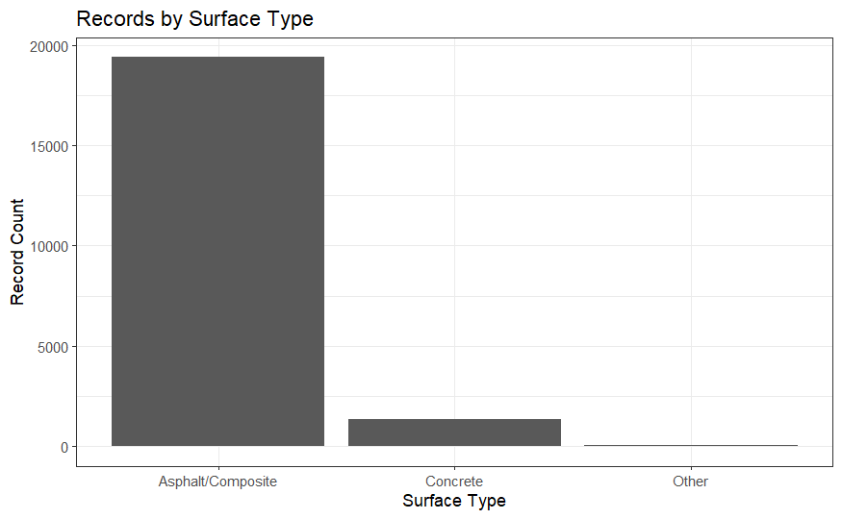
EDA - Counts
Pavement Designations
Surface Type
 | Off NHS | On NHS
Non-Interstate | 14,683 | 5,608
Interstate | 0 | 529
Expected zero in Interstate/Off NHS – good for validating data
Not much concrete data – may affect model accuracy for concrete section

