Slide 1
Coverage of 1-sample proportion bootstrap methods
Connor Demorest

Slide 2
Background
Intro Stats courses traditionally teach theory-methods
Ex: 1 and 2 sample t-test, Normal approx. to binomial, etc
Bootstrap methods have some pedagogical value
”Montana State Introductory Statistics with R” – By Stacey!
Tim Hesterberg – bootstrap resampling as a teaching tool
Not a ton of literature on the bootstrap binomial approximation
Tons of literature about the t-tests and different ways to do resampling

Slide 3
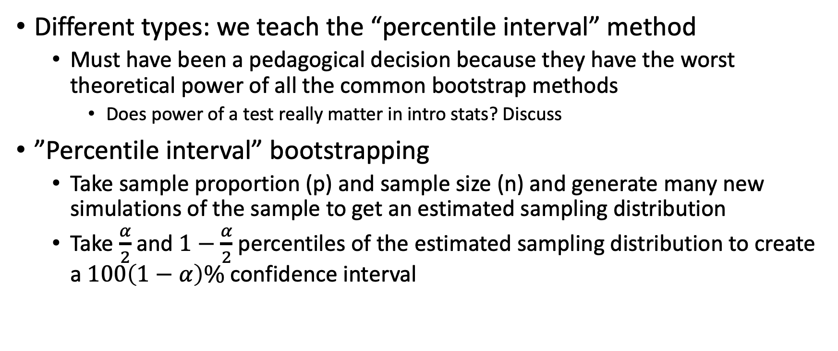
What is bootstrap resampling?
Different types: we teach the “percentile interval” method
Must have been a pedagogical decision because they have the worst theoretical power of all the common bootstrap methods
Does power of a test really matter in intro stats? Discuss
”Percentile interval” bootstrapping
Take sample proportion (p) and sample size (n) and generate many new simulations of the sample to get an estimated sampling distribution
Take $\frac{α}{2}$ and $1−\frac{α}{2}$ percentiles of the estimated sampling distribution to create a $100\left(1−α\right)\%$ confidence interval

Slide 4
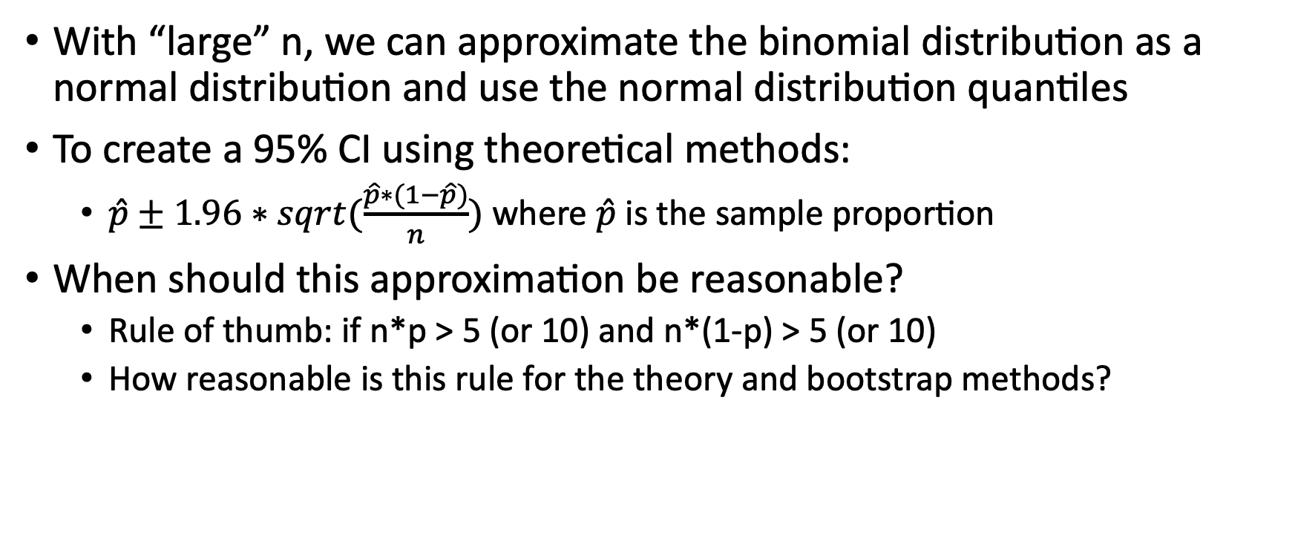
Review of theory-based methods
With “large” n, we can approximate the binomial distribution as a normal distribution and use the normal distribution quantiles
To create a 95% CI using theoretical methods:
$\hat{p}±1.96∗sqrt(\frac{\hat{p}∗(1−\hat{p})}{n})$where $\hat{p}$ is the sample proportion
When should this approximation be reasonable?
Rule of thumb: if n*p > 5 (or 10) and n*(1-p) > 5 (or 10)
How reasonable is this rule for the theory and bootstrap methods?

Slide 5
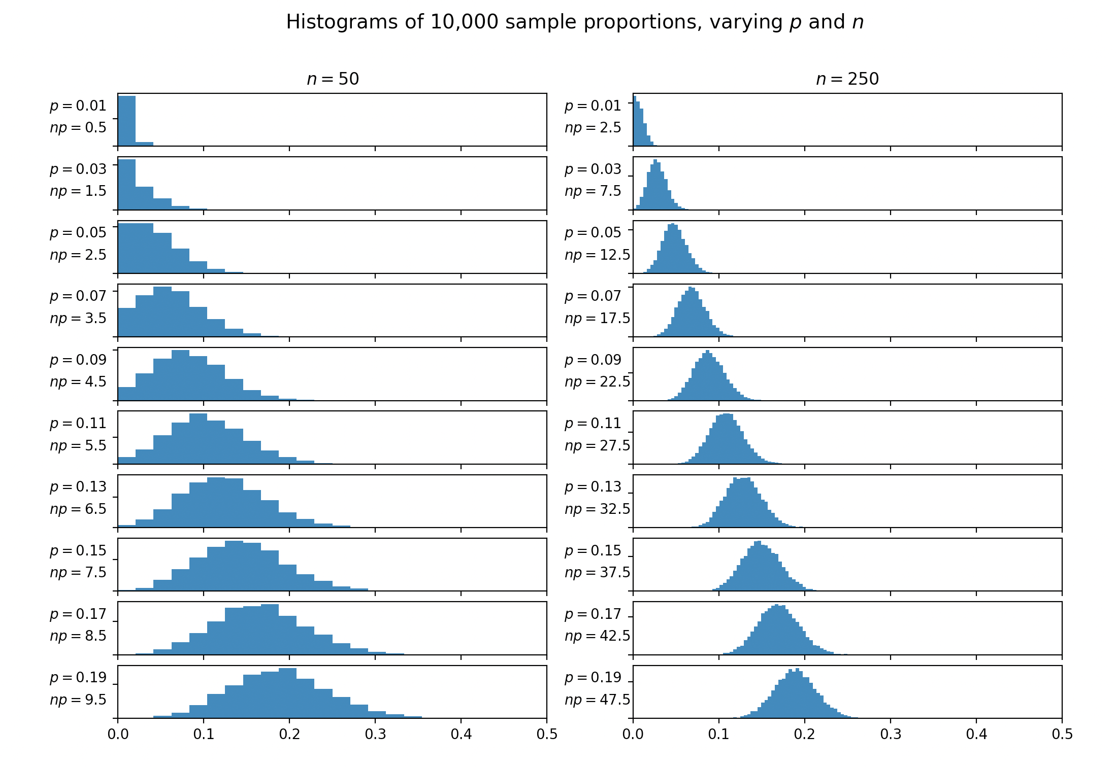
Sampling distributions of values of n*p
When n*p = 5, there is some “bunching” at 0
N*p > 10 seems to be too strong of an assumption based on this plot
I suggest n*p > 7.5 could be a good middle ground

Slide 6
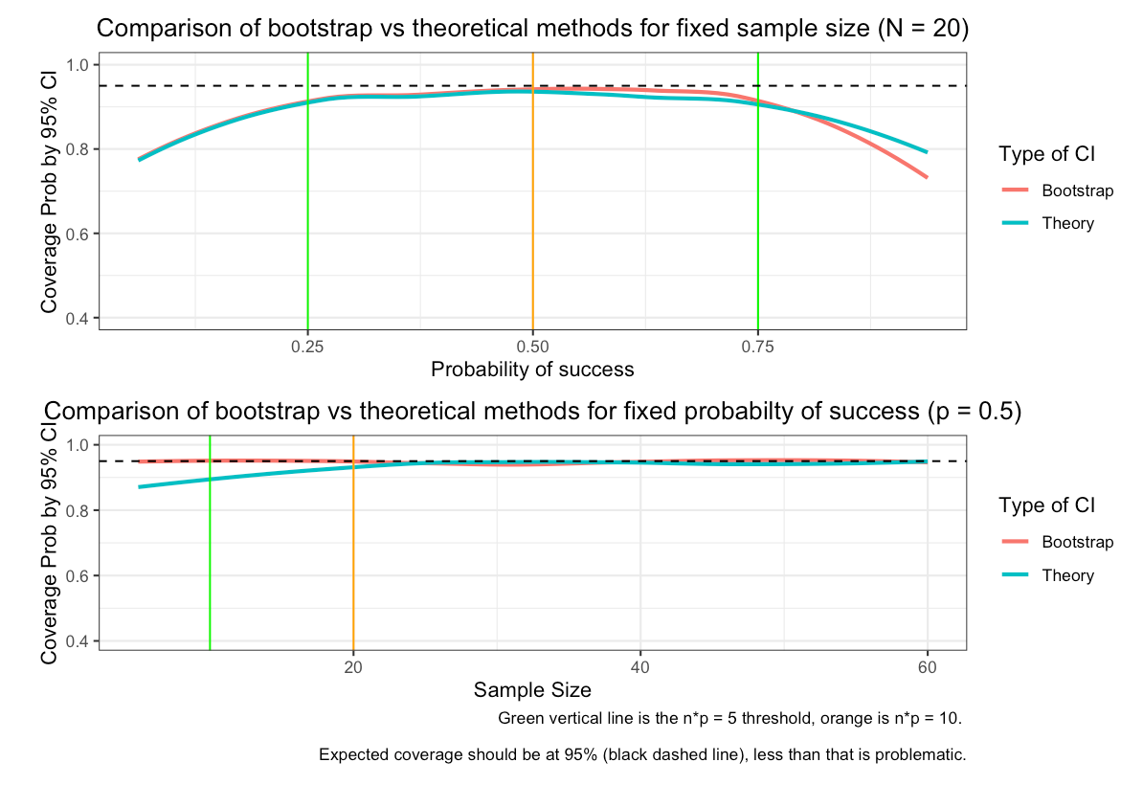
Results: n = 20, p = 0.5
For a fixed n = 20, bootstrap methods and theory methods are very similar
For a fixed p = 0.5, bootstrap is slightly better for very small sample sizes
Below green (n*p = 5), there is weak coverage around 80-90%
At n*p = 10 (orange), almost perfect coverage for both methods

Slide 7
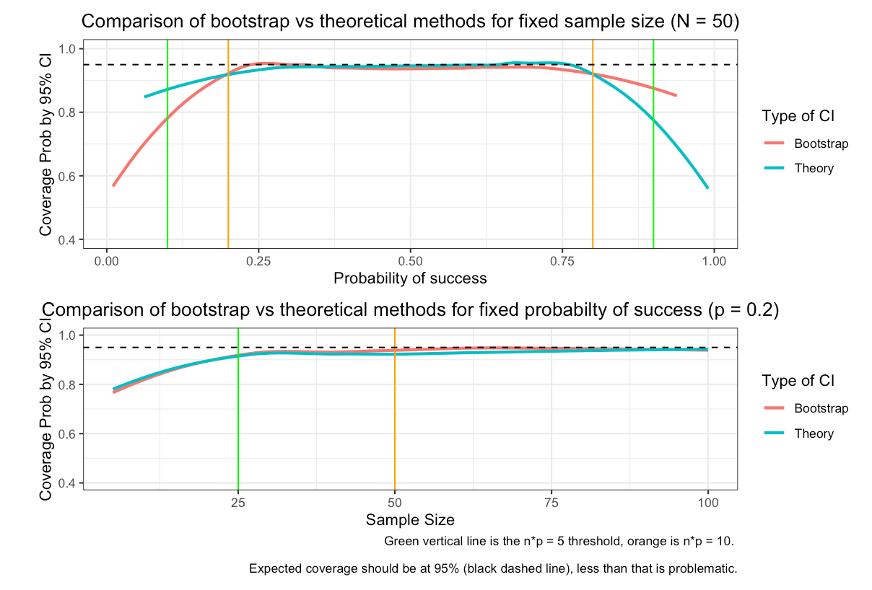
Results: n = 50, p = 0.2
Bootstrap and theory seem very similar here
Between green and orange there is strong coverage at least 90% for both methods
Might support the n*p > 10 is too strong theory
See R shiny app for more (if time) ☺
I’m not sure what next steps would make sense. T-tests have been done to death for this sort of thing

