Slide 1
Local false discovery rate control in a case study of synovial fluid metabolomics
Connor Demorest
Advised by Shinjini Nandi

Slide 2
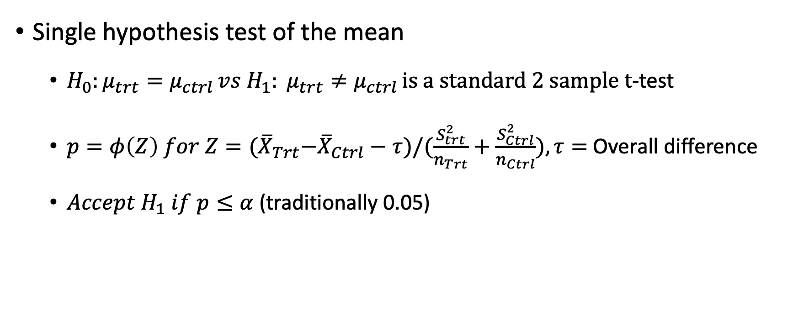
Hypothesis testing review
Single hypothesis test of the mean
$H_{0}:μ_{trt}=μ_{ctrl }vs H_{1}: μ_{trt}≠μ_{ctrl }is a standard 2 sample t$-test
$p=φ\left(Z\right) for Z={(\overline{X}}_{Trt}−{\overline{X}}_{Ctrl}−τ)/(\frac{S_{trt}^{2}}{n_{Trt}}+\frac{S_{Ctrl}^{2}}{n_{Ctrl}}), τ=$Overall difference
${Accept H}_{1} if p≤α$ (traditionally 0.05)
Notes:
Too many words? Should I assume more background knowledge?

Slide 3
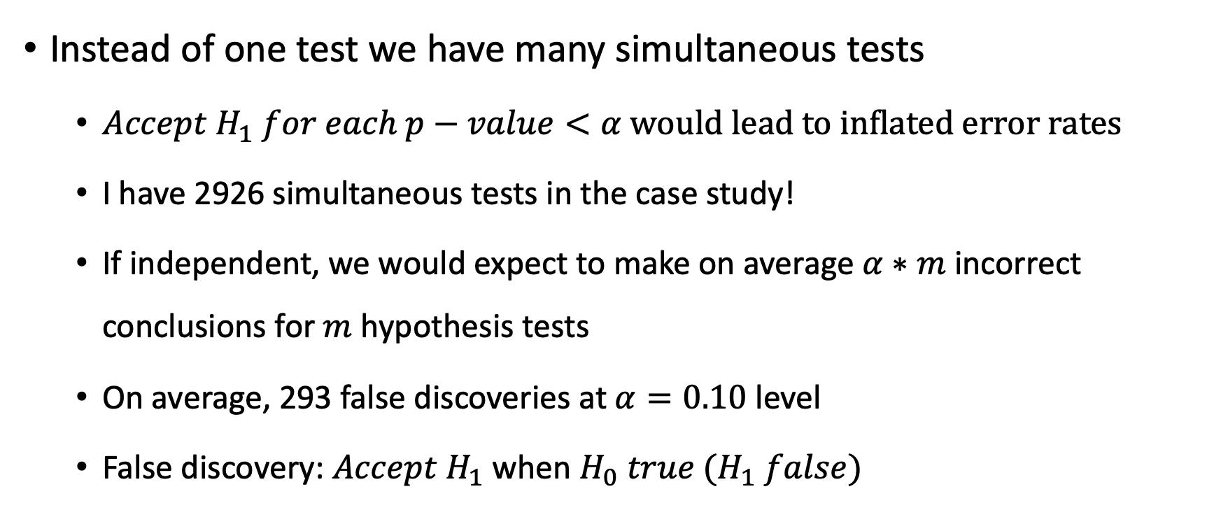
Multiple hypothesis tests
Instead of one test we have many simultaneous tests
${Accept H}_{1} for each p−value<α would lead to inflated error rates$
I have 2926 simultaneous tests in the case study!
If independent, we would expect to make on average $α∗m$ incorrect conclusions for $m$ hypothesis tests
On average, 293 false discoveries at $α=0.10$ level
False discovery: ${Accept H}_{1}$ when $H_{0} true (H_{1} false)$

Slide 4
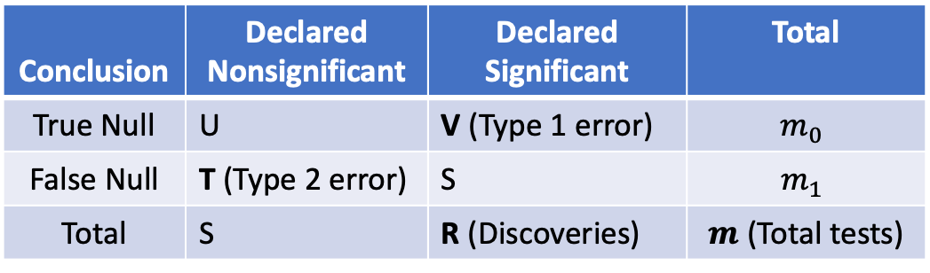
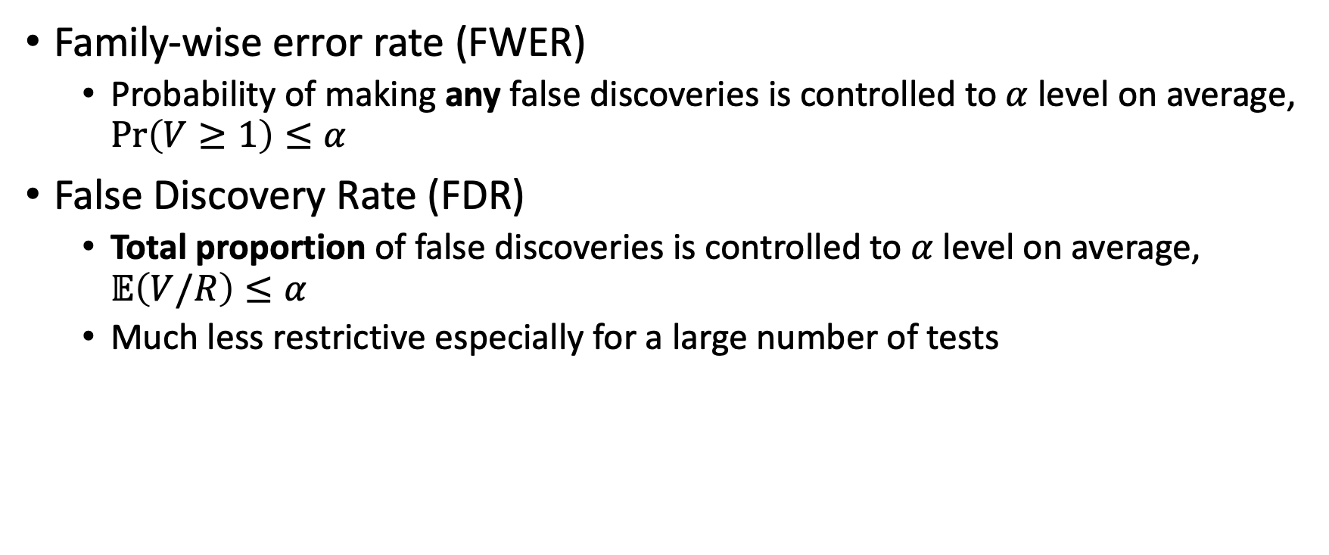
Error measures to control
Family-wise error rate (FWER)
Probability of making any false discoveries is controlled to $α$ level on average, $\operatorname{Pr}\left(V≥1\right)≤α$
False Discovery Rate (FDR)
Total proportion of false discoveries is controlled to $α$ level on average, $𝔼\left(V/R\right)≤α$
Much less restrictive especially for a large number of tests
Conclusion | Declared Nonsignificant | Declared Significant | Total
True Null | U | V (Type 1 error) | $$m_{0}$$
False Null | T (Type 2 error) | S | $$m_{1}$$
Total | S | R (Discoveries) | $m$ (Total tests)

Slide 5
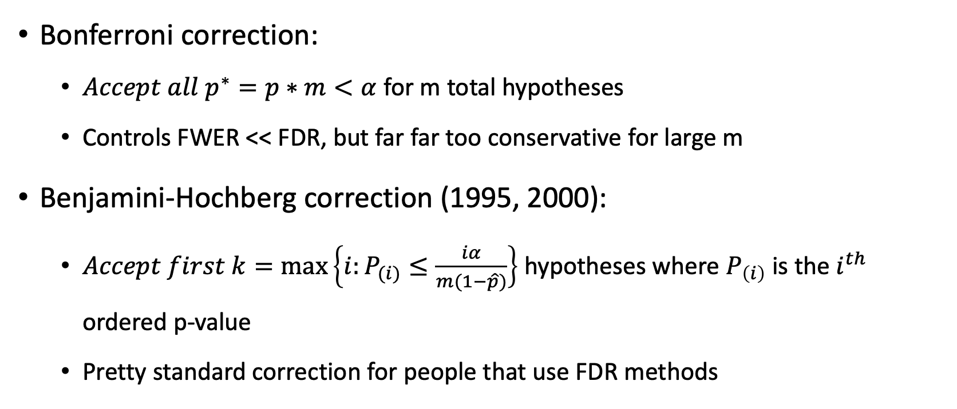
Typical methods to correct inflated error rates
Bonferroni correction:
${Accept all p}^{∗}=p∗m<α$ for m total hypotheses
Controls FWER << FDR, but far far too conservative for large m
Benjamini-Hochberg correction (1995, 2000):
$Accept first k=\max\left\{i:P_{(i)}≤\frac{iα}{m(1−\hat{p})}\right\}$ hypotheses where $P_{\left(i\right)}$ is the $i^{th}$ ordered p-value
Pretty standard correction for people that use FDR methods
Notes:
P hat = 0.5 or should I get into that more?

Slide 6
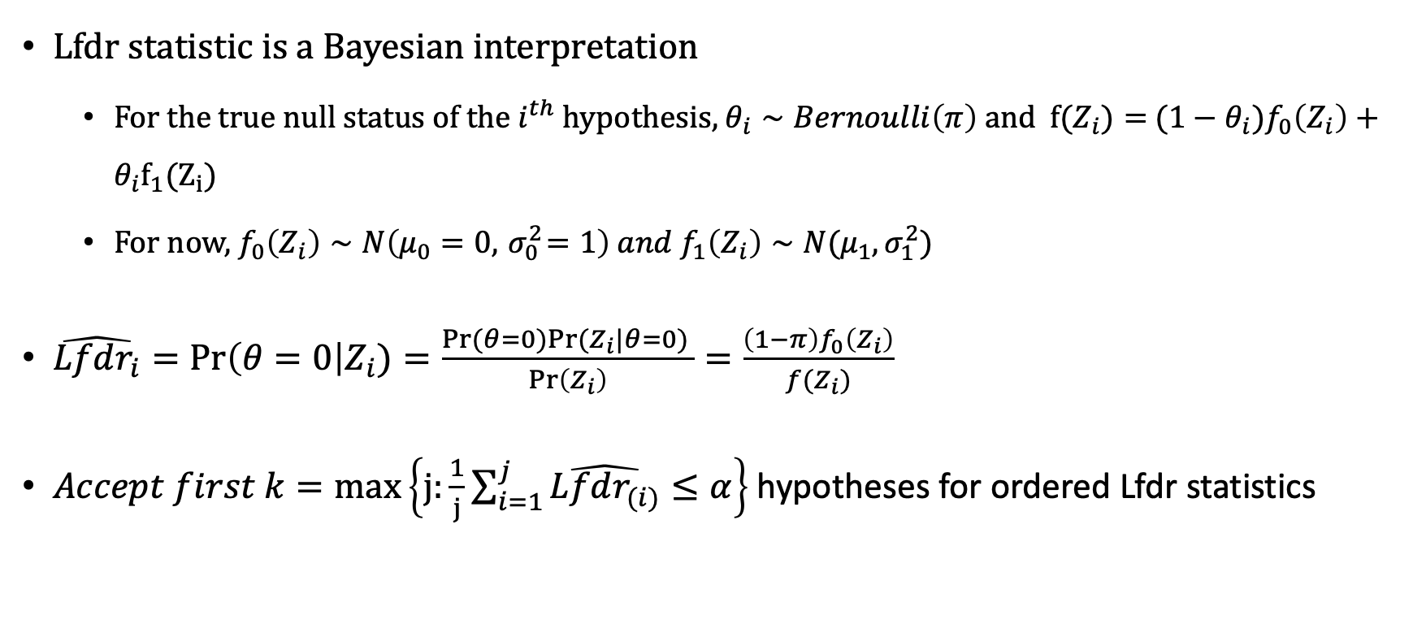
Local false discovery rate (Lfdr) (Sun & Cai, 2007)
Lfdr statistic is a Bayesian interpretation
For the true null status of the $i^{th}$ hypothesis, $θ_{i}∼Bernoulli\left(π\right)$ and $f(Z_{i})=$ ${(1−θ}_{i})f_{0}\left(Z_{i}\right)+θ_{i}f_{1}(Z_{i})$
For now, $f_{0}\left(Z_{i}\right)∼N\left(μ_{0}=0, { σ}_{0}^{2}=1\right) and f_{1}\left(Z_{i}\right)∼N(μ_{1}, σ_{1}^{2})$
$\hat{Lfdr_{i}}=\operatorname{Pr}\left(θ=0\right|Z_{i})=\frac{Pr⁡(θ=0)Pr⁡(Z_{i}|θ=0) }{\operatorname{Pr}\left(Z_{i}\right)}=\frac{\left(1−π\right)f_{0}\left(Z_{i}\right)}{f(Z_{i})}$
$Accept first k=\max\left\{j:\frac{1}{j}\sum_{i=1}^{j}{\hat{Lfdr_{(i)}}}≤α\right\}$hypotheses for ordered Lfdr statistics

Slide 7
Case study: equine synovial fluid metabolomics
Collaborators Ron June and Katie Steward in Mechanical & Industrial Engineering brought a consulting seminar project
4 Horses were treated in right knee with flavopiridol and left knee with saline
Followed up one week later to see if there are differences in metabolomics between treatment and control legs (arms? lmao)
4730 metabolites detected at least 3 times, 2926 metabolites detected all 8 times

Slide 8
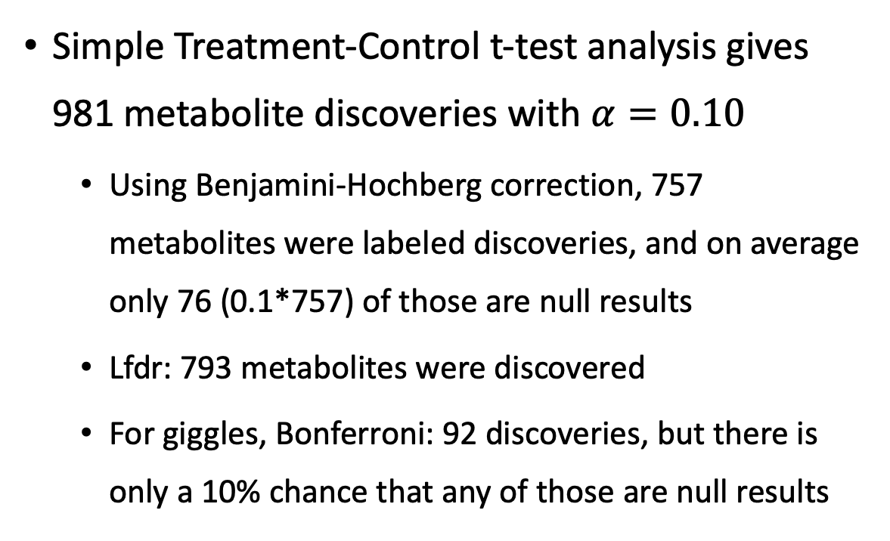
Results
Simple Treatment-Control t-test analysis gives 981 metabolite discoveries with $α=0.10$
Using Benjamini-Hochberg correction, 757 metabolites were labeled discoveries, and on average only 76 (0.1*757) of those are null results
Lfdr: 793 metabolites were discovered
For giggles, Bonferroni: 92 discoveries, but there is only a 10% chance that any of those are null results
Number of discoveries
𝛂 | Lfdr | BH | Bonferroni | Unadjusted
1% | 318 | 340 | 60 | 429
5% | 582 | 577 | 83 | 757
10% | 793 | 757 | 92 | 981

Slide 9
Future work
For this project:
Cluster analysis to see which metabolites are similar and see how the discoveries cluster. Maybe there is something interesting to see there?
Ex. Metabolites in “X” cluster are relating to a certain trait, and 90% of those are significant
Re-convene with Dr. June and Dr. Steward. Their software returned 238 discoveries, so not sure what it uses?
Impute and use metabolites with missing or below detection limit values
Study design of equine synovial fluid was more complicated, and we threw away information to make it easier.
General future work:
Use informative priors to try to increase number of discoveries while still controlling FDR
Each test is (probably) not independent, and there is not a Lfdr-based solution to that. I have shown in simulations that the FDR is not controlled under dependence

Slide 10
References
Benjamini, Y., & Hochberg, Y. (1995). Controlling the false discovery rate: a practical and powerful approach to multiple testing. Journal of the Royal Statistical Society: Series B (Methodological), 57(1), 289-300.
Benjamini, Y., & Hochberg, Y. (2000). On the adaptive control of the false discovery rate in multiple testing with independent statistics. Journal of Educational and Behavioral Statistics, 25(1), 60-83.
Efron, B. (2005). Local false discovery rates.
Efron, B., Tibshirani, R., Storey, J. D., & Tusher, V. (2001). Empirical Bayes analysis of a microarray experiment. Journal of the American Statistical Association, 96(456), 1151-1160.
Sun, W., & Cai, T. T. (2007). Oracle and adaptive compound decision rules for false discovery rate control. Journal of the American Statistical Association, 102(479), 901-912.

Slide 11
Appendix: Simulation study results

Slide 12
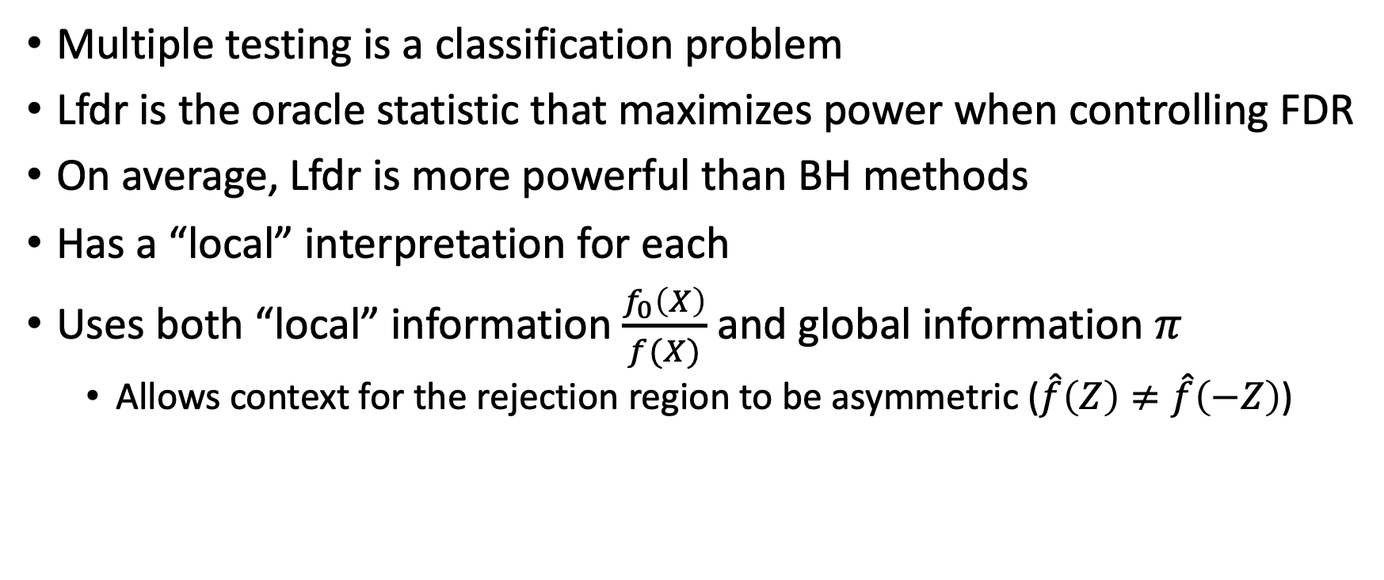
Appendix: Properties of Lfdr method
Multiple testing is a classification problem
Lfdr is the oracle statistic that maximizes power when controlling FDR
On average, Lfdr is more powerful than BH methods
Has a “local” interpretation for each
Uses both “local” information $\frac{f_{0}\left(X\right)}{f(X)}$ and global information $π$
Allows context for the rejection region to be asymmetric ($\hat{f}\left(Z\right)≠\hat{f}\left(−Z\right)$)

