Slide 1
A Bayesian multiple testing approach to a case study of synovial fluid metabolomics
Connor Demorest
Advised by Shinjini Nandi
Special thanks to collaborators Dr. Ron June and Dr. Katie Steward

Slide 2

Case study: Equine synovial fluid metabolomics
Metabolomics is the scientific study of chemical processes involving metabolites, the small molecule substrates, intermediates and products of cell metabolism
Is there a difference in metabolic makeup in the synovial fluid between treatment and control knees of horses?
4 Horses were treated in right knee with flavopiridol and left knee with saline
Followed up one week later to see if there are differences in metabolomics between treatment and control legs
Data on 4722 metabolites were detected and 2926 total metabolites completely observed and used for this study
Not a knee!
Treatment
Control

Slide 3
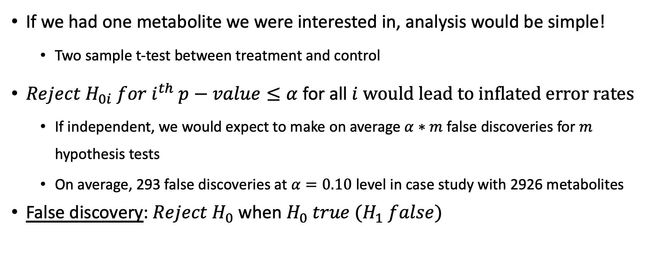
Multiple hypothesis tests (MHT)
If we had one metabolite we were interested in, analysis would be simple!
Two sample t-test between treatment and control
${Reject H}_{0i} for i^{th} p−value≤α$ for all $i$ $would lead to inflated error rates$
If independent, we would expect to make on average $α∗m$ false discoveries for $m$ hypothesis tests
On average, 293 false discoveries at $α=0.10$ level in case study with 2926 metabolites
False discovery: ${Reject H}_{0}$when $H_{0} true (H_{1} false)$

Slide 4
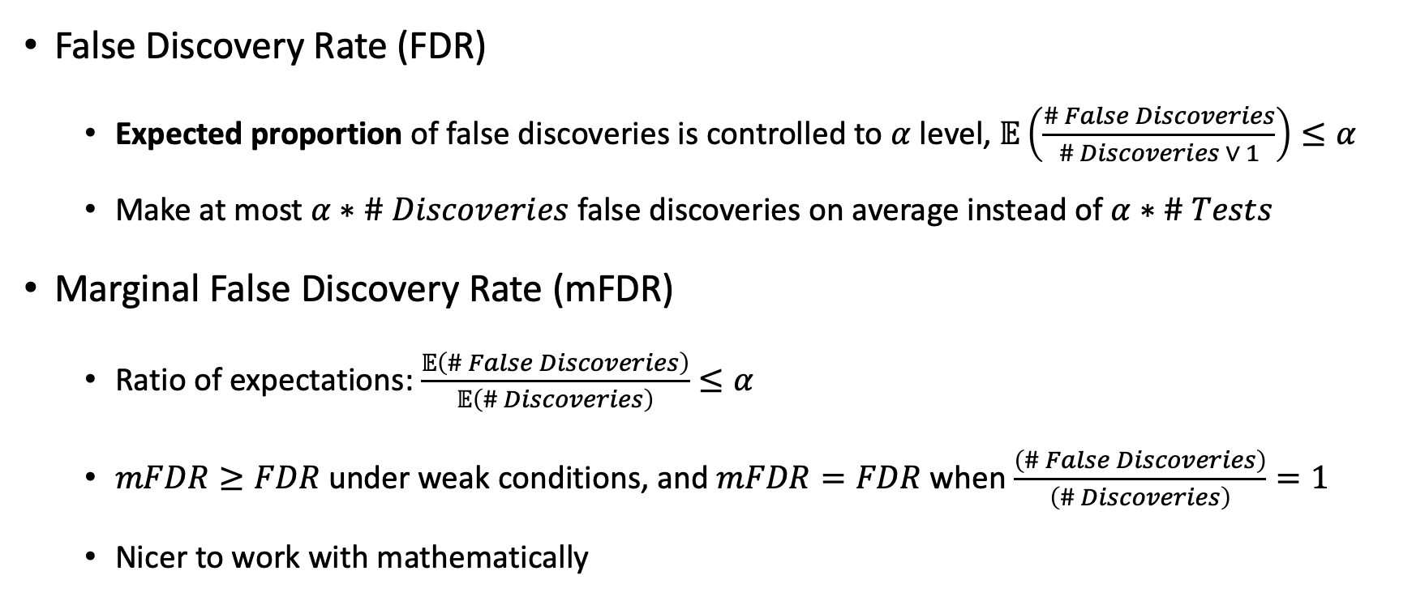
Error measures to control
False Discovery Rate (FDR)
Expected proportion of false discoveries is controlled to $α$ level, $𝔼\left(\frac{\# False Discoveries}{\# Discoveries ∨ 1}\right)≤α$
Make at most $α∗\# Discoveries$ false discoveries on average instead of $α∗\# Tests$
Marginal False Discovery Rate (mFDR)
Ratio of expectations: $\frac{𝔼\left(\# False Discoveries\right)}{𝔼\left(\# Discoveries\right)}≤α$
$mFDR≥FDR$ under weak conditions, and $mFDR=FDR$ when $\frac{\left(\# False Discoveries\right)}{\left(\# Discoveries\right)}=1$
Nicer to work with mathematically

Slide 5
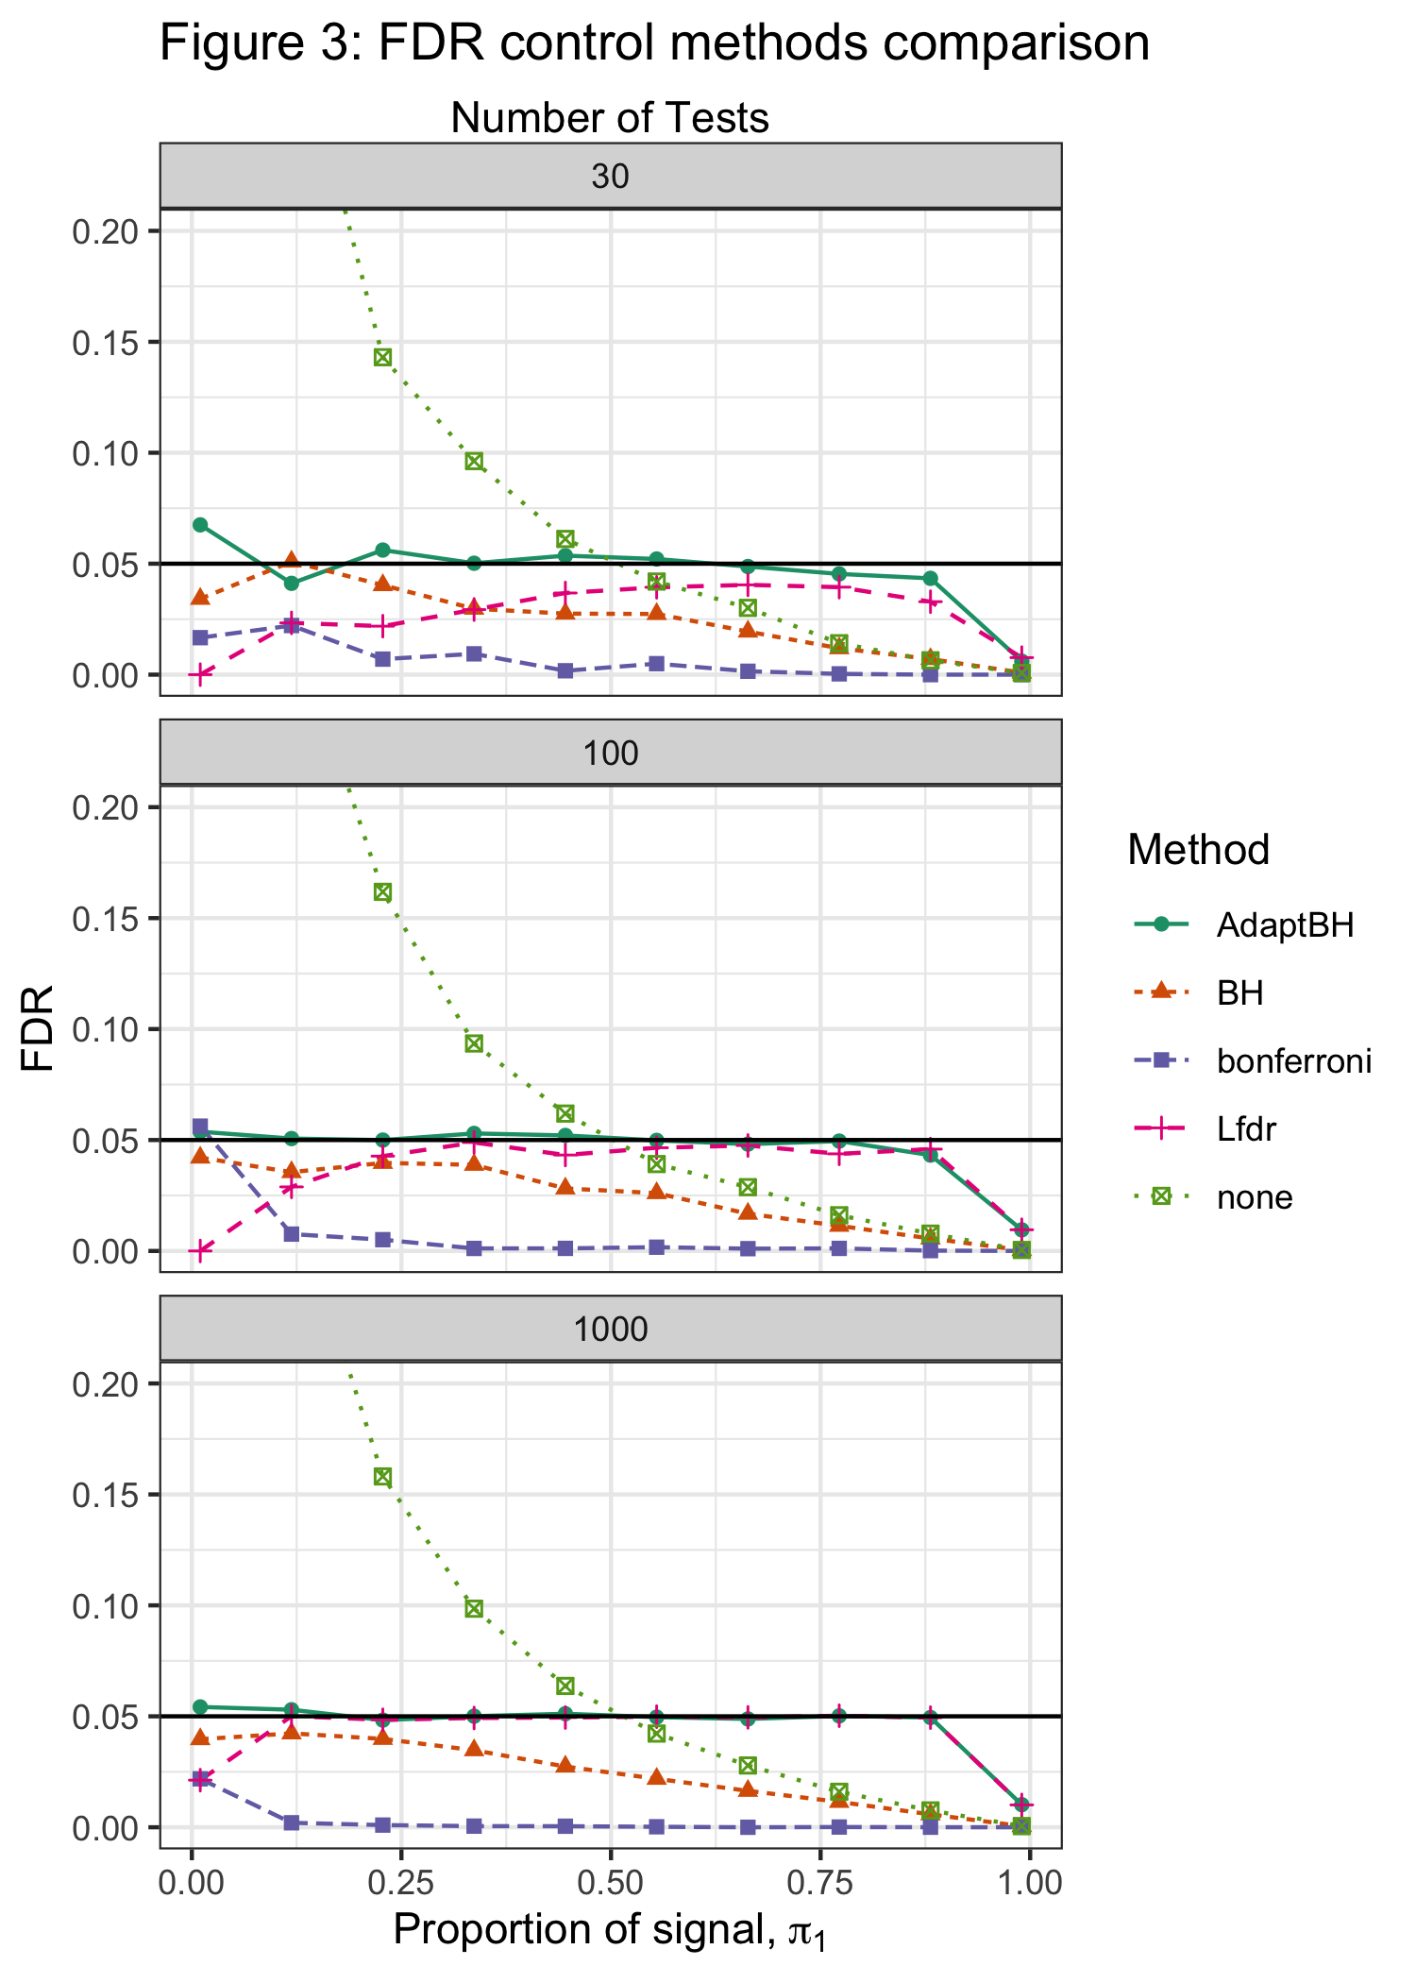
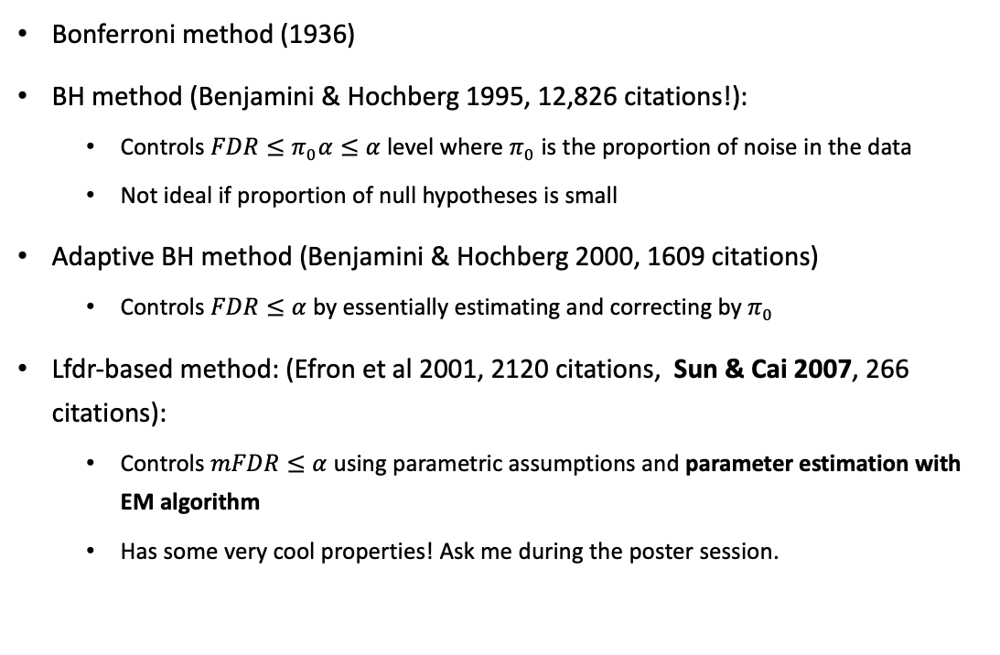
Methods to correct inflated error rates
Bonferroni method (1936)
BH method (Benjamini & Hochberg 1995, 12,826 citations!):
Controls $FDR≤π_{0}α≤α$ level where $π_{0}$ is the proportion of noise in the data
Not ideal if proportion of null hypotheses is small
Adaptive BH method (Benjamini & Hochberg 2000, 1609 citations)
Controls $FDR≤α$ by essentially estimating and correcting by $π_{0}$
Lfdr-based method: (Efron et al 2001, 2120 citations, Sun & Cai 2007, 266 citations):
Controls $mFDR≤α$ using parametric assumptions and parameter estimation with EM algorithm
Has some very cool properties! Ask me during the poster session.

Slide 6
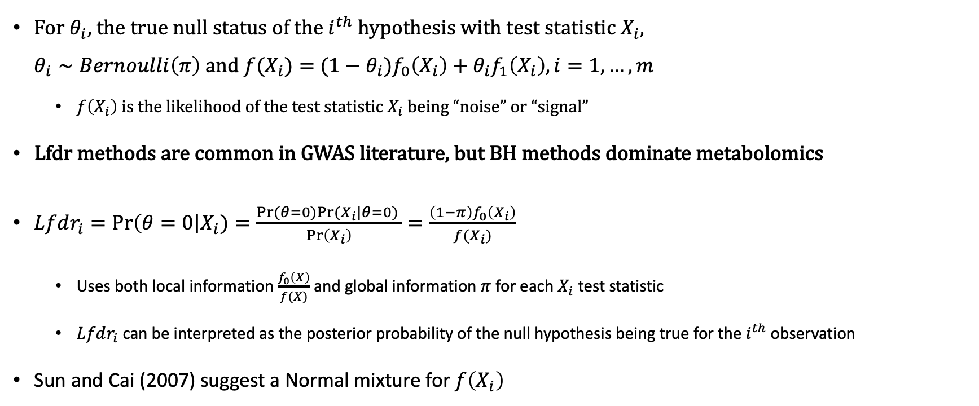
Local false discovery rate (Lfdr) (Efron et al. 2001, Storey 2003)
For $θ_{i}$, the true null status of the $i^{th}$ hypothesis with test statistic $X_{i}$, $θ_{i}∼Bernoulli\left(π\right)$ and $f(X_{i})=$ ${(1−θ}_{i})f_{0}\left(X_{i}\right)+θ_{i}f_{1}\left(X_{i}\right), i=1,…, m$
$f\left(X_{i}\right)$ is the likelihood of the test statistic $X_{i}$ being “noise” or “signal”
Lfdr methods are common in GWAS literature, but BH methods dominate metabolomics
$Lfdr_{i}=\operatorname{Pr}\left(θ=0\right|X_{i})=\frac{Pr⁡(θ=0)Pr⁡(X_{i}|θ=0) }{\operatorname{Pr}\left(X_{i}\right)}=\frac{\left(1−π\right)f_{0}\left(X_{i}\right)}{f(X_{i})}$
Uses both local information $\frac{f_{0}\left(X\right)}{f(X)}$ and global information $π$ for each $X_{i}$ test statistic
$Lfdr_{i}$ can be interpreted as the posterior probability of the null hypothesis being true for the $i^{th}$ observation
Sun and Cai (2007) suggest a Normal mixture for $f\left(X_{i}\right)$

Slide 7
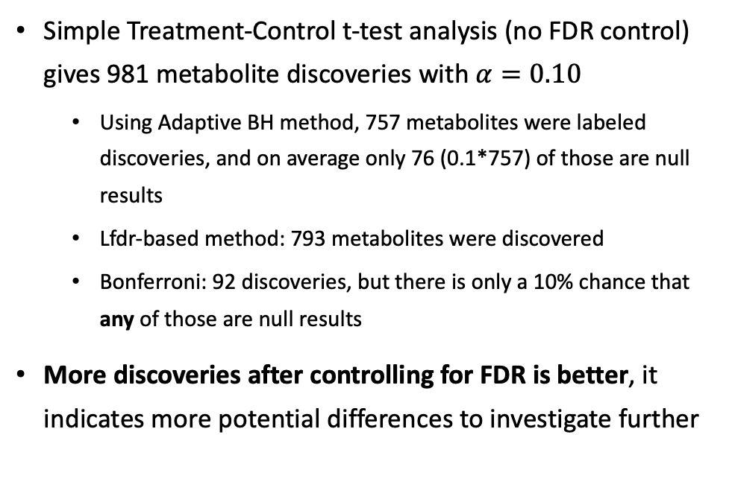
Case study results
Simple Treatment-Control t-test analysis (no FDR control) gives 981 metabolite discoveries with $α=0.10$
Using Adaptive BH method, 757 metabolites were labeled discoveries, and on average only 76 (0.1*757) of those are null results
Lfdr-based method: 793 metabolites were discovered
Bonferroni: 92 discoveries, but there is only a 10% chance that any of those are null results
More discoveries after controlling for FDR is better, it indicates more potential differences to investigate further
Number of discoveries for FDR control levels and methods (more is better)
𝛂 | Lfdr method | Adaptive BH | Bonferroni method | No FDR control
1% | 318 | 340 | 60 | 429
5% | 582 | 577 | 83 | 757
10% | 793 | 757 | 92 | 981

Slide 8
Future work
For this project:
Cluster analysis to see which metabolites are similar and see how the discoveries cluster. Maybe there is something interesting to see there?
Ex. Metabolites in “X” cluster are relating to a certain trait, and 90% of those are significant
Impute and use metabolites with missing or below detection limit values
Study design of equine synovial fluid was more complicated, and we threw away information to make it easier.
General future work:
Use informative priors to try to increase number of discoveries while still controlling FDR
Each test is potentially not independent, and there is not a Lfdr-based solution to that.

Slide 9
References
Benjamini, Y., & Hochberg, Y. (1995). Controlling the false discovery rate: a practical and powerful approach to multiple testing. Journal of the Royal Statistical Society: Series B (Methodological), 57(1), 289-300.
Benjamini, Y., & Hochberg, Y. (2000). On the adaptive control of the false discovery rate in multiple testing with independent statistics. Journal of Educational and Behavioral Statistics, 25(1), 60-83.
Efron, B., Tibshirani, R., Storey, J. D., & Tusher, V. (2001). Empirical Bayes analysis of a microarray experiment. Journal of the American Statistical Association, 96(456), 1151-1160.
Storey, J. D. (2003). The positive false discovery rate: a Bayesian interpretation and the q-value. The Annals of Statistics, 31(6), 2013-2035.
Sun, W., & Cai, T. T. (2007). Oracle and adaptive compound decision rules for false discovery rate control. Journal of the American Statistical Association, 102(479), 901-912.

Slide 10
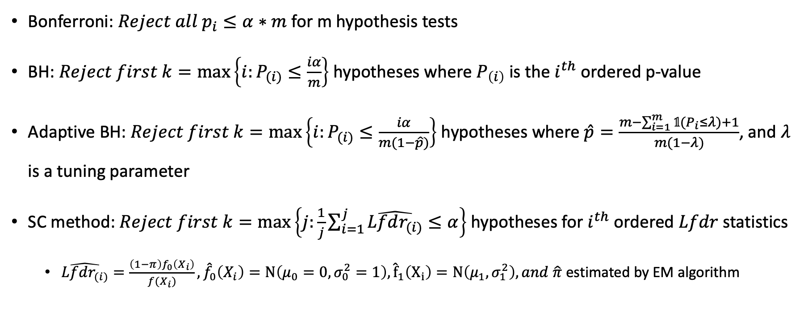
Appendix: MHT Algorithms
Bonferroni: $Reject all p_{i}≤α∗m$ for m hypothesis tests
BH: $Reject first k=\max\left\{i:P_{(i)}≤\frac{iα}{m}\right\}$ hypotheses where $P_{\left(i\right)}$ is the $i^{th}$ ordered p-value
Adaptive BH: $Reject first k=\max\left\{i:P_{(i)}≤\frac{iα}{m(1−\hat{p})}\right\}$ hypotheses where $\hat{p}=\frac{m−\sum_{i=1}^{m}{𝟙(P_{i}≤λ)}+1}{m(1−λ)}$, and $λ$ is a tuning parameter
SC method: $Reject first k=\max\left\{j:\frac{1}{j}\sum_{i=1}^{j}{\hat{Lfdr_{(i)}}}≤α\right\}$hypotheses for $i^{th}$ ordered $Lfdr$ statistics
$\hat{Lfdr_{(i)}}=\frac{\left(1−π\right)f_{0}\left(X_{i}\right)}{f(X_{i})}, {\hat{f}}_{0}\left(X_{i}\right)=N\left(μ_{0}=0,σ_{0}^{2}=1\right),{\hat{f}}_{1}\left(X_{i}\right)=N\left(μ_{1}, σ_{1}^{2}\right), and \hat{π}$ estimated by EM algorithm

Slide 11
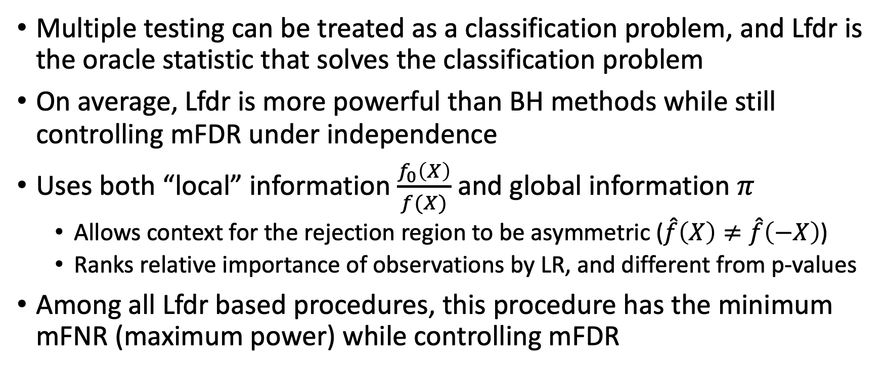
Appendix: Properties of Sun & Cai 2007 method
Multiple testing can be treated as a classification problem, and Lfdr is the oracle statistic that solves the classification problem
On average, Lfdr is more powerful than BH methods while still controlling mFDR under independence
Uses both “local” information $\frac{f_{0}\left(X\right)}{f(X)}$ and global information $π$
Allows context for the rejection region to be asymmetric ($\hat{f}\left(X\right)≠\hat{f}\left(−X\right)$)
Ranks relative importance of observations by LR, and different from p-values
Among all Lfdr based procedures, this procedure has the minimum mFNR (maximum power) while controlling mFDR

Slide 12

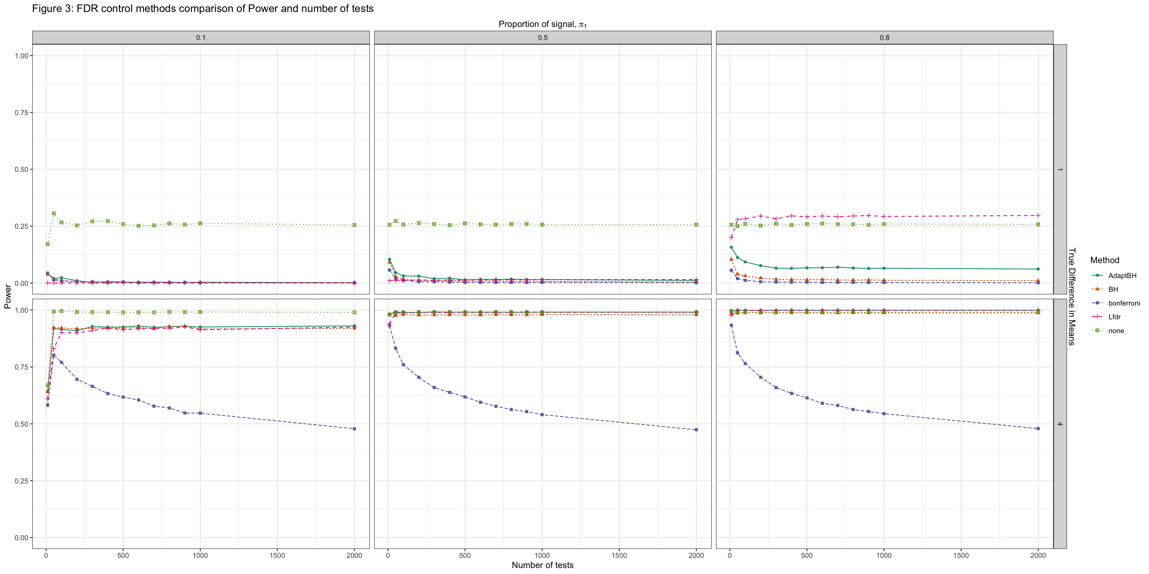
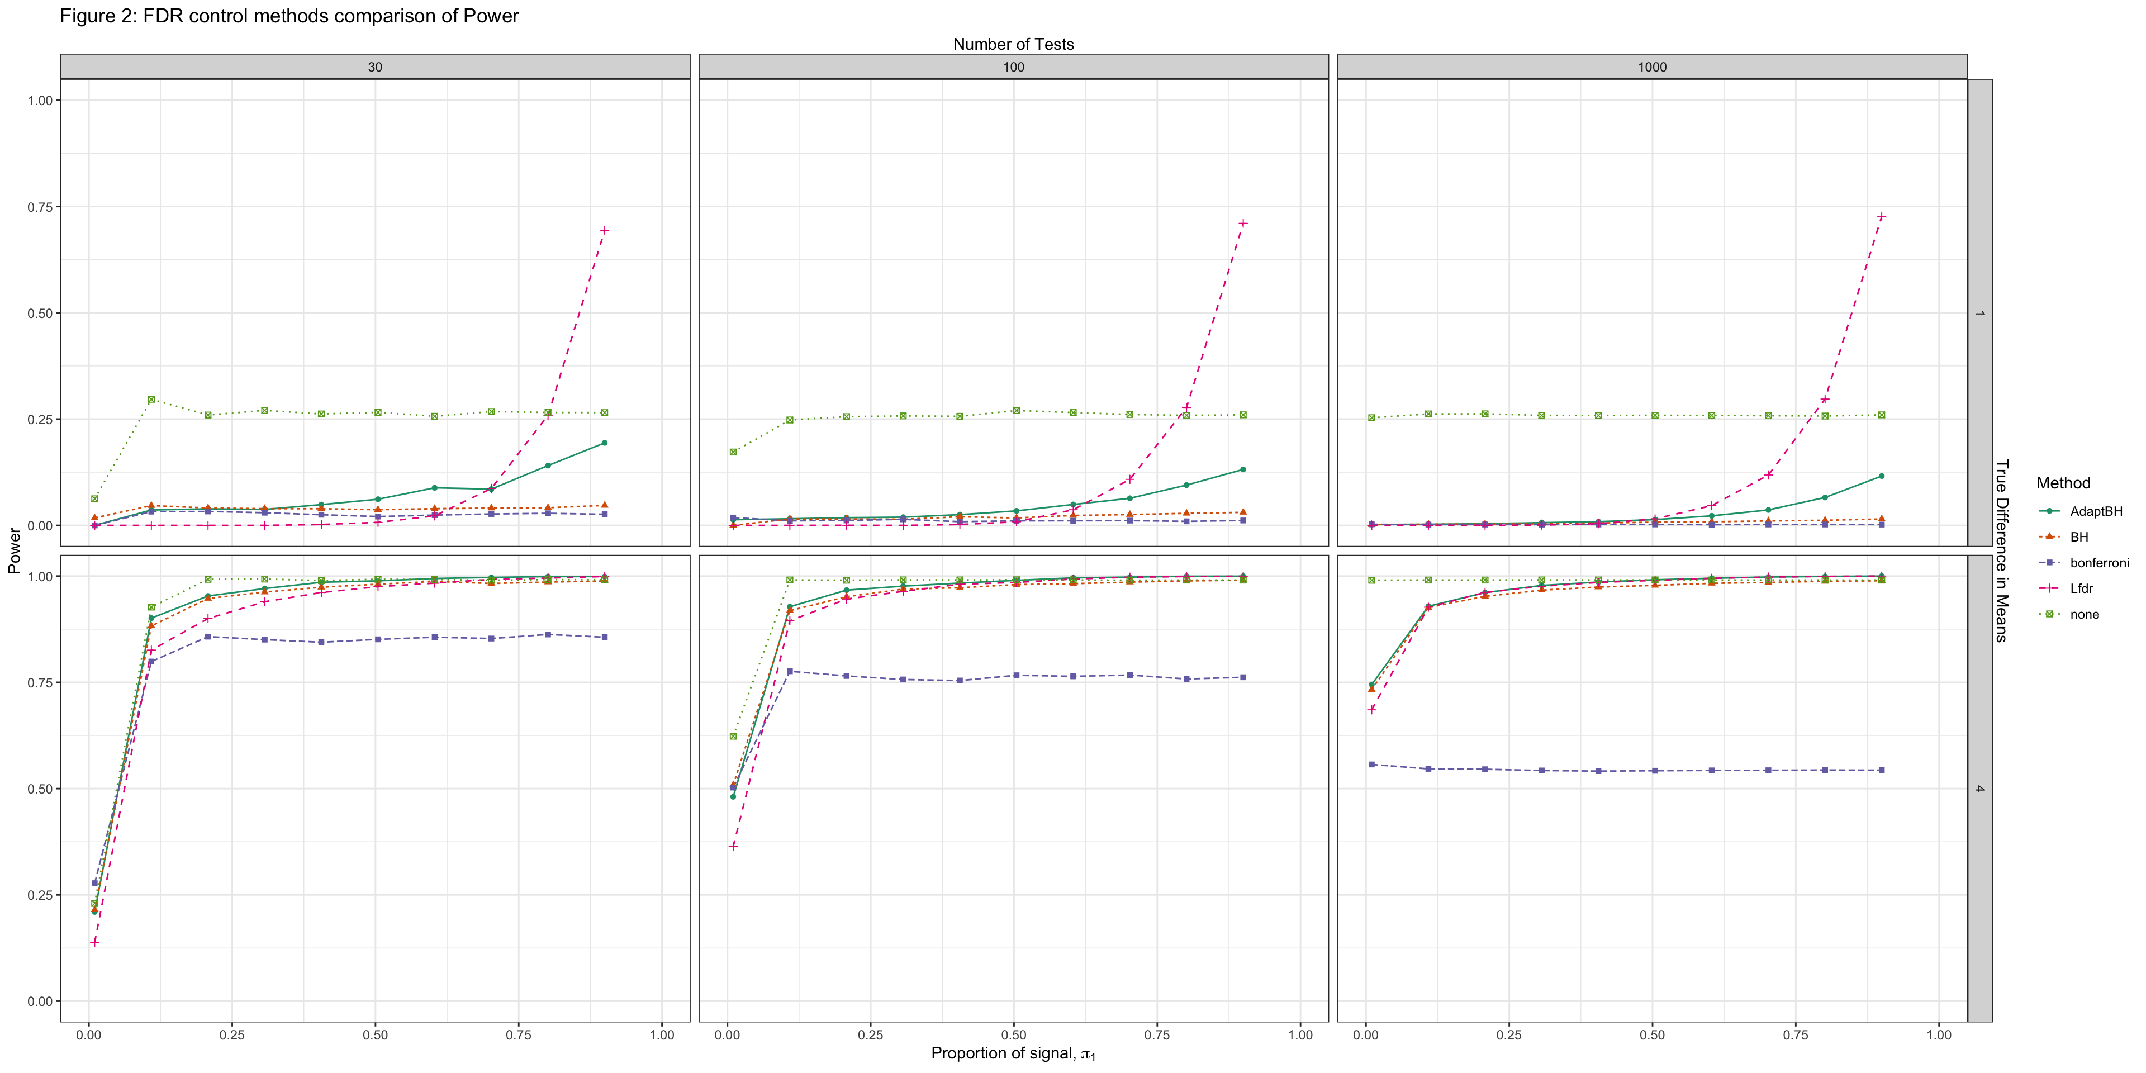


A Bayesian multiple testing approach to a case study of synovial fluid metabolomics
Connor Demorest
Dr. Shinjini Nandi
ideas for peer review processes in the context of mentoring students as statistical consultants and collaborators.
Local FDR, a Bayesian interpretation
k
MHT and FDR
Research Question
Simulation Results
Multiple hypothesis testing (MHT) is an active and highly influential area of research used by both statisticians and other academic disciplines to evaluate many hypotheses simultaneously.
Methodology to improve MHT are important and widely used across many disciplines (See Benjamini & Hochberg 1995, 2000, Efron et al 2001, Storey 2002, and many others).
The false discovery rate (FDR) introduced in Benjamini & Hochberg 1995 paper provided a new way to think about MHT methods. They proposed a way to control FDR in 1995 and improved on it in 2000.
Expected proportion of false discoveries is controlled to $α$ level, $𝔼\left(\frac{\# False Discoveries}{\# Discoveries ∨ 1}\right)≤α$
Many extensions exist to account for correlated tests (Benjamini & Yekutieli 2001), online tests (Foster & Stein 2008), or a more complicated structure of data (Nandi, Sarkar, & Chen 2021).
Is there a difference in metabolic makeup in the synovial fluid between treatment and control knees of horses?
4 Horses were treated in right knee with flavopiridol and left knee with saline
Followed up one week later to see if there are differences in metabolomics between treatment and control legs
Data on 4722 metabolites were detected and 2926 total metabolites completely observed and used for this study
I compared Sun and Cai’s method to BH method for a case study of synovial fluid metabolomics
Lfdr-based methods are more common in Genome-Wide Association studies, but not much in metabolomics literature.
My contribution is to compare how Sun and Cai’s method and BH methods compare in the metabolomics literature, and interpret the local false discovery rate results in meaningful context.
Simulations show that under ideal circumstances, Sun and Cai’s methods are at least as powerful as
Local false discovery rate (Lfdr) methods of control were developed by Efron et al (2001).
They used an empirical Bayes approach to estimate the Lfdr statistic in a genetic microarray data setting.
$Lfdr=\operatorname{Pr}\left(θ=0\right|X)=\frac{\left(1−π\right)f_{0}\left(X\right)}{\left(1−π\right)f_{0}\left(X\right)+πf_{1}\left(X\right)}$ where $π$ is the proportion of signal in the data and $f_{0},f_{1}$ are the density of test statistics for unaffected and affected genes
Sun and Cai (2007) suggest a Normal distribution for $f_{0}, f_{1}$, and show that their method among all Lfdr based procedures, this procedure has maximum power while controlling mFDR
Ranks relative importance of observations with likelihood ratio, and gives different results than p-value methods
Allows context for the rejection region to be asymmetric $\hat{f}\left(X\right)≠\hat{f}\left(−X\right)$

Slide 13
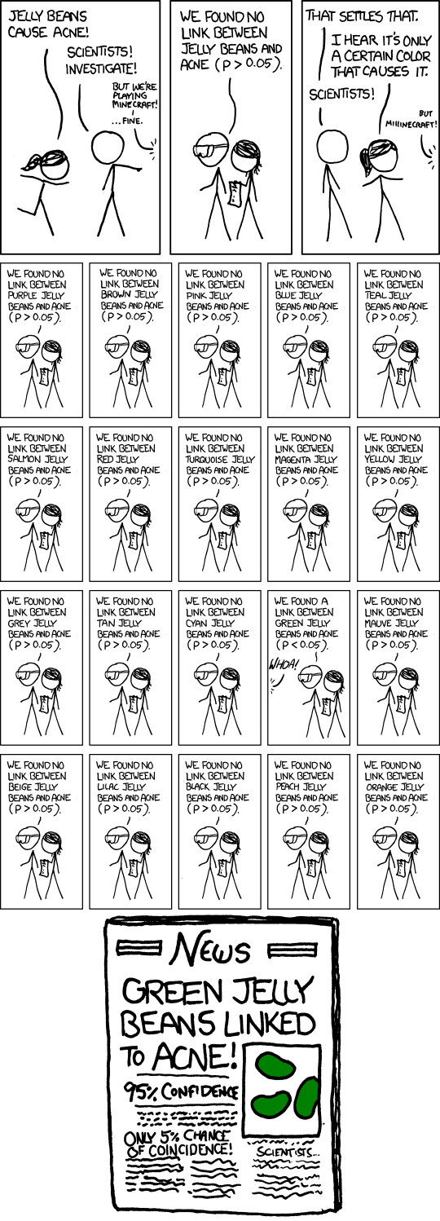

A Bayesian multiple testing approach to a case study of synovial fluid metabolomics
Connor Demorest
Dr. Shinjini Nandi
ideas for peer review processes in the context of mentoring students as statistical consultants and collaborators.
Real data results
k
Algorithms
Jelly beans cause acne!
References
Bonferroni: $Reject all p_{i}≤α∗m$ for m hypothesis tests
BH: $Reject first k=\max\left\{i:P_{(i)}≤\frac{iα}{m}\right\}$ hypotheses where $P_{\left(i\right)}$ is the $i^{th}$ ordered p-value
Adaptive BH: $Reject first k=\max\left\{i:P_{(i)}≤\frac{iα}{m(1−\hat{p})}\right\}$ hypotheses where $\hat{p}=\frac{m−\sum_{i=1}^{m}{𝟙(P_{i}≤λ)}+1}{m(1−λ)}$, and $λ$ is a tuning parameter
SC method: $Reject first k=\max\left\{j:\frac{1}{j}\sum_{i=1}^{j}{\hat{Lfdr_{(i)}}}≤α\right\}$hypotheses for $i^{th}$ ordered $Lfdr$ statistics
$\hat{Lfdr_{(i)}}=\frac{\left(1−π\right)f_{0}\left(X_{i}\right)}{f(X_{i})}, {\hat{f}}_{0}\left(X_{i}\right)=N\left(μ_{0}=0,σ_{0}^{2}=1\right), {\hat{f}}_{1}\left(X_{i}\right)=N\left(μ_{1}, σ_{1}^{2}\right), and \hat{π}$ estimated by EM algorithm
Possible extension to add reasonable informative priors to parameters?
$iid$ assumption to $X_{i}$ test statistics, which is possibly not reasonable
Often test statistics are assumed to be positively correlated (see Benjamini & Yekutieli 2001 for example)
The Lfdr method found slightly more rejections than the Adaptive BH method, and many more than the normal BH method.
EM algorithm was used to estimate parameters, but future work may include priors and would probably be MCMC algorithms.
More work with our collaborators Dr. June and Dr. Steward to investigate which metabolites to follow up on and how to do so could also be future work.
Hopefully Lfdr methods would be more standard in the metabolomics literature in the future!
Benjamini, Y., & Hochberg, Y. (1995). Controlling the false discovery rate: a practical and powerful approach to multiple testing. Journal of the Royal Statistical Society: Series B (Methodological), 57(1), 289-300.
Benjamini, Y., & Hochberg, Y. (2000). On the adaptive control of the false discovery rate in multiple testing with independent statistics. Journal of Educational and Behavioral Statistics, 25(1), 60-83.
Efron, B., Tibshirani, R., Storey, J. D., & Tusher, V. (2001). Empirical Bayes analysis of a microarray experiment. Journal of the American Statistical Association, 96(456), 1151-1160.
Storey, J. D. (2003). The positive false discovery rate: a Bayesian interpretation and the q-value. The Annals of Statistics, 31(6), 2013-2035.
Sun, W., & Cai, T. T. (2007). Oracle and adaptive compound decision rules for false discovery rate control. Journal of the American Statistical Association, 102(479), 901-912.
Number of discoveries for FDR control levels and methods (more is better), out of 2926 tests
𝛂 | Lfdr method | Adaptive BH | Bonferroni method | No FDR control
1% | 318 | 340 | 60 | 429
5% | 582 | 577 | 83 | 757
10% | 793 | 757 | 92 | 981

