Slide 1
StackOverflow Power Rankings
Orange Team 1
Connor Folk, Carlos Huisa, Taylor Agarwal, Sue Manner, Nikita Jumani, Ishanee Rudra
Notes:
Hi, my name is Connor Folk and along with my group: Carlos Huisa, Taylor Agarwal, Nikita Jumani, Sue Manner, Ishanee Rudra, I’d like to welcome you to our presentation on Stack Overflow Text Analysis.

Slide 2
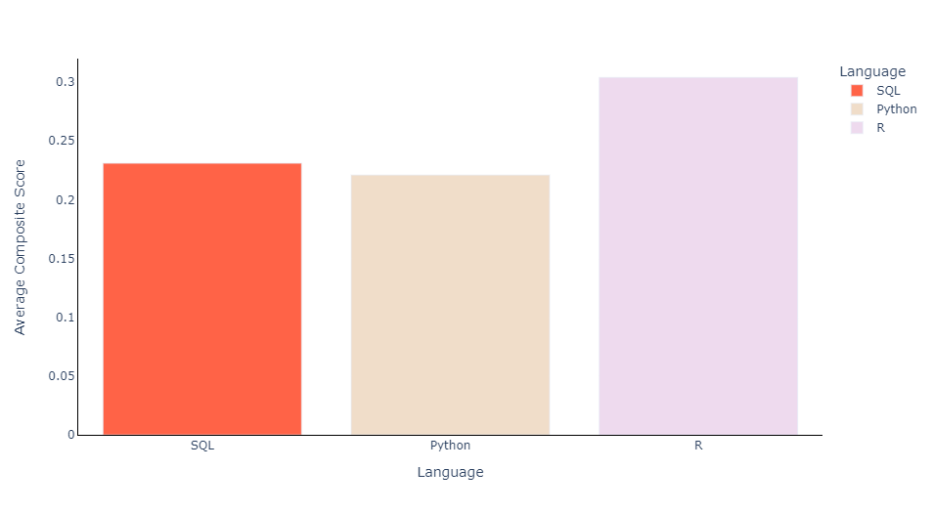
Overview
We found 21 distinct topic clusters among Python, R, and SQL StackOverflow questions
We discovered that R has a 31.6% higher average sentiment than Python
Notes:
Through our analysis of StackOverflow questions, we found 21 distinct clusters among Python, R, and SQL. Additionally, we discovered that questions about R have the highest overall sentiment and is 31.6% higher on average than second place SQL.

Slide 3
Agenda
StackOverflow Background
Project Plan
Topic Clustering
Sentiment Analysis
Conclusion
Notes:
We will start with a brief background of StackOverflow, followed by the plan for our project, and ending with Sentiment Analysis and Topic Clustering

Slide 4
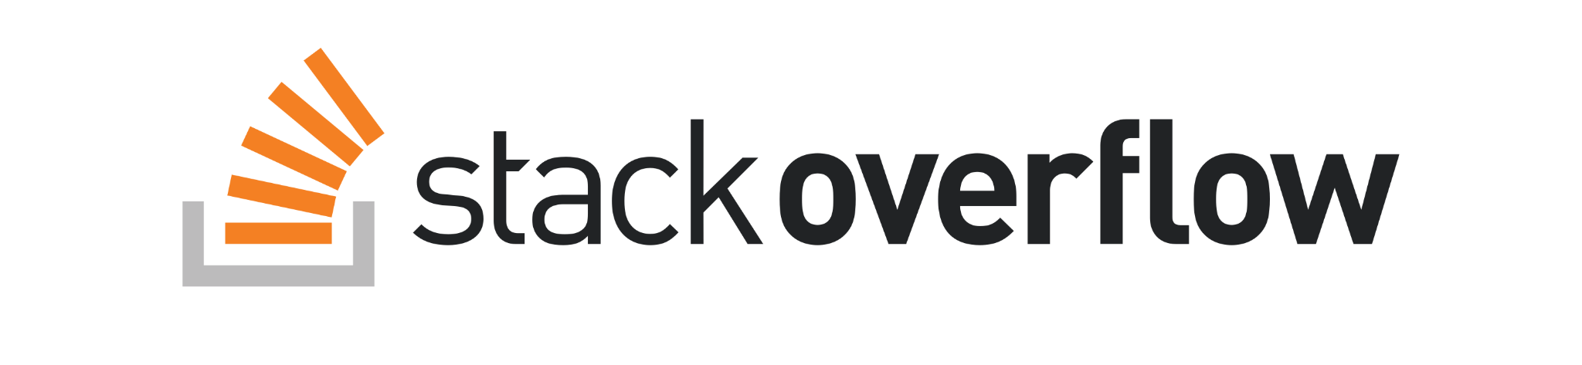
Stack Overflow
Project Plan
Topic Clustering
Sentiment Analysis
Conclusion
Notes:
Let’s start with an overview of Stack Overflow. As many of you already know, Stack Overflow is a public forum where individuals can ask and answer questions about coding languages. It is used by both professional and enthusiast programmers alike.

Slide 5



StackOverflow Dataset
VS
VS
Stack Overflow
Project Plan
Topic Clustering
Sentiment Analysis
Conclusion
Notes:
As a result, we decided this would be the perfect place to gain insights into the main programming languages we learn in this program: R, Python, and SQL. To do this, we queried from StackOverflow question database on Kaggle. We pulled 100,000 questions that mentioned one of the coding languages, had at least 50 views, and were posted after 2018. There requirements ensured only relevant and clear questions about the languages were included in the data.

Slide 6

Project Plans
Stack Overflow
Project Plan
Topic Clustering
Sentiment Analysis
Conclusion
Notes:
After querying the data, we first needed to clean the data. The data had _ columns, but we only wanted to focus on the text in the title and body of the question. The data was in html format so we used a simple html parser to pull out only the paragraph portions, leaving out code chunks. We, then, subsetted the data by coding language. Next, we decided to cluster within each language to find common topics within questions. Lastly, we performed sentiment analysis to find out which language was liked the most (or more likely the least).

Slide 7
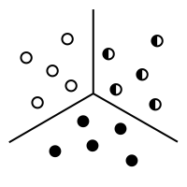
Project Plans
Stack Overflow
Project Plan
Topic Clustering
Sentiment Analysis
Conclusion
Notes:
Next, we decided to cluster within each language to find common topics within questions.

Slide 8

Project Plans
Stack Overflow
Project Plan
Topic Clustering
Sentiment Analysis
Conclusion
Notes:
Lastly, we performed sentiment analysis on the questions in each language to find out which language was liked the most (or more likely which was liked the least).

Slide 9
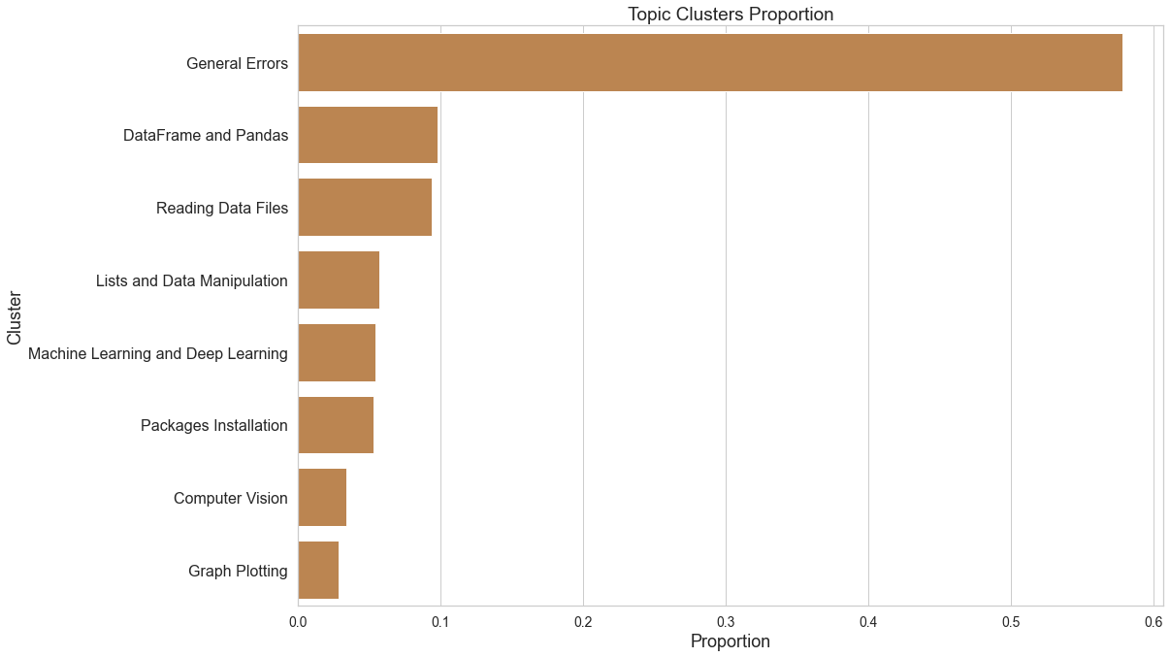
Topic Clustering - Python
Stack Overflow
Project Plan
Topic Clustering
Sentiment Analysis
Conclusion

Slide 10
Topic Clustering - Machine Learning and Deep Learning
Example 1 | Pytorch multilabel classification network not training
Example 2 | TensorFlow 2.3: load model from ModelCheckPoint callback with both custom layers and model
Example 3 | Making my Logistic Regression testing accuracy closer to my training accuracy with Python
Example 4 | tf.keras.layers.BatchNormalization with trainable=False appears to not update its internal moving mean and variance
Example 5 | My machine learning model keeps predicting the wrong thing even though it has a high accuracy
Stack Overflow
Project Plan
Topic Clustering
Sentiment Analysis
Conclusion

Slide 11
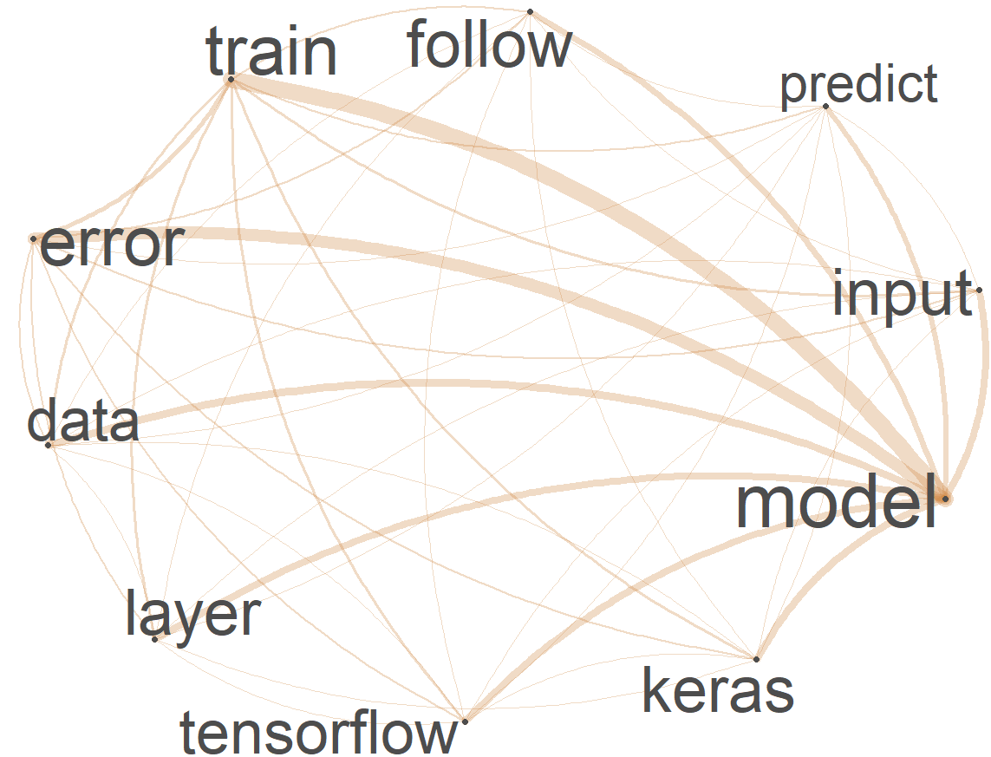
Topic Clustering - Machine Learning and Deep Learning
Stack Overflow
Project Plan
Topic Clustering
Sentiment Analysis
Conclusion

Slide 12
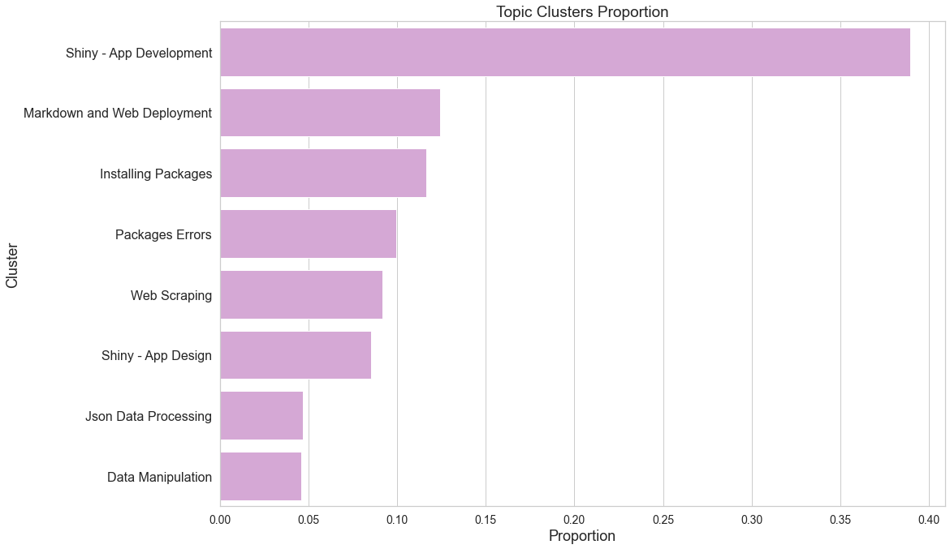
Topic Clustering - R
Stack Overflow
Project Plan
Topic Clustering
Sentiment Analysis
Conclusion

Slide 13
Topic Clustering - Shiny App Design
Example 1 | How to change css in rmarkdown cell & shiny?
Example 2 | Change color of a Shiny theme
Example 3 | Use javascript to change the background color of selectinput in R shiny
Example 4 | R shiny: change colour of individual check boxes in checkboxGroupInput
Example 5 | Shiny: How to change the background colour of a button while it is clicked
Stack Overflow
Project Plan
Topic Clustering
Sentiment Analysis
Conclusion

Slide 14
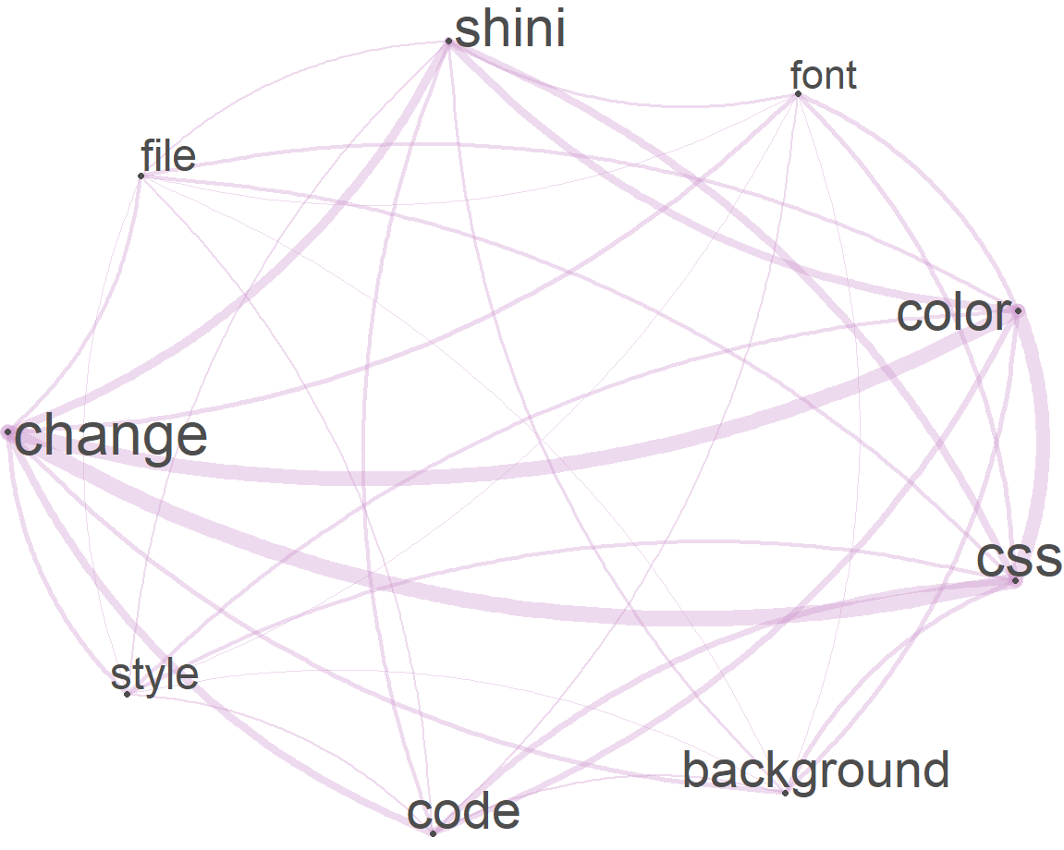
Topic Clustering - Shiny App Design
Stack Overflow
Project Plan
Topic Clustering
Sentiment Analysis
Conclusion

Slide 15
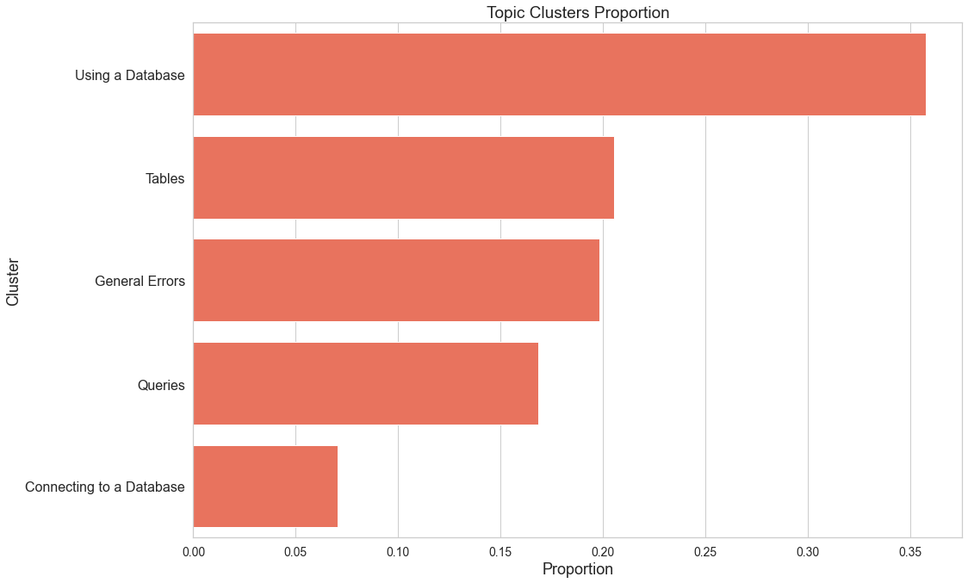
Topic Clustering - SQL
Stack Overflow
Project Plan
Topic Clustering
Sentiment Analysis
Conclusion

Slide 16
Topic Clustering - Connecting to a Database
Example 1 | Cannot successfully Install mysql-server in WSL
Example 2 | I´m can´t connect MySQL.
Example 3 | I'm getting below error connecting to Azure SQL Server database when using sql spark connector with DataBricks notebook.
Example 4 | SSIS Server Maintenance Job Fail need your help on this
Example 5 | Adding postgresql DB to travis It's my first time using any CI. I have used Travis. In current commit I added postgresql, but it is failing building
Stack Overflow
Project Plan
Topic Clustering
Sentiment Analysis
Conclusion

Slide 17
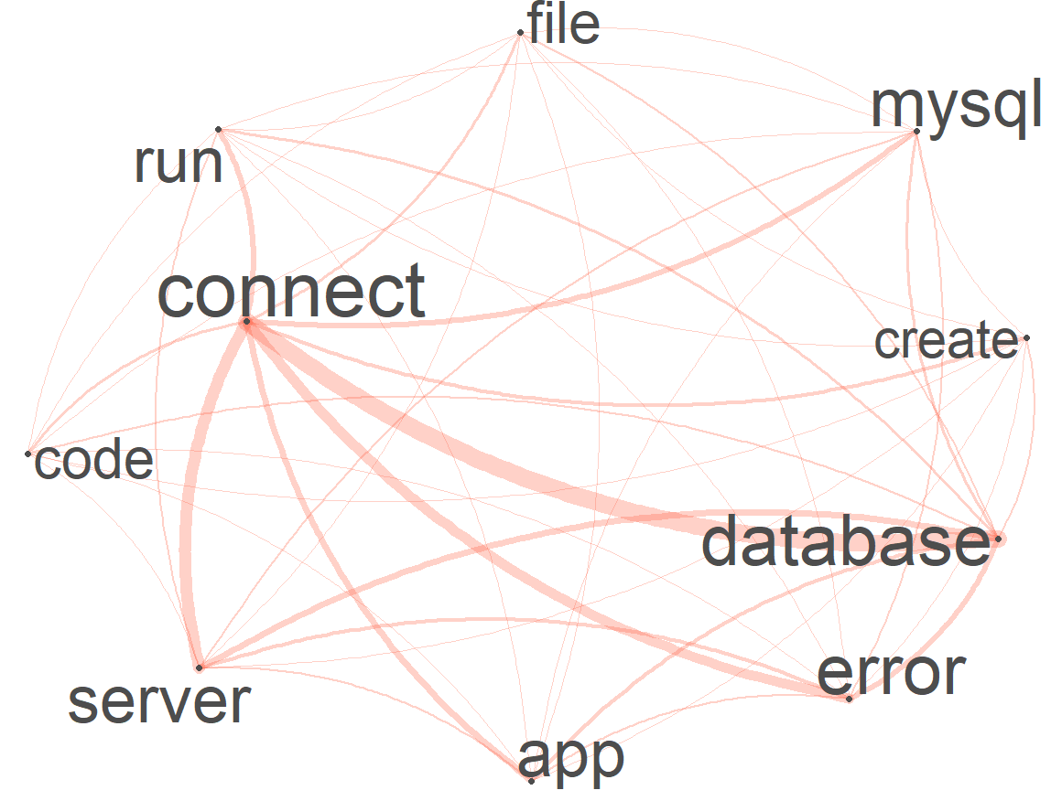
Topic Clustering - Connecting to a Database
Stack Overflow
Project Plan
Topic Clustering
Sentiment Analysis
Conclusion

Slide 18
Sentiment Analysis
Very Negative Question:
Chromedriver issue
ERROR
Very Positive Question:
Format data to create neat table in R markdown using kable
I want to create a neat table in R markdown using the kable package, but my data need to be transformed.
My data look like this:
I would like to create a table in R markdown that looks like this (but I welcome other suggestions):
Any ideas on how to solve this? I appreciate any help!
Stack Overflow
Project Plan
Topic Clustering
Sentiment Analysis
Conclusion
Notes:
Thank you Carlos. The next stage of our project explored the sentiment of the questions being asked. Here are two examples of questions in our data set, with any code blocks removed. These two examples illustrate some of the differences between very negative and very positive questions. We see the very negative question has only three words of text, and one of those words, “error”, carries a negative sentiment in the Vader lexicon. Therefore the question is negative. At the other end of of the sentiment spectrum, we have this positive question, containing several positive terms such as “neat” and “appreciate”.

Slide 19
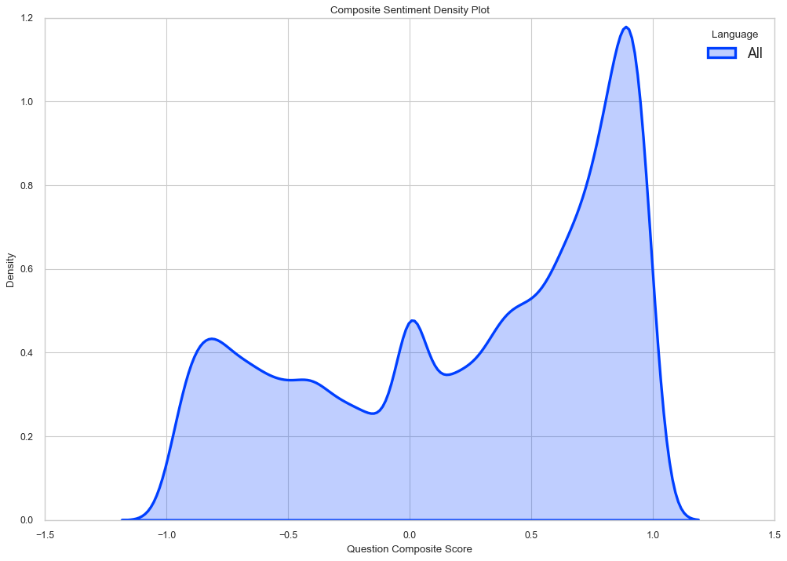
Sentiment Analysis
Stack Overflow
Project Plan
Topic Clustering
Sentiment Analysis
Conclusion
Notes:
Using Vader sentiment analysis, we evaluated the sentiment of every question in our data. Here we have the distribution of sentiment for all questions in our data. On the x-axis we have the composite sentiment score for each question. A negative one represents questions with a high proportion of negative words, and a positive one represents questions with a high proportion of positive words. Notice that there are three peaks on this density plot.

Slide 20
Sentiment Analysis
Stack Overflow
Project Plan
Topic Clustering
Sentiment Analysis
Conclusion
Notes:
We see that there are several scores that are completely neutral. This means that they contained no positive or negative terms in Vader lexicon.

Slide 21
Sentiment Analysis
Stack Overflow
Project Plan
Topic Clustering
Sentiment Analysis
Conclusion
Notes:
We also see that there are two peaks near positive one and negative one. In general, question text tends to be very neutral, but we noticed that several questions in the database were very neutral but had a little bit of positive or negative sentiment. Since neutral sentiment does not weight as heavily into the compound score as positive or negative sentiment, these questions are pushed to either extreme.

Slide 22
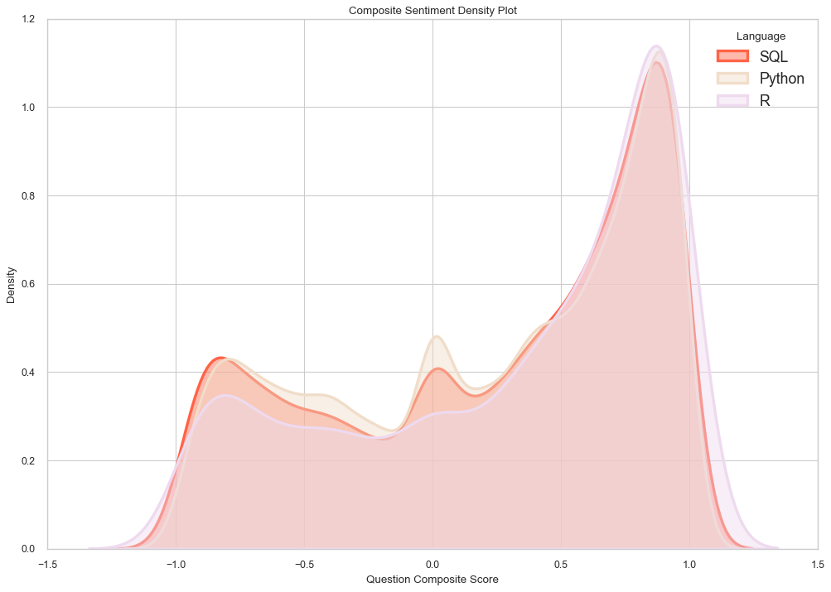
Sentiment Analysis
Stack Overflow
Project Plan
Topic Clustering
Sentiment Analysis
Conclusion
Notes:
We see the breakdown by language has a similar structure, but there are some key inferences that can be made. For instance, the R programming language appears to be distributionally dominant over the other languages. R has a higher density of positive questions and a lower density of negative questions than either language, indicating that it is more well regarded by question askers.

Slide 23
Sentiment Analysis
Stack Overflow
Project Plan
Topic Clustering
Sentiment Analysis
Conclusion
Notes:
This is further supported by the average composite score. Here we see that R has a higher average composite score,

Slide 24
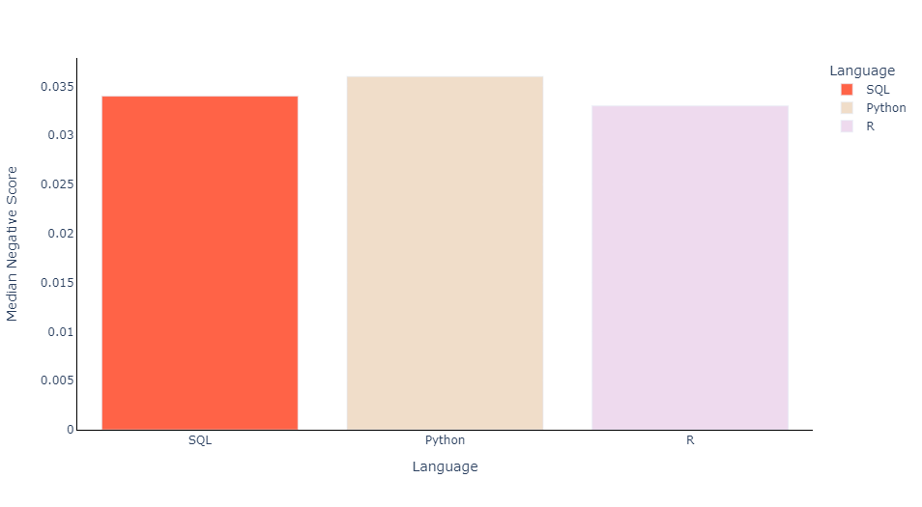
Sentiment Analysis
Stack Overflow
Project Plan
Topic Clustering
Sentiment Analysis
Conclusion
Notes:
Lower median negative score

Slide 25
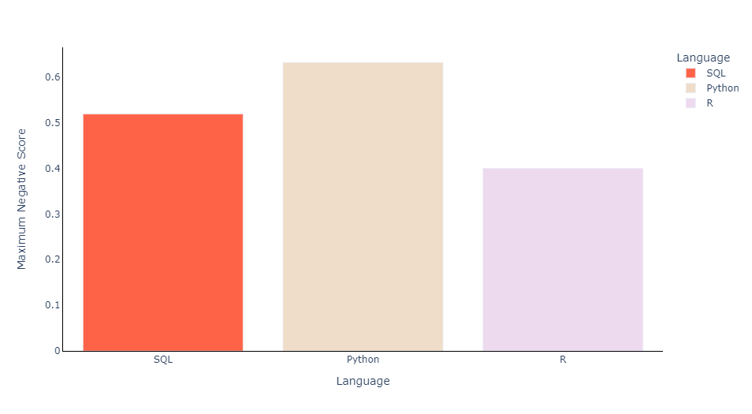
Sentiment Analysis
Stack Overflow
Project Plan
Topic Clustering
Sentiment Analysis
Conclusion
Notes:
And lower maximum negative score than either Python or SQL.

Slide 26
Conclusion
Determined that R is looked upon more favorably than Python or SQL
Distinguished 8 clusters in R and Python and 5 clusters in SQL
Analyzed network graph of terms within each of those clusters
Stack Overflow
Project Plan
Topic Clustering
Sentiment Analysis
Conclusion
Notes:
This analysis would indicate that R is more favorably looked upon by StackOverflow users than either SQL or Python. This is likely because Python is the most taught programming language of the three, so several novice programmers will be posting Python questions and expressing their frustrations with the language. Our topic clustering analyses indicate that there are several groups of distinct frequently asked topics for each programming language. Further digging into these clusters could provide insight into potential gaps in programming education.

