Slide 1

IT 420 Business Intelligence
Connor Gaskill

Slide 2
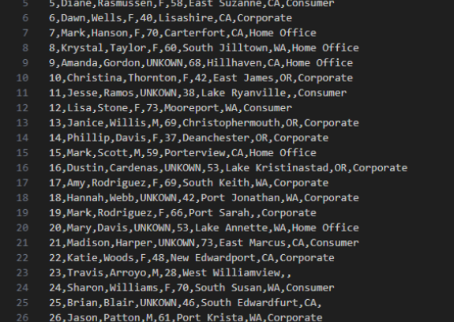
The Data
Incomplete,
Incompatible
Cannot use for analytics

Slide 3

Process
Flat File → ETL with SSIS → Building SQL tables → Inserting data into SQL tables → Generating reports with SSRS and Power BI

Slide 4
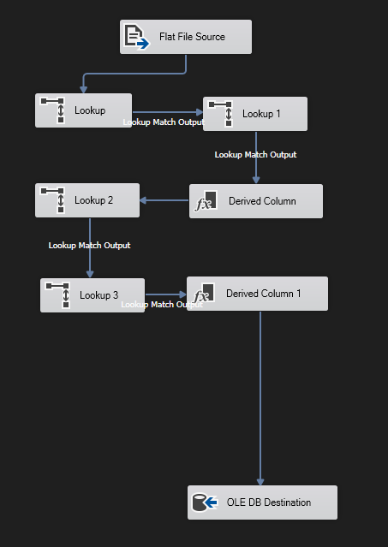
ETL
Extract
Transform
Load

Slide 5
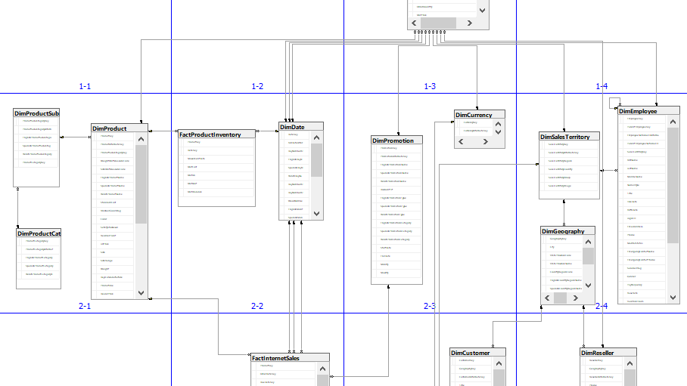
SSMS
Building tables and relations

Slide 6
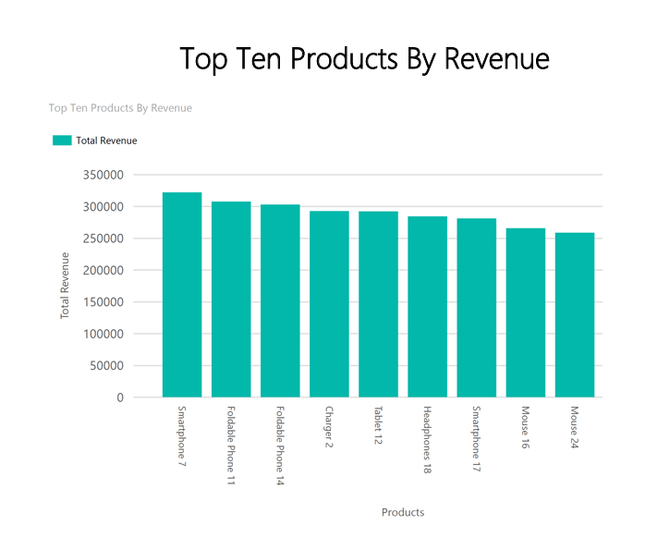
SSRS
Generating reports

Slide 7
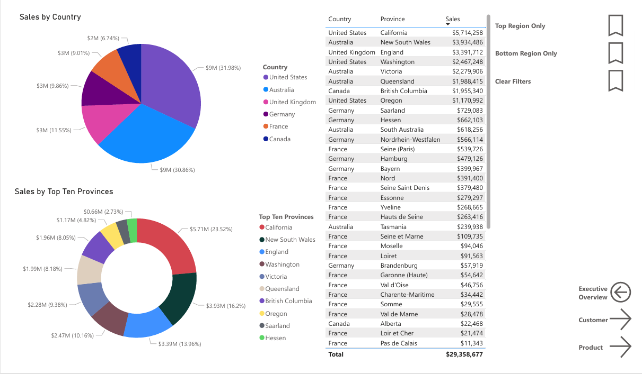
Power BI
Generating dashboards

Slide 8
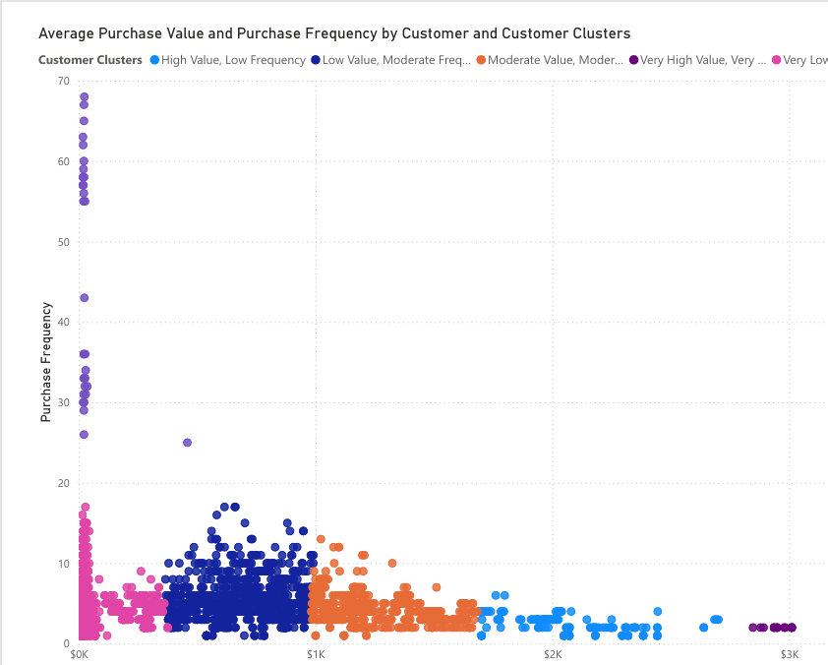
Findings
Very Low Value, Moderate Frequency (10,711 customers) – A large segment that purchases regularly but at low value, suggesting potential for upselling or bundling.
Very High Value, Very Low Frequency (358 customers) – High-value customers with infrequent purchases; targeted engagement could increase repeat business.
Low Value, Moderate Frequency (3,975 customers) – Customers with moderate purchasing habits; opportunities exist to increase average spend.
Moderate Value, Moderate Frequency (2,453 customers) – Steady contributors to revenue; could be nurtured to move into higher-value segments.
High Value, Low Frequency (891 customers) – Valuable but infrequent customers; retention and engagement strategies are recommended.
Very Low Value, Very High Frequency (36 customers) – Frequent purchasers with low individual value; potential for promotions or loyalty programs.

Slide 9

Conclusion

