Slide 1
CS 4476 PS3
<Jinghong Peng>
<jpeng78@gatech.edu>
<jpeng78>
<903568613>

Slide 2
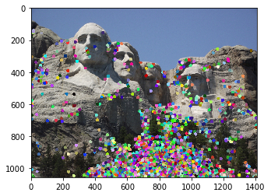
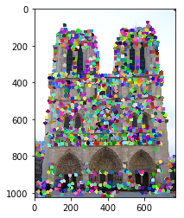
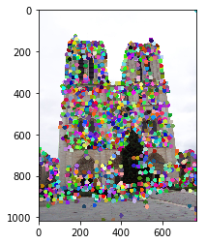
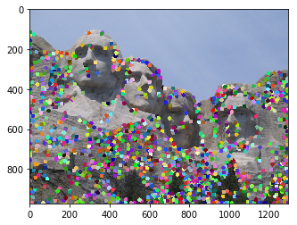
1.1: Harris Corner Detector
<insert visualization of Notre Dame interest points from proj3.ipynb here>
< insert visualization of Rushmore interest points from proj3.ipynb here >

Slide 3
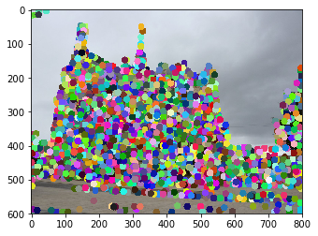
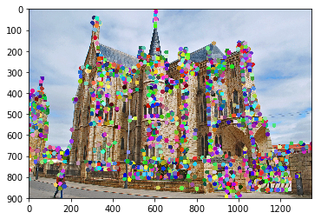
1.1: Harris Corner Detector
< insert visualization of Gaudi interest points from proj3.ipynb here >

Slide 4
1.1: Harris Corner Detector
Briefly describe how the Harris corner detector works.
We take the SSD(Sum squared difference) of pixel values before and after shifting the window in all 8 directions, and then find the the largest SSD value. We find the eigenvalues of M, which is λ1 and λ2. R is calculated by detM – alpha(traceM)^2. When R is large, it means λ1 and λ2 are both large, and thus the region is a corner.
What does the second_moments() helper function do?
We convolve with a gaussian kernel to get sx2, sy2, sxsy, essential parts of the matrix. These values are used by corner_response()
What does the corner_response() helper function do?
Corner_response uses values calculated from second_moments to calculated the R score. R is used to determine if it is a corner or not.

Slide 5
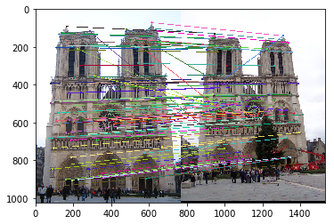
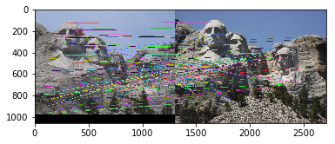
1.3: Feature Matching
<insert feature matching visualization of Notre Dame from proj3.ipynb>
<insert feature matching visualization of Rushmore from proj3.ipynb >

Slide 6
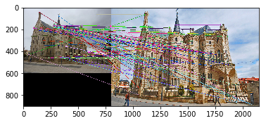
1.3: Feature Matching
<insert feature matching visualization of Gaudi from proj3.ipynb >
<Describe your implementation of feature matching.>
I first use computer_feature_distance to get the distances from each feature in features1 to each feature in features2. Then I iterate through each feature, and get the ratio of closest distance/2nd closest distance. I set the threshold to 0.95. And build an array of result using the filtered matches.

Slide 7
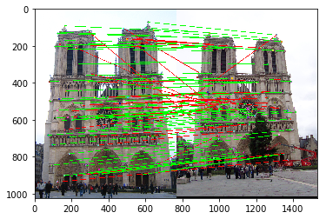
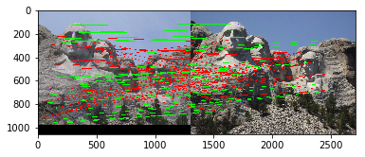
Results: Ground Truth Comparison
<Insert visualization of ground truth comparison with Notre Dame from proj3.ipynb here>
<Insert visualization of ground truth comparison with Rushmore from proj3.ipynb here>

Slide 8
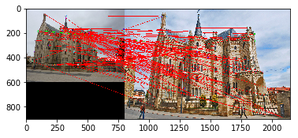
Results: Ground Truth Comparison
<Insert visualization of ground truth comparison with Gaudi from proj3.ipynb here>
<Insert numerical performances on each image pair here. Also discuss what happens when you change the 4x4 subgrid to 2x2, 5x5, 7x7, 15x15 etc?>
Image1: You found 98/100 required matches Accuracy = 0.670000
Image2: You found 92/100 required matches Accuracy = 0.350000
Image3: You found 100/100 required matches Accuracy = 0.010000

Slide 9
1.4(a): Hyperparameter Tuning part 1 [Extra credit]
<Insert images of the ground truth correspondence and their corresponding accuracies for varying sigma in the second moments [3, 6, 10, 30] >
When changing the values for large sigma (>20), why are the accuracies generally the same?

Slide 10
1.4(a): Hyperparameter Tuning part 2 [Extra credit]
<Insert images of the ground truth correspondence and their corresponding accuracies for varying feature width in the SIFT [8, 16, 24, 32] >
What is the significance of changing the feature width in SIFT?

Slide 11
1.4(c): Accelerated Matching [Extra credit]
<Insert Runtime/Accuracy of your faster matching implementation. What did you try and why is it faster?>

