Slide 1
The NA correction of the Brillouin shift
Procedure, effect on the width, and why a post-hoc scalar is justified
Fit unchanged, correct afterwards
Proven equivalent
Width barely moves
divide the fitted shift by ⟨cos(v/2)⟩ — a number, not a lineshape
full in-fit model built and raced: correction is constant to 0.01 MHz; in-fit differs by only 0.3 MHz
−0.65 ± 0.05 MHz flat at NA 0.42, nothing at NA 0.14; dΓ/dT untouched
Water-series analysis 2026-08 · NA 0.14 (5X) and NA 0.42 (20X)

Slide 2
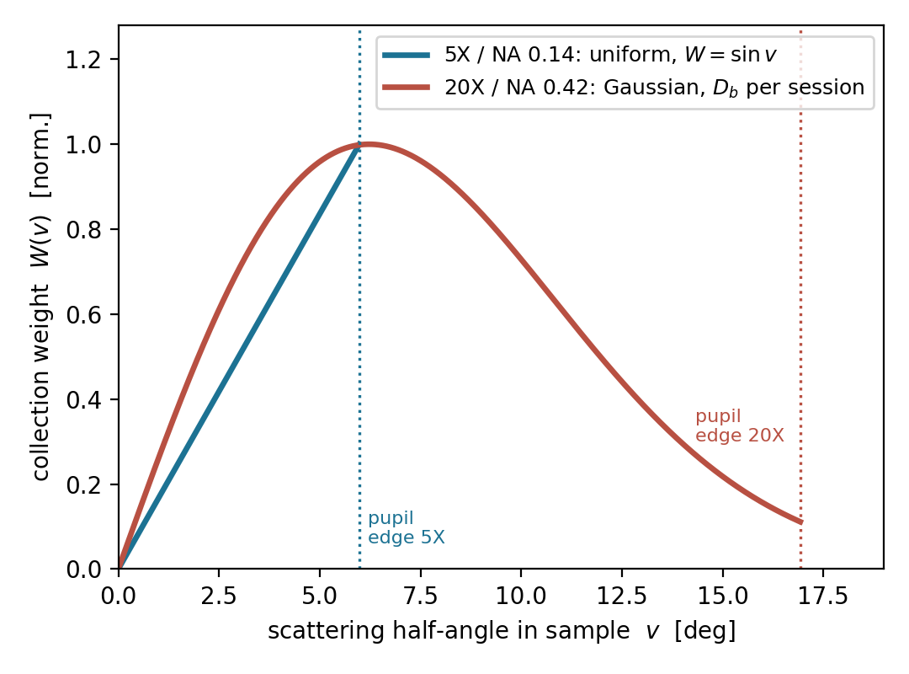
Why the shift needs a correction at all
The objective collects a cone of angles, not a single 180° ray
Each collected angle v sees a smaller scattering vector: its sub-peak sits at f(v) = f₁₈₀·cos(v/2) ≤ f₁₈₀
• The recorded line is the W(v)-weighted superposition of these sub-peaks — every symmetric fit lands below the true 180° shift.
Size of the deficit (water): −3.5 MHz (−0.068%) at NA 0.14, −14 to −18 MHz (−0.27 to −0.36%) at NA 0.42
• W(v) is lens-specific: the 5X is a plain hard pupil (uniform); the 20X is apodized by its out-of-band aberration — modelled as a Gaussian with one per-session width D_b anchored on water.
The model
measured(f) = ∫ W(v) · Lor( f − f₁₈₀cos(v/2) ) dv ⊗ instrument kernel
uniform: W = sin v (no free parameter) · Gaussian: W = sin v · exp(−2(v/v₀)²), v₀ from D_b

Slide 3
The procedure: fit as usual, then divide by one number
Nothing changes in the production pipeline — the NA model never enters the fit
Fit the spectrum with prm1, exactly as at low NA
The scalar, in MHz
NA 0.14
+3.5 MHz
uniform pupil, zero free parameters
NA 0.42
+14–18 MHz
Gaussian W(v), per-session D_b from the water anchor
1
Pixel-response Lorentzian, per-peak linear background, frozen σ/τ kernel, β = 3 window — against that scan's own raw-calibration refit.
Convert to MHz and take the distance
2
Per-peak calibration polynomials as always; the L–R distance/mean is the shift observable.
Divide by the scalar ⟨cos(v/2)⟩ = ∫W cos(v/2) dv / ∫W dv
3
NA 0.14: uniform W — parameter-free, factor 0.99932. NA 0.42: Gaussian W with that session's water-anchored D_b — factor ≈0.9973 (D_b ≈ 6 mm).
Requirement: only datasets with RAW per-scan calibration frames — and at NA 0.42 a same-session water bracket for D_b (it drifts ~0.1 mm/day).

Slide 4
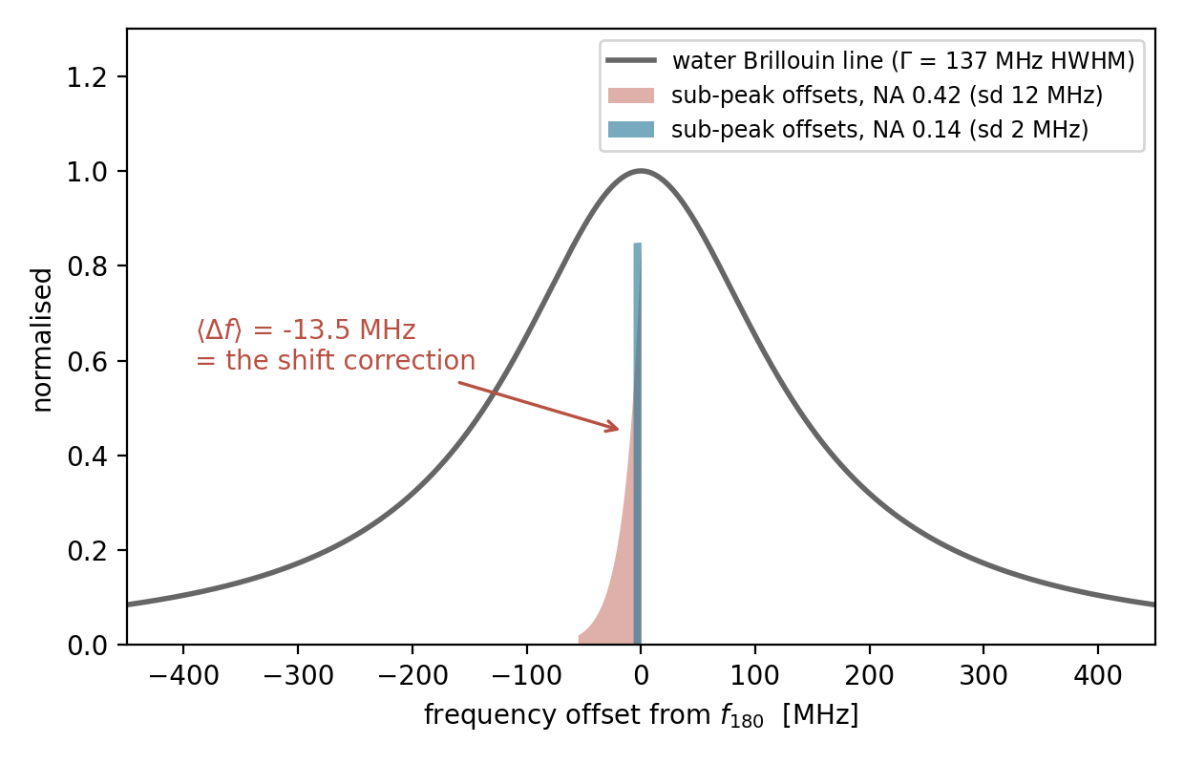
Why one number can stand in for the full integral
Separation of scales: the cone's frequency spread is tiny compared with the linewidth
The sub-peak offsets span 7 MHz (NA 0.14) / 55 MHz (NA 0.42), with weighted sd 2 MHz and 12 MHz — against a linewidth Γ ≈ 137 MHz.
Spread/Γ = 1.5% and 9%. To first order the superposition is the same Lorentzian, translated by ⟨Δf⟩ — the correction factorizes out of the fit.
• Second order (the variance) goes into the width, not the shift — and is percent-level even at NA 0.42.
So the integral is used only to compute ⟨cos(v/2)⟩ — it produces a number, never a lineshape.

Slide 5
We didn't just argue it — we built the in-fit model and raced them
Full numerical model: sub-peaks summed in frequency, kernel-convolved, production semantics kept (2026-08-05)
• In-fit version: ∫W(v)·Lor dv inside the optimizer, sub-peak centres mapped per peak through its own calibration polynomial, then ⊗ pixel-response kernel + per-peak background.
Tested on all 5 datasets carrying raw per-scan calibrations (7-9 water ×2 at both apertures, 8-2 water ×3), prm0 and prm1.
The correction is a pure constant. Same value for prm0 and prm1, sd 0.01 MHz across every frame, scan, and dataset.
• Everything else untouched: Δsplit ≤ 0.09 MHz, Δwidth ≤ 0.006 px, Δscan-sd ≤ 0.02 MHz, Δrms ≤ 0.14.
• The 0.32 MHz in-fit/post-hoc difference is the β = 3 window weighting vs the first moment — both are constants, just slightly different ones (~2% of the correction).
• In-fit costs ~20× the compute.
in-fit correction | NA 0.14 | NA 0.42
value (prm0 = prm1) | +3.71 MHz | +34.28 MHz
frame-to-frame sd | 0.01 MHz | 0.01 MHz
in-fit − post-hoc | +0.07 MHz | +0.32 MHz
(uniform W at both apertures for the race — hence +34.28 at 0.42; production uses the Gaussian scalar)
Verdict: in-fit ≡ post-hoc × a constant. Keep the fit as it is; multiply afterwards. Use the in-fit formula only if chasing sub-MHz absolute accuracy at 20X.

Slide 6
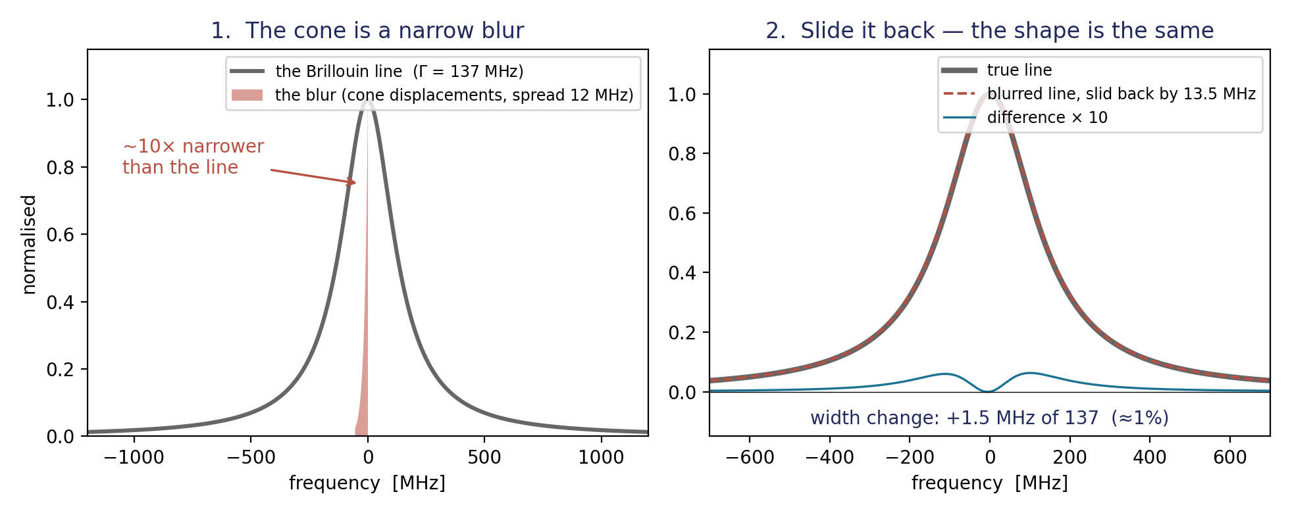
Why the shift feels the cone at full strength — and the width does not
The whole NA integral is nothing but a blur — and a small blur slides a line without changing its shape
1 · It is a blur
2 · A blur slides the line — full strength
3 · It widens only “squared”
Every angle in the cone gives the SAME Lorentzian, just displaced a little. The camera sums them: the true line, smeared by a 12 MHz-wide blur — 10× narrower than the 137 MHz line.
The line moves by the blur's average, −13.5 MHz. That is the entire NA correction — and an average is just a number, which is why post-hoc division works.
The average motion is used up by the slide; only the 12 MHz spread is left, and it enters as (12/137)² ≈ 1%. Bound: ≤3 MHz at NA 0.42, ≤0.08 at NA 0.14. Measured: even less.

Slide 7
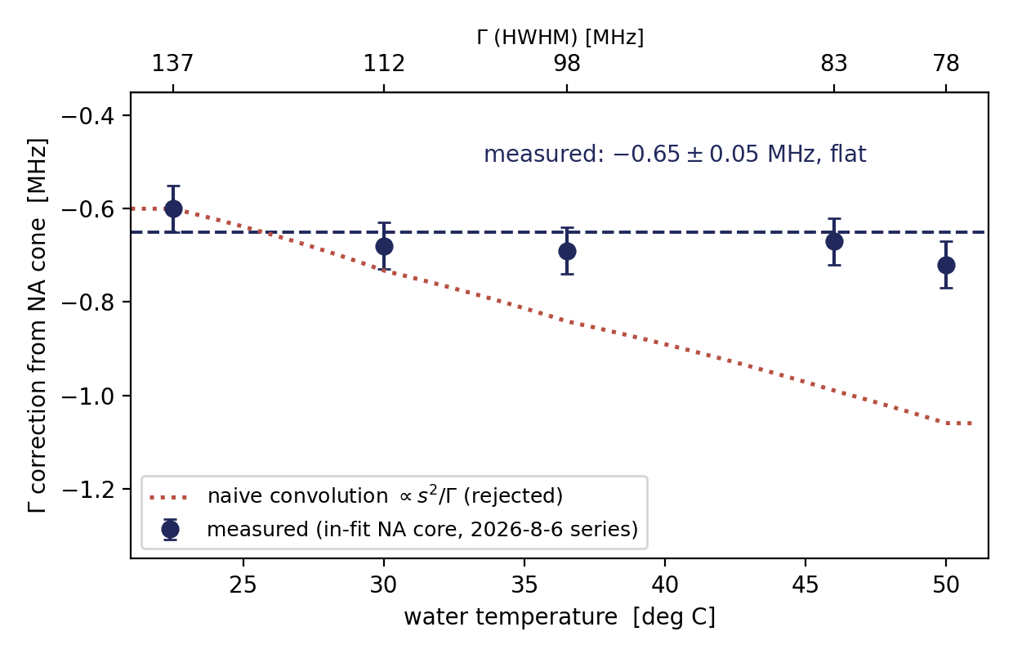
The width concern, measured: a flat −0.65 MHz at NA 0.42
Refit of the full 57-scan temperature series with the NA core inside the fit (2026-08-06)
The cone does broaden the line — 12 MHz of sub-peak spread ≈ 9% of Γ at NA 0.42; only 1% at NA 0.14 (0.0001 px in the fit, nothing).
Measured correction: Γ falls by −0.65 ± 0.05 MHz, flat from 23 to 50 °C while Γ itself drops 137 → 78 MHz.
dΓ/dT is completely unaffected (−3.37 → −3.38 MHz/°C etc.) — every temperature conclusion stands.
The naive convolution estimate (∝ s²/Γ, should nearly double) is wrong — the fit trades the cone's skew against width instead of simply broadening.

Slide 8
What the NA term does NOT do for the width
Same in-fit test, NA 0.42, 2026-8-6 — the 20X width problems are not the cone
observable (NA 0.42) | without NA core | with NA core
Γ left / right [MHz] | 140.6 / 136.3 | 140.0 / 135.6
L−R width gap [MHz] | +4.32 | +4.40 (unchanged)
dgap QA (|dgap| ≤ 1.5) | −3.87 fails | −3.89 still fails
Recommendation for Γ
NA 0.14:
quote uncorrected — the cone contributes nothing measurable.
NA 0.42:
subtract the flat 0.65 MHz (or carry it as a systematic); dΓ/dT needs no correction at all.
Either way:
a post-hoc constant again — the in-fit version buys nothing for width, split, or QA.
The NA broadening is common-mode: both peaks sit the same distance from their own elastic line under the same cone — it cannot create an L−R asymmetry.
• So the residual 20X width pathologies (L−R gap, dgap QA failures at low T) are background/window physics, and no NA treatment — in-fit or post-hoc — will repair them.

Slide 9
Why the value of the scalar is trustworthy: W(v) is validated
Post-hoc vs in-fit is settled above — this is the evidence the weights themselves are right
evidence | result
NA 0.14, uniform pupil — zero free parameters | −0.70 ± 0.11 MHz residual over 64 scans, 23–53 °C — 83% of the raw deficit removed with nothing fitted
NA 0.42, one D_b vs 57 measurements | D_b = 5.99 mm fits 23–51 °C with residual 0.00 ± 0.85 MHz — heavily overdetermined
Uniform pupil at NA 0.42 | excluded 7 independent times (over-corrects by +8.5 to +14.4 MHz) — the apodization is load-bearing
Two-aperture gap (0.14 vs 0.42) | +13.4 MHz matched-T, reproducing +10.5…13.8 MHz across 8 sessions May–Aug
Refractive-index transfer | residuals ≤ 1.4 MHz across n = 1.33 / 1.355 / 1.376 at fixed calibration
Caveat that remains: D_b is phenomenological (the 20X apodization is out-of-band aberration, not the fiber mode) and drifts with coupling state — the per-session water anchor is mandatory, not optional. Pupil imaging would turn W(v) into a measured instrument property.

Slide 10
Summary
The procedure: fit prm1 exactly as at low NA → calibrate per peak → divide the shift by ⟨cos(v/2)⟩ (uniform at NA 0.14; Gaussian with the session's water-anchored D_b at NA 0.42). For Γ at NA 0.42, subtract a flat 0.65 MHz.
Equivalence is measured, not assumed — the full in-fit model returns a constant (sd 0.01 MHz), equal for prm0/prm1, all other observables untouched; in-fit vs post-hoc differ by 0.32 MHz at 20X.
The physics says it must factorize — cone spread is 1.5–9% of the linewidth — first order is a pure translation; second order is the measured, flat −0.65 MHz on Γ.
The weights are independently validated — parameter-free at 0.14; one D_b over 57 scans and 28 °C at 0.42; uniform excluded 7×; gap reproduced over 8 sessions.
Keep in view: raw per-scan calibrations required · same-session water anchor for D_b · the scalar corrects the absolute only — split, precision, and all relative results never needed it.

