Slide 1
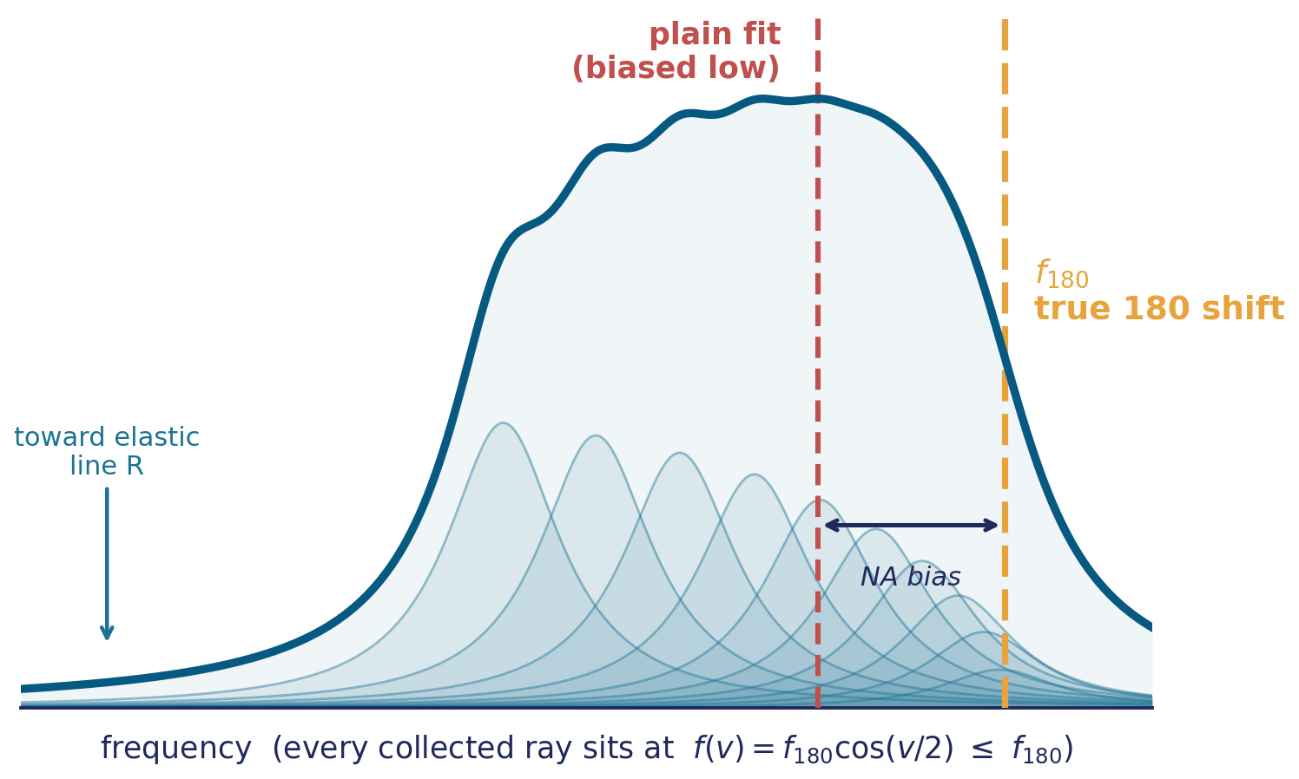
Why a plain fit is biased at high NA — and how we correct it
NA-integrated lineshape fit · clear samples · ballistic term of Mattarelli et al., ACS Photonics 9, 2087 (2022)
THE PROBLEM
A high-NA objective collects a cone of scattering directions around exact 180° backscatter. A ray at deviation angle v exchanges a smaller wavevector, so it resonates lower:
Every collected ray sits at or below f180. The recorded peak is a weighted superposition of these sub-peaks — so a symmetric fit lands below the true shift and the peak is skewed.
The fix: fit the superposition directly. The fitted peak centre returns f180 — the true 180° shift — as a free parameter.

Slide 2
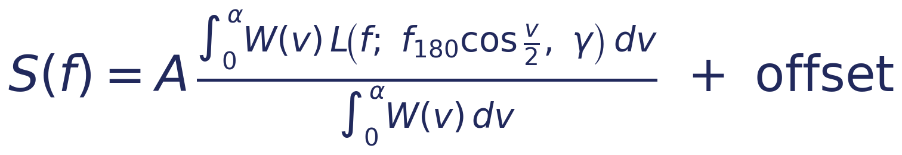
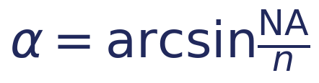
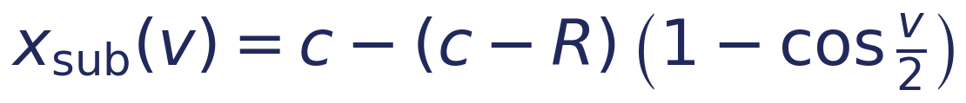
The NA-integrated lineshape model
Each sub-peak is a Lorentzian core; the NA cone is carried entirely by the collection kernel, so the fitted γ stays the intrinsic width.
MODEL
the kernel average is normalized by ∫W dv;
the offset is added outside it — the flat background is never rescaled.
α — aperture half-angle
R — elastic anchor
W(v) — collection weight
zero-GHz root of each peak's calibration polynomial, by Newton iteration — one per order (Rleft, Rright). A fixed input, not fitted.
from the objective NA and sample index n (Snell).
uniform pupil, or Gaussian fibre-coupling — the complete model (session-calibrated on water).
SUB-PEAK POSITION
WHAT COMES OUT — 7 free parameters
slides from centre c toward the elastic order R as v grows.
c₁, c₂ are the true 180° positions — stored in the normal centre fields, so they flow through the standard shift/distance → GHz pipeline with no NA-specific branch.

Slide 3
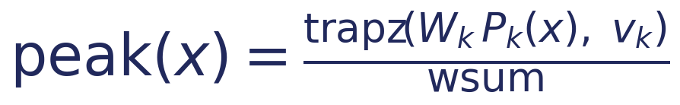
In practice: the pixel-space equation the code fits
Slide 2's integral, discretized on a 41-node quadrature grid and integrated over each pixel — the actual compute path (make_2na_lorentzian_binned).
1
QUADRATURE GRID · 41 nodes across the collection cone
2
PIXEL-AREA-INTEGRATED LORENTZIAN CORE · per node
3
WEIGHTED AVERAGE OVER THE CONE · one peak
Same arctan core as the plain 2-Lorentzian, so amplitudes and widths stay directly comparable — the whole NA correction lives inside xsub.
4
FULL TWO-PEAK MODEL · 7 free parameters

