Slide 1
CSCI 4711: Employee Scheduling System
Matthew Tennis Christopher Gonsalves Connor Williams Ryan Mahoney

Slide 2
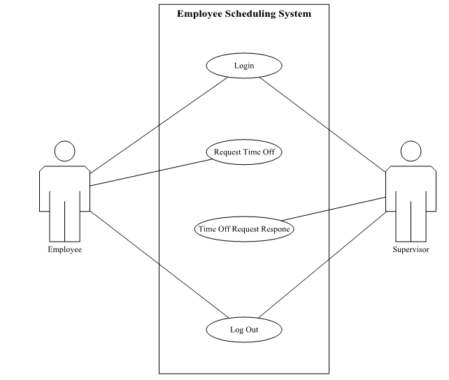
Employee Scheduling System: Use Case Diagram

Slide 3
[Screen Mock-up 1: Login/Auth Image]

Slide 4
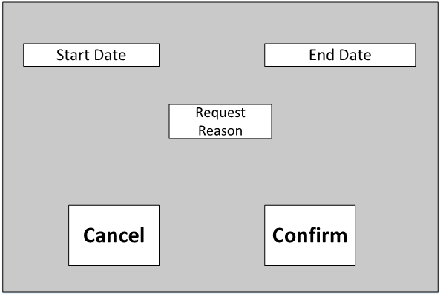
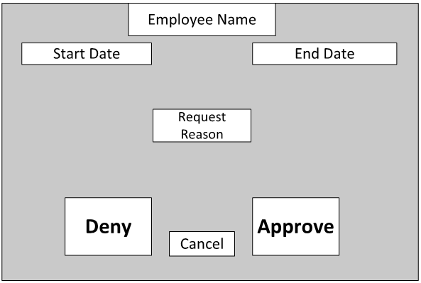
Employee Request GUI Mockup / Supervisor Response GUI Mockup

Slide 5
[Conclusion]
Bullet 1
Bullet 2
Project Repository: https://github.com/tattymennis/csci4711-project

