Slide 1
CSCI 4711: Employee Scheduling System
Matthew Tennis Christopher Gonsalves Connor Williams Ryan Mahoney

Slide 2
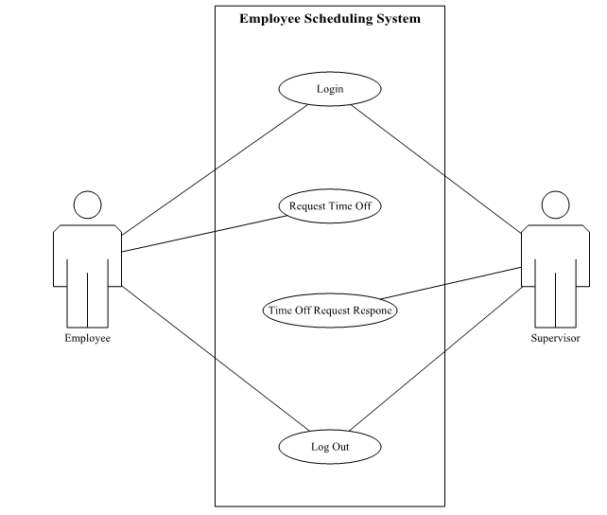
Employee Scheduling System: Use Case Diagram

Slide 3
Employee Request GUI Mockup

Slide 4
Supervisor Response GUI Mockup

Slide 5
Conclusion
Our employee scheduling application will facilitate secure login in and log out of the system.
With our application, employees will be able to quickly request time off of work and their supervisors are easily able to approve or deny that request.
Our system offers the benefit of weighted leave requests to ensure minimal time off conflicts between multiple employees.
Project Repository: https://github.com/tattymennis/csci4711-project

