Slide 1
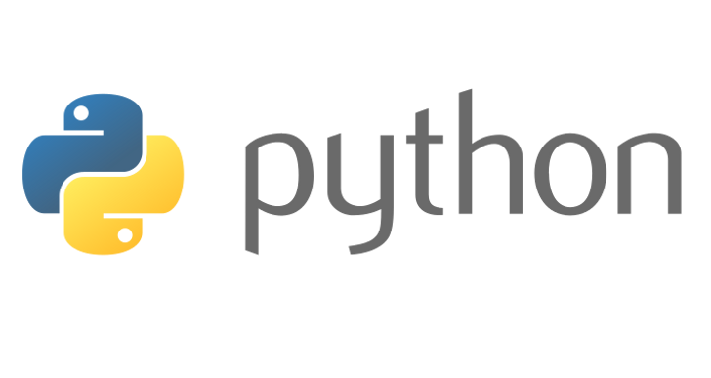
AIS
Python Workshop

Slide 2
Python 2.7 vs. 3.x
Python 2.7 -> Last version (most likely) in the 2.X branch. Many systems are currently running 2.X code.
Advantages of using 2.7 is that it is already in use (no need to update existing code)
No active development (will remain stable)
Python 3.7 -> Most recent version of the language. Many new features and fixes to issues.
Actively being developed.
NOT backwards compatible with 2.X

Slide 3
Getting Started
Go to http://www.python.org/downloads
Download Python 3.6.8 (64-bit)
Python 3.7.2 is the newest but has some compatibility issues with Tensorflow, which is widely used in MIS.
(Mac / Linux users?) You probably already have it installed, but probably an older version.
If prompted choose to “add python.exe to the PATH” variable.
Open up Idle (Interactive Shell)
print(‘Hello World’)
Viola.

Slide 4
Using Python
How to use Python
Interactive Mode
Anywhere you see 3 angle brackets >>>
IDLE Shell
Command Line Interface (CLI)
Python Console in IDE
Script Mode
Create .py file or project, execute with:
IDE (PyCharm, Visual Studio, Other…)
CLI w / Text Editor (VS Code, Sublime)
IDLE (“Run Module”)

Slide 5
Day 1 Objectives
Getting Input / Printing
Importing Modules
Built-in Python object types
Bools
Numbers
Strings
Lists
Dictionaries
Tuples
Sets
Collections
Sequences
Mappings

Slide 6
Getting User Input
We use input() to get input from the user.
The value passed to input() is provided as a prompt to the user.
The value the user types (after hitting enter) is returned from input() and can be referenced by a variable
Example:
>>>name = input(‘Hello, what is your name?\n’)
>>>print(‘Hello’, name)

Slide 7
Importing Modules
A Module is some useful code that someone else has written… We don’t want to recreate the wheel!
Python provides many modules as part of their standard library.
Modules can be used after they are imported.
Example:
>>>import math
>>>square = math.sqrt(9)
>>>print(square)

Slide 8
Importing Modules (Cont)
Another Example
>>> from datetime import datetime
>>> now= datetime.now()
>>> print now.year
2014
>>> print now.month
7
>>> print now.day
1

Slide 9
Some Built-In (Core) Object Types
Object Type | Example
Bool | True, False
Numbers | 123, 3.1415,3+4j, Decimal(), Fraction()
Strings | ‘spam’, “Bob’s Shop”
Lists | [1, [2, ‘three’],4.5], list(range(10))
Dictionaries | {‘food’: ‘spam’, ‘taste’: ‘yum’}, dict(hours=10)
Tuples | (1,’spam’,4,’U’), tuple(‘spam’)
Sets | Set(‘abc’), {‘a’,’b’,’c’}
User-Defined | Class Car

Slide 10
Bool
bool
Bool will return either True or False.
Typically only used in conditional tests. (e.g. if)
E.g.
>>>some_test = bool(“”)
>>>some_test
False
>>>some_test = bool(“Hello”)
>>>some_test
True
Helpful to think “Is there something or nothing?”)

Slide 11
Numbers
Expression Operators: + , - , *, / , %
Built-In mathematical functions pow, abs, round, int, hex, bin
Floating point vs. Decimal Operations
Utility Modules random, math, decimal
Mixed expressions will follow the operator precedence.
When in doubt, use parentheses for clarity (remember explicit is better than implicit)
Python Operator Precedence

Slide 12
Numbers (Continued)
num_one = 5.1
num_two = 3.3
result = num_one + num_two
8.399999999999999 ?????
If you need precision, use decimal (import decimal)
import decimal
num_one = decimal.Decimal(‘5.1’)
num_two = decimal.Decimal(‘3.3’)
result = num_one + num_two

Slide 13
Strings
Technically a collection of characters in a sequence. This means we can use:
Access by Index (zero-based) (e.g. name[0])
Slicing – Get only part of the string (e.g. name[0:2])
Concatenation (e.g. f_name + ' ' + l_name)
Strings can be wrapped in either double of single quotes (or triple quotes).
https://www.pythoncentral.io/cutting-and-slicing-strings-in-python/

Slide 14
String Methods
https://docs.python.org/3.7/library/stdtypes.html#string-methods
.find – Returns left most index of the search string, or -1 if not found.
>>>some_string = ‘A long string to search’
>>>some_string.find(‘long’)
.join – Joins each item in the sequence together
>>> ‘.’.join(‘Knights’)#K.n.i.g.h.t.s
.lower / .upper
.replace… e.g.
>>>'Hello my naem is, hello my naem is, hello my naem is'.replace('naem','name')
'Hello my name is, hello my name is, hello my name is'

Slide 15
String Methods continued…
.split – Splits a string into a list of strings on a specified character sequence. Returns a list of strings.
.strip – Removes Whitespace

Slide 16
Mutable vs. Immutable
Immutable – Unchanging over time or unable to be changed once created.
Numbers
Strings,
Tuples
Mutable – Liable to change after creation.
Lists,
Dictionaries

Slide 17
Collections
There are two types of collections in Python.
Sequences (Lists, Tuples, Strings) – Accessed by index, sequential
Mappings (Dictionaries) –Accessed by key, order CANNOT be assumed (different between Python versions, etc…)

Slide 18
Lists
Lists are the “workhorse” of Python.
They are mutable, meaning you can access and change values directly in the data structure.
You can nest lists, that is, you can have a list of a list of lists. (and so forth).
Create by using :
>>> L = []
Or
>>> L = list()

Slide 19
Lists continued…
Methods
Append – Adds object to the end of the list
Count – Counts number of occurrences of a value.
Extend Similar to using +, but actually modifies the list
e.g. [‘red’,’black’].extend([‘yellow’]) vs. [‘red’,’black’] + [‘yellow’]
Index – Finding location
Insert – Add to a specified index
Pop – Removes last element from the list
Remove – Delete the first occurrence in the list.
Sort – Sort the list in place

Slide 20
Lists - Multiple Object Types
Lists can hold many different object types
>>> some_stuff = [‘a string’, 440, [‘a’,’b’,’c’]
>>> new_list = list(some_stuff)# Creates a new list
>>> l = [5,3,4,2,1]
>>> nl = l.sort() # acts on current list

Slide 21
Matrices (Lists of Lists)
Lists allow nesting, which means we can create matrices.
M = [[1, 2, 3],
[4, 5, 6],
[7, 8, 9]]
M[1], M[1][2]

Slide 22
Dictionaries
Where lists are an ordered list of objects, Dictionaries are an unordered list of objects.
This means that instead of accessing them by index we access them by a unique key, similar to an associative array or hash.
They are a “mapping” type, because they map keys to values.
Dictionaries are mutable, meaning they can be changed in place.

Slide 23
Dictionaries continued…
Create a dictionary:
>>> D = {‘name’:’Bob’, ‘age’:30}
>>> http_status_codes = {404:’Not Found’}
>>> http_status_codes[404]
‘Not Found’
>>> D = {}
>>> D = dict(name = ‘knight of ni’)

Slide 24
Sets
Sets are like lists but they are required to have only unique items. This makes them useful for storing things like colors, or number lookup tables.
They are created as follows:
>>>colors = {‘red’,’blue’,’green’}

Slide 25
Tuples
Just like lists, but they are immutable, meaning they can’t be changed.
Created using comma separated values or empty parentheses.
tuple() will convert a value to a tuple.
>>> T = (‘Hello’,’World’)

