Slide 1

G08

Slide 2
Function
1. Key expansion, enc, dec
2. Step mode
3. Display current address, next_pc, relative register and Imm
4. enc/dec selection
5. TextIO verified

Slide 3
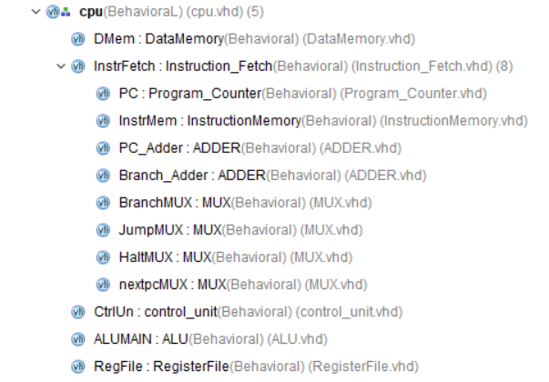
Structure

Slide 4
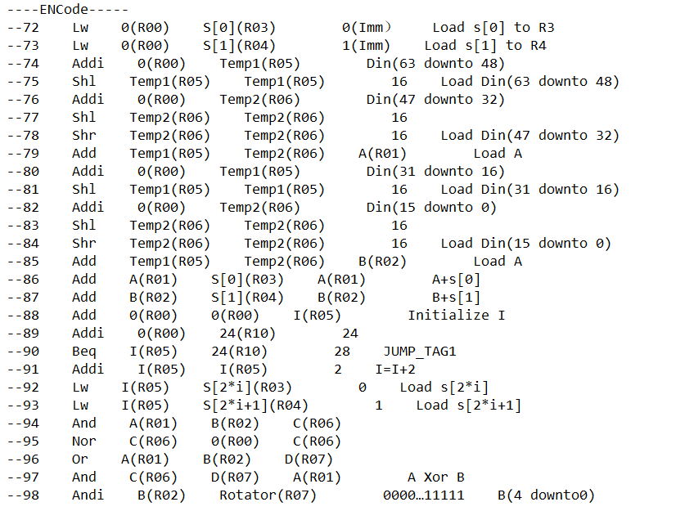
Assembly Code

Slide 5
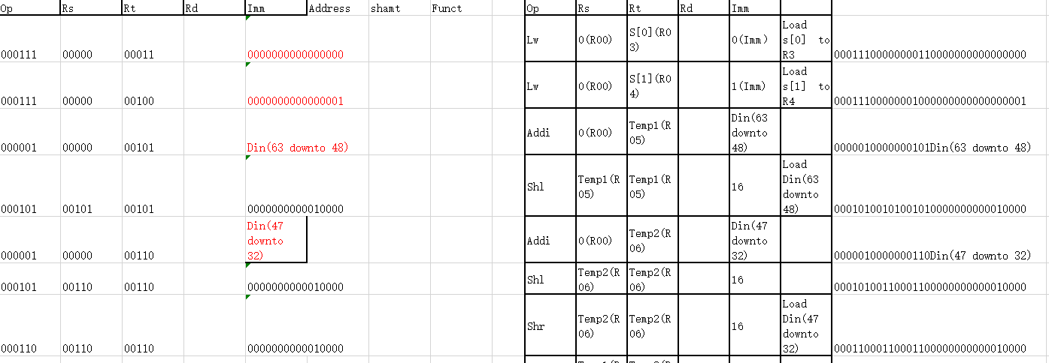
Machine Code

Slide 6
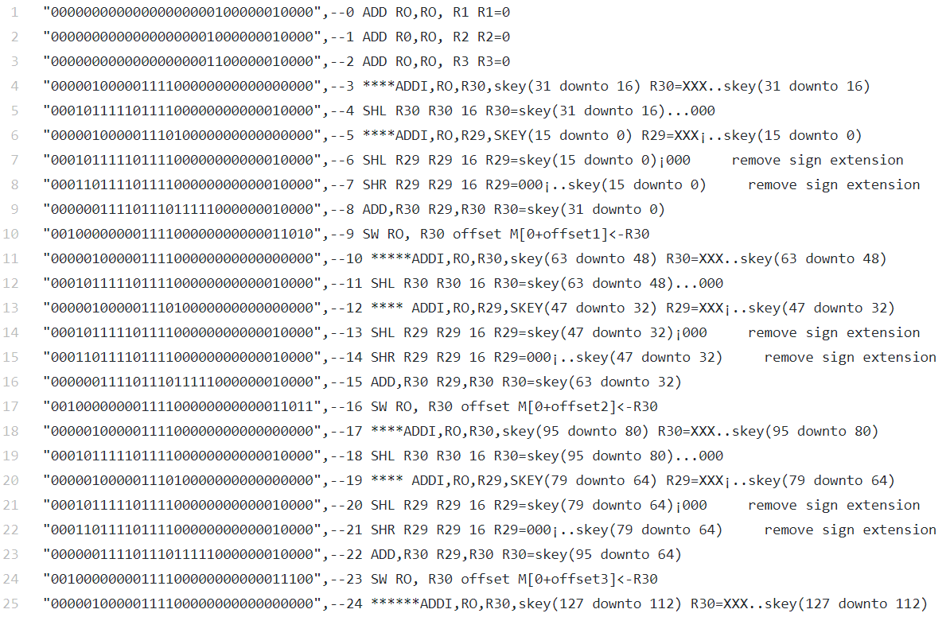
Machine Code

Slide 7
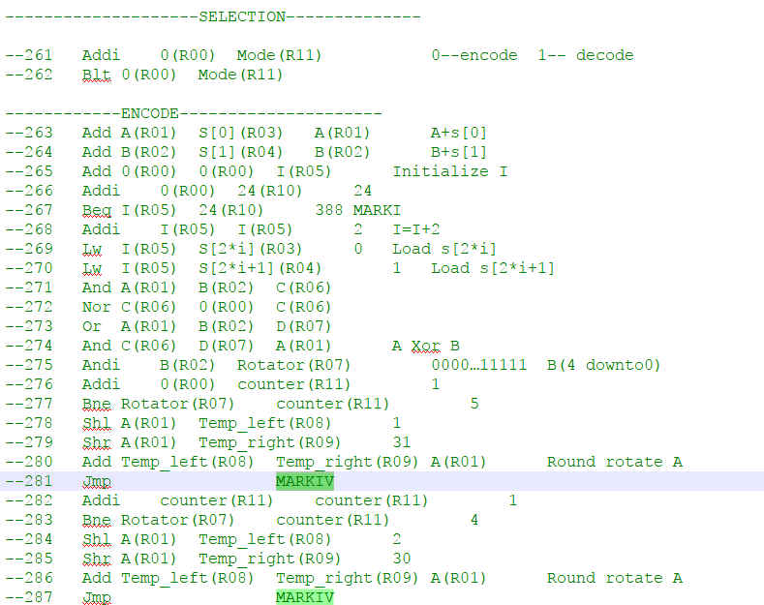
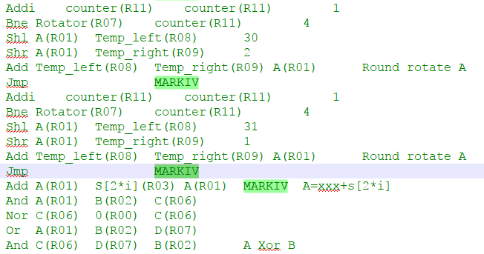
Optimization

Slide 8
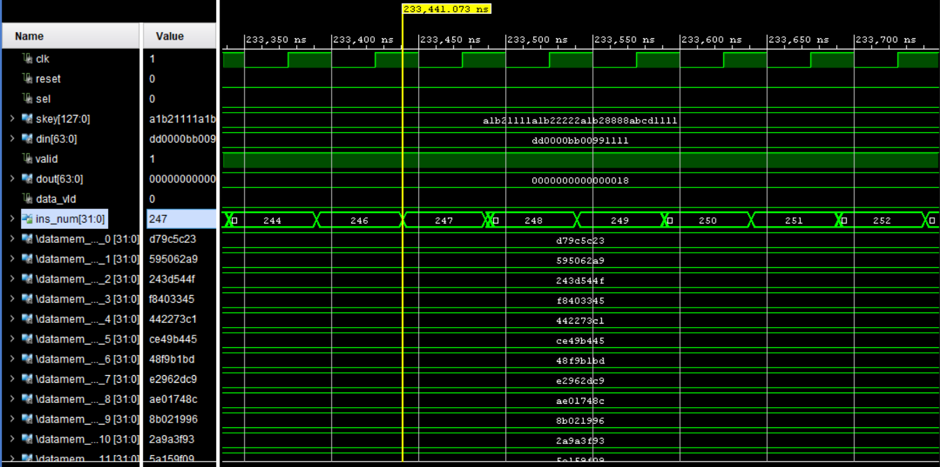
Key Expansion Timing Simulation
Latency = 4663 clock cycles.
Notes:
We save the Skey to Data memory[25 downto 0], as we can see the data memory is filled and updated during the simulation.

Slide 9
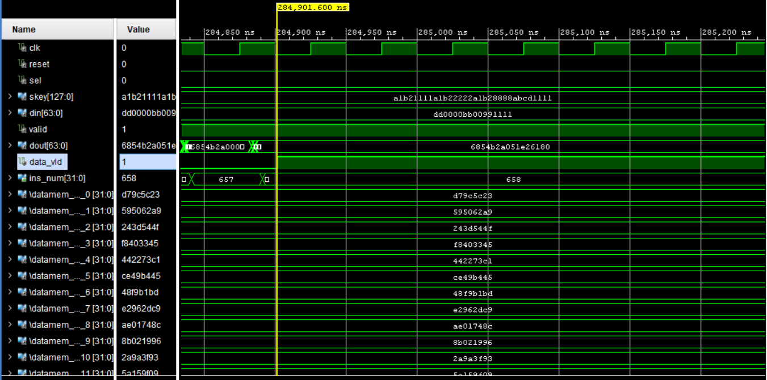
Encryption Timing Simulation
Latency = 1030 clock cycles.

Slide 10
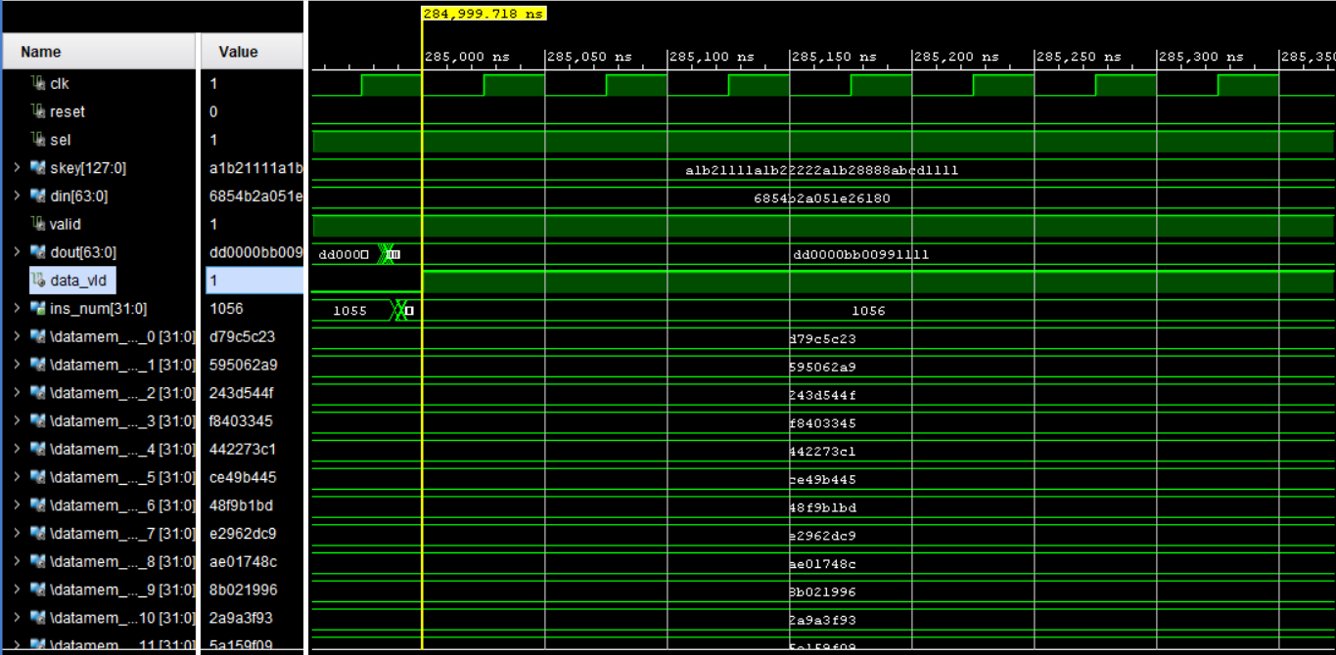
Decryption Timing Simulation
Latency = 1032 clock cycles.

Slide 11
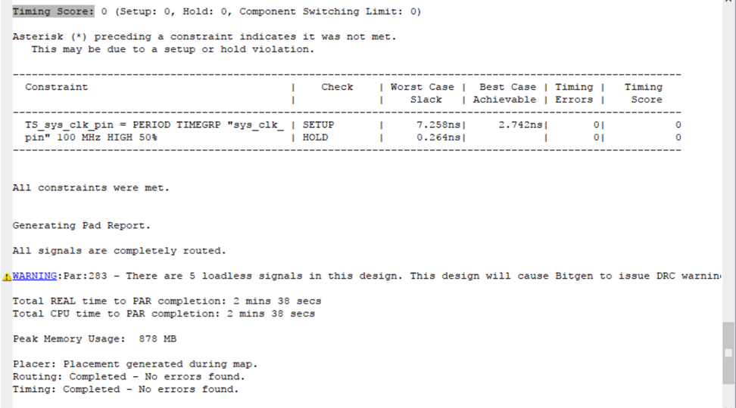
Critical Path Delay
Critical path delay: 7.258ns
Max Frequency: 137.779MHz

Slide 12
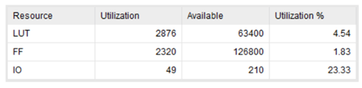
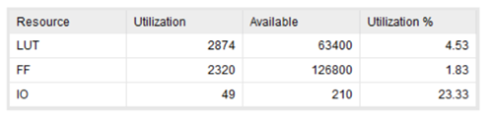
Resource Utilization
Synthesis Stage
Place and Route Stage

Slide 13
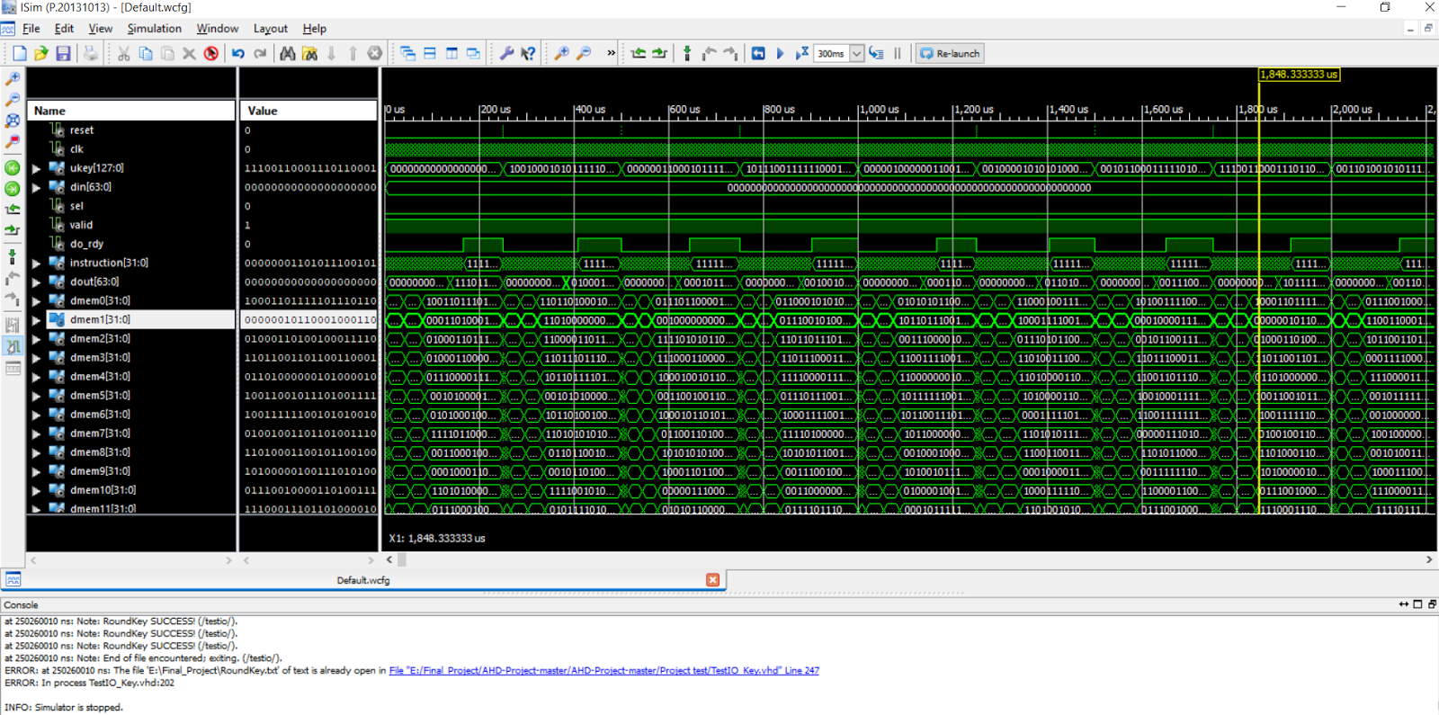
TextIO Verification_Key exp

Slide 14
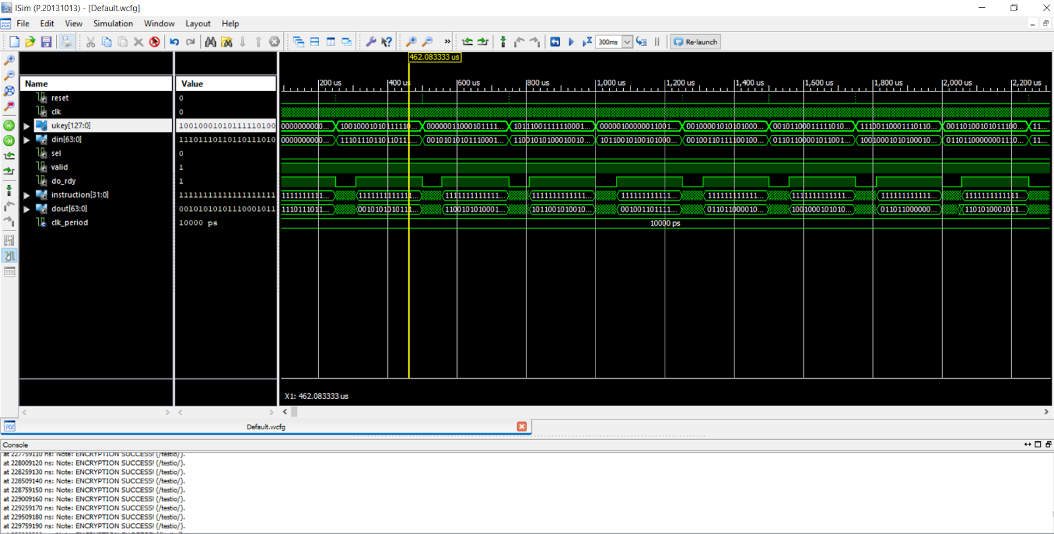
TextIO Verification_Enc

Slide 15
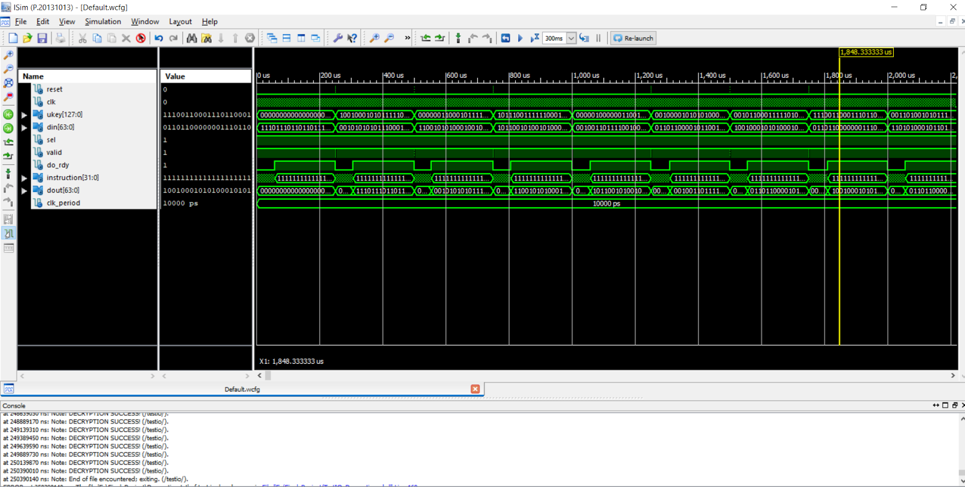
TextIO Verification_Dec

Slide 16
Test Vector for Final Analysis
Encryption:
ukey: x”a1b21111 a1b22222 a1b28888 abcd1111”, din: x”dd0000bb 00991111”
skey: d79c5c23 595062a9 243d544f f8403345 442273c1 ce49b445 48f9b1bd e2962dc9 ae01748c 8b021996 2a9a3f93 5a159f09 5b33435f 14c0deae b2f89959 e6ce3921 d2b1be3b 6ceac0c7 87c826ec 70cd4587 edca72f2 eb1327f4 ae7326d0 7f02eb80 4196cb32 7c0738a3
dout: x”6854b2a0 51e26180“
Decryption:
ukey: x”a1b21111 a1b22222 a1b28888 abcd1111”, din: x” 6854b2a0 51e26180”
skey: d79c5c23 595062a9 243d544f f8403345 442273c1 ce49b445 48f9b1bd e2962dc9 ae01748c 8b021996 2a9a3f93 5a159f09 5b33435f 14c0deae b2f89959 e6ce3921 d2b1be3b 6ceac0c7 87c826ec 70cd4587 edca72f2 eb1327f4 ae7326d0 7f02eb80 4196cb32 7c0738a3
dout: x”dd0000bb 00991111“

Slide 17
Key Expansion

Slide 18
Encryption

Slide 19
Decryption

Slide 20
The number of cycles for round key generation: 4663 cycles
The number of cycles for encryption: 1030 cycles
The number of cycles for decryption: 1032 cycles
Clock frequency of the processor: 50MHZ

Slide 21
FPGA Implementation
Buttons:
Button center (Reset), Button down(Next Instruction), Button right(Input)
Switches:
<0>: Step Mode
<1>: Input or not
<2>: ukey/din input
<3>: Enc/Dec
<8 downto 4>: Input data
<10>: Input data confirm
<15 downto 13>: Display Din, Dout, Ukey in full execution mode
Display Rs, Rt, Rd, Next_pc… in step mode

Slide 22
FPGA Implementation
7-Seg Digital LED:
Input/Output Display
LED:
<15>: Dout Ready
<3 downto 0>: opcode<3 downto 0>, distinguish R type instruction and addi, subi, jump, halt, and etc. in step mode
<6 downto 4>: Function code<2 downto 0>, distinguish R type instruction add, and, or, etc. in step mode

