Slide 1

Careers that make a crisis?
University of Bristol – project pitch
26/Feb/2019
Dr Daniel Tischer

Slide 2
The Problem and Data
Guiding question:
Does the existence of particular collateral manager (CM) career patterns help us understand CDO performance?
Data from the pilot project:
We have CM careers (#563); who worked for CM Firms (#37); that produced CDOs for which we know the performance (#57) and structuration participants (#56). We also have data on CDO performance (downgrades) as a reference dataset.

Slide 3
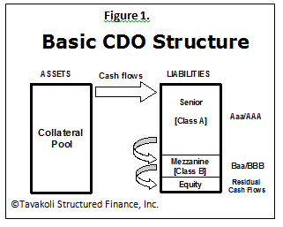
Background
CM firms were hired by investment banks to select and manage assets for the CDO;
Assets (mostly mortgage backed securities) are given a rating by CRAs (Aaa to Equity);
Waterfall of income from mortgages paid out to Aaa first; shortfall wipes out equity first before mezzanine;
CM important fiduciary actor for investors – they are meant to act in the interest of investors only!
But if they are hired by banks, how independent are they in their decision making / selection?
CM function was relatively nascent and not professionalised
So who are these people and how are they connected?
Legal action suggests wrongdoing by CM firms and investment banks
Risk

Slide 4
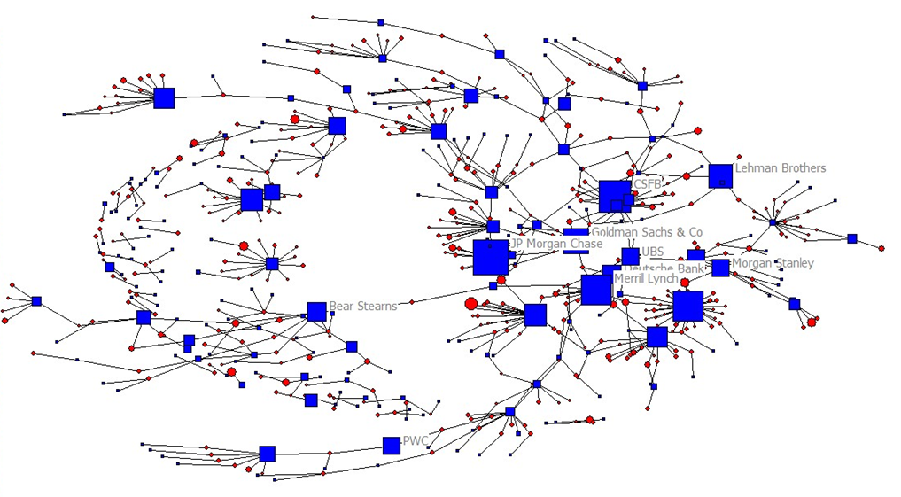
Careers (5y+) and firms

Slide 5
Guiding Questions/Hypothesis
H1: The Presence of CRA expertise in the collateral manager has a positive influence on CDO performance.
H2: Long careers (5years+ ???) by some collateral managers at investment banks have a negative influence on CDO performance.
H3a: CDOs managed by CM firms with a diverse range of expertise do better during the financial crisis
H3b: CM firms dominated by people with shared previous careers manage CDOs that do worse in the financial crisis
H4a: Investment banks do not hire collateral management firms where employees previously worked at their firm.
H4b: If they do, these CDOs fare worse than the average
H5: Sequences of career moves (from A to B to C) can be identified that coincide with negative CDO performance.
Please note: if you have interesting ideas what else to do,
feel free to do it

Slide 6
Data
Career data:
for each individual we have a set of relations (ordered in sequence) with duration of tenure: ID>Previous place of employment[Name]>Tenure[years]
Final destination is the collateral management firm
List of CDOs issued by each collateral management firm as per the sample
(you may want to collect data for additional CDOs issued by these firms – I can give you there names)
Names of firms involved in the structuration/creation of each CDO
CDO>date[month/year]>currency[USD/EUR]>actors[Initial Purchasers, Collateral Managers, Issuers, Trustees…ect]

Slide 7
Type of Analysis?
Admission: I am not a quants person
ERGMs (this may require more data)
Regression models: such as QAP
time-stamped models (Siena models)
(social) sequence analysis
correlations

Slide 8
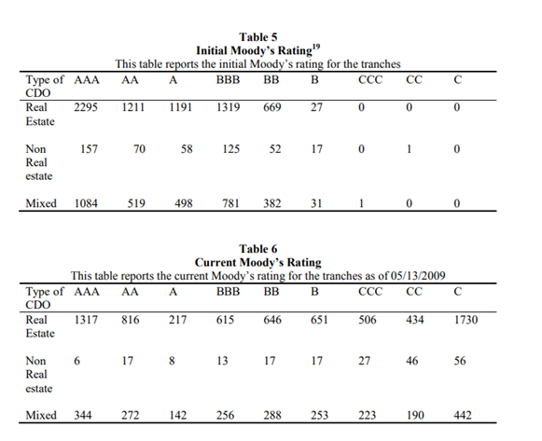
Moody initial versus current (May 2009) ratings*
For each CDO we have CDO rating deterioration over Crisis period
*see http://www.columbia.edu/~yao2103/wp1.pdf

Slide 9
Some tips / observations re data
Data needs cleaning and performance data of CDOs needs transforming
C- [& CA] rated securities are in default [or default is imminent]; withdrawing rating [WR] is an important event – may be linked to default of issuer etc.
You may want to exclude CM careers with fewer than 1 or 2 previous jobs:
Likely entry level jobs;
BUT they may be relevant if tenure at CM firm or previous firm is long
You may want to include CDO type (cash/synthetic for which data is available online*)
*see e.g. https://fcic-static.law.stanford.edu/cdn_media/fcic-docs/0000-00-00%20Merrill%20Lynch%20CDO%20Deal%20Documents.pdf

Slide 10
Some literature
Chernenko, S. (2017) The Front Men of Wall Street: the role of CDO collateral managers in the CDO boom and bust. The Journal of Finance, 72(5): 1893-1936.
Cordell, L., Huang, Y. & Williams, M. (2012) Collateral Damage: Sizing and assessing the subprime CDO crisis. FED Philadelphia, Working Paper No, 11-30/R.
Maehlmann, T. (2013) Hedge Funds, CDOs and the Financial Crisis: An empirical investigation of the “Magnetar trade”. Journal of Banking & Finance, 37(2): 537-548.
Leaver, A. & Tischer, D. (2017) Through a glass darkly: Tracing the mundane organisation of a bubble network. Academy of Management Proceedings, 1

