Slide 1

Year 3 Group Project
Uber-based Taxi Application by Eoin, Bartek, Conor and Thomas.

Slide 2
Contents:
Phone App by Bartek & Eoin
Ardunio Code from Eoin
Web App from Conor and Thomas

Slide 3

Phone Application

Slide 4
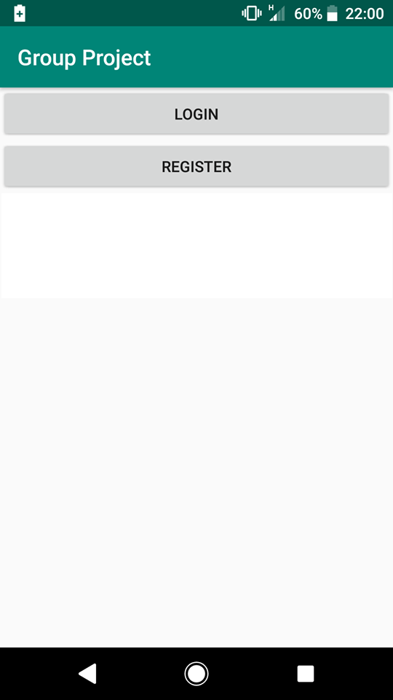
Phone App
This is the start screen that you get upon launching the app from which you can choose 2 options either login if you’re an existing user or register as a new user.

Slide 5
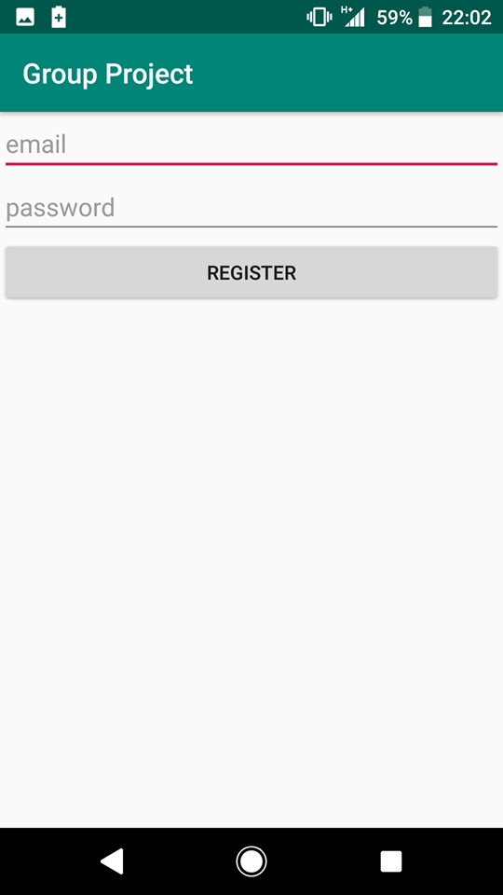
This is the window that opens when you click the Register button in which you get asked to input your email and password and then you can register with these.

Slide 6
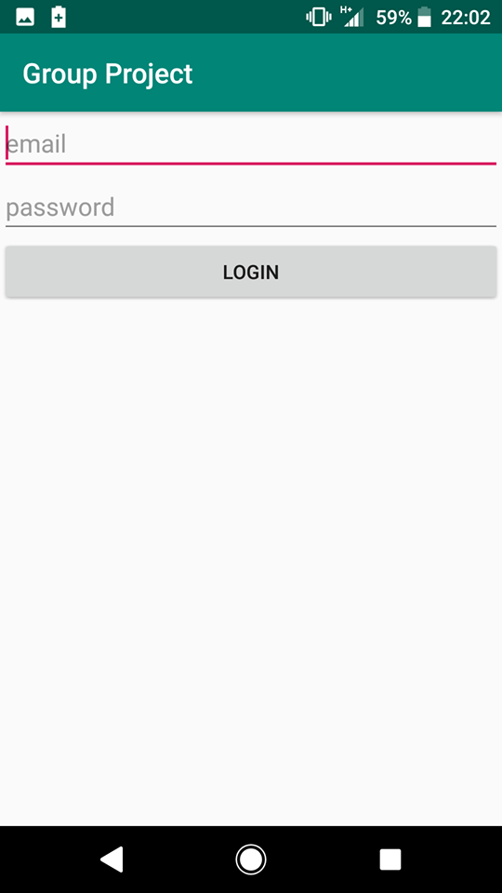
This is the window that opens when you click the login button in the previous window. In this window you put in your email and password to login as an existing user.

Slide 7
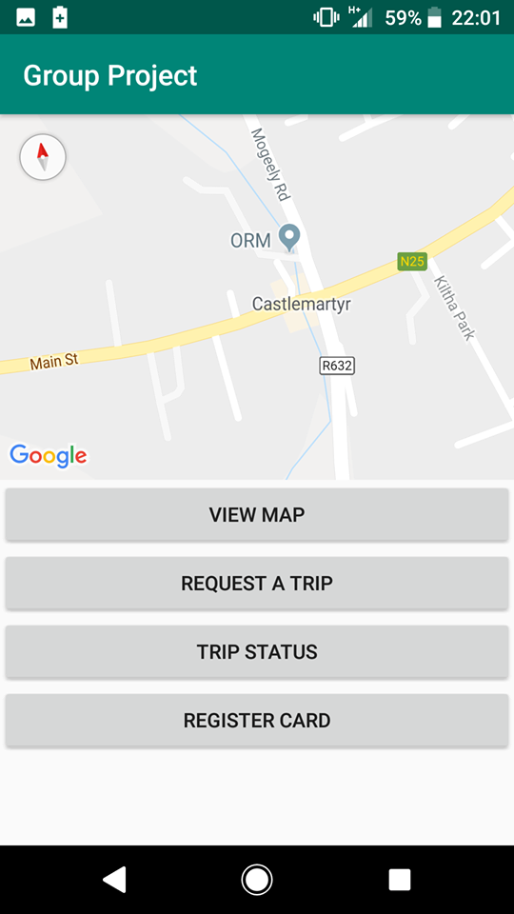
After either registering or logging in, this is the main menu that shows up on the app where you can navigate to the different parts of the app. On the very top there is a google map that shows your current location.

Slide 8

Ardunio/GPS of the Phone App

Slide 9
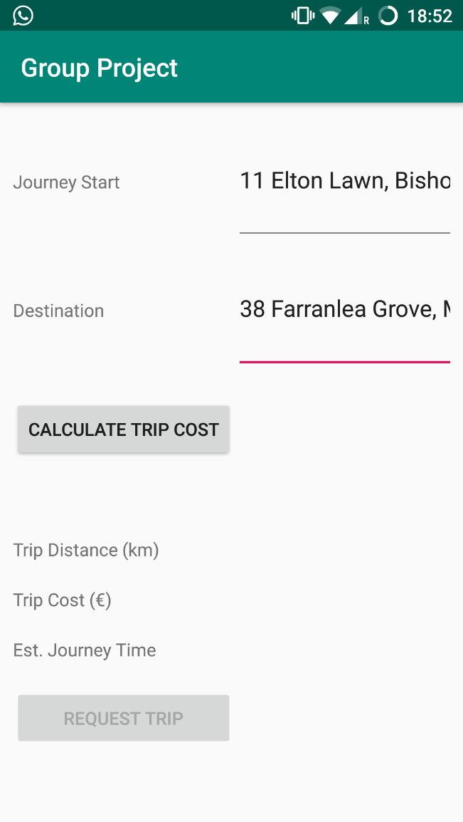
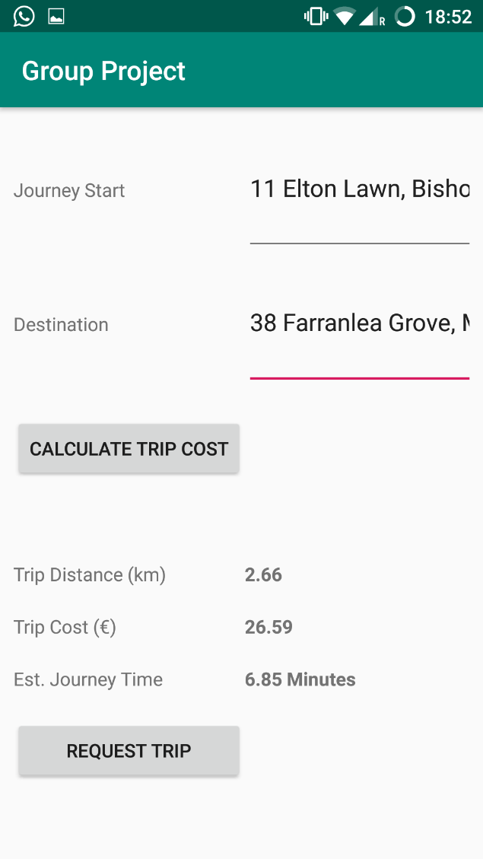
Uses autofill text views and the Google geocoding API Suggests address based on user input
Uses the Google distance matrix API to calculate trip distance and estimated journey time.
Price is a set price/km
Trip can be requested once price is calculated

Slide 10
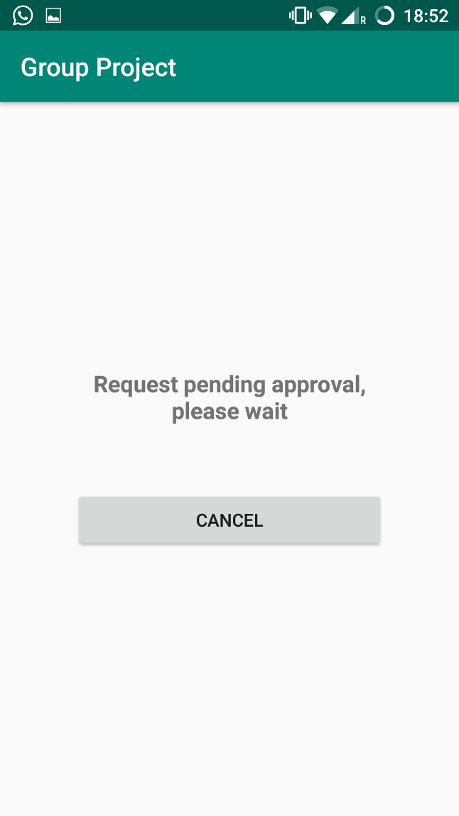
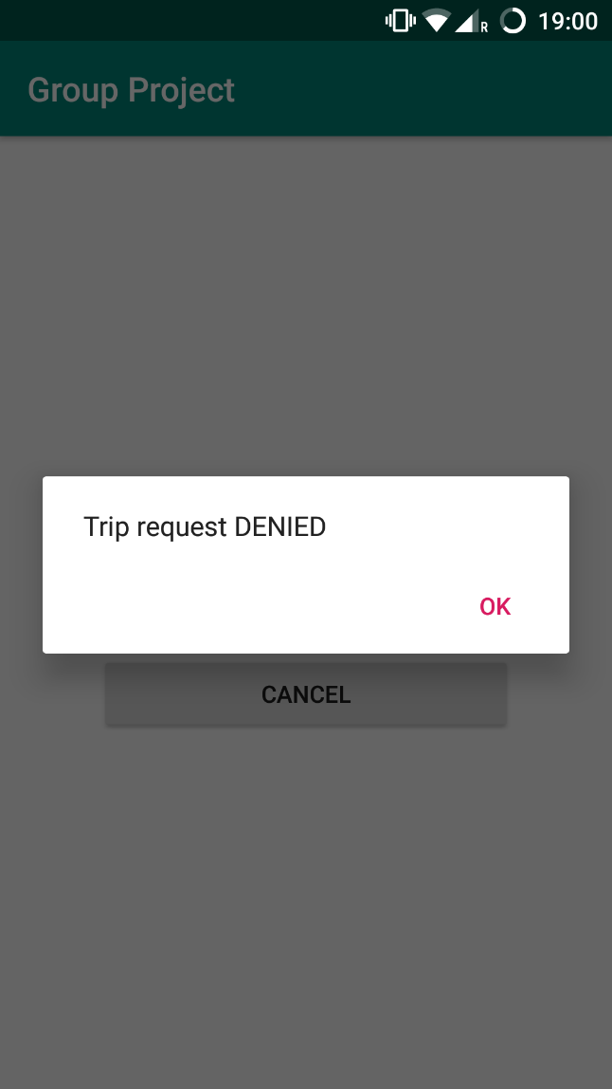
Trip request is pushed to Firebase live database with a state of pending The code listens for changes to the elements of the database and checks if the request has been approved or denied User can cancel the request at this point
Admin can refuse to accept the trip and the user will be informed

Slide 11
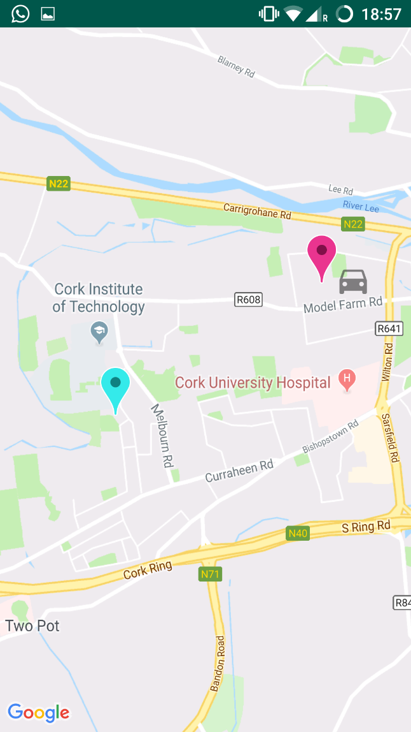
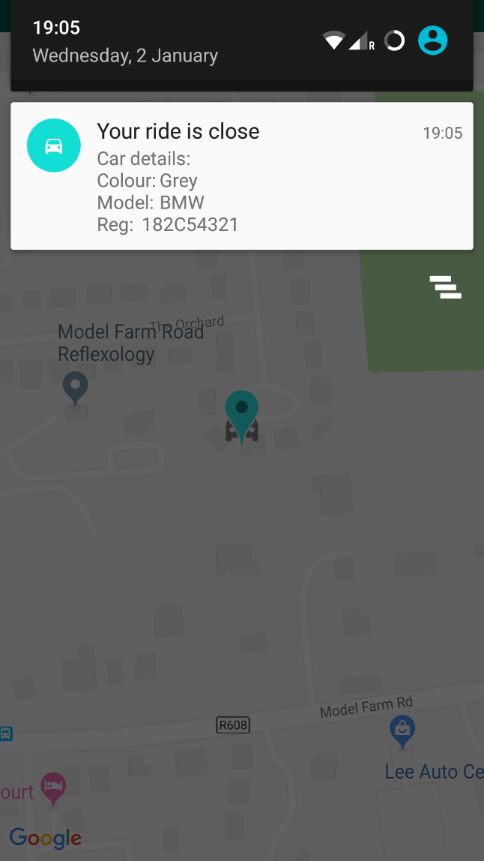
User will see a live view of the vehicle’s position as it approaches and throughout the journey.
When the vehicle is close to the pickup point, the user will be informed of the vehicles details via notification

Slide 12
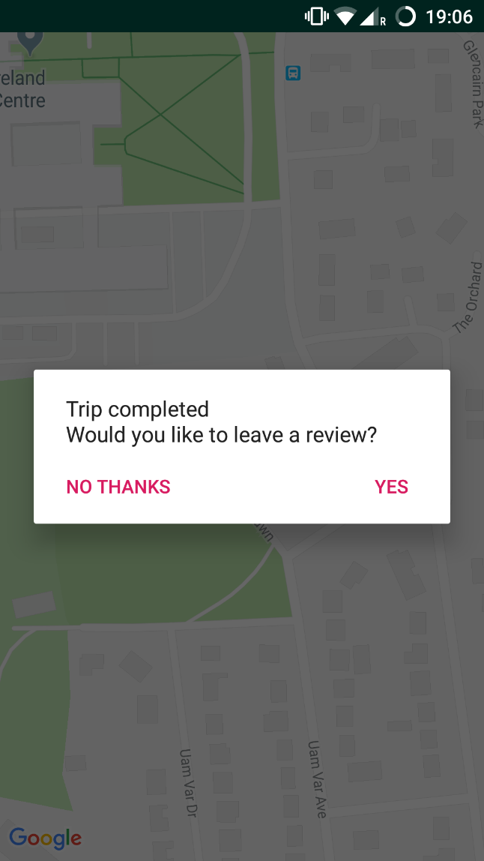
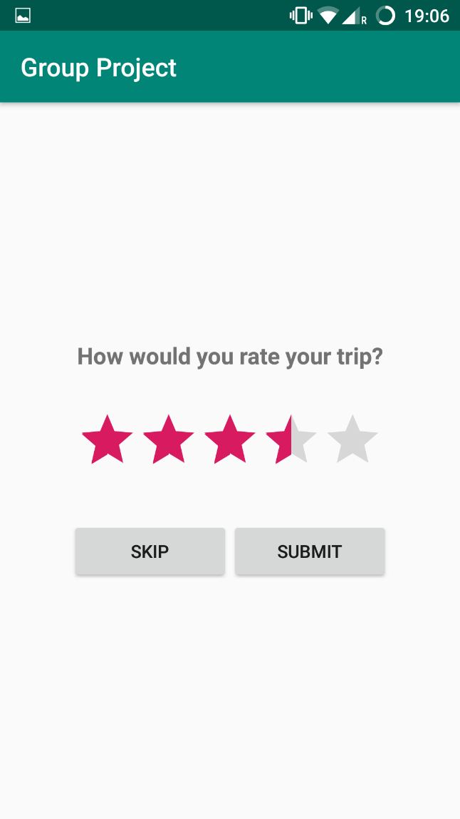
Prompt for review when the vehicle reaches the destination.
Reviews are tied to the trip ID and pushed to the firebase live database

Slide 13

Admin Panel/Web App

Slide 14
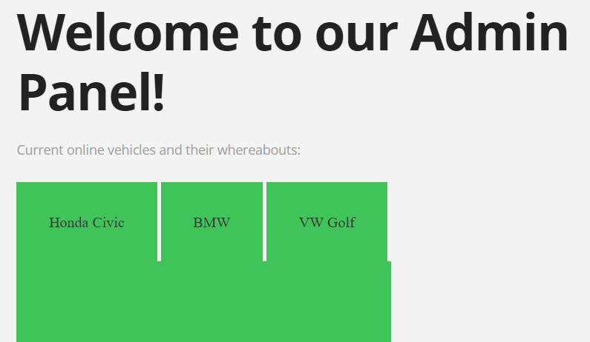
The initial page of the admin panel allows a user to see the current vehicles that’re already available for duty (vehicles that’re already allowed in the database), and then an admin can add more vehicles as they see fitting below in the registration form. These vehicles will appear in the box below as they are registered into the web app.

Slide 15
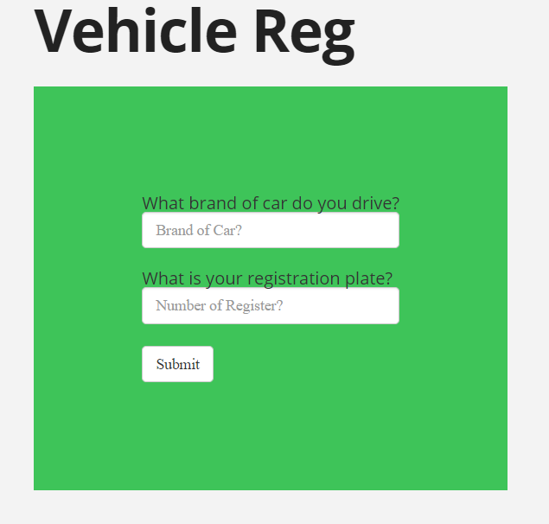
This part of the web app allows the admin to register new vehicles that will display above with the other vehicles, these vehicles by default will be set as on duty unless specified otherwise by the admin. It takes the cars name and plate, and then a button beneath has an onClick to submit these into the database.

Slide 16
There is also a navigation bar on top that allows the admin for quick navigation throughout the website as they see fit, when they click on a certain part of the bar, it’ll automatically scroll them down to the part they wish to review.

Slide 17
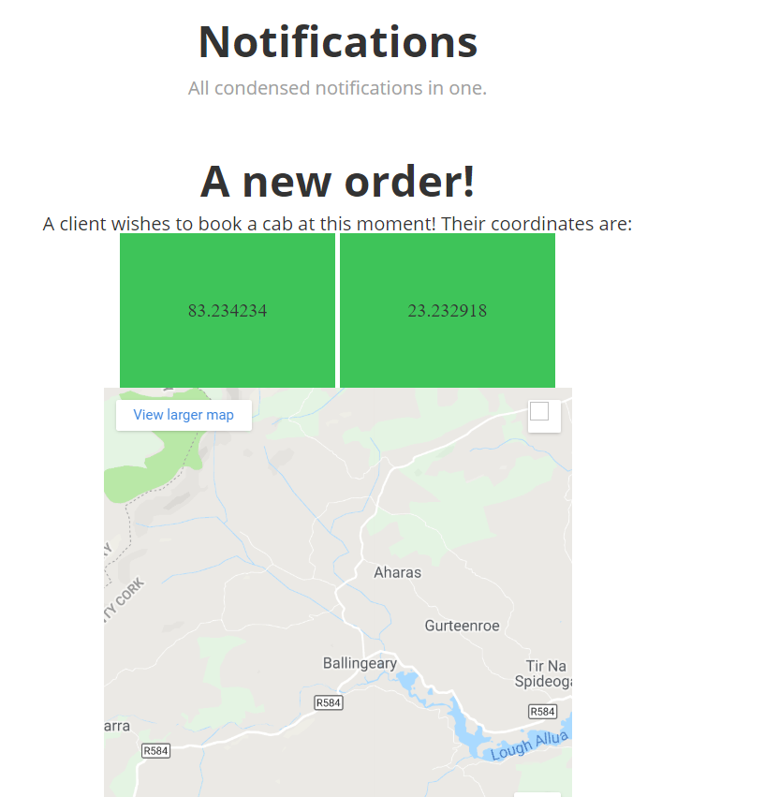
The notifications section will display a clients longitude and latitude in the green squares, and will display a google maps beneath it. I wasn’t able to acquire a route to for the google maps, as it involved money according to google if I was to integrate it into firebase.

Slide 18
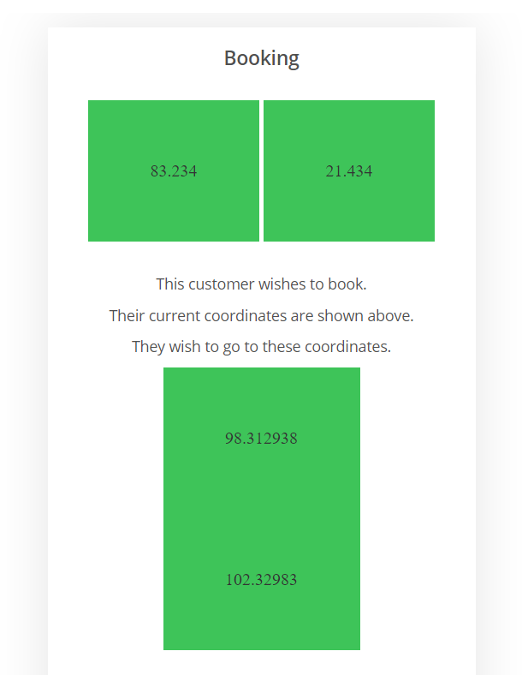
Booking will display a clients longitude and latitude in the firebase in these green squares, it’ll show their current location and where they wish to go to.

Slide 19
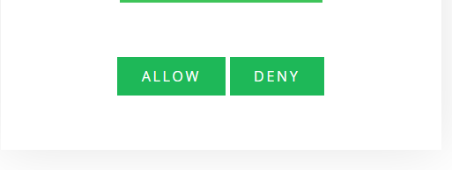
Beneath the booking, there are two buttons that are labelled allow and deny, these are simple enough as it allows the admin to allow or deny the current request that a client is booking. It simply updates the firebase and changes the requests state from either allow or deny, simple enough but it’s usage is important for the phone app.

Slide 20
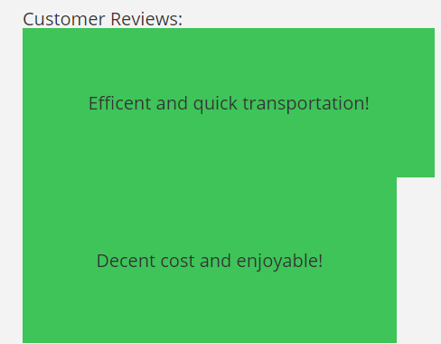
As for the support function, there are some simple values displayed on the firebase under “support”, it displays these and are obviously editable. I hadn’t been able to implement it on the phone apps end but the functionality is there to allow it.

Slide 21
Thank you for reading our powerpoint presentation! Bartek, Eoin, Conor and Thomas.

