Slide 1

Driving 101
Supervisor: Martin Kenirons
By Conor Murphy and Rohan Sikder

Slide 2




Aim and Objective
To develop a driving theory test website where you can take a mock test and study.
User can choose how many questions test to be.
Random selection of questions displayed.
Have a user-friendly UI and have a minimalistic look for all target audience.
Have a scoring system with a leaderboard.

Slide 3
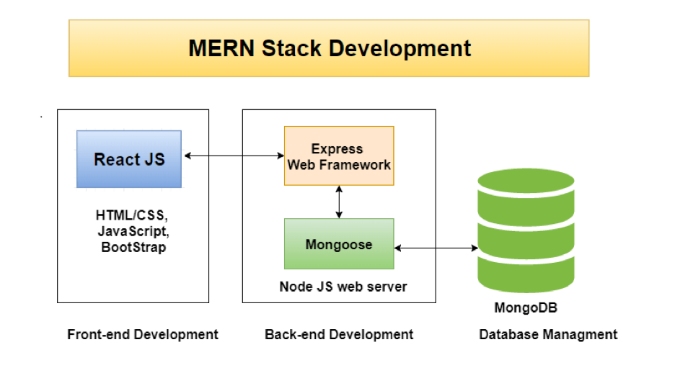


Architecture used for development
HTML, JavaScript and CSS
MERN Stack – MongoDB, ExpressJS, React and Node
Testing – Selenium IDE and POSTMAN

Slide 4
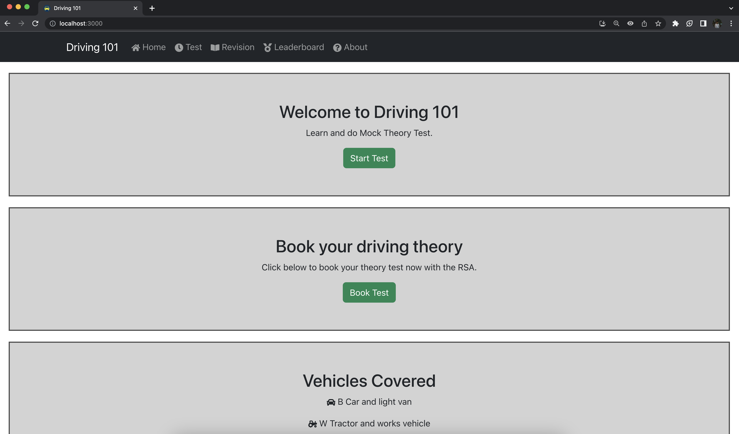
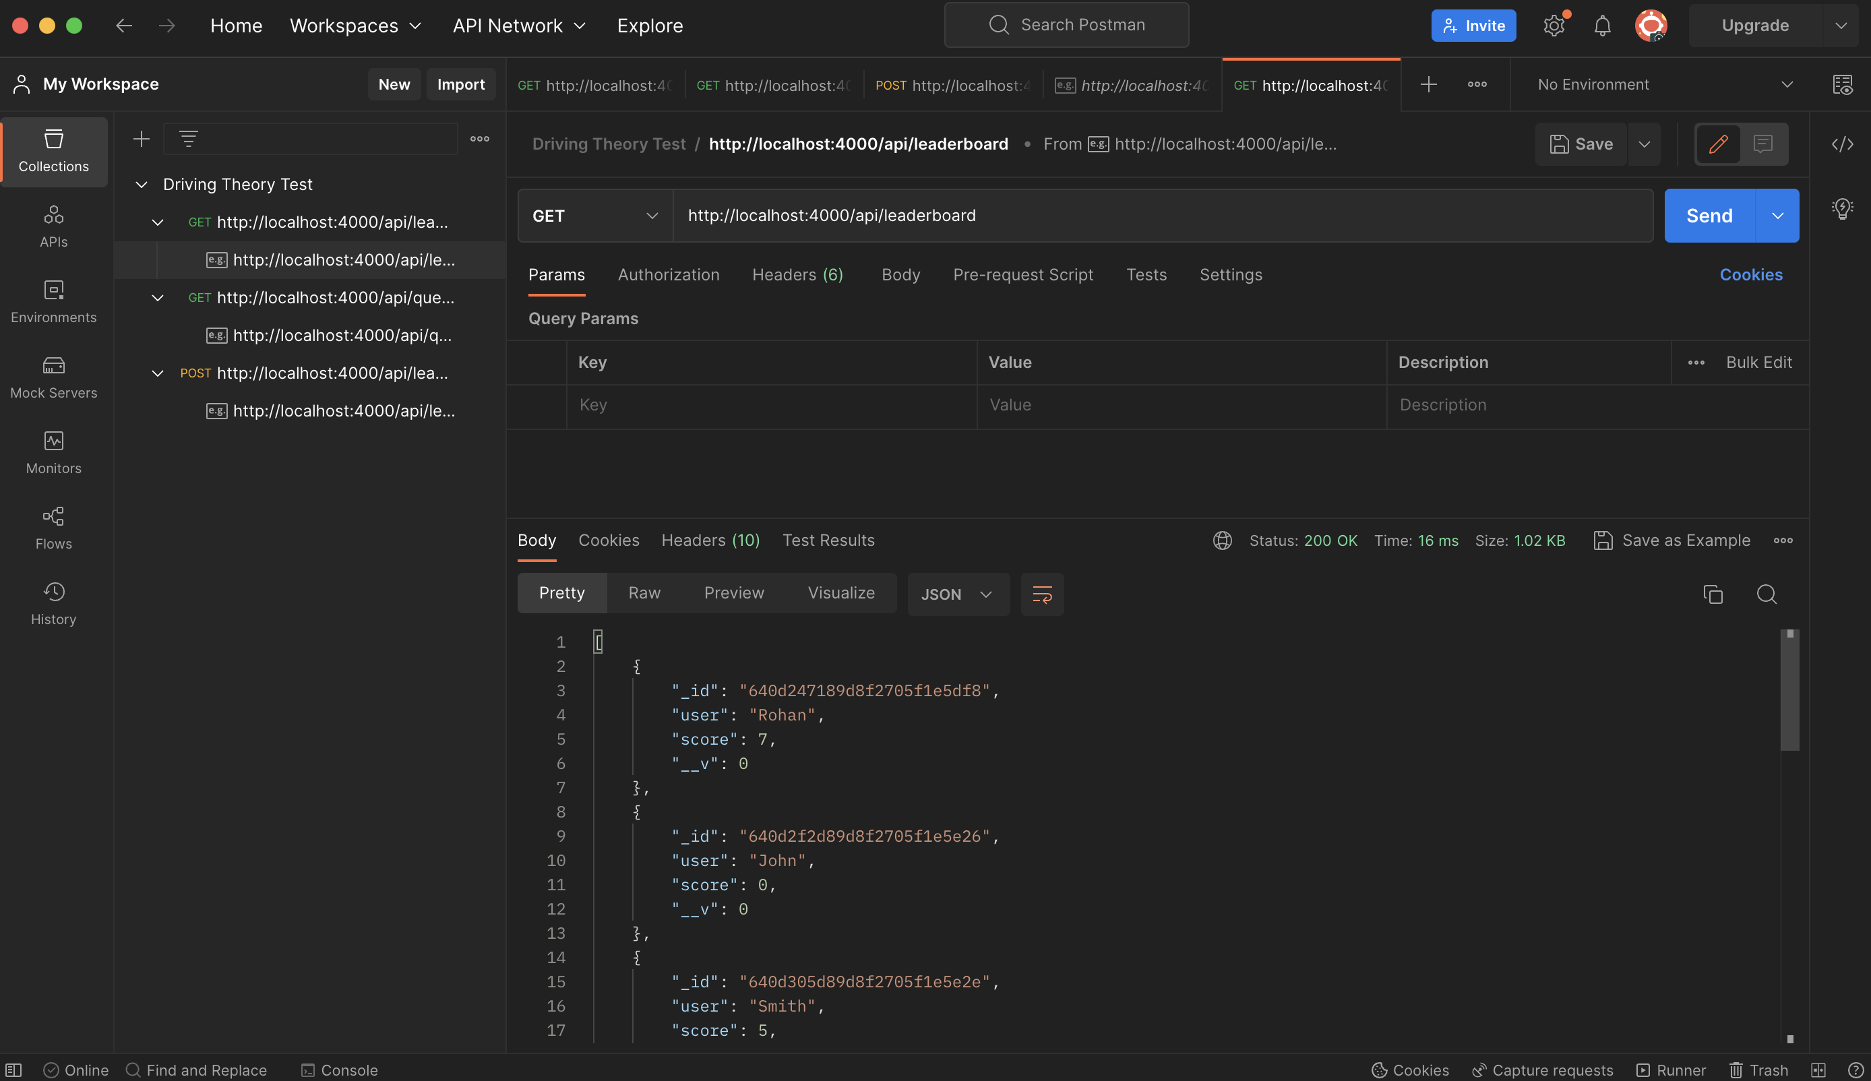
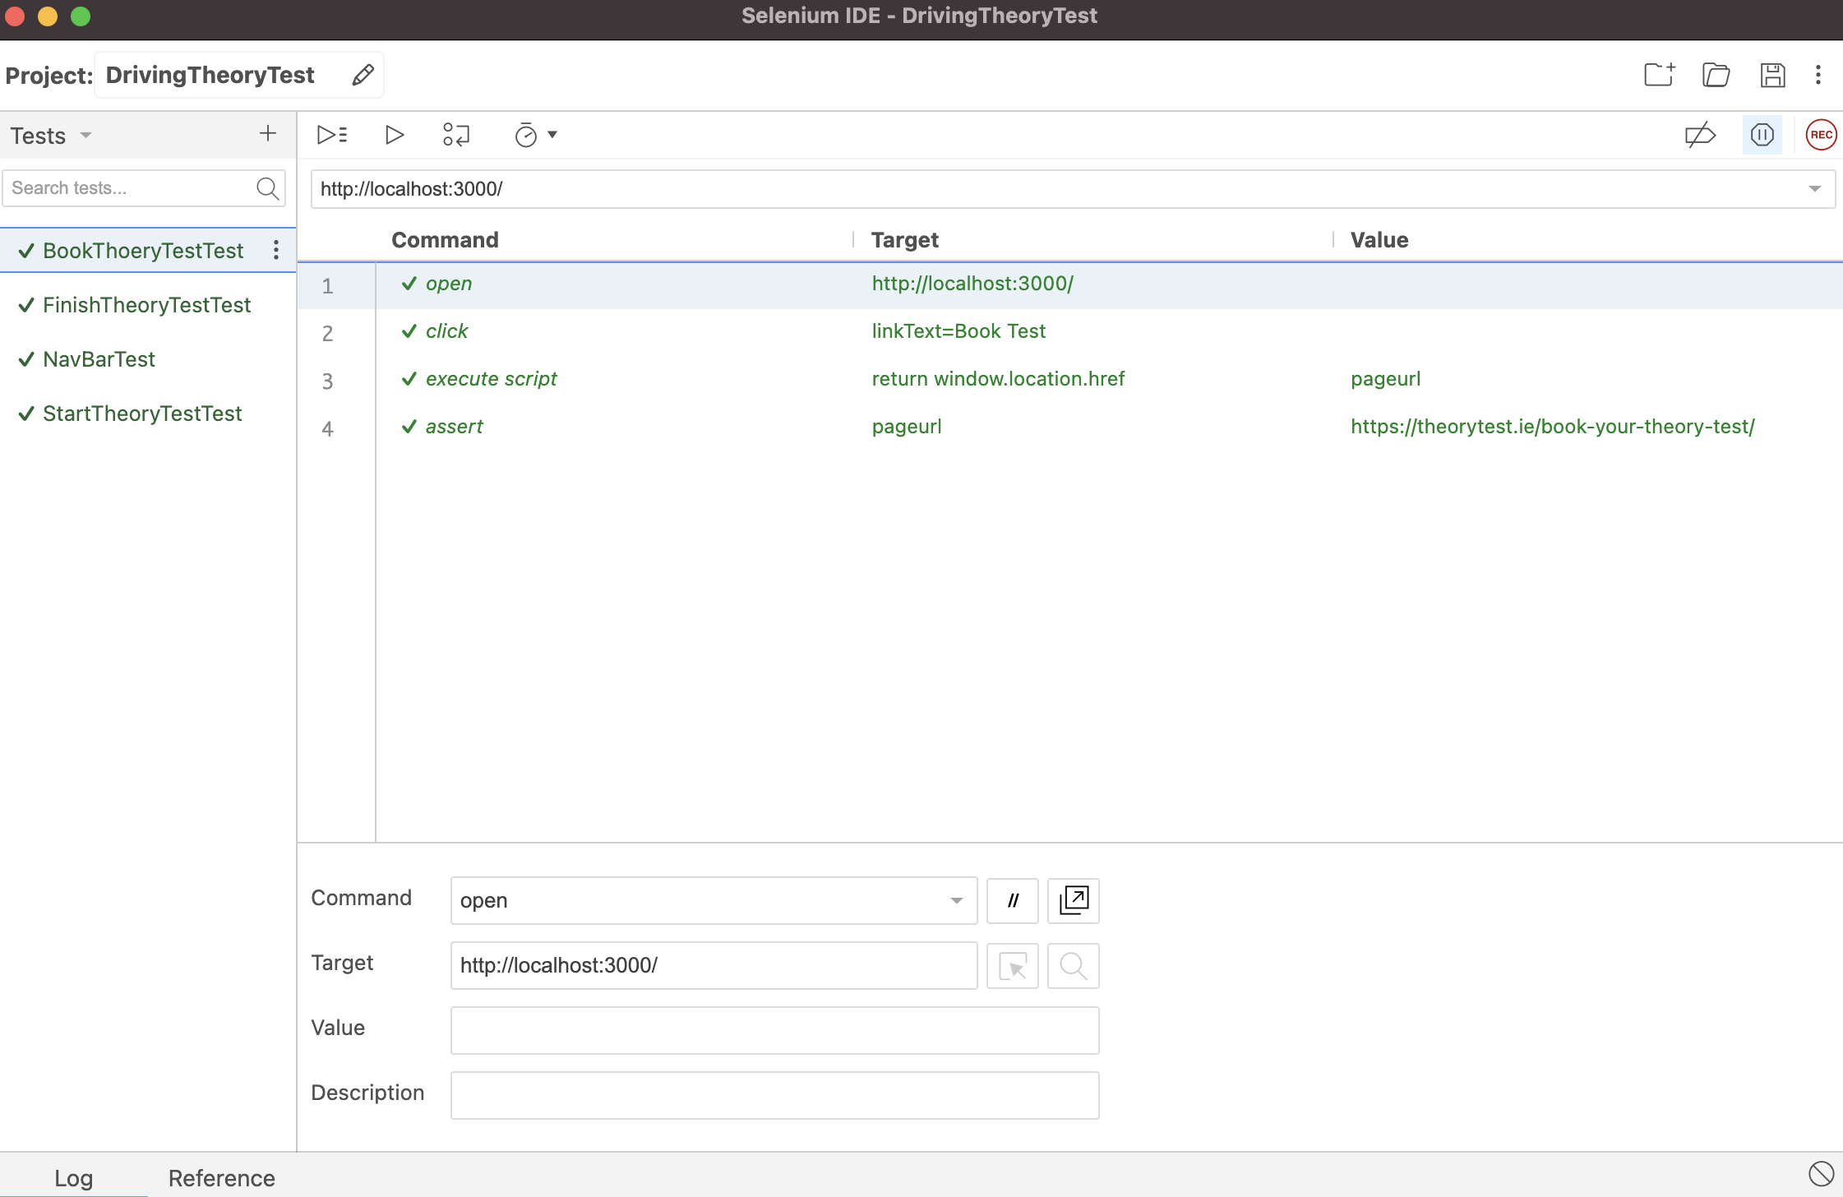
Demo
z
Demo of our Application and Testing
Feel free to check out our codebase:
https://github.com/ConorPadraigMurphy/ProfessionalPractice

Slide 5
Conclusion
In the future more features could be implemented, E.g., Timer, Admin Functionality.
Strict Deadlines for Features and Requirements excelled development.
Overall, Very happy with outcome. Set Idea and Plan was executed to the point which was planned.

Slide 6

Questions & Answers
z

