Slide 1
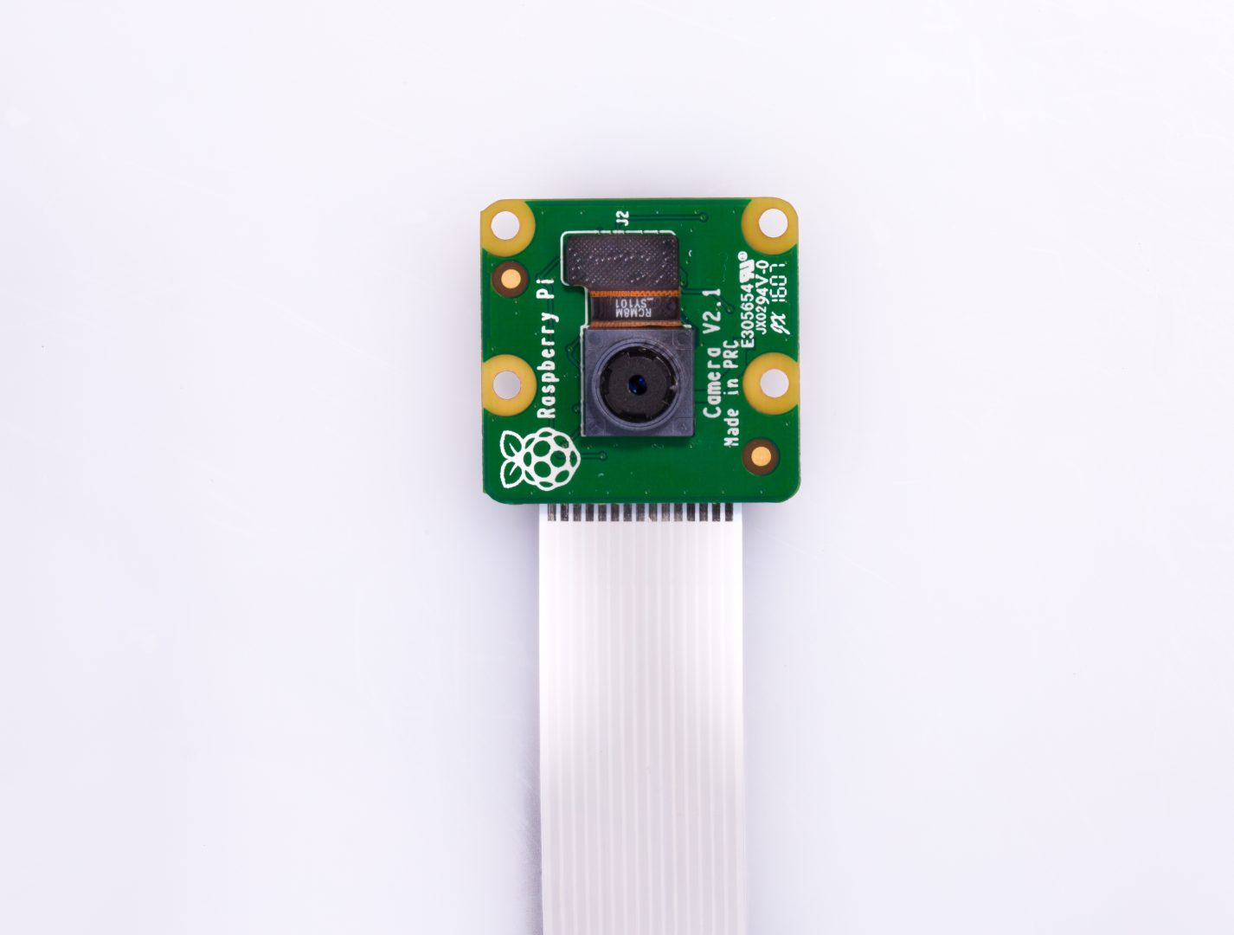
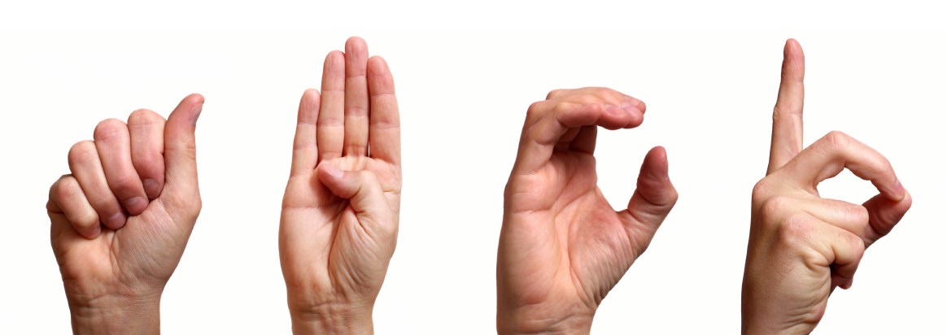
American Sign Language app hosted on a Raspberry pi

Slide 2

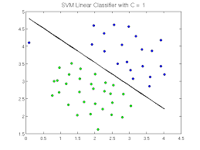

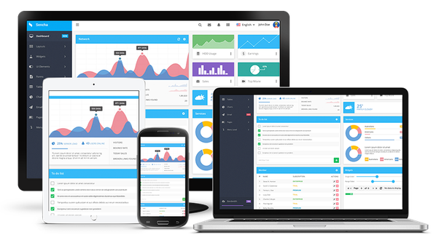
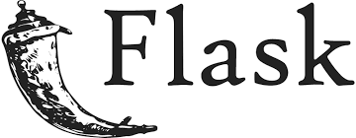
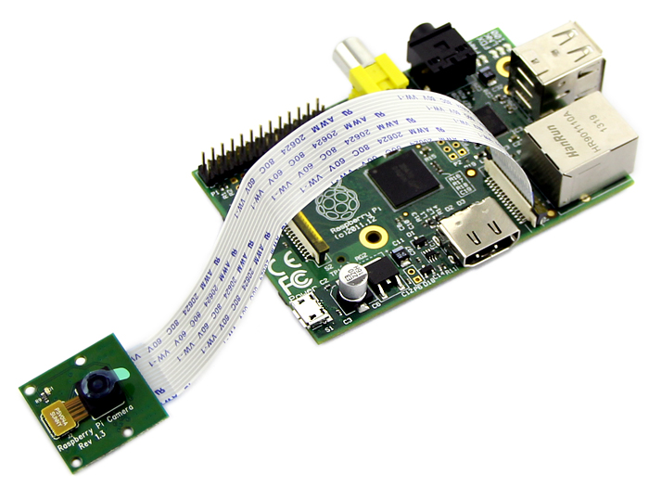
SVM Model
Web App

Slide 3
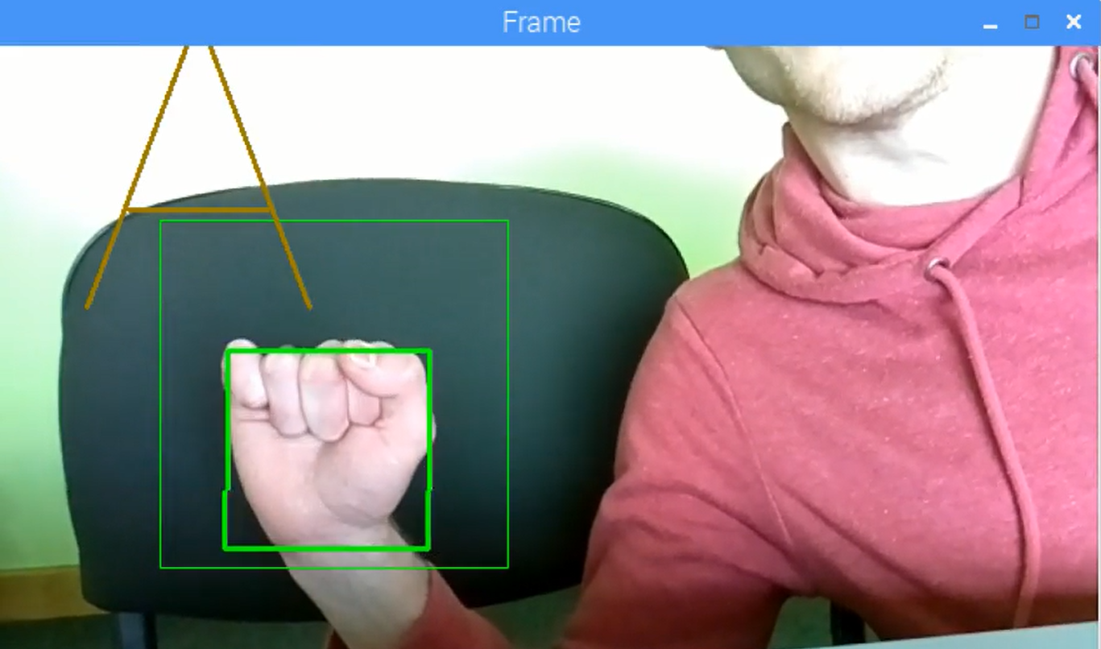
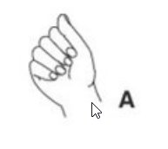
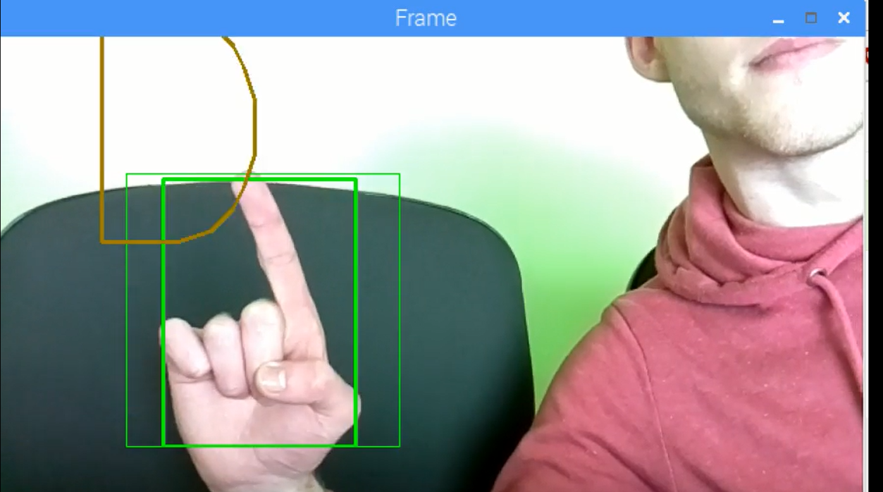
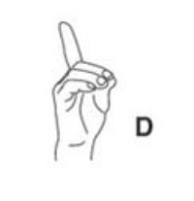
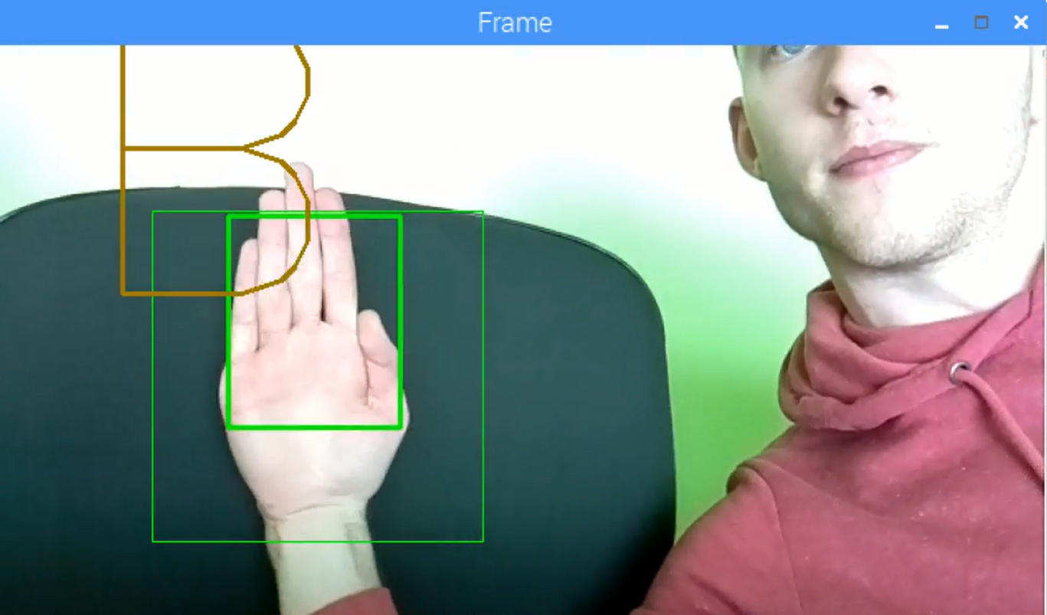
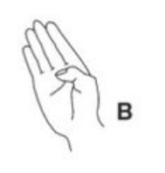
SVM Trained to recognize Full ASL Alphabet of gestures
Training SVM with data (supervised learning)
Creates classifier on based on an optimal hyperplane
Application accuracy can be increased by increasing training data sets or learning iterations
Application can also recognise ASL numbers by creating masks out of camera contours
Making a 3 will cause the raspberry pi camera to capture the screen

