Slide 1
TRINZO
Where We Are & Where We Go
Leadership Working Session · May 2026
People
Sales
Client
RED
AMBER
UNCLEAR
CONFIDENTIAL

Slide 2
Today's Session
01
02
03
04
The Numbers
The Team
Three Paths
The Decision
Revenue, valuation, and the gap between where we are and where we need to be
Who we have, what's billable, who's at risk — the honest picture
Each option mapped by roles, KPI impact, and 2029 exit value
What we align on today — not a full plan, but a clear direction
This is a working session — come with views, not just questions.

Slide 3
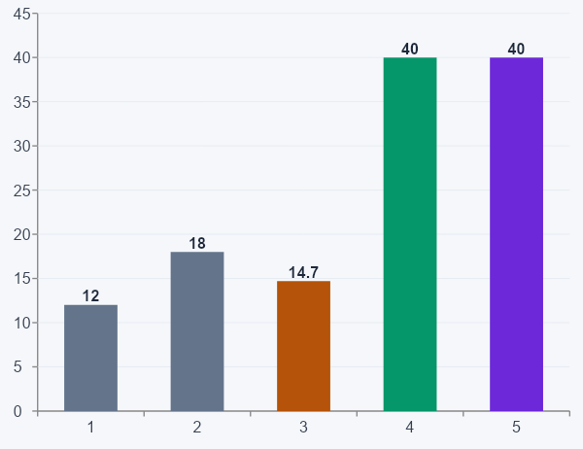
The Valuation Gap
€6.5M
2026 Revenue Forecast
~€12M
Current Company Valuation
€40M
Target Exit Valuation (3–4 yrs)

Slide 4
Where We Stand: Three KPIs
● AMBER
● RED
● UNCLEAR
SALES
PEOPLE
CLIENT
Revenue tracking to €6.5M year-end
Margin ahead of target
New Head of Sales joins next month
Risk: arrives with no onboarding, no content, no sales ops support
Risk: Kate is the only internal sales support remaining
Lost 7+ team members in 12 months
Only 40% of FTEs are billable
50%+ of remaining team at flight risk
Only Liam fully stable; Conor & Kathryn next
No senior leadership in Finance or Margin Improvement
Clients enthusiastic about AI — but engaging for free
Delivery keeping clients happy; extensions increasing
Extensions not invoiced — effort going unpaid
No shared definition of what 'delight' means commercially
Sales frustrated; delivery not incentivised to convert

Slide 5
Our Team: The Real Picture
15
6 / 40%
50%+
10–30
Total FTEs (incl. incoming HoS)
Currently Billable
At Flight Risk
Active Contractors
Billable — stable
Billable — flight risk
Non-billable — flight risk
New / joining
BILLABLE
RECENTLY DEPARTED
Liam
Jacqui
Head of Sales
MI Assistant
CEO
Client Delivery
departed
departed
Conor
Marissa
Head of Finance
Sales Ops (Ciara)
Head of Innovation
Client Delivery
departed
leaving in 6 wks
Kathryn
Jack
Head of MI
Client Delivery
Margin Improvement
departed
NON-BILLABLE
New HoS
Kate
Hannah
Emma
Amy
Catriona
Kate F.
Sales
Sales
HR
IT & Ops
Talent
Finance
Finance

Slide 6
Three Paths Forward
OPTION 1
OPTION 2
OPTION 3
Stay the Course
Hire Like for Like
Reposition (AI-First)
Continue with the current model. Manage the gaps from recent departures. No structural change to how Trinzo operates or goes to market. The safest-feeling option — but not the safest in reality.
Rebuild departed roles with junior hires. More expensive than the staff who left. Less institutional knowledge. Multiple simultaneous onboardings into an already depleted team.
Use the departures as a forcing function. Automate non-value-adding functions with AI. Shift FTE mix toward billable roles. Position Trinzo as the AI-first life science consultancy.
Each option carries different implications for roles, KPI trajectory, and exit valuation — explored on the following slides.

Slide 7
Option 1 — Stay the Course
ROLES
KPI TRAJECTORY
2029 EXIT
Liam
SALES
Revenue
CEO — strategic and commercial lead, unchanged
AMBER → RED RISK
€9.5M
New HoS
New HoS unsupported; sales continuity fragile
Arrives next month. No onboarding plan, no content library, no ops support.
EBITDA Margin
10%
Kate
Sales assistant — same limited role. Sole sales support.
PEOPLE
EBITDA
Kathryn / Jacqui / Marissa
RED → STAYS RED
€950k
Delivery continues. Extensions unresolved commercially.
No structural improvement; flight risk continues
Jack
Val. Multiple
Sole MI person. No head above, no junior below. Exposed.
1.8x
Finance
CLIENT
Two juniors, no senior direction or leadership.
Implied Val.
UNCLEAR → STAYS UNCLEAR
€18M
Hannah / Emma / Amy
Free/paid tension deepens; no commercial clarity
Unchanged. Non-billable support functions throughout.
€22M short of target

Slide 8
Option 2 — Hire Like for Like
ROLES
KPI TRAJECTORY
2029 EXIT
Liam
SALES
Revenue
CEO — unchanged
AMBER → RED → AMBER
€9.8M
New HoS
Three parallel onboardings; recovers only by month 12
Same unsupported setup as Option 1
EBITDA Margin
8%
+ Junior Sales Ops
New hire. Higher cost than Ciara. 6–9 month ramp. No tribal knowledge.
PEOPLE
EBITDA
+ Junior MI Support
RED → REDDER
€784k
Added alongside Jack. Cost without senior capability.
More hires, less knowledge; management overhead increases
+ Finance Junior (possible)
Val. Multiple
Three juniors, still no head. More cost, same direction problem.
1.5x
All others
CLIENT
Unchanged. Non-billable overhead persists.
Implied Val.
UNCLEAR → UNCHANGED
€14.7M
Jacqui / Marissa / Kathryn
No commercial model change whatsoever
Delivery unchanged. Same commercial tension unresolved.
Most expensive path. Worst outcome.

Slide 9
Option 3 — Reposition (AI-First)
ROLE TRANSFORMATION — EVERY PERSON HAS A FUTURE
KPI TARGETS
2029 EXIT
Liam
Client relationships + company sale process. Real-time visibility via AI — no manual reports needed.
SALES
Revenue
→ GREEN
€18M
Conor
AI Hub lead + internal transformation. His work becomes the proof of concept Trinzo sells.
AI ops gives HoS a strong start from week one
Adeline
Technical build → billable client delivery. Automation for clients. No longer overhead.
EBITDA Margin
PEOPLE
19%
New HoS
Arrives to AI-powered ops: content engine, CRM, pipeline visibility, proposals — ready from day one.
→ AMBER → GREEN
Kate
Sales assistant → Client Success hybrid. More client-facing, less admin. AI handles the admin layer.
Retention programme + compelling vision to stay
EBITDA
€3.4M
Kathryn / Jacqui / Marissa
Delivery + commercial accountability. Extensions flagged and invoiced. Value captured.
CLIENT
SPLIT → 2 KPIs
Val. Multiple
Jack
Billable MI consultant. MI becomes a client-facing AI-backed service line. Has a future.
2.5x
Satisfaction and Commercialisation tracked separately
Hannah
Retention lead. Most important role for next 12 months given 50%+ flight risk.
Implied Val.
Emma
AI tools admin → Operations consulting. From cost centre to future value.
+ NEW KPIs
€40M ✓
Added
Amy
Screening automated → Contractor relationship manager. Strategic value to delivery engine.
Free→paid %, billable FTE ratio, extension invoice rate
Finance
1 junior + fractional CFO + AI tooling. Right-sized, directed, analytical.
Hits the target.

Slide 10
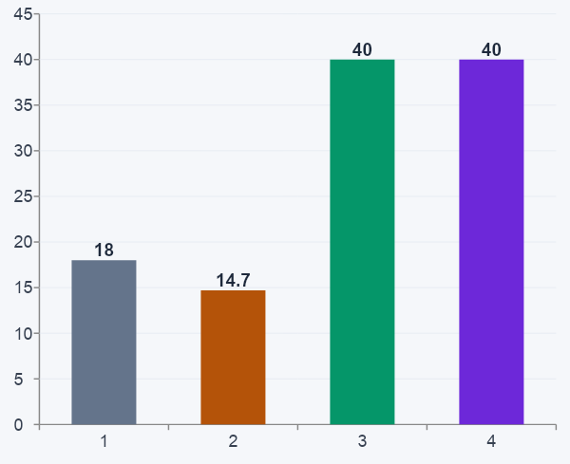
2029 Exit Comparison: Option by Option
Option 1
Option 2
Option 3
Revenue
€9.5M
€9.8M
€18M
EBITDA %
10%
8%
19%
EBITDA
€950k
€784k
€3.4M
Multiple
1.8x
1.5x
2.5x
Valuation
€18M
€14.7M
€40M ✓

Slide 11
Rating Each Option: The Four Value Drivers
Value Driver
Option 1
Option 2
Option 3
EBITDA / Revenue
Modest growth only
Margin compressed by cost
Revenue doubles; margin improves
Can we hit the EBITDA profile that justifies €40M?
Brand
Holds; fades without investment
No change
AI-first premium grows over time
Does our positioning command a premium multiple?
People
Stays red; no action
Gets worse short-term
Retention plan + billable shift
Do we have people an acquirer would value and retain?
Operations
Heavy; an acquirer liability
Heavier with more hires
Automated; becomes a proof point
Is our model lean, scalable, and attractive to a buyer?
2029 Implied Valuation
€18M
€14.7M
€40M ✓

Slide 12
What We Decide Today
01
Do we agree on the problem?
Can we align on where we stand — people, KPIs, the valuation gap — before we discuss which direction to take?
02
Which path fits our reality?
Considering our team, our clients, and our risk appetite — which option can we actually commit to and execute?
03
What is our first commitment?
If we leave aligned on direction, what is the one concrete action we agree on in the next 30 days?
We don't need a fully-formed plan today. We need direction.

