Slide 1
Problem 1
Assumptions:
The product type is a subprime line of credit.
Customers who are SelfEmployed, RetirementPension, or SocialSecurityDisability can never be considered “Laid-Off”
Risk of customers who aren’t laid of remains constant throughout the analysis (BAU).
Risk of customers who are SelfEmployed, RetirementPension, or SocialSecurityDisability remains constant throughout the analysis (BAU).
Some Statistics:
81.6% (14690/18009) of customers could be considered “Laid-Off” at some point.
In the first 12 weeks, 78.3% (11497/14690) will make more if unemployed.
21.5% (3161/14690) of customers would make less on Unemployment.

Slide 2
Problem 1 Conclusion (Part 1)
Portfolio Risk will decrease in the next 12 weeks.
Average Line Balance will Decrease.
80% of customer would make more if laid-off during these 12 weeks.
Charge-Off Balance will Decrease.
With only laid-off customers impacting portfolio risk and 80% of those laid-off receiving a higher weekly income we should expect less defaults.
Please Consider:
New Applications during these first 12 weeks are going to have higher fraud rates. Being laid-off would lead to higher weekly incomes, higher weekly incomes decreases the need for a subprime loan; leaving only fraudsters applying.

Slide 3
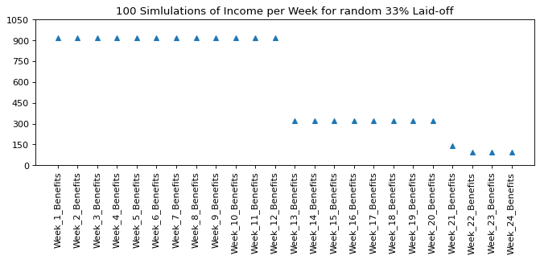
Problem 1 Conclusion (Part 2)
2. With risk at a minimum during the first 12 weeks of Covid we should see a drastic increase in risk in the 13th week.
Federal Unemployment made up >50% of the benefits customers had in the first 12 weeks.
50% decrease in income will lead to higher Line Balances and Charge-Off rates.
Pre-Covid, the Average Weekly Income was ~$800
Pre-Pandemic Avg Income
$(600)
Week 13: Average Laid-Off Weekly Income Drops 66% from week 12 to $300
Week 13 will have higher Average Line Balances and Charge-Off rates than pre-pandemic. Should take caution in customers running up their credit limits in the next week.

Slide 4
Problem 2
Some Statistics:
From the dataset provided, 18.1% of applications are covered by the new data product.
From the dataset provided, 18.4% of funded accounts are covered by the new data product.
Should we design a model/strategy around a data product we can only use 18% of the time?
How long will it take to collect enough data for a new strategy if only 18% of apps have the data?
Sometimes the lack of data can have value, in this case it doesn’t seem so.
Lower Lifetime Revenue and High Charge-Off? Does this indicate randomness/lack of importance?

Slide 5
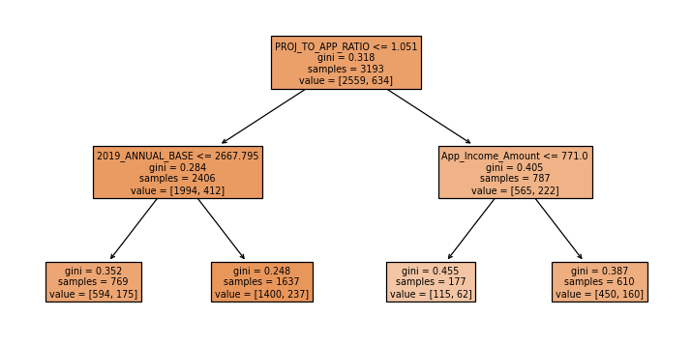
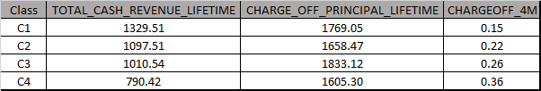
Problem 2 Continued..
If we decide that 4,500 funded accounts is enough to develop a business strategy, we can use a segmentation technique to identify riskier customers.
Found 3 Features that can split the funded accounts into 4 Classes.
PROJ_TO_APP_RATIO – This is (Annual Income From Application/Annual Income From Vendor). People often lie about their income on applications. If this value is > 1 they have overstated their income. Could be fraudsters guessing income.
2019_ANNUAL_BASE – What was the customers annual base compensation in 2019. -999 if annual base compensation not available for 2019.
App_Income_Amount – What is the Amount per paycycle the customer receives.
TRUE
FALSE
C2
C1
C4
C3
This New Vendor has at least 2 features that rank risk
I limited this strategy to 3 features because of the amount of data available and fear of overfitting. More data and complex tree-based models would lead to improved risk segmentation techniques/strategy.

Slide 6
Problem 2 Conclusion
Is it worth purchasing this data?
No, I think that we should have at least 50% coverage. It will take us years to collect enough data for a ML strategy if only 18% of apps have data. We need more data.
We also need to compare this vendor to CBB or TU. Maybe these new features have no improvement over normal credit bureau indicators.
Need to know how much this data costs per application. If it is $23 per application, I would say it is not worth investing in.
The new features do rank risk.
The simple segmentation technique on previous slide does a good job of ranking charge off without overfitting (val and dev rate for C4 are within +/-3%)
Is $23 per funded customer worth the time/effort required to integrate this product into UW?
If our team decides this enough data to build a strategy, we can swap out C4. This would free up $430K for other products, increase average lifetime revenue by $23, and decrease 4M Charge Off rates by 1%. Decreasing Application to Booked by 0.5%

