Slide 1
Outline
Alternative Circuit Representation – Line diagrams
CSE250 Review
- KCL, KVL
- Series, Parallel resistor network – Voltage Division, Current division
- Examples
IV Characteristics
- Linear IV – Resistors, Voltage Source, Current Source, SC, OC.
- Non-Linear IV – Piecewise Linear Model

Slide 2
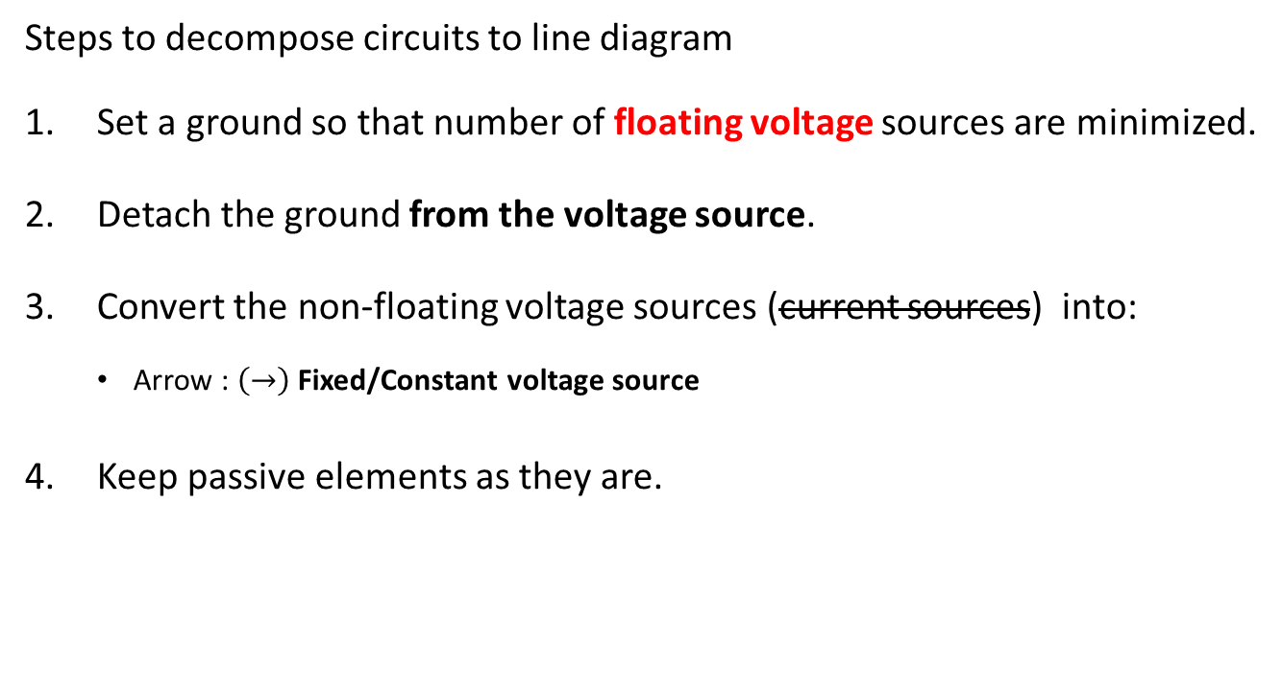
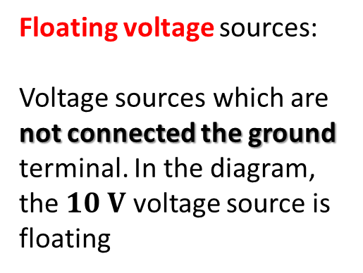
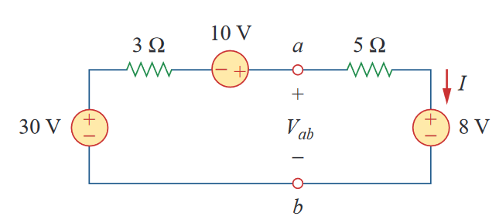
Alternative Circuit Representation: Line diagrams

Slide 3

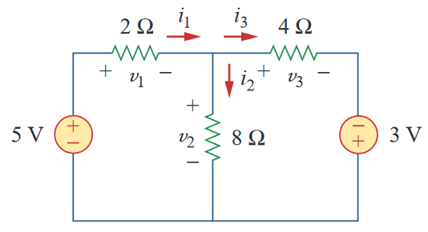












Line diagrams: Example 1

Slide 4










Line diagrams: Example 2

Slide 5

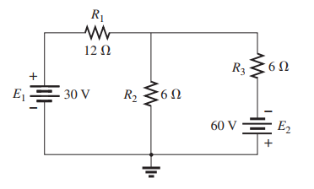
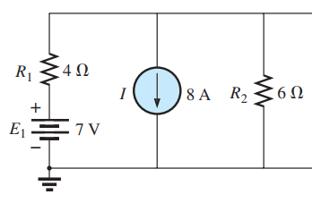
More Examples
Difficulty : 2/5
Difficulty : 3/5
Example: 2
Example: 3

Slide 6
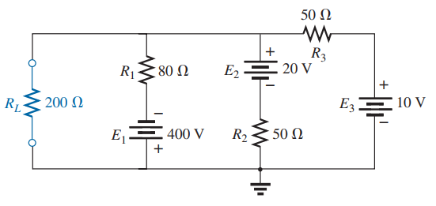
More Examples
Difficulty : 4/5
Step – (4) Make all the active elements (dc/ac type, voltage/current sources) into single terminals (arrows/circles) using the voltages you wrote as much as you can [THERE MIGHT BE CASES WHERE YOU CAN’T DO THAT]
Example: 4

Slide 7
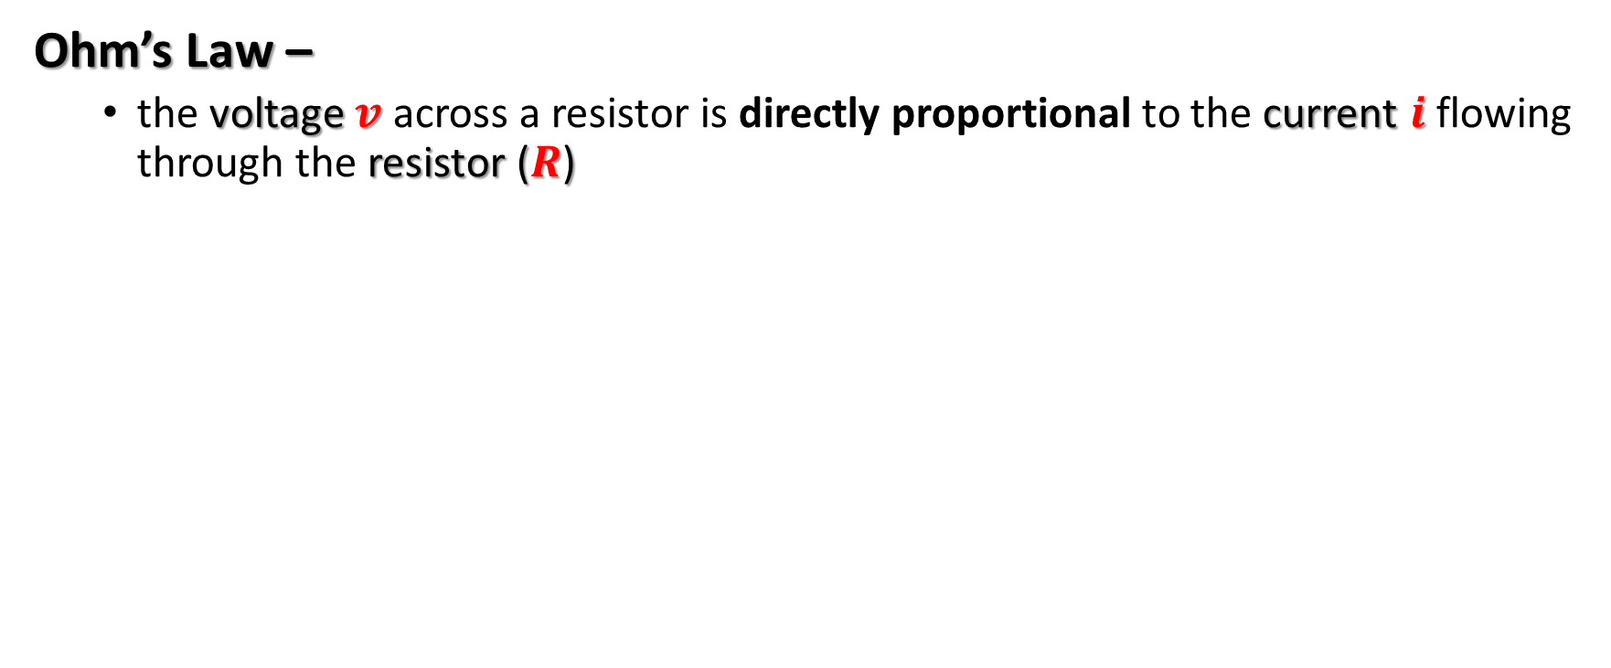
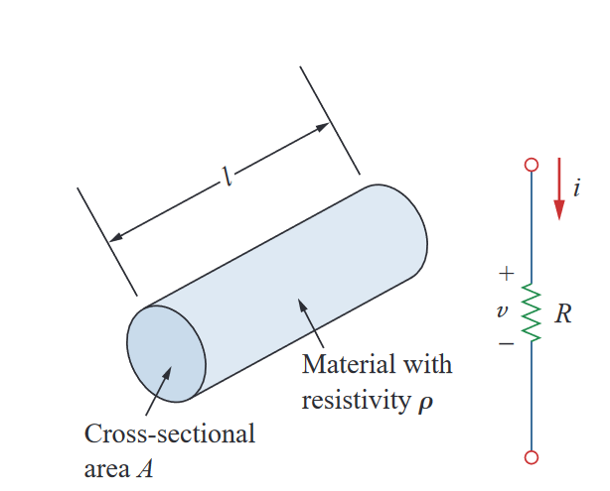
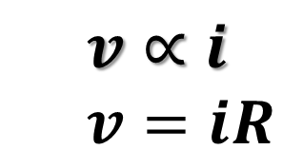
The fundamentals …

Slide 8
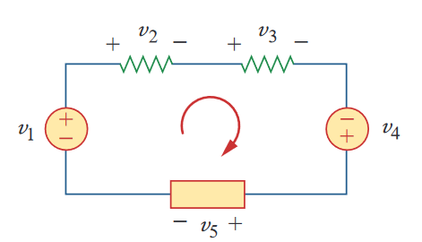


KVL: Kirchhoff’s voltage law
The algebraic sum of all voltages around a closed path (or loop) is zero.
Sum of voltage drops = Sum of voltage rises

Slide 9
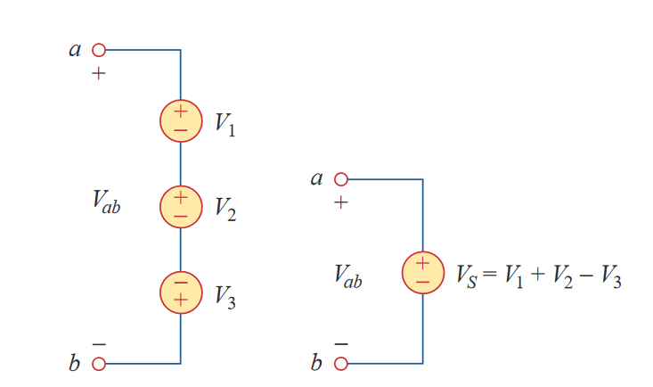


KVL: Kirchhoff’s voltage law
Equivalent Circuits

Slide 10

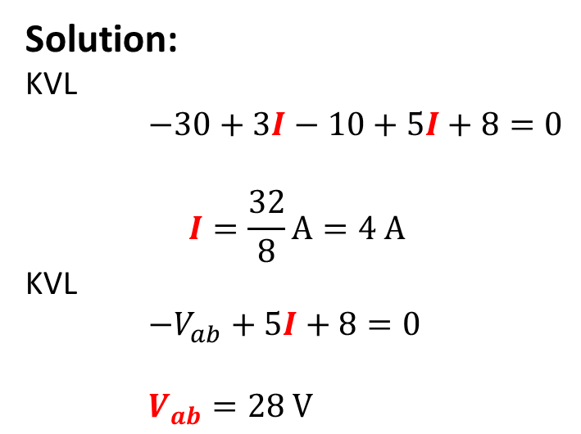
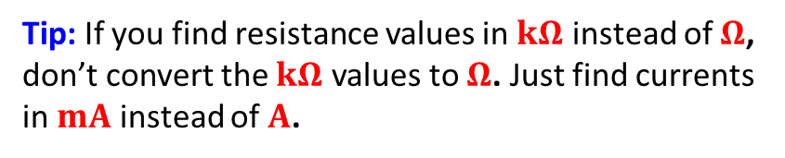
KVL – Example 1

Slide 11


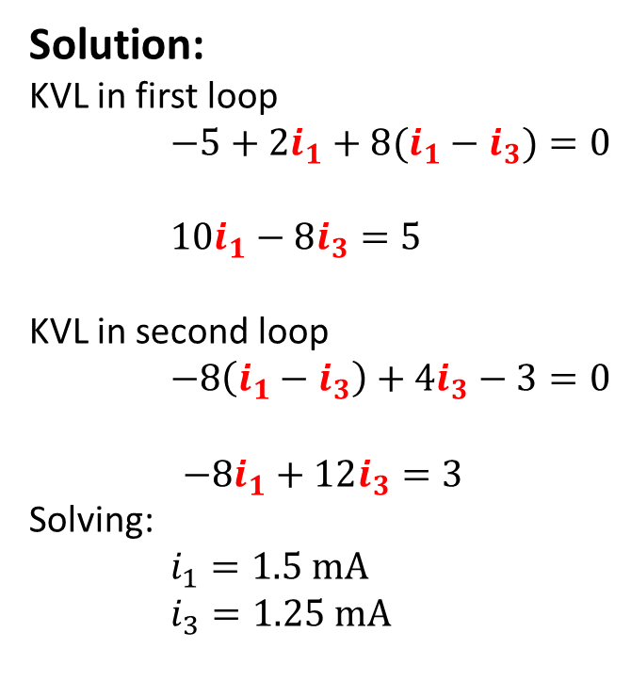


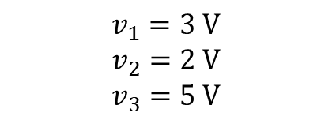

KVL – Example 2

Slide 12
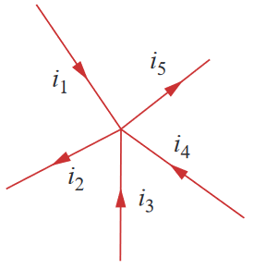

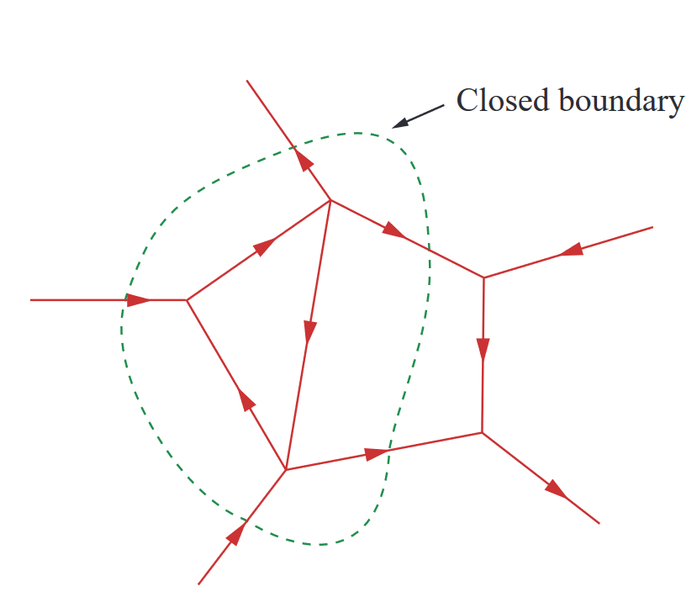
KCL: Kirchoff’s Current Law
The algebraic sum of the currents entering a node (closed boundary) is equal to the sum of the currents leaving the node.
Current Entering node: Positive
Current Exiting node: Negative
Or vice versa…

Slide 13
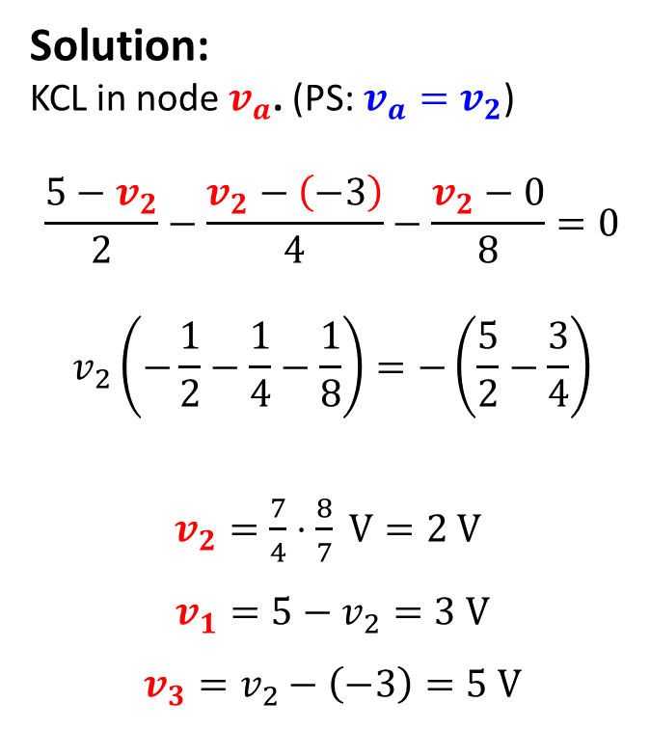

KCL- Example 1

Slide 14
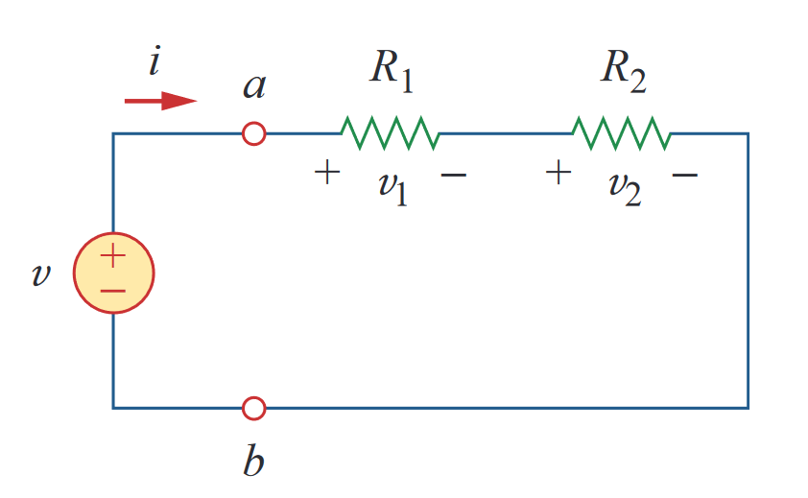
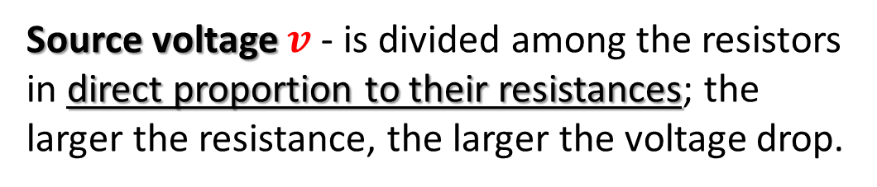

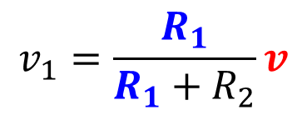
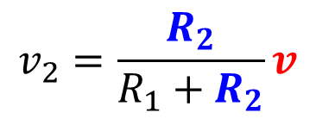
Series Resistors and Voltage Division
The equivalent resistance of any number of resistors connected in series is the sum of the individual resistances.
Principle of voltage division

Slide 15

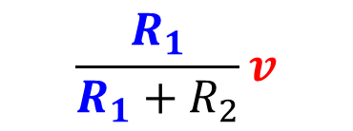

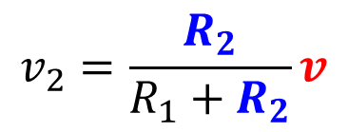
Line diagram: Example 3
}
{

Slide 16
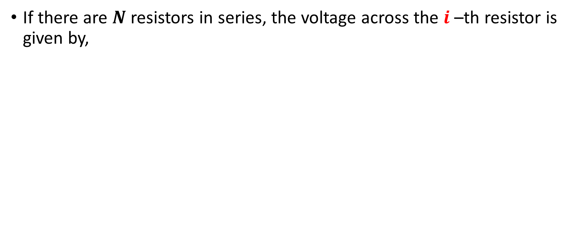
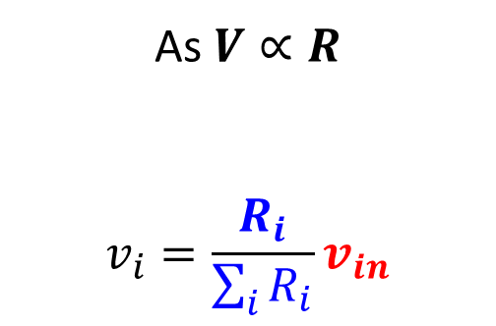
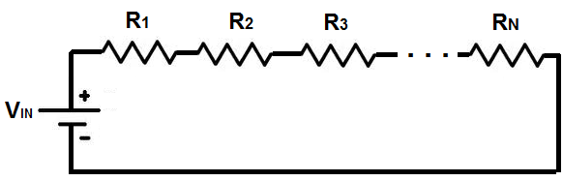

Series Resistors and Voltage Division

Slide 17


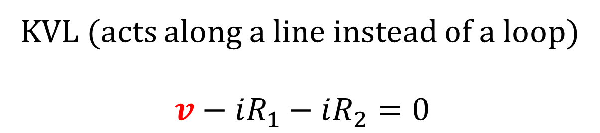
Line diagram: Example 3
}
{

Slide 18
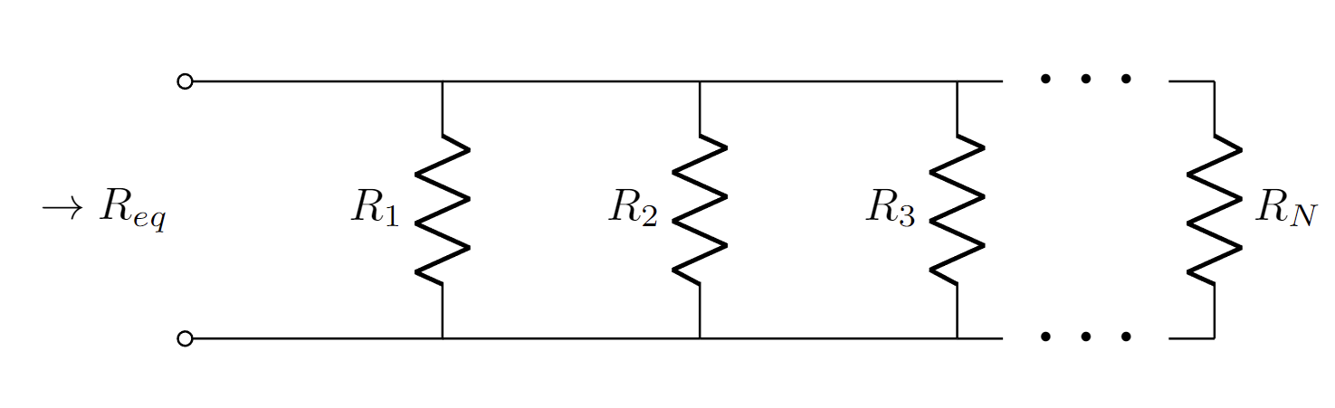
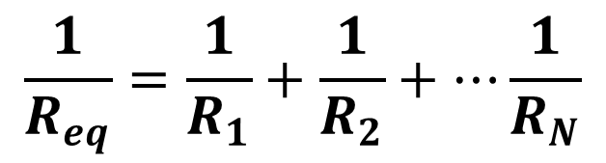
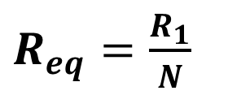
Parallel Resistors and Current Division
The equivalent resistance of any number of resistors connected in parallel is the inverse of the sum of the individual conductances.

Slide 19
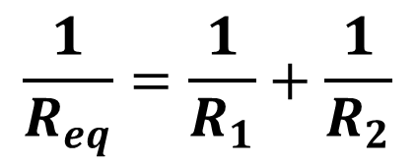

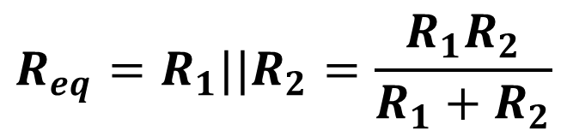
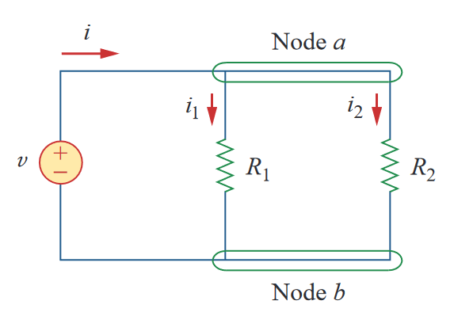
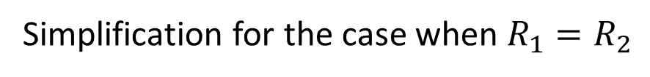
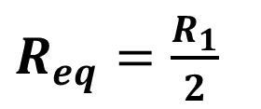
Parallel Resistors and Current Division
The equivalent resistance of any number of resistors connected in parallel is the inverse of the sum of the individual conductances.

Slide 20

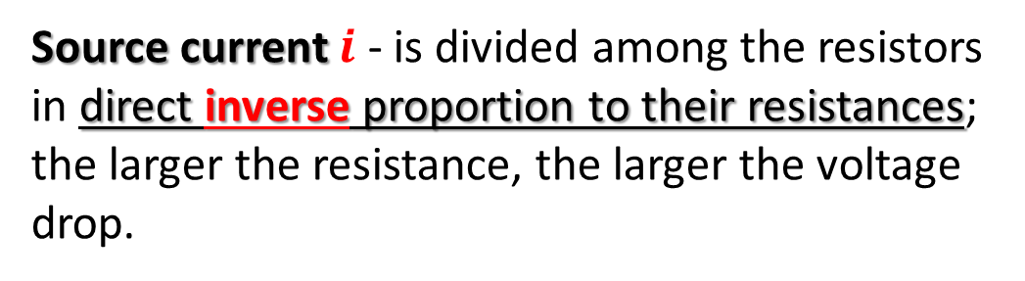
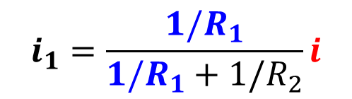
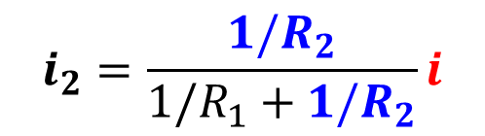
Parallel Resistors and Current Division
The equivalent resistance of any number of resistors connected in parallel is the inverse of the sum of the individual conductances.
Principle of current division

Slide 21
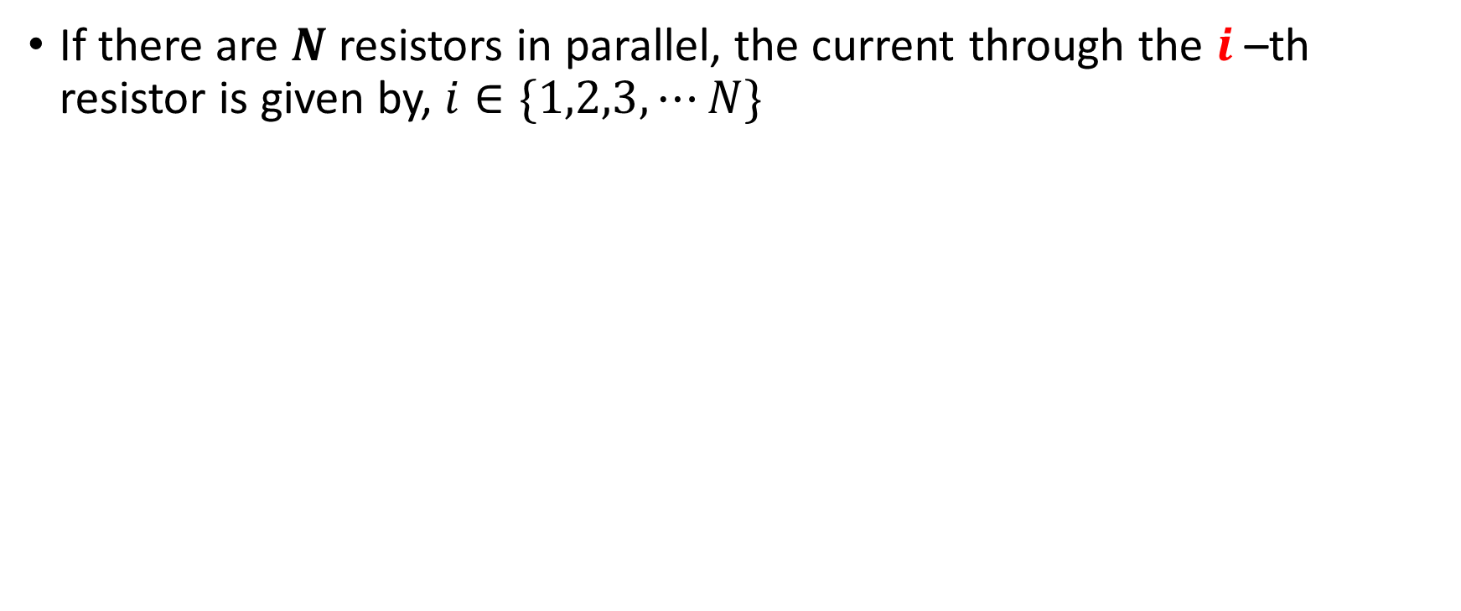
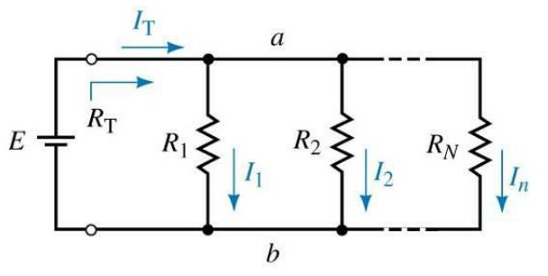
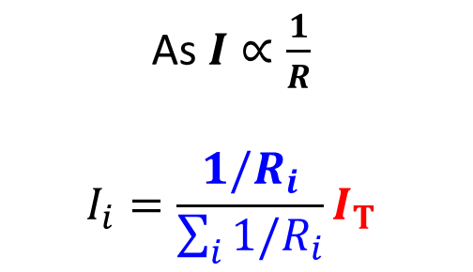
Parallel Resistors and Current Division

Slide 22
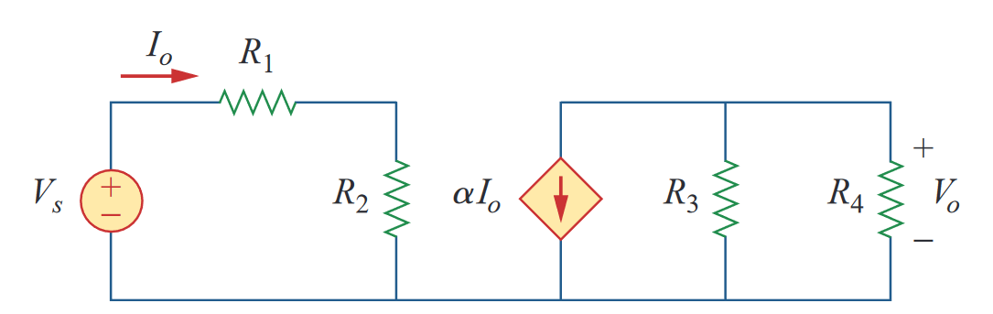
Line diagrams: Example 4

Slide 23
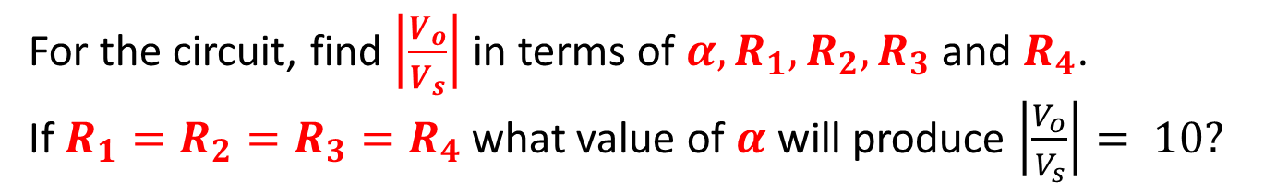
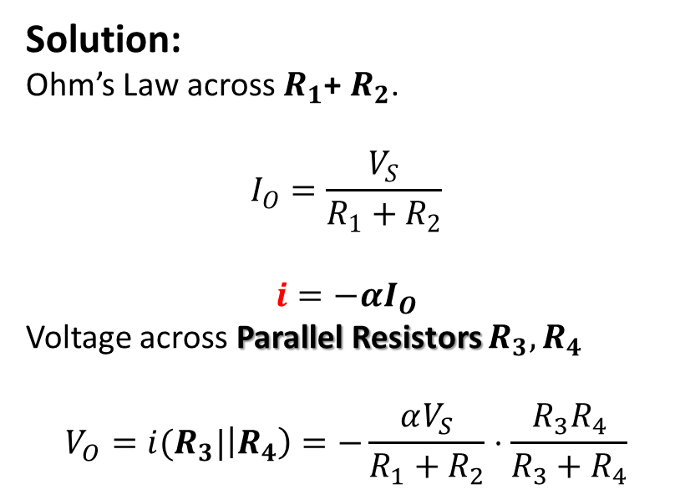

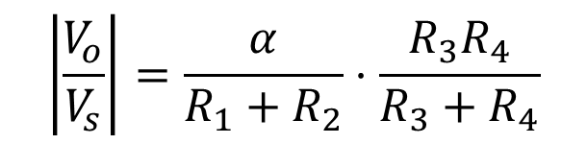

Practice Problem 1

Slide 24
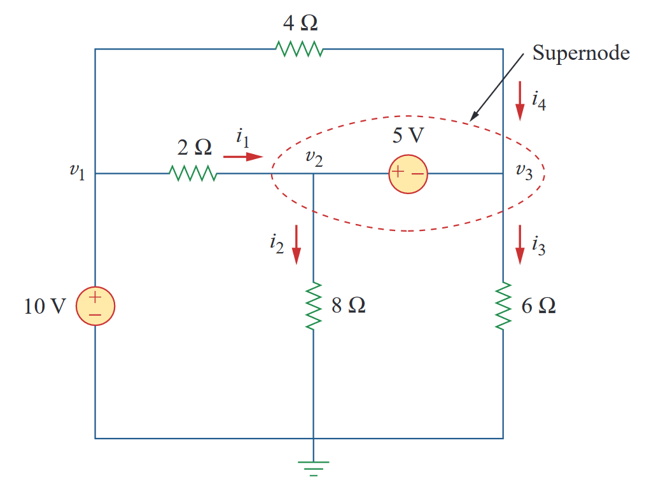
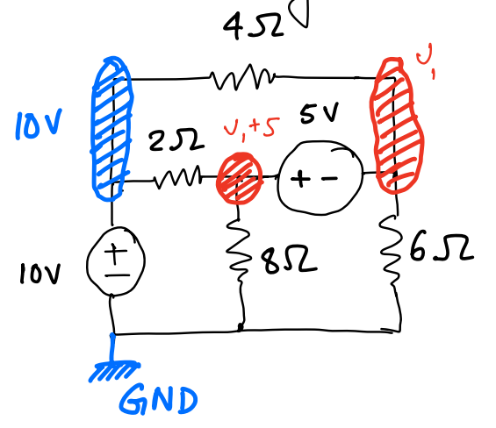
Example 1- Nodal Analysis

Slide 25
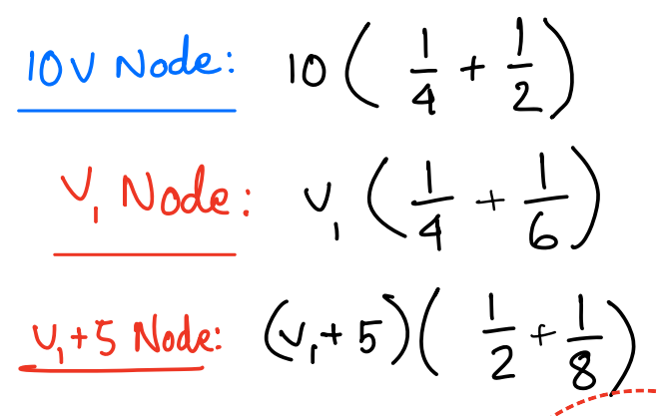


Example 1- Nodal Analysis

Slide 26


Example 2- Nodal Analysis – Home Task 1

Slide 27

Example 3

Slide 28

Example 4

Slide 29

Example 5

Slide 30


Example 6 – Home Task 2

Slide 31
Current-Voltage (I-V) Characteristics
I-V characteristic defines the relationship between the current flow (through), I and voltage (across), V an electronic device or element.
A tool for understanding the operation of the circuit element.
The Current-Voltage (I-V) characteristics are found by evaluating the response of a device/element under different excitation conditions. The behavior of a device depends on the applied excitation and can change if the excitation changes.

Slide 32


Current-Voltage (I-V) Characteristics
Example:

Slide 33




Current-Voltage (I-V) Characteristics

Slide 34

Type of (I-V) Characteristics

Slide 35

Type of (I-V) Characteristics
Identify which of these I-V curves are Linear and which are Nonlinear

Slide 36

Linear Devices/Elements
Write down the slopes of these following regions in ascending order (you do not need to calculate the slopes)

Slide 37

Linear Devices/Elements
Find out the slope of the following curves

Slide 38


Linear Devices/Elements

Slide 39




Linear Devices/Elements:
Resistors
Current Source
Voltage Source

Slide 40





Resistor

Slide 41




Current Source
The value of current flow through a current source is FIXED and thus does not change with voltage. The equation is as follows

Slide 42




Voltage Source
The value of voltage across a voltage source is FIXED and thus does not change even if the current through the branch changes.

Slide 43


Electrical Sources
Ideally, internal resistance of a CURRENT SOURCE is infinite (undefined)
That of a VOLTAGE SOURCE is zero

Slide 44

Hybrid/ Compound Linear Circuits
Voltage Source in Series with a Resistor
Current source in Parallel with a Resistor

Slide 45




Voltage Source in Series with a Resistor

Slide 46



Current source in Parallel with a Resistor
The value of a resistor CAN NOT be Negative!

Slide 47






Degenerate Linear Elements
Open Circuit
Short Circuit

Slide 48


Voltage Source in Series with a Resistor
Find the circuit

Slide 49


Current source in Parallel with a Resistor
Find the circuit

Slide 50

Practice Problems

Slide 51






Non-Linear Devices/Elements
Diode
MOSFET
BJT

Slide 52

Piecewise Linear Approximation for NL devices
Simplifying non-linear IV characteristics by piecewise linear parts.
Non-linear functions are usually approximated by a series of linear segments that follow the tangent of the non-linear segment as can be seen from the following figure.

Slide 53

Piecewise Linear Approximation for NL devices

Slide 54


Piecewise Linear Approximation for NL devices

