Slide 1
Outline
Linear IV characteristics.
Non-linear IV characteristics
Piecewise Linear Approximation of Non-linear circuit elements
Example 1
Example 2
Solving Circuits with Non-Linear elements: Method of Assumed States
Example 3
Example 4

Slide 2
Current-Voltage (I-V) Characteristics
I-V characteristic defines the relationship between the current flow (through), I and voltage (across), V an electronic device or element.
A tool for understanding the operation of the circuit element.
The Current-Voltage (I-V) characteristics are found by evaluating the response of a device/element under different excitation conditions. The behavior of a device depends on the applied excitation and can change if the excitation changes.

Slide 3
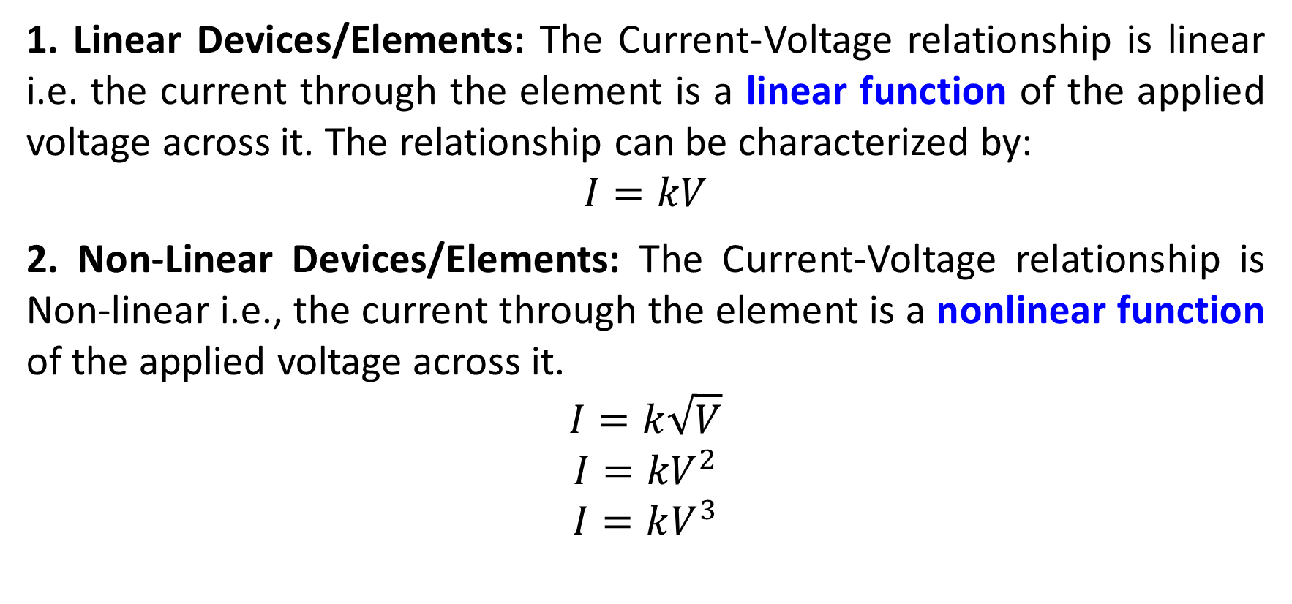
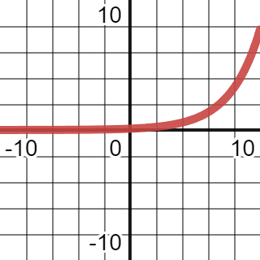
Type of (I-V) Characteristics

Slide 4
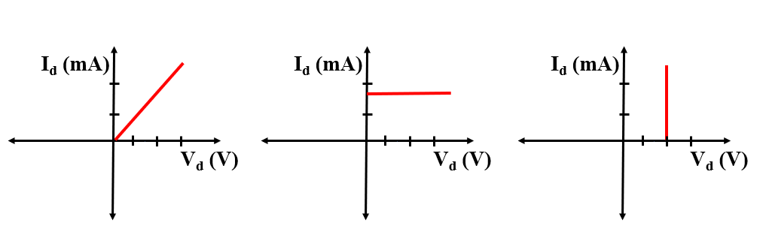
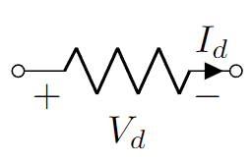
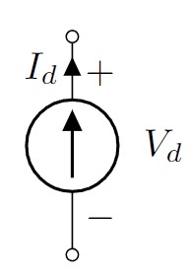
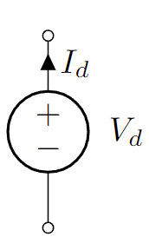
Linear IV Char.
Resistors
Current Source
Voltage Source

Slide 5
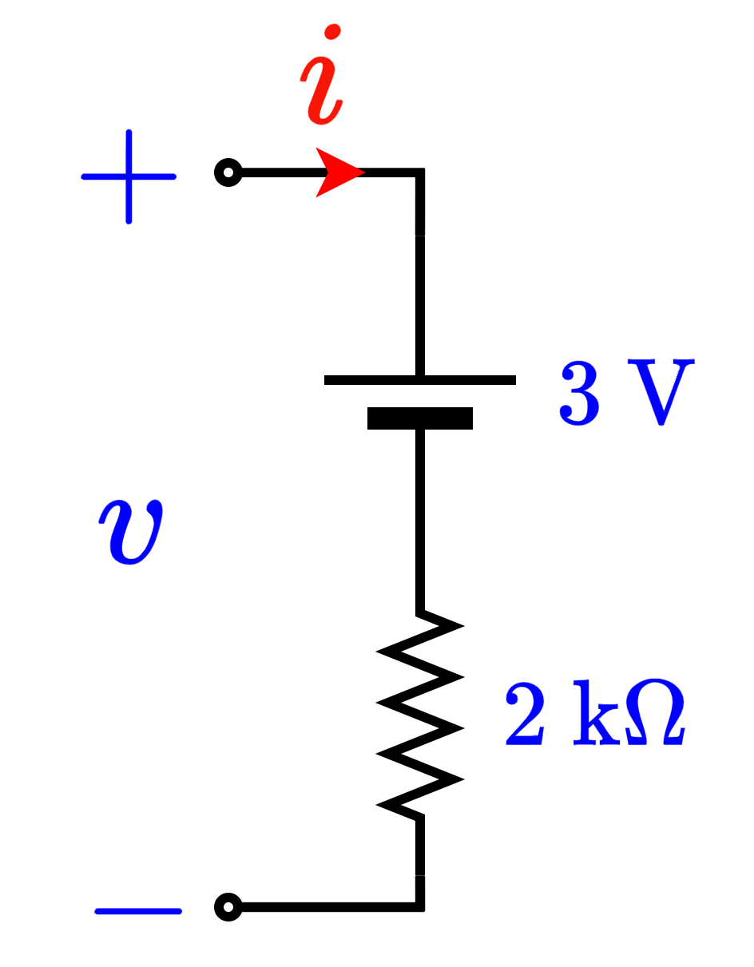
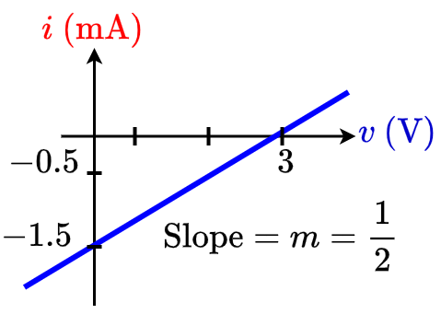
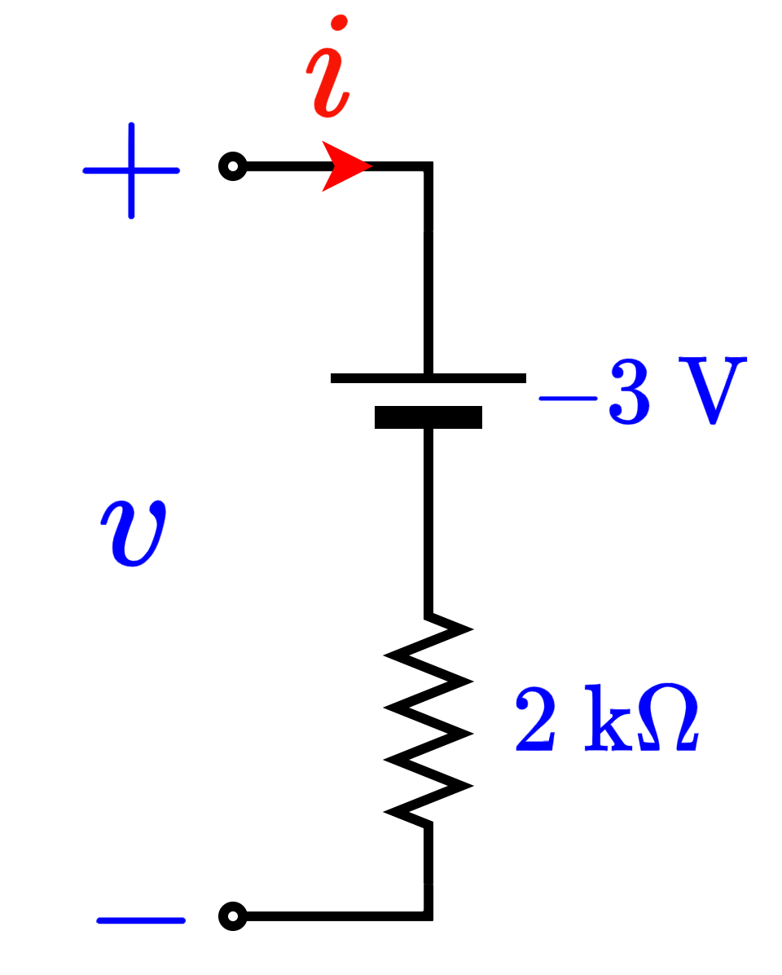
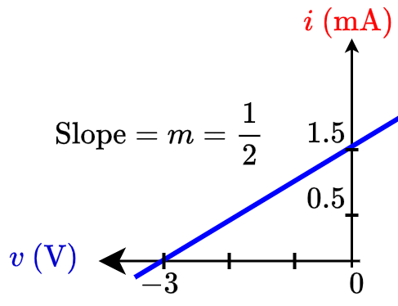
Linear IV Char.
Voltage source in series with a resistor
Voltage source in series with a resistor

Slide 6
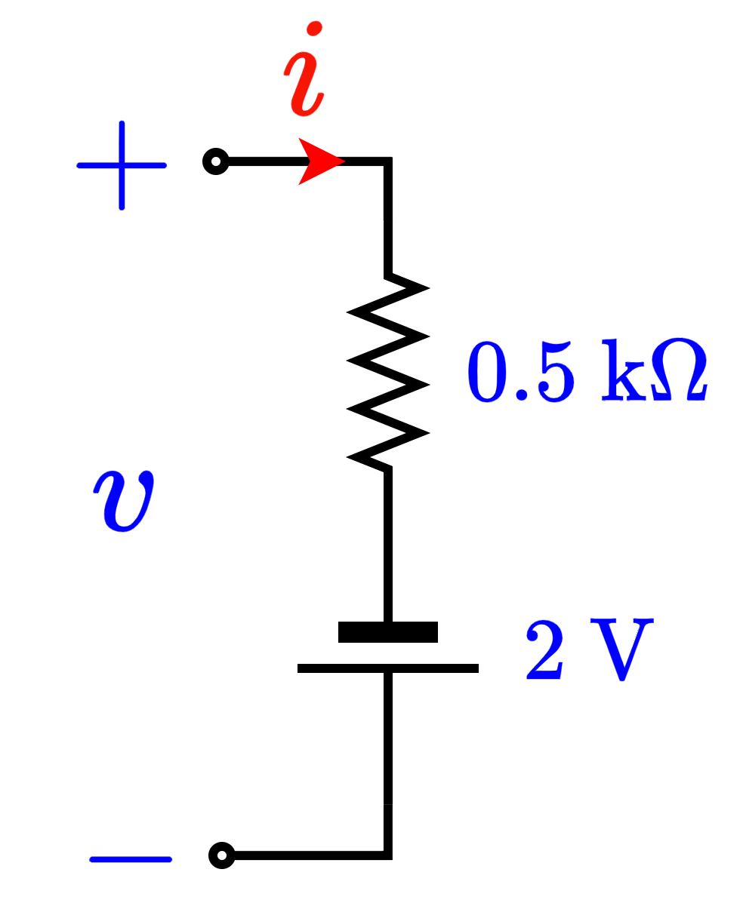
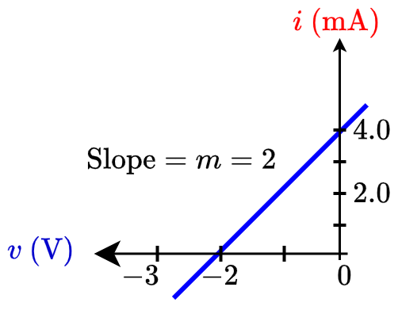
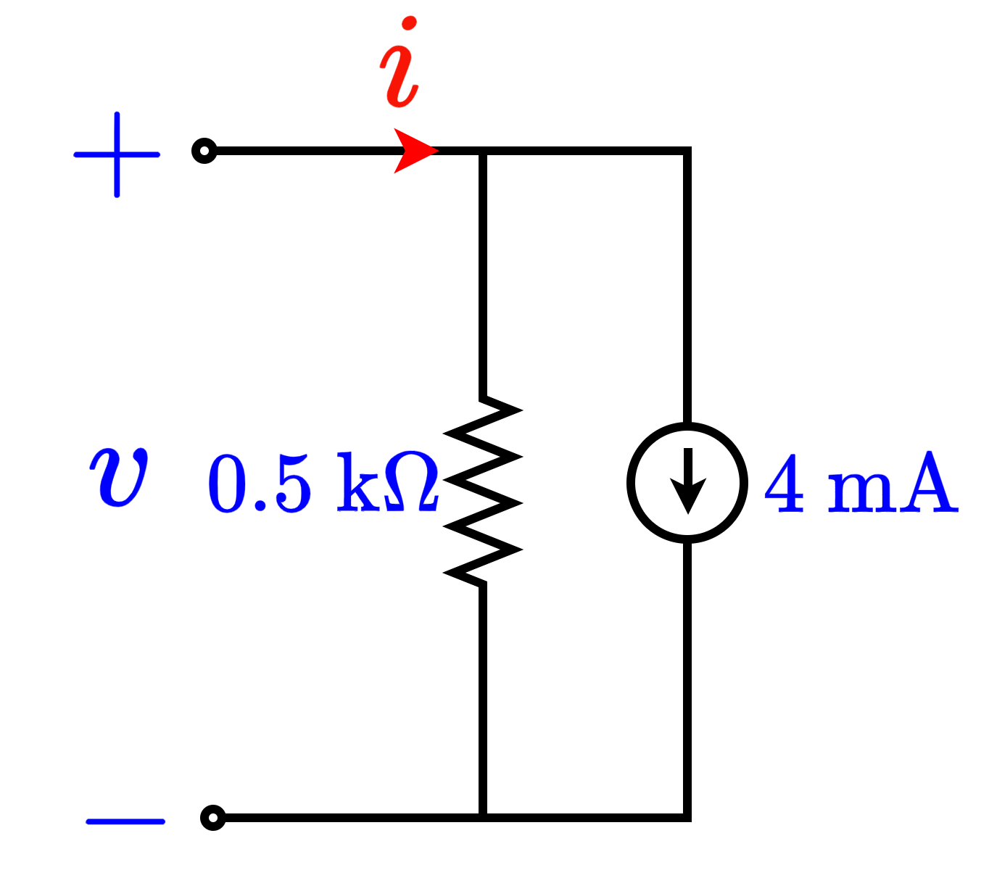
Linear IV Char.
Voltage source in series with a resistor
Current source parallel to a resistor

Slide 7
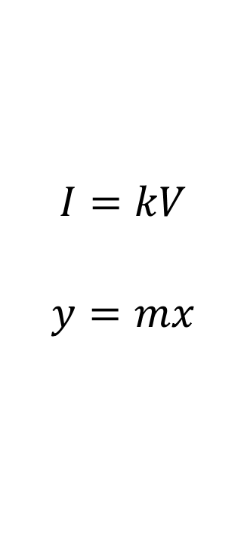
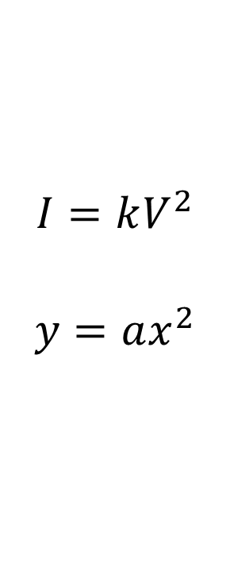
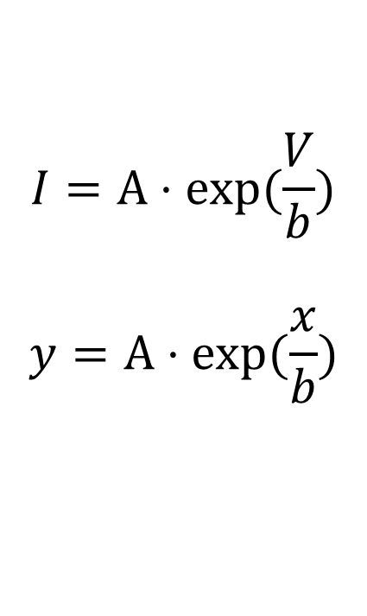
Non-Linear I-V Char.

Slide 8
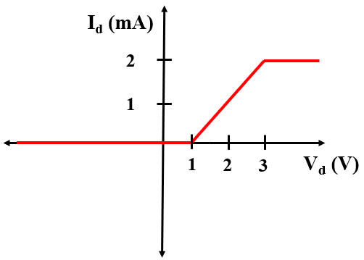
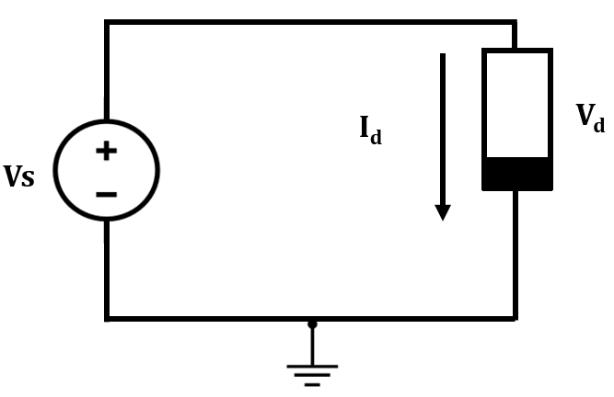
Non-Linear I-V Char.
Example:
Piecewise linear function is a Non-linear function.

Slide 9
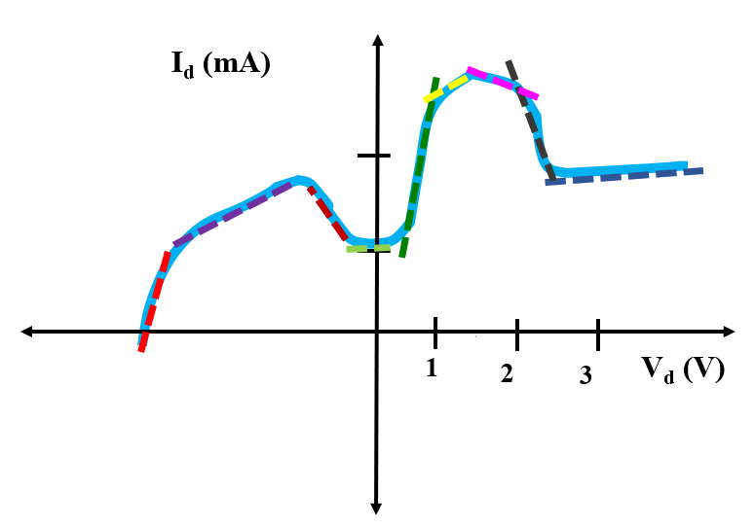
Non-Linear I-V Char.: Piecewise Linear Model
Simplifying non-linear IV characteristics by piecewise linear parts.
Non-linear functions are usually approximated by a series of linear segments that follow the tangent of the non-linear segment as can be seen from the following figure.

Slide 10
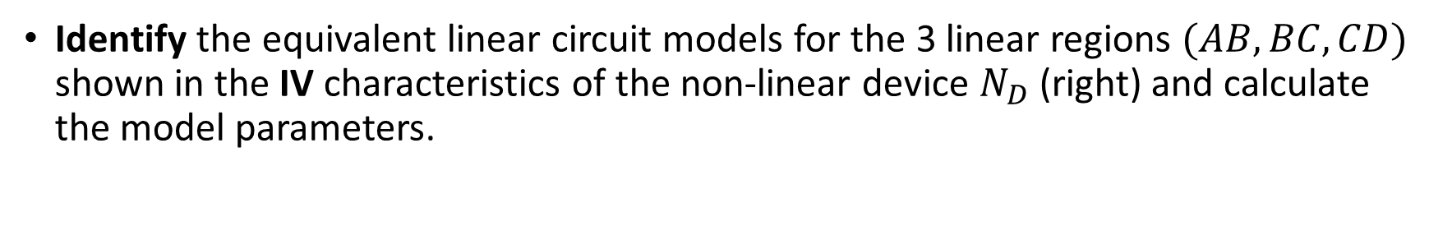
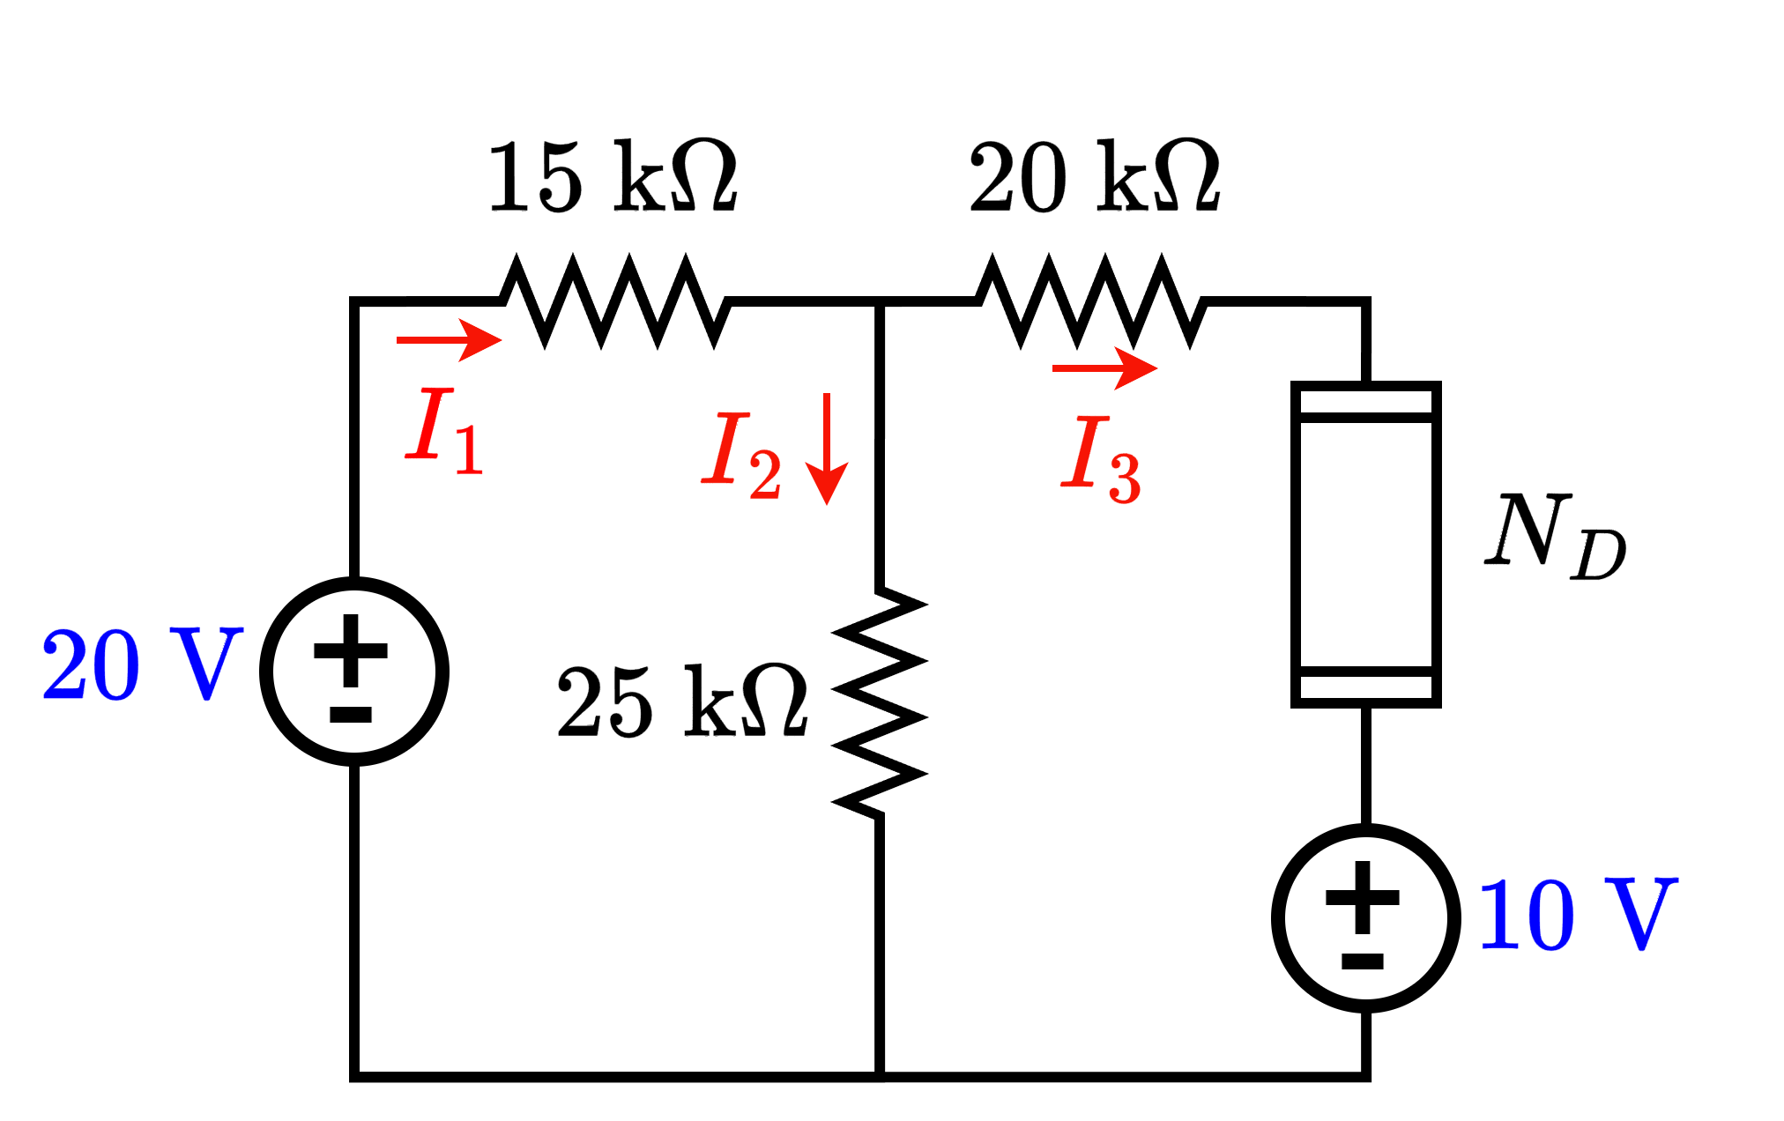
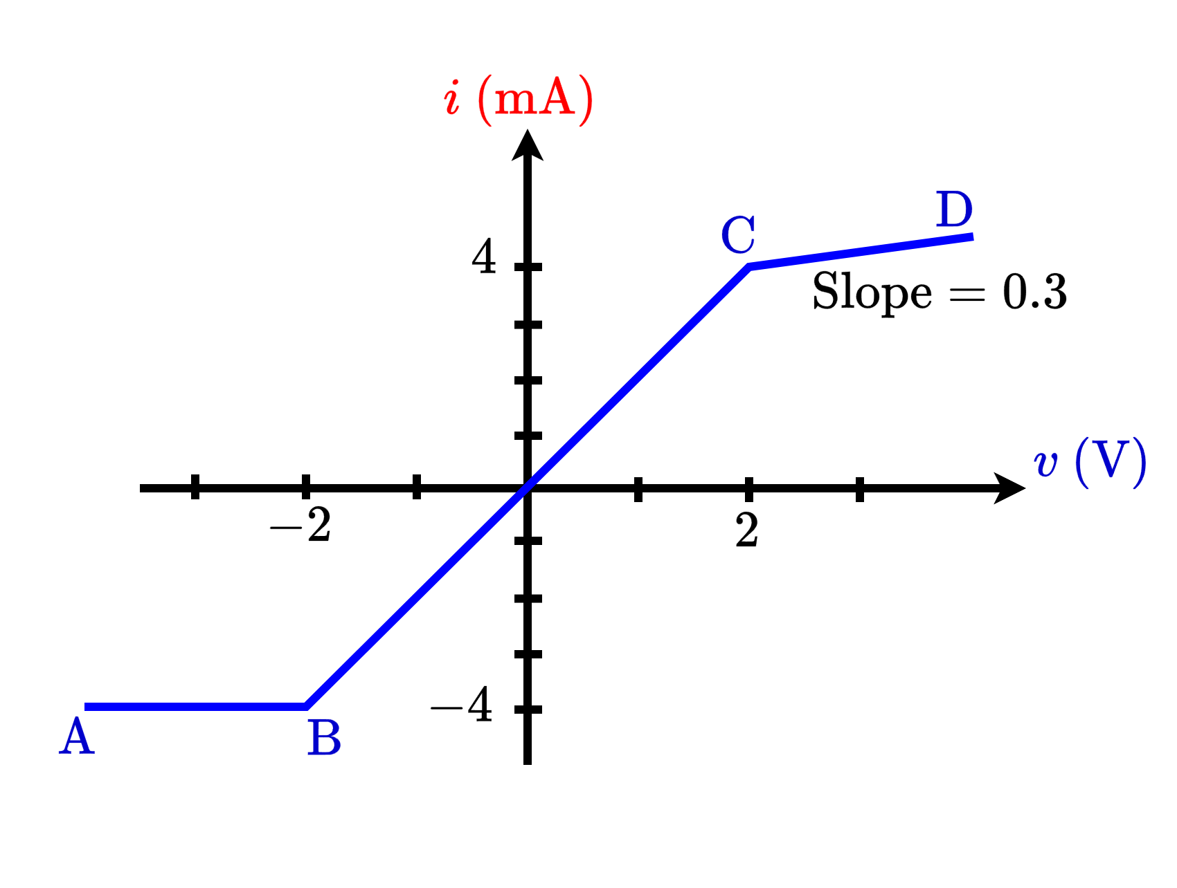
NL I-V Char.: PL Model Example 1

Slide 11
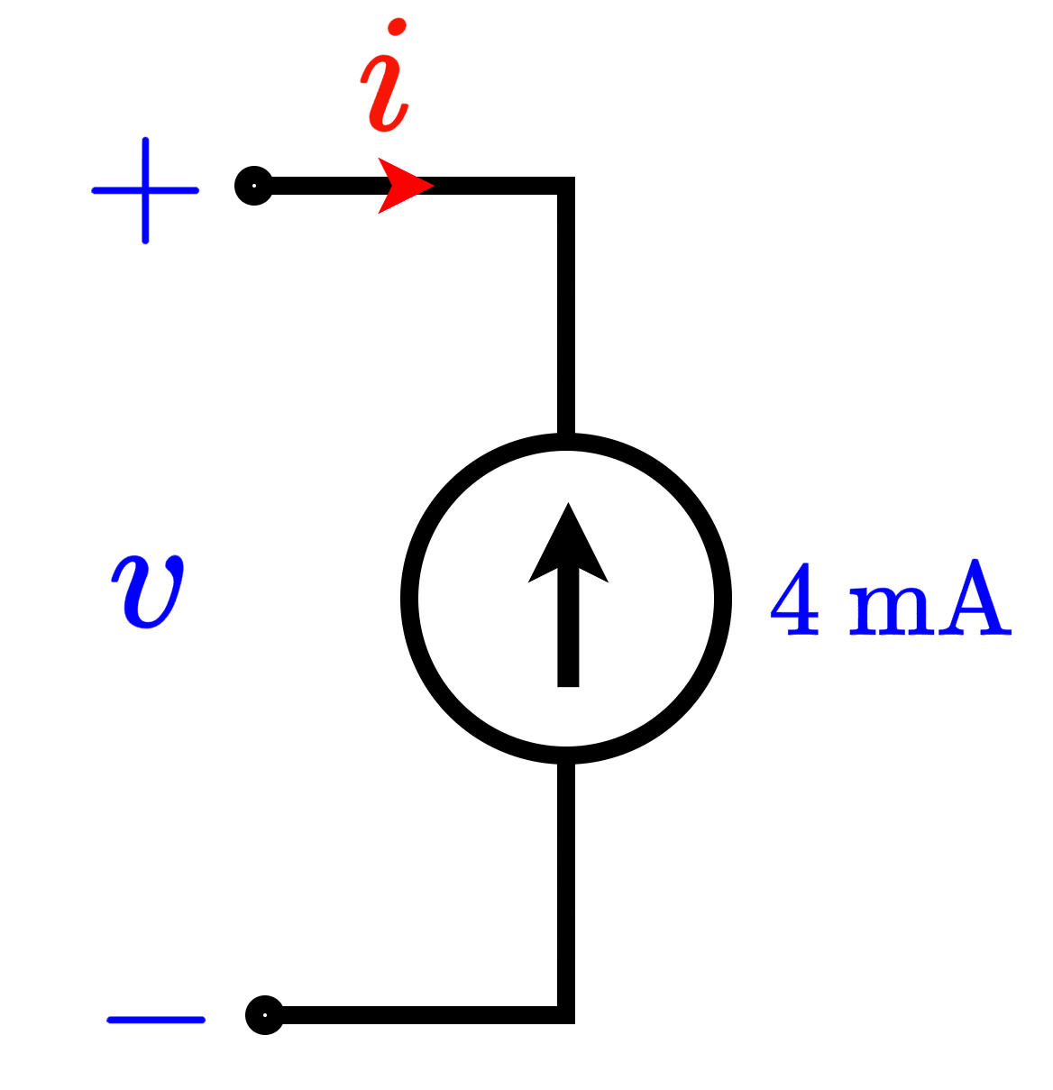
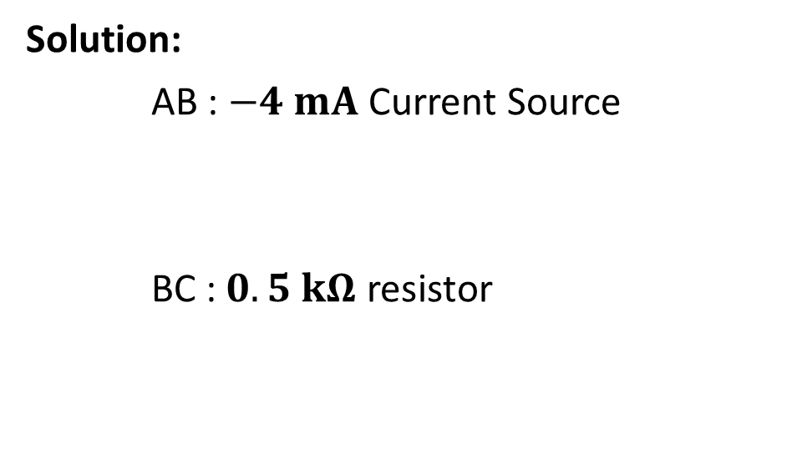
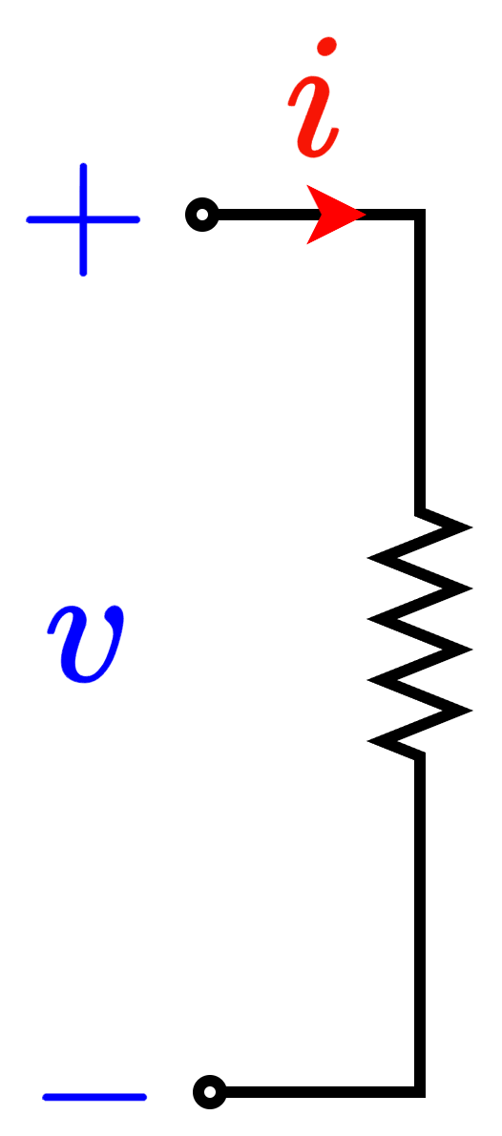
NL I-V Char.: PL Model Example 1

Slide 12
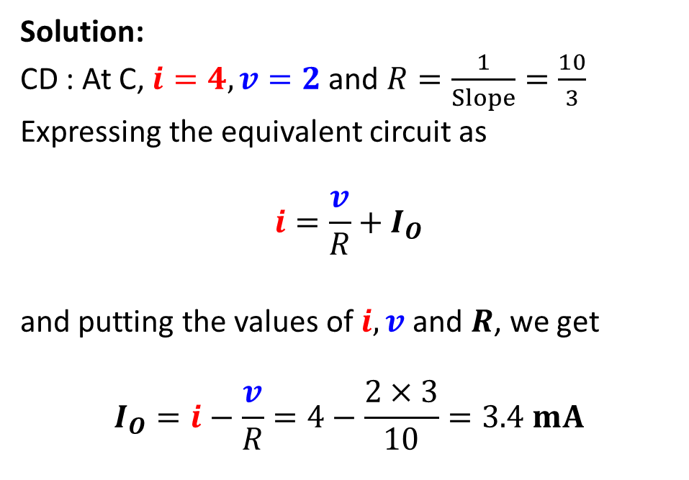
NL I-V Char.: PL Model Example 1

Slide 13

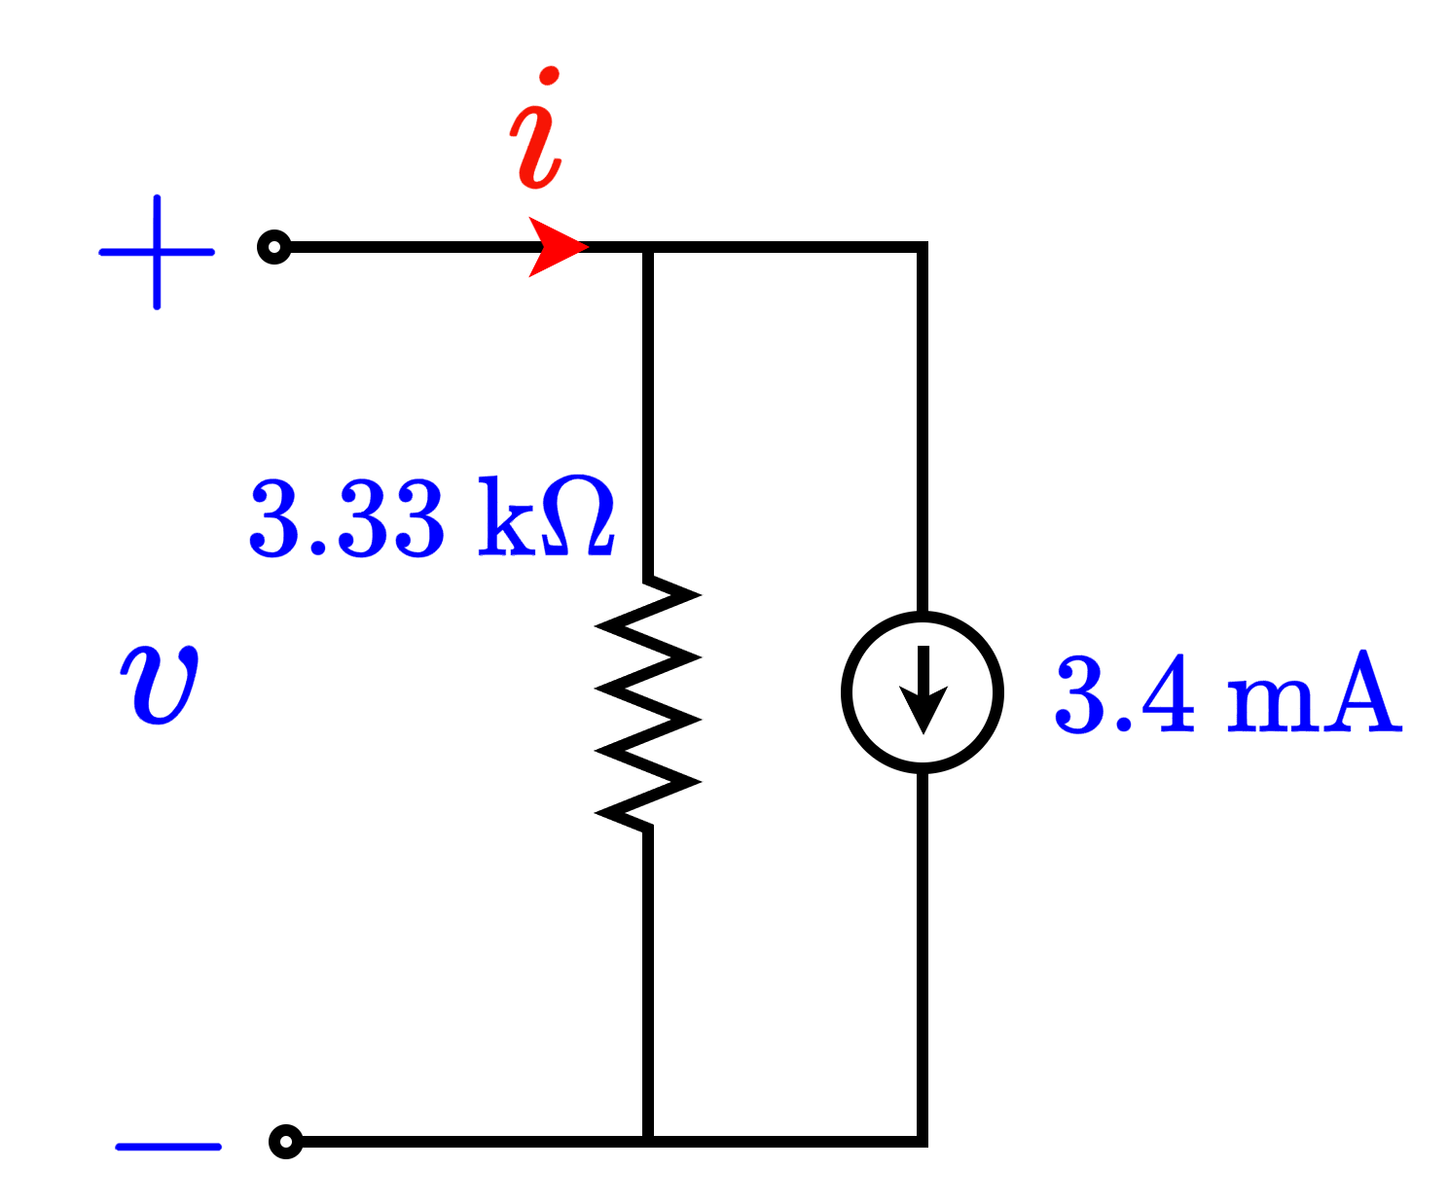
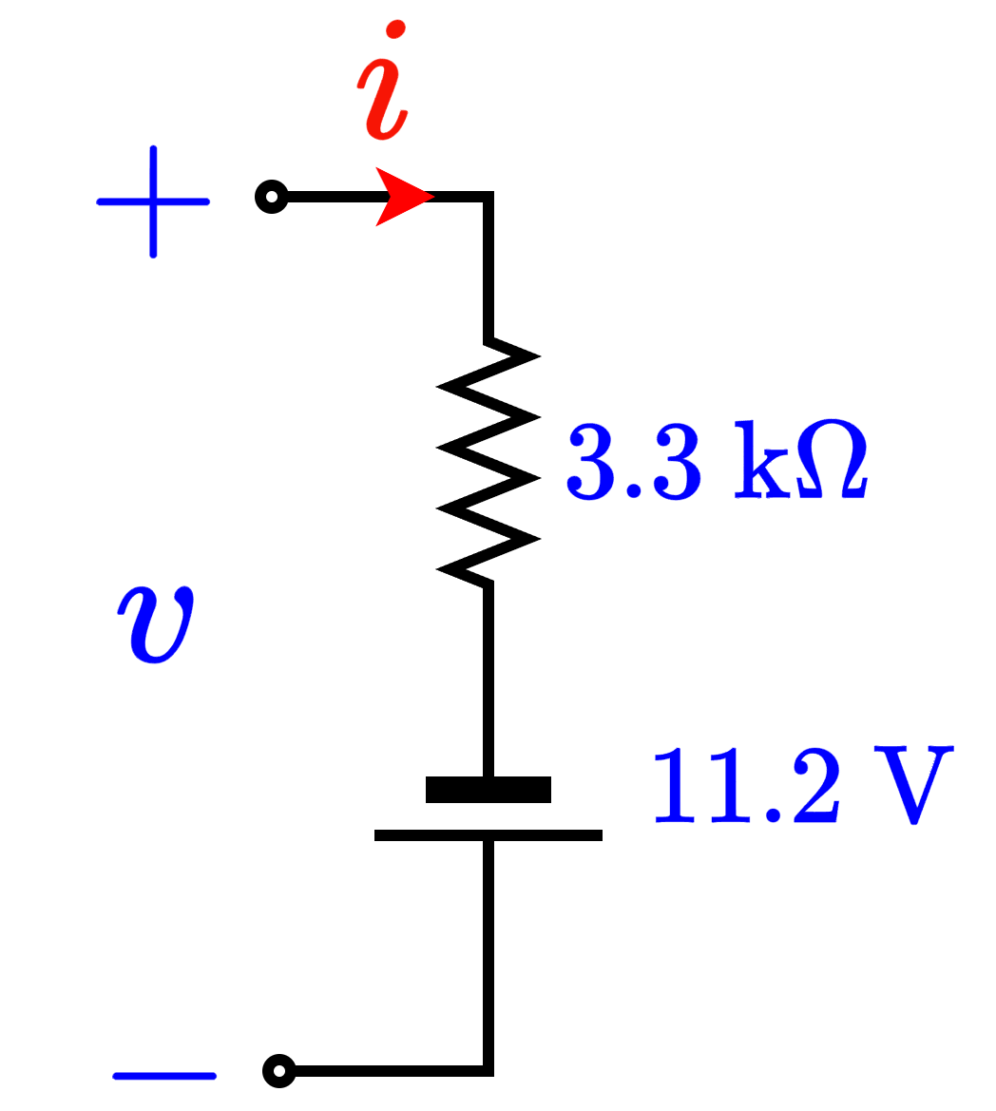
NL I-V Char.: PL Model Example 1

Slide 14

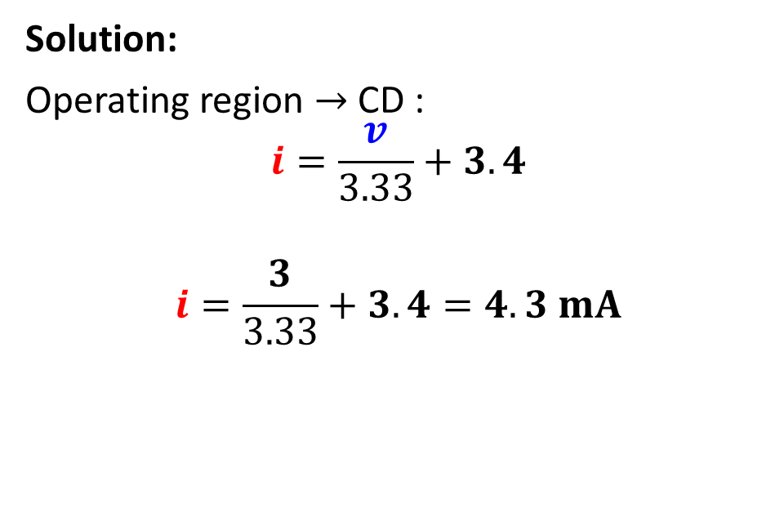
NL I-V Char.: PL Model Example 2

Slide 15

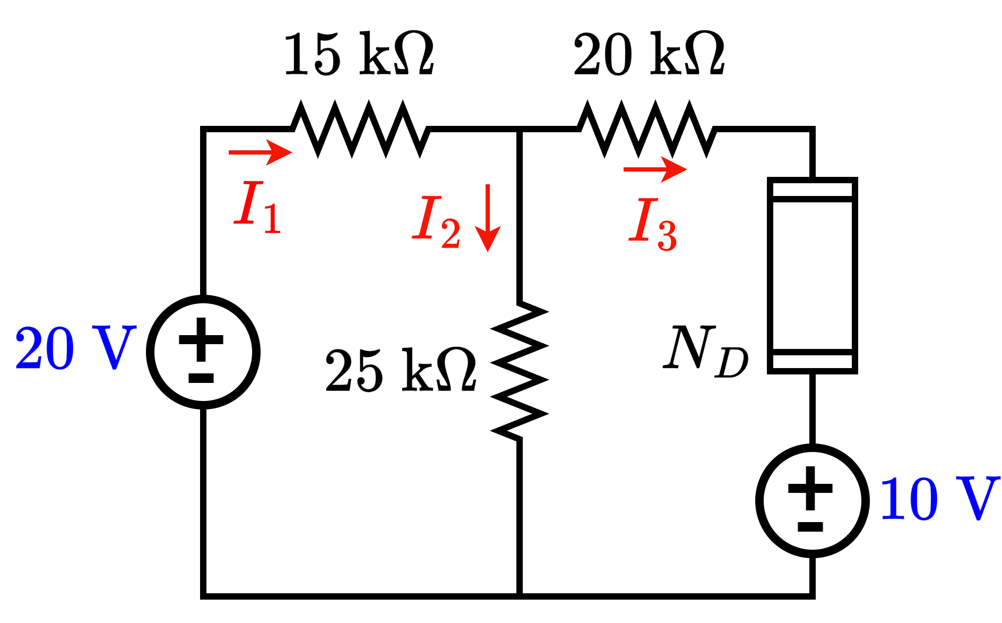
NL I-V Char.: PL Model Example 3

Slide 16
Solving Circuits with Non-Linear elements
Use Method of Assumed State!
Three steps:
Assume: One of the operating modes (AB, BC, CD)
Solve: Use corresponding equation with any circuit analysis tool
Verify: Check if the conditions of the NL device are satisfied. If not, repeat.

Slide 17
NL I-V Char.: PL Model Example 3

Slide 18
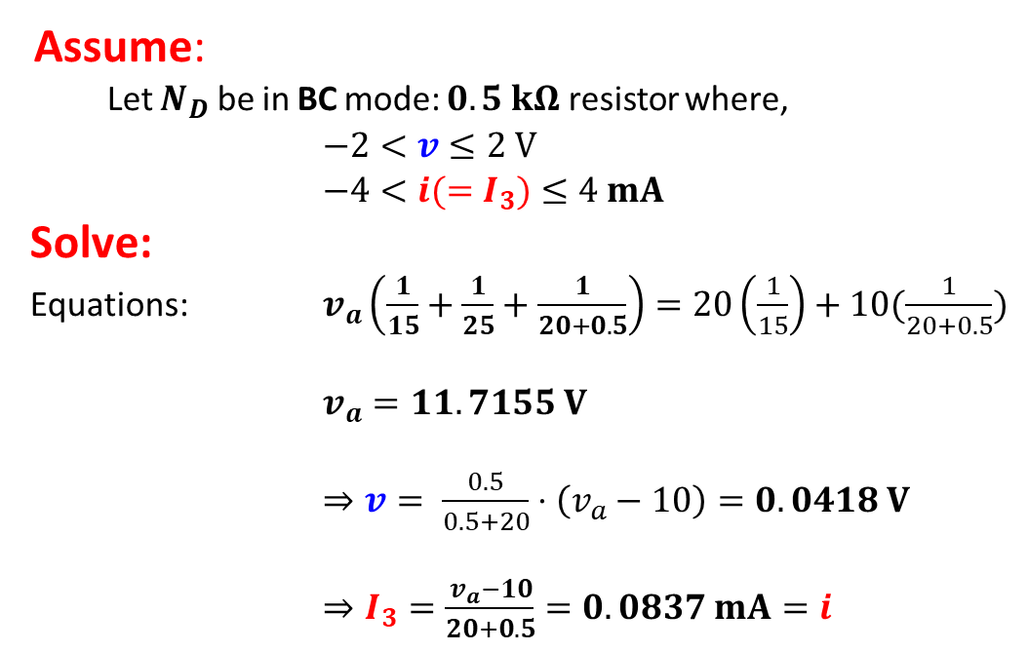

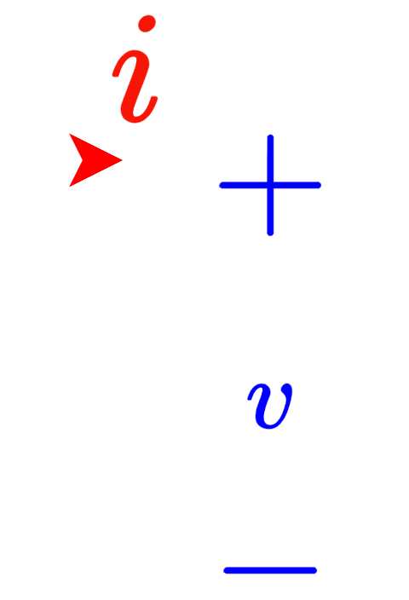
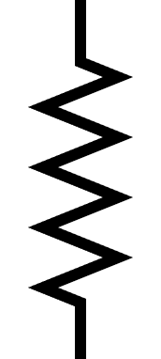

Method of Assumed State: Example 3

Slide 19
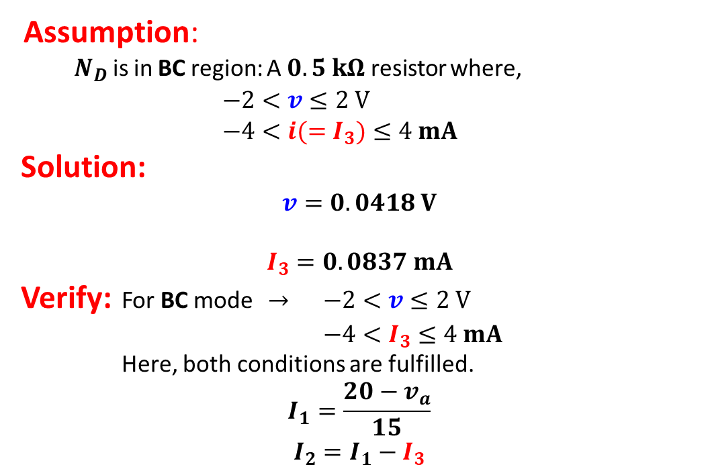

Method of Assumed State: Example 3
Assumption is Correct!

Slide 20
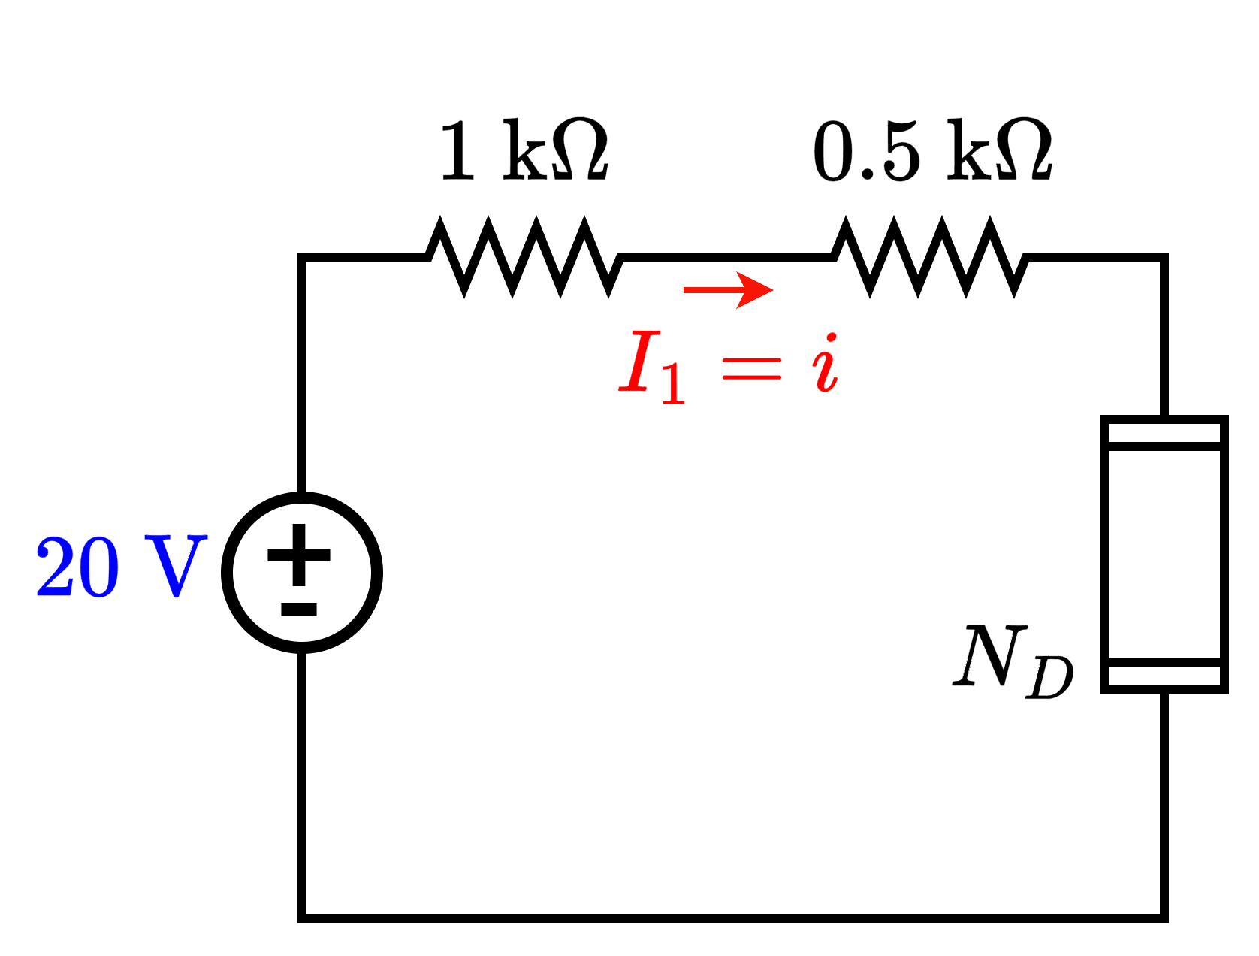
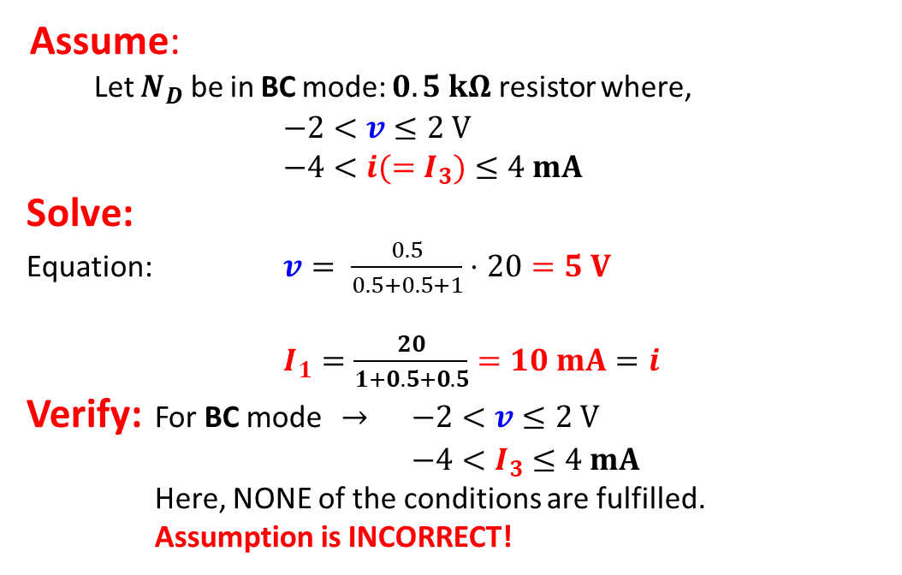


Method of Assumed State: Example 4

Slide 21
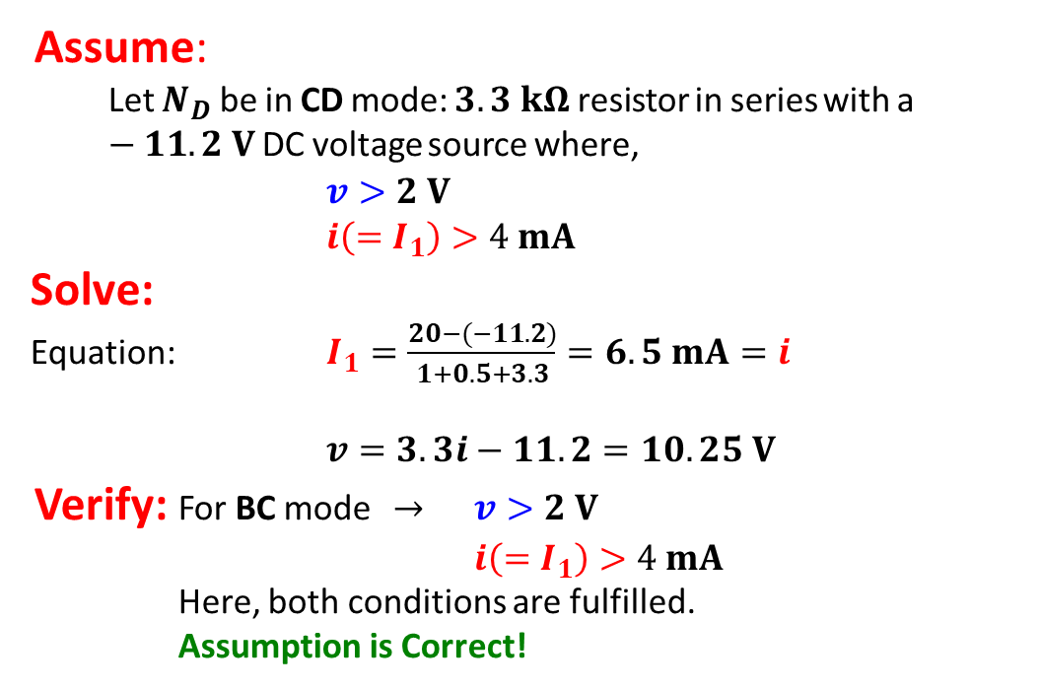
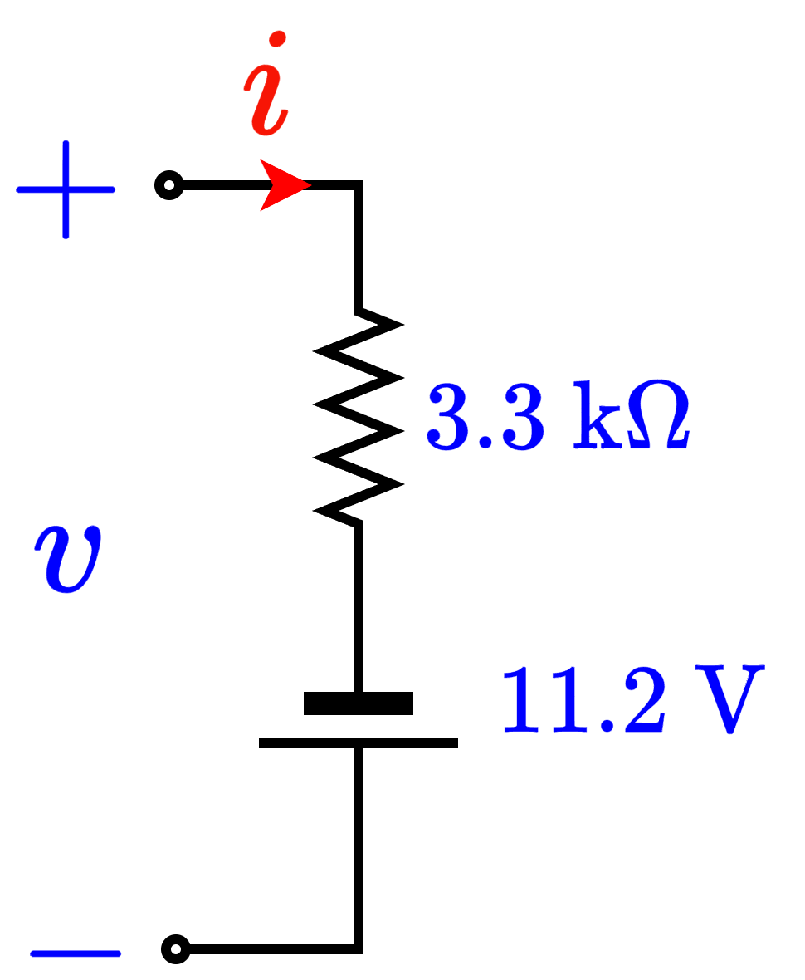
Method of Assumed State: Example 4

Slide 22
Part 1 ends here

Slide 23
Outline
Semiconductor Materials
n-type
p-type
Semiconductor Devices: pn junction Diode
Physical Characteristics
Modes of Operation

Slide 24
Semiconductor Materials
Semiconductors are special class of materials (as opposed to conductors and insulators) that fall between conductors and insulators in terms of their electrical conductivity.
By making simple material changes, such as doping, these materials can achieve remarkably precise control over electron flow.
This ability to control electron flow makes semiconductors the optimal candidate for building non-linear electrical devices, where electron (current) flow is not always just proportional to the applied voltage.
As these non-linear devices offer exceptional control over electron flow, the class of devices and circuits are branched under the umbrella term “Electronics”

Slide 25
Semiconductor Materials
What is doping?
Doping is to deliberately inject atomic level “impurities” into a material (such as an “intrinsic” or pure semiconductor such as Silicon. These atoms are called dopants.
Usually, the concentration of the “dopant” atoms is much less than the actual concentration of the host material.
Since the atoms being injected are different from the actual material atom, they are considered impurities. A doped semiconductor is also known as “Extrinsic” semiconductor.

Slide 26
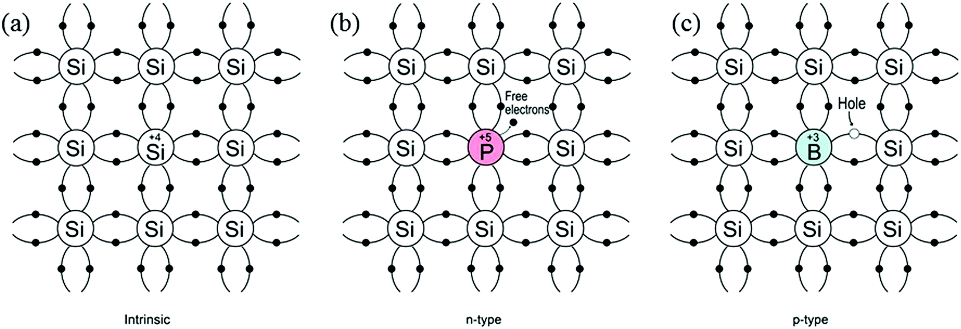
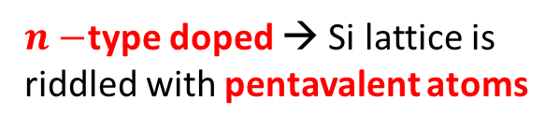
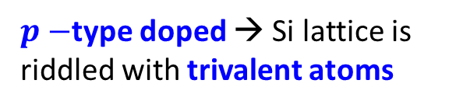
Semiconductor Materials

Slide 27
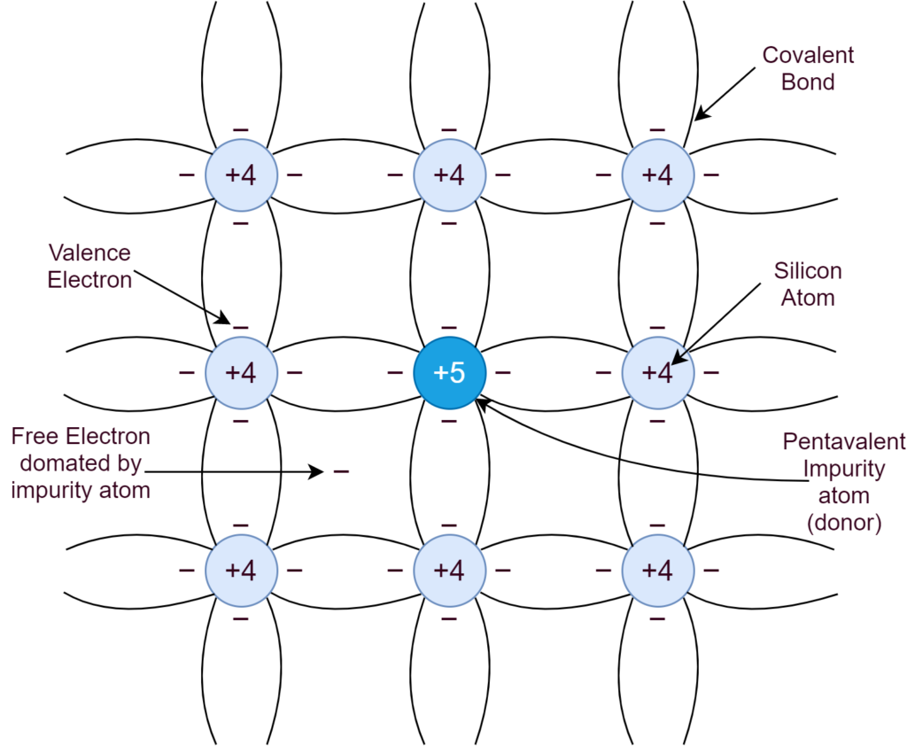
n-type doping
n-type materials are doped with pentavalent atoms.
Pentavalent atoms have one more electron than the surrounding tetravalent Si atoms.
This lone extra electron acts as a mobile electron that can flow easily as it is not bonded to any atom.

Slide 28
p-type doping
p-type materials are doped with trivalent atoms.
Trivalent atoms have one less electron than the surrounding tetravalent Si atoms.
This absence of an electron (termed as a hole) acts as can flow easily from atom to atom across the material as it is not bonded to any atom. The flow of holes is opposite to the actual flow of electrons.

Slide 29
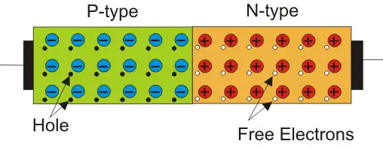
Semiconductor Devices: Diode
Diode is the most basic semiconductor device.
It is made by doping an intrinsic semiconductor (Si) half as p-type and the other half as n-type.

Slide 30
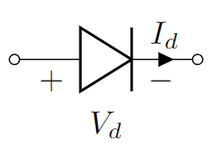
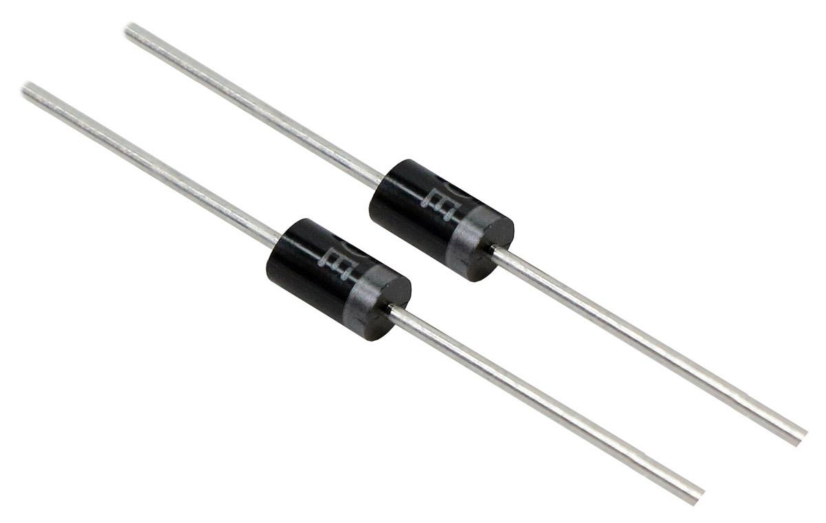
The pn junction diode: Physical characteristics
Internal Structure
Circuit Schematic
Real device image
Anode
Cathode

Slide 31
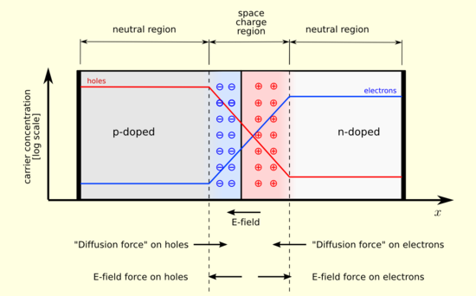
The pn junction diode: Physical characteristics
The depletion region:
This is the region in a pn-junction device sandwiched between the n-doped and p-doped regions.
In n-doped region, mobile electrons dominate charge flow. In p-type, holes dominate.
In a pn-junction depletion regions form naturally, as charge carriers (holes in p-type and electrons in n-type) near the pn junction boundary seep into each other.

Slide 32
The pn junction diode: Physical characteristics
The depletion region:
In a pn-junction depletion regions form naturally, as charge carriers (holes in p-type and electrons in n-type) near the pn junction boundary seep into each other.
Electrons from n-type region flow into p-type region while holes flow into n-type region from p-type region.
This mutual overflow into the opposite region, creates a space charge barrier, (like that in a capacitor).

Slide 33
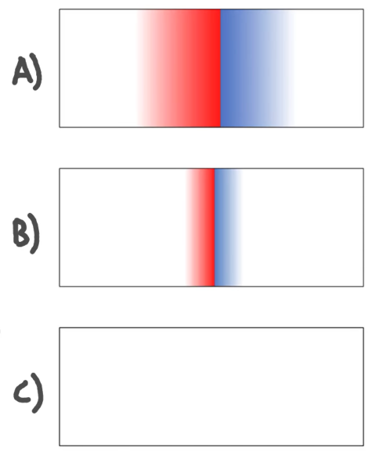
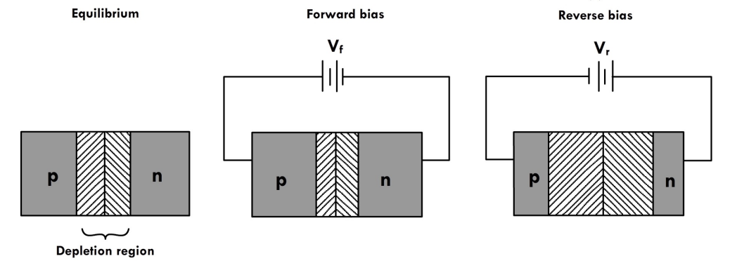
The pn junction diode: Modes of operation
P
n
Reverse Bias
No Bias
Forward Bias
P
n
P
n
Depletion Region

Slide 34
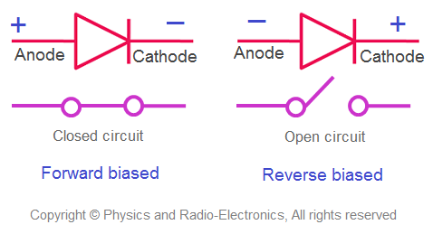
The pn junction diode: 2 Modes of operation
Forward Bias (FB):
Depletion Region is constricted.
Allow electrons to flow through the junction
Ideally acts as a short circuit
Reverse Bias (RB):
Depletion Region is expanded.
Bars / does not allow electron flow through the junction.
Ideally acts as an open circuit

Slide 35
Part 2 ends here

Slide 36
Outline
pn junction Diode IV Characteristics: Circuit Model
Ideal Diode Model:
Constant Voltage Drop (CVD) Model:
Constant Voltage Drop with Resistor (CVD+R) Model
Exponential Model (Shockley Model):
Examples: 6

Slide 37
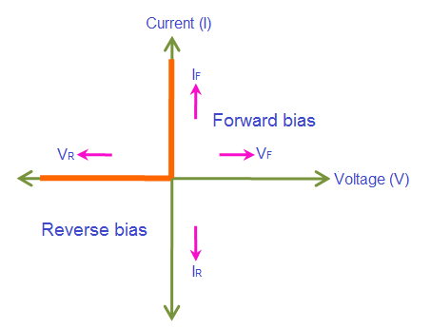

Diode Circuit Models
Ideal Versus Real Diode
Constant Voltage Drop (CVD) Model
Ideal Model
Real / Shockley Model
Low Accuracy
Increased Accuracy
CVD with resistance (CVD+R) Model
Simple
More Complex

Slide 38


Diode Circuit Models
}
Ideal Diode Model:
Constant Voltage Drop (CVD) Model:
Constant Voltage Drop with Resistor (CVD+R) Model
Exponential Model (Shockley Model):
Piecewise Linear IV Models

Slide 39






Diode Models
Ideal Diode Model:
Forward Bias
Reverse Bias

Slide 40
Solving Circuits with Diodes
Use Method of Assumed State!
Three steps:
Assume: One of the two operating modes (Forward Biased – FB or Reverse Biased - RB) *Correct assumptions will make solving circuit easier.
Solve: Use corresponding equation and KCL/KVL or any circuit analysis tool of your choice.
Verify: Check if the conditions of the diodes in the chosen region (FB or RB) are satisfied. If not, one can be sure that the other operating mode is correct.

Slide 41








Example Problems (Ideal Diode)

Slide 42









Example Problems (Ideal Diode)

Slide 43





Example Problems (Ideal Diode)

Slide 44









Diode Models
2. Constant Voltage Drop (CVD) Model:
Reverse Bias
Forward Bias

Slide 45




Diode Models
2. Constant Voltage Drop (CVD) Model:
Reverse Bias
Forward Bias

Slide 46




Example Problems (CVD Diode)

Slide 47





Example Problems (CVD Diode)

Slide 48




Example Problems (Ideal Diode)

Slide 49







Diode Models
3. CVD+R Model:
Reverse Bias
Forward Bias

Slide 50






Diode Models
3. CVD+R Model:
Reverse Bias
Forward Bias

Slide 51



Example Problems (CVD+R Diode)

Slide 52




Example Problems (CVD+R Diode)

Slide 53






Diode Models
3. CVD+R Model:
Forward Bias
Reverse Bias

Slide 54




Diode Models
4. Shockley Diode Equation Model:
Where I_{S} is reverse saturation current

Slide 55



Diode Models: Summary
Ideal Diode
CVD Diode
Forward Bias
Reverse Bias

Slide 56



Diode Models: Summary
CVD+R Diode
Forward Bias
Reverse Bias

Slide 57
Part 3 ends here

Slide 58
Outline
Practice Problems

Slide 59


Solving Circuits with diodes (7)

Slide 60

Solving Circuits with diodes (7)

Slide 61

Solving Circuits with diodes (9)

Slide 62




Solving Circuits with diodes (9)

Slide 63



Solving Circuits with diodes (9)

Slide 64

Solving Circuits with diodes (10)

Slide 65




Solving Circuits with diodes (11)

Slide 66


Solving Circuits with diodes (12)

Slide 67
Solving Circuits with diodes (12)

Slide 68

Solving Circuits with diodes (12)
X

Slide 69


Solving Circuits with diodes (13)

Slide 70


Solving Circuits with diodes (14)

Slide 71


Solving Circuits with diodes (15)

Slide 72

Solving Circuits with diodes (16)

Slide 73
Thank You!

