Slide 1
Outline
Diode Models and IV Characteristics: Review
Diode Logic OR operation
Diode Logic AND operation

Slide 2
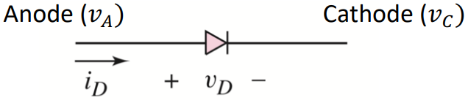
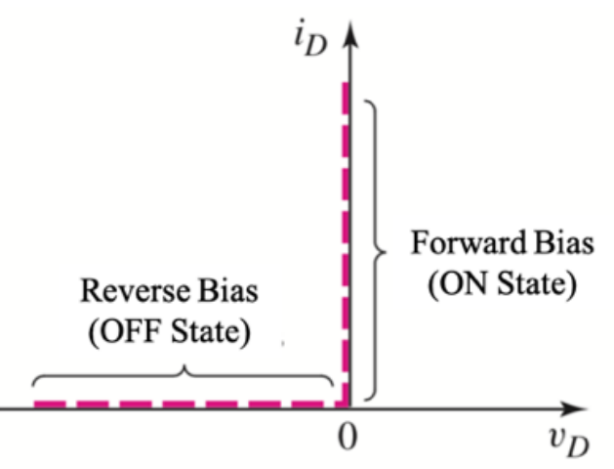
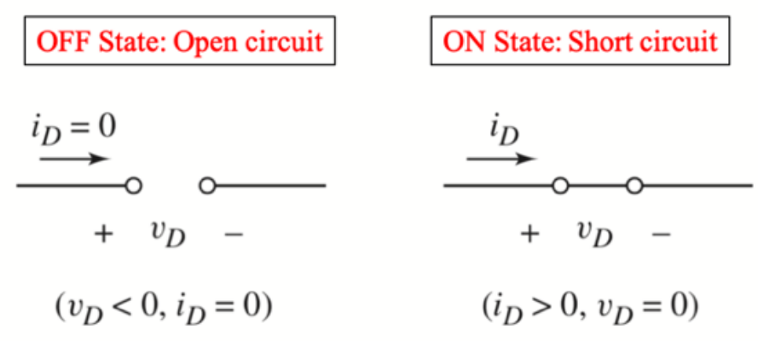
Review: Ideal Diode Model
From Microelectronics: Circuit Analysis and Design by Donald A. Neamen: Chapter 2. 4th edition. Published by the McGraw-Hill Companies, Inc. Used for educational purposes only.

Slide 3
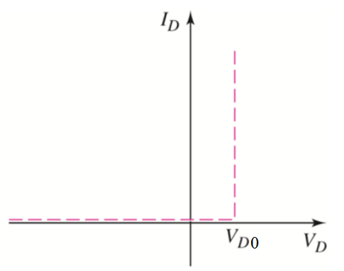
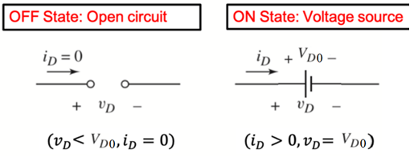
Modeling the real diode
1. Ideal diode model
2. Constant voltage drop (CVD) model
3. CVD+R model

Slide 4
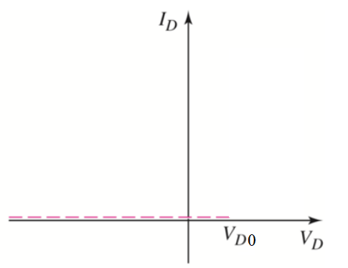
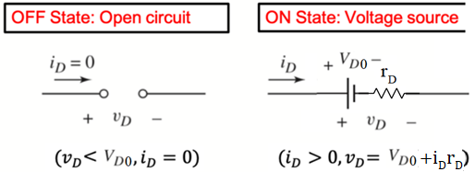
Modeling the real diode
1. Ideal diode model
2. Constant voltage drop (CVD) model
3. CVD+R model
1/slope = R

Slide 5
Digital Representation
Binary → Two states (0/False, 1/True)
Binary variables in circuit, need to use two states of device/parameters
Voltage |  | Current |  |  |  | State
5V 🡪 | 1 |  | 2mA | 🡪 | 1 | ON 🡪 | 1
0V 🡪 | 0 |  | 3mA | 🡪 | 0 | OFF 🡪 | 0
0V 🡪 1 3.3V 🡪 0 |  |  |  |  |  | Low resistance High resistance
Diode
Memristor
🡪 1
🡪 0

Slide 6
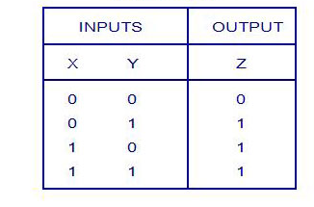
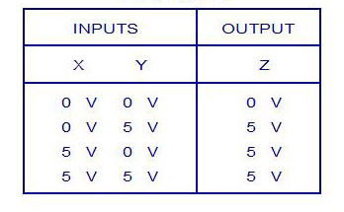
Logical Operations with Diode (OR)
Logic Truth Table
Voltage Truth Table
Low/False High/True
Logic Levels: 0 1
Corresponding voltage levels: 0V 5V

Slide 7
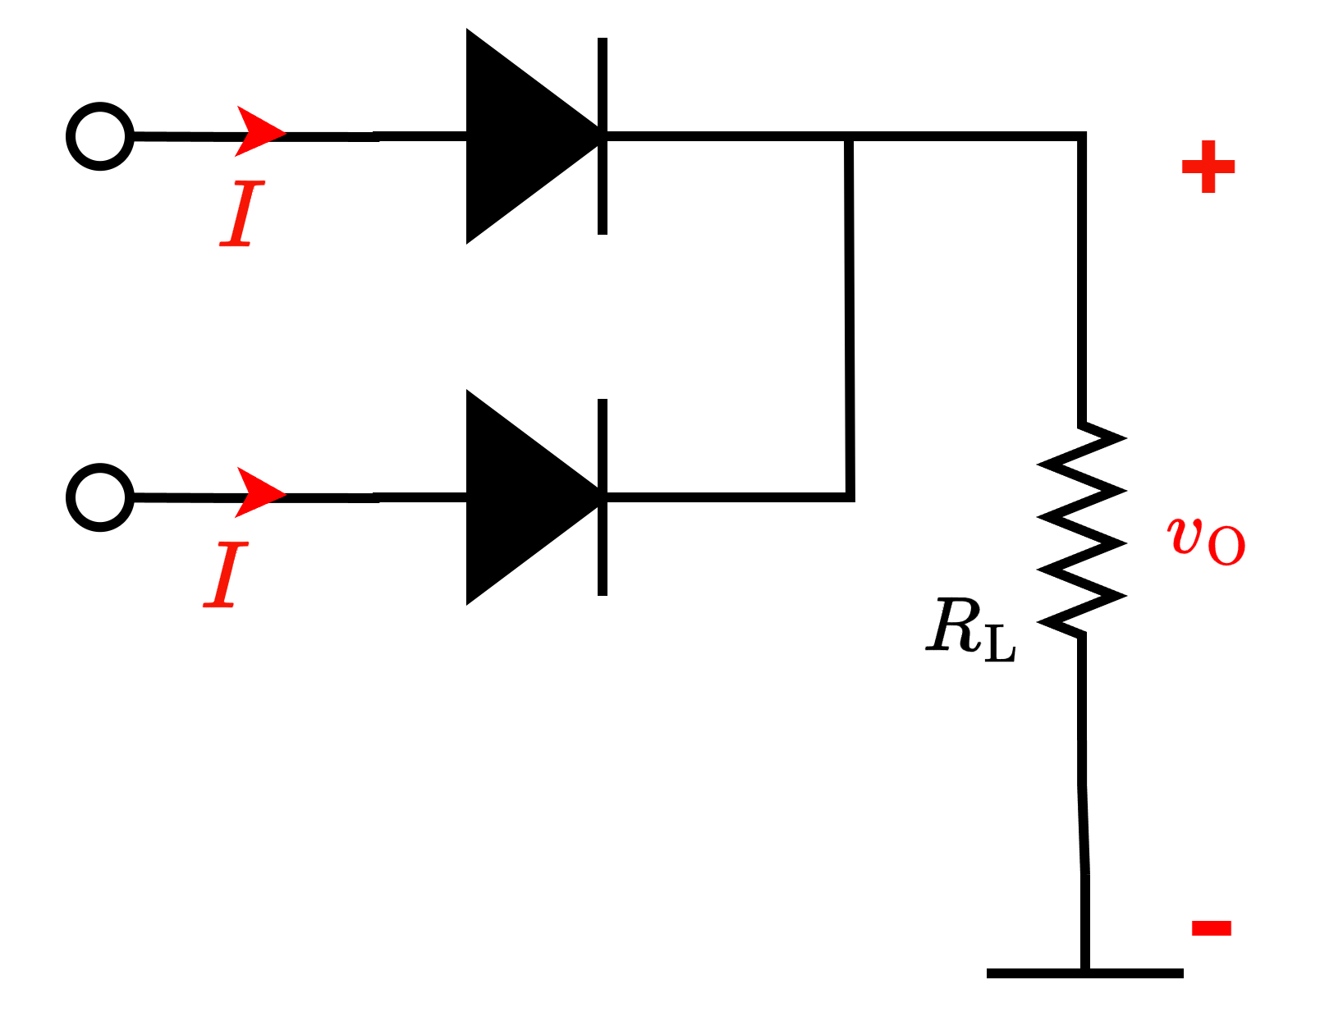

Logical Operations with Diode (OR)
Voltage Truth Table
X
Y
=Z

Slide 8
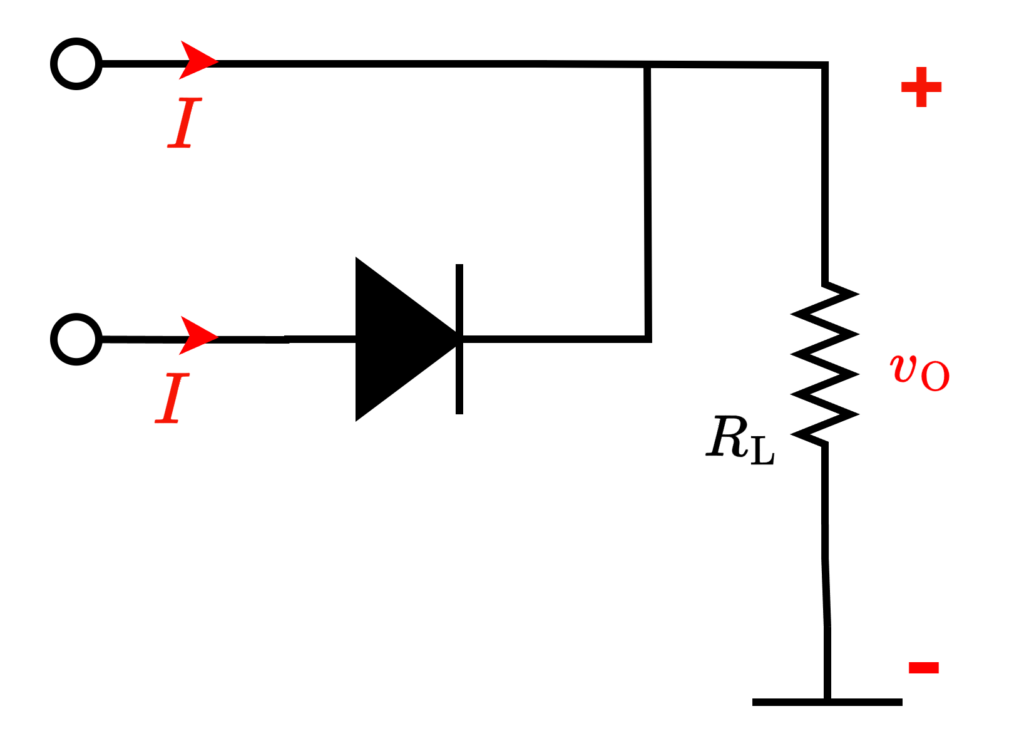
Logical Operations with Diode (OR)
Ideal diode
5 V
5 V
5 V
0 V
0 V
Z = 5 V

Slide 9
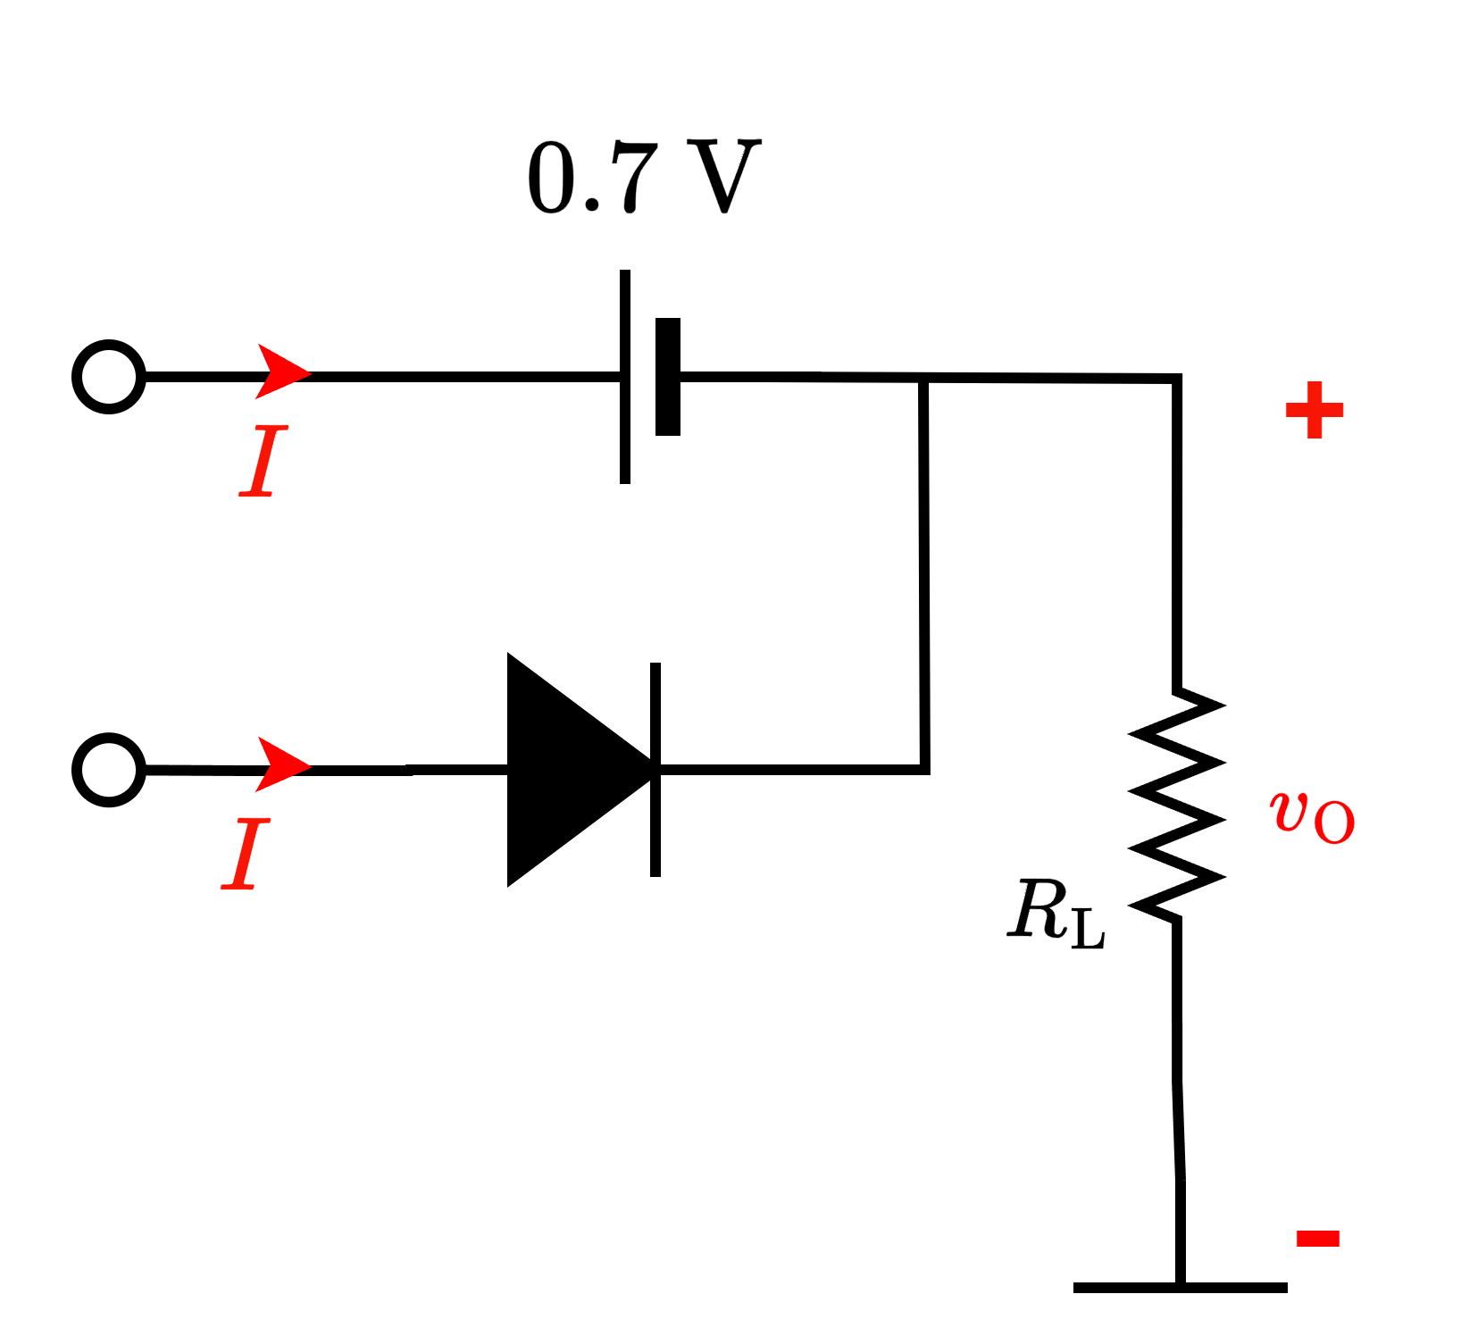
Logical Operations with Diode (OR)
CVD diode
4.3 V
5 V
5 V
0 V
0 V
Z = 4.3 V
Degraded 5 V

Slide 10
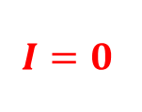
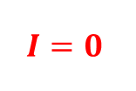
Logical Operations with Diode (OR)
Ideal diode
0 V
0 V
0 V
0 V
0 V
Z = 0 V

Slide 11
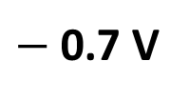
Logical Operations with Diode (OR)
CVD diode
0 V
0 V
0 V
0 V
Z = 0 V

Slide 12
Logical Operations with Diode (OR)
Ideal diode
5 V
5 V
5 V
5 V
5 V
Z = 5 V

Slide 13
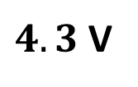
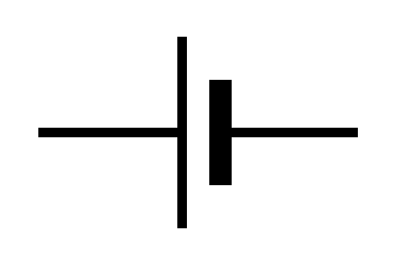
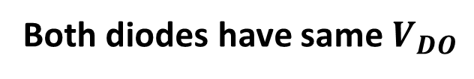
Logical Operations with Diode (OR)
CVD diode
5 V
5 V
5 V
5 V
0.7 V
Z = 4.3 V
Degraded 5 V

Slide 14
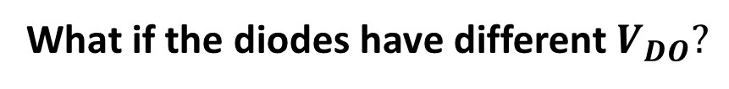

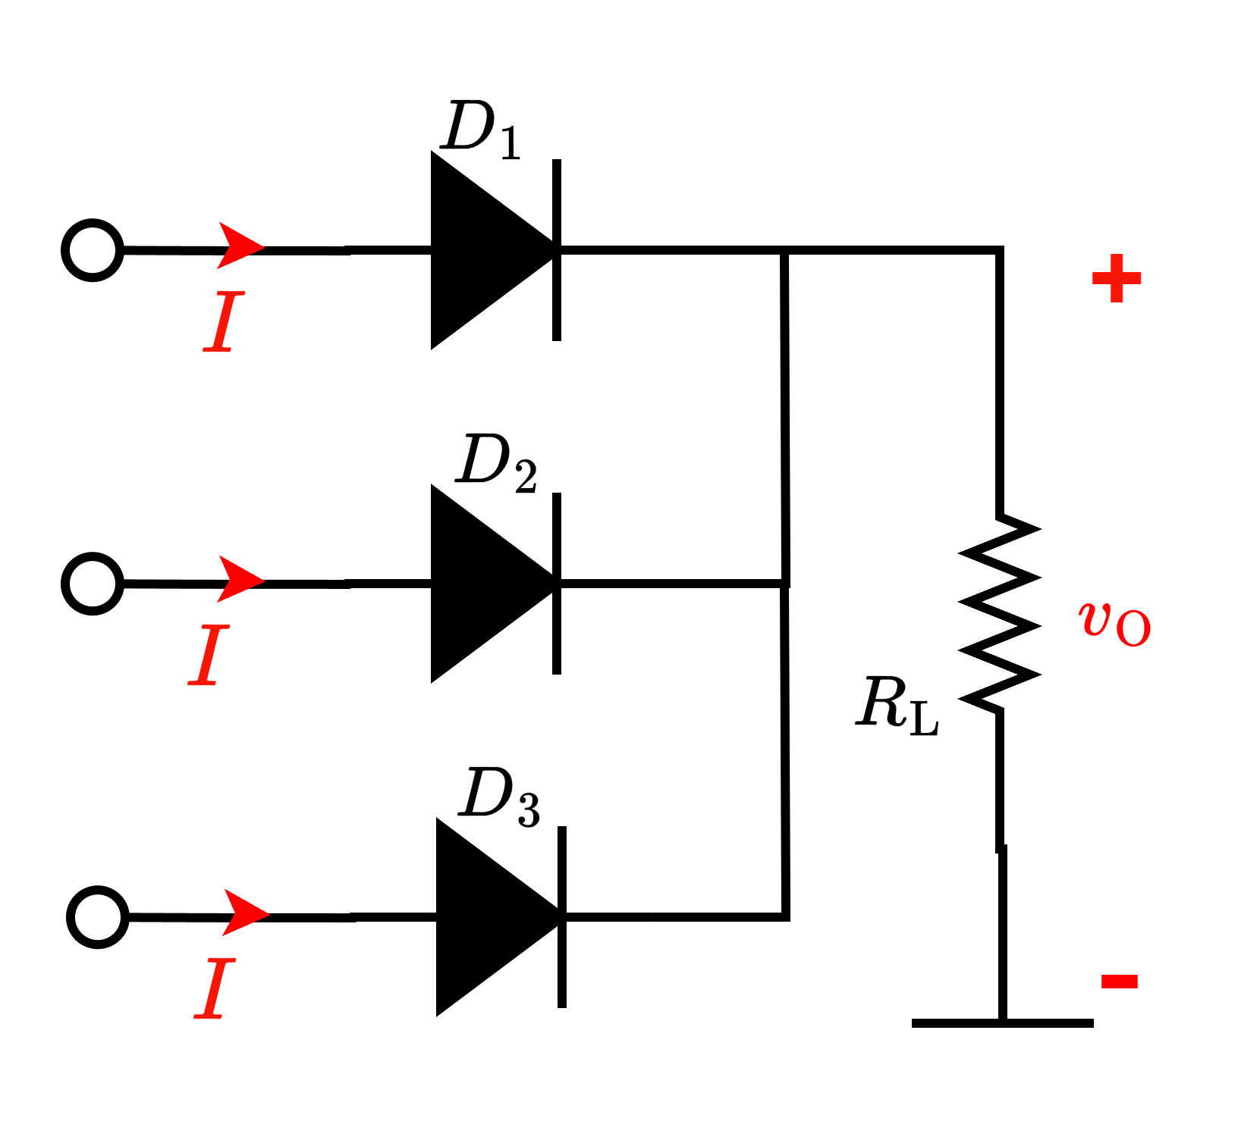
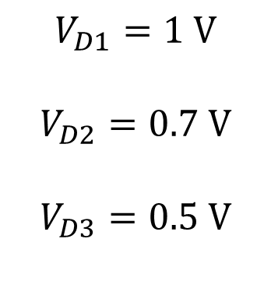
Logical Operations with Diode (OR)
CVD diode
5 V
5 V
5 V

Slide 15


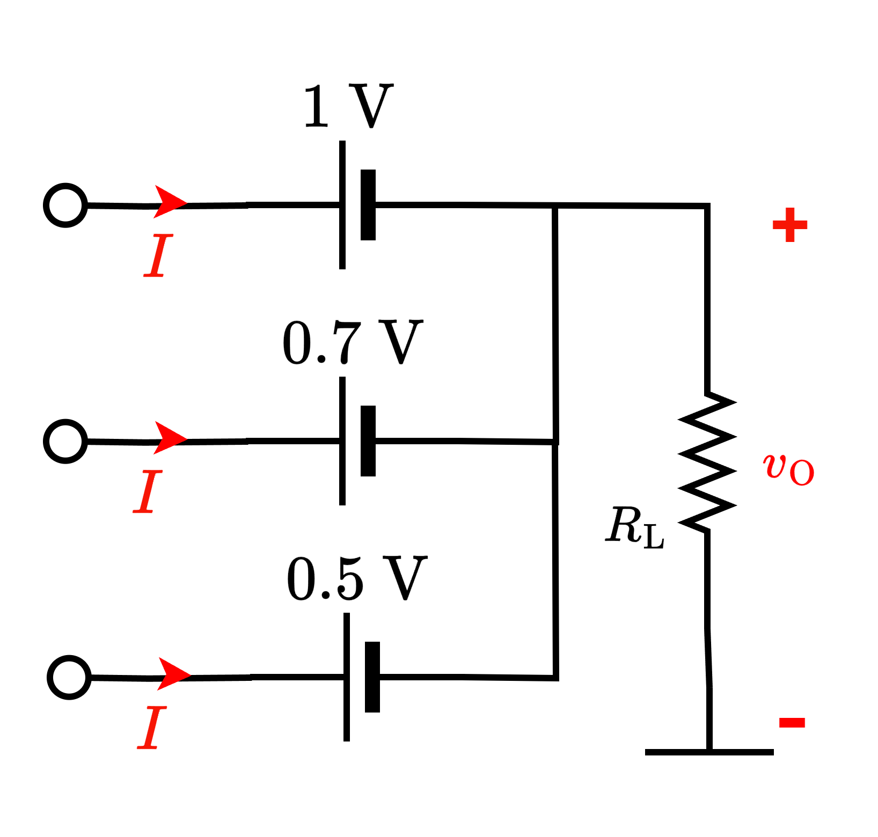
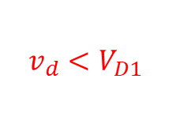
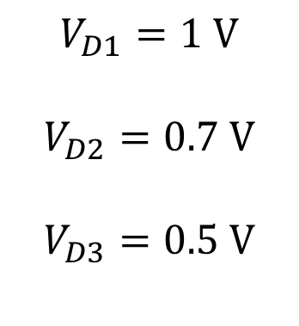
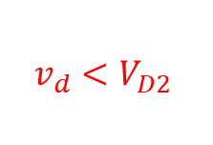

Logical Operations with Diode (OR)
CVD diode
Highest (possible – and consistent)
voltage here!
4.5 V
5 V
5 V
Z = 4.5 V
5 V

Slide 16
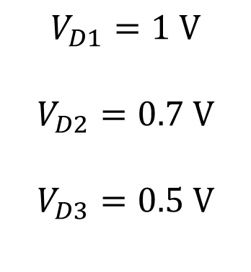
Logical Operations with Diode (OR)
CVD diode
What if the input voltages are different?
4.2 V
4 V
3.5 V

Slide 17
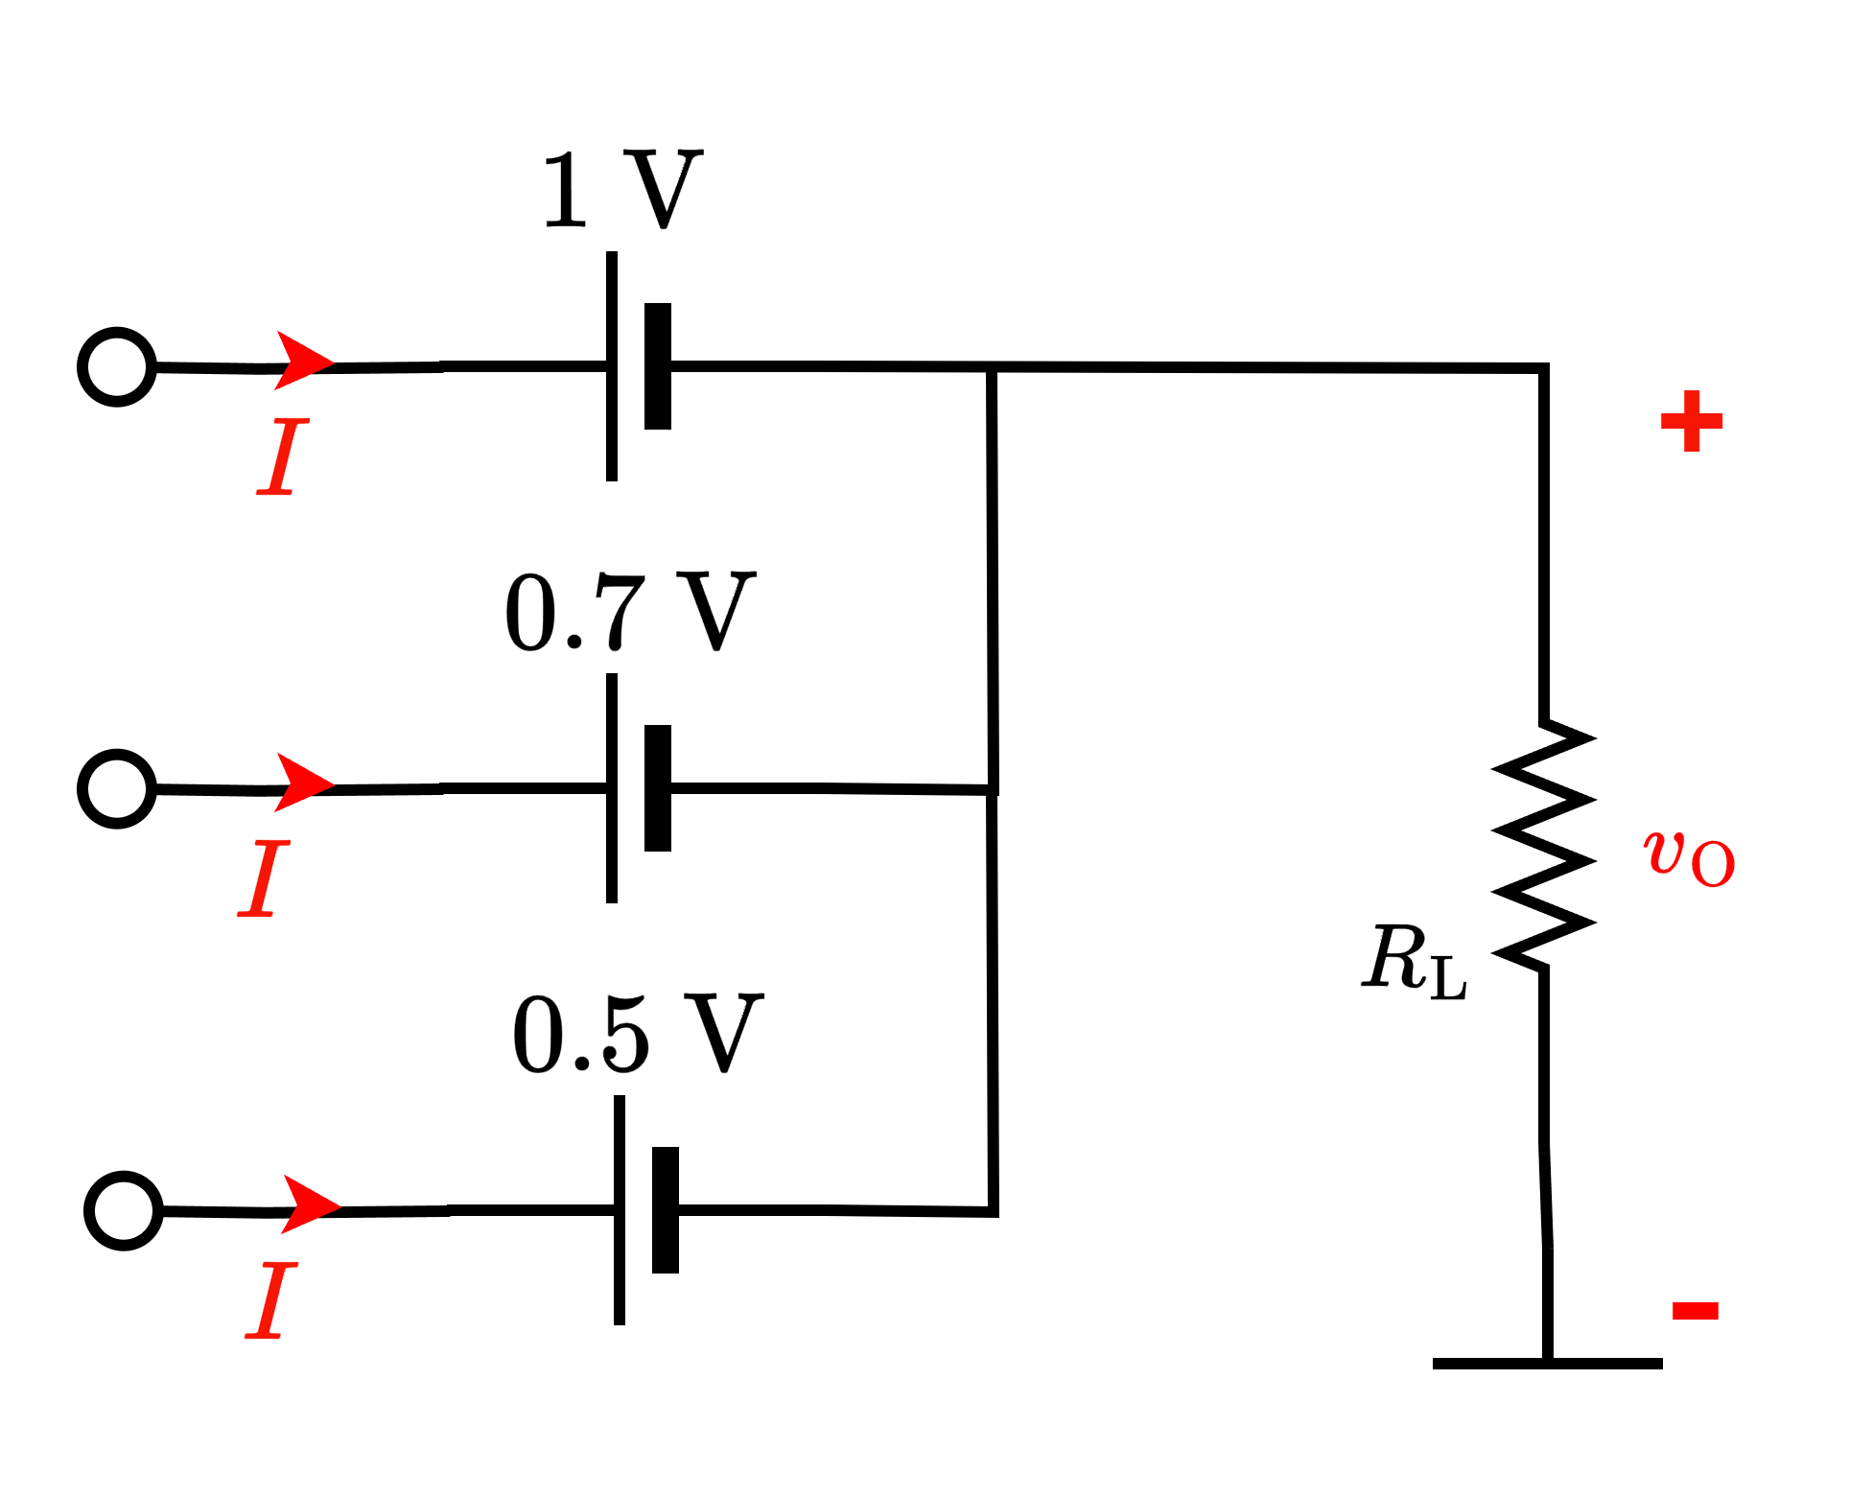
Logical Operations with Diode (OR)
CVD diode
What if the input voltages are different?
Highest (possible – and consistent)
voltage here!
3.2 V
4.2 V
3.3 V
4 V
Z = 3.3 V
3.5 V
3 V

Slide 18
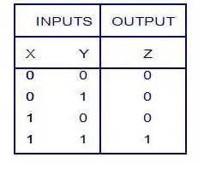
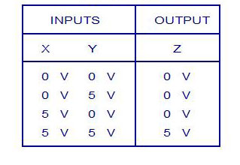
Logical Operations with Diode (AND)
Logic Truth Table
Voltage Truth Table
Low/False High/True
Logic Levels: 0 1
Corresponding voltage levels: 0V 5V

Slide 19
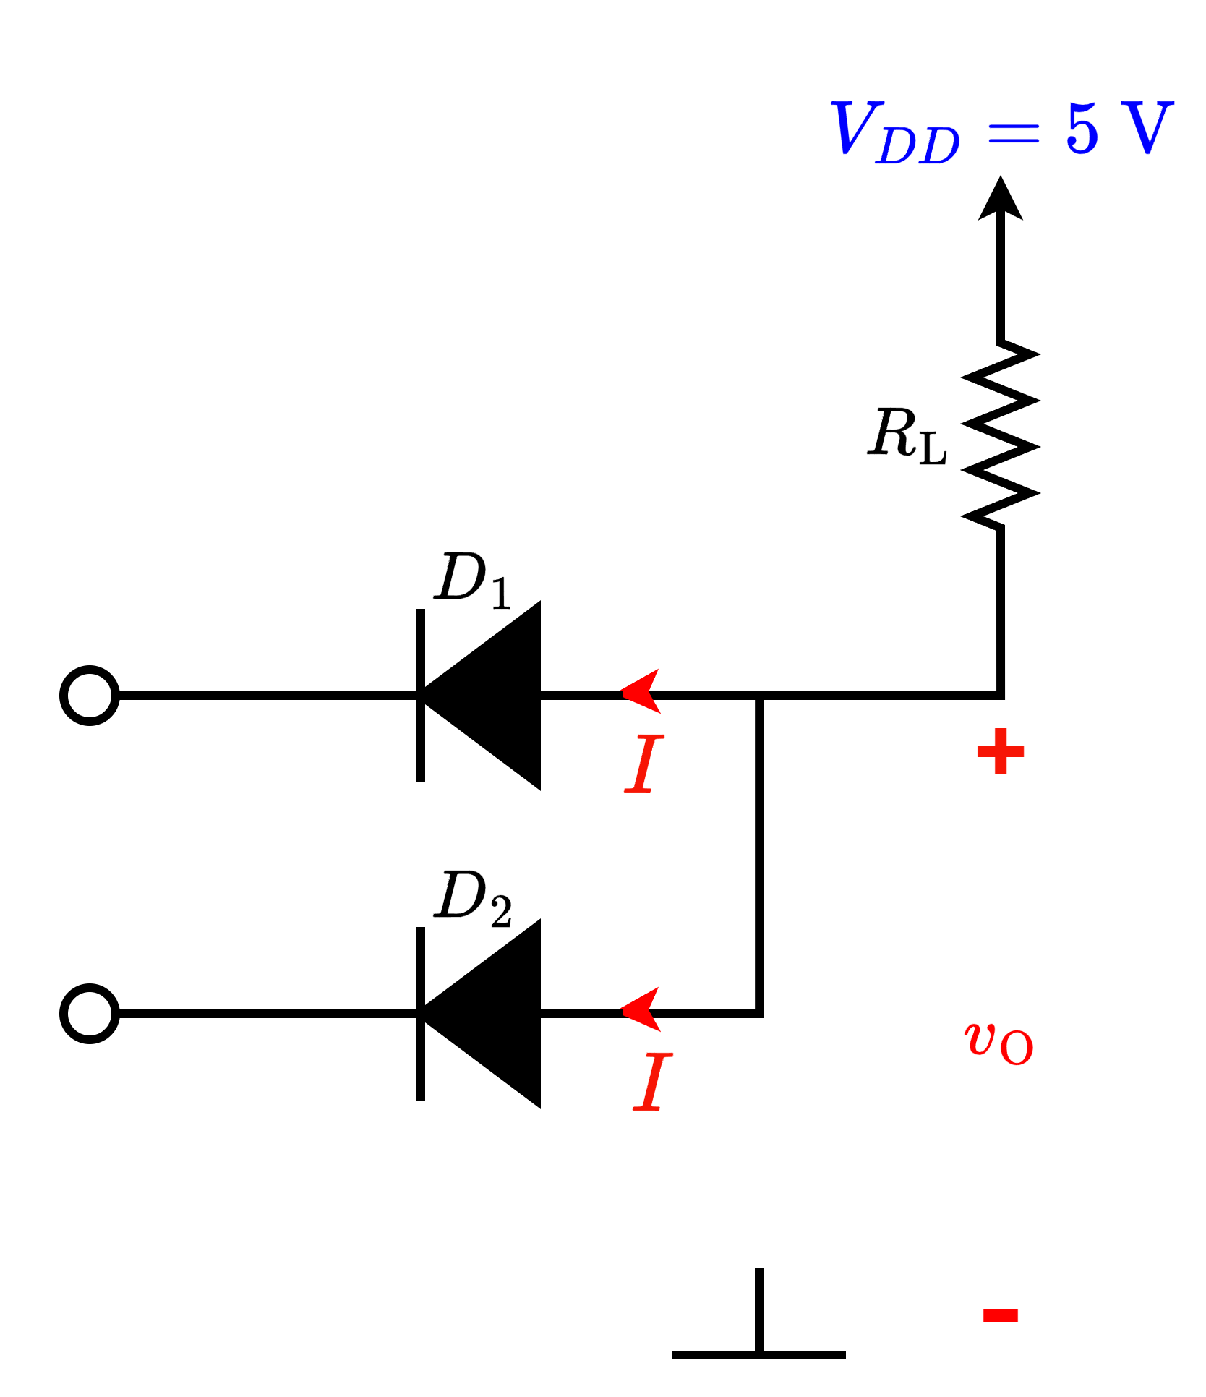
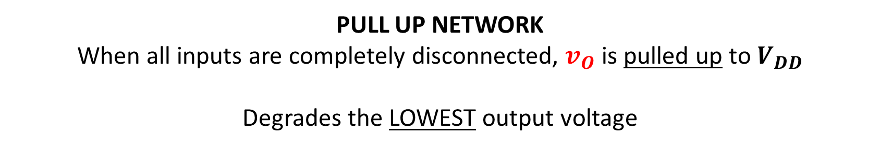
Logical Operations with Diode (AND)
Voltage Truth Table
X
Y
=Z

Slide 20
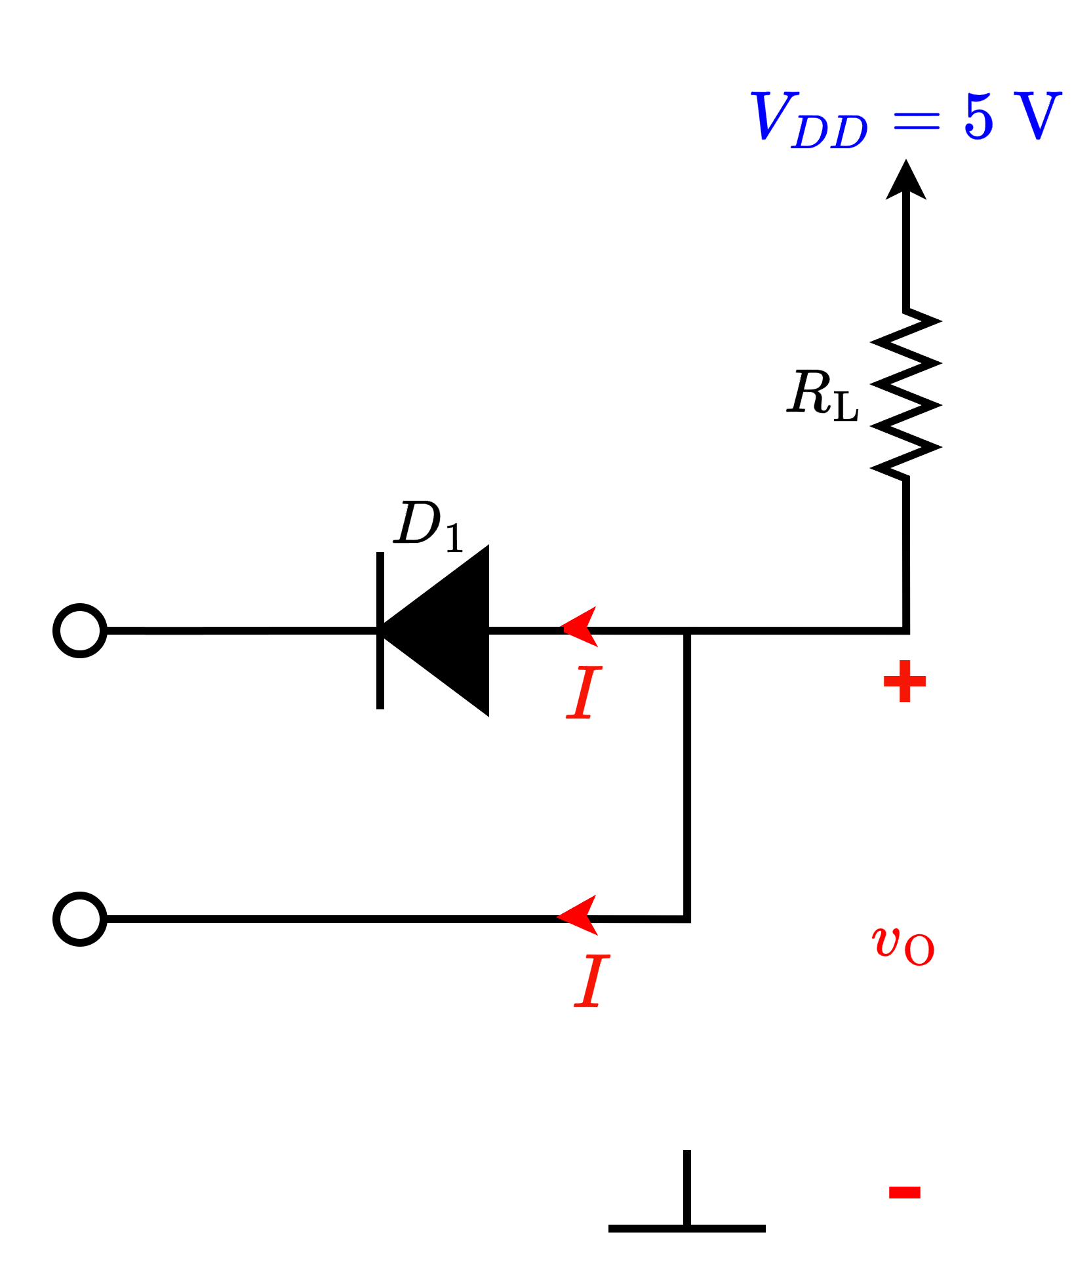
Logical Operations with Diode (AND)
Ideal diode
5 V
0 V
5 V
0 V
0 V
Z = 0 V

Slide 21
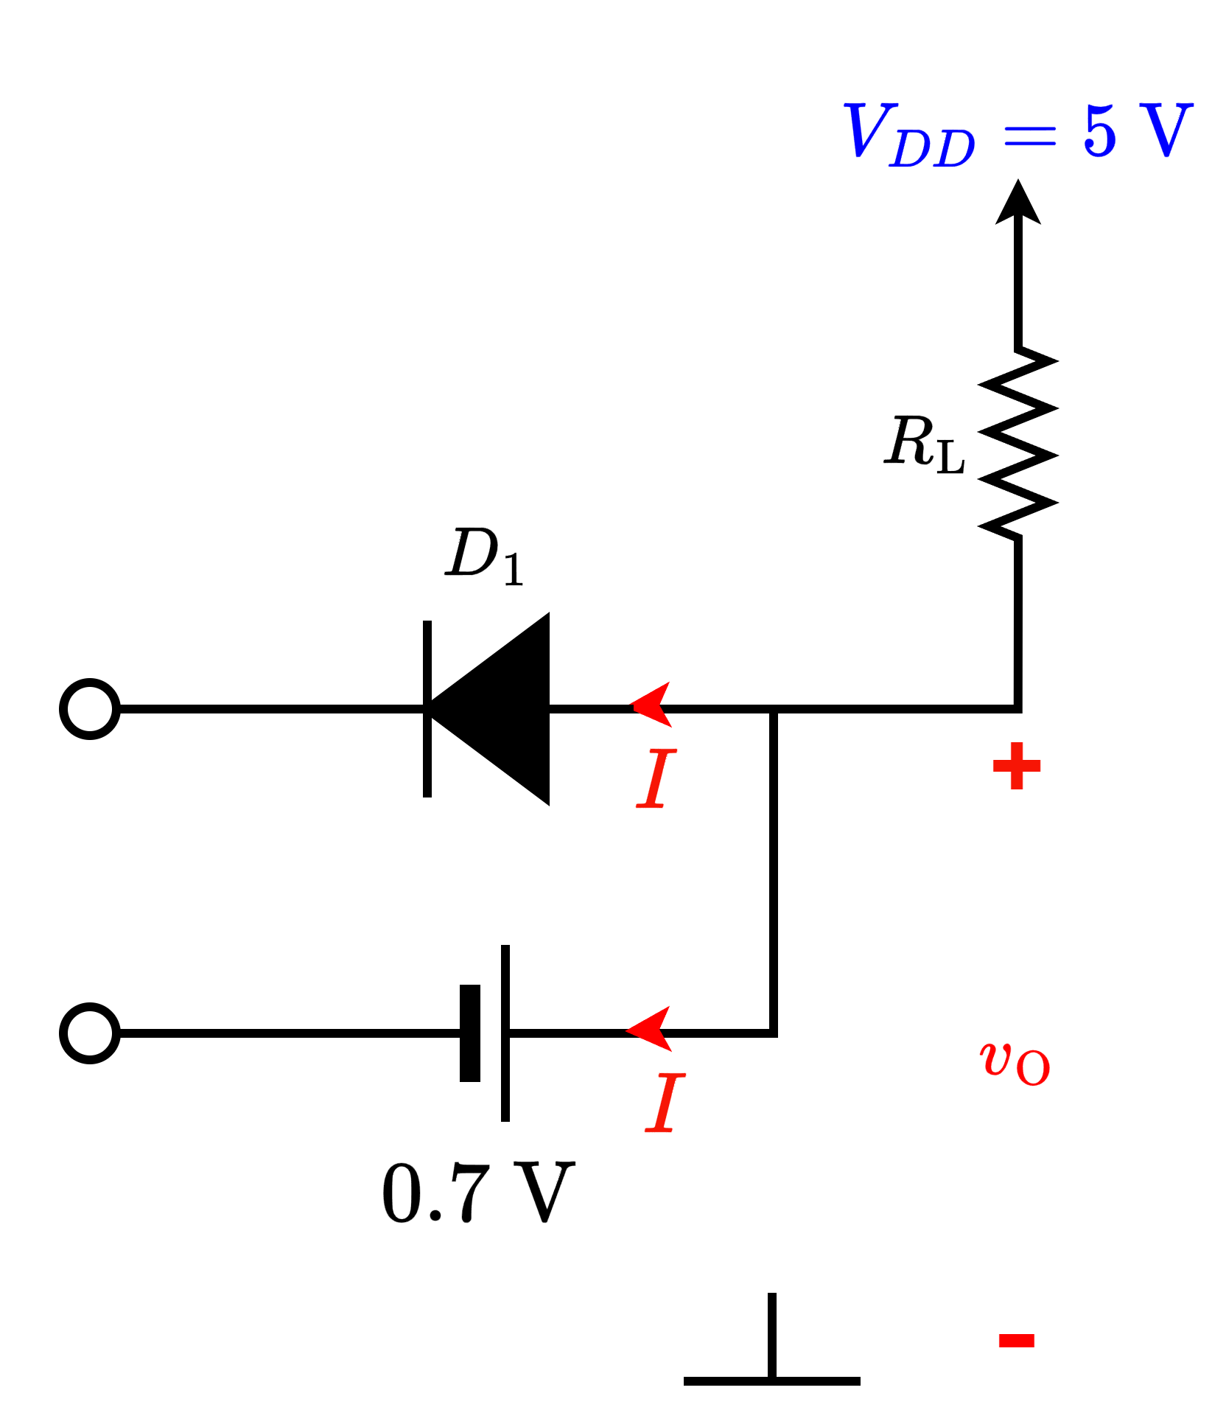
Logical Operations with Diode (AND)
CVD diode
5 V
0.7 V
5 V
0 V
0 V
Z = 0.7 V
Degraded 0 V

Slide 22
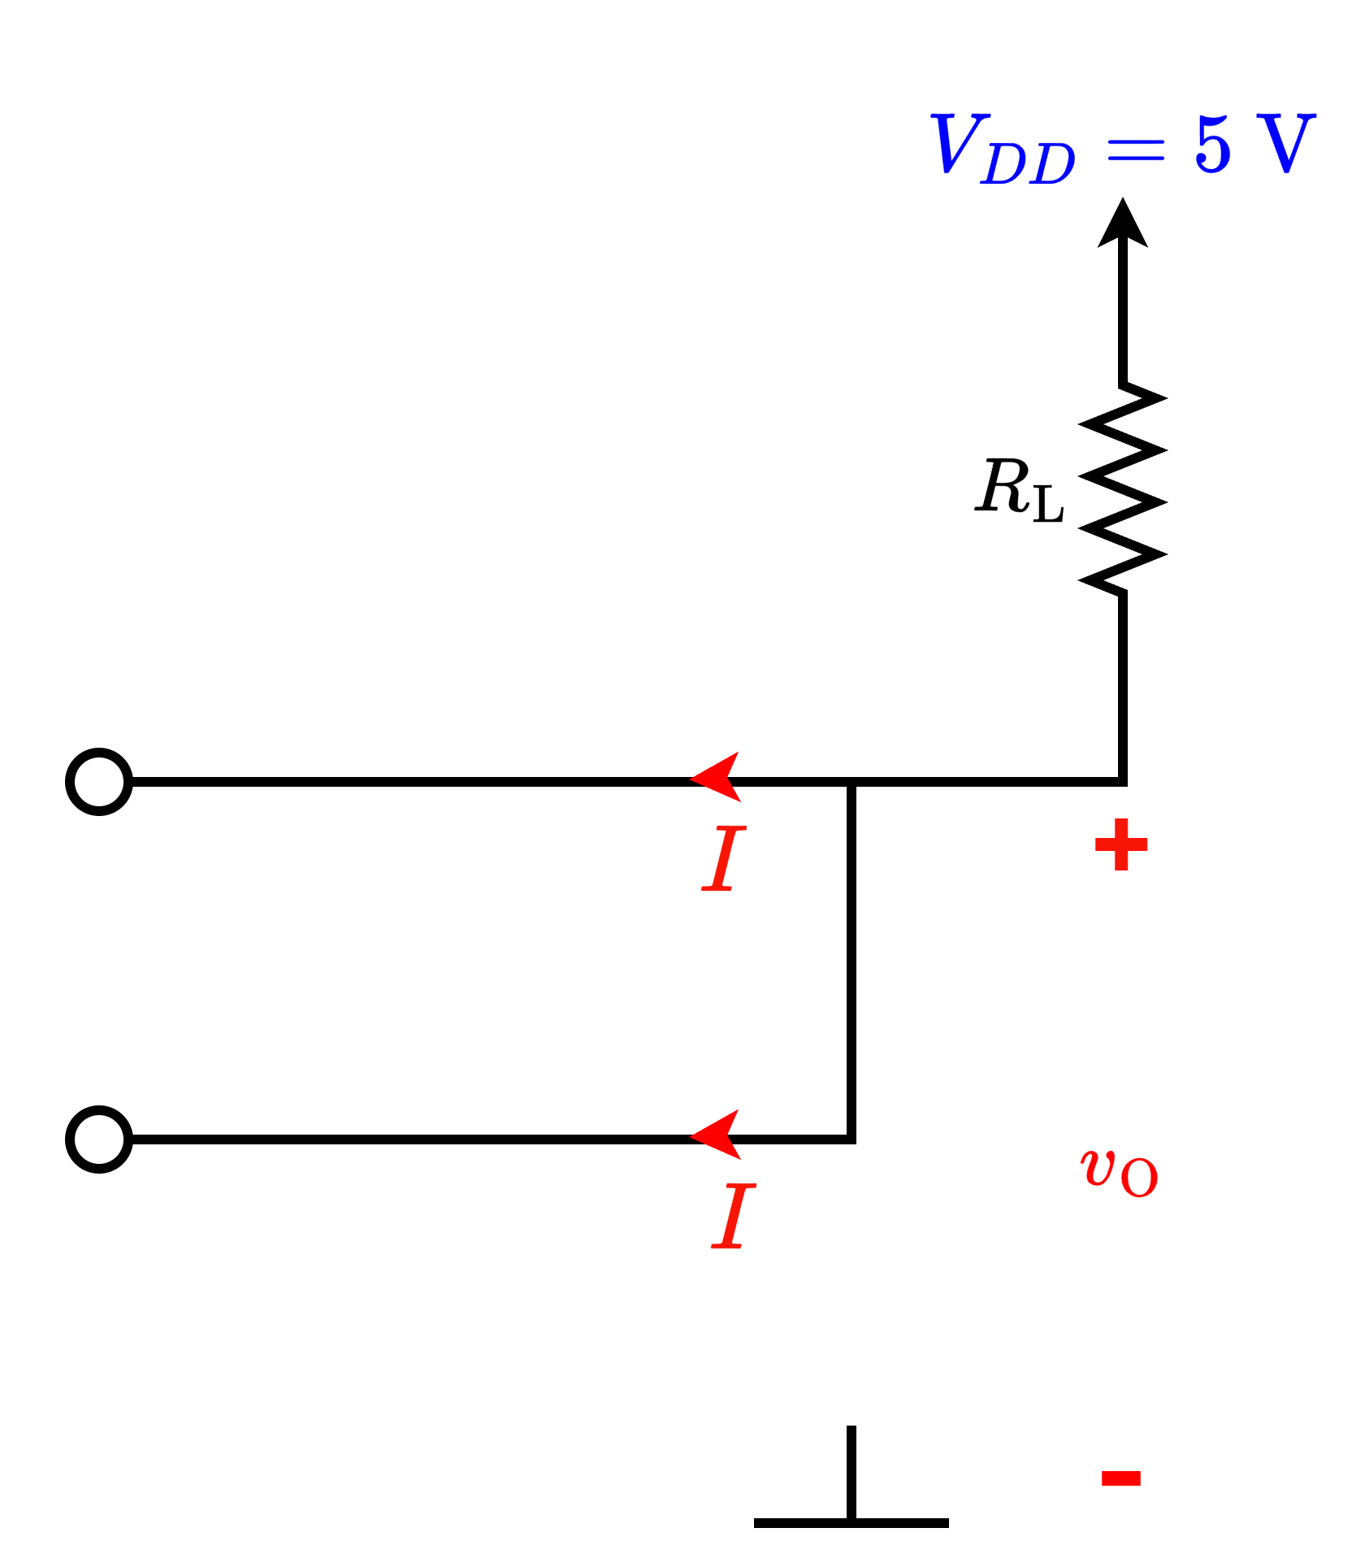
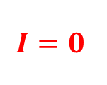

Logical Operations with Diode (AND)
Ideal diode
5 V
5 V
5 V
5 V
5 V
Z = 5 V

Slide 23

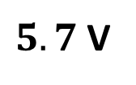
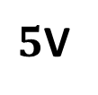
Logical Operations with Diode (AND)
CVD diode
5 V
5 V
5 V
5 V
Z = 5 V

Slide 24



Logical Operations with Diode (AND)
Ideal diode
0 V
0 V
0 V
0 V
0 V
Z = 0 V

Slide 25
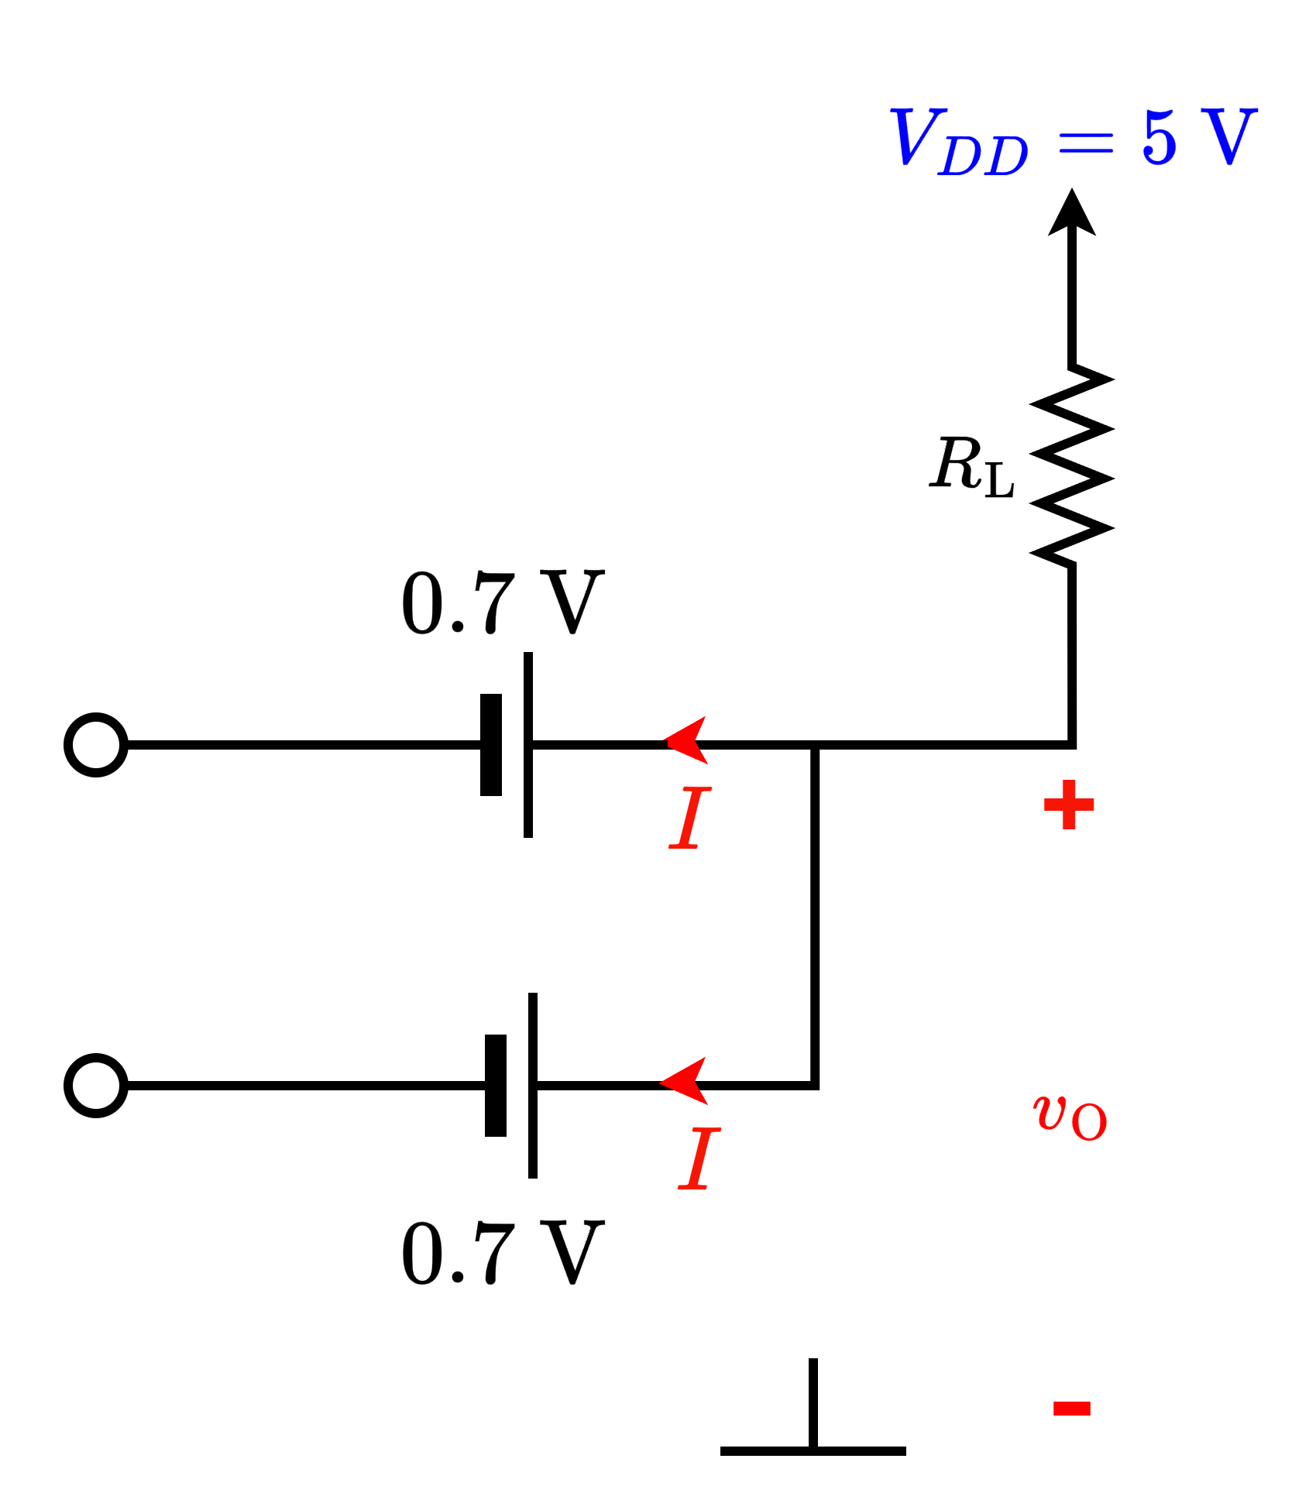
Logical Operations with Diode (AND)
CVD diode
0 V
0 V
0 V
0 V
Z = 0.7 V
Degraded 0 V

Slide 26
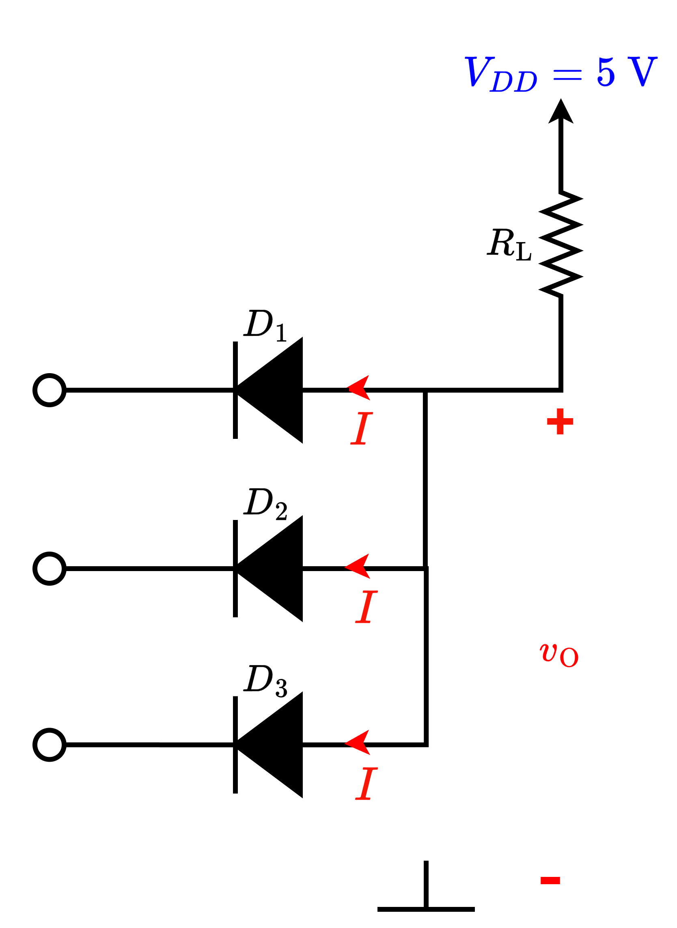

Logical Operations with Diode (AND)
CVD diode
0 V
0 V
0 V

Slide 27
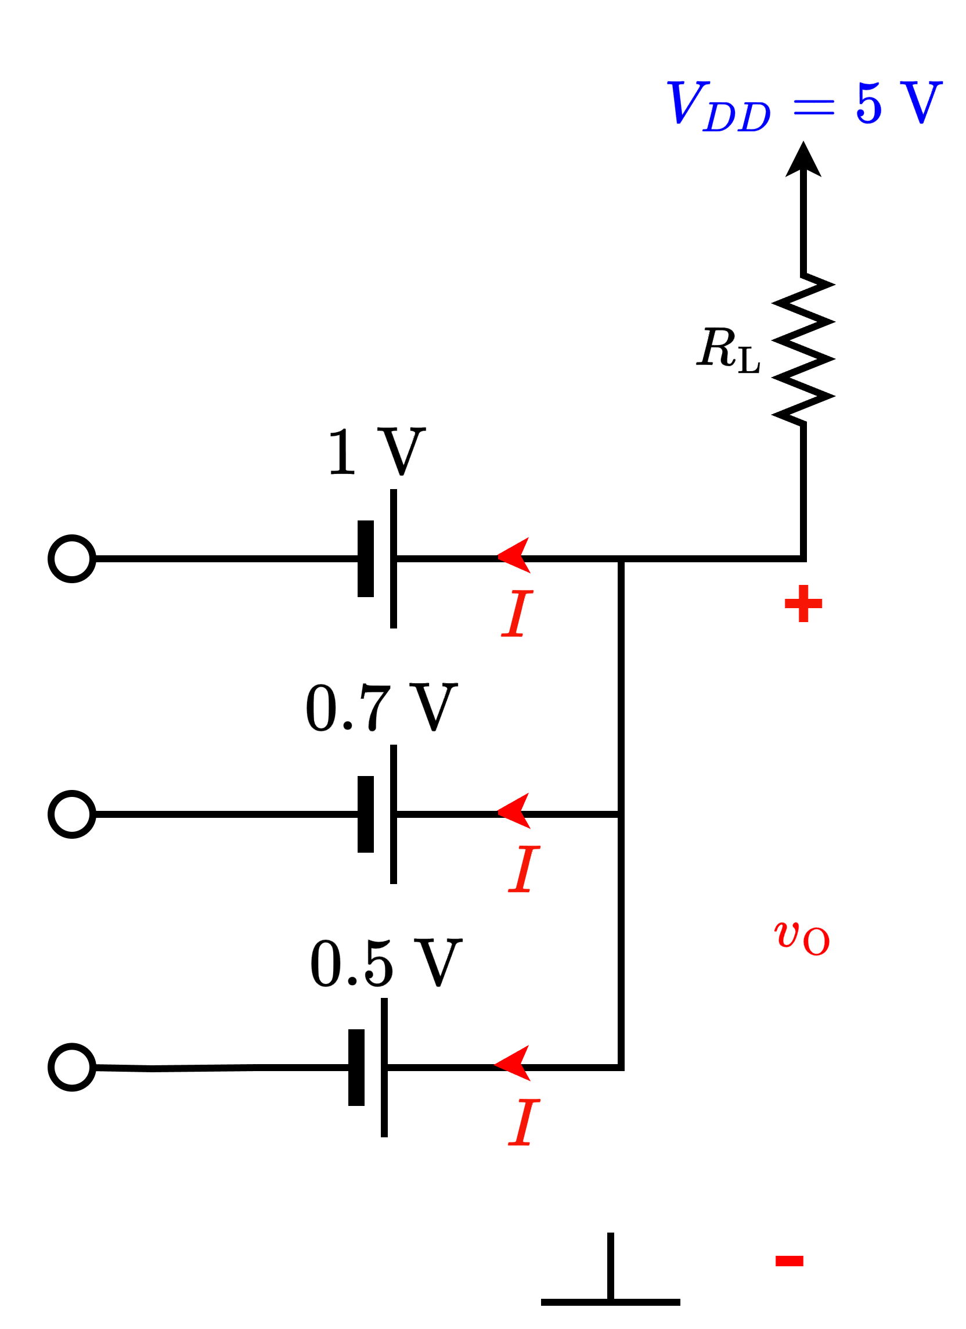

Logical Operations with Diode (AND)
CVD diode
0.5 V
0 V
0 V
Lowest (possible – and consistent)
voltage here!
0 V

Slide 28
Part 1 ends here

Slide 29
Outline
Diode Logic Gates – Examples and combined operation

Slide 30
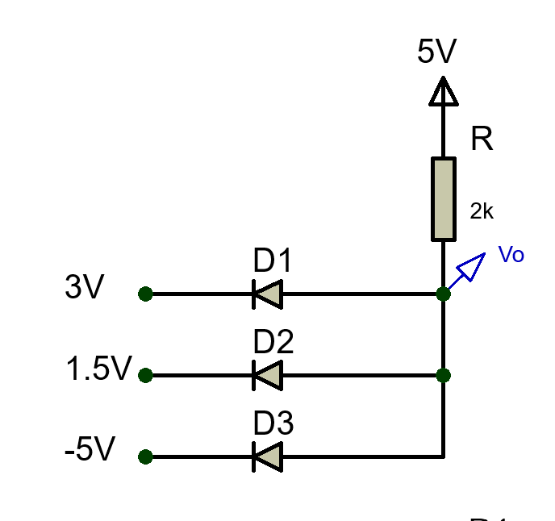
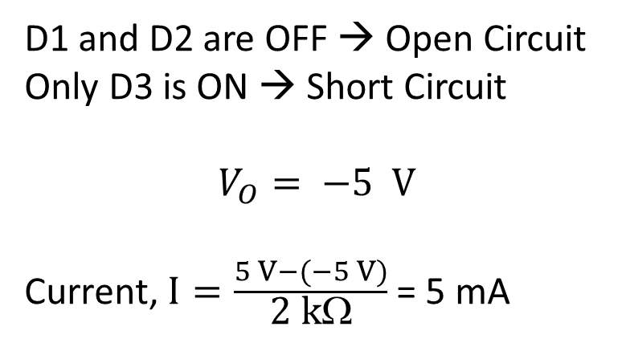
Effect of input Voltage Variation in Logic Gates (AND)
Example 1: Find the value of Vo (All the diodes are ideal diodes)
Lowest (possible – and consistent)
voltage here!

Slide 31
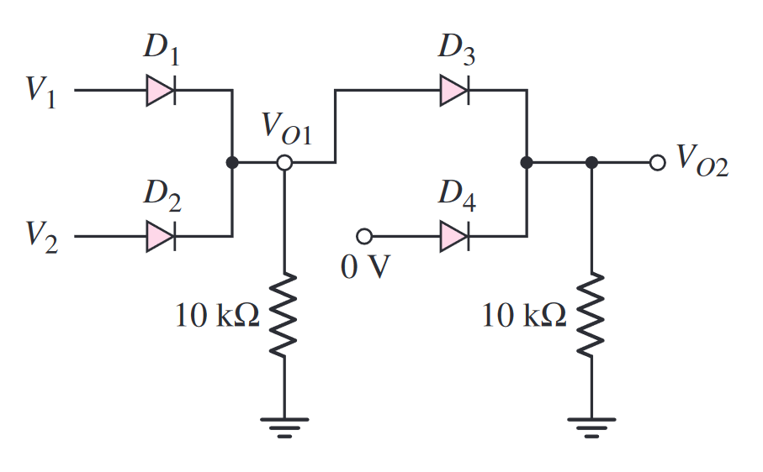
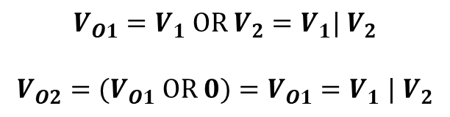
Combined Logic Circuits

Slide 32

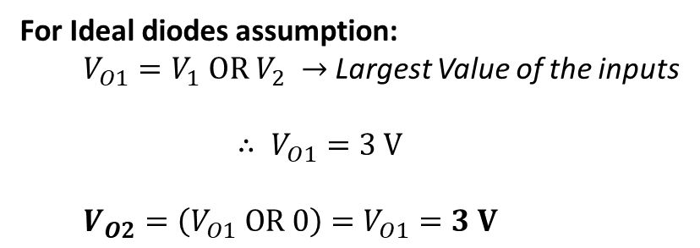
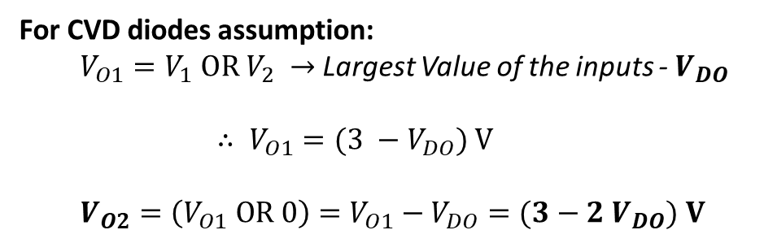
Combined Logic Circuits
Example 2:
** In CVD diode models, we are assuming that all diodes have equal drop.

Slide 33
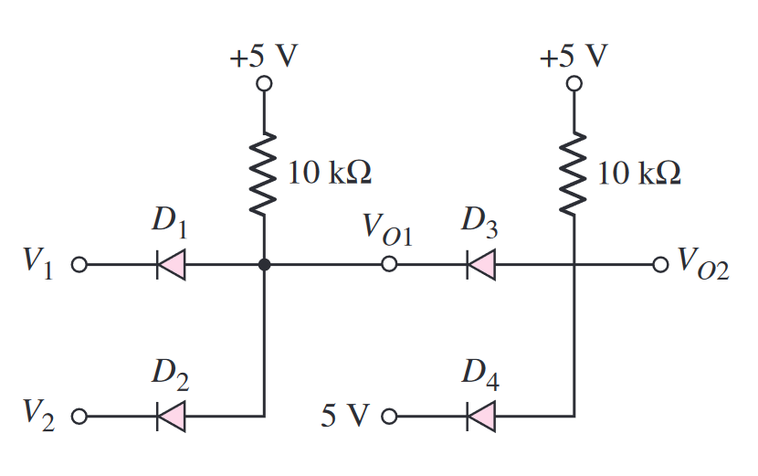
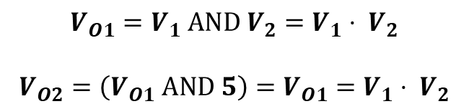
Combined Logic Circuits

Slide 34

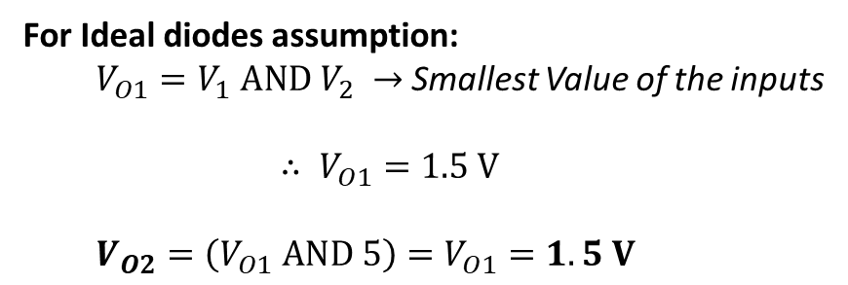
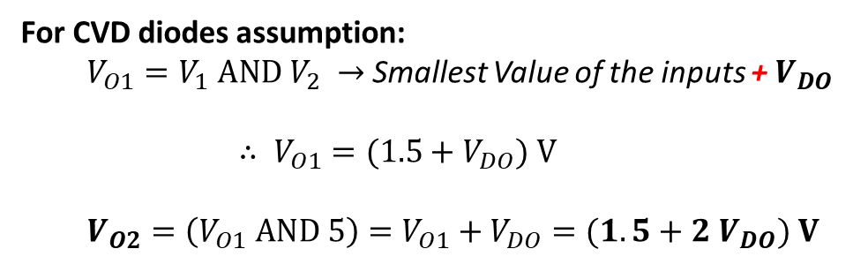
Combined Logic Circuits
Example 3:
** In CVD diode models, we are assuming that all diodes have equal drop.

Slide 35












Combined Logic Circuits
Example 4:

Slide 36
Part 2 ends here

Slide 37
Outline
Op-Amp + Diodes
Exponential Converter
Logarithmic Converter
Multiplier
Divider
Hybrid Problems

Slide 38


Real diode
Relation between diode current and diode voltage:
I-V characteristics of a real diode
η is called the ideality factor (try to recall, you measured this in the lab!)

Slide 39


Exponential (Anti-log) Converter

Slide 40


Logarithmic Amplifier

Slide 41

APPLICATIONS:

Slide 42

APPLICATIONS:

Slide 43

Multiplier

Slide 44

Divider

Slide 45

Hybrid Problems
Example 1:

Slide 46

Hybrid Problems
Example 2:

Slide 47
Thank You!

