Slide 1
Chapter 5
Large and Fast: Exploiting Memory Hierarchy
Notes:
Morgan Kaufmann Publishers
*
Chapter 5 — Large and Fast: Exploiting Memory Hierarchy
‹#›

Slide 2
Principle of Locality
§5.1 Introduction
Programs access a small proportion of their address space at any time
Temporal locality
Items accessed recently are likely to be accessed again soon
e.g., instructions in a loop, induction variables
Spatial locality
Items near those accessed recently are likely to be accessed soon
E.g., sequential instruction access, array data
Chapter 5 — Large and Fast: Exploiting Memory Hierarchy — ‹#›
Notes:
Morgan Kaufmann Publishers
*
Chapter 5 — Large and Fast: Exploiting Memory Hierarchy
‹#›

Slide 3
Taking Advantage of Locality
Memory hierarchy
Store everything on disk
Copy recently accessed (and nearby) items from disk to smaller DRAM memory
Main memory
Copy more recently accessed (and nearby) items from DRAM to smaller SRAM memory
Cache memory attached to CPU
Chapter 5 — Large and Fast: Exploiting Memory Hierarchy — ‹#›
Notes:
Morgan Kaufmann Publishers
*
Chapter 5 — Large and Fast: Exploiting Memory Hierarchy
‹#›

Slide 4
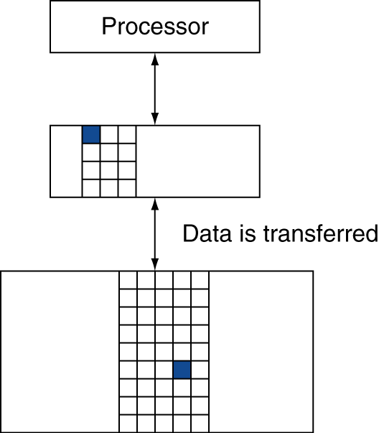
Memory Hierarchy Levels
Block (aka line): unit of copying
May be multiple words
If accessed data is present in upper level
Hit: access satisfied by upper level
Hit ratio: hits/accesses
If accessed data is absent
Miss: block copied from lower level
Time taken: miss penalty
Miss ratio: misses/accesses = 1 – hit ratio
Then accessed data supplied from upper level
Chapter 5 — Large and Fast: Exploiting Memory Hierarchy — ‹#›
Notes:
Morgan Kaufmann Publishers
*
Chapter 5 — Large and Fast: Exploiting Memory Hierarchy
‹#›

Slide 5
Memory Technology
Static RAM (SRAM)
0.5ns – 2.5ns, $2000 – $5000 per GB
Dynamic RAM (DRAM)
50ns – 70ns, $20 – $75 per GB
Magnetic disk
5ms – 20ms, $0.20 – $2 per GB
Ideal memory
Access time of SRAM
Capacity and cost/GB of disk
§5.2 Memory Technologies
Chapter 5 — Large and Fast: Exploiting Memory Hierarchy — ‹#›
Notes:
Morgan Kaufmann Publishers
*
Chapter 5 — Large and Fast: Exploiting Memory Hierarchy
‹#›

Slide 6
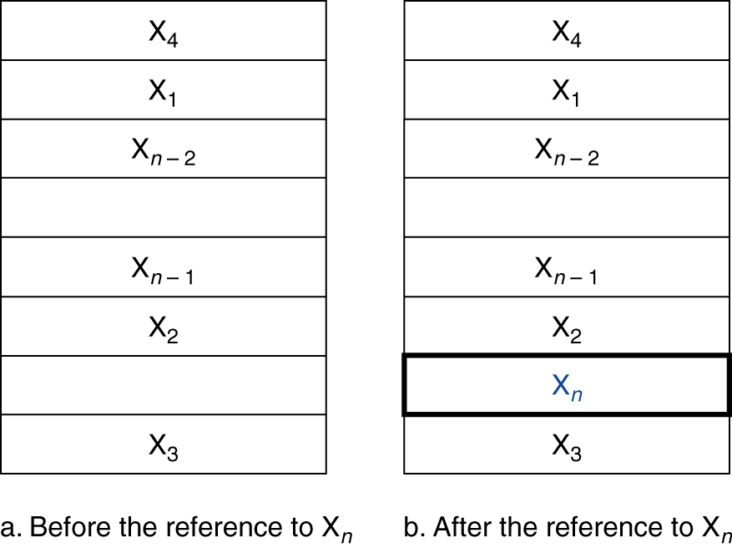
Cache Memory
Cache memory
The level of the memory hierarchy closest to the CPU
Given accesses X₁, …, X_{n–1}, X_{n}
§5.3 The Basics of Caches
How do we know if the data is present?
Where do we look?
Chapter 5 — Large and Fast: Exploiting Memory Hierarchy — ‹#›
Notes:
Morgan Kaufmann Publishers
*
Chapter 5 — Large and Fast: Exploiting Memory Hierarchy
‹#›

Slide 7
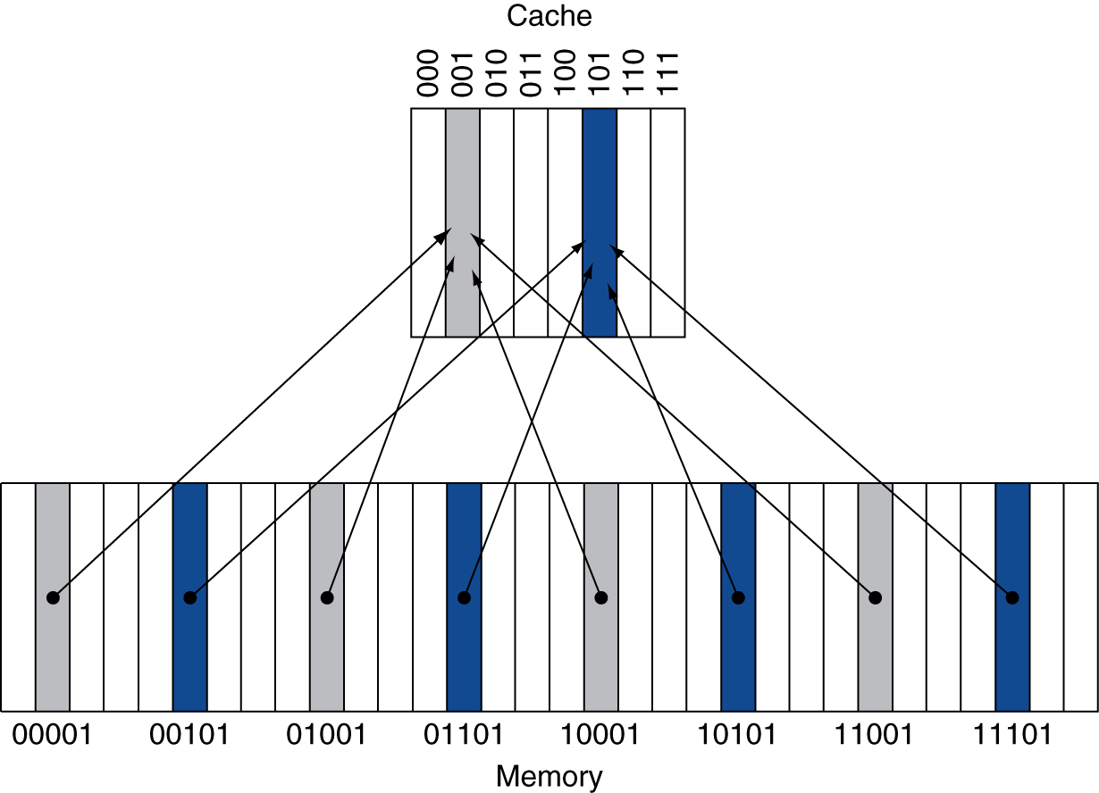
Direct Mapped Cache
Location determined by address
Direct mapped: only one choice
(Block address) modulo (#Blocks in cache)
#Blocks is a power of 2
Use low-order address bits
Chapter 5 — Large and Fast: Exploiting Memory Hierarchy — ‹#›
Notes:
Morgan Kaufmann Publishers
*
Chapter 5 — Large and Fast: Exploiting Memory Hierarchy
‹#›

Slide 8
Tags and Valid Bits
How do we know which particular block is stored in a cache location?
Store block address as well as the data
Actually, only need the high-order bits
Called the tag
What if there is no data in a location?
Valid bit: 1 = present, 0 = not present
Initially 0
Chapter 5 — Large and Fast: Exploiting Memory Hierarchy — ‹#›
Notes:
Morgan Kaufmann Publishers
*
Chapter 5 — Large and Fast: Exploiting Memory Hierarchy
‹#›

Slide 9
Cache Example
8-blocks, 1 word/block, direct mapped
Initial state
Index | V | Tag | Data
000 | N
001 | N
010 | N
011 | N
100 | N
101 | N
110 | N
111 | N
Chapter 5 — Large and Fast: Exploiting Memory Hierarchy — ‹#›
Notes:
Morgan Kaufmann Publishers
*
Chapter 5 — Large and Fast: Exploiting Memory Hierarchy
‹#›

Slide 10
Cache Example
Word addr | Binary addr | Hit/miss | Cache block
22 | 10 110 | Miss | 110
Index | V | Tag | Data
000 | N
001 | N
010 | N
011 | N
100 | N
101 | N
110 | Y | 10 | Mem[10110]
111 | N
Chapter 5 — Large and Fast: Exploiting Memory Hierarchy — ‹#›
Notes:
Morgan Kaufmann Publishers
*
Chapter 5 — Large and Fast: Exploiting Memory Hierarchy
‹#›

Slide 11
Cache Example
Word addr | Binary addr | Hit/miss | Cache block
26 | 11 010 | Miss | 010
Index | V | Tag | Data
000 | N
001 | N
010 | Y | 11 | Mem[11010]
011 | N
100 | N
101 | N
110 | Y | 10 | Mem[10110]
111 | N
Chapter 5 — Large and Fast: Exploiting Memory Hierarchy — ‹#›
Notes:
Morgan Kaufmann Publishers
*
Chapter 5 — Large and Fast: Exploiting Memory Hierarchy
‹#›

Slide 12
Cache Example
Word addr | Binary addr | Hit/miss | Cache block
22 | 10 110 | Hit | 110
26 | 11 010 | Hit | 010
Index | V | Tag | Data
000 | N
001 | N
010 | Y | 11 | Mem[11010]
011 | N
100 | N
101 | N
110 | Y | 10 | Mem[10110]
111 | N
Chapter 5 — Large and Fast: Exploiting Memory Hierarchy — ‹#›
Notes:
Morgan Kaufmann Publishers
*
Chapter 5 — Large and Fast: Exploiting Memory Hierarchy
‹#›

Slide 13
Cache Example
Word addr | Binary addr | Hit/miss | Cache block
16 | 10 000 | Miss | 000
3 | 00 011 | Miss | 011
16 | 10 000 | Hit | 000
Index | V | Tag | Data
000 | Y | 10 | Mem[10000]
001 | N
010 | Y | 11 | Mem[11010]
011 | Y | 00 | Mem[00011]
100 | N
101 | N
110 | Y | 10 | Mem[10110]
111 | N
Chapter 5 — Large and Fast: Exploiting Memory Hierarchy — ‹#›
Notes:
Morgan Kaufmann Publishers
*
Chapter 5 — Large and Fast: Exploiting Memory Hierarchy
‹#›

Slide 14
Cache Example
Word addr | Binary addr | Hit/miss | Cache block
18 | 10 010 | Miss | 010
Index | V | Tag | Data
000 | Y | 10 | Mem[10000]
001 | N
010 | Y | 10 | Mem[10010]
011 | Y | 00 | Mem[00011]
100 | N
101 | N
110 | Y | 10 | Mem[10110]
111 | N
Chapter 5 — Large and Fast: Exploiting Memory Hierarchy — ‹#›
Notes:
Morgan Kaufmann Publishers
*
Chapter 5 — Large and Fast: Exploiting Memory Hierarchy
‹#›

Slide 15
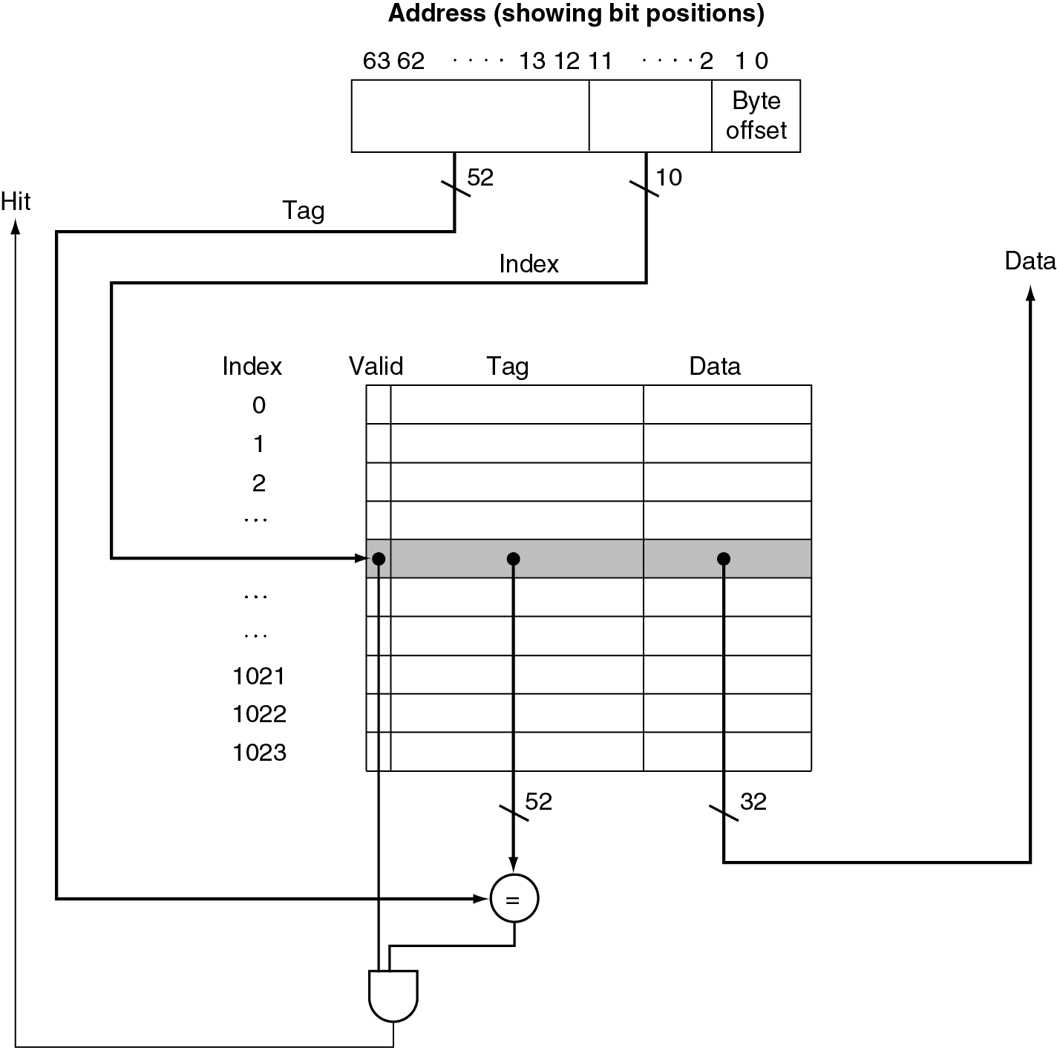
Address Subdivision
Chapter 5 — Large and Fast: Exploiting Memory Hierarchy — ‹#›
Notes:
Morgan Kaufmann Publishers
*
Chapter 5 — Large and Fast: Exploiting Memory Hierarchy
‹#›

Slide 16
Example: Larger Block Size
64 blocks, 16 bytes/block
To what block number does address 1200 map?
Block address = ⎣1200/16⎦ = 75
Block number = 75 modulo 64 = 11
63
10
9
4
3
0
Tag
Index
Offset
52 bits
6 bits
4 bits
Chapter 5 — Large and Fast: Exploiting Memory Hierarchy — ‹#›
Notes:
Morgan Kaufmann Publishers
*
Chapter 5 — Large and Fast: Exploiting Memory Hierarchy
‹#›

Slide 17
Block Size Considerations
Larger blocks should reduce miss rate
Due to spatial locality
But in a fixed-sized cache
Larger blocks ⇒ fewer of them
More competition ⇒ increased miss rate
Larger blocks ⇒ pollution
Larger miss penalty
Can override benefit of reduced miss rate
Early restart and critical-word-first can help
Chapter 5 — Large and Fast: Exploiting Memory Hierarchy — ‹#›
Notes:
Morgan Kaufmann Publishers
*
Chapter 5 — Large and Fast: Exploiting Memory Hierarchy
‹#›

Slide 18
Cache Misses
On cache hit, CPU proceeds normally
On cache miss
Stall the CPU pipeline
Fetch block from next level of hierarchy
Instruction cache miss
Restart instruction fetch
Data cache miss
Complete data access
Chapter 5 — Large and Fast: Exploiting Memory Hierarchy — ‹#›
Notes:
Morgan Kaufmann Publishers
*
Chapter 5 — Large and Fast: Exploiting Memory Hierarchy
‹#›

Slide 19
Write-Through
On data-write hit, could just update the block in cache
But then cache and memory would be inconsistent
Write through: also update memory
But makes writes take longer
Solution: write buffer
Holds data waiting to be written to memory
CPU continues immediately
Only stalls on write if write buffer is already full
Chapter 5 — Large and Fast: Exploiting Memory Hierarchy — ‹#›
Notes:
Morgan Kaufmann Publishers
*
Chapter 5 — Large and Fast: Exploiting Memory Hierarchy
‹#›

Slide 20
Write-Back
Alternative: On data-write hit, just update the block in cache
Keep track of whether each block is dirty
When a dirty block is replaced
Write it back to memory
Can use a write buffer to allow replacing block to be read first
Chapter 5 — Large and Fast: Exploiting Memory Hierarchy — ‹#›
Notes:
Morgan Kaufmann Publishers
*
Chapter 5 — Large and Fast: Exploiting Memory Hierarchy
‹#›

Slide 21
Write Allocation
What should happen on a write miss?
Alternatives for write-through
Allocate on miss: fetch the block
Write around: don’t fetch the block
Since programs often write a whole block before reading it (e.g., initialization)
For write-back
Usually fetch the block
Chapter 5 — Large and Fast: Exploiting Memory Hierarchy — ‹#›
Notes:
Morgan Kaufmann Publishers
*
Chapter 5 — Large and Fast: Exploiting Memory Hierarchy
‹#›

Slide 22
Average Access Time
Hit time is also important for performance
Average memory access time (AMAT)
AMAT = Hit time + Miss rate × Miss penalty
Example
CPU with 1ns clock, hit time = 1 cycle, miss penalty = 20 cycles, I-cache miss rate = 5%
AMAT = 1 + 0.05 × 20 = 2ns
2 cycles per instruction
Chapter 5 — Large and Fast: Exploiting Memory Hierarchy — ‹#›
Notes:
Morgan Kaufmann Publishers
*
Chapter 5 — Large and Fast: Exploiting Memory Hierarchy
‹#›

Slide 23
Performance Summary
When CPU performance increased
Miss penalty becomes more significant
Decreasing base CPI
Greater proportion of time spent on memory stalls
Increasing clock rate
Memory stalls account for more CPU cycles
Can’t neglect cache behavior when evaluating system performance
Chapter 5 — Large and Fast: Exploiting Memory Hierarchy — ‹#›
Notes:
Morgan Kaufmann Publishers
*
Chapter 5 — Large and Fast: Exploiting Memory Hierarchy
‹#›

Slide 24
Multilevel Caches
Primary cache attached to CPU
Small, but fast
Level-2 cache services misses from primary cache
Larger, slower, but still faster than main memory
Main memory services L-2 cache misses
Some high-end systems include L-3 cache
Chapter 5 — Large and Fast: Exploiting Memory Hierarchy — ‹#›
Notes:
Morgan Kaufmann Publishers
*
Chapter 5 — Large and Fast: Exploiting Memory Hierarchy
‹#›

Slide 25
Multilevel Cache Considerations
Primary cache
Focus on minimal hit time
L-2 cache
Focus on low miss rate to avoid main memory access
Hit time has less overall impact
Results
L-1 cache usually smaller than a single cache
L-1 block size smaller than L-2 block size
Chapter 5 — Large and Fast: Exploiting Memory Hierarchy — ‹#›
Notes:
Morgan Kaufmann Publishers
*
Chapter 5 — Large and Fast: Exploiting Memory Hierarchy
‹#›

Slide 26
Virtual Memory
§5.7 Virtual Memory
Use main memory as a “cache” for secondary (disk) storage
Managed jointly by CPU hardware and the operating system (OS)
Programs share main memory
Each gets a private virtual address space holding its frequently used code and data
Protected from other programs
CPU and OS translate virtual addresses to physical addresses
VM “block” is called a page
VM translation “miss” is called a page fault
Chapter 5 — Large and Fast: Exploiting Memory Hierarchy — ‹#›
Notes:
Morgan Kaufmann Publishers
*
Chapter 5 — Large and Fast: Exploiting Memory Hierarchy
‹#›

Slide 27
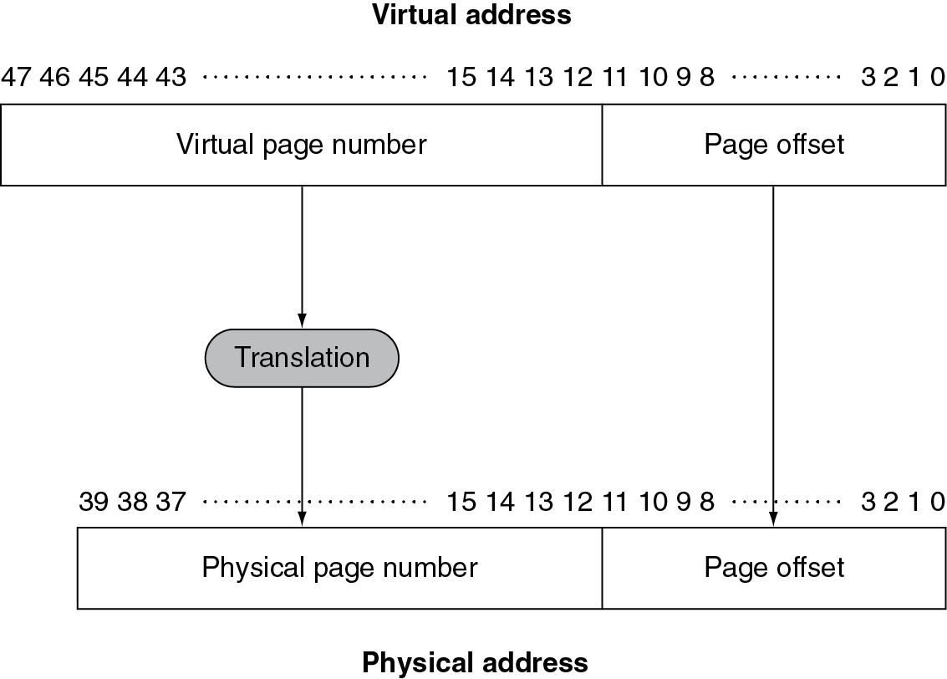
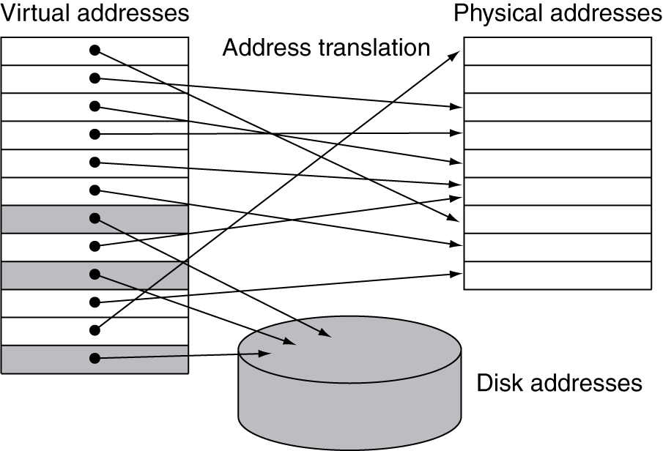
Address Translation
Fixed-size pages (e.g., 4K)
Chapter 5 — Large and Fast: Exploiting Memory Hierarchy — ‹#›
Notes:
Morgan Kaufmann Publishers
*
Chapter 5 — Large and Fast: Exploiting Memory Hierarchy
‹#›

Slide 28
Page Fault Penalty
On page fault, the page must be fetched from disk
Takes millions of clock cycles
Handled by OS code
Try to minimize page fault rate
Fully associative placement
Smart replacement algorithms
Chapter 5 — Large and Fast: Exploiting Memory Hierarchy — ‹#›
Notes:
Morgan Kaufmann Publishers
*
Chapter 5 — Large and Fast: Exploiting Memory Hierarchy
‹#›

Slide 29
Page Tables
Stores placement information
Array of page table entries, indexed by virtual page number
Page table register in CPU points to page table in physical memory
If page is present in memory
PTE stores the physical page number
Plus other status bits (referenced, dirty, …)
If page is not present
PTE can refer to location in swap space on disk
Chapter 5 — Large and Fast: Exploiting Memory Hierarchy — ‹#›
Notes:
Morgan Kaufmann Publishers
*
Chapter 5 — Large and Fast: Exploiting Memory Hierarchy
‹#›

Slide 30
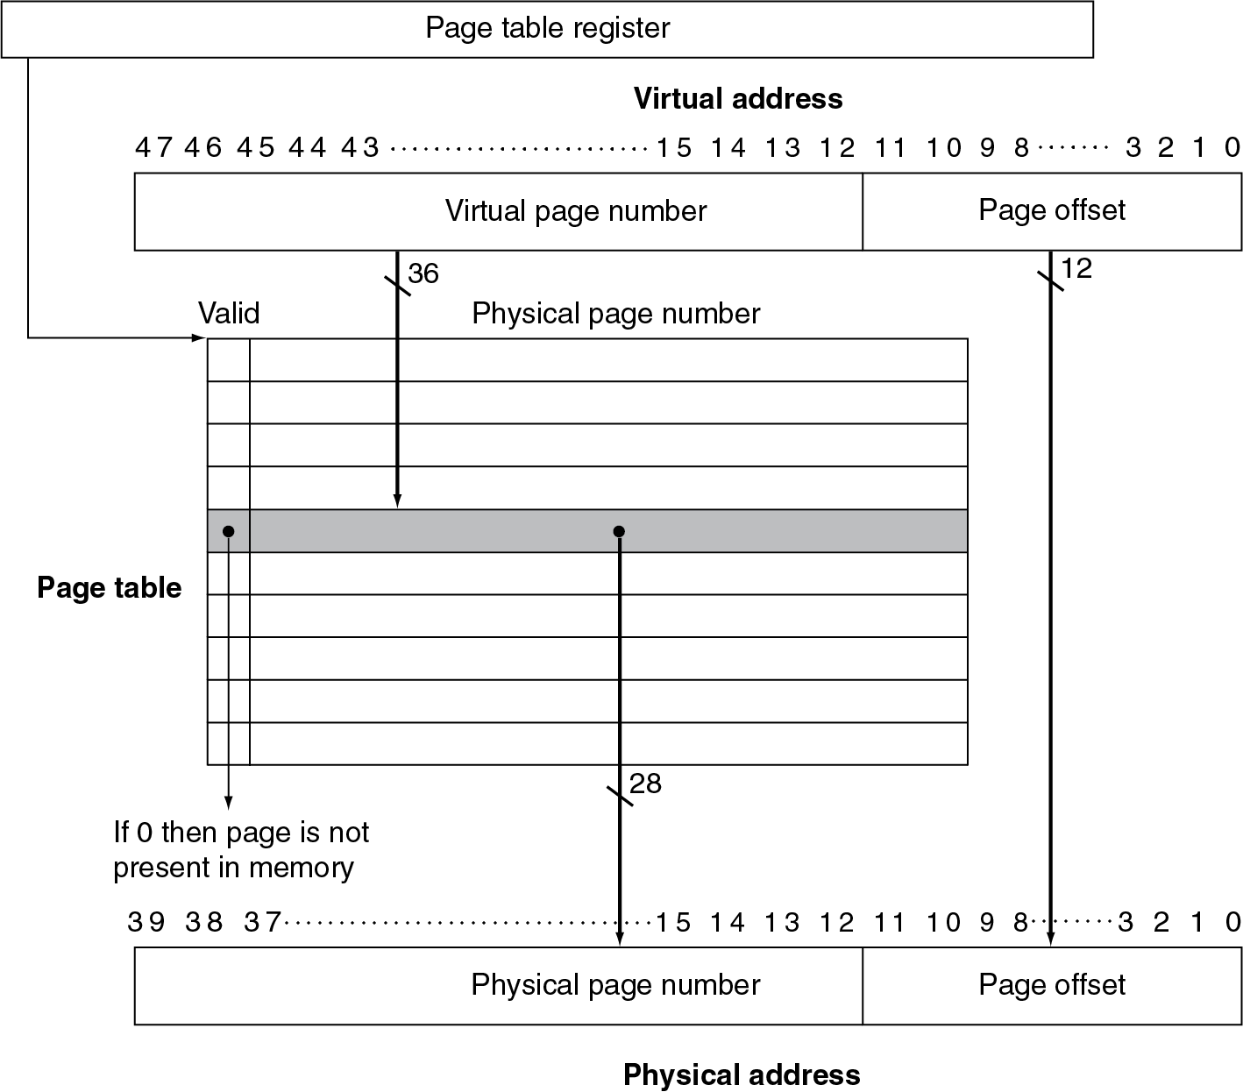
Translation Using a Page Table
Chapter 5 — Large and Fast: Exploiting Memory Hierarchy — ‹#›
Notes:
Morgan Kaufmann Publishers
*
Chapter 5 — Large and Fast: Exploiting Memory Hierarchy
‹#›

Slide 31
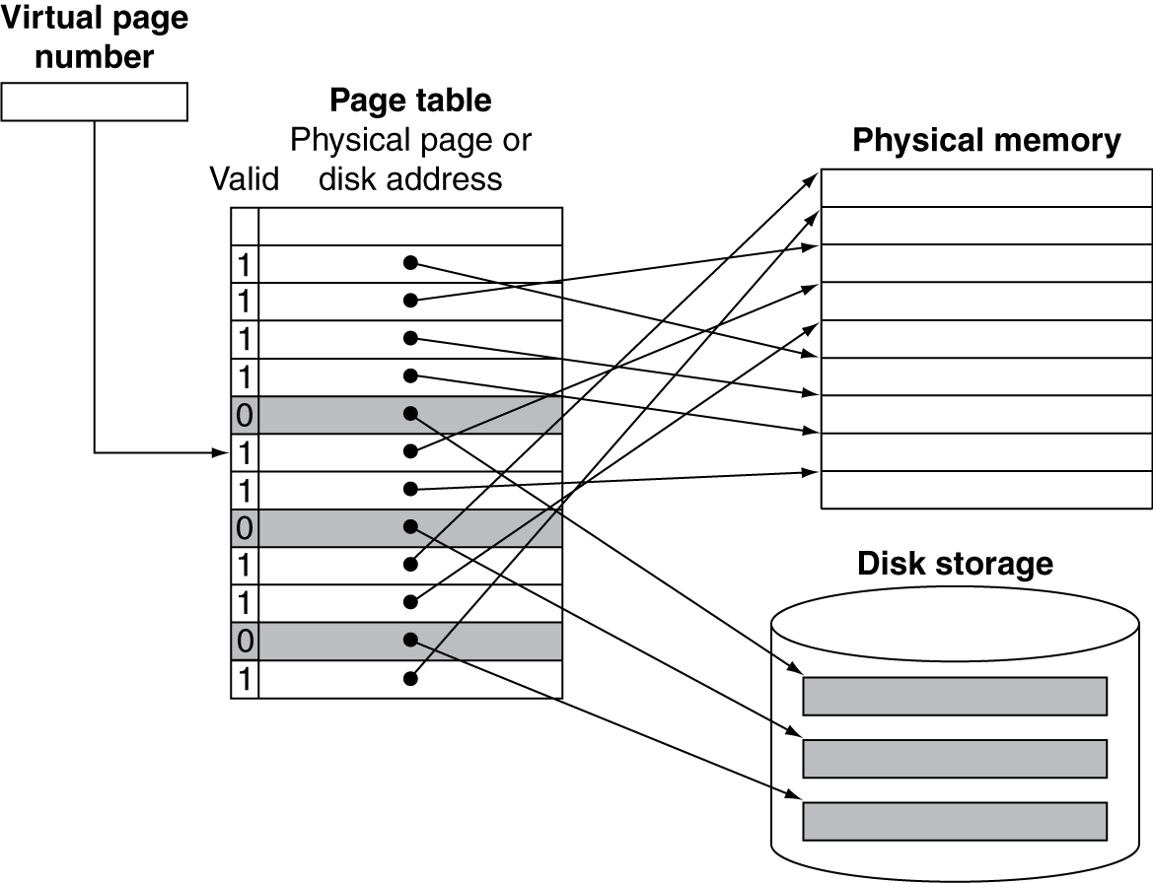
Mapping Pages to Storage
Chapter 5 — Large and Fast: Exploiting Memory Hierarchy — ‹#›
Notes:
Morgan Kaufmann Publishers
*
Chapter 5 — Large and Fast: Exploiting Memory Hierarchy
‹#›

Slide 32
Replacement and Writes
To reduce page fault rate, prefer least-recently used (LRU) replacement
Reference bit (aka use bit) in PTE set to 1 on access to page
Periodically cleared to 0 by OS
A page with reference bit = 0 has not been used recently
Disk writes take millions of cycles
Block at once, not individual locations
Write through is impractical
Use write-back
Dirty bit in PTE set when page is written
Chapter 5 — Large and Fast: Exploiting Memory Hierarchy — ‹#›
Notes:
Morgan Kaufmann Publishers
*
Chapter 5 — Large and Fast: Exploiting Memory Hierarchy
‹#›

Slide 33
Fast Translation Using a TLB
Address translation would appear to require extra memory references
One to access the PTE
Then the actual memory access
But access to page tables has good locality
So use a fast cache of PTEs within the CPU
Called a Translation Look-aside Buffer (TLB)
Typical: 16–512 PTEs, 0.5–1 cycle for hit, 10–100 cycles for miss, 0.01%–1% miss rate
Misses could be handled by hardware or software
Chapter 5 — Large and Fast: Exploiting Memory Hierarchy — ‹#›
Notes:
Morgan Kaufmann Publishers
*
Chapter 5 — Large and Fast: Exploiting Memory Hierarchy
‹#›

Slide 34
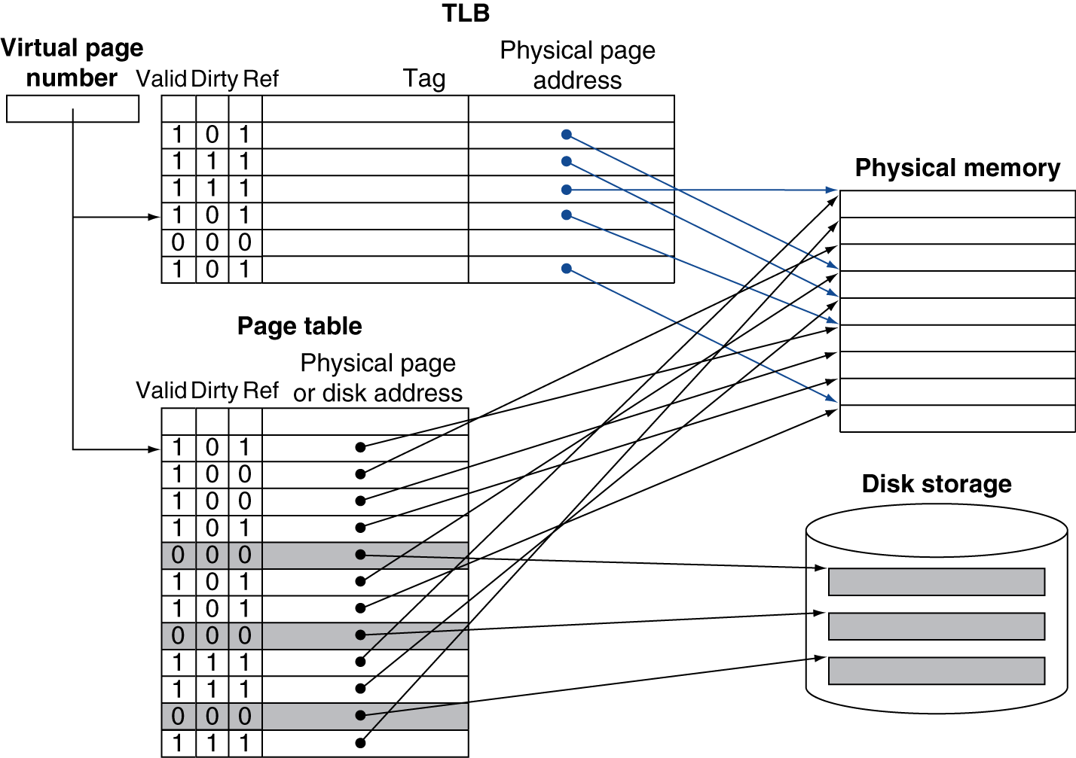
Fast Translation Using a TLB
Chapter 5 — Large and Fast: Exploiting Memory Hierarchy — ‹#›
Notes:
Morgan Kaufmann Publishers
*
Chapter 5 — Large and Fast: Exploiting Memory Hierarchy
‹#›

Slide 35
TLB Misses
If page is in memory
Load the PTE from memory and retry
Could be handled in hardware
Can get complex for more complicated page table structures
Or in software
Raise a special exception, with optimized handler
If page is not in memory (page fault)
OS handles fetching the page and updating the page table
Then restart the faulting instruction
Chapter 5 — Large and Fast: Exploiting Memory Hierarchy — ‹#›
Notes:
Morgan Kaufmann Publishers
*
Chapter 5 — Large and Fast: Exploiting Memory Hierarchy
‹#›

Slide 36
TLB Miss Handler
TLB miss indicates
Page present, but PTE not in TLB
Page not preset
Must recognize TLB miss before destination register overwritten
Raise exception
Handler copies PTE from memory to TLB
Then restarts instruction
If page not present, page fault will occur
Chapter 5 — Large and Fast: Exploiting Memory Hierarchy — ‹#›
Notes:
Morgan Kaufmann Publishers
*
Chapter 5 — Large and Fast: Exploiting Memory Hierarchy
‹#›

Slide 37
Page Fault Handler
Use faulting virtual address to find PTE
Locate page on disk
Choose page to replace
If dirty, write to disk first
Read page into memory and update page table
Make process runnable again
Restart from faulting instruction
Chapter 5 — Large and Fast: Exploiting Memory Hierarchy — ‹#›
Notes:
Morgan Kaufmann Publishers
*
Chapter 5 — Large and Fast: Exploiting Memory Hierarchy
‹#›

Slide 38
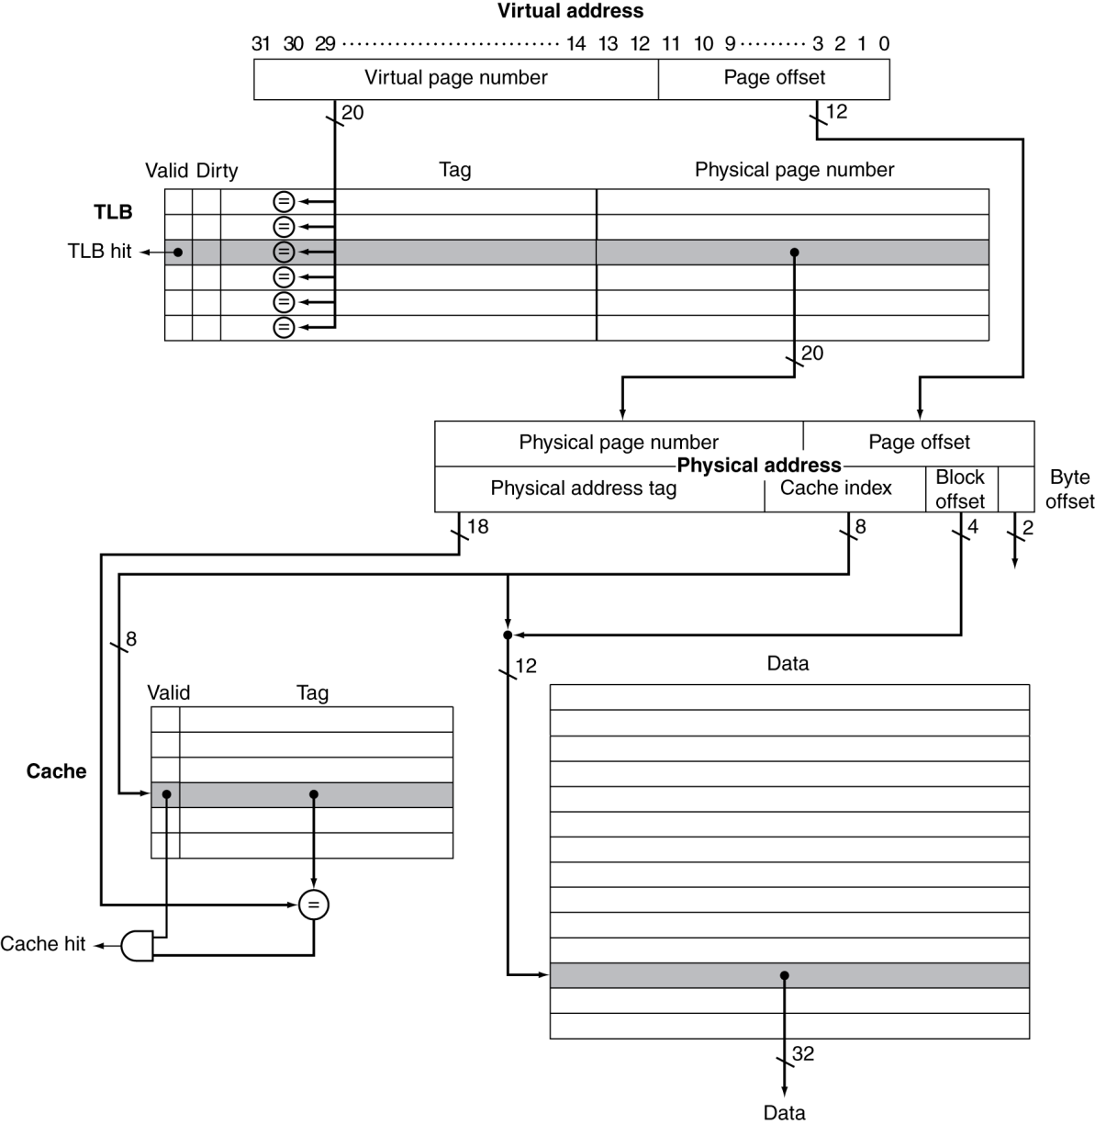
TLB and Cache Interaction
If cache tag uses physical address
Need to translate before cache lookup
Alternative: use virtual address tag
Complications due to aliasing
Different virtual addresses for shared physical address
Chapter 5 — Large and Fast: Exploiting Memory Hierarchy — ‹#›
Notes:
Morgan Kaufmann Publishers
*
Chapter 5 — Large and Fast: Exploiting Memory Hierarchy
‹#›

Slide 39
Memory Protection
Different tasks can share parts of their virtual address spaces
But need to protect against errant access
Requires OS assistance
Hardware support for OS protection
Privileged supervisor mode (aka kernel mode)
Privileged instructions
Page tables and other state information only accessible in supervisor mode
System call exception (e.g., ecall in RISC-V)
Chapter 5 — Large and Fast: Exploiting Memory Hierarchy — ‹#›
Notes:
Morgan Kaufmann Publishers
*
Chapter 5 — Large and Fast: Exploiting Memory Hierarchy
‹#›

Slide 40
The Memory Hierarchy
The BIG Picture
Common principles apply at all levels of the memory hierarchy
Based on notions of caching
At each level in the hierarchy
Block placement
Finding a block
Replacement on a miss
Write policy
§5.8 A Common Framework for Memory Hierarchies
Chapter 5 — Large and Fast: Exploiting Memory Hierarchy — ‹#›
Notes:
Morgan Kaufmann Publishers
*
Chapter 5 — Large and Fast: Exploiting Memory Hierarchy
‹#›

