Slide 1
Data and Project Goals
By : Yash Kasundra
A1838670

Slide 2
Data Selection :
The Main reason for selecting these datasets were as follows:
The RAVDESS is a validated multimodal database of emotional speech and song. It consists of 24 professional actors, vocalizing lexically matched statements in neutral North American accent and it has 8 different emotions in the dataset.
CREMA-D consists of 7,442 clips of 91 actors from diverse ethnic background Categorized in 6 different emotions.
SAVEE has recordings from 7 different male actors, with 480 British utterance in total distributed over 7 different emotions (Common, Anger, Disgust, Fear, Happiness, Sadness, Surprise, Neutral).
TESS consists is a collection of Audio clips of 2 women expressing 7 different emotions (anger, disgust, fear, happiness, pleasant surprise, sadness, and neutral)
1

Slide 3
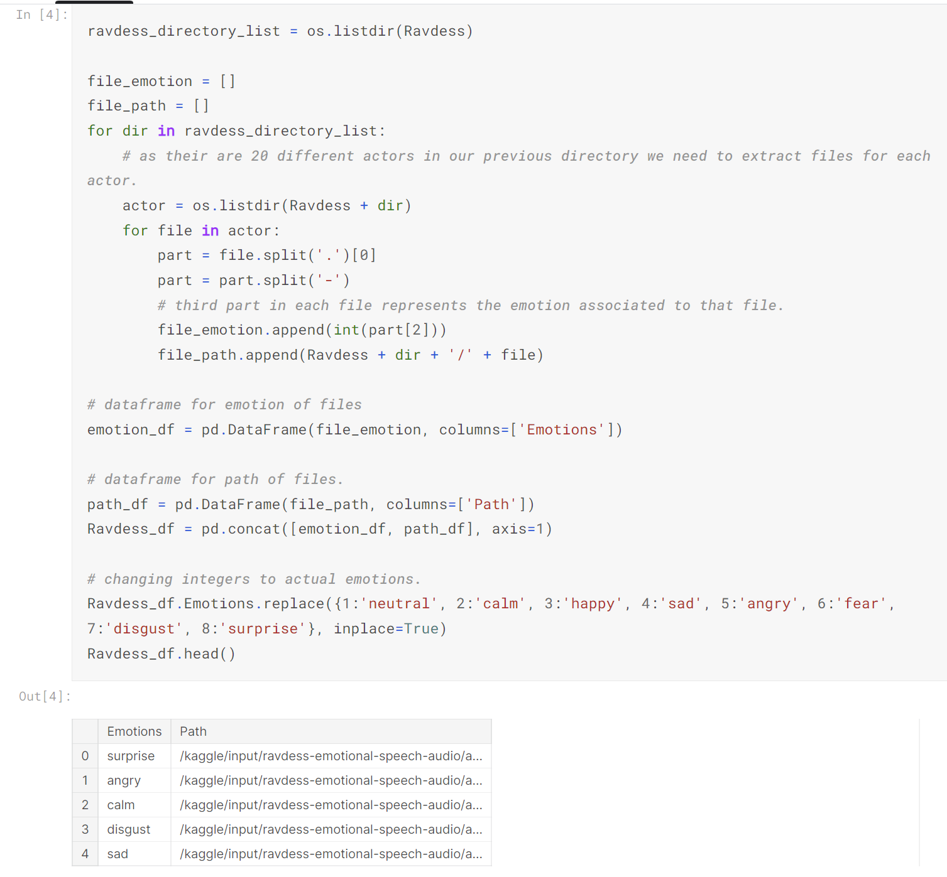
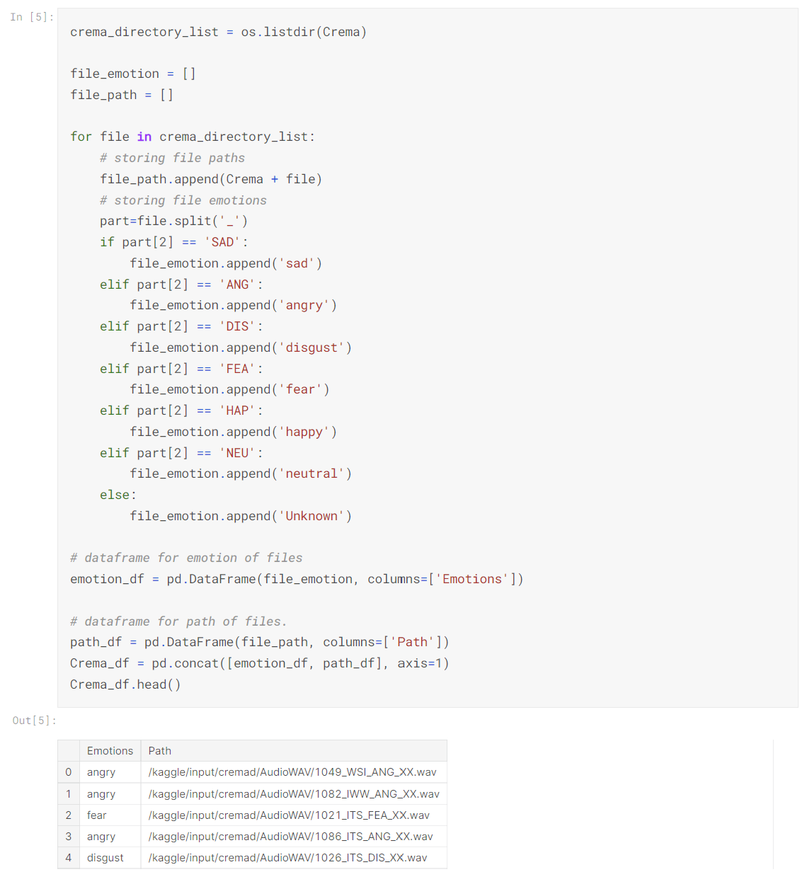
Data Loading & Transformation :
First task of the project was to Load the data and unify all the datasets into a single format to load that into a dataframe. Below Images will show the code I used to achieve that task:
2

Slide 4
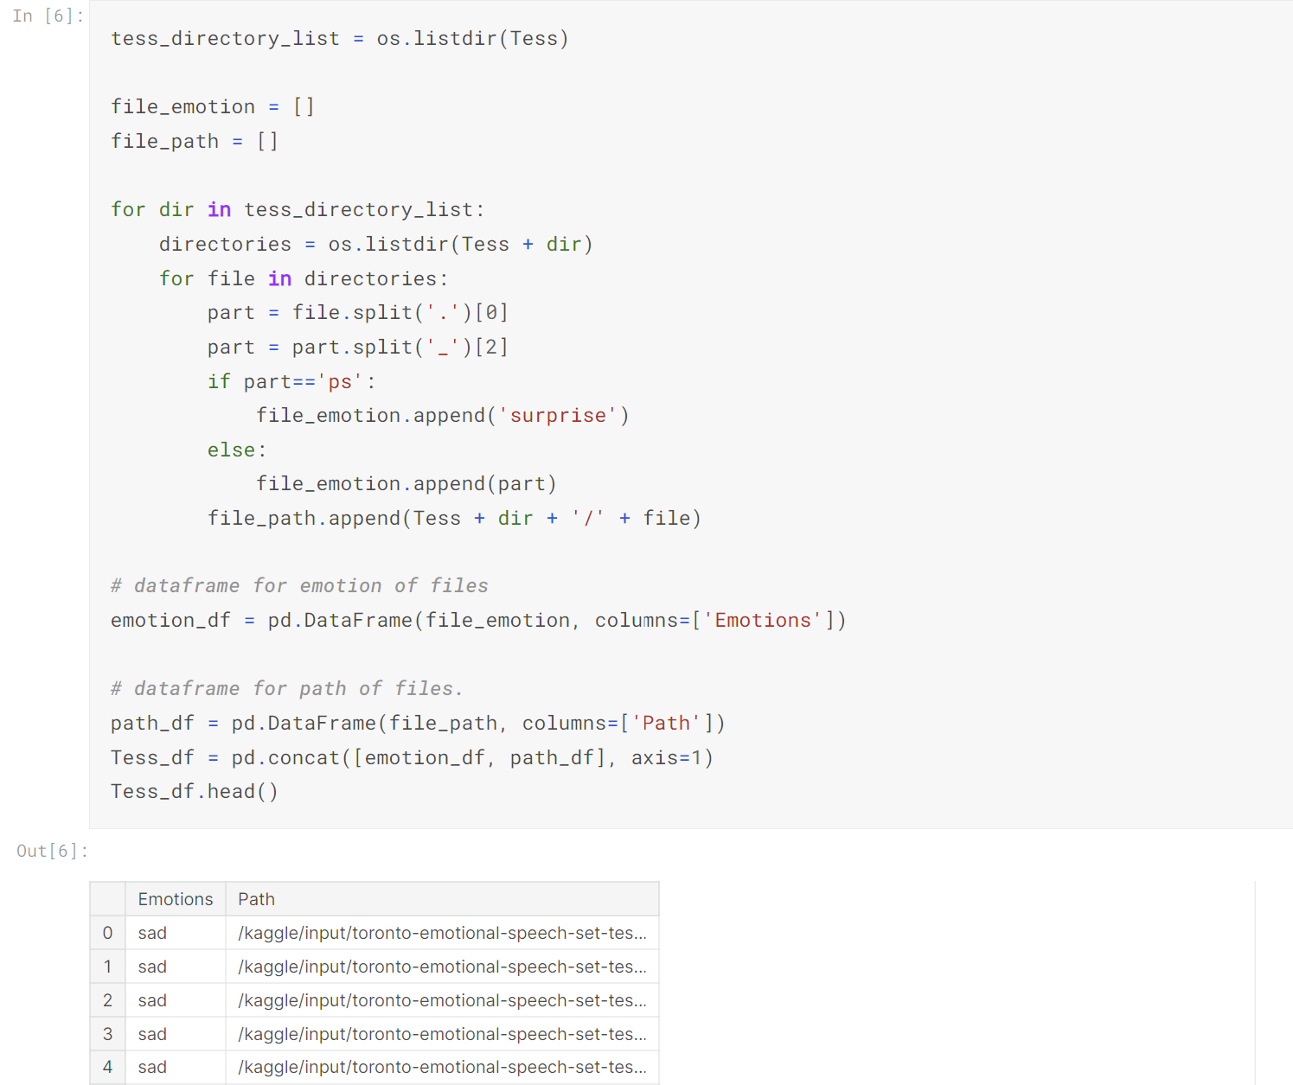
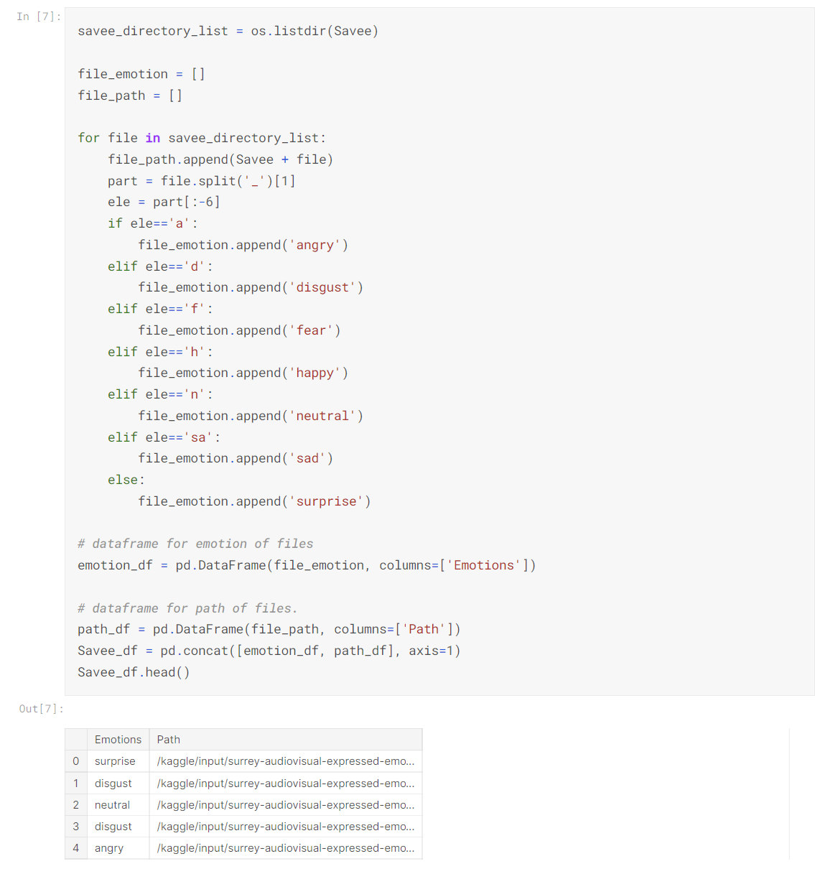
Data Loading & Transformation :

Slide 5
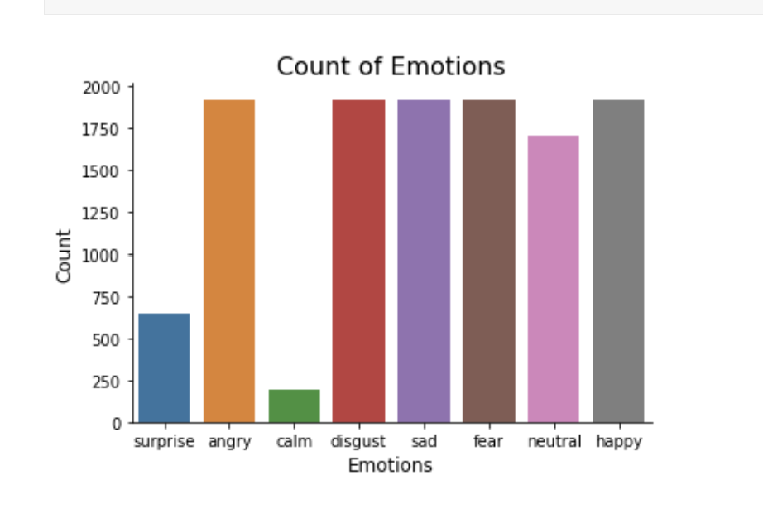
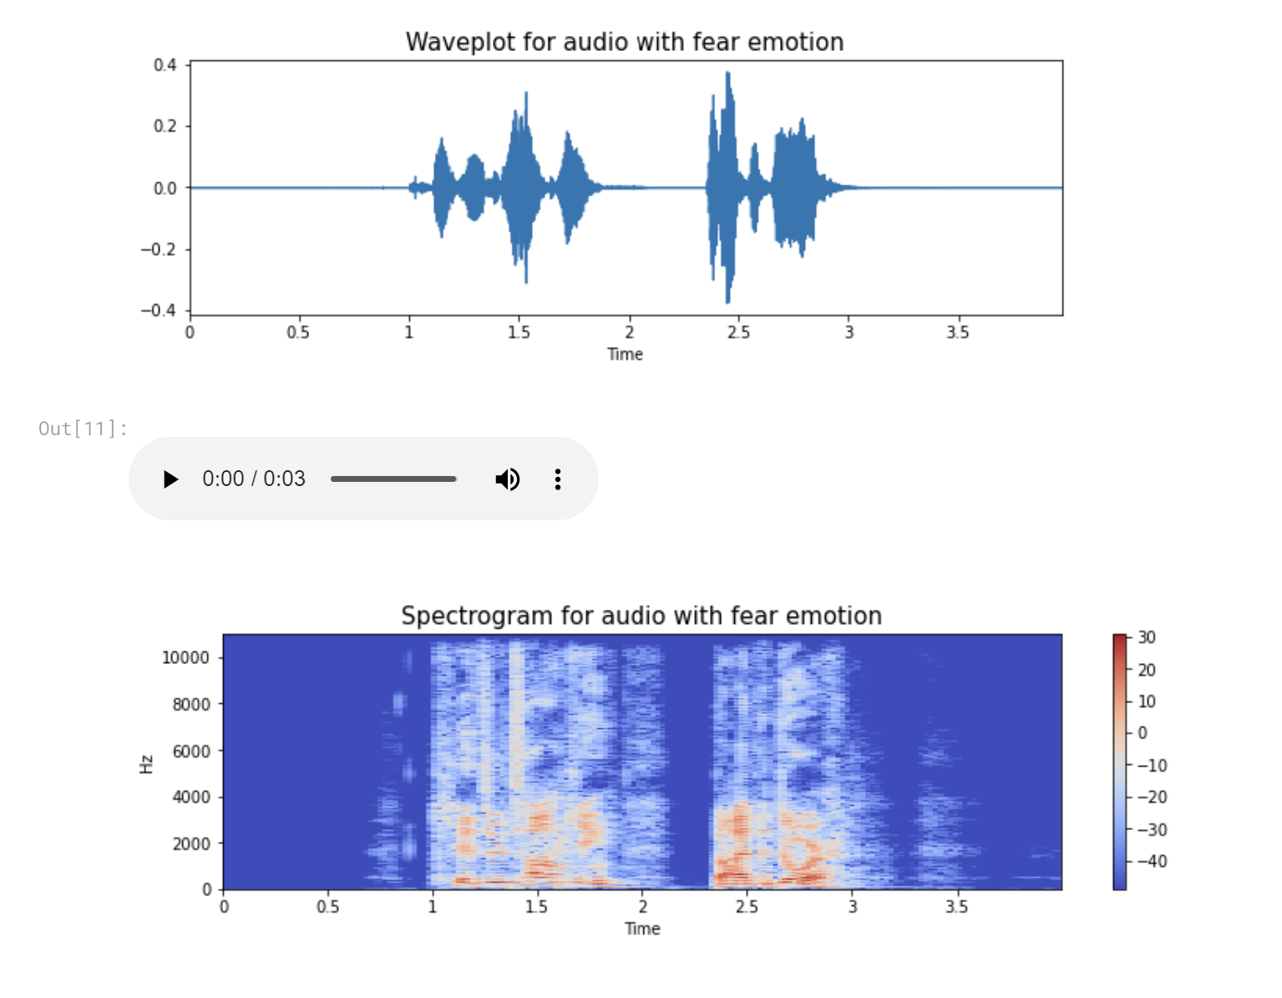
Data Visualization :
After merging all the datasets successfully, it was time to visualize the data that I gathered to identify some features or relationships.
To check the number of sample I had for different emotions I plotted a bar graph.
To gain some more insights from the data I plotted wavelengths and spectograms of different emotions. So a spectrogram is visual representation of frequencies as they vary with time.
3

Slide 6
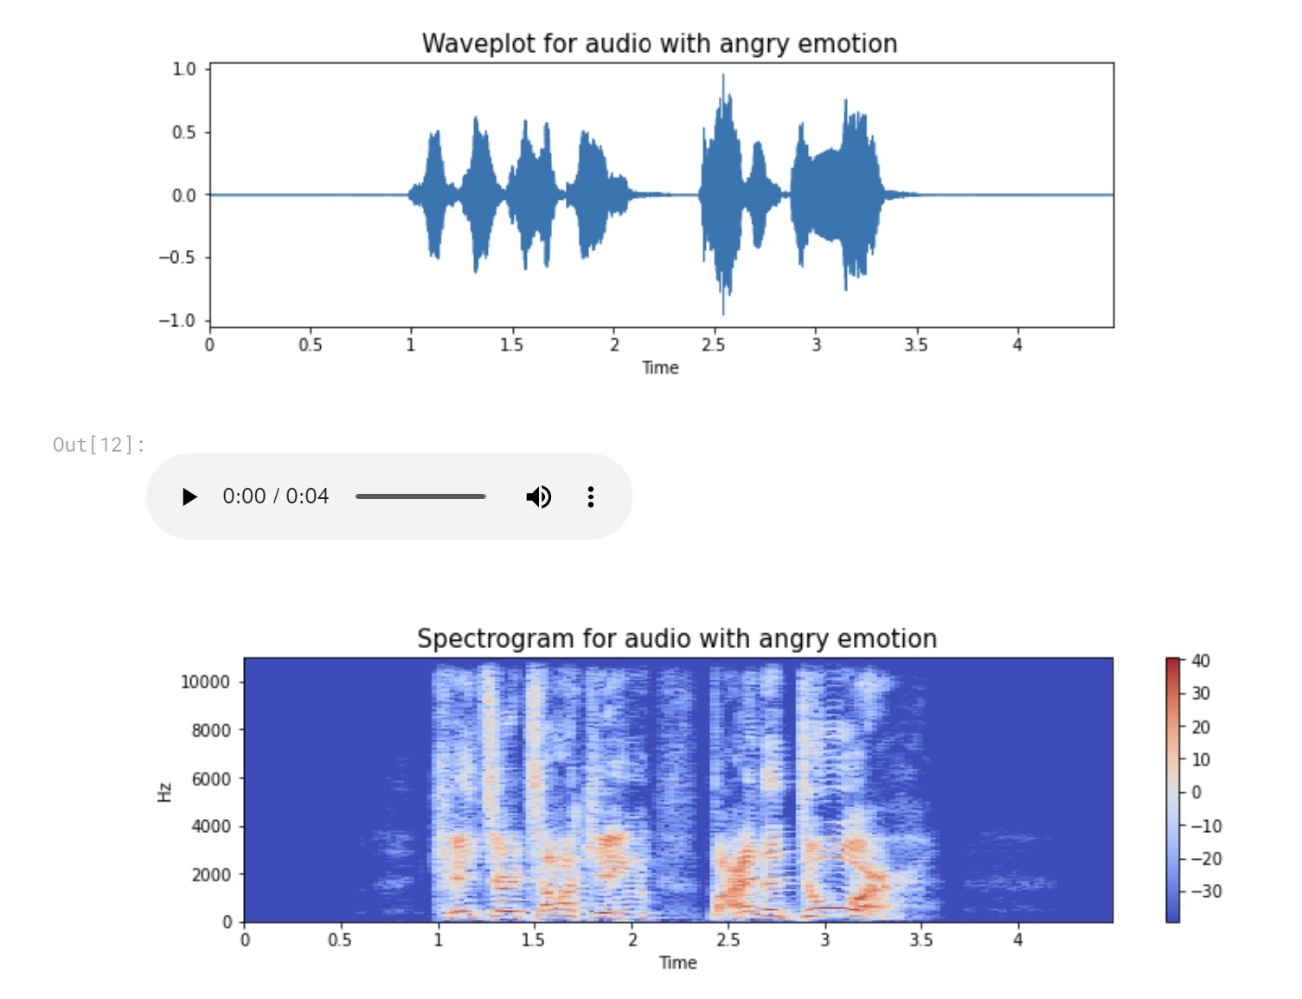
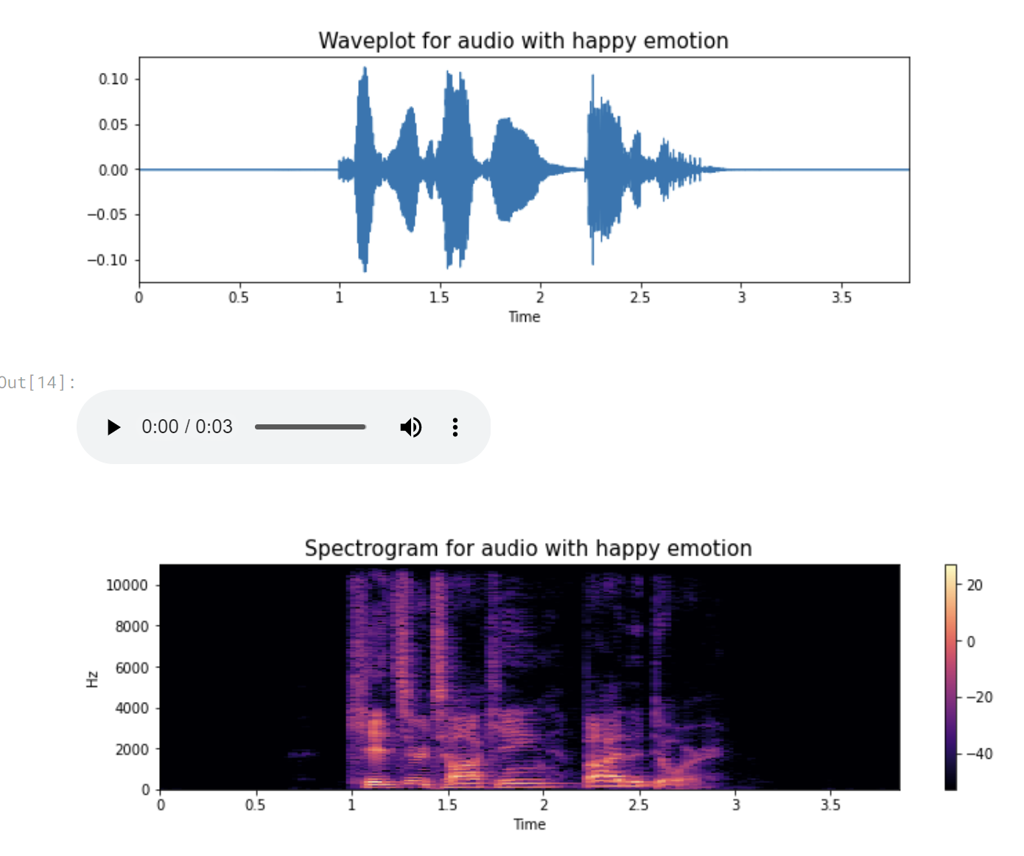
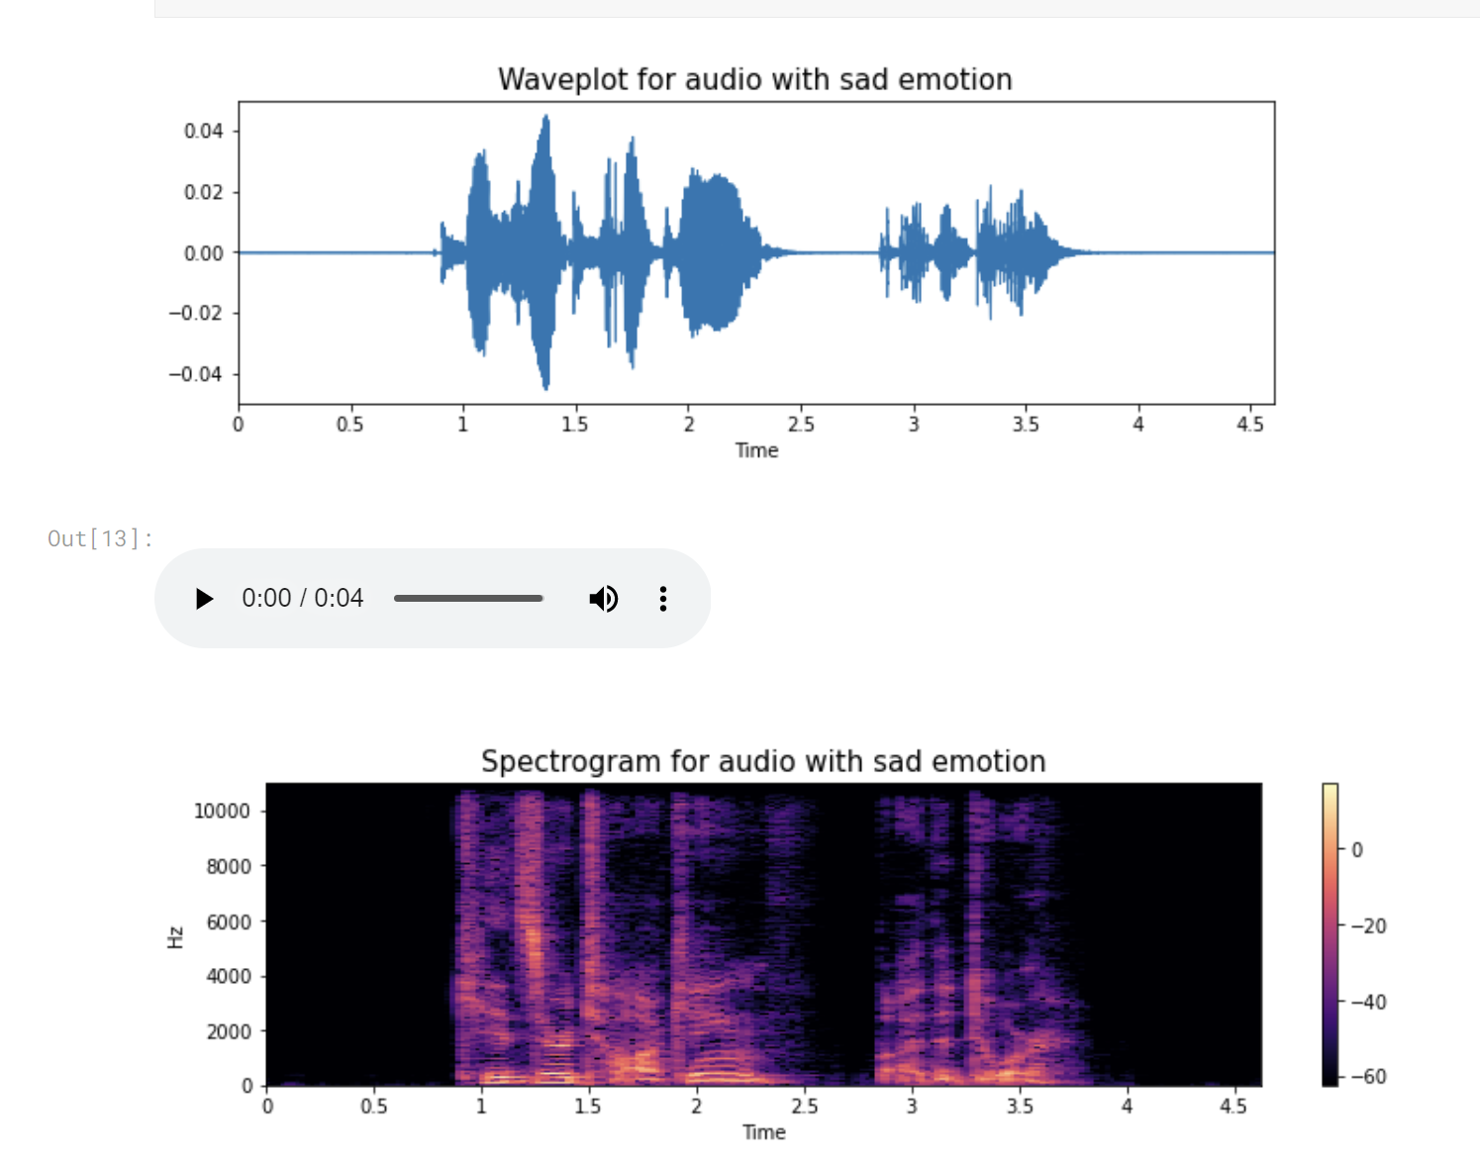
Data Visualization :
Few more plots of wavelengths and spectrograms:

Slide 7
Data Augmentation :
Data augmentation is the process by which we create new synthetic data samples by adding small perturbations on our initial training set.
To generate syntactic data for audio, we can apply noise injection, shifting time, changing pitch and speed.
The objective is to make our model invariant to those perturbations and enhance its ability to generalize.
In order to this to work adding the perturbations must conserve the same label as the original training sample.
4

Slide 8

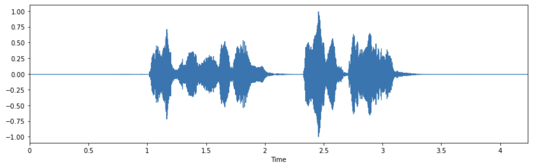
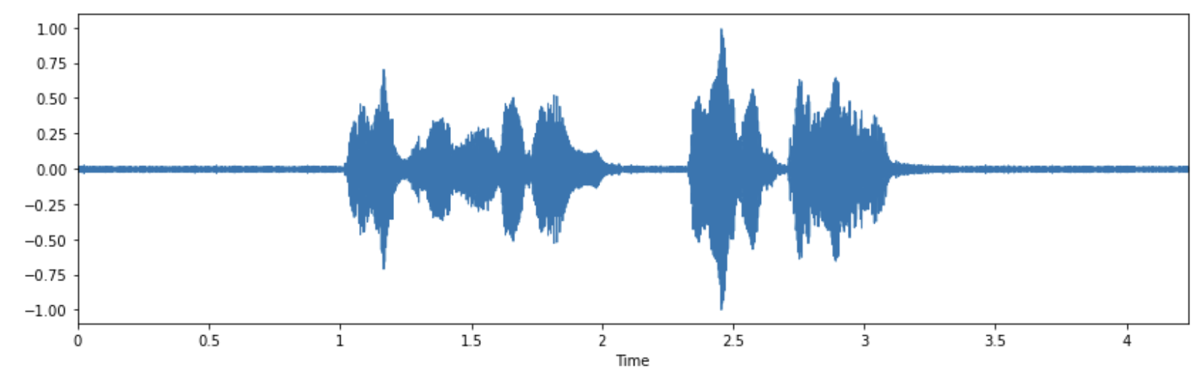
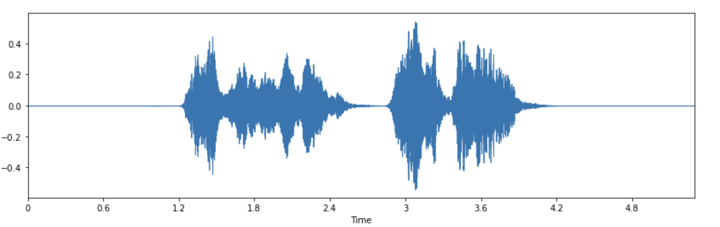
Data Augmentation :
Here I’ve added some audio files and their wave plots to show how I have augmented the original audio in order to get more samples for my project:
Normal Voice:
Injecting Noise:
Stretching:

Slide 9
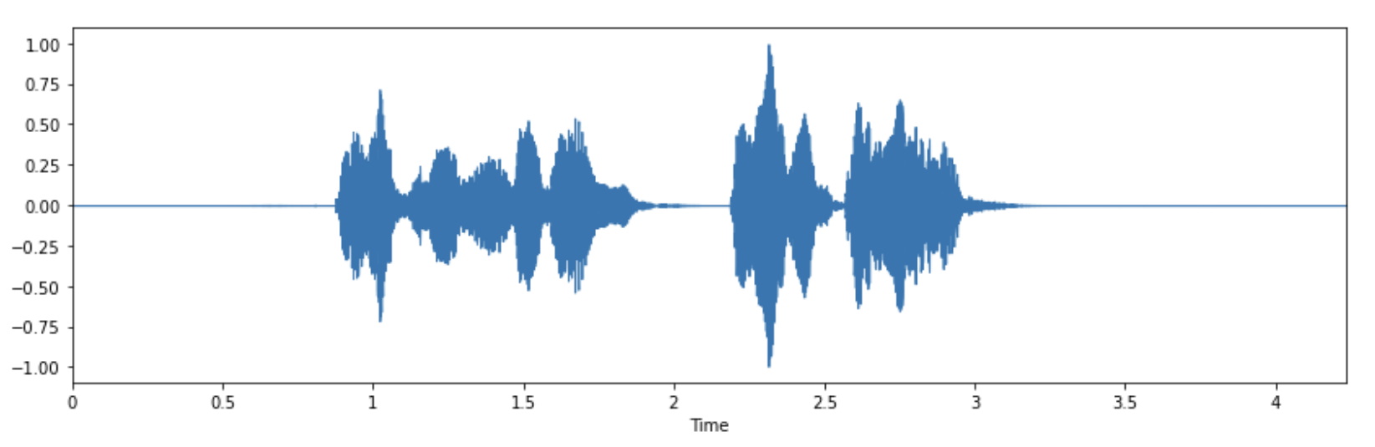
Data Augmentation :
Here I’ve added some audio files and their wave plots to show how I have augmented the original audio in order to get more samples for my project:
Shifting:
Pitch:

Slide 10
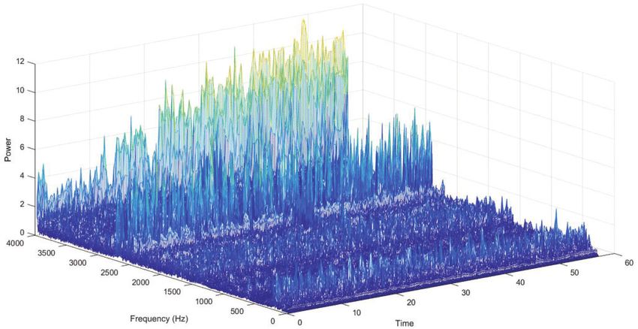
Feature Selection:
Now as you can see from this graph Audio is a 3-d signal, in which axis represents time amplitude and frequency. So here it is of crucial importance to find some relations and analyze some features, since audio cannot be understood by models directly, I will have to convert it into an understandable format by using feature extraction.
5
Image from : https://www.researchgate.net/figure/Three-dimensional-plot-of-the-power-spectral-density-of-audio-signal_fig9_315745637

Slide 11
Feature Selection:
I am no expert on audio signals and feature extraction on audio files, I found a great blog by Aakash Mallik (https://medium.com/heuristics/audio-signal-feature-extraction-and-clustering-935319d2225) :
Zero Crossing Rate : The rate of sign-changes of the signal during the duration of a particular frame.
Energy : The sum of squares of the signal values, normalized by the respective frame length.
Entropy of Energy : The entropy of sub-frames’ normalized energies. It can be interpreted as a measure of abrupt changes.
Spectral Centroid : The center of gravity of the spectrum.
Spectral Spread : The second central moment of the spectrum.
Spectral Entropy : Entropy of the normalized spectral energies for a set of sub-frames.
Spectral Flux : The squared difference between the normalized magnitudes of the spectra of the two successive frames.
Spectral Rolloff : The frequency below which 90% of the magnitude distribution of the spectrum is concentrated.
MFCCs Mel Frequency Cepstral Coefficients form a cepstral representation where the frequency bands are not linear but distributed according to the mel-scale.
Chroma Vector : A 12-element representation of the spectral energy where the bins represent the 12 equal-tempered pitch classes of western-type music (semitone spacing).
Chroma Deviation : The standard deviation of the 12 chroma coefficients.

Slide 12
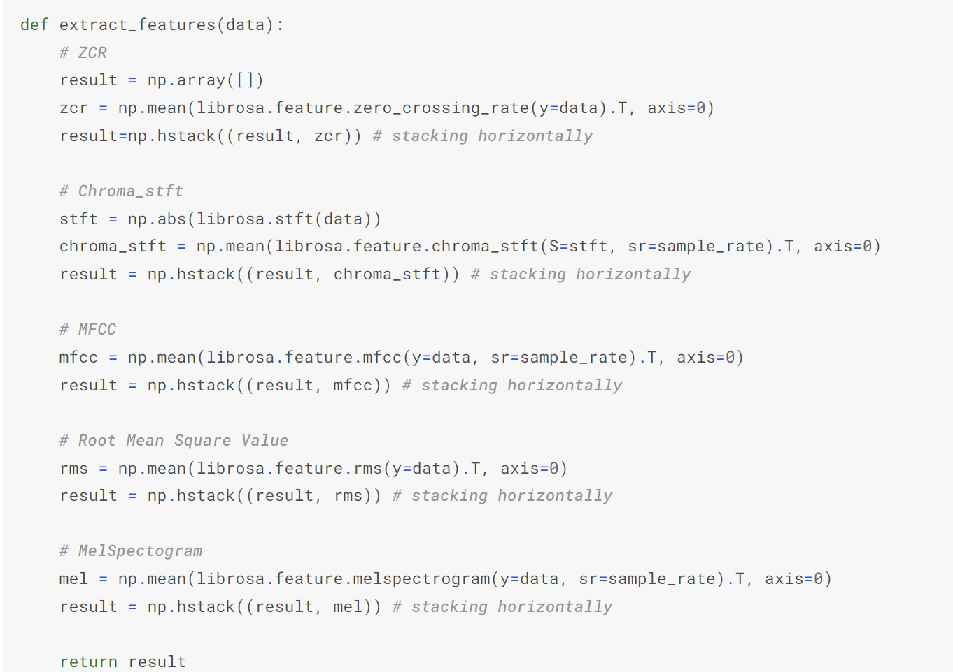
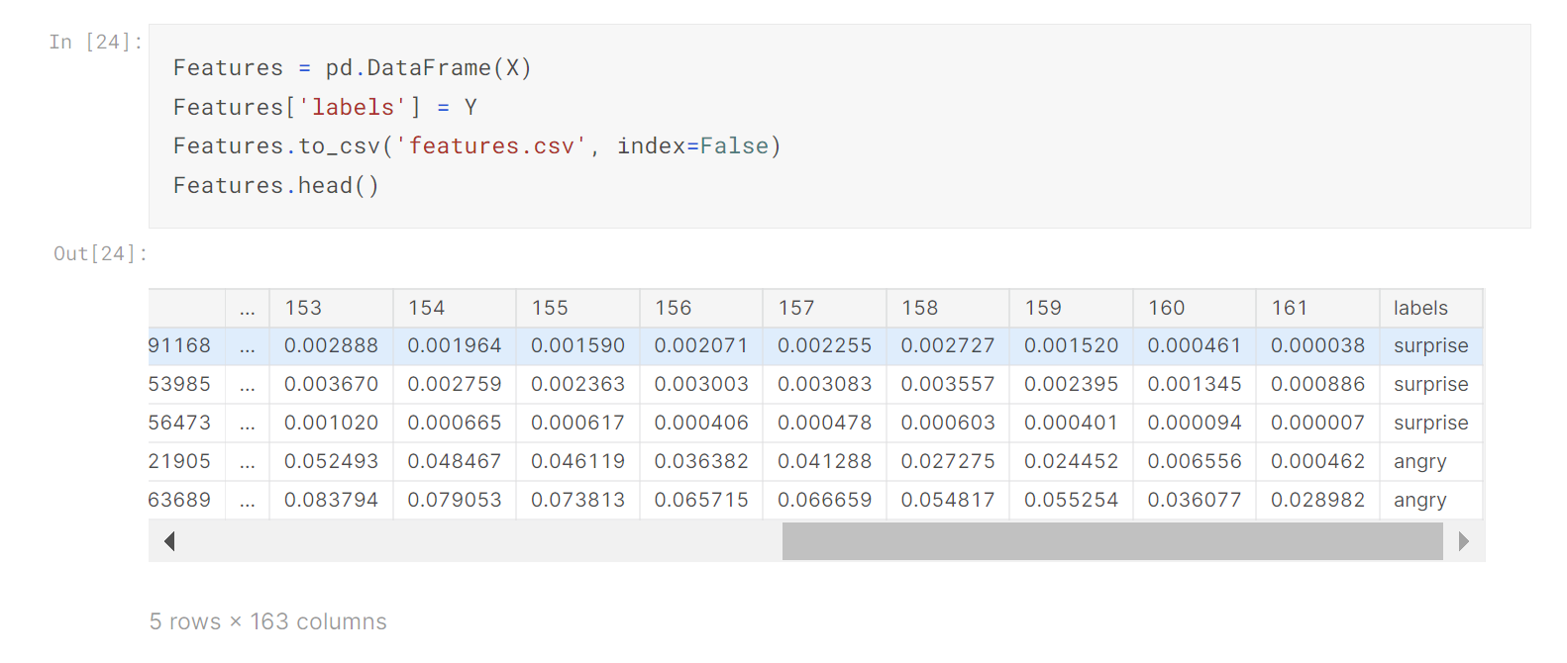
Feature Selection:
Amongst those features, I decided to select the following features to work with based on the information on that blog and few testing done by me.
Zero Crossing Rate
Chroma_stft
MFCC
RMS(root mean square) value
MelSpectogram to train our model.

Slide 13
Thank You!!!
By : Yash Kasundra
A1838670

