Slide 1
Final Analysis
By : Yash Kasundra
A1838670

Slide 2
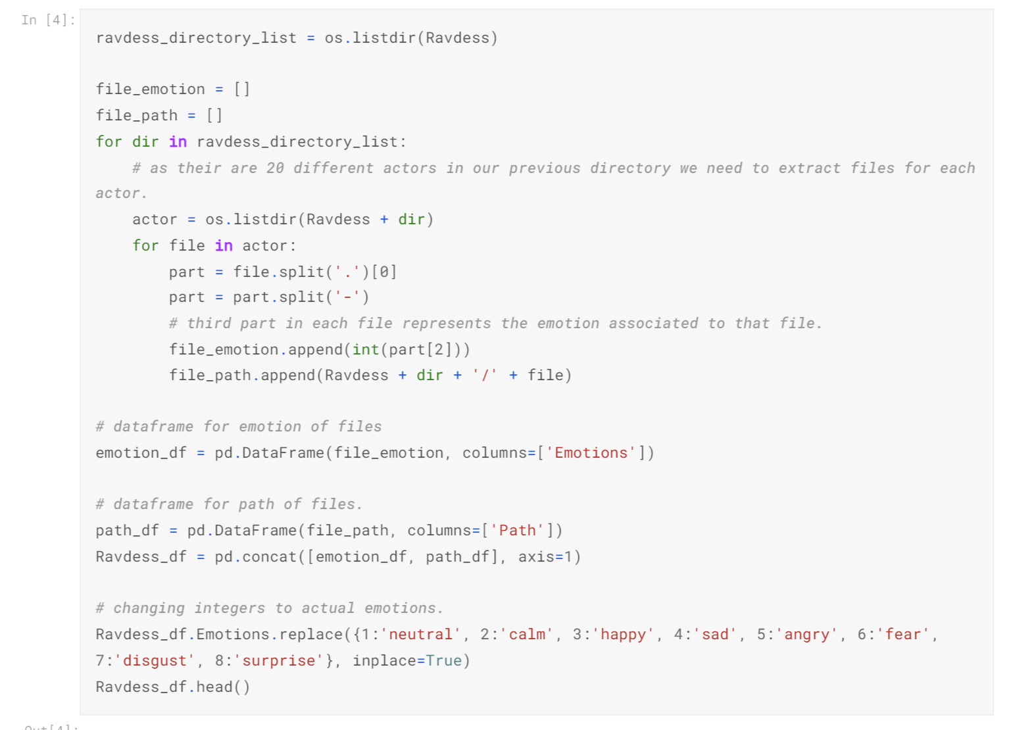
Data Preparation :
Create 4 different functions to load data into data frames from all 4 different datasets.
1
After loading all 4 data frames we merged the data into single data frame for further usage.

Slide 3
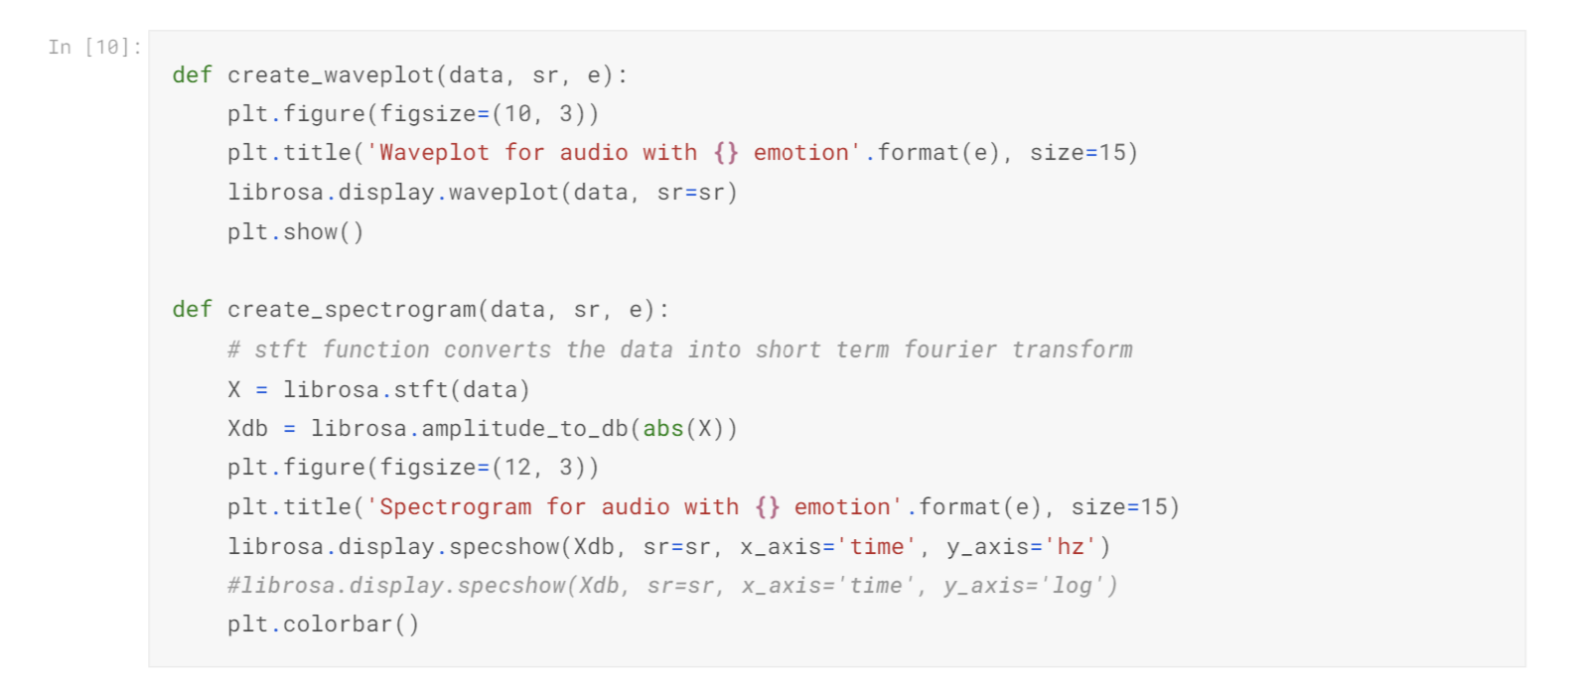
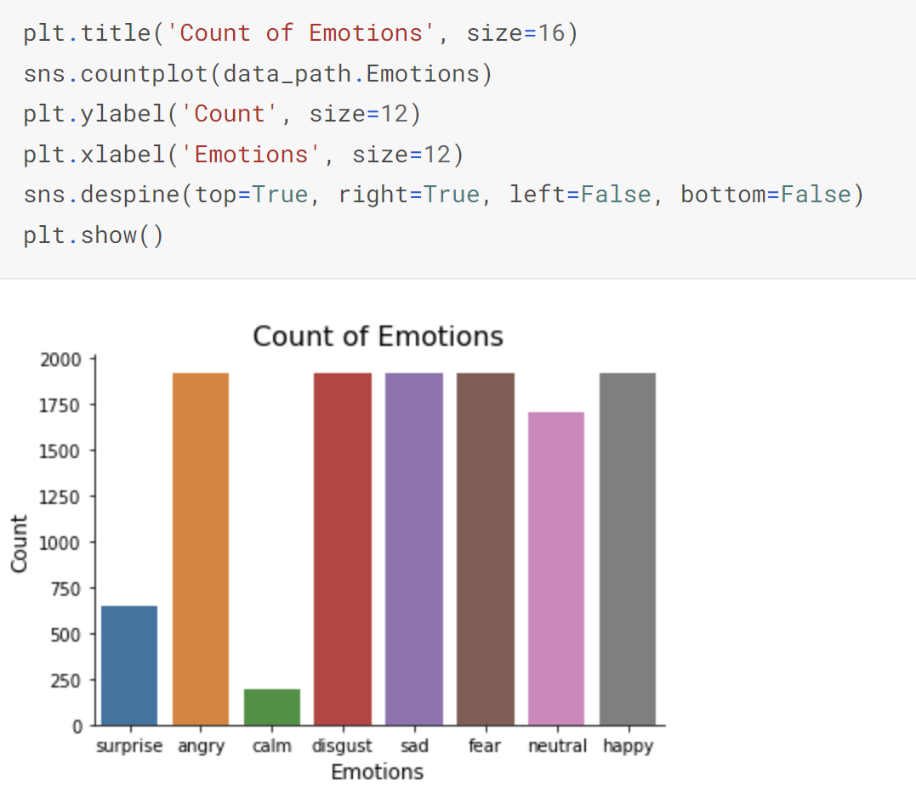
Data Visualization
Plotted few graphs to find the count of all emotions.
And to further understand different emotions also plotted wavelength plots as well as spectrogram plots.

Slide 4
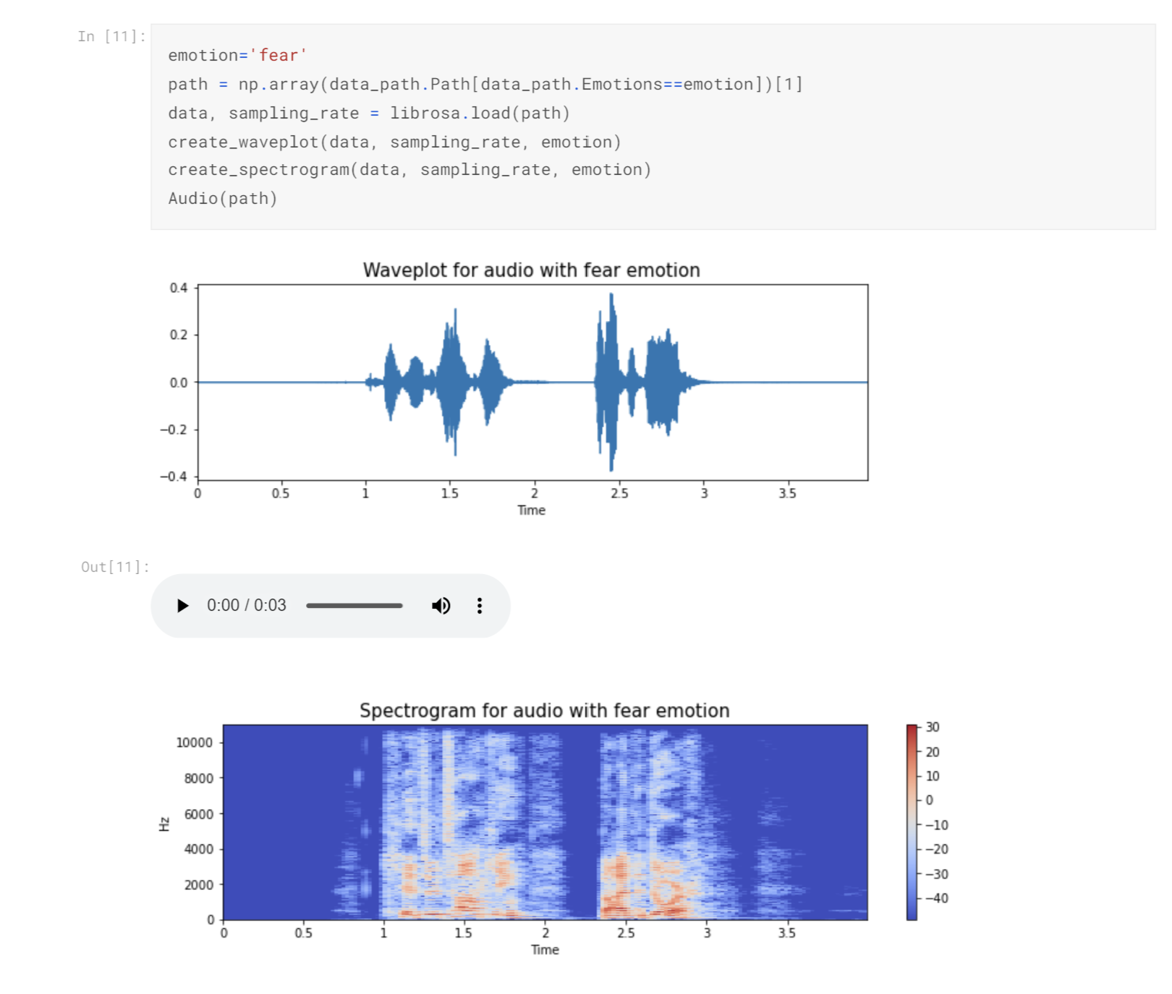
Data Visualization
Example of the waveplot and spectrogram plot

Slide 5
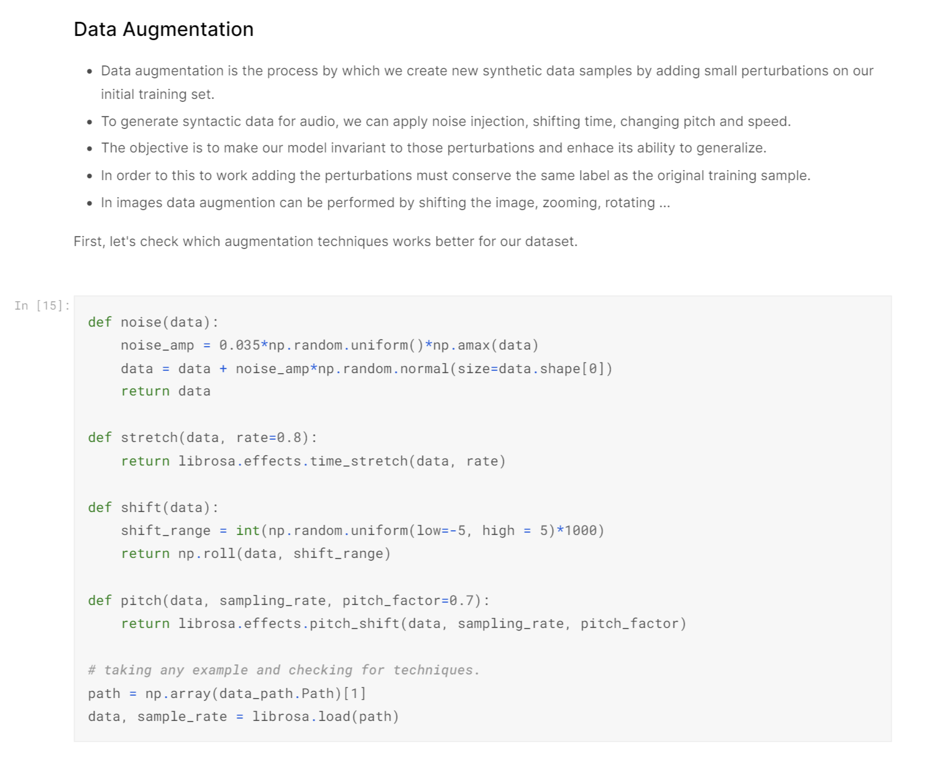
Data Augmentation:
Based on previous graphs, I found the need to upsample few emotions. Thus, I research different techniques to achieve that result and found voice can be upsampled using these techniques mentioned below.
I added a description so that anyone could understand the usage of these function.
2

Slide 6
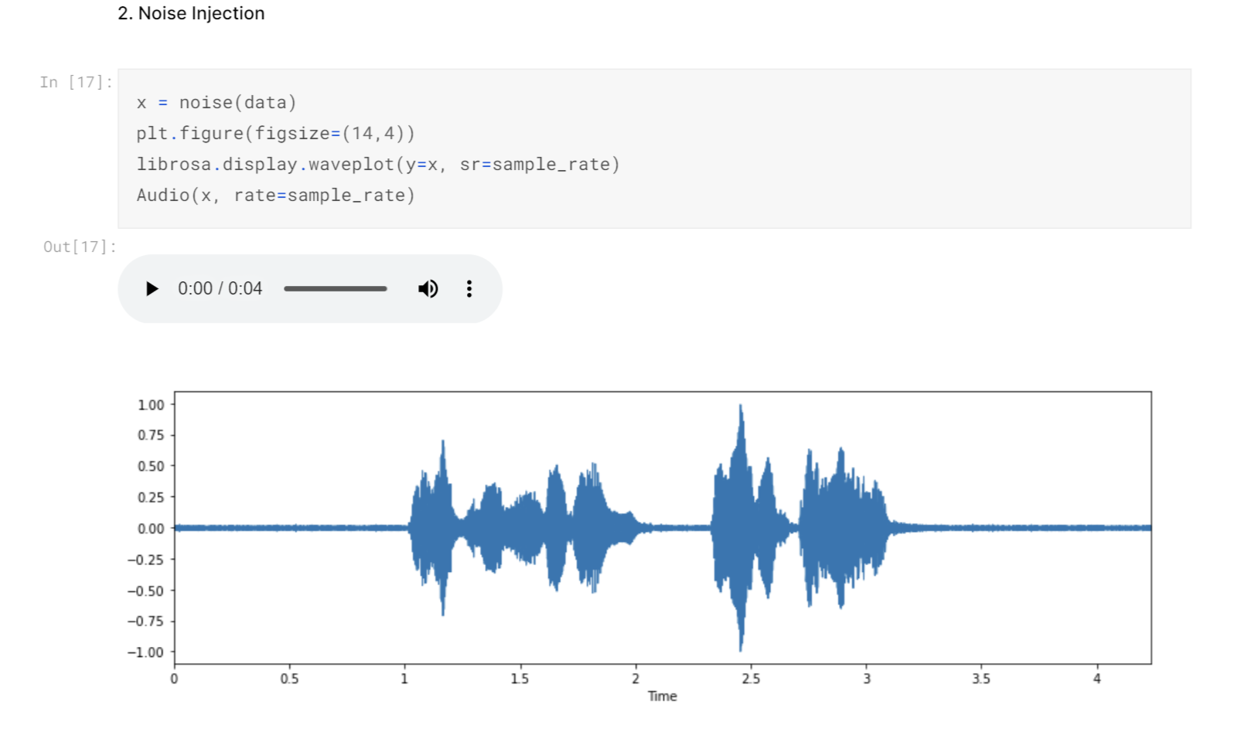
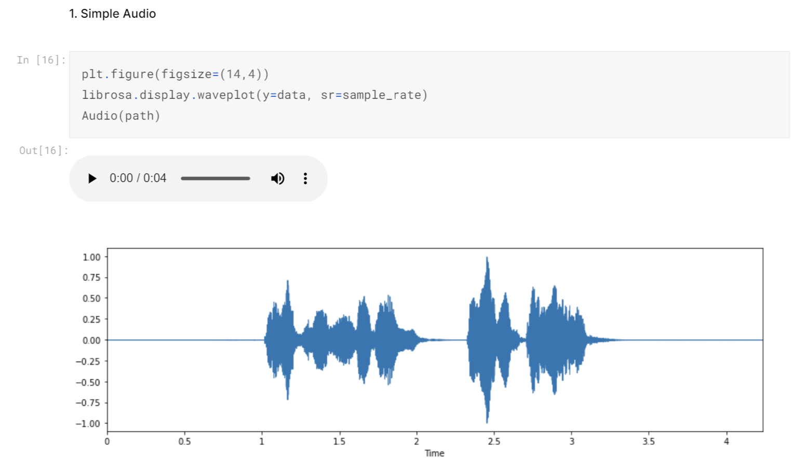
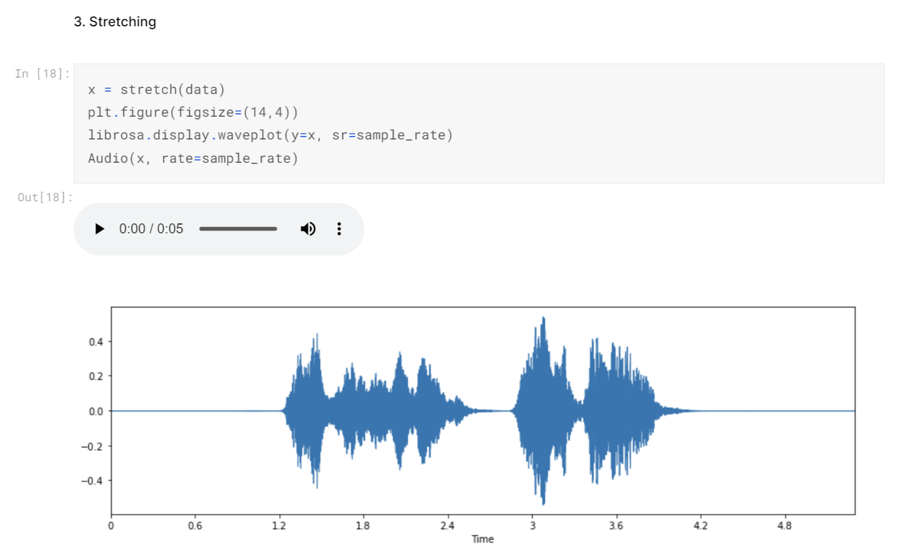
Data Augmentation
Few Examples of different augmentation techniques used.

Slide 7
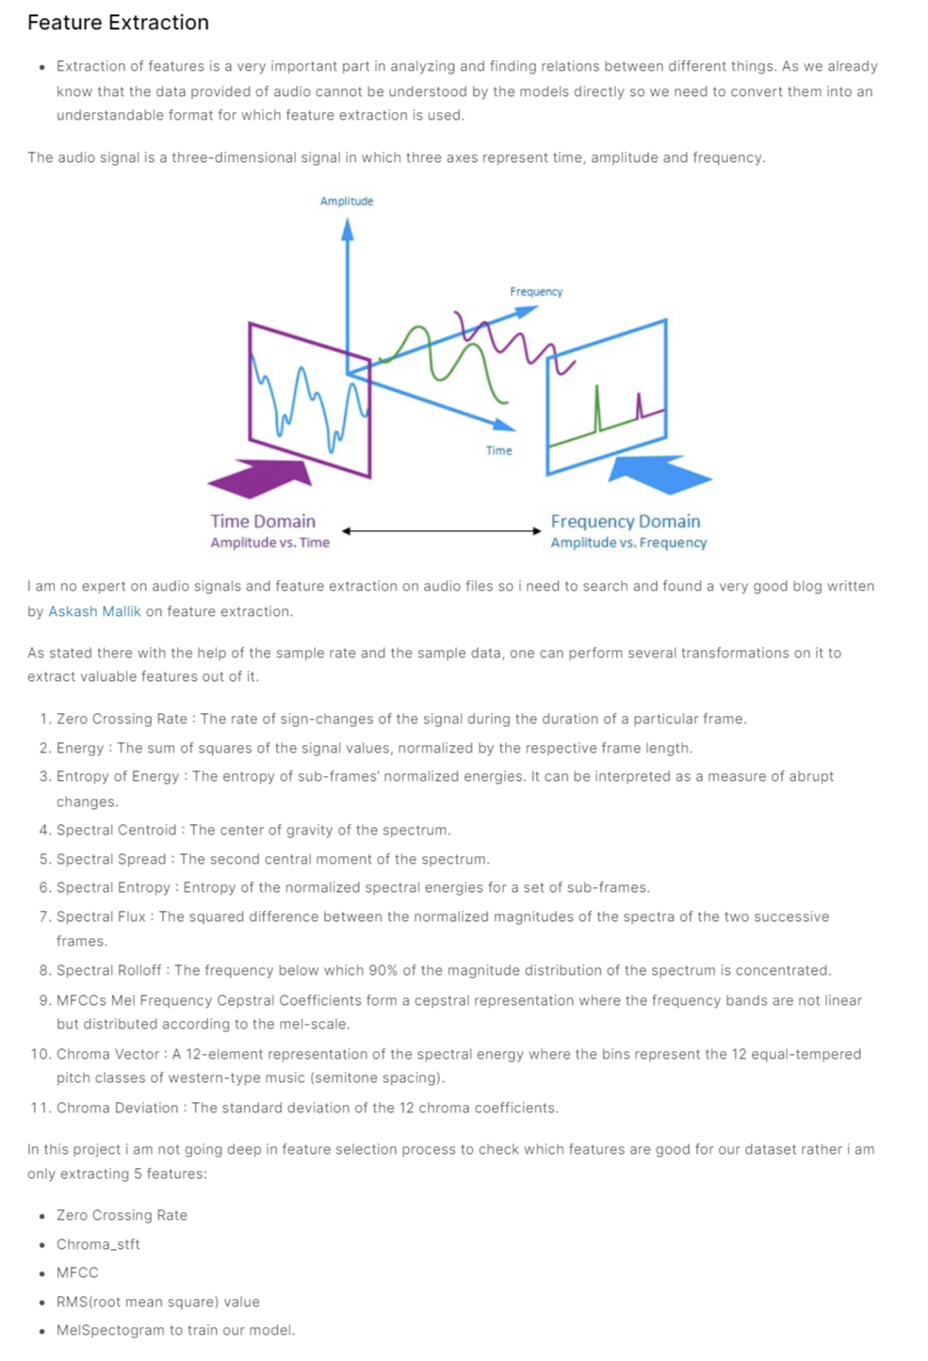
Feature Extraction :
I again provided description about the working of different features and how one’s I selected are better fit for this project.
3

Slide 8
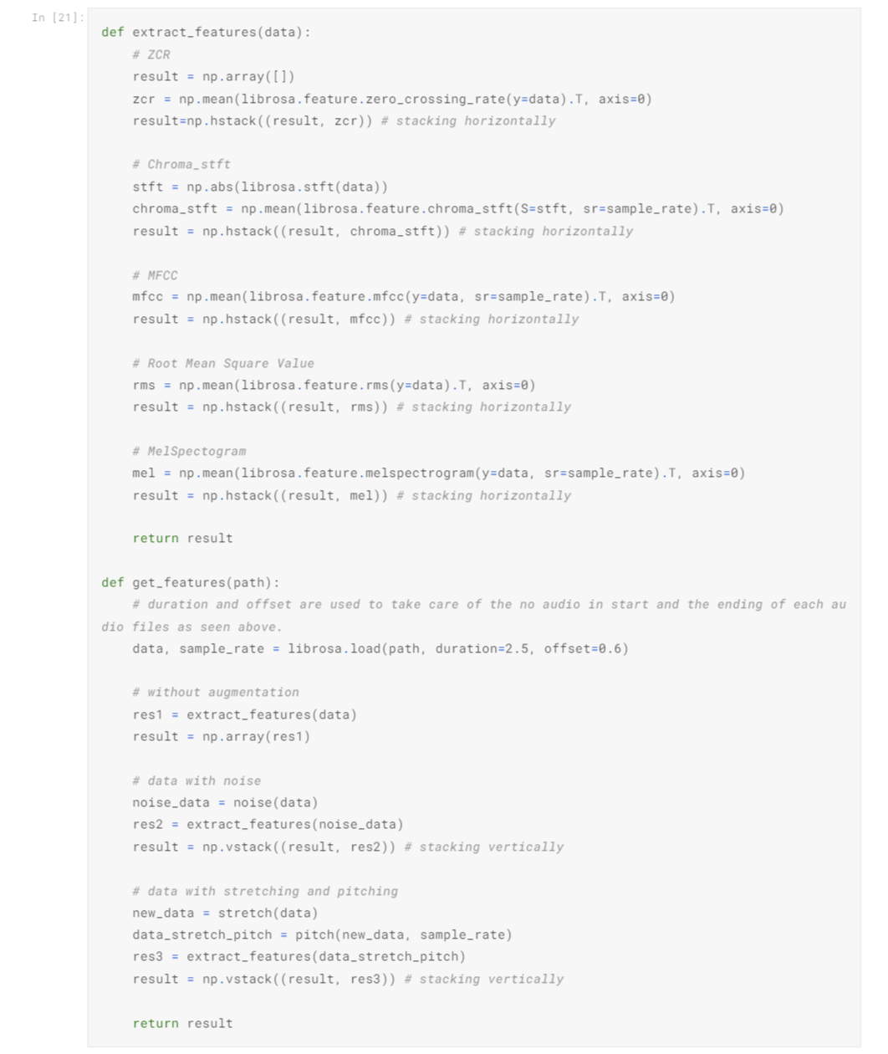
Feature Extraction :
Again I put in a lot of effort to create this function, where we extract these 5 features from our data : Zero Crossing Rate, Chroma_stft, MFCC, RMS(root mean square) value, MelSpectogram to train our model.

Slide 9
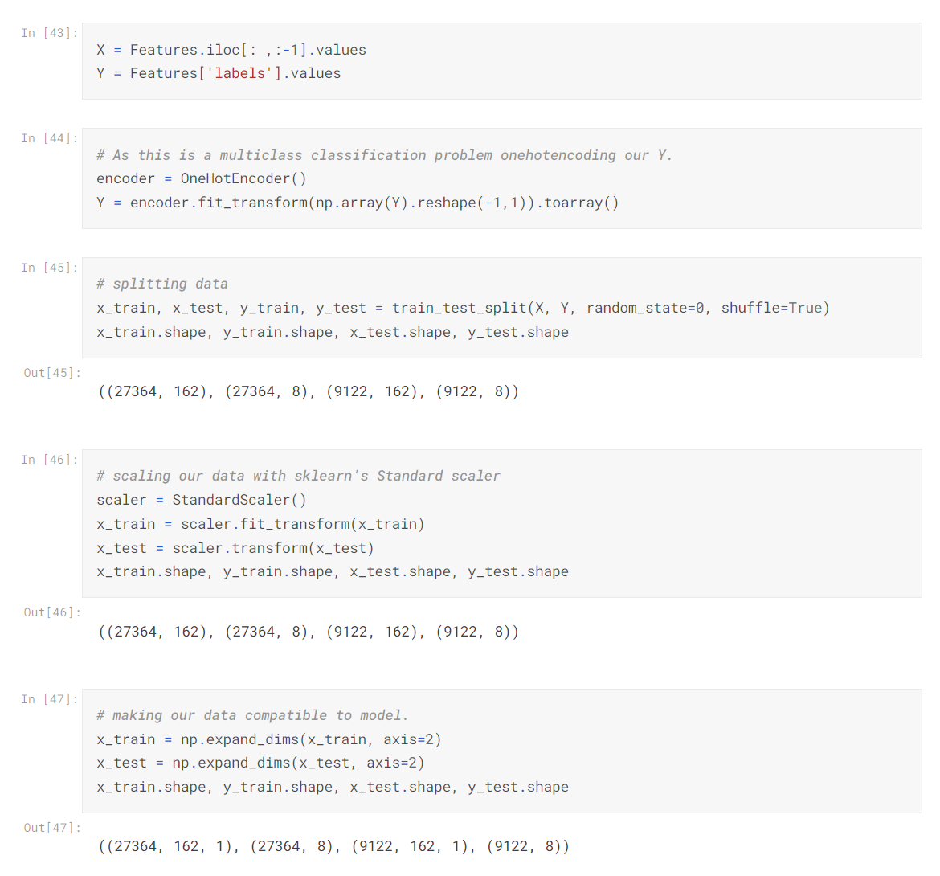
Data Preparation:
Now we have successfully converted the voice signals into numerical data with help from feature extraction code.
But it is still not ready to be passed into our neural network models yet.
Now, I have some raw data which needed to be normalized and thus I used oneHotEncoder.
After normalizing, I created train-test split.
I applied StandardScaler method to remove mean and scale each feature to unit variance.

Slide 10
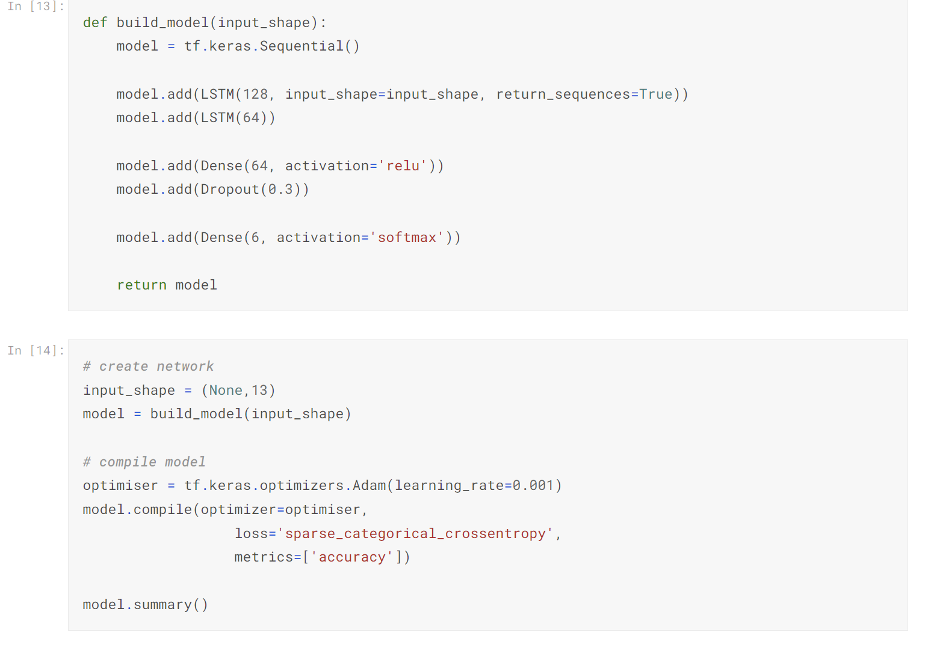
Model Creation:
These are few models that I tested but few of these were underfitting or overfitting thus I didn’t use them in the end.
3
LSTM Model (Underfit)

Slide 11
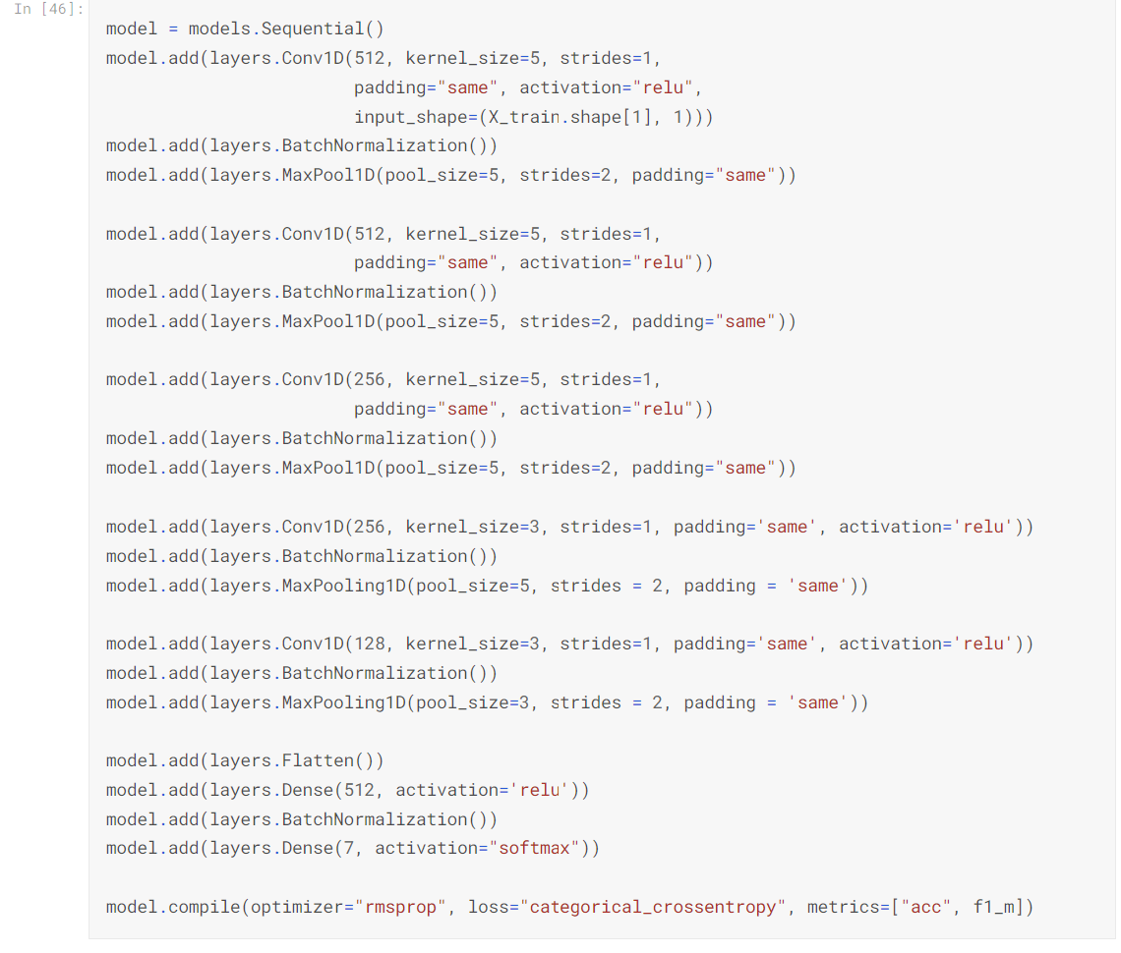
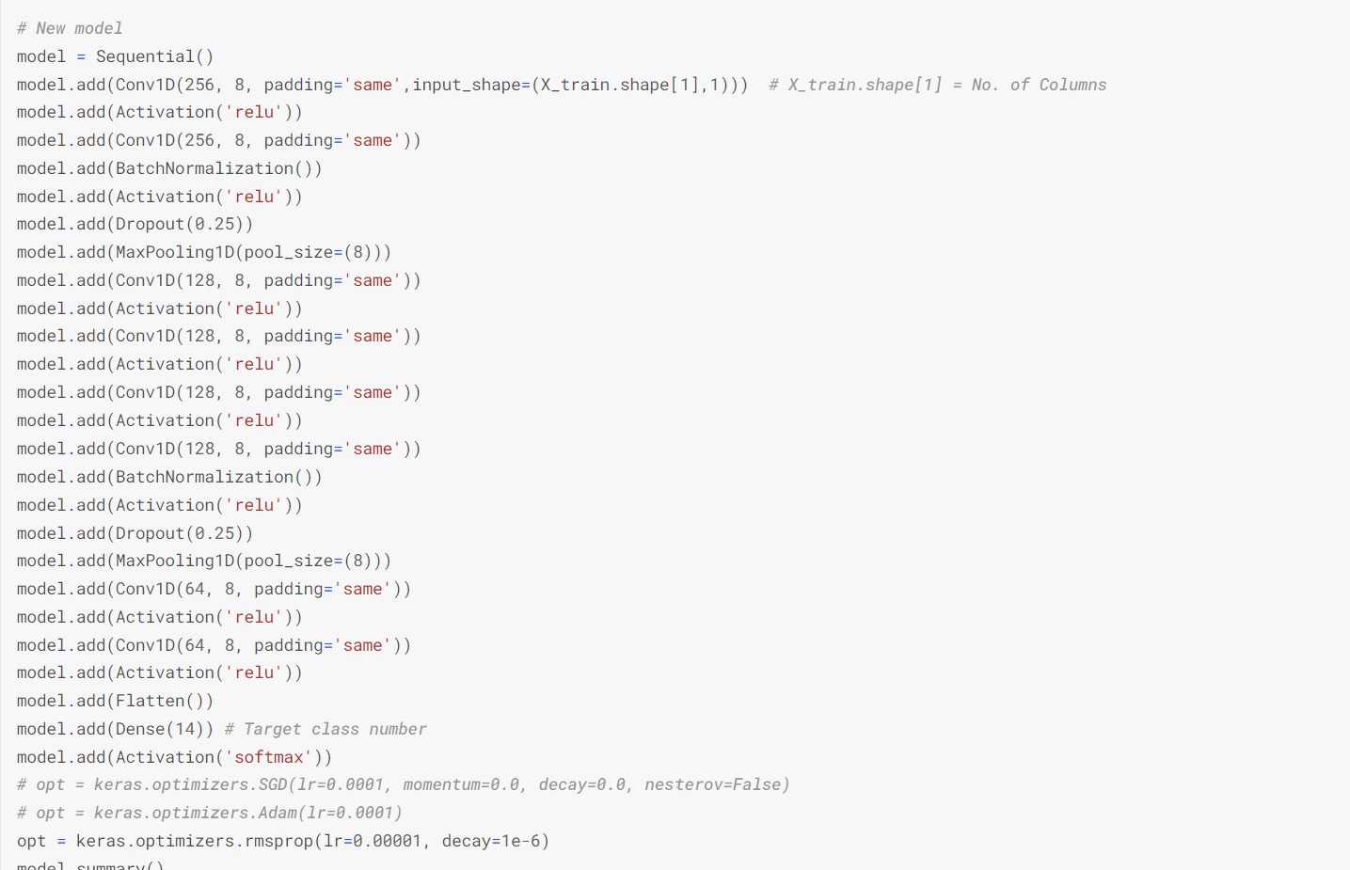
Model Architecture :
Different CNN architecture, both of these models were overfitting

Slide 12
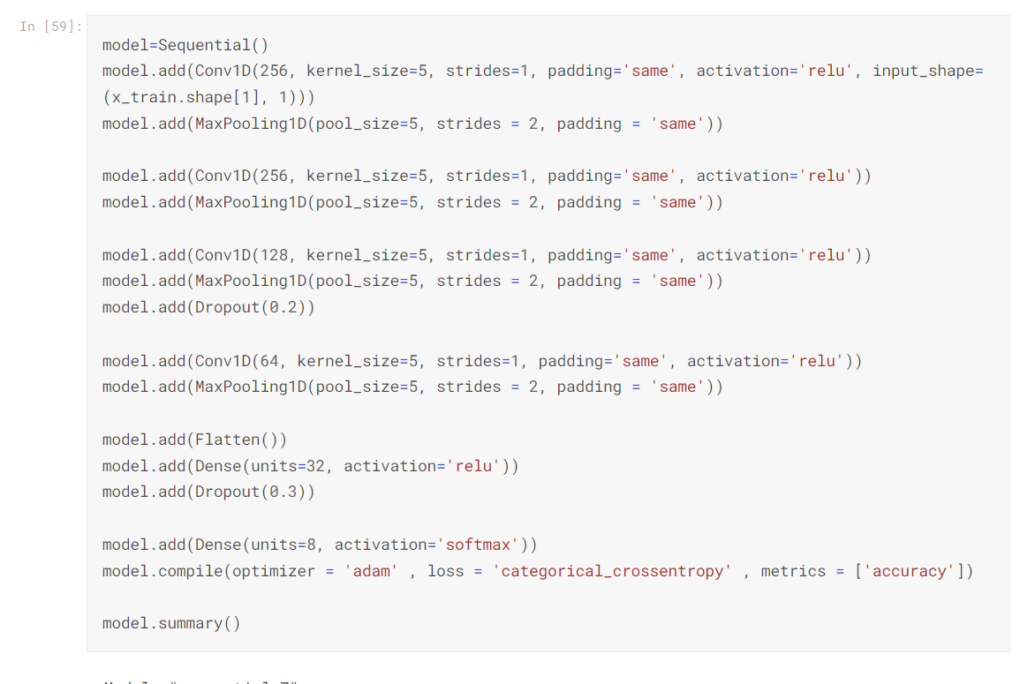
Final Model:
After testing out different hyper-parameters, I found my optimal options and this is my final model that I created.
3

Slide 13
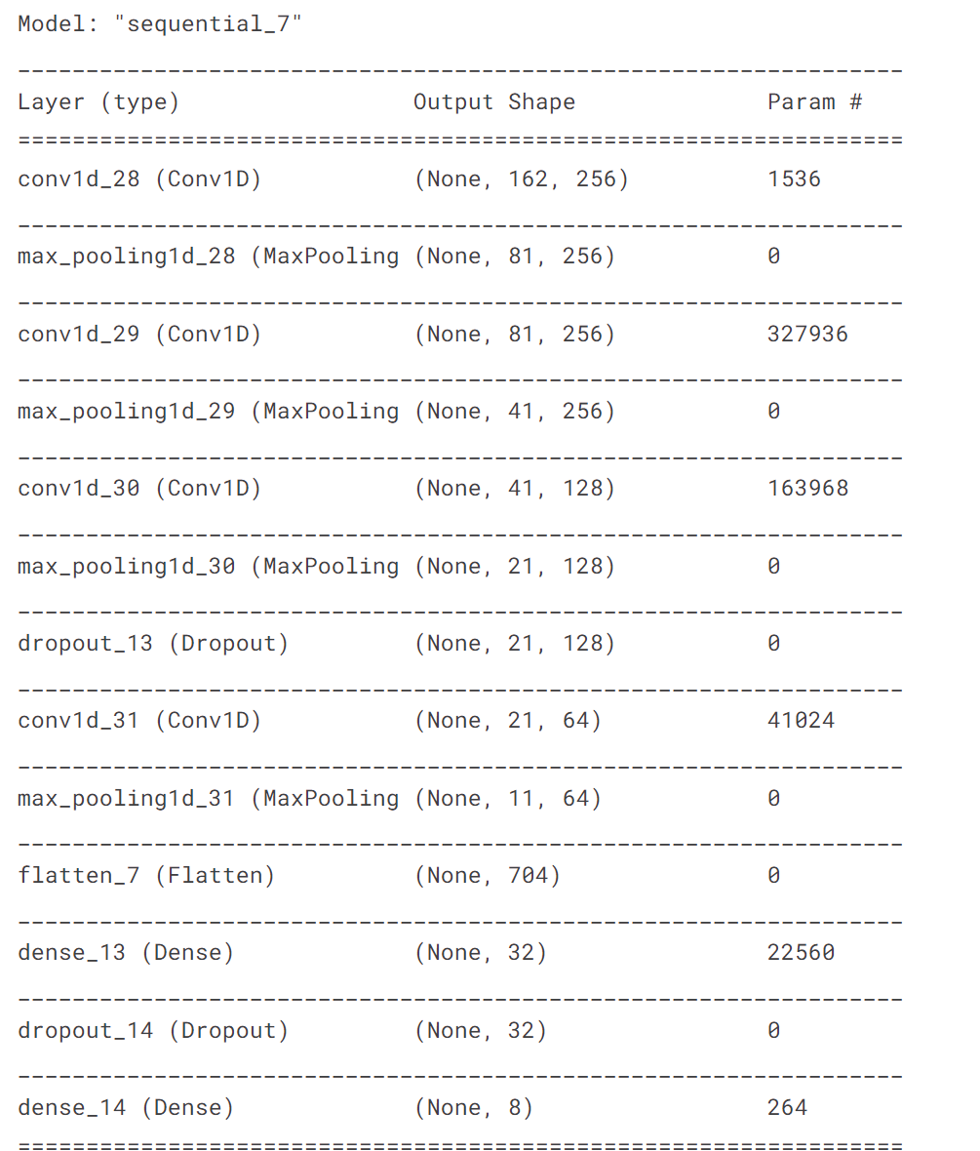
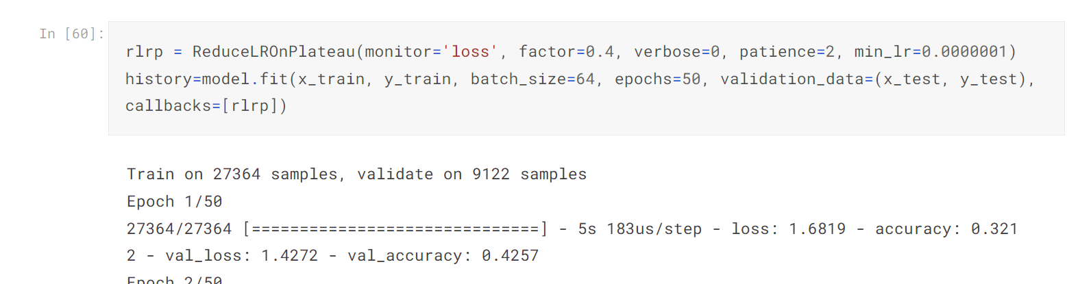
Model Architecture :

Slide 14
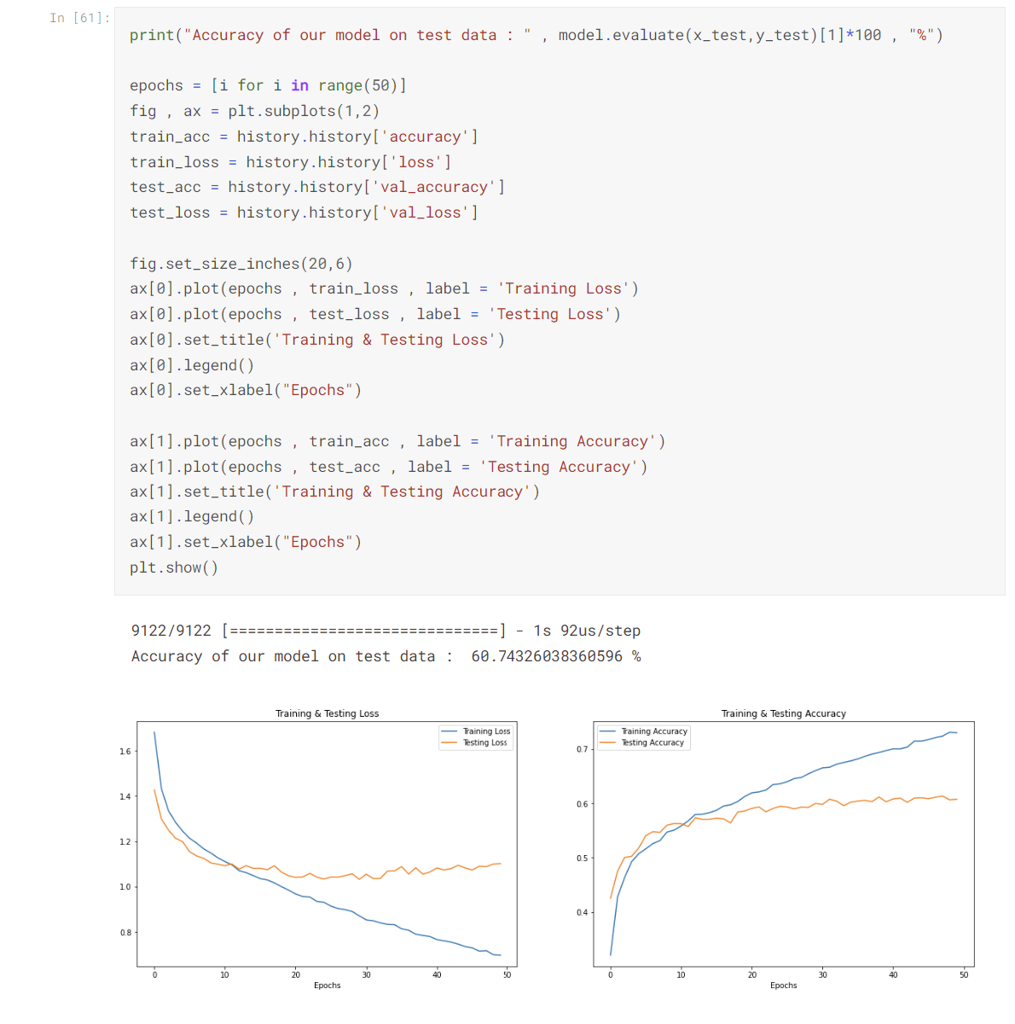
Loss Curves :

Slide 15
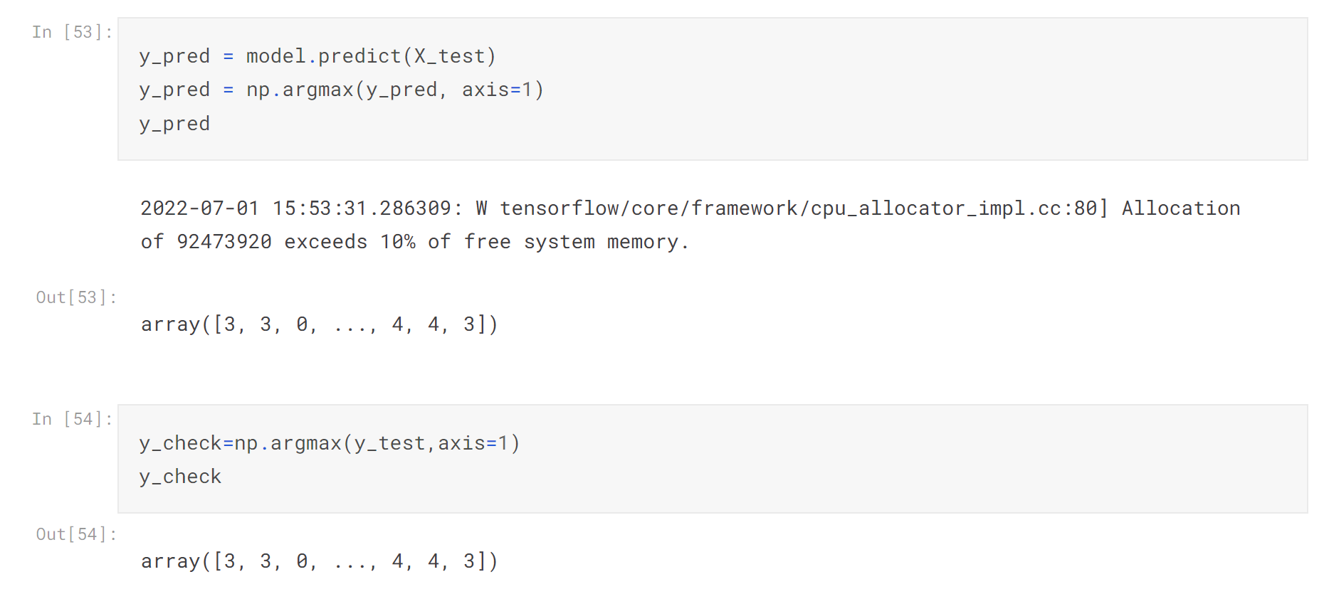
Prediction & Evaluation :
Below image shows the predictions done on test set using the latest model’s result.
Compare the numbers from y_pred and y_check, each number signify different emotion.
4

Slide 16
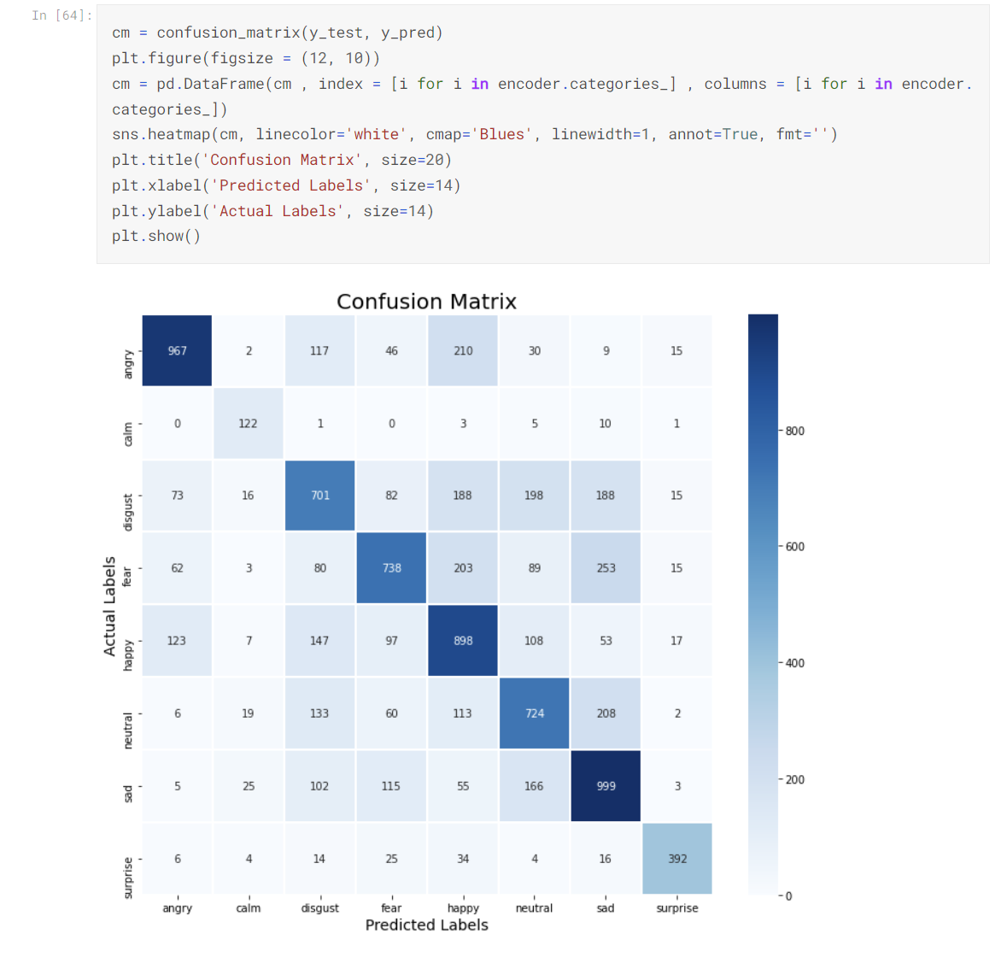
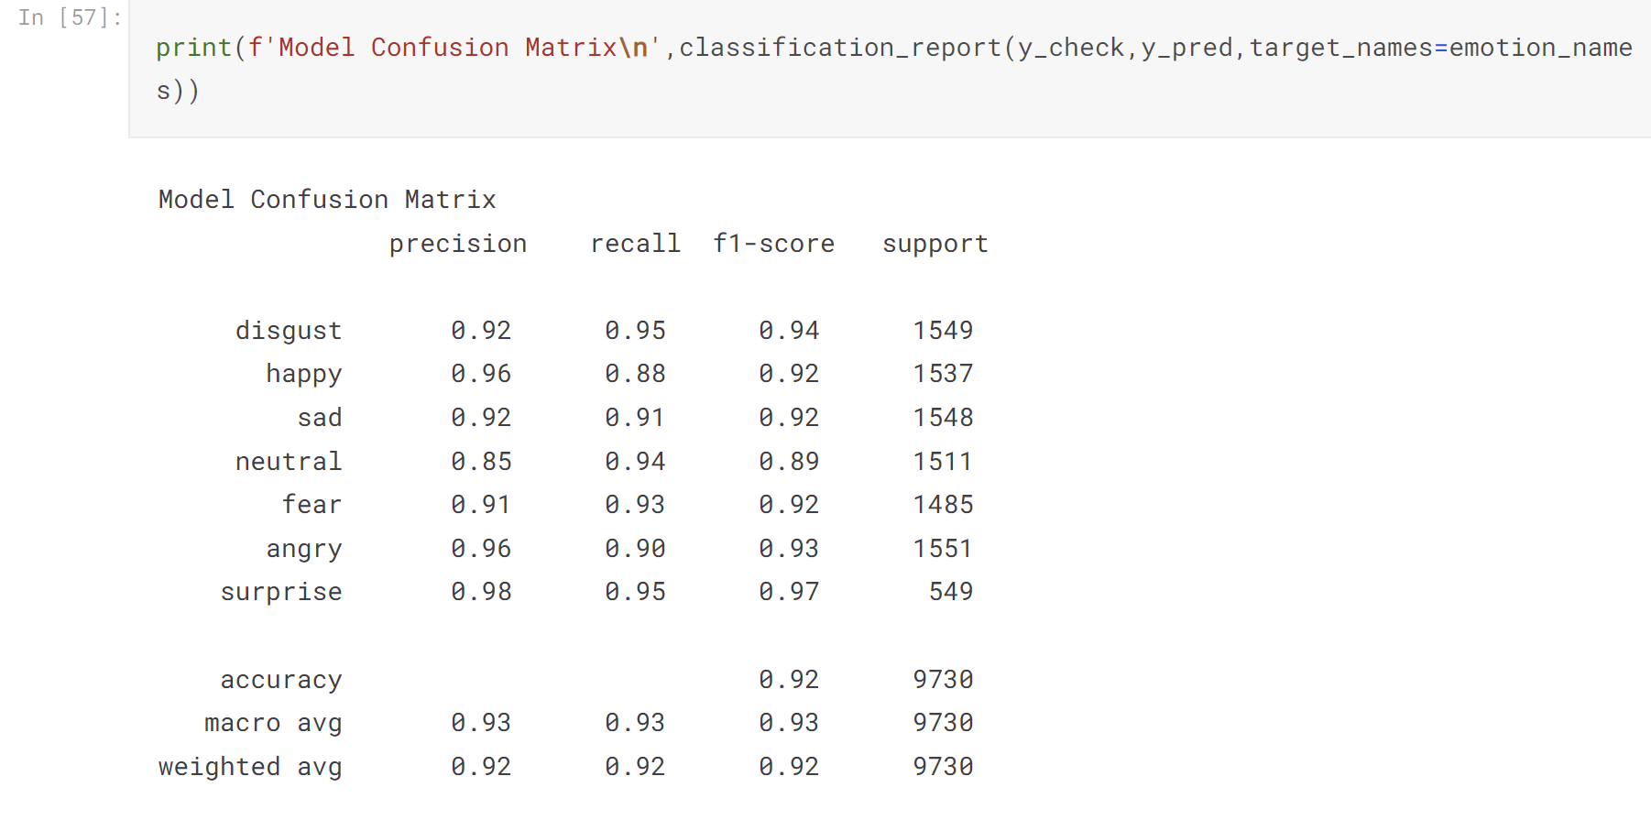
Evaluation Metric :

Slide 17
Thank You!!!
By : Yash Kasundra
A1838670

