Slide 1
Methodology & Evaluation Metric
By : Yash Kasundra
A1838670

Slide 2
Data Preparation :
After Extracting the features from the preprocessed data, I applied one hot encoding on it to normalize the data. And then split that data into 75% training and 25% testing sets
1
One Hot Encoding :
One Hot Encoder Basically, converts the categorical data into numerical data to make it easier for our machine to learn is the task of one-hot encoding. Simply its meaning that if a feature is represented by that column, it receives a 1. Otherwise, it receives a 0

Slide 3
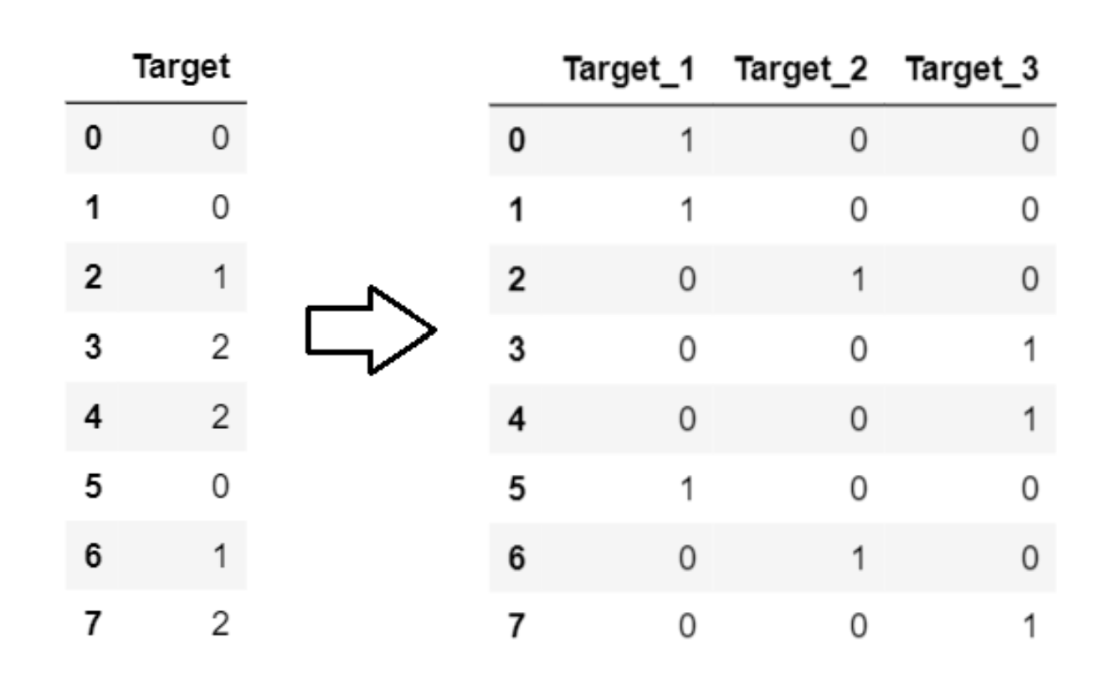
Example of One-Hot Encoding :
1

Slide 4
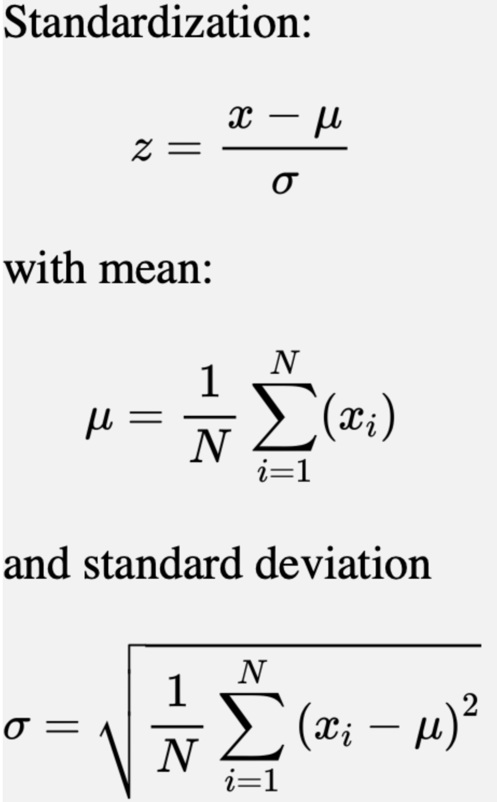
Standard Scaler :
I applied StandardScaler method to remove mean and scale each feature to unit variance. And the main reason for using this method is, since all Features are different their worth to the model is also different. Some Features might contribute more towards the success of model, while some might contribute less. Thus each feature is measured at different scales this might end up creating a bias. To deal with such kind of problem, feature wide standardization (μ=0, σ=1) is used prior to model fitting
2

Slide 5
Modelling :
Based on the research I did on previous works in SER. I planned to use convolutional neural networks from the start.
The main question now was which convolution layer to use 1D or 2D. Conv-2D would give me better results but take more computational powers to train, while if I used Conv-1D I would sacrifice a little on the performance but save a lot of computational powers. So I decided to use 1D convolution layer
But one might ask what is convolution layer ? And what does it do?
Convolution layer handles the main computation of the network and thus it is the core building block of CNN. The basic working of Convolutional layer is that it performs a dot product between 2 matrices, where one matrix is restricted portion of the data and other is the set of learnable parameters sometimes known as kernel
3

Slide 6
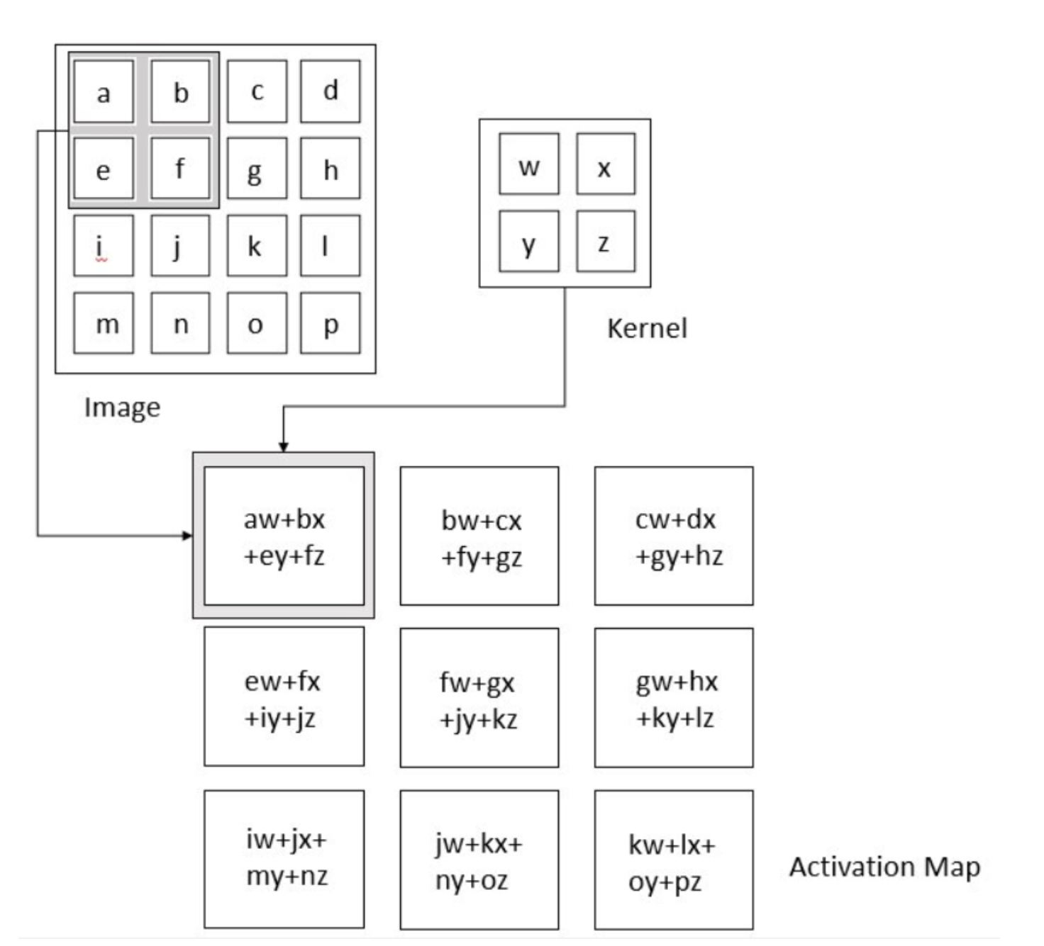
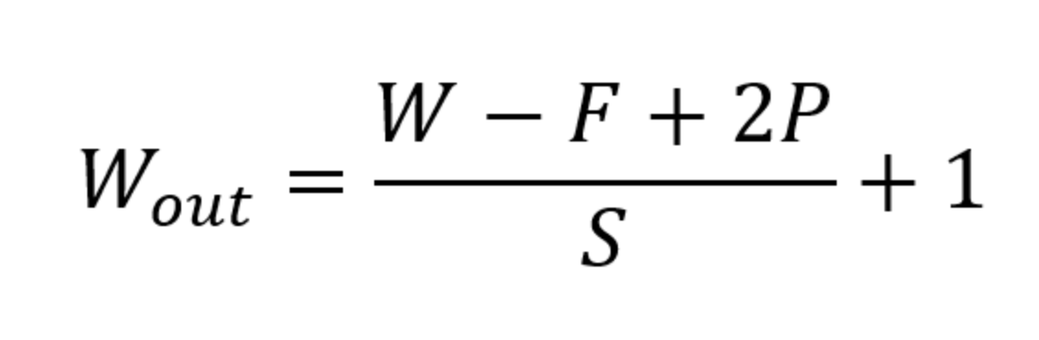
Working of Convolution Layer :

Slide 7
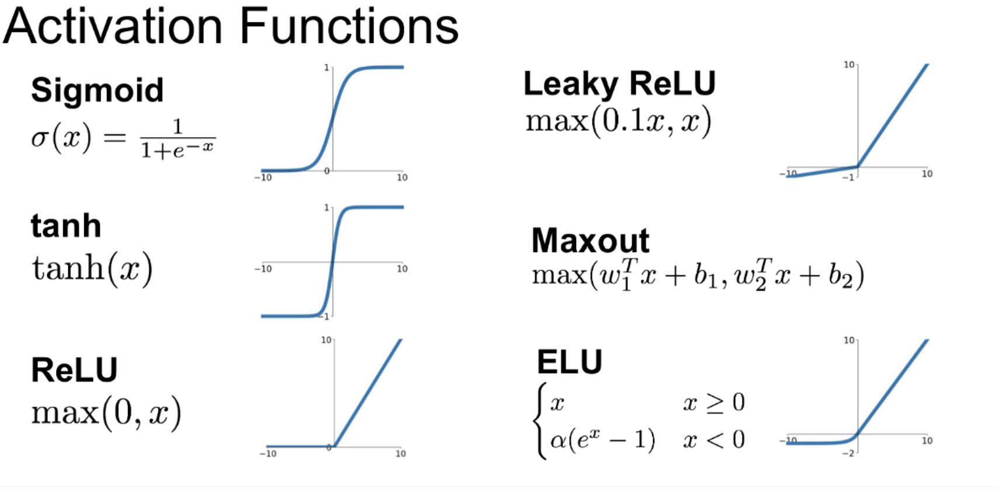
Choosing Activation function :
The main reason why ReLu is used is because it is simple, fast, and empirically it seems to work well.
Empirically, early papers observed that training a deep network with ReLu tended to converge much more quickly and reliably than training a deep network with sigmoid activation.
Main benefit is that the derivative of ReLu is either 0 or 1, so multiplying by it won't cause weights that are further away from the end result of the loss function to suffer from the vanishing gradient problem
Different Activation Functions and their Graphs

Slide 8
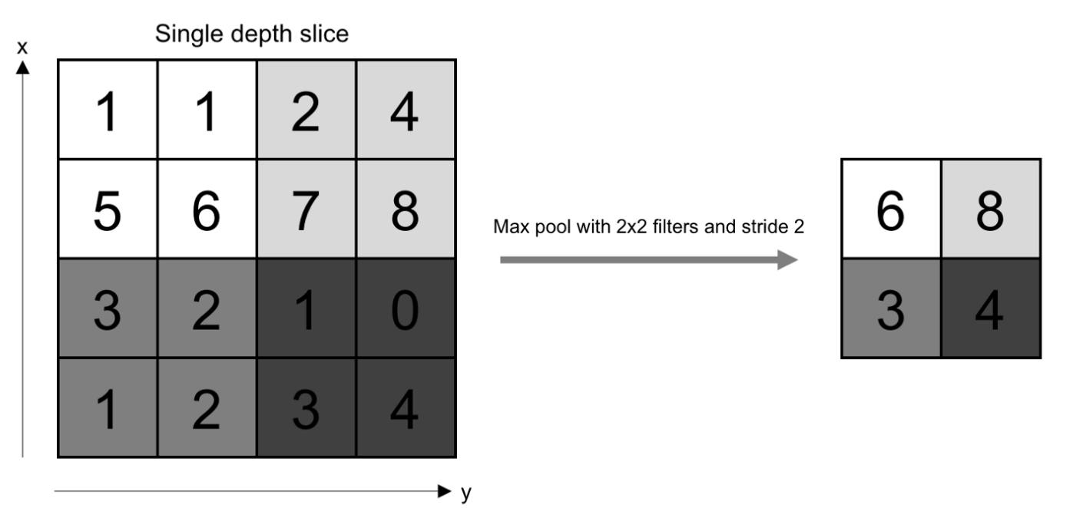
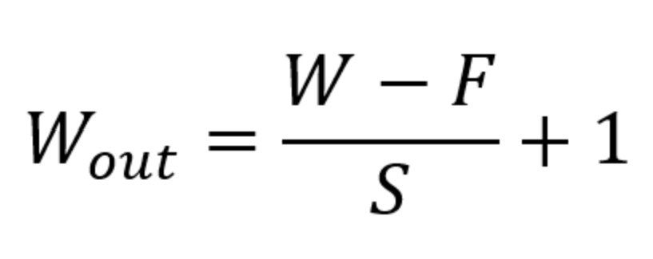
Working of Pooling Layer :
Based on the nearby outputs, pooling layer changes the output of network at certain location based on the pooling layer used. This helps in reducing the required number of computations and weights by reducing the spatial size of the representation. The pooling operation is processed on every piece of the representation separately.
There are several pooling functions such as the L2 norm of the rectangular neighborhood, weighted average based on the distance from the central pixel and mean of the neighborhood. However, the most popular process is max pooling, which reports the maximum output from the neighborhood.

Slide 9
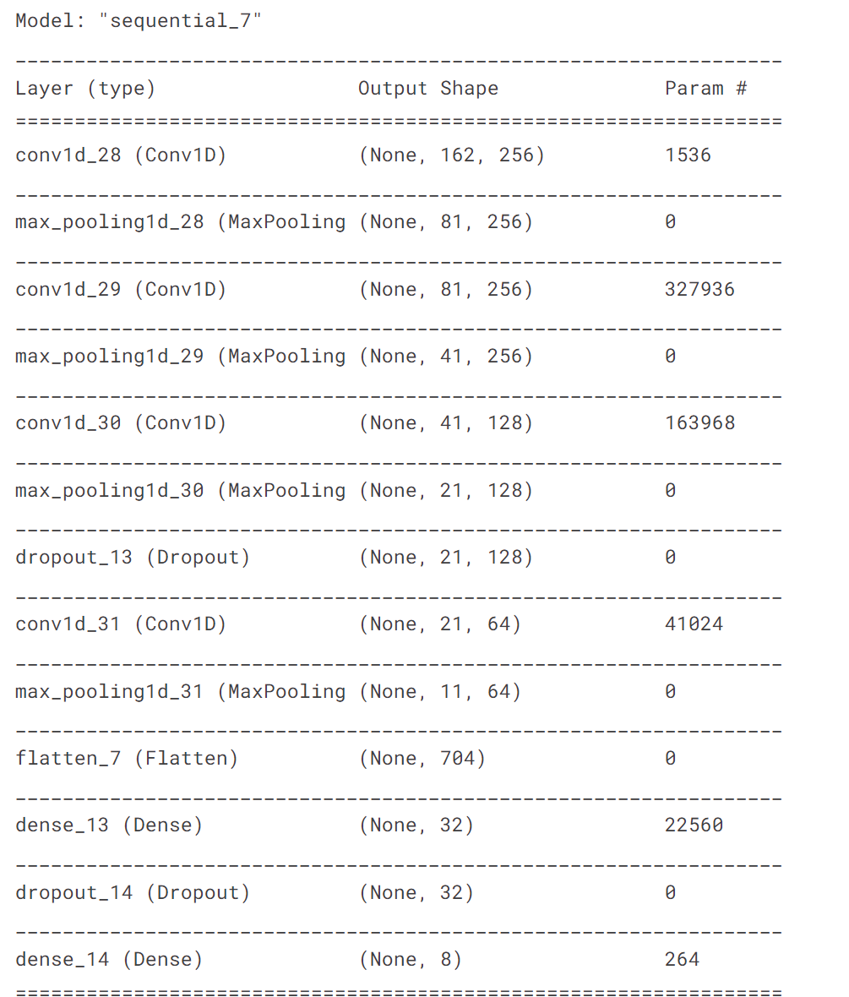
Model Architecture :

Slide 10
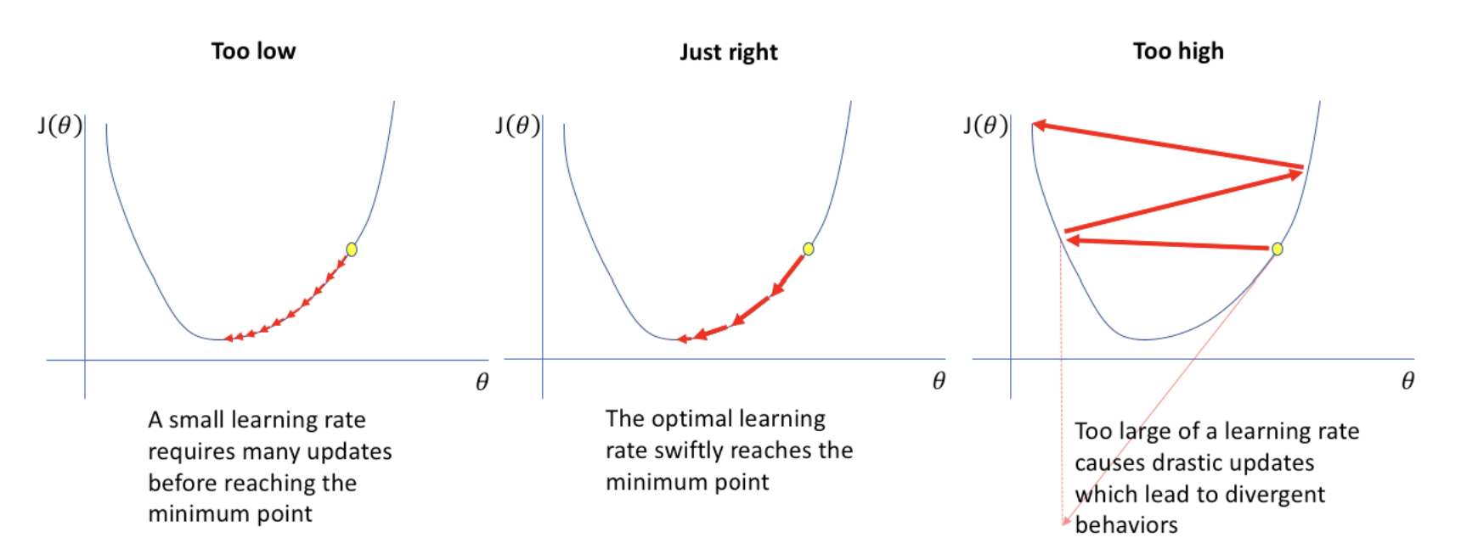
ReduceLRonPlateau :
A large learning rate can miss the global minimum and in extreme cases can cause the model to diverge completely from the optimal solution. On the other hand, a small learning rate can stuck to a local minimum.
It is always a good practice to reduce the learning rate when a metric has stopped improving.
Models often benefit from reducing the learning rate by a factor of 2-10 once learning stagnates. This callback monitors a quantity and if no improvement is seen for a 'patience' number of epochs, the learning rate is reduced.
Different Learning rates

Slide 11
Evaluation Metric :
For this project, I would mainly be using precision, recall and F1-Score
Precision: Precision is the ratio of correctly predicted positive observations to the total predicted positive observations.
Recall: It is also known as sensitivity because it is the ration of correctly predicted positive observation to all the observation in actual class.
F1 Score: F1 Score is the weighted average of Precision and Recall. Therefore, this score takes both false positives and false negatives into account. F1 score is a metric that combines both precision and recall.
4

Slide 12
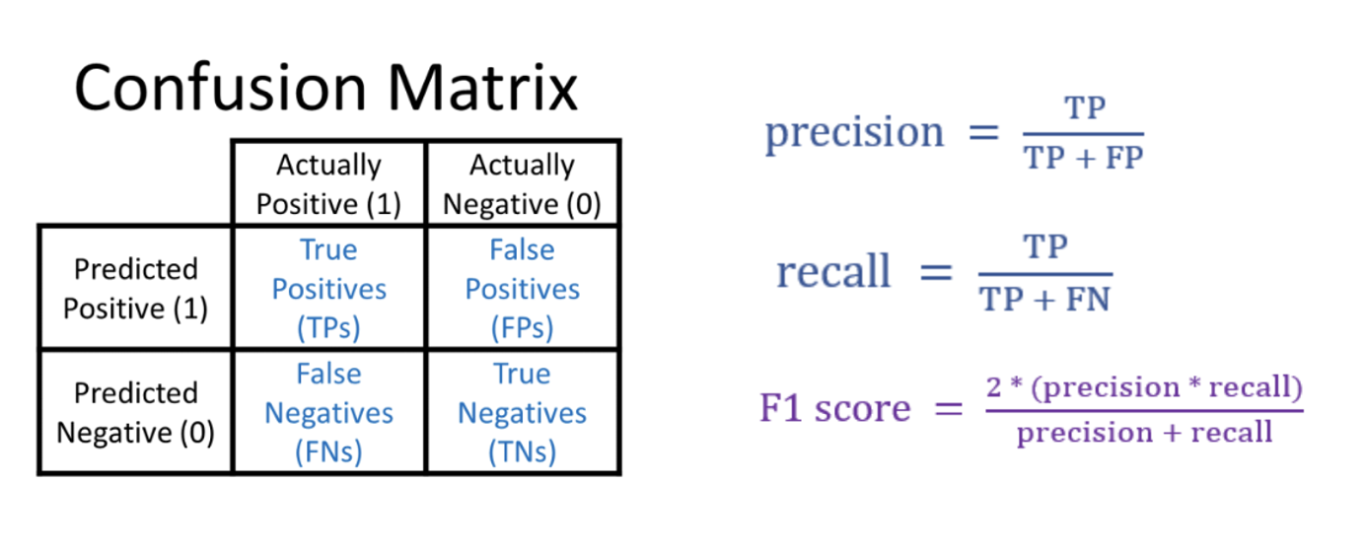
Evaluation Metric :
In most real-life classification problems, imbalanced class distribution exists and thus F1-score is a better metric to evaluate our model on.
One big difference between F1 score and ROC AUC is that the first one takes predicted classes and the second takes predicted scores as input. Because of that, with F1 score you need to choose a threshold that assigns your observations to those classes. Often, you can improve your model performance by a lot if you choose it well.

Slide 13
Thank You!!!
By : Yash Kasundra
A1838670

