Slide 1
TOPIC 6
Encapsulation, Object Relationships
and UML Modelling
Object-Oriented Programming Using Python
Running case study: Library Management System
1

Slide 2
Learning Outcomes
Apply encapsulation to protect object state and preserve valid data.
Use properties and validation to control access to attributes.
Distinguish association, aggregation, composition and dependency relationships.
Model one-to-one, one-to-many and many-to-many relationships.
Construct and interpret UML class diagrams with multiplicities.
Translate UML class relationships into working Python code.
2

Slide 3
From Topic 5 to Topic 6
The same Library Management System now becomes a multi-class design problem.
Topic 5 introduced Book, Member, Loan and Library as classes and objects.
We created objects and allowed them to collaborate.
Topic 6 asks two deeper questions:
  How should each object protect its own state?
  What exactly is the relationship between the different objects?
UML gives us a standard visual language for representing those relationships.
3

Slide 4
Running Case Study: UCU Library
The library owns many physical book copies.
Each physical copy has a unique copy ID.
Members register before borrowing books.
A member may borrow several books.
A physical book copy can be on only one active loan at a time.
Each borrowing transaction is represented by a Loan object.
The Library coordinates books, members and loans.
Late returns attract a fine based on the number of overdue days.
Book
Member
Loan
Library
Attributes
copy_id
title
author
available
Methods
borrow()
return_book()
Attributes
member_id
name
borrowed_books
Methods
add_book()
remove_book()
Attributes
loan_id
book
member
due_date
Methods
calculate_fine()
close_loan()
Attributes
books
members
loans
Methods
add_book()
borrow_book()
return_book()
4

Slide 5
Encapsulation
Encapsulation is an OOP principle where we keep an object's
data and the methods that operate on that data together
inside a class, and control how that data can be accessed or changed.
Encapsulation is not simply making attributes private. It is giving an object
responsibility for protecting and managing its own state.
5

Slide 6
Why Encapsulation?
Objects contain data that represents their current state.
If any part of the program can freely change that data, the object may enter an invalid state.
Encapsulation places responsibility for protecting state inside the class that owns it.
Other objects interact through controlled methods and properties rather than changing internal data carelessly.
book = Book("B001", "Python Programming", "John Smith")
# External code can create an impossible state:
book.available = False
book.current_borrower_id = None
# The book is marked unavailable,
# but nobody is recorded as the borrower.
6

Slide 7
Example: Uncontrolled Book State
class Book:
def __init__(self, copy_id, title, author):
self.copy_id = copy_id
self.title = title.strip()
self.author = author.strip()
self._available = True
self._current_borrower_id = None
def borrow(self, member_id):
if not self._available:
return False
self._available = False
self._current_borrower_id = member_id
return True
7

Slide 8
How does Python handle Access modifiers?
Python handles access differently. It does not enforce public, private, and protected keywords in the same way. Instead, Python mainly uses naming conventions, with one special mechanism called name mangling.
Python form | Common interpretation | Example
Name | Public | self.name
_name | Protected/internal by convention | self._name
__name | Private-like via name mangling | self.__name
Public (name) – Can be freely accessed and modified from inside or outside the class.
Protected (_name) – Intended for use within the class and its subclasses, but Python does not strictly prevent outside access.
Private (__name) – Intended for use within the class and uses name mangling to discourage direct access from outside the class
8

Slide 9
Public Attributes in Python
Python does not enforce access modifiers in the same way as Java or C++.
An ordinary attribute such as book.title is public.
Python relies heavily on conventions and properties to communicate intended access.
Public attributes are appropriate when direct access does not threaten object validity.
class Book:
def __init__(self, title):
self._title = title
book = Book("Python Programming")
print(book._title) # possible, but convention says:
# "internal use; do not modify carelessly"
9

Slide 10
Single Underscore Convention
class Member:
def __init__(self, name):
self.__name = name
member = Member("Amina")
# Python internally changes __name to a mangled name.
# This discourages accidental access; it is not absolute security.
10
Notes:
Name mangling is Python's automatic renaming of attributes beginning with two underscores (__) to reduce accidental direct access and name conflicts.

Slide 11
Double Underscore Name Mangling
11

Slide 12
Encapsulation Is More Than Hiding Data
Encapsulation groups data and the operations that maintain that data.
It protects invariants: conditions that should always remain true.
For a Book object, availability and borrower information must agree.
For a Loan object, a return date should not precede the borrowing date.
For a Member object, duplicate borrowed-copy IDs should not be recorded.
class Book:
def __init__(self, title):
self._title = title
@property
def title(self):
return self._title
book = Book("Python Programming")
print(book.title) # accessed like an attribute
# print(book.title()) # incorrect
12
Notes:
@property allows us to write a method that behaves like an attribute. It is particularly useful for encapsulation, because the class can control or calculate what external code sees without requiring direct access to the internal attribute.

Slide 13
@property: Controlled Attribute Access
class Loan:
def __init__(self):
self.return_date = None
@property
def is_returned(self):
return self.return_date is not None
loan = Loan()
print(loan.is_returned) # False
13

Slide 14
Why is_returned Should Be a Property
return_date is the stored fact.
is_returned is derived from that fact.
Storing both values separately creates a risk of inconsistency.
A property calculates the answer whenever it is requested.
This gives the caller attribute-style syntax while keeping the logic inside the class.
class Member:
def __init__(self, name):
self._name = ""
self.name = name
@property
def name(self):
return self._name
@name.setter
def name(self, value):
value = value.strip()
if not value:
raise ValueError("Name cannot be empty")
self._name = value
15

Slide 15
Property Setter: Validating Data
A property setter allows us to control what happens when someone tries to change the value of a property.
class Library:
def __init__(self):
self.books = {}
@property
def total_books(self):
return len(self.books)
library = Library()
print(library.total_books)
# library.total_books = 100
# No setter exists: treat as read-only.
16

Slide 16
Class Responsibility
A well-designed class should have a clear responsibility.
Book manages the state of one physical book copy.
Member manages information about one registered borrower.
Loan manages one borrowing transaction.
Library coordinates the overall collection and workflows.
A class should not perform unrelated responsibilities simply because it can.
Member
Loan
Book
Attributes
member_id
name
Methods
borrow...
Attributes
loan_id
dates
Methods
close_loan()
Attributes
copy_id
title
Methods
borrow()
borrower
borrowed copy
18

Slide 17
Object Relationships: The Big Picture
Association
Library System
Member and Loan are related; Loan keeps a reference to a Member.
19

Slide 18
Association
A general relationship in which objects know about or interact with one another.
class Loan:
def __init__(self, book, member):
self.book = book
self.member = member
book1 = Book("B001", "Python Programming", "John Smith")
member1 = Member("M001", "Amina")
loan1 = Loan(book1, member1)
print(loan1.book.title)
print(loan1.member.name)
20

Slide 19
Association in the Loan Class
One-to-One
Library System
Each individual Loan refers to exactly one Member and one Book.
21

Slide 20
One-to-One Relationship
One-to-Many
Library System
One Member can have many Loan records over time.
22

Slide 21
One-to-Many Relationship
Many-to-Many
Library System
Members and book titles can be related many-to-many over time through Loan records.
23

Slide 22
Many-to-Many Relationship
Aggregation
Library System
Library manages Book objects that can exist independently.
24

Slide 23
Aggregation
A whole–part relationship in which the parts can exist independently of the whole.
25

Slide 24
Aggregation in the Library System
Composition
Library System
A strong whole–part relationship: the part belongs to the whole.
26

Slide 25
Composition
A strong whole–part relationship in which the part's lifecycle is controlled by the whole.
class Library:
def __init__(self, name):
self.name = name
self.books = {}
self.members = {}
def add_book(self, book):
self.books[book.copy_id] = book
# Book and Member objects can exist independently
# of this particular Library object.
27

Slide 26
Composition Example
Aggregation vs Composition
Library System
Ask whether the part can meaningfully exist independently.
28

Slide 27
Aggregation vs Composition
class Loan:
def __init__(self, book, member):
self.book = book
self.member = member
# The Loan is meaningful because it represents
# this borrowing transaction. Its Book and Member
# references are essential parts of that transaction.
29

Slide 28
Dependency
A temporary 'uses' relationship between classes.
Dependency
Library System
One class temporarily uses another without storing it as long-term state.
30

Slide 29
Dependency Example
31

Slide 30
Choosing the Right Relationship
Ask whether one object needs to keep a reference to another object.
Ask whether one object owns or merely uses the other object.
Ask whether the part can meaningfully exist without the whole.
Ask whether the relationship is permanent or only needed during a method call.
Use the weakest relationship that correctly represents the real-world problem.
class Library:
def search(self, keyword):
return [
book for book in self.books.values()
if keyword.lower() in book.title.lower()
]
# 'keyword' is used temporarily by search().
# The Library does not store keyword as part of its state.
32

Slide 31
Introduction to UML
UML stands for Unified Modeling Language.
A UML class diagram shows the static structure of an object-oriented system.
It can show classes, attributes, methods and relationships.
UML helps move from a written problem description to an implementation design.
The diagram is a model; Python code is the implementation.
33

Slide 32
Anatomy of a UML Class
Book
Attributes
- copy_id: str
- title: str
- available: bool
Methods
+ borrow(member_id): bool
+ return_book(): None
+ available: bool
34

Slide 33
UML Visibility Symbols
+ means public.
- means private.
# means protected.
In Python these symbols express design intention rather than strict language enforcement.
Example: -available: bool can be implemented as _available plus controlled methods/properties.
35

Slide 34
UML Relationship Notation
Association: solid line.
Aggregation: solid line with a hollow diamond at the whole.
Composition: solid line with a filled diamond at the whole.
Dependency: dashed arrow.
Inheritance/generalisation uses a solid line with a hollow triangular arrowhead and is covered in Topic 7.
36

Slide 35
Multiplicity
Multiplicity tells us how many objects may participate in a relationship.
1 means exactly one.
0..1 means zero or one.
* or 0..* means zero or many.
1..* means one or many.
Multiplicity should reflect the business rules of the system.
37

Slide 36
Library System Multiplicities
One Library manages many Books: Library 1 —— 0..* Book.
One Library registers many Members: Library 1 —— 0..* Member.
One Library records many Loans: Library 1 —— 0..* Loan.
Each Loan refers to exactly one Member and exactly one Book.
Over time, one Member can participate in many Loans.
Over time, one Book copy can participate in many Loans, but only one active loan at a time.
38

Slide 37
UML: Book Class
Book
Attributes
- copy_id: str
- title: str
- author: str
- _available: bool
Methods
+ available: bool
+ borrow(): None
+ return_book(): None
39

Slide 38
UML: Member Class
Member
Attributes
- member_id: str
- name: str
- borrowed_book_ids: list
Methods
+ add_borrowed_book(id): None
+ remove_borrowed_book(id): None
40

Slide 39
UML: Loan Class
Loan
Attributes
- loan_id: str
- book: Book
- member: Member
- due_date: date
- return_date: date
Methods
+ is_returned: bool
+ calculate_fine(): int
+ close_loan(date): int
41

Slide 40
UML: Library Class
Library
Attributes
- name: str
- books: dict
- members: dict
- loans: list
Methods
+ add_book(book): None
+ register_member(member): None
+ borrow_book(...): Loan
+ return_book(...): int
42

Slide 41
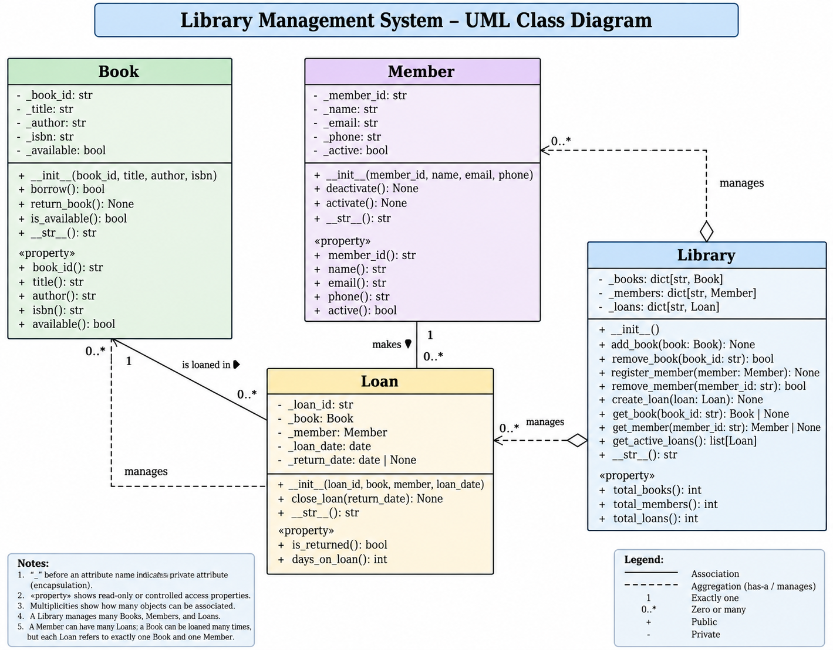
Integrated UML Model
43

