Slide 1
OSDM - An Introduction
February 2021
Clemens Gantert, Chairman OSDM
Andreas Schlapbach, Tech Lead FSM & Chairman OSDM

Slide 2
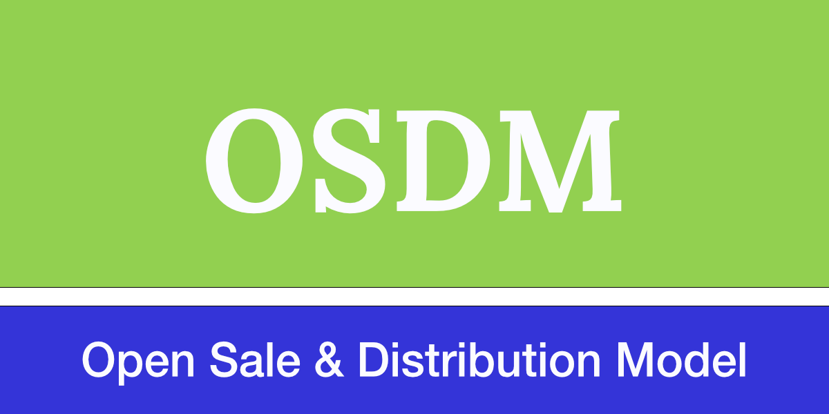
1. Introduction
The aims of the Open Sales and Distribution Model (OSDM) are twofold:
to substantially simplify the booking process for customers of rail trips and,
to lower complexity and distribution costs for distributors and railway carriers.
Thus, distributors and railways joint forces and developed a state-of-the-art distribution API and fare exchange model.
Specification is Open Source and available to everybody:
https://unioninternationalcheminsdefer.github.io/OSDM/

Slide 3
1. OSDM – Vision
Powerful combination
It must be possible to combine fares according to existing fare combinations (e.g., NRT-style PRIFIS) as well as new fare combination models.
Easy distribution
It must be easily possible to distribute existing and new products.
Easily possible means two things:
Firstly, for a customer it must be easily possible to find and book and – if needed – refund a booking.
Secondly, for the rail sector as a whole the complexity of distribution must be reduced to save costs both for development as well as distribution.

Slide 4
1. PRIFIS is End of Live Replacement: OSDM-Offline
PRIFIS
OSDM Implementation
phase
OSDM
On Test
OSDM
Productive
Bulk exchange
of Fares
27.10.2020
PRIFIS stops
OSDM live
01.01.2021
15.9.2021

Slide 5
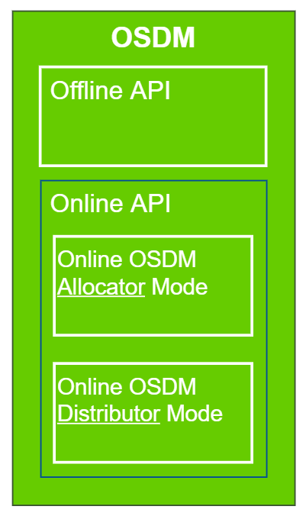
2. Overview of OSDM
Replaces old PRIFIS infrastructure with the OSDM-Offline Plattform
New Online Distribution and Carrier Interface

Slide 6
2. OSDM Online API
The OSDM is a light-weight API consisting of a set of micro services.
It is modelled in YAML, fully supporting the REST paradigm.
The specification is completely Open Source and developed in an agile manner.

Slide 7
2. Supported Processes
Sales and Distribution processes:
Searching for trips
Getting offers
Booking an offer
Confirmation of the booking
Fulfillment of the booking
After-sale processes:
Getting a refund/exchange offers
Booking a refund/exchange offer
Fulfillment of the booking

Slide 8
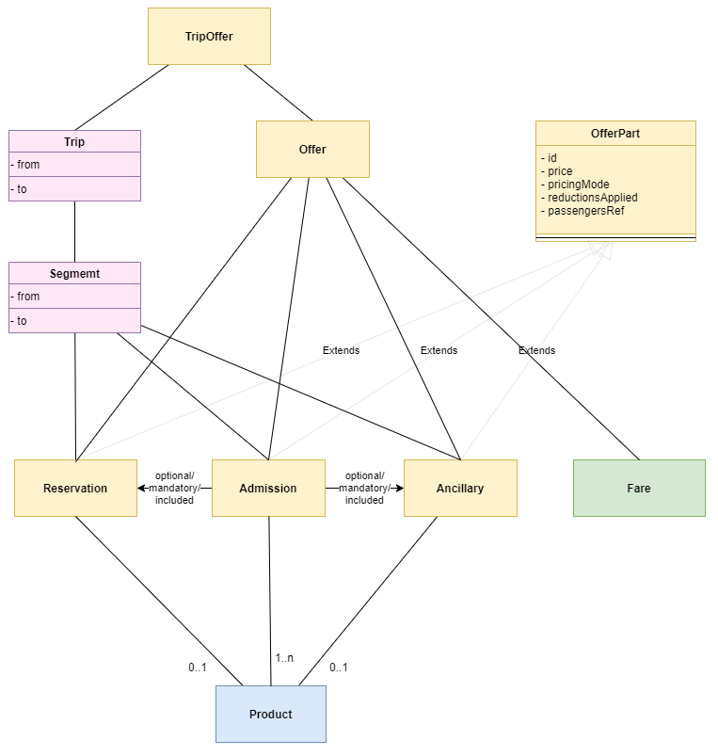
2. Supported Products
Offers consist of the following parts:
Admissions (aka. tickets),
Reservations,
Ancillaries
Fares (priced segments)
The offers are linked by optional / mandatory / included relations to an overall offer.

Slide 9
2. OSDM – Roles Definitions
The OSDM Online API is split between roles participants can take:
Fare Provider – defining the fare and combination rules and providing them to allocators offline or online.
Allocator – combining fares, defining after sales rules within the frames et by the fare provider, providing combined offers and managing the booking transaction, managing the ticket security (barcode, control processes), managing compensations processes, managing the stock control process.
Distributor – selling tickets from one or more allocators to the customer. Selecting the allocators and joining multiple independent bookings.
A RU or system provider can support more than one role.

Slide 10

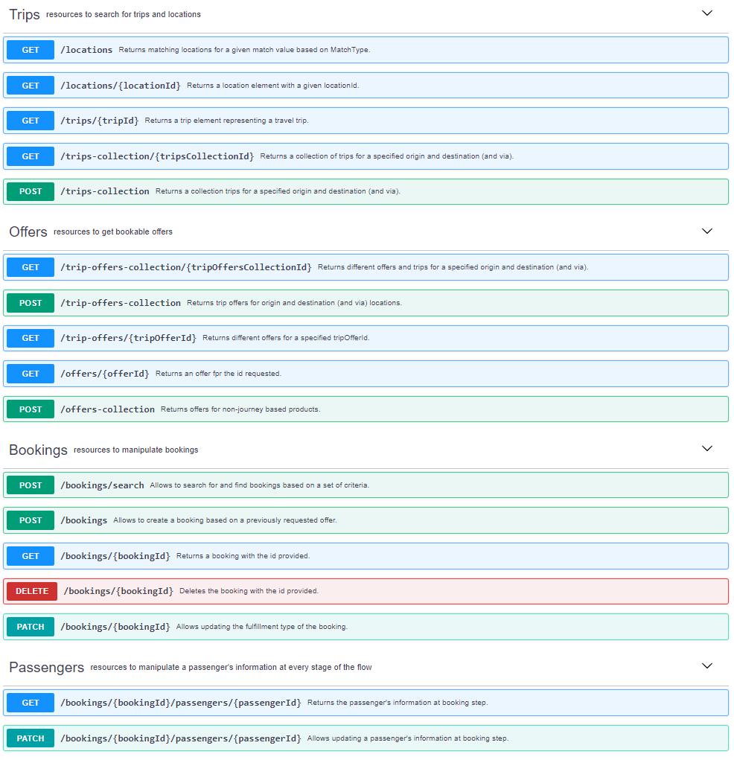

Slide 11
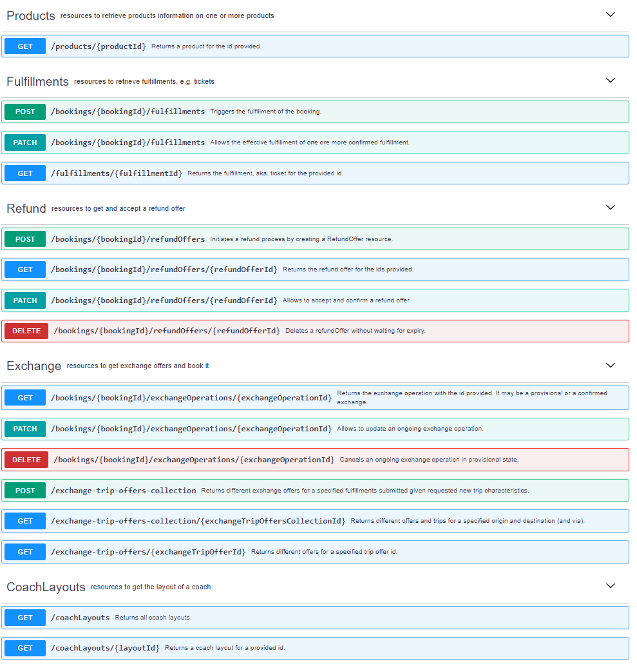

Slide 12
3. Organization of OSDM Working Group Evolution process
Basic Ideas
A specification is product.
We have a backlog of improvements where all parties can contribute.
An improvement addresses a need and solves a problem, thus producing business value.
The OSDM executive committee prioritizes the backlog based on the value for the railway customer and the railway sector as a whole.
The OSDM executive committee is a fair representation of the parties involved, thus railways and distributors and others.
The OSDM technical working group designs improvements to the standard. To stay focused, the work in progress should not be larger than 3.
The OSDM technical working group taking special care not to break existing implementations, thus securing investments made by all the parties.

Slide 13
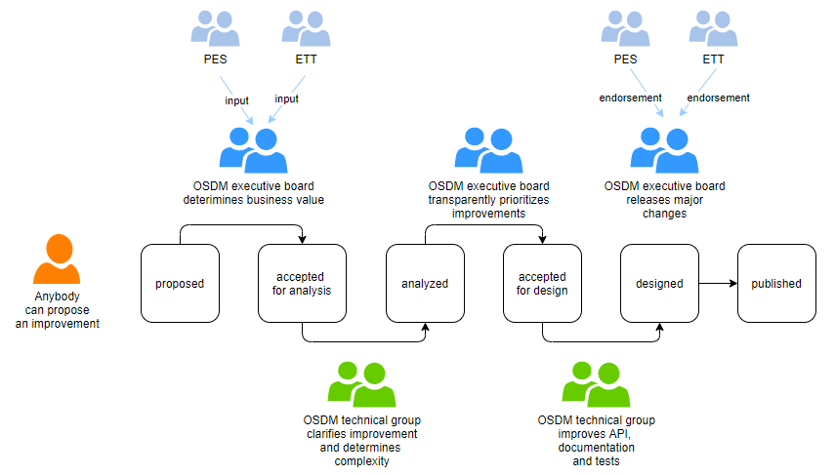
3. Organization of OSDM Working Group Evolution process

Slide 14
3. Organization of OSDM Working Group Aim: incremental and steady improvement
Technical Aspect
Versioning major/minor versions following semantic versioning.
Organizational Aspect
annual publication of an approved IRS 90918-10 version by UIC
Intermediary minor changes published within the work group
Maintenance Process
New requirements can be added by all participants in OSDM

Slide 15
4. Schedule for Specification Work
Offline Stream
OSDM Implementation
phase
OSDM
On Test
OSDM
Productive
Online Stream
OSDM Working Group
every Friday 9:00-11:00
Scope List for PI-2
I-16 Add support to sell non-journey based products (passes) (DB/öBB/SBB)
I-3 Complete support for partial refund/exchange (Trenitalia/SNCF/Amadeus/BeNe)
I-4 Align /locations and /trips to Transmodel (OJP) (SBB)
I-28 Add support to query availabilities (Sqills/SBB/ÖBB/DB)
I-18 Combinations of tickets by distributors (SBB/Amadeus)
I-7 Add full support for PRMs (CIT-Rail)
Enabler
I-19 Add support for distributed tracing (SBB)
Working Group:
All features in scope for PI-1 are designed and ready for release.
OSDM (12.02.2021)
OSDM meeting (24.06.2021)
01.02.2021
01.03.2021
01.04.2021
01.05.2021
01.06.2021
Sign-off OSDM (OSDM.V1.1)
PI-2

Slide 16
5. Summary
Specification work is on track.
OSDM will reach a very mature and complete state in Q2/2021
Specification is ready to be implemented
SBB plans implementing parts of OSDM in Q3/2021 (reservation part).
öBB and SBB will start a prototype to test online fare combination in Q3/2021
Next meeting.
28.10.2021

Slide 17
backup

Slide 18
4. Mapping Business Capabilities to Specification
The specification needs to layout the business requirements/capabilities first before documenting the technical implementation
In order to reflect the functional requirements leading to API they need be made explicit and documented.
This gives the business representatives the possibility to be ascertained that their needs a reflected and addressed.
Additionally, it helps preventing repeating discussions already had.

Slide 19
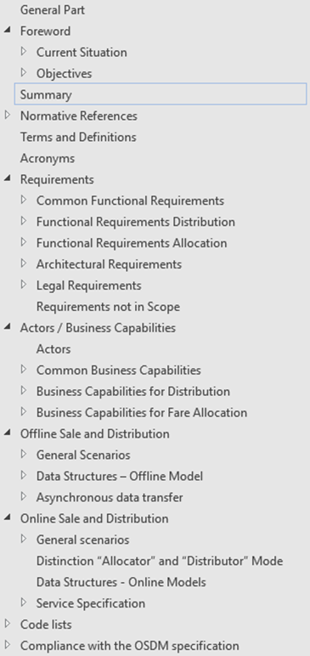
4. Mapping Capabilites to API

Slide 20
5. List of Future Enhancements The API is continuously enhanced
Scope for Later PIs
I-7 Add full support for PRMs (CIT)
I-6 Add support for new mobility services based on pay-after-use (UIC)
I-8 Add real-time support (DB)
I-10 Add support for offers only spanning part of a trip (SBB)
I-17 Add support for stock management (DB)
I-20 Include links to possible actions (BENE)
I-21 Add support to support zone-based offer (SBB)
I-22 Better isolate non-passenger related functionalities & schemas (cars, trailers, etc.) (BENE)
I-27 Add support for group reservations (SBB)
I-29 Support promotions in price calculations (SBB)
I-30 Add the possibility for direct booking (Sqills/Amadeus/SBB)

