Slide 1
OSDM - An Introduction
December 2020
Clemens Gantert, Chairman OSDM
Andreas Schlapbach, Tech Lead FSM & Chairman OSDM

Slide 2
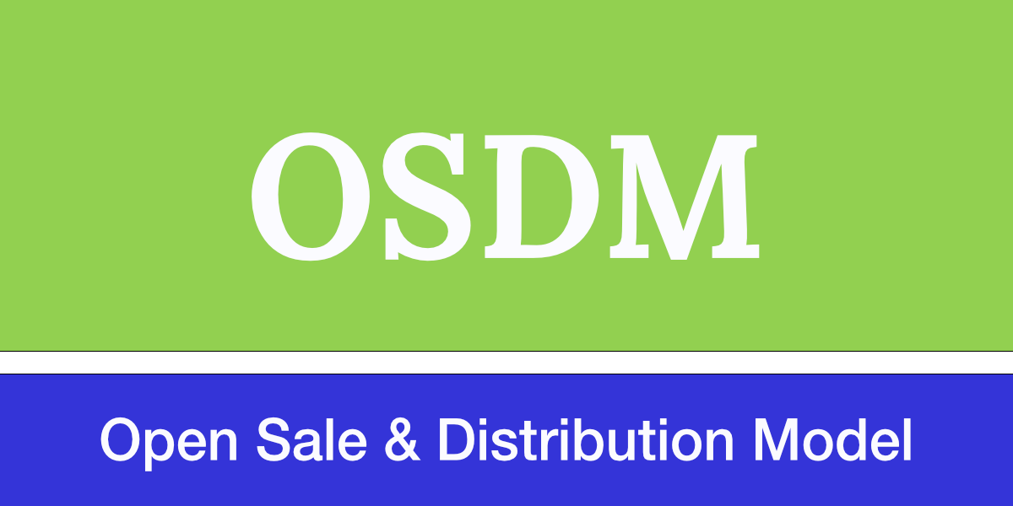
1. Introduction
The aims of the Open Sales and Distribution Model (OSDM) are twofold:
to substantially simplify the booking process for customers of rail trips and,
to lower complexity and distribution costs for distributors and railway carriers.
Thus, distributors and railways joint forces and developed a state-of-the-art distribution API and fare exchange model.
Specification is Open Source and available to everybody:
https://unioninternationalcheminsdefer.github.io/OSDM/

Slide 3
1. OSDM – Vision
Powerful combination
It must be possible to combine fares according to existing fare combinations (e.g. NRT-style PRIFIS) as well as new fare combination models.
Easy distribution
It must be easily possible to distribute existing and new products.
Easily possible means two things:
Firstly, for a customer it must be easily possible to find and book and – if needed – refund a booking.
Secondly, for the rail sector as a whole the complexity of distribution must be reduced to save costs both for development as well as distribution.

Slide 4
1. PRIFIS is End of Live Replacement: OSDM-Offline
PRIFIS
nTM requirement
phase
OSDM tender phase
OSDM Implementation
phase
OSDM
On Test
OSDM
Productive
Bulk exchange
of Fares
27.10.2020
PRIFIS stops
OSDM live
01.01.2021
15.9.2021

Slide 5
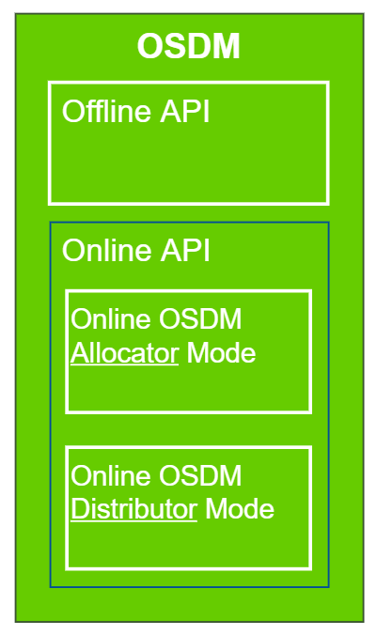
2. Overview of OSDM
Replaces PRIFIS
New Online Distribution and Carrier Interface

Slide 6
2. OSDM Online API
The OSDM is a light-weight API consisting of a set of micro services.
It is modelled in YAML, fully supporting the REST paradigm.
The specification is completely Open Source and developed in an agile manner.

Slide 7
2. Supported Processes
Sales and Distribution processes:
Searching for trips
Getting offers
Booking an offer
Confirmation of the booking
Fulfillment of the booking
After-sale processes:
Getting a refund/exchange offers
Booking a refund/exchange offer
Fulfillment of the booking

Slide 8
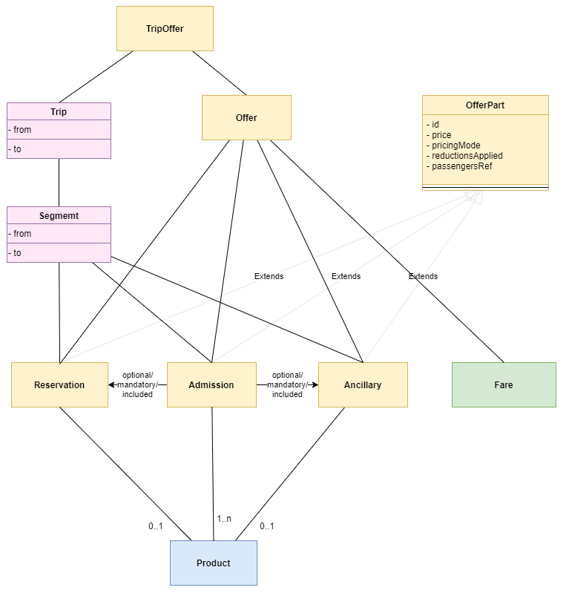
2. Supported Products
Offers consist of the following parts:
Admissions (aka. tickets),
Reservations,
Ancillaries
Fares (priced segments)
The offers are linked by optional / mandatory / included relations to an overall offer.

Slide 9

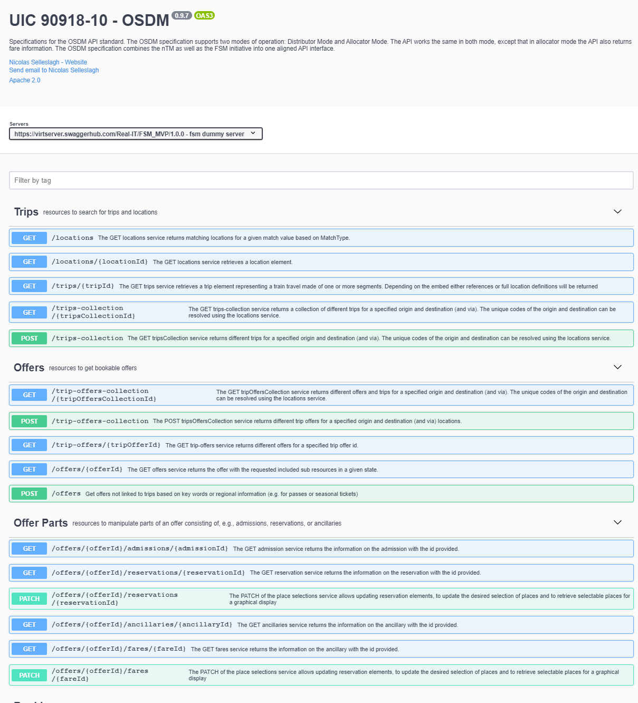

Slide 10
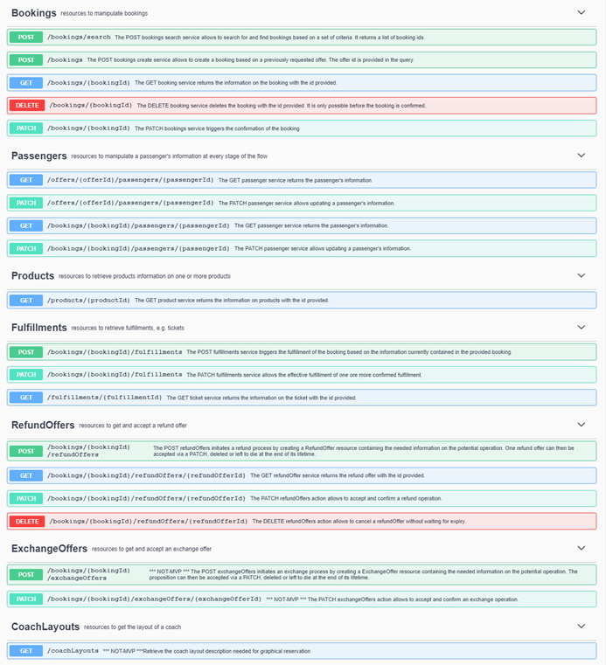

Slide 11
2. OSDM – Roles Definitions
The OSDM Online API is split between roles participants can take:
Fare Provider – defining the fare and combination rules and providing them to allocators offline or online.
Allocator – combining fares, defining after sales rules within the frames et by the fare provider, providing combined offers and managing the booking transaction, managing the ticket security (barcode, control processes), managing compensations processes, managing the stock control process.
Distributor – selling tickets from one or more allocators to the customer. Selecting the allocators and joining multiple independent bookings.
A RU or system provider can support more than one role.

Slide 12
3. Organization of OSDM Working Group Evolution process
Basic Ideas
A specification is product.
We have a backlog of improvements where all parties can contribute.
An improvement addresses a need and solves a problem, thus producing business value.
The OSDM executive committee prioritizes the backlog based on the value for the railway customer and the railway sector as a whole.
The OSDM executive committee is a fair representation of the parties involved, thus railways and distributors and others.
The OSDM technical working group designs improvements to the standard. To stay focused, the work in progress should not be larger than 3.
The OSDM technical working group taking special care not to break existing implementations, thus securing investments made by all the parties.

Slide 13
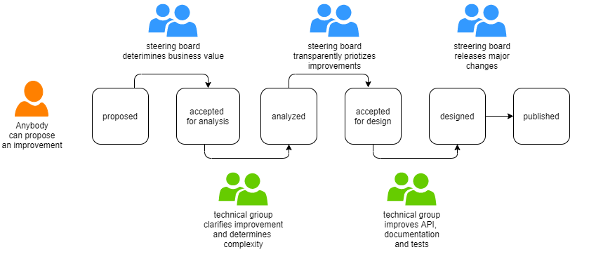
3. Organization of OSDM Working Group Evolution process
Input needed by
PES for RUs
ETT/Ectaa for 3rd party distributors
Endorsement needed by
PES for RUs
ETT/Ectaa for 3rd party distributors

Slide 14
3. Organization of OSDM Working Group Aim: incremental and steady improvement
Technical Aspect
Versioning major/minor versions following semantic versioning.
Organizational Aspect
annual publication of an approved IRS 90918-10 version by UIC
Intermediary minor changes published within the work group
Maintenance Process
New requirements can be added by all participants in OSDM

Slide 15
4. Schedule for Specification Work
Offline Stream
Start implementation of OSDM offline platform (ex-Prifis)
Online Stream
Steering Group:
Finalize evolution process (appoint steering group)
Finalize validation & verification process
Working Group:
Improve online-part of OSDM (IRS 90918-10)
Chapter: Functional Requirements Distributions
Chapter: Business Capabilities for Distributions
Add notion of OfferResourceLocation
Finalize reviews
Add Improvement 0: «Reduce complexity of online model», Improvement 11: «Add support for round trips» and Improvement 14: «Let the customer choose offer per segments»
OSDM Working Group
every Friday 9:00-11:00
PSS/OSDM
(19.–22.10.2020)
FSM (01.12.2020)
OSDM meeting
(17.12.2020)
FSM (13.10.2020)
Sign-off OSDM offline (OSDM.0.9)
01.11.2020
01.12.2020
Sign-off
OSDM 1.0
(off- &online)
01.01.2021

Slide 16
4. Mapping Business Capabilities to Specification
The specification needs to layout the business requirements/capabilities first before documenting the technical implementation
In order to reflect the functional requirements leading to API they need be made explicit and documented.
This gives the business representatives the possibility to be ascertained that their needs a reflected and addressed.
Additionally it helps preventing repeating discussions already had.

Slide 17
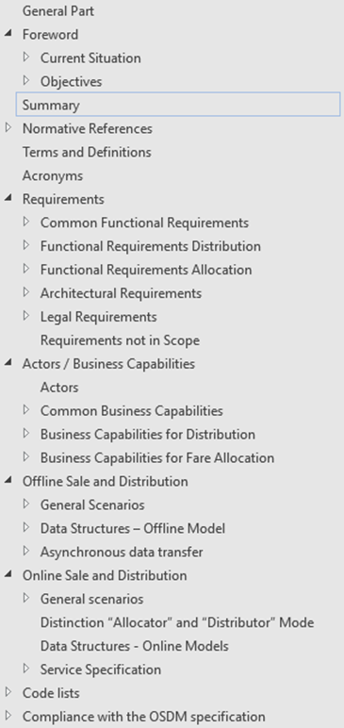
4. Mapping Capabilites to API

Slide 18
5. List of Enhancements The API is continuously enhanced
# | Improvements name | Owner | State
0 | Reduce complexity of online model | ETT | Published in Version 1.0
11 | Add support for round trips | DB / Sqills | Published in Version 1.0
 |  | Bayer Ralf (IT-SCP-MVD-ETS - Extern)
 |  | Nieuwerth Johan (IT-SCP-MVD-ETS - Extern)
1 | Offer-based combination | Amadeus | Accepted for analysis
 |  | Parmigiani Elisa (IT-SCP-MVD-ETS - Extern)
2 | Need for stateless processes | Sqills | Accepted for analysis
 |  | Nieuwerth Johan (IT-SCP-MVD-ETS - Extern)
3 | Support for partial refund / exchange | Trenitalia | proposed
 |  | Stefano Turri
4 | Align /locations and /trips to Transmodel (OJP) | SBB | Proposed
 |  | Hirzel Peter (IT-SCP-BP-VTP)
5 | Add a notion of a fee | DB | Accepted for analysis
 |  | Bayer Ralf (IT-SCP-MVD-ETS - Extern
6 | Support for new mobility services based on pay-after-use | UIC:Door2Door | proposed
7 | Add full support for persons with reduced mobility | CIT | proposed
 |  | Jan Vavra
8 | Add real-time support | DB | proposed
 |  | Bayer Ralf (IT-SCP-MVD-ETS - Extern)
9 | Add pdf binary in fulfillment messages | DB | Accepted for analysis
 |  | Dorsch Jessica (IT-SCP-MVD-ETS - Extern)
10 | Add support for offers only spanning part of a journey | SBB | proposed
 |  | Schlapbach Andreas (IT-SCP-MVD-ETS)
12 | Add support for URT ticket | Jan Vavra | Published in Version 1.0
13 | Add support for mixed forms of fulfillment types (mix value paper and non-value paper) | Jan Vavra | proposed
14 | Let the customer choose offers per segments independently | Trenitalia (Luca/Sandara) | Published in Version 1.0

