Slide 1



The database
and other translocation databases (WP2)
Session of the Translocation Workshop, Paris, September 11th, 2025
Workshop for academics in the framework of the project entitled:
Translocations of flora and fauna for conservation and restoration: ecological, evolutionary, and socio-economic impacts, at multiple scales
selected by the BiodivRestore call from Biodiversa+ and Water JPI

Slide 2










The database:
purpose, scope, content, functioning and perspectives
Bruno Colas, Isabelle Baly, Linda Angulo Lopez, Zixuan Xu, Carline Pitz and François Sarrazin
Notes:
To Bruno:
Title of the presentation
Structure of the presentation will be exactly as the title suggests, with the largest part devoted to the functioning of the database.

Slide 3
Purpose
Notes:
To Bruno:
Let’s begin with the purpose of the database
I’ll be quick because we are all involved in translocation issues and we are all aware of the context and of the objectives associated with this type of databases

Slide 4
Purpose
Context
Translocation projects --- increasing
Efforts to implement translocations --- heterogeneous
Monitoring --- heterogeneous
Vocabulary --- source of misunderstanding
Data --- scattered (grey literature)
Notes:
To Bruno:
We are operating in a context where:
- Translocation projects have been increasing over the last 10-20 years
- Efforts to implement translocations vary greatly between projects
- Monitoring of translocated populations is heterogeneous
- Vocabulary can be a source of misunderstanding
- Data is scattered, often in grey literature, especially for plants

Slide 5
Purpose
Objectives (short-term)
Collect data and documentation on translocations and make the data more widely available
Standardize the language used and the translocation data
Inform those involved in translocations about past translocations and the data available on them
Enable translocation stakeholders to enter their own data
Notes:
To Bruno:
The objectives of the database are multiple
These are short-term objectives. We think that they have been mostly achieved.
[Read the slide]

Slide 6
Purpose
Objectives (long-term)
→ Promote exchanges between translocation stakeholders: managers, decision-makers, experts, researchers
→ Facilitate research on translocations
→ Improve future translocations and inform decisions on whether or not to translocate
Notes:
To Bruno:
There are also long-term objectives, or, let’s say, more ambitious objectives.
The first and third objectives have not yet been achieved

Slide 7
Scope
Notes:
To Bruno:
That's all for the purpose of the database. Now let's move on to its scope.

Slide 8

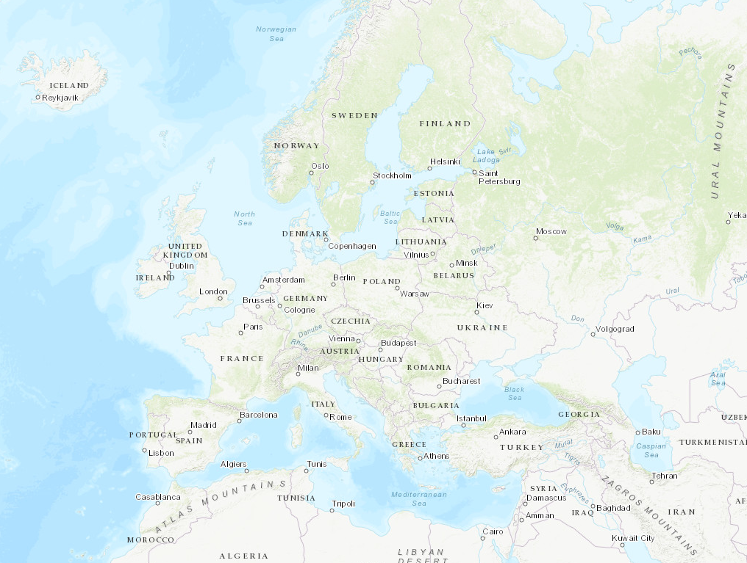
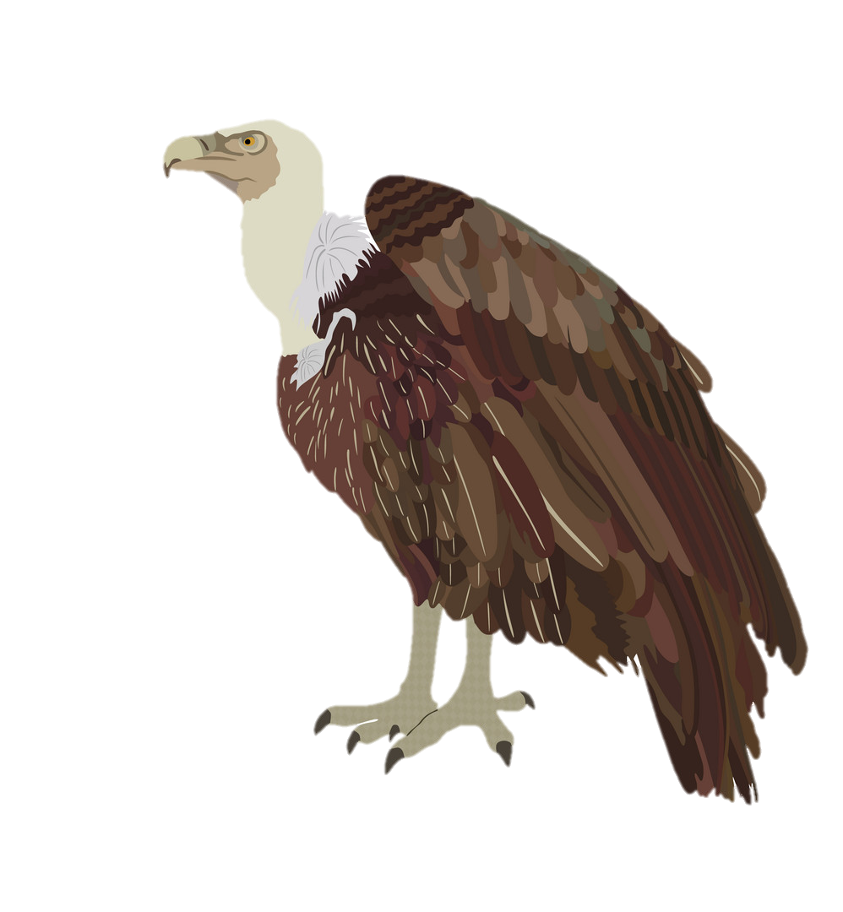
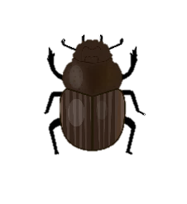

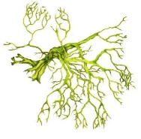
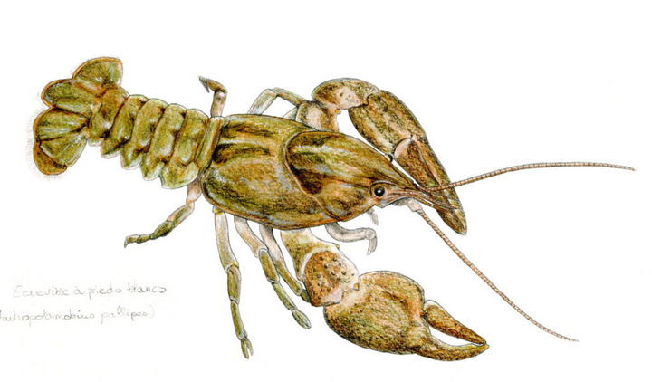
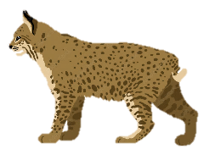

Scope
Western Palearctic
Plants, animals, fungi
Notes:
To Bruno:
The database deals with all kinds of plants, animals and fungi.
Geographical perimeter: Europe in the geographical sense: from Iceland up to the Ural Mountains and the Caucasus, plus the Mediterranean countries.

Slide 9
Scope
Initial motivation
Final goals
Conservation motivation
Conservation status of the focal species (local to global scale)
Restoration of a community or ecosystem
Provision of an ecosystem service
Notes:
To Bruno:
According to IUCN, a conservation translocation is the intentional movement and release of a living organism where the primary objective is a conservation benefit: this will usually comprise improving the conservation status of the focal species locally or globally, and/or restoring natural ecosystem functions or processes.
These goals correspond more or less to the final goals written here, which are not always easy to disantangle.
In many translocations, these goals coincide with the initial motivations that led to the translocation project.

Slide 10
Scope
Initial motivation
Final goals
Conservation motivation
Conservation status of the species (local to global scale)
Restoration of a community or ecosystem
Provision of an ecosystem service
Response to a regulatory obligation
(mitigation hierarchy)
Notes:
To Bruno:
But sometimes, there are mitigation translocations that have similar goals, even though the translocation project has its origins in the application of legal or regulatory obligations (in particular as a measure to compensate for or accompany development work).

Slide 11
Scope
Initial motivation
Final goals
Conservation motivation
Conservation status of the species (local to global scale)
Restoration of a community or ecosystem
Provision of an ecosystem service
Population viability objective
Response to a regulatory obligation
(mitigation hierarchy)
Notes:
To Bruno:
To achieve these goals, it is generally necessary to go through an intermediate objective, which is the viability of the translocated population.

Slide 12
Scope
Transloc includes translocations with a population viability objective
→ Conservation-driven and certain mitigation-driven translocations are included
→ Species-centred and certain community-centred translocations are included
Notes:
To Bruno:
Transloc database includes translocations of wild species which have a population viability objective, whatever the initial motivation and the final goals.
This includes conservation-driven translocations and certain mitigation-driven translocations, the one where ther is a clear conservation objective at the population or community levels.
And this includes species-centred and certain community-centred translocations.

Slide 13
Content
Notes:
To Bruno:
What is the content of the database?

Slide 14
Content
Structure - The Transloc database is population-based
The Population table is the core of the database
One entry in the population part of the database = one translocated population corresponding to a unique population code.
A translocated population corresponds to a species in a host (=recipient) site.
To create an entry, the following is required: a species name, a country name, a year (or range of years)
Notes:
To Bruno:
[Read the slide]

Slide 15
Content
Structure - The Transloc database is population-based
Consequences :
→ a species can have multiple entries in the population table
→ several entries can correspond to the same host site if several species have been translocated to this site
→ an entry may correspond to multiple release, sowing or transplantation events (RST) of a given species in a given site over multiple years
→ a project or program can appear in several entries if it concerns several species or several host sites
Notes:
To Bruno:
[Read the slide]
This is probably fairly trivial. What is perhaps less so, because it is not perhaps shared by all databases, is that a project or program can appear in several entries if it concerns several species or several host sites.

Slide 16
Content
Structure - other important tables connected to the population table
- Table of species
- Table of localities
- Table of references
- Table of organisations
- RST (= Release, Sowing, Transplantation) table
- Tables of demog. results: pop dynamics, demographic progress, viability
(other tables accessible to admins only and many intermediate tables, e.g., listing the options available in the drop-down lists)
Notes:
To Bruno:
In the database, there are other important tables connected to the population table. For example…
[Read the slide]
The RST table shows the number of individuals translocated. There are three tables of demographic results: ‘Population dynamics’ simply corresponds to post-translocation population sizes. The other two tables correspond to demographic analysis results, which François, JB or Juliette will discuss in WP4.
There are other tables accessible to admins only (for example the table of users) and many intermediate tables that you can access only if you go into the code of the database, for example the tables listing the options available in the drop-down lists.

Slide 17
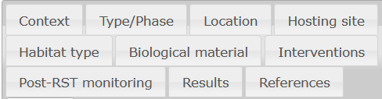
Content
Population data
160 information fields
Notes:
To Bruno:
Let’s go to the content in terms of data. I won't go into detail about the fields included in the database. We can discuss them in the discussion if you wish. There are 160 fields, which we found it convenient to classify into the 12 tabs or frames on the website and which are shown on this slide.
[Read the tabs]

Slide 18
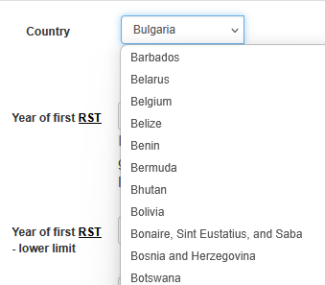
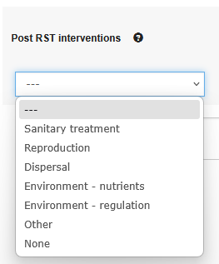
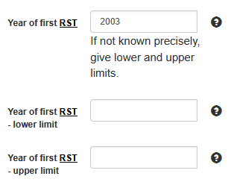
Content
Population data
Notes:
To Bruno:
For some fields, there is a choice to be made from a drop-down list in the database; for others, it may be numerical data, a date, or free text; and some fields are linked to external databases such as GeoNames for state names.

Slide 19
Content
Data available today
 | Populations | Species
Animals | 518 | 89
Fungi | 10 | 3
Plants | 1214 | 534
Total | 1742 | 626
Not a random sample of translocations in Europe and the Mediterranean
Limited information for most populations
Notes:
To Bruno:
Today are included in the DB data on 1700 populations. These data are by no means a random sample of translocations in Europe and around the Mediterranean. They are mainly representative of the efforts made to collect data from various sources of information.

Slide 20
Functioning
Notes:
To Bruno:
Now, let’s pass to the biggest part of the presentation: the functioning of the DB.

Slide 21
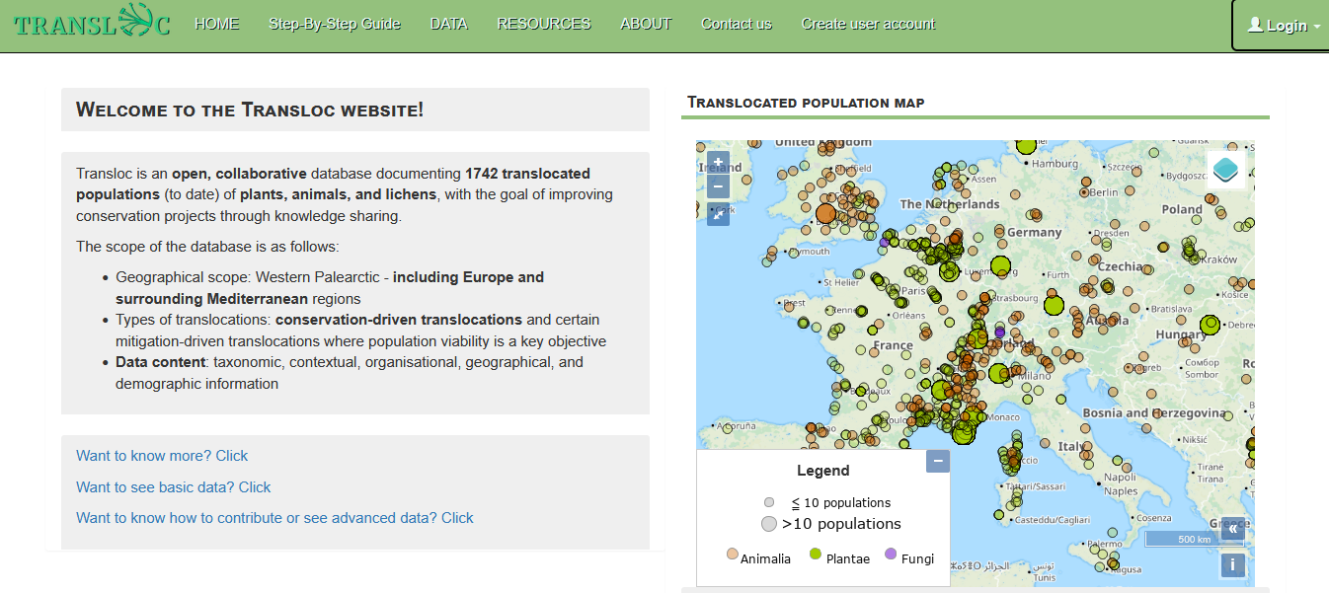
Functioning
Access to the database: The Transloc website
Three levels of access:
Visitors
Users
Admins
Notes:
To Linda:
Just say that there are 3 levels of access

Slide 22
Functioning
Access to the database: The Transloc website
Can see basic data on maps and tables
Visitors
Can contribute to the Transloc DB
Can see most data of the DB
Users
Can download the data with restrictions
Admins
Manage user accounts
Validate data entered by users
Notes:
To Linda:
Visitors: can see basic data on maps and tables and that’s it
Users can contribute, see most of the data and download them with some restrictions, which will be discussed later
To become a user, you juste need to fill in a simple form on the website, and wait for the validation of your account by an admin.
Admins validate user accounts and also the data entered by users.

Slide 23
Functioning
How to use the website and database
Notes:
To Linda:

Slide 24
Functioning
How to use the website and database
Home page with menus
Notes:
To Linda:

Slide 25
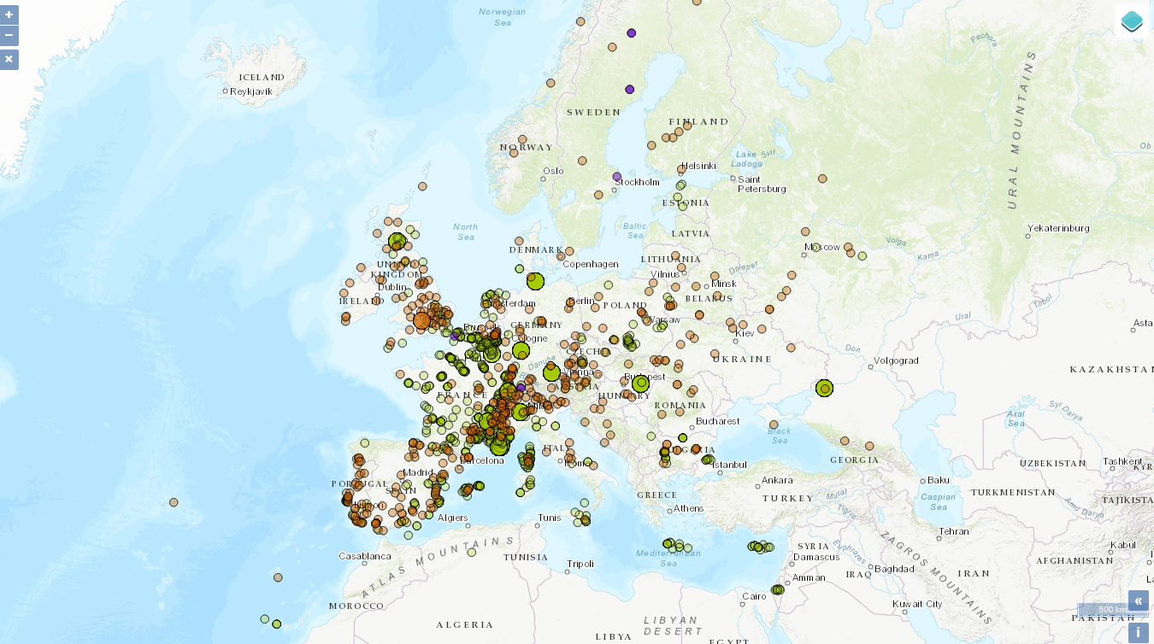
Functioning
Notes:
To Linda:
This can be shown online, if possible.
Show the map, zoom in, zoom out, change the landscape, see species and years on the dots
These are approximate locations (generally at the municipality level)

Slide 26
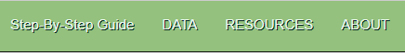
Functioning
How to use the website and database
Home page with menus
Notes:
To Linda:
This can be shown online, if possible.
3 main menus: DATA, RESOURCES and ABOUT, and a short cut to step-by-step guide
We will forget about the ABOUT menu today because it is not yet online

Slide 27
Functioning
How to use the website and database
Step-by-step guide
Notes:
To Linda:
This can be shown online, if possible.
Let’s begin by the step-by-step guide

Slide 28
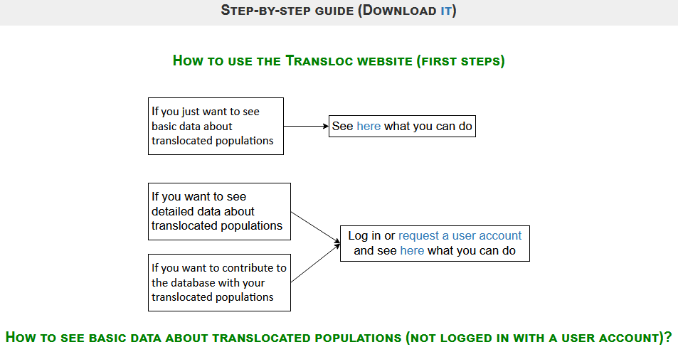
Functioning
Notes:
To Linda:
This can be shown online, if possible.
There are several pages, you can download it. It’s shown how to use the website when your are a beginner

Slide 29
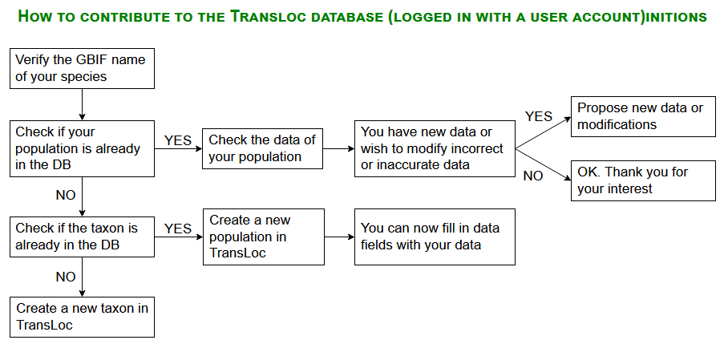
Functioning
Notes:
To Linda (or if you prefer, I can explain this one, it’s as you want!):
This can be shown online, if possible.
For example here it is explained how to contribute to the database if you want to enter a translocated population: you first have to verify the GBIF name of your species (because we use GBIF species names), then you check if your pop already exists in the database. If it is yes, you can check the available data and eventually propose new data.
If your pop is not on the database, you can create this population, eventually after creating the species if it is the first population for this particular species.

Slide 30
Functioning
How to use the website and database
How to contribute
There are two possibilities:
- using the web form (for all data)
- using Excel template files (not for all data)
Notes:
To Linda:
In fact, there are 2 possibilites to contribute:
- either you use the web form and enter your data in the fields online
- either you download Excel template files, you fill them and then upload the completed files on the website.

Slide 31
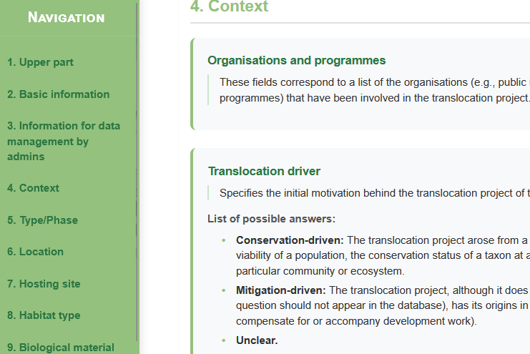
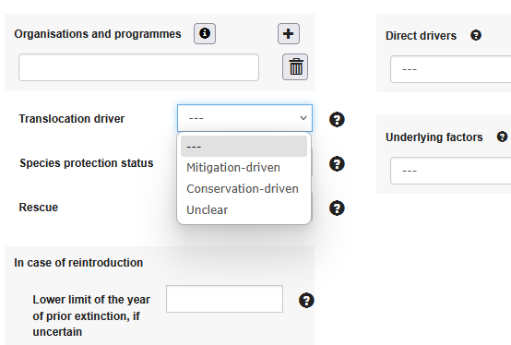
Functioning
How to use the website and database
How to contribute using the web form
Notes:
To Linda:
This can be shown online, if possible.
This is an example using the web form. Here you enter the translocation driver (conservation or mitigation-driven). There is a brief définition of the field in the tool tip to help you. And you can check the definition pages for complete definitions if anything is unclear.

Slide 32
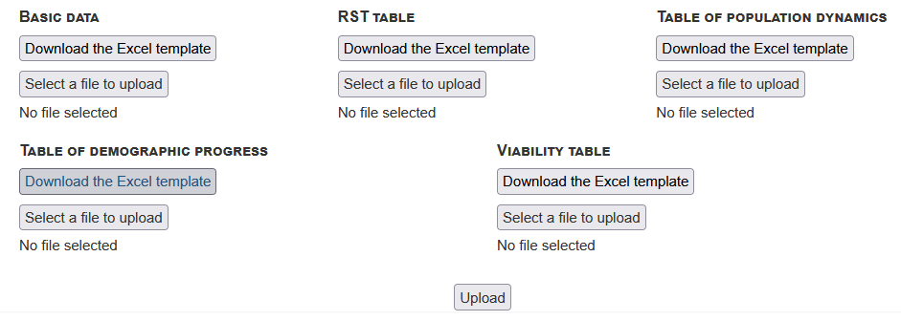
Functioning
How to use the website and database
How to contribute using Excel template files
- using the web form (for all data)
- using Excel template files
Notes:
To Linda:
This can be shown online, if possible.
If you want to enter data using Excel files, there are five different Excel templates: the first one is for basic data, the other four are for quantitative data. RST table is for the numbers of translocated individuals (released, sown or transplanted). Table of pop dynamics is for the post translocation population sizes. The table of demographic progress and the viability table are for more sophisticated estimators which François, JB or Juliette will develop in WP4.
These Excel models are useful if you have a large amount of data on a population or series of populations, for which it may be easier to fill in these Excel tables than to enter the data directly online. However, for non-demographic data, only a few fields can be entered in the Basic Data Excel model; most fields must be completed online.

Slide 33
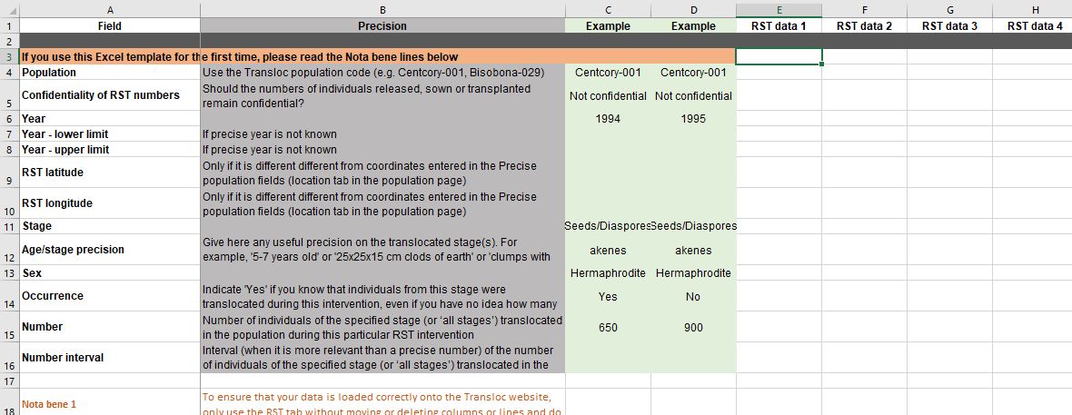
Functioning
How to use the website and database
How to contribute using Excel template files. Example: RST template
Notes:
To Linda:
This can be shown online, if possible.
For example, in the RST template, you have the name of the fields, a short description, there are two columns serving as examples. And then you can fill as many columns as you need with your data, indicating the Tranloc population code of the populations.

Slide 34
Functioning
How to use the website and database
What happens to the data provided by contributors?
It is immediately visible on the site
It appears highlighted in yellow while waiting for an administrator to validate it
It can no longer be modified until an administrator has validated it
Contributors who previously modified the population are notified by e-mail of the proposed new data.
Notes:
To Linda:
What happens to the data provided by contributors?
[You can just read the text on the slide]

Slide 35
Functioning
How to use the website and database
How to query the database
Notes:
To Linda:
Instead of entering data, you can just wish query the database.

Slide 36
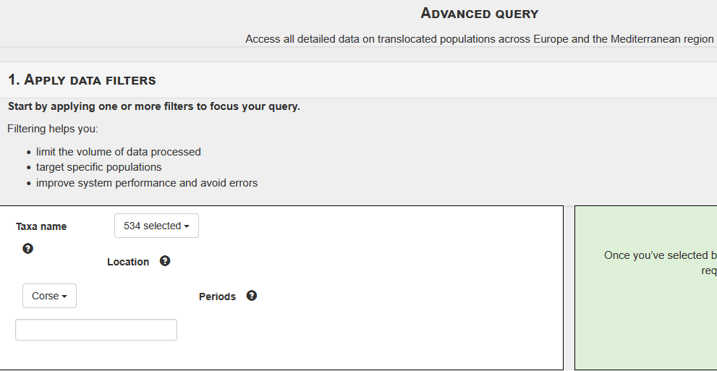
Functioning
How to use the website and database
How to query the database
Notes:
To Linda:
This can be shown online, if possible.
You can apply filters to species, locations and time periods.
For example here we selected plant taxa in Corsica.

Slide 37
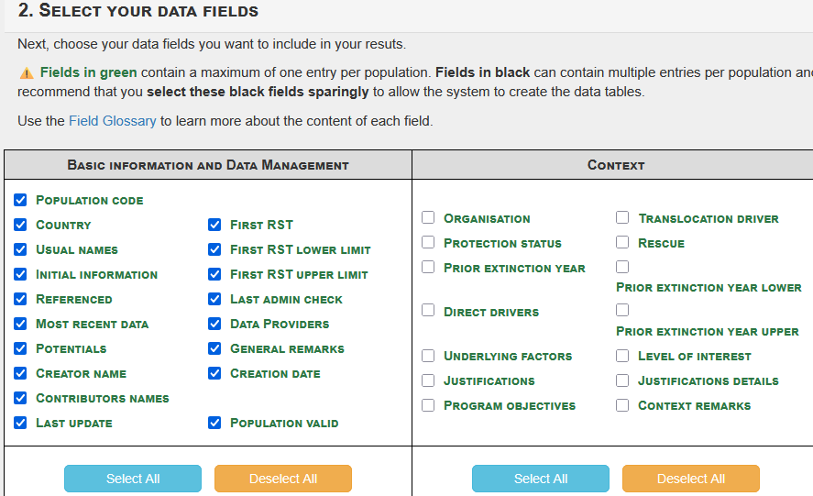
Functioning
How to use the website and database
How to query the database
Notes:
To Linda:
This can be shown online, if possible.
Then you select the data fields that interest you. For example here we selct all data fields related to basic information.

Slide 38
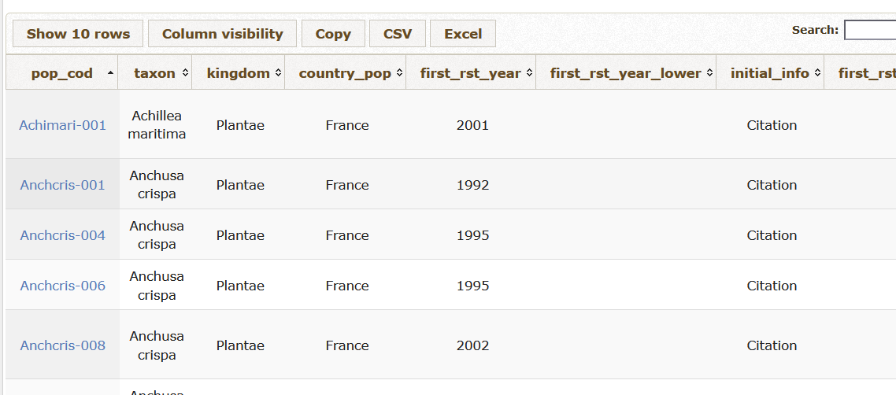
Functioning
How to use the website and database
How to query the database
Notes:
To Linda:
This can be shown online, if possible.
You send the request and the results you obtain are presented in a table, with all populations corresponding to your filters.

Slide 39
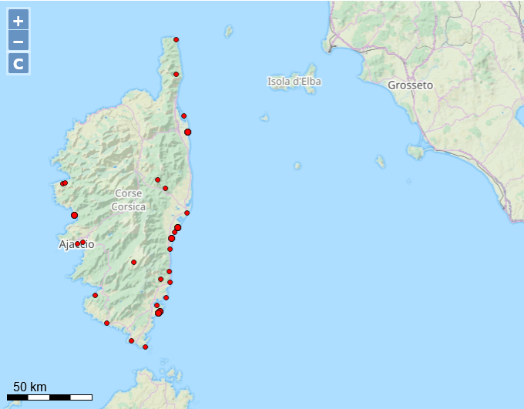
Functioning
How to use the website and database
How to query the database
Notes:
To Linda:
This can be shown online, if possible.
You also have a map that allows you to visualise the location of the populations you have selected.

Slide 40
Functioning
How to use the website and database
Limitations to users
1. Users can only download the data for populations they have contributed to.
2. Confidential data is hidden. Data that may be confidential:
- Precise locations (translocated AND natural populations)
- Table of RST
- Table of Pop dynamics
Notes:
To Linda:
However, there are some limitations to users.
First, the tables of results are downloadable. But users can only download the data for populations they have contributed to. In the database, we keep a history of all contributions and validations by administrators. This history is visible on the Transloc website. Users who would like other records can send a request via a contact form. Maps are downloadable without restrictions.
Second, contributors are given the option to keep several types of data confidential. This includes the precise locations (GPS points) of populations, whether they are translocated populations or natural populations of origin of the biological material, which is part of the data that can be entered. There is also the number of translocated individuals. and the post-translocation population sizes. Users therefore cannot access this data.
We hope to limit the amount of confidential data as much as possible. However, in some countries, legislation requires that the precise location of populations of some species be kept confidential.

Slide 41
Perspectives
Notes:
To Bruno:

Slide 42
Perspectives
Expected contribution from managers
Generate new ideas for analysis and research work
Promote the database to environmental authorities
Establish links with other European and international databases
Notes:
To Bruno:
We hope that managers will take advantage of this tool and contribute to it by submitting their data. We will be holding a webinar in November specifically for managers.
Generate new ideas for analysis and research work
Promote the database to environmental authorities, at least in France, so that experts who issue opinions can refer to it for comparison purposes.
Establishing links with other European and international databases, which is a topic that will probably be part of the discussions we will have in a while.

Slide 43
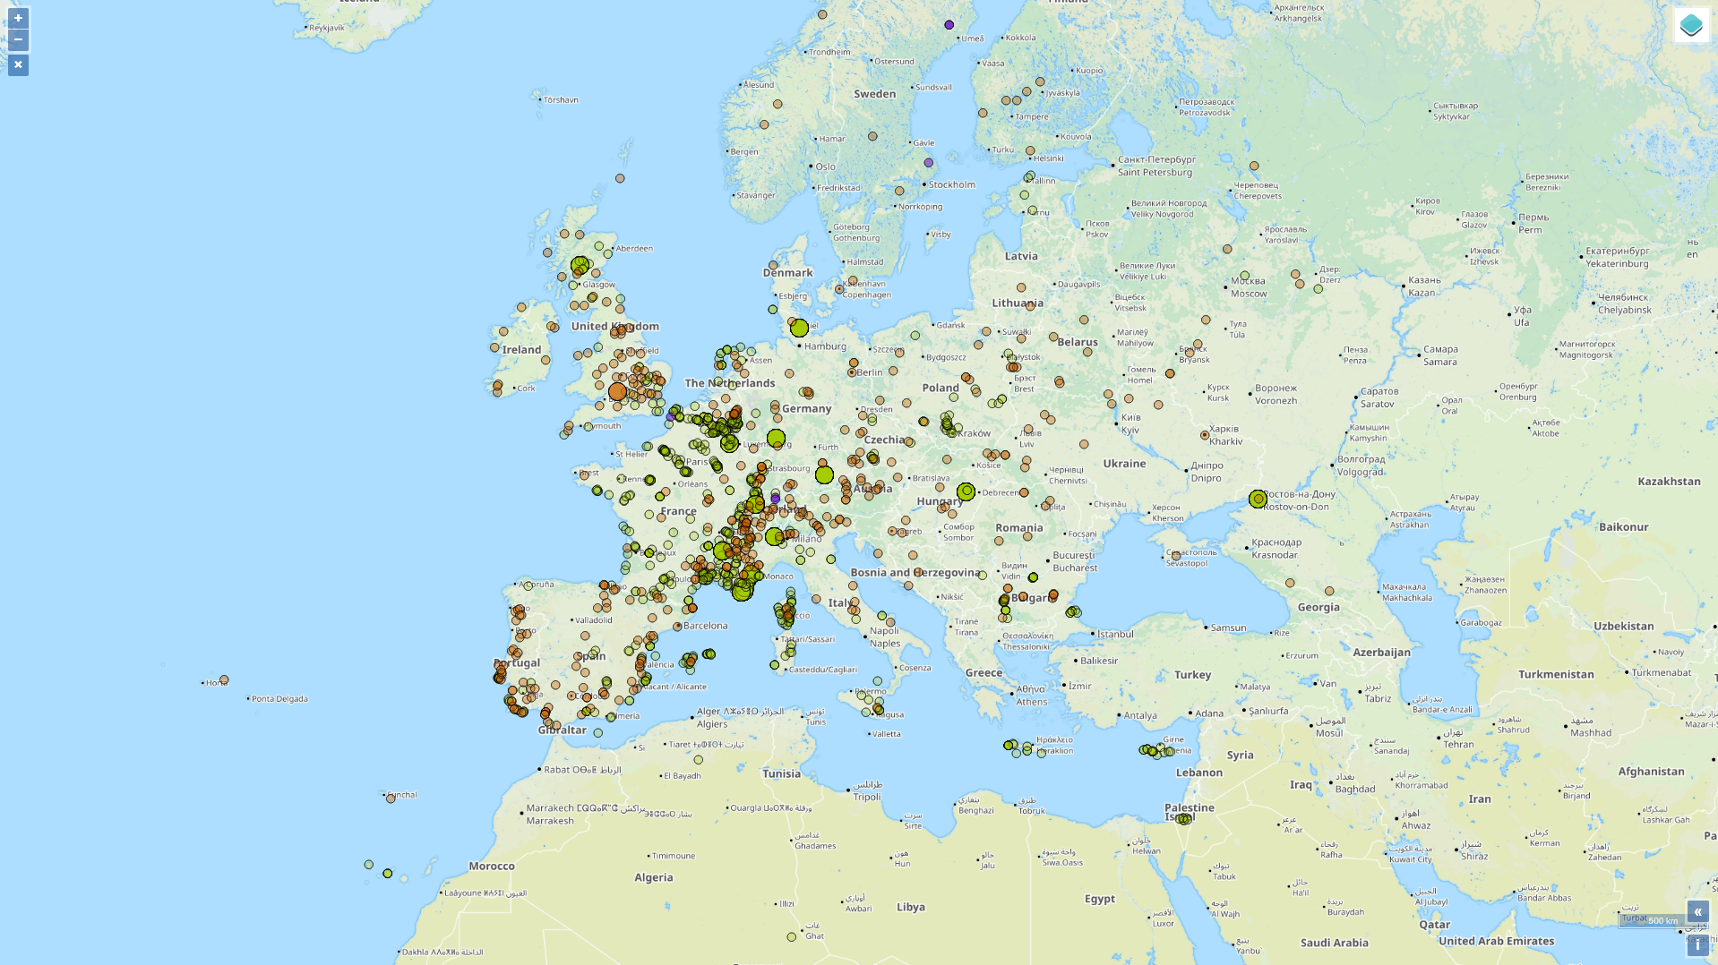

Merci !
Notes:
To Bruno:

