Slide 1
Test

Slide 2
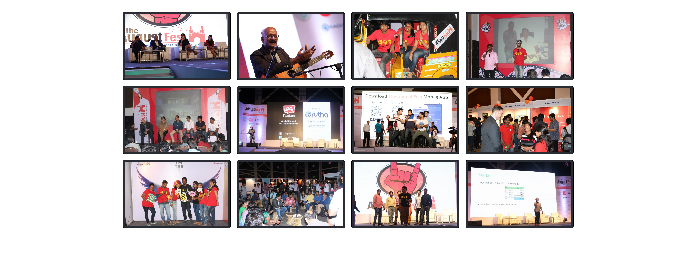

Slide 3
link
https://codepen.io/beeraiah/pen/qraeRb

