Slide 1
Test
https://codepen.io/beeraiah/pen/qraeRb

Slide 2
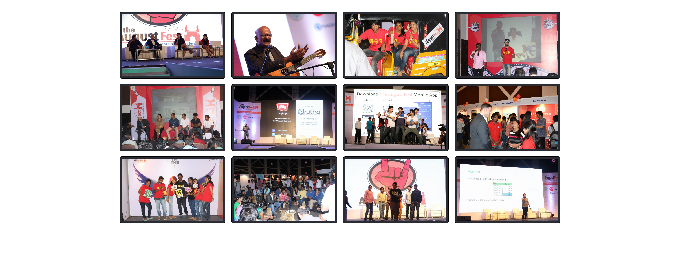

Slide 3
link
https://codepen.io/beeraiah/pen/qraeRb

