Slide 1
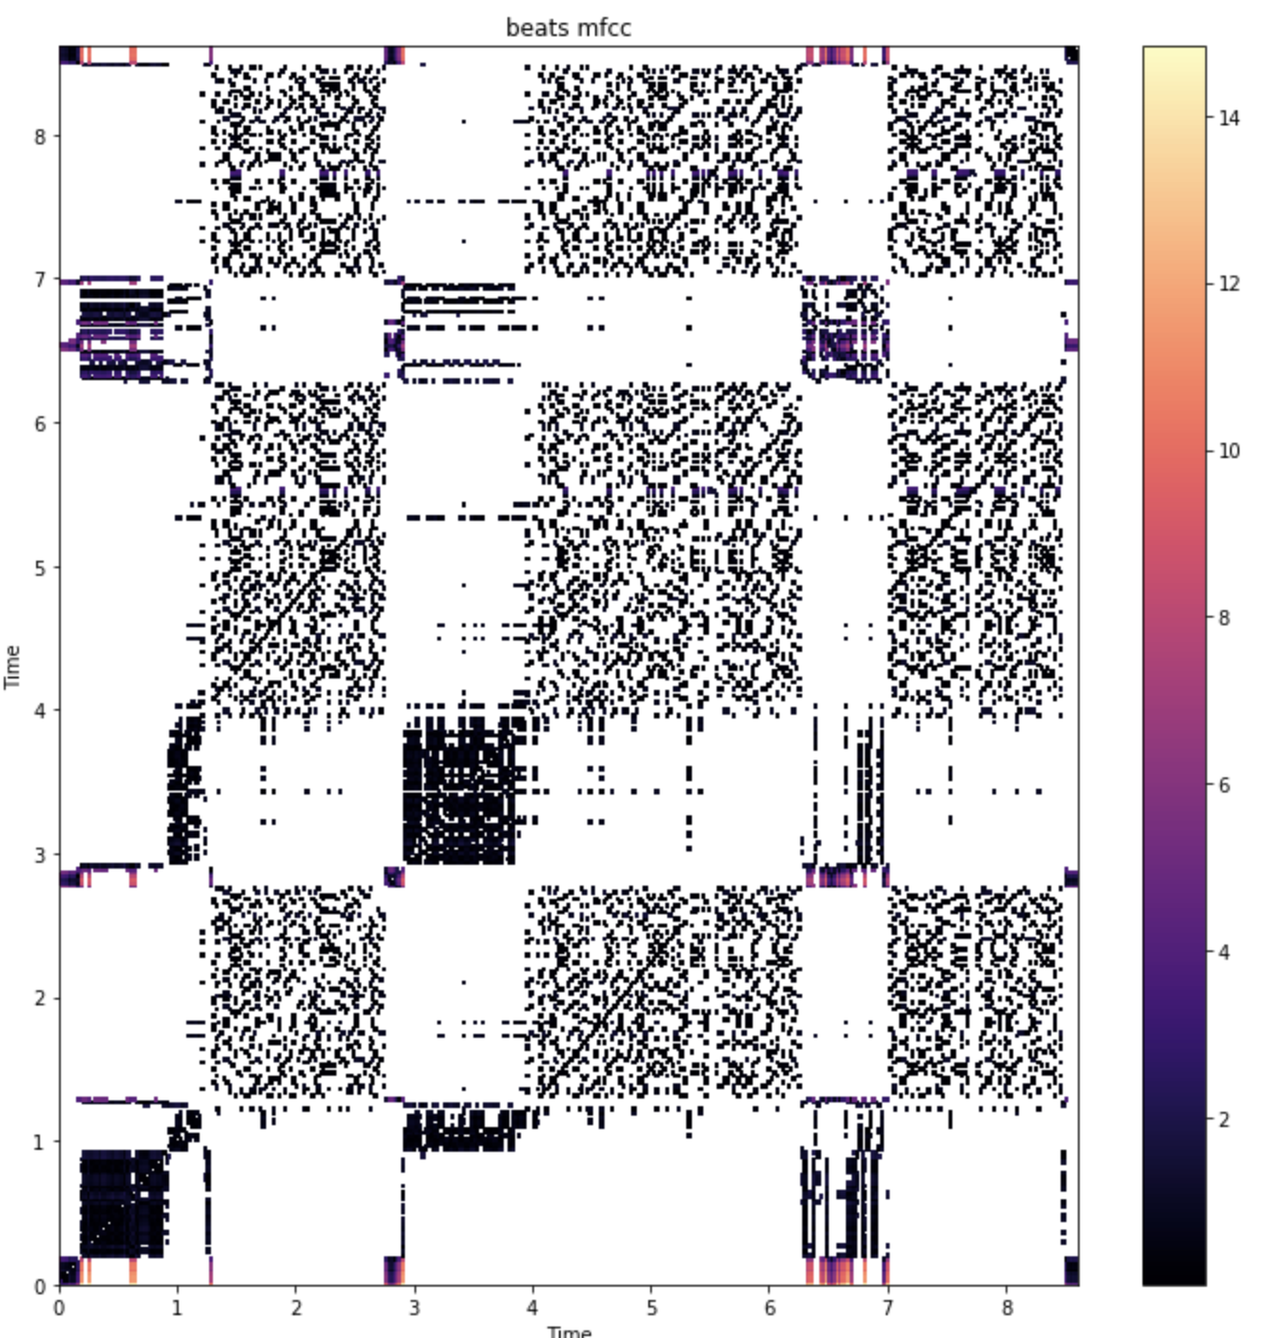
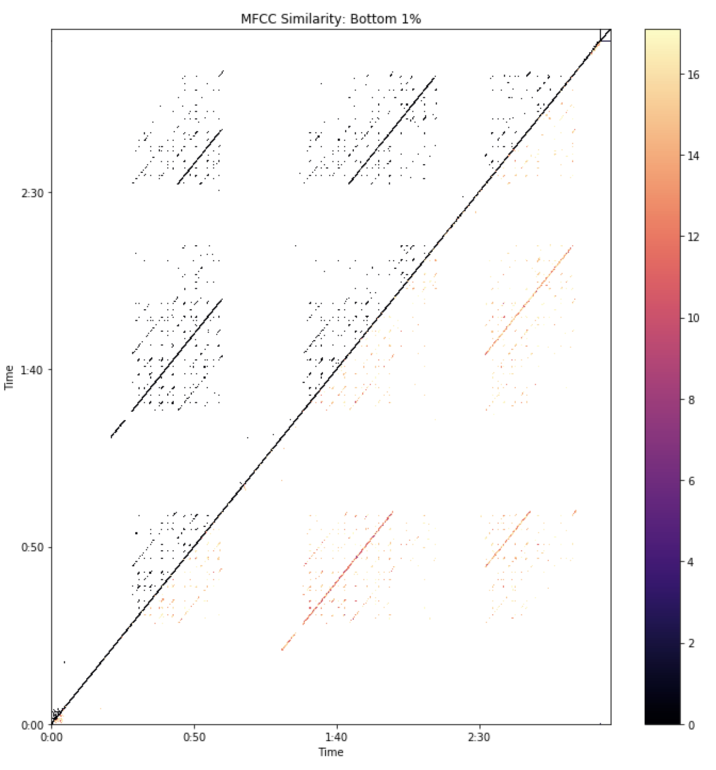
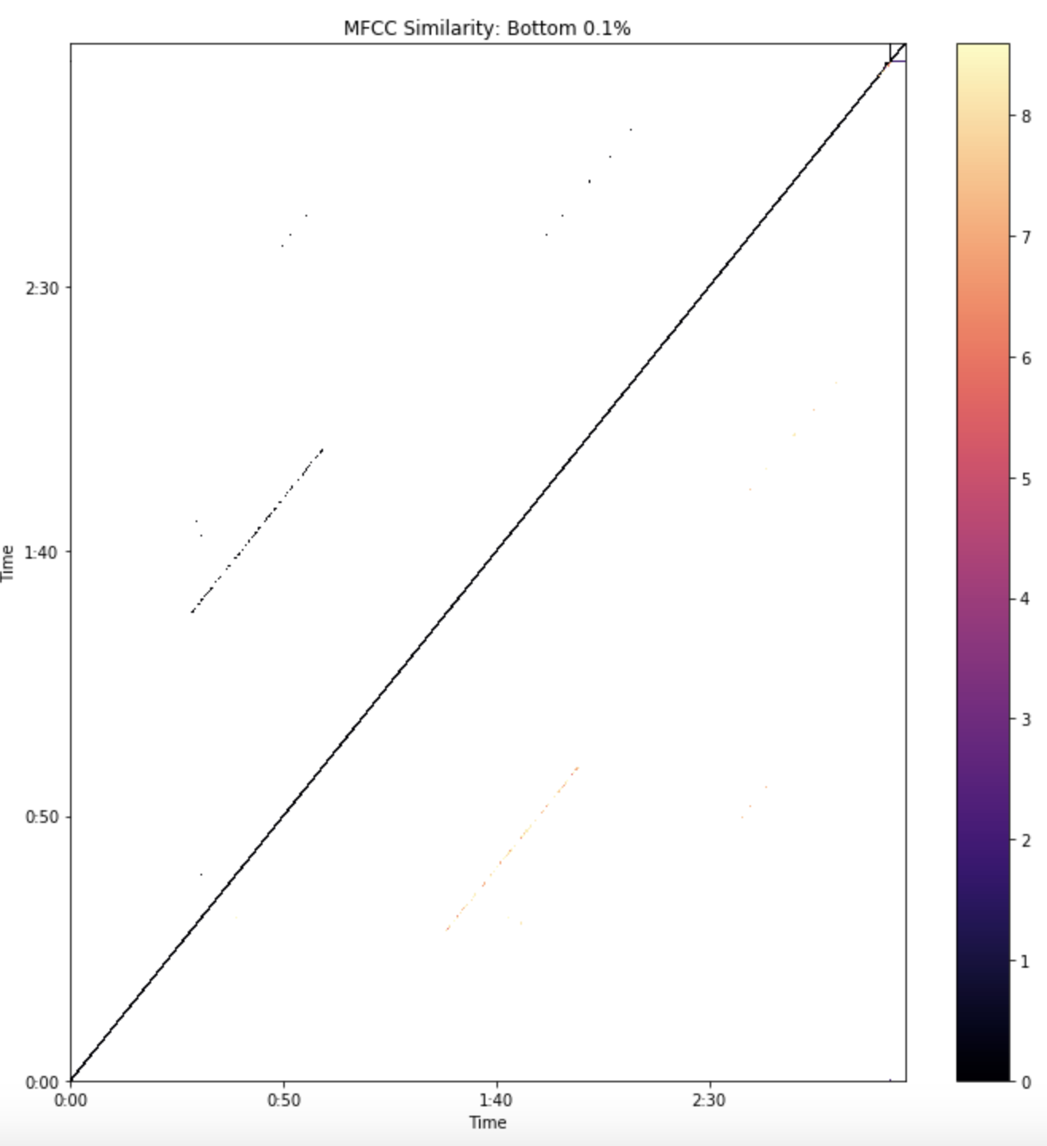
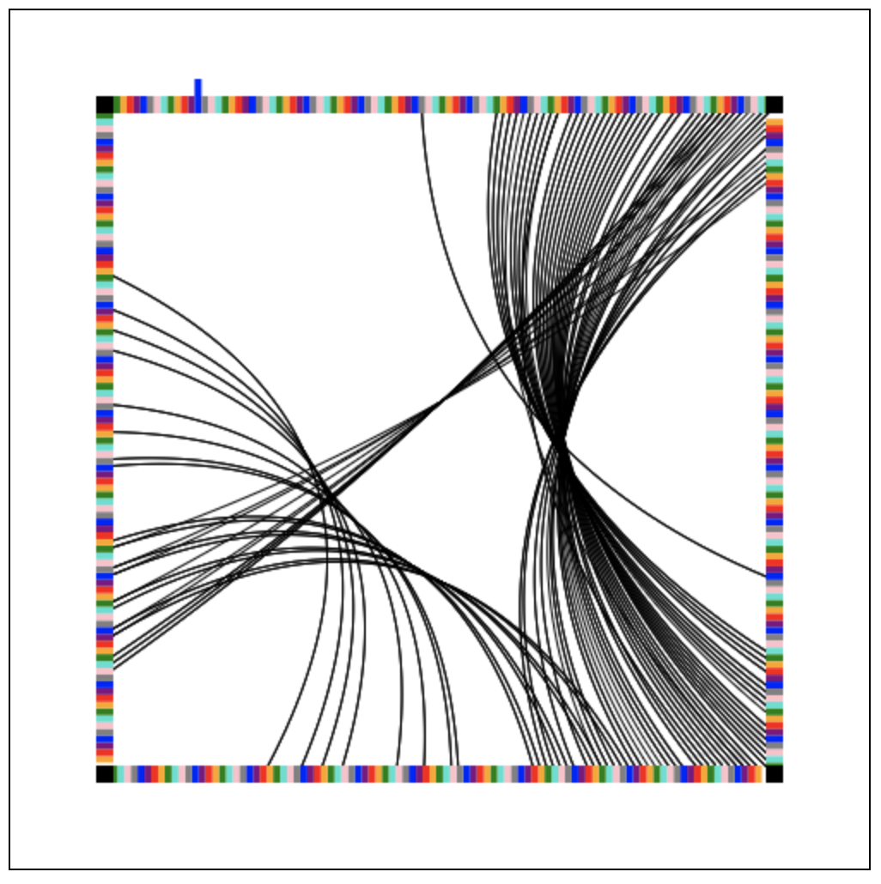
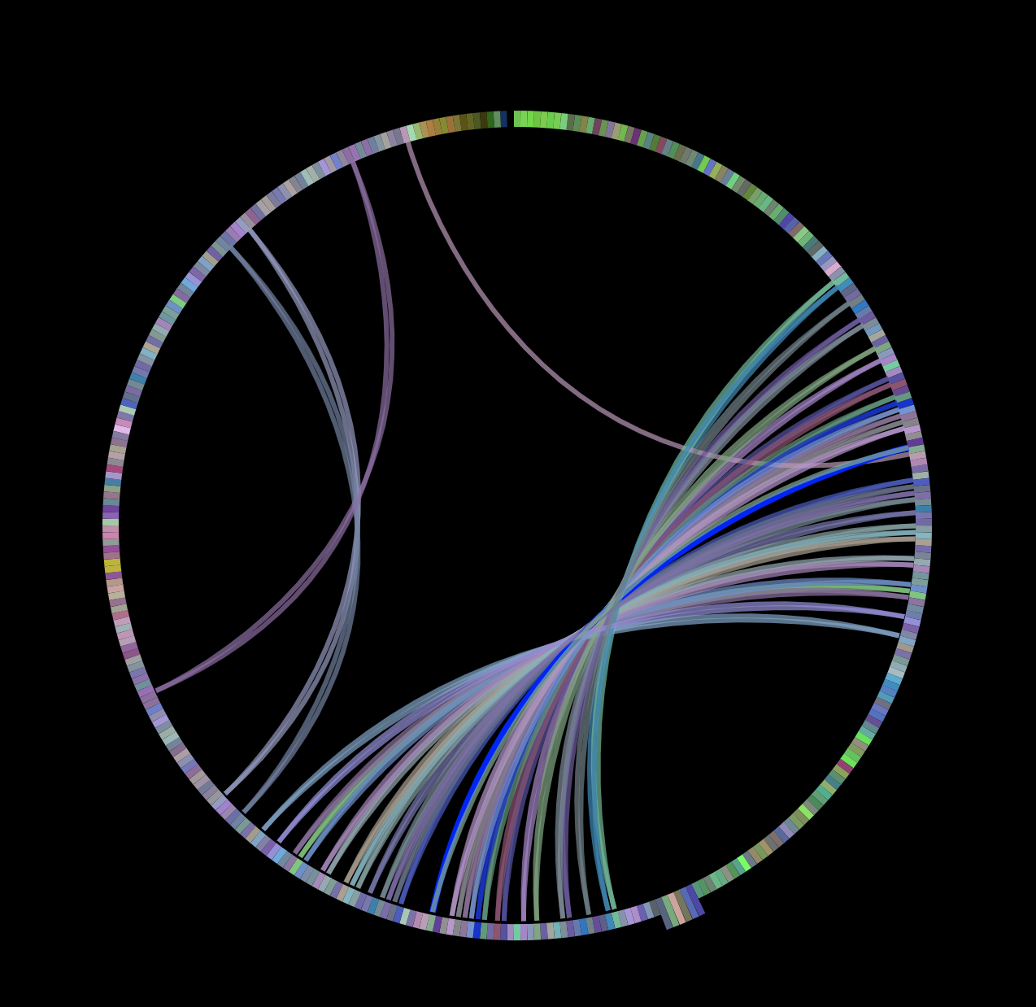
Looping a Song through Feature Extraction of Individual Beats
(Infinite Jukebox Clone)
Try it out at
Ethan Lee, Michael Considine, Shengkai Zhou
EECS 352 Northwestern University Winter 2019 Bryan
1. How can we get music to smoothly repeat itself?
4. Approach: Similarity Matrices
In music editing sometimes we want to extend clips of music without having it sound choppy
Found Infinite Jukebox through class and thought it would be a cool project to implement
Reference: infinitejukebox.playlistmachinery.com/
Our biggest problem was having to try out lots of combinations very quickly.
Comparing similarity matrices between different approaches was a good idea because it allowed us to visually observe our progress and make decisions
2. How do we choose where to jump to?
Beats
Music is naturally split up into measures and beats, often using the exact same sound bit for the chorus
By extracting the MFCCs we can identify similar beats and jump between them
The above demonstrates a classic Goldilocks paradigm. We weren’t sure how strict with our distance measure between two features so we quickly plotted the similarity matrices between using all distance measures, using the best 1%, and using the best 0.1%.
5. UI Design
Originally we planned on implementing a straight line representing the song and jumping a cursor back and forth on that. But we deemed that less user-friendly than the original design because users wouldn’t be able to see exactly where all the connection between beats have been made
3. Problems
MFCCs aren’t calculated for every beat, instead we had to aggregate features
There were many different ways we could have approached this problem and it’s hard to choose one that’s the “best” – which features to use, which distance measure, how to aggregate features, how similar beats have to be in order to be able to jump between them, etc
It’s difficult to quickly show how a song is looping back on itself; this method proved to be so efficient that we needed a very visually engaging user interface in order for users to know what a jump is occurring
6. Results
Comparing with the Original
We chose Call Me Maybe as our original song because we would be able to compare the beats we chose to hop between with the beats they chose – turns out we were a bit more lenient with our beat correlation and only some of our beats are off by a beat or two
Another way we measured results was by having friends listen to an arbitrarily long clip of the song and to note when they hear anything unusual. Of the 139 jumps in 6 random samples, testers only thought they heard something wrong 16 times, and 3 of them were false-alarms.
7. Looking Forward/Limitations
The iteration process was quite slow after working with over 8000 MFCC samples for so long. If we wanted to commercialize this somehow we’d have to think about a cache system or rethinking our algorithm so that it’s a lot faster
Our product does hiccup a couple times, but very rarely
UI isn’t quite as interactive as the original
Looking forward, this was a fun project that taught us all a lot about project ownership and the interpretation of music.
Original Infinite Jukebox UI
We wanted to keep the ability to visually see jumps as they’re occurring
Acknowledgements: This work was supported by NSF Grant 1617497

