Slide 1
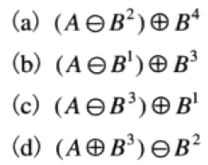
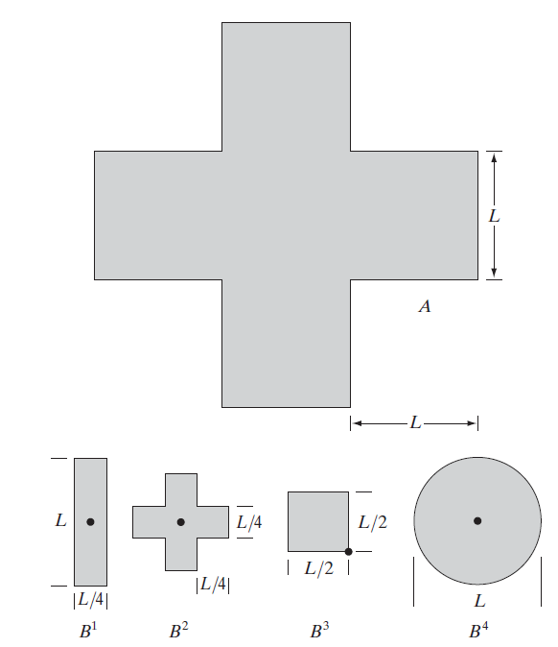



Slide 2
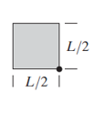
import cv2 import numpy as np import pdb if __name__ == '__main__': L = 160 block_0 = np.zeros([L, L]) block_1 = np.ones([L, L]) I0 = np.hstack([block_0, block_0, block_0, block_0, block_0]) I1 = np.hstack([block_0, block_0, block_1, block_0, block_0]) I2 = np.hstack([block_0, block_1, block_1, block_1, block_0]) I3 = np.hstack([block_0, block_0, block_1, block_0, block_0]) I4 = np.hstack([block_0, block_0, block_0, block_0, block_0]) I = np.vstack([I0, I1, I2, I3, I4]).astype(np.uint8) B1 = cv2.getStructuringElement(cv2.MORPH_RECT, (int(L / 4), L)) B2 = cross_struct(int(L / 4)) B3 = cv2.getStructuringElement(cv2.MORPH_RECT, (int(L / 2), int(L / 2))) B4 = cv2.getStructuringElement(cv2.MORPH_ELLIPSE, (L, L)) # question (b) cv2.imshow('original', I*255) I_a1 = cv2.erode(I, B1)
I_a2 = cv2.dilate(I_a1, B3, anchor=(int(L / 2) - 1, int(L / 2) - 1)) I_a2_w = cv2.dilate(I_a1, B3)
cv2.imshow('I_a_step1', I_a1 * 255) cv2.imshow('I_a_step2', I_a2 * 255) cv2.imshow('I_a_step2_w', I_a2_w * 255) cv2.waitKey(0) cv2.destroyAllWindows()
Python+openCV

Slide 3



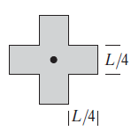
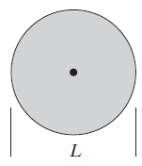

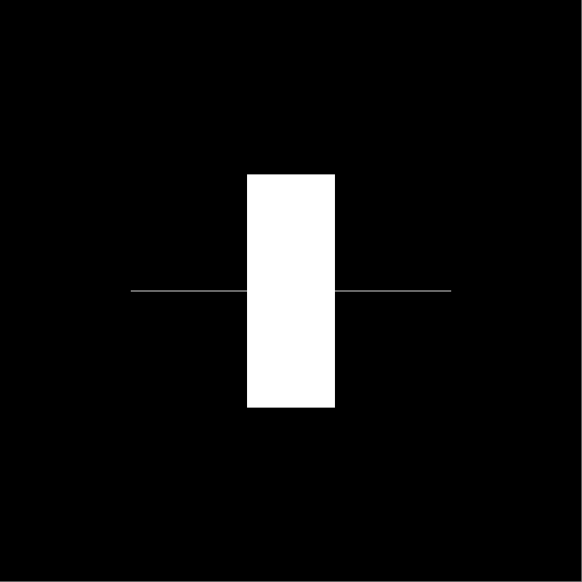

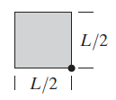

a)
腐蚀
膨胀
b)
腐蚀
膨胀

Slide 4




c)
腐蚀
膨胀
d)
膨胀
腐蚀

Slide 5
Thank you!

