Slide 1
Artificial Intelligence
Deep Learning – CNN model
IBANEZ Shirley​ - HENIN Constance​ - Ishak Edem

Slide 2
Project 7: Project Title: Traffic Sign Recognition for Autonomous Vehicles
An autonomous vehicle traffic sign recognition system capable of accurately detecting
and interpreting traffic signs from images captured by onboard cameras. This project advances
the capabilities of autonomous vehicles, enabling safer and more efficient navigation in diverse driving environments.

Slide 3
1) Dataset Collection
First we imported the necessary packages and then choose to import data from kaggle.
We imported the dataset : GTSRB (German Traffic Sign Recognition Benchmark), it contains images of various traffic signs categorized into 43 classes.
We decided to split them in 3 dataset :
Training set (Train.csv + images)
Testing set (Test.csv + images)
Meta set (Meta.csv for additional information)
After that preprocessed and organized the images into subfolders for training

Slide 4
2) Model Training
Before we train the model we pre-process the images for training and testing. We standardized the pixel to augment the images by using ImageDataGenerator:
Rescaling
Rotation, width & height shifts
Shear & zoom transformations
So we created the CNN Model based on 2 hiden layers using relu and trained for 30 epochs, using categorical cross-entropy loss function.
After training, we validated the model performance by looking at the accuracy.

Slide 5
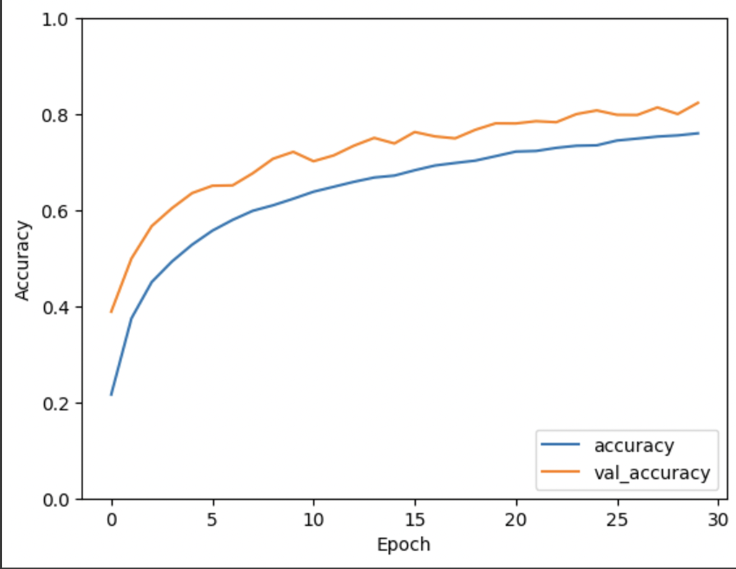
3) System Integration & Testing
After we tested the Model on validation dataset. We analised the Performance evaluated using:
Accuracy metric
Classification Report (Precision, Recall, F1-score)
We have a quit good accuracy with our developt model (82%)

Slide 6
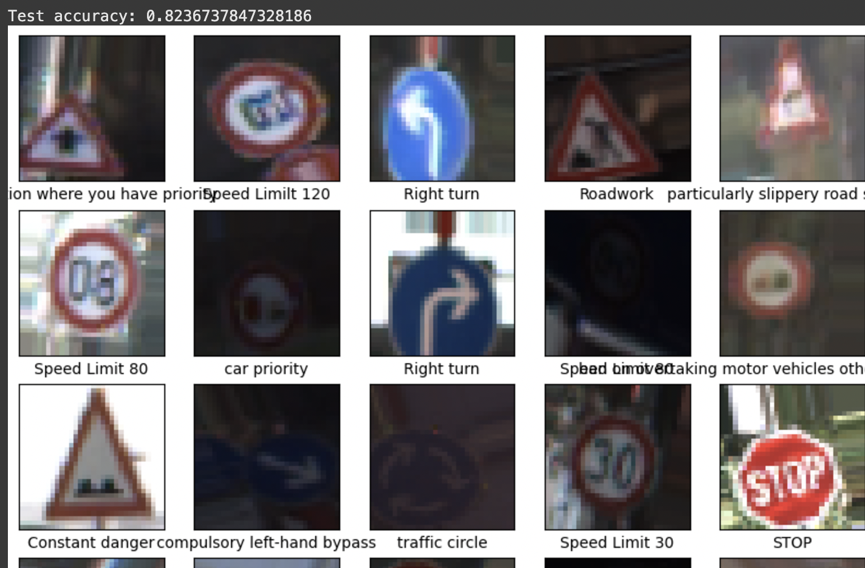
4) Results
We can see that with our model we can have a clear traffic sign recognition that improves road safety by helping autonomous vehicles correctly interpret traffic signs.
We see here that the first images displayed are well tagged.
Our model help reduce chances of accidents due to sign misinterpretation and cvan be integrated into real-time AI-driven navigation systems.

