Slide 1

TPU: In-Datacenter Performance Analysis of a Tensor Processing Unit
Company Google
44th International Symposium on Computer Architecture (ISCA), 2017
Presenter: Constant (Sang-Soo) Park
http://esoc.hanyang.ac.kr/people/sangsoo_park/index.html
March 29, 2020
Neural Network Acceleration Study Season #2

Slide 2
Contents of presentation
Introduction and Background
Fast acceleration, Acceleration HW, Convolutional neural network (CNN)
Convolution shapes, Primitives (DNN convolution algorithm)
Key contribution: Primitive selection
Partitioned Boolean quadratic assignment problem (PBQP) based selection
Performance
Conclusion and Discussion
Neural Network Acceleration Study #2

Slide 3
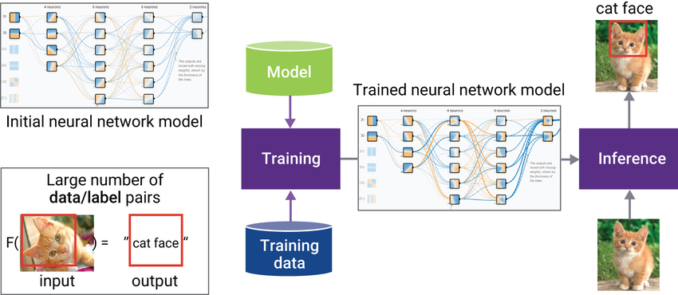
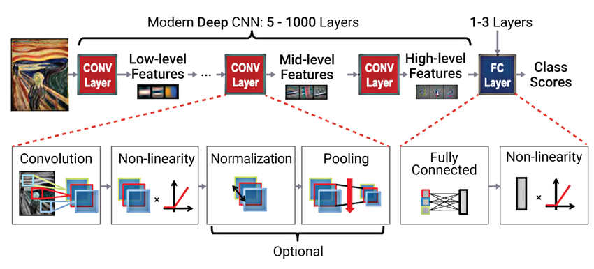
Introduction: Fast Acceleration
Fast inference or training
Inference: Image classification, Acoustic speech recognition
Training: ImageNet, TIMIT learning, Etc.
The goal of fast acceleration is to classify or learn data quickly
Target: Convolution or Fully-connected layer
Neural network models in deep learning framework^{[1]}
Modern convolutional neural networks ^{[1]}
[1] https://www.synopsys.com/designware-ip/technical-bulletin/building-efficient-deep-learning-dwtb_q318.html
Neural Network Acceleration Study #2

Slide 4
Thank you
Neural Network Acceleration Study #2
Notes:
46.2/278

