Slide 1


Slide 2
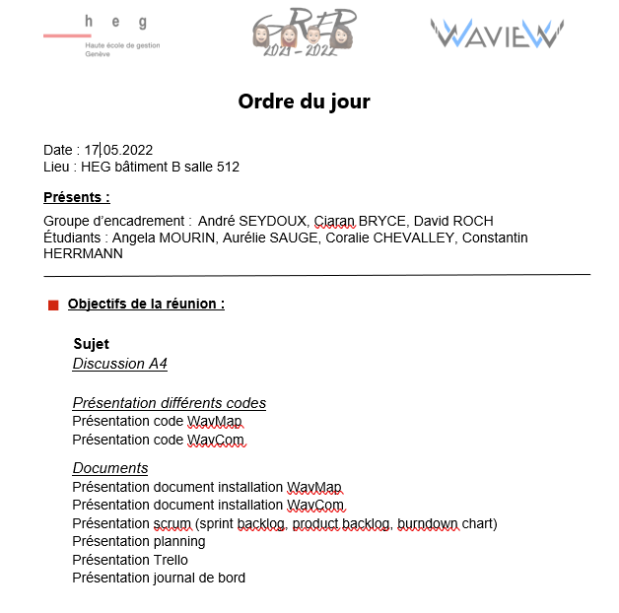
Ordre du jour

Slide 3

Application WavCom Visual Studio

Slide 4

Application WEB WavMap

Slide 5

Manuel Installation WavCom
Manuel INSTALLATION WavMaP

Slide 6

Sprint backlog
Product backlog
Burdown chart

Slide 7

Journal de bord
Trello
Planning

