Slide 1
GOOD DAY !
FOR MY NEXT TRICK, I
AM GOING TO CONTROL
YOUR MIND THROUGH
YOUR COMPUTER.
SIT BACK AND CLICK THE MOUSE
TO ADVANCE THE SCREEN.

Slide 2
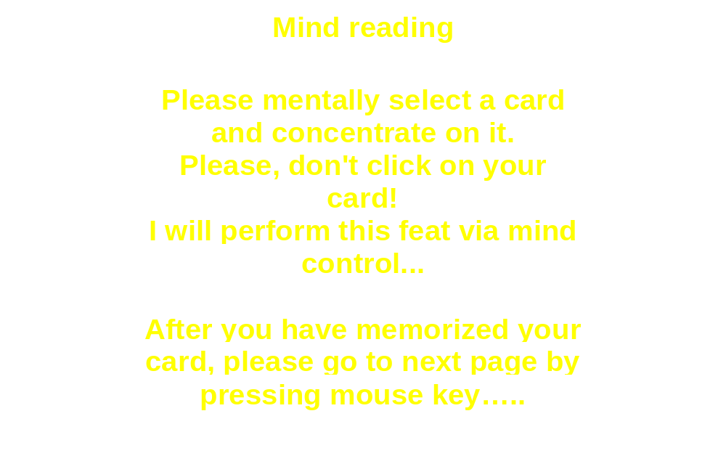


Slide 3
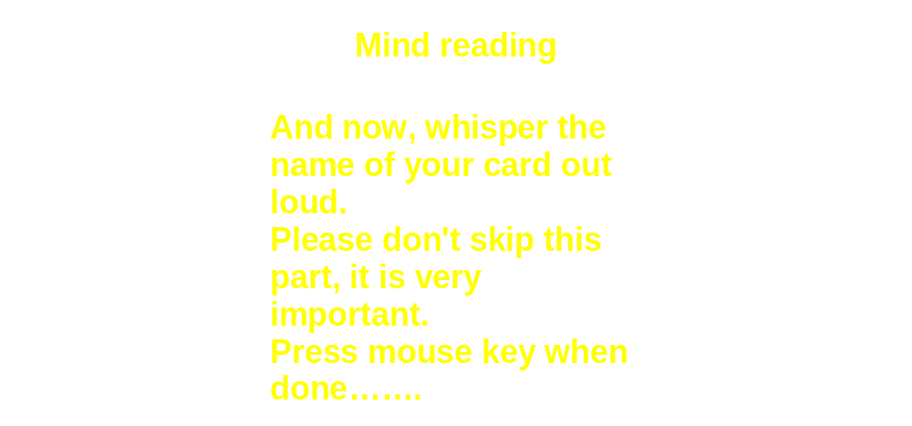

Slide 4
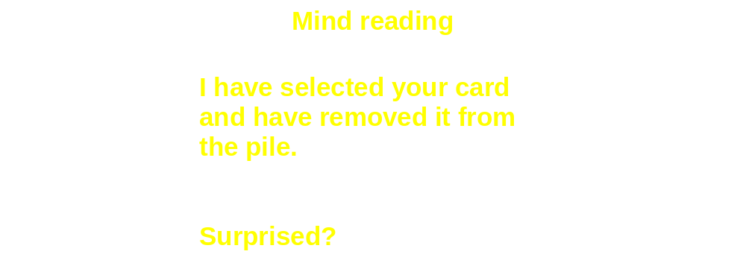

Thank you for your time.
- Richard

