Slide 1





DSLs, Scout and Docker in the Web
Eclipse DemoCamp – Zurich / 06-2016
Serano Colameo
Notes:
I want to show you shortly a demo about these cool technologies, which I used to build a Web Application to manage Docker infrastructures.

Slide 2
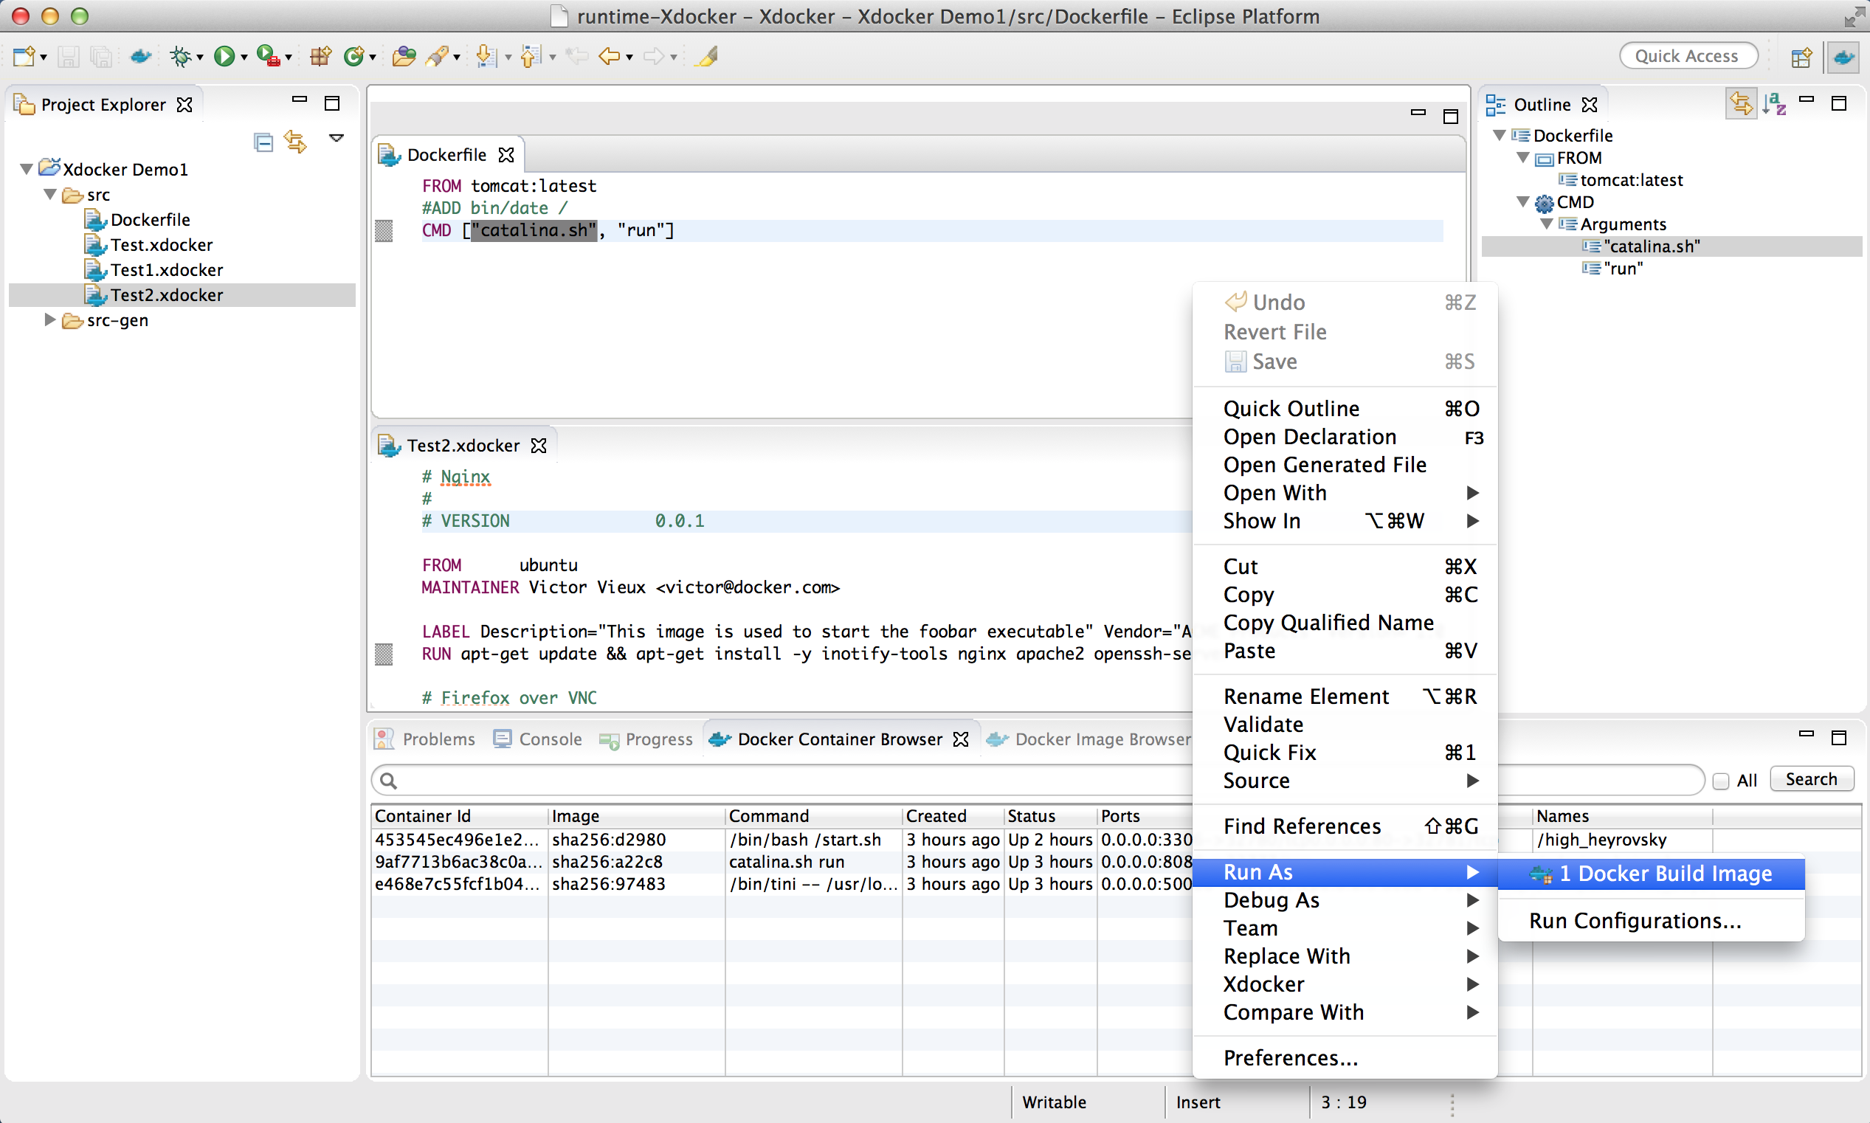
Xdocker – An eXtensible Docker DSL with IDE Features
An Eclipse IDE for Docker written in Xtext, Xtend (90%) and Java
Eclipse Features to manage Docker Files, Images, Container etc.
Editor with Code Completion, Validation and Syntax Highliting
Build and run Docker Images with Launch Configuration
Notes:
A couple of years ago I developed an IDE for Docker for a project, where we used Docker to build typical infrastructure environment.
I‘m not going to talk about that, but I took this example to build the Web Application with Scout, Xtext and Docker which I will present now.

Slide 3

Xtext and Scout both support Web
Why not develop a Web DSL for Docker in a Scout Application?
Notes:
So, the idea came, because of the new Web features provided by Xtext and Scout Neon.
I thought to myself, why not build something similar to the Xdocker IDE but as Web Application?

Slide 4

How to bring all these pieces together?
…put it all together, but how?
Notes:
As usual, I started to analyse the brand new features and how to integrate them into a nice looking Web Applikcation.
And of course, the whole application has to be available as docker image as well

Slide 5
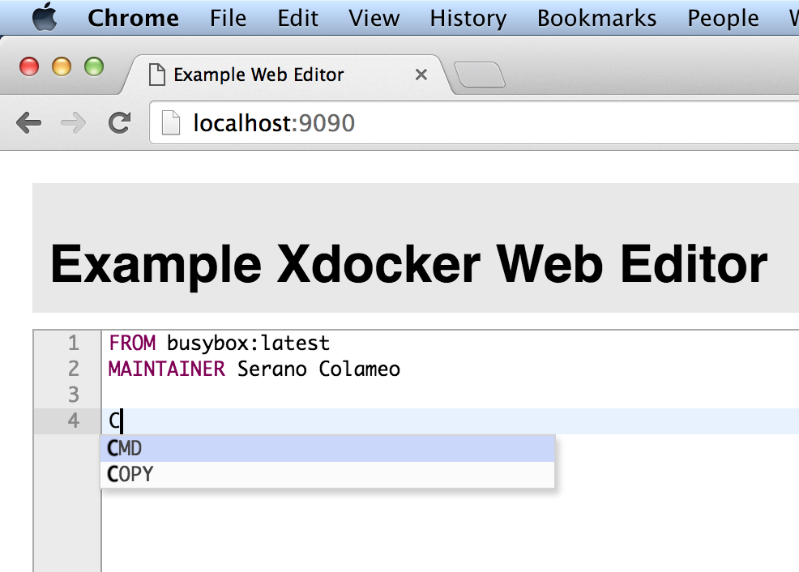
Xtext Web DSL Architecture
Migrate the Xdocker DSL to Xtext 2.10.x
DSL Server running in a Web Container
HTTP Communication
Notes:
I first migrated the exisintg DSL solution to the new Xtext version and made some simple aproaches to understand in deep the new features.

Slide 6
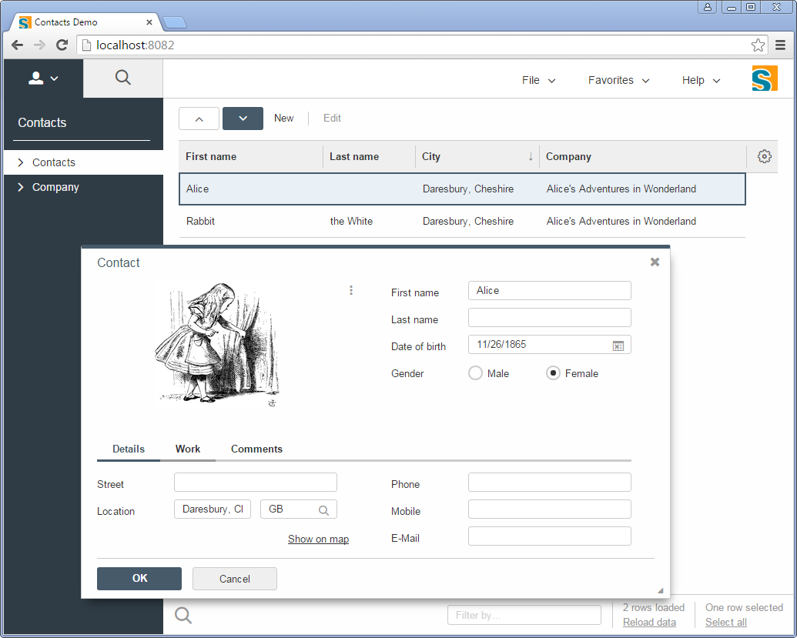
Scout Neon Architecture
Understand how Scout Neon works, Web Integration, JavaScript, JQuery stuff etc.
Frontend Server
(WAR)
HTTP
HTTP
Backend Server
(WAR)
Notes:
And the same also with Scout Neon, which now uses web technologies like JavaScript, Jquery and so on.

Slide 7
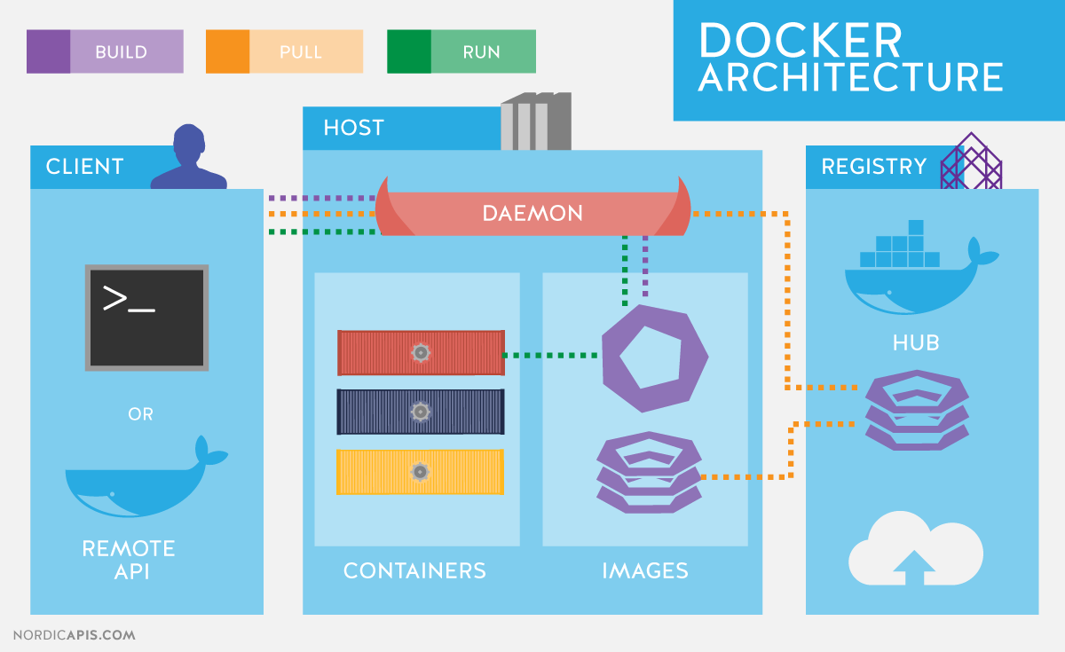
Docker Architecture

Slide 8
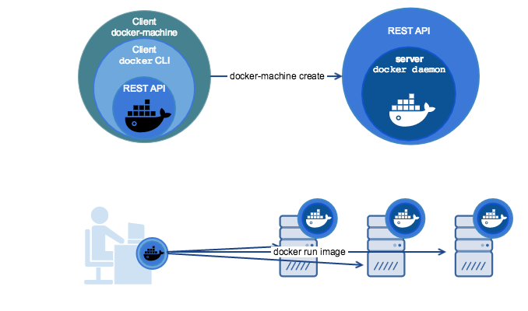
Docker REST API Integration with Xtend
Xtend API
Scout Backend Server (WAR)
Notes:
Docker offers a REST API and a Websocket Stream API which are used normally for Web UI‘s. And as I already implemented a library with Xtend I could easely integrate it in the Scout Backend as a Service.

Slide 9
Xtend API for Docker as internal DSL
docker [
val callback = build('./tomcat8/docker') val response = callback.awaitCompletion println(response)
val id = image.run('/usr/share/tomcat8/bin/catalina.sh') println('''Cotainer id = «id»''')
images.forEach [ print(it.id + ' ') println(it.repoTags.get(0))
]
callback = pull('tomcat:latest') val result = callback.awaitCompletion println(result) ...
]
Notes:
...here you can see shortly how the Xtend implementation looks like.
In Xtend you can build nice looking internal DSLs like in Groovy, which facilitates the understanding of an API.

Slide 10
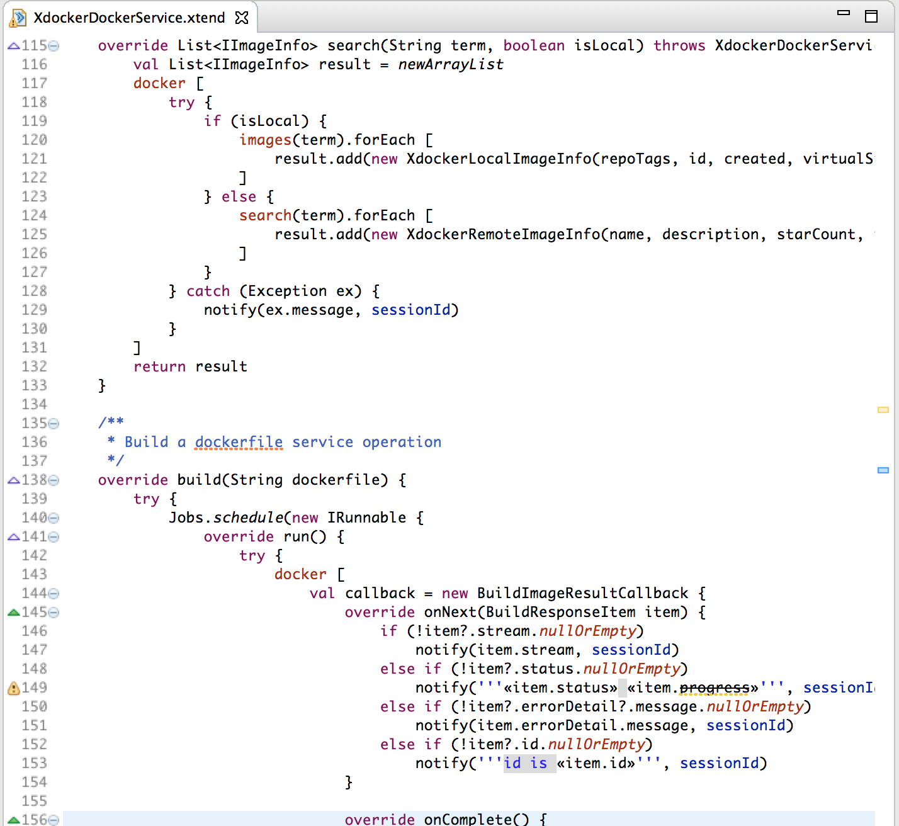
Xtend in Scout

Slide 11
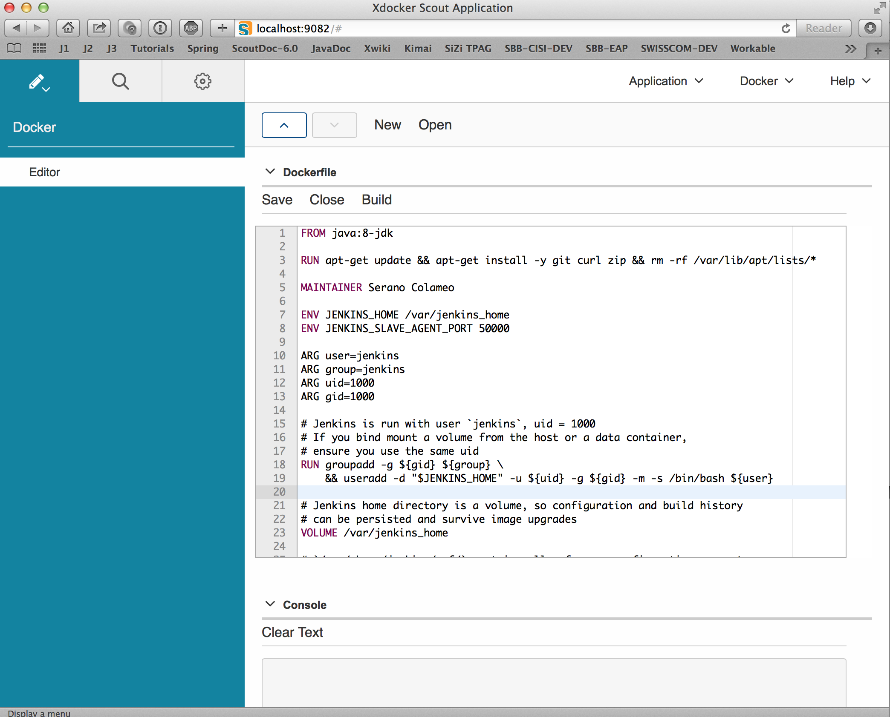
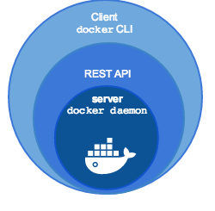
Xdocker Web App Architecture
Frontend
Xdocker DSL Server (WAR)
Scout Frontend
(WAR)
Scout/JS Integration
Scout Backend Server
(WAR)
Xtend API
Scout Client Model
Notes:
And of course, finally I had to put all these pieces together and build the Web Applikation with Scout.
So basically the Web App consists of 3 Web modules: A Scout Frontend, A Scout Backend and a DSL Backend server.
The DSL Editor is integrated via Scout JavaScript APIs to the Scout Client Model.
The communication between JavaScript and Java goes through JSON.

Slide 12

Demo – „Xdocker in Action“
Demo

Slide 13
Serano Colameo
Phone: +41 (0)56 442 68 63
Email: serano.colameo@itemis.ch
13

