Slide 1
AppointmentAI
Multi-clinic appointment scheduling
https://appointease-5k7if8qbo-n-sfds-projects.vercel.app
Team briefing
Notes:
Introduce AppointmentAI as a production scheduling product. Open the live URL if available.

Slide 2
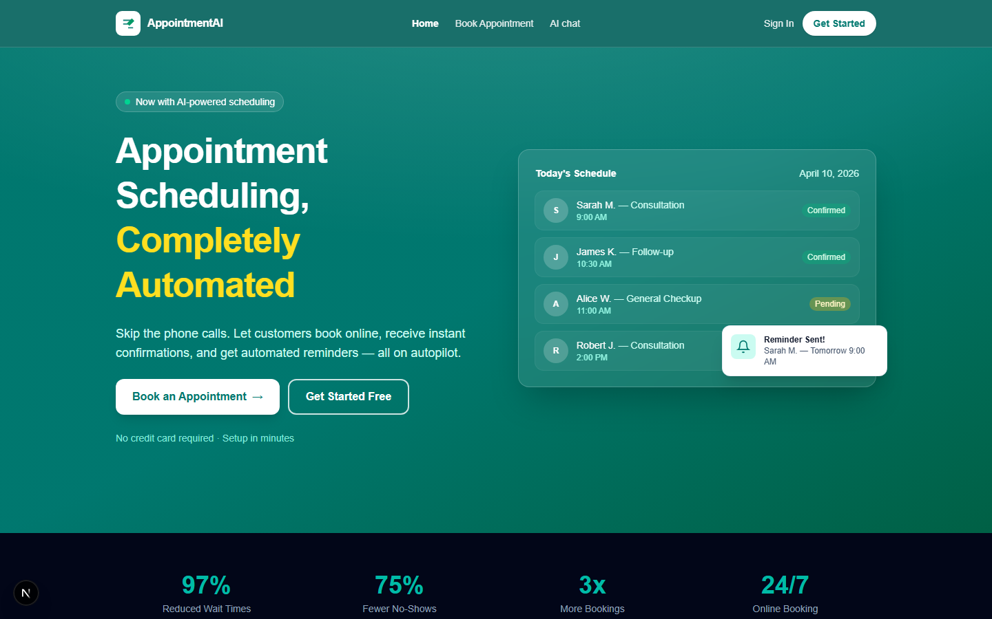
Overview
Landing and entry to booking
Notes:
Customers book services online with live availability.
Clinic admins manage schedule, staff, and services in one dashboard.
Optional AI chat uses the same booking data as the web flows.

Slide 3
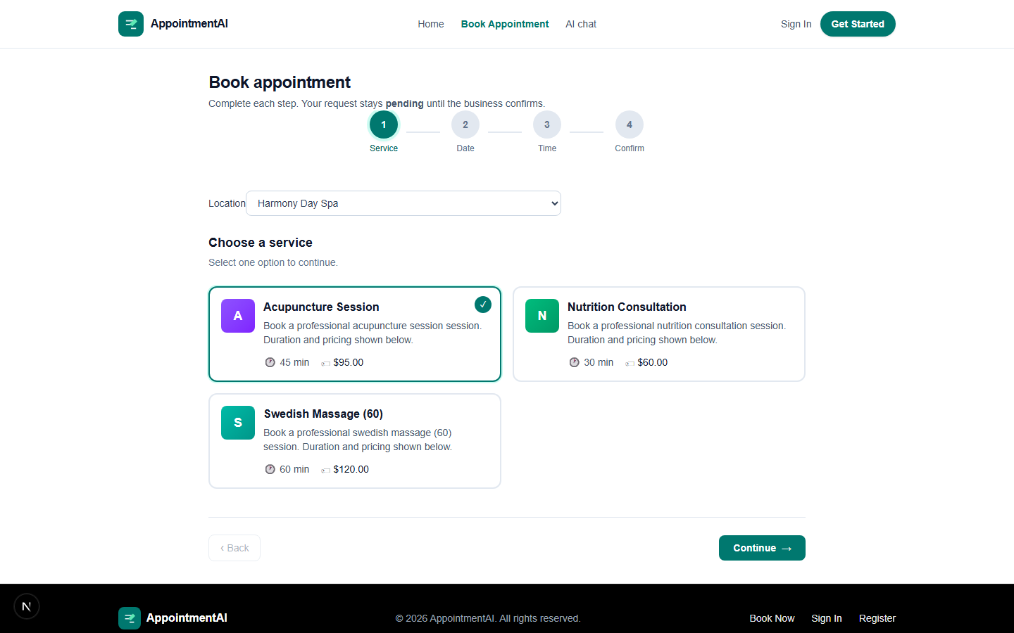
Booking
Clinic, service, and time selection
Notes:
Show live slots loaded from the database.

Slide 4
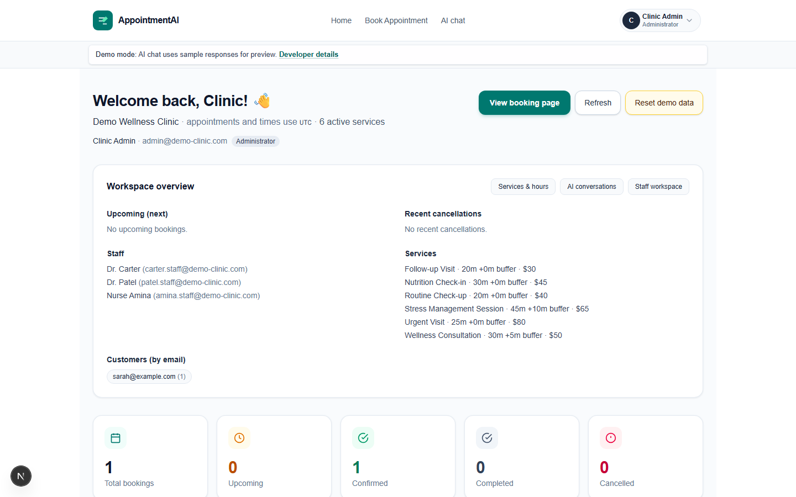
Admin dashboard
Day-to-day operations
Notes:
Log in as clinic admin. Cover today’s list and key actions.

Slide 5
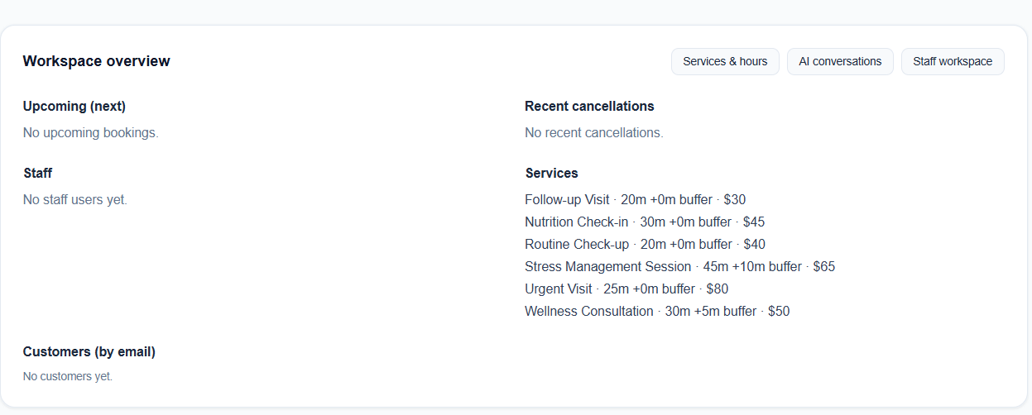
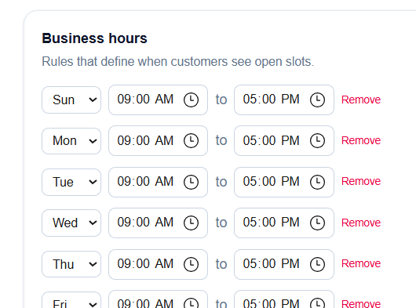
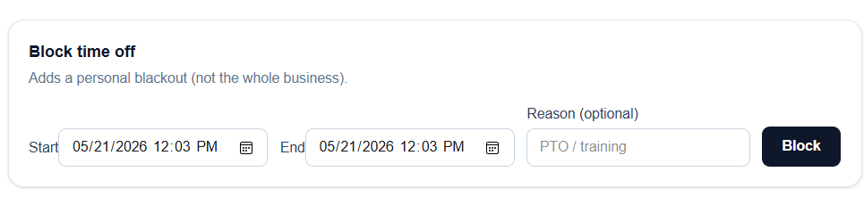
Users
Three roles, separate workspaces
Customer
Book visits, view and cancel appointments.
Staff
See assigned visits and availability.
Admin
Run the clinic: services, staff, today’s schedule.
Notes:
Clarify who signs in where: /customer, /staff, /admin.

Slide 6
Technical foundation
Application
Next.js 16, React, TypeScript, Tailwind
Data
PostgreSQL (Neon), Prisma ORM
Auth & security
Auth.js, role-based access, audit logging
Hosting
Vercel serverless
Notes:
For engineering stakeholders only; skip or shorten for business audiences.

