Slide 1
Case study
Credit Card (CC) Transaction for a Bank
Marco Calavaro
0295233

Slide 2
Description of the environment UC
Use Case: Credit Card (CC) Transaction for a Bank Every CC transaction:
Checking the CC is valid
Checking the POS is valid
Checking the money amount is valid:
That the specific CC is within single transaction limits, daily limits and monthly limits
Checking if the transaction is suspect
Check if the POS type requires a second step identification:
If so, run that step and check complete successfully
At the end of the transaction, issue OK or abort
Store all the information about the transaction whatever is the exit status

Slide 3
Description of the environment NFR
Non-Functional Requirements are:
The average number of transactions per second (TPS) is 500:
90% of the time the peak is below double of the average
The maximum peak that the system must handle is the double of the 90% peak
The system must ensure a HA at 99.999%
In case of a disaster the DS recovery plan is:
Restore 100% of Production and Non-Production capabilities
Restore, at least, 50% of the Dev and Test Capabilities.
The size of Dev environment is half the size of the full Production environment, Test has the same size of Dev environment
Before putting in production any new release of software:
Run a complete round of functional test
Run a complete round of performance test with the system at TPS peaks
Software and Database are specified in the TCO.xlsx file
Modeled in a workload of 2000 TPS

Slide 4
Sizing
The workload provided is that the system must support up to 2000 TPS:
Based on the literature we supposed that a x86 core can process, on average, 20* TPS
With the same supposition a LinuxOne core can process 200 TPS
This value depends on the precise configuration of x86 server, but this differences does not impact the global view

Slide 5
Technical Architectures for the two cases
Inputs:
Workload =
2000TPS
Site 1
Site 2
Case 1
x86 server:
Xeon® Gold 5218 2.3G, 16C/32T
(2 Chips, 32 core)
Servers: 21
Cores allocated: 564
Cores available: 672
Construction that guarantee:
100% Prod and PreProd,
50 % Dev and Test
In case of DR
Prod:
5 server
132 cores
Pre Prod:
4 server
100 cores
Dev:
2 server
50 cores
Test:
2 server
50 cores
DR:
8 server
232 cores
Site 1
Site 2
Case 2
LinuxOne server
Servers: 2
Cores: 30
Spare: 22
1 LinuxONE server
1 LinuxONE server
Prod:
10 cores
Dev:
5 cores
Spare:
11 cores
Pre Prod:
10 cores
Test:
5 cores
Spare:
11 cores

Slide 6
TCO Comparison on 5 years

Slide 7
x86 TCO Assumptions
Hardware
Software
Rack Server with Xeon® Gold 5218 2.3GHz, 16C/32T, 2 Chips, 128 RAM, 1U
Acquisition cost: 8K$ - 37% discount including 3 years Support
Support for following years is 20% of purchase price
Consumption: 0,450 kW per server
OS: subscription 2000$/year 20% discount per socket
VM: license @5000$/socket 20% discount, maintenance 20% of purchase price from second year
Application Server: license 25000$/socket, maintenance 20% of purchase price from fifth year
DB: license 40.000$ for 2 cores, 75% discount, maintenance 20% of purchase price from second year
Data Replication Tools: subscription 3000$/year, 75% discount per core
Monitoring Tools: license 5.000$/server, 40% discount, maintenance 20% of purchase price from second year
Security Tools: license 5.000$/server, 40% discount, maintenance 20% of purchase price from second year
Network
7000$ per Server 30% discount
From second year maintenance cost is 10% of purchase price
People
One FTE covers 30 servers
Average yearly fully loaded costs of IT Staff: 100K$
Space
Electricity
Fully loaded cost of space per Sq. meter: 2.800$
Cost per kWh = 0,31 $ (Italy 0,26 €/kWh)
Additional cost for cooling, UPS and other peripherals: 66%

Slide 8
LinuxONE TCO Assumptions
Hardware
software
LinuxONE servers configured as the
Acquisition cost: 1050K$ (for 3 years)- 30% discount
Maintenance: 10% of purchase price from fourth year
Consumption: 15K kW
OS: subscription 2000$/year 20% discount per socket
VM: license @5000$/socket 20% discount, maintenance 20% of purchase price from second year
Application Server: license 25000$/socket, maintenance 20% of purchase price from fifth year
DB: license 40.000$ for 2 cores, 75% discount, maintenance 20% of purchase price from second year
Data Replication Tools: subscription 3000$/year, 75% discount per core
Monitoring Tools: license 5.000$/server, 40% discount, maintenance 20% of purchase price from second year
Security Tools: license 5.000$/server, 40% discount, maintenance 20% of purchase price from second year
Network
14K$ per Server, 30% discount
From second year maintenance cost is 10% of purchase price
People
One FTE covers 10 servers
Average yearly fully loaded costs of IT Staff: 100K$
Space
Electricity
Fully loaded cost of space per Sq. meter: 2.800$
Cost per kWh = 0,31 $ (Italy 0,26 €/kWh)
Additional cost for cooling, UPS and other peripherals: 66%

Slide 9
TCO final consideration
The most impactful cost during a five years period for both system is the software one:
But the elevate number of core in the x86 system leads to a large gap between the architecture costs
8.786.100$ for x86 (great impact from Disaster recovery [3.542.400$]) and 3.456.600$ for LinuxONE
With 2000 TPS workload the LinuxONE architecture is the most affordable, apart from hardware cost (which is 90% higher compared to x86):
LinuxOne server are made with more sophisticate and advance hardware that guarantee more reliability and utilization, thanks to this outlay the TCO has a great gain (Saving 42% of money)
LinuxONE architecture has a very small expenditure for disaster recovery environments:
Thanks to the investment in spere cores (cost included in hardware)
Active – active architectures saves on the number of expected servers for DR
For a small workload (350 TPS) the two architecture have the same cost (next slide comparison)

Slide 10
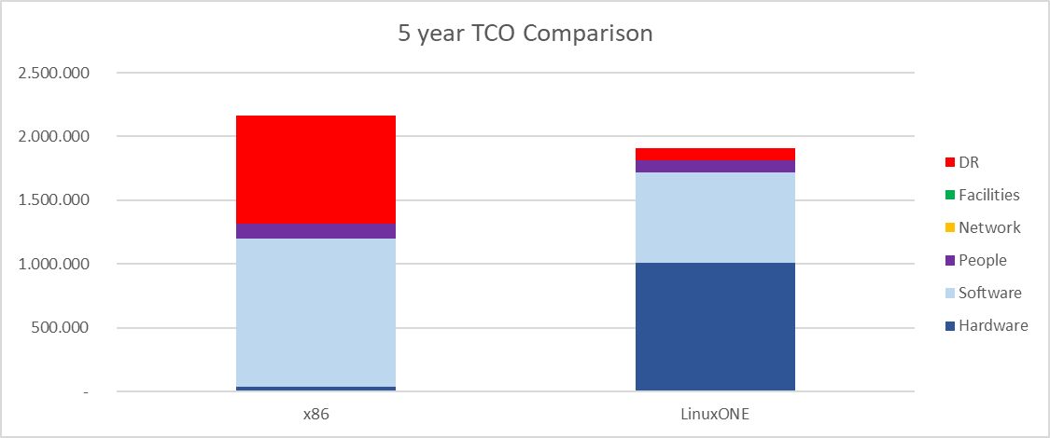
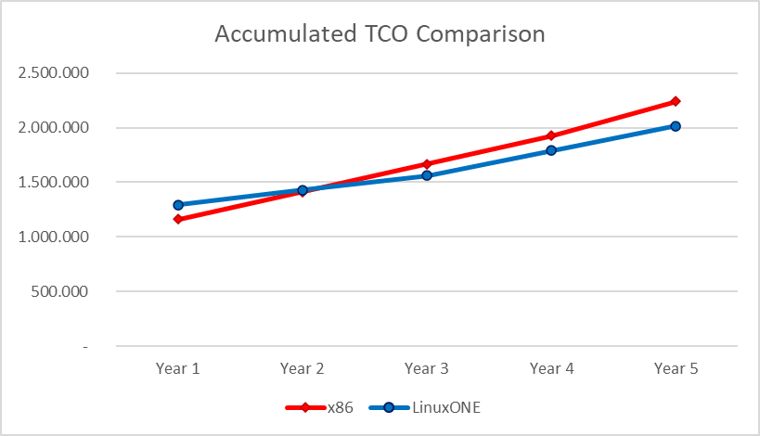
TCO Comparison on 5 years (small workload)

Slide 11
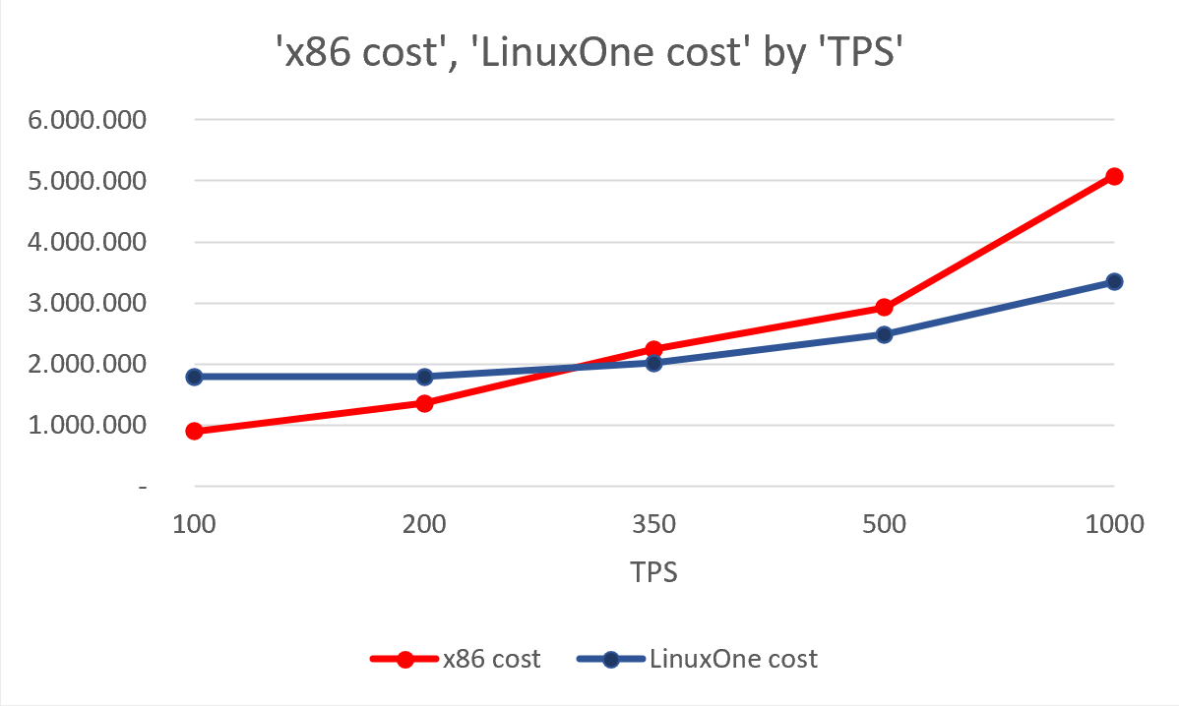
Impact of TPS on TCO
This graph shows the fifth years TCO for x86 and LinuxONE architectures as the TPS changes:
For a limited number of TPS (< 300) x86 is cheaper than LinuxONE
But for higher values ​​it is the other way around

Slide 12
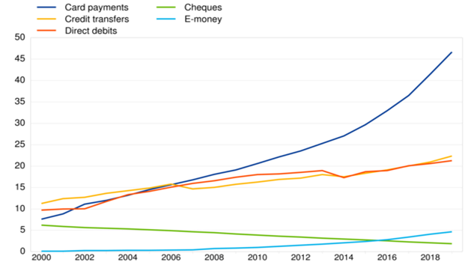
Data research consideration
The system is modelized over-provisioning the workload (2000 TPS), the supposed average value is 500 TPS:
This value is also high in a real bank system relying on EBC study, according to that the total number of transaction in European Union during 2019 was about 47 billions (that means an average 1500 TPS)
In general, is not easy to find information about hardware and software price:
That depends on company policy with costumers, some are very open and allow them to customize the system and immediately return the total price, other company prefer to do this job themselves and invite the customer to contact them, showing on website only few information
https://www.ecb.europa.eu/press/pr/stats/paysec/html/ecb.pis2019~71119b94d1.en.html

