Slide 1


CONTENT-MINING FOR TRANSPARENCY OF DRUG RESEARCH
@chris_kittel
@stefankasberger
Notes:
This presentation will be a quick introduction to the ContentMine software for literature scraping, normalising, and fact extraction.

Slide 2
1. open bit.ly/cm-mozfest15
2. open pad
3. copy files
Notes:
This presentation will be a quick introduction to the ContentMine software for literature scraping, normalising, and fact extraction.

Slide 3
1. Collaboration
2. Reproducibility
3. Big scale
4. Open Research Data
5. Do it together
Notes:
This presentation will be a quick introduction to the ContentMine software for literature scraping, normalising, and fact extraction.

Slide 4
Agenda:
1. Introduction (30min)
2. Hands-On (60min)
3. World Cafe (45min)
Notes:
This presentation will be a quick introduction to the ContentMine software for literature scraping, normalising, and fact extraction.

Slide 5
Introduction Round
Notes:
This presentation will be a quick introduction to the ContentMine software for literature scraping, normalising, and fact extraction.

Slide 6
ContentMine
Notes:
This presentation will be a quick introduction to the ContentMine software for literature scraping, normalising, and fact extraction.

Slide 7
the scale of the task
~ 27,000 peer reviewed journals*
> 5,000 publishers
~ 3,000 new papers per day
“costing” 15 Billion USD to publish
Representing 500 Billion USD of research
*Ulrich’s database: http://ulrichsweb.serialssolutions.com/login

Slide 8
The right to read
is the right to mine.

Slide 9
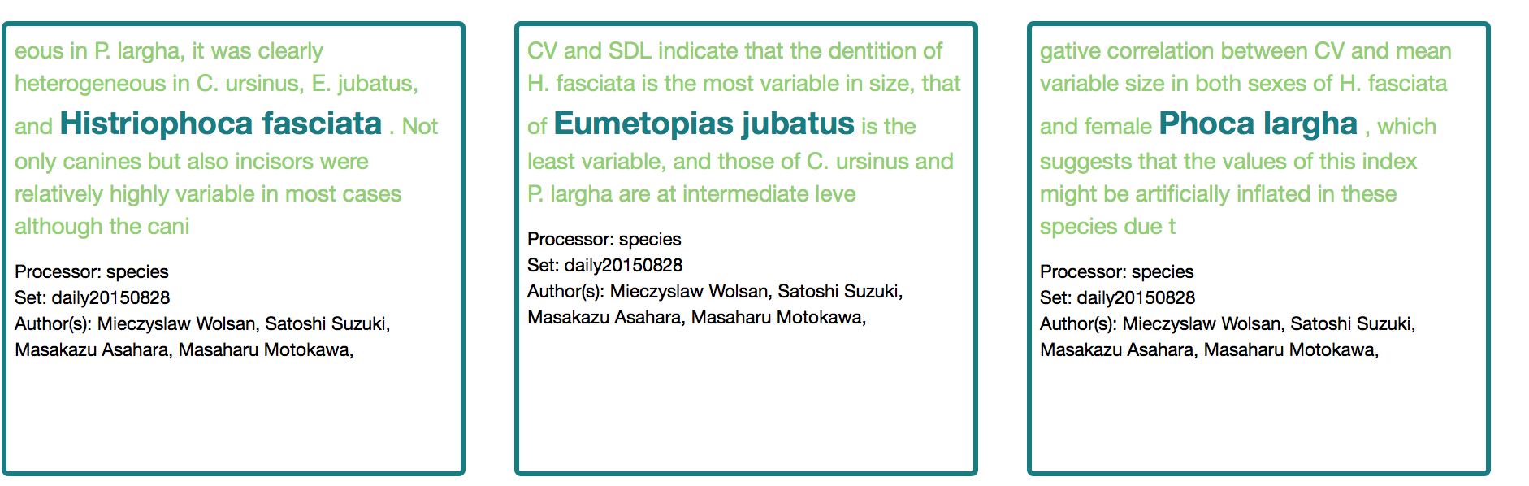
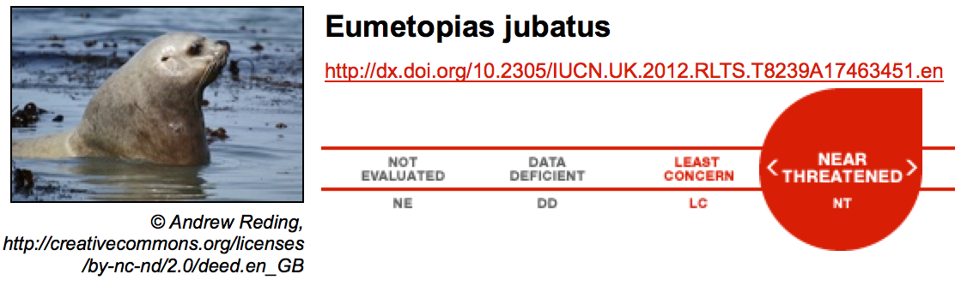
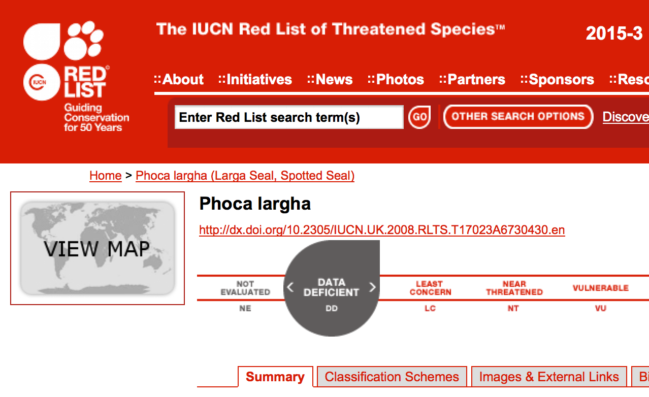
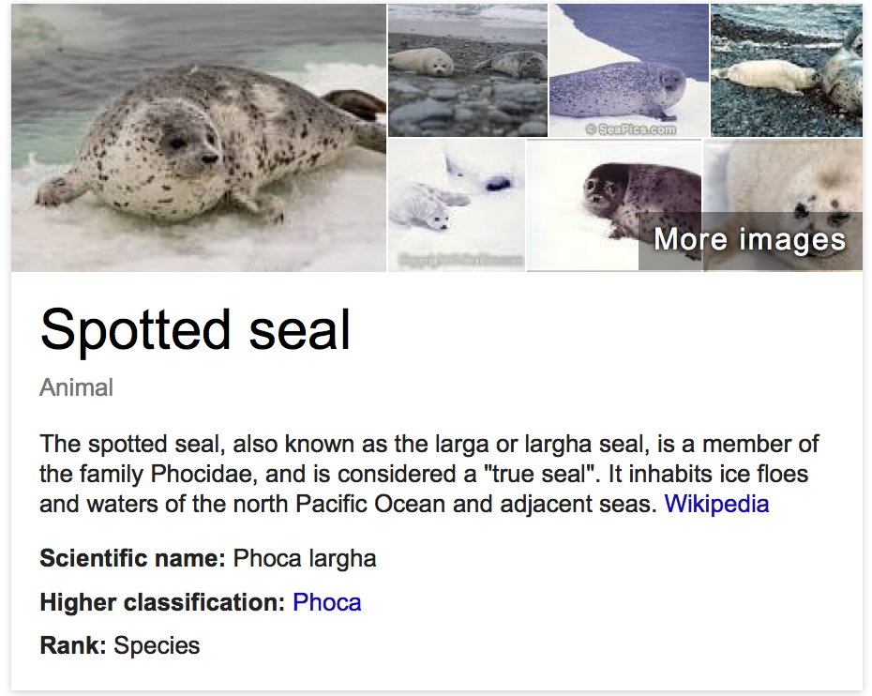
Facts in context daily IUCN endangered species news
en.wikipedia.org CC By-SA

Slide 10
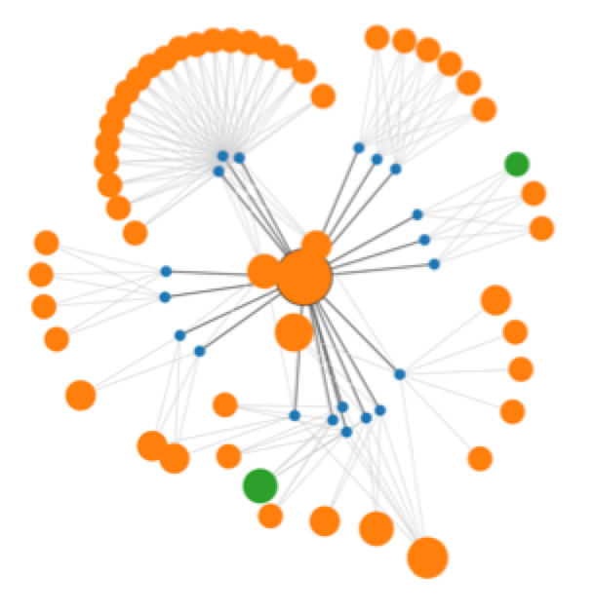
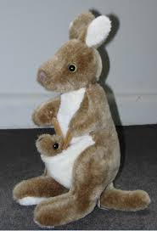

EuPMC, arXiv
CORE , HAL,
(UNIV repos)
Publisher Sites
Figures
query
Data
PloSONE, BMC, peerJ… Nature, IEEE, Elsevier…
PNG
EPS
crawl
getpapers
CSV
XLS
URLs
DOIs
quickscrape
ToC
services
Daily
Crawl
PDF HTML
DOC ePUB
TeX XML
scrapers
Text
UNIV
Repos
Normalizer
Sectioner
Semantic
Tagger
COMMUNITY
norma
taggers
plugins
abstract
Captioned
Figures
search
Facts
methods
Fig. 1
catalogue
ami
HTML tables
references
CONTENT
MINING
Visualization
and Analysis
Lookup
Up to 30, 000 pages/day Semantic ScholarlyHTML

Slide 11
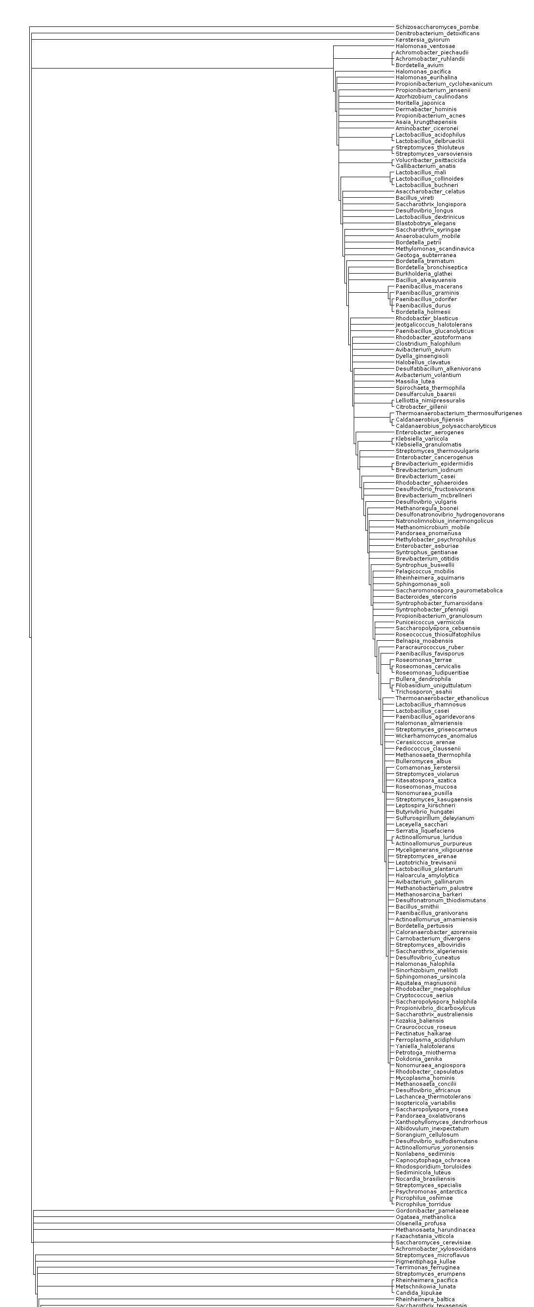
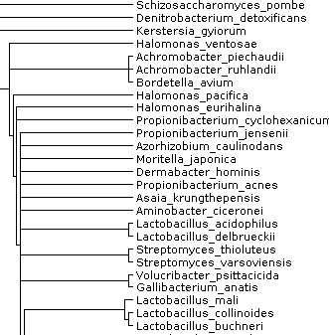
Supertree for 924 species
Tree

Slide 12
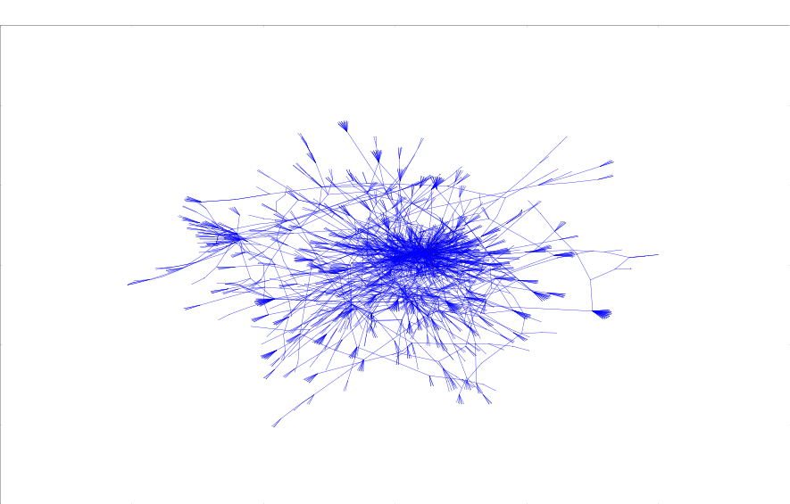

Slide 13
HACK WITH FACTS
Notes:
This presentation will be a quick introduction to the ContentMine software for literature scraping, normalising, and fact extraction.

Slide 14
What have you found?
Notes:
This presentation will be a quick introduction to the ContentMine software for literature scraping, normalising, and fact extraction.

Slide 15
WORLD CAFE
Notes:
This presentation will be a quick introduction to the ContentMine software for literature scraping, normalising, and fact extraction.

Slide 16
1. Get in groups (4-5 people)
2. 3 rounds (discuss and document)
3. Harvest in Circle
Notes:
This presentation will be a quick introduction to the ContentMine software for literature scraping, normalising, and fact extraction.

Slide 17
Questions:
1. What kind of questions could the data from the hacking session answer in terms of transparency and collaboration?
2. What are the opportunities you see in ContentMining on a massive scale? Think big!
3. What challenges do you see for ContentMining?
Notes:
This presentation will be a quick introduction to the ContentMine software for literature scraping, normalising, and fact extraction.

Slide 18
The right to read is the right to mine.
contentmine.org
Notes:
This presentation will be a quick introduction to the ContentMine software for literature scraping, normalising, and fact extraction.

