Slide 1
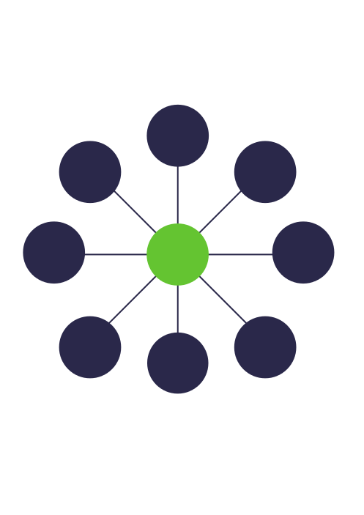



ContentMine:
extracting millions of facts from the scientific literature
@jenny_molloy OpenCon Nov 2015

Slide 2
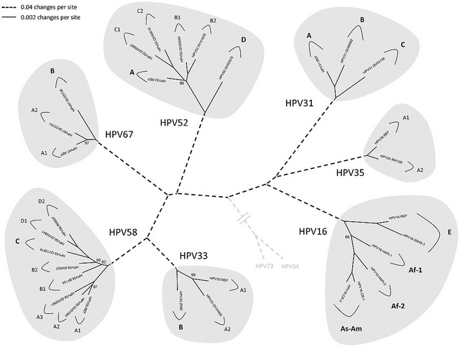
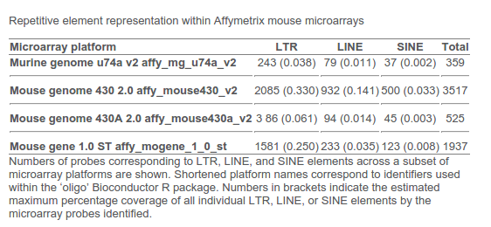
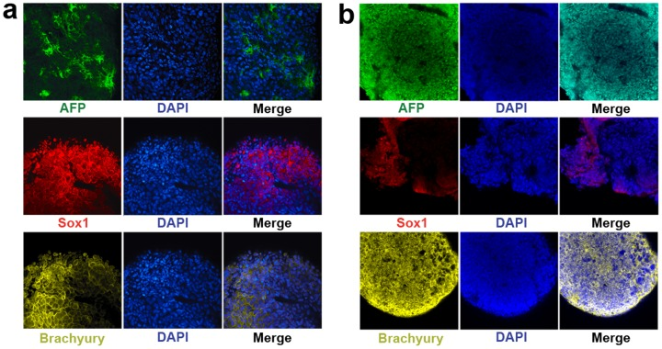
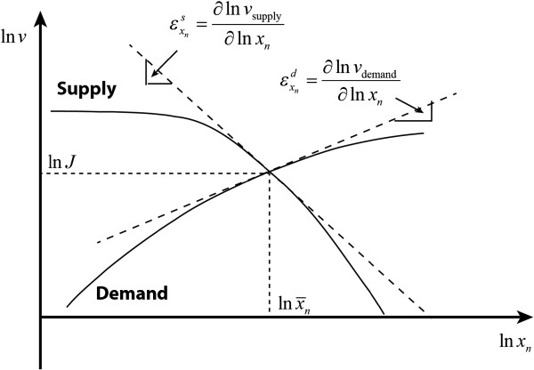
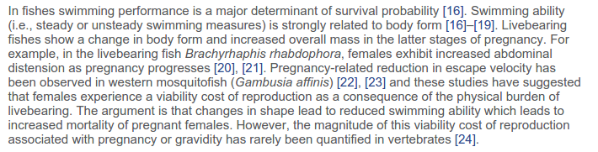
What is content?

Slide 3
1982
“Automatically generating logical representations of text passages... by means of an analysis of the coherence structure of the passages.”
Jerry R. Hobbs, Donald E. Walker, and Robert A. Amsler. 1982. Natural language access to structured text. In Proceedings of the 9th conference on Computational linguistics - Volume 1(COLING '82), Ján Horecký (Ed.), Vol. 1. Academia Praha, , Czechoslovakia, 127-132. DOI=10.3115/991813.991833 http://dx.doi.org/10.3115/991813.991833
What is mining?
2008
“The use of automated methods for exploiting the enormous amount of knowledge available in the biomedical literature.”
Cohen, K. Bretonnel; Hunter, Lawrence (2008). "Getting Started in Text Mining". PLoS Computational Biology 4 (1): e20. doi:10.1371/journal.pcbi.0040020. PMC 2217579.PMID 18225946.

Slide 4
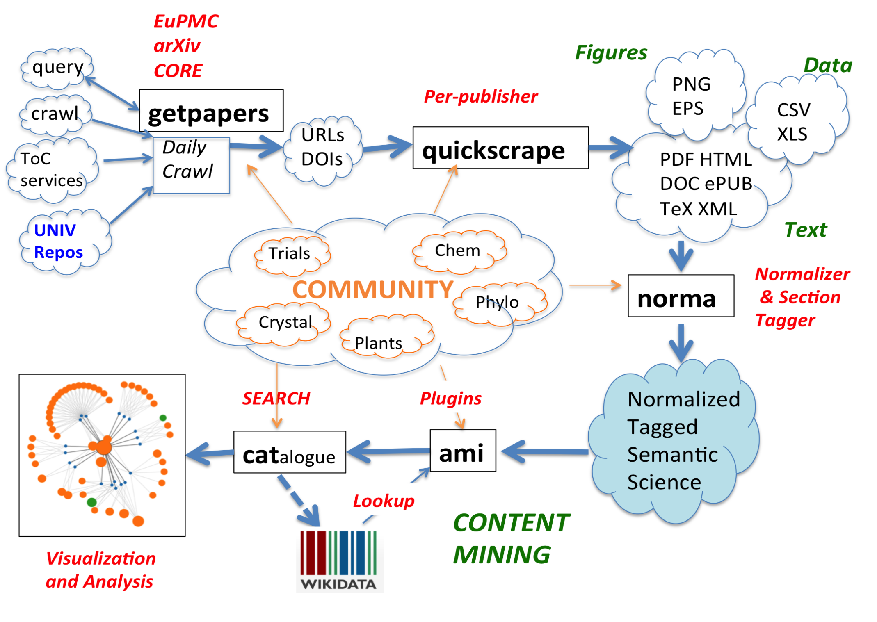

Slide 5
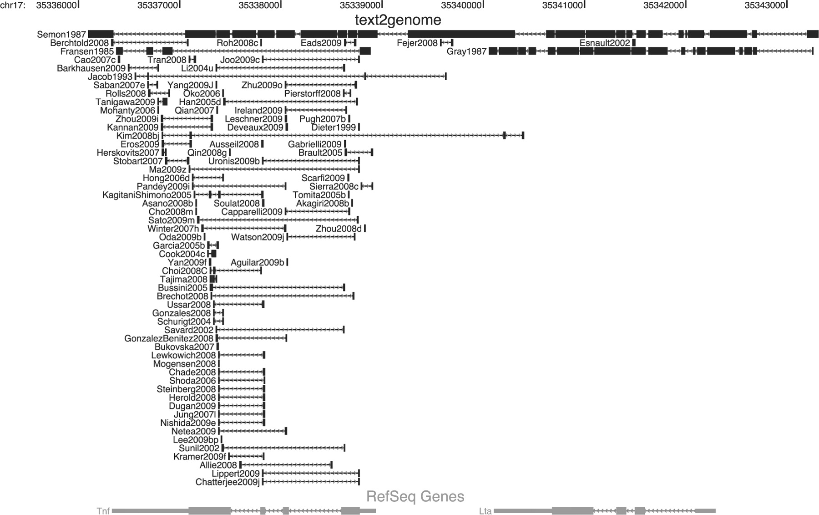
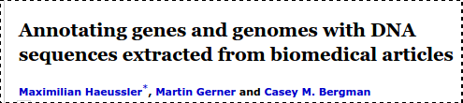

Annotation
Potential to improve
quality and efficiency
of genomic research.
Many applications:
- Find primers
- Enhance positive controls
- Find novel sequence information
- More detailed and accurate annotation

Slide 6
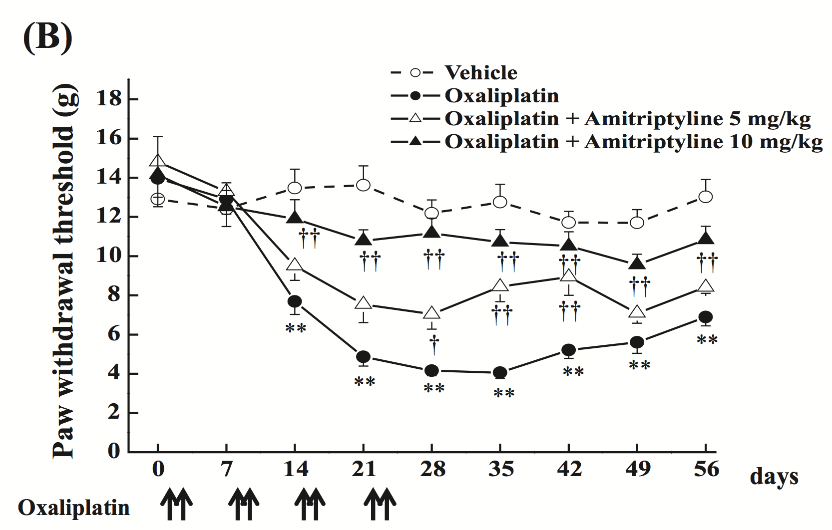
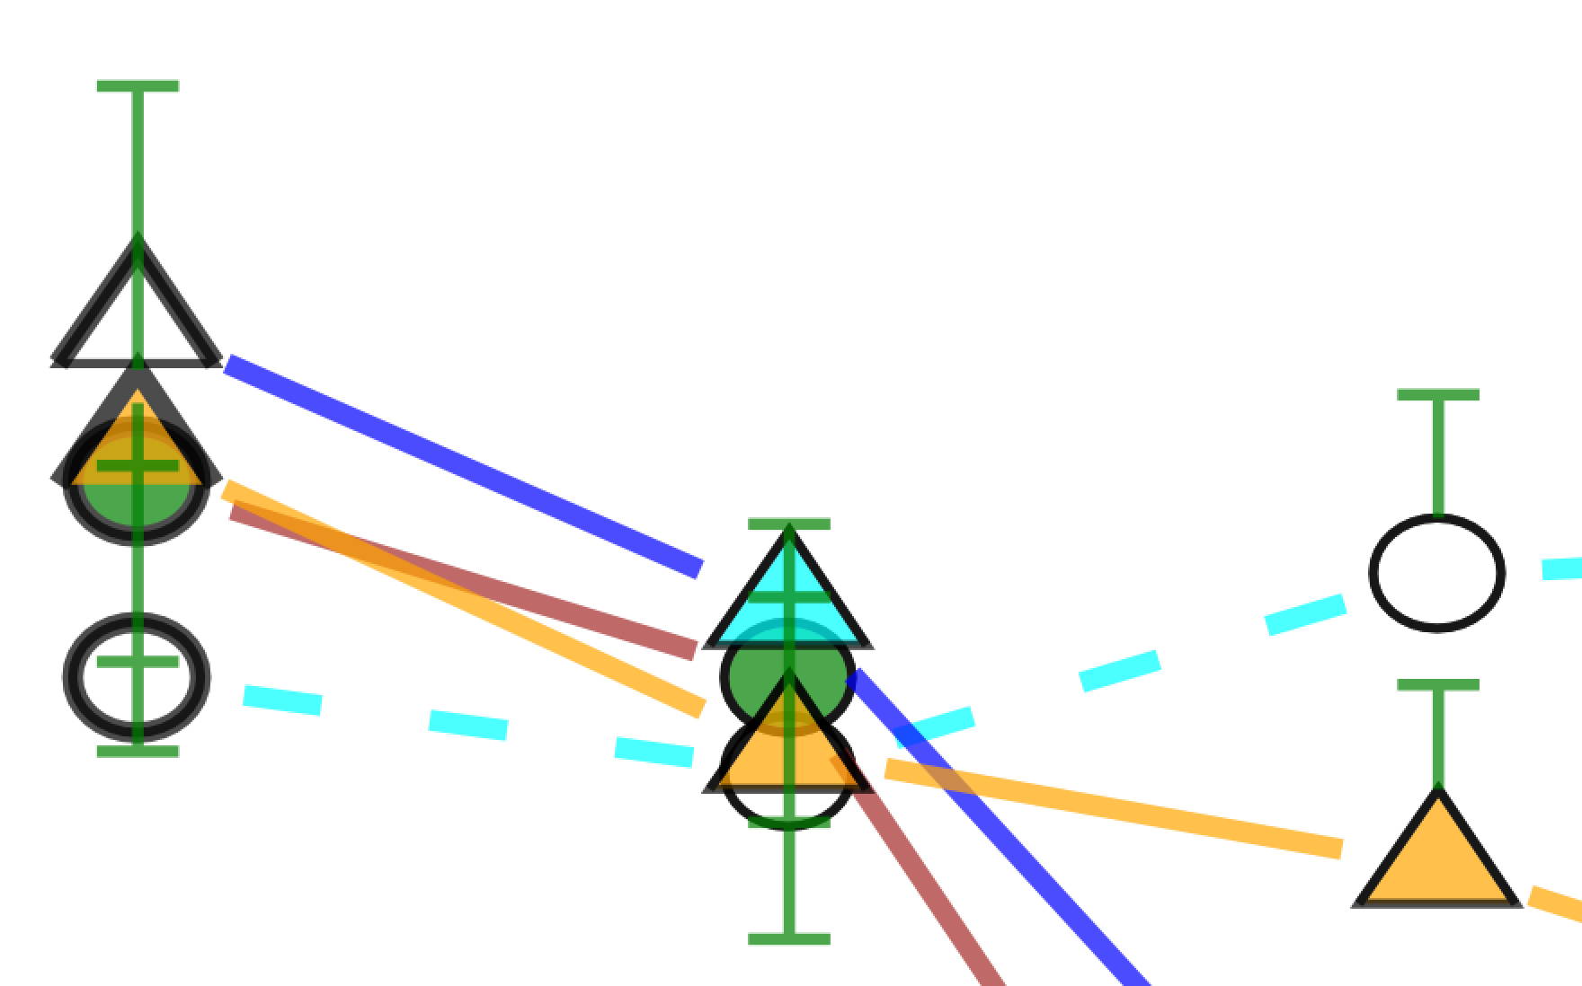
Clinical Trials
Clinical trials offer clear use cases
for content mining.
Data extraction from graphs could be very useful for meta-analyses where raw data is unavailable.

Slide 7

Legal Considerations
Copyright
Database
rights
Contract
Law

Slide 8
Peter Murray-Rust
Ross Mounce
Richard Smith-Unna
Jenny Molloy
Mark MacGillivray
Graham Steel
Stefan Kasberger
Christopher Kittel
With thanks to:
Charles Oppenheim
Michelle Brook
Follow @TheContentMine
contentmine.org
Find the code on
github.com/ContentMine
Funded by:
bit.ly/cm-opencon15
Thank you very much
for your attention!
Any questions?

Slide 9
All images are licensed under CC-BY unless otherwise stated
What is Content?
Phylogenetic Tree from Figure 1 in Evolution and Taxonomic Classification of Human Papillomavirus 16 (HPV16)-Related Variant Genomes: HPV31, HPV33, HPV35, HPV52, HPV58 and HPV67. Chen Z, Schiffman M, Herrero R, DeSalle R, Anastos K, et al. (2011) Evolution and Taxonomic Classification of Human Papillomavirus 16 (HPV16)-Related Variant Genomes: HPV31, HPV33, HPV35, HPV52, HPV58 and HPV67. PLoS ONE 6(5): e20183. doi: 10.1371/journal.pone.0020183
Graph from He F, Fromion V, Westerhoff HV. (Im)Perfect robustness and adaptation of metabolic networks subject to metabolic and gene-expression regulation: marrying control engineering with metabolic control analysis. BMC Syst Biol. 2013;7 131. doi:10.1186/1752-0509-7-131. PubMed PMID: 24261908; PubMed Central PMCID: PMC4222491.
Table from Table 1 Young GR, Mavrommatis B, Kassiotis G. Microarray analysis reveals global modulation of endogenous retroelement transcription by microbes. Retrovirology. 2014;11 59. doi:10.1186/1742-4690-11-59. PubMed PMID: 25063042; PubMed Central PMCID: PMC4222864.
Text from Laidlaw CT, Condon JM, Belk MC. Viability Costs of Reproduction and Behavioral Compensation in Western Mosquitofish (Gambusia affinis). PLoS One. 2014;9(11) e110524. doi:10.1371/journal.pone.0110524. PubMed PMID: 25365426; PubMed Central PMCID: PMC4217728.
Cell microscopy image from Pettinato G, Vanden Berg-Foels WS, Zhang N, Wen X. ROCK Inhibitor Is Not Required for Embryoid Body Formation from Singularized Human Embryonic Stem Cells. PLoS One. 2014;9(11) e100742. doi:10.1371/journal.pone.0100742. PubMed PMID: 25365581; PubMed Central PMCID: PMC4217711.
Annotation:
Stubben, C. J., & Challacombe, J. F. (2014). Mining locus tags in PubMed Central to improve microbial gene annotation. BMC bioinformatics, 15(1), 43.
Figure from Haeussler, M., Gerner, M., & Bergman, C. M. (2011). Annotating genes and genomes with DNA sequences extracted from biomedical articles. Bioinformatics, 27(7), 980-986.

