Slide 1



Mining Scientific Images
Peter Murray-Rust,
and TheContentMine
WOSP, London, UK, 2014-09-12
The ContentMine is supported by a grant to PMR as a

Slide 2
Research requires mining the WHOLE literature (3000 papers/day)
Aggregation of similar objects (phylogenetic trees) e.g. bacterial
Aggregation of complementary information (chemicals and species)
Metabolism (EBI and Cambridge)
Phytochemistry (Mint taxonomy)

Slide 3
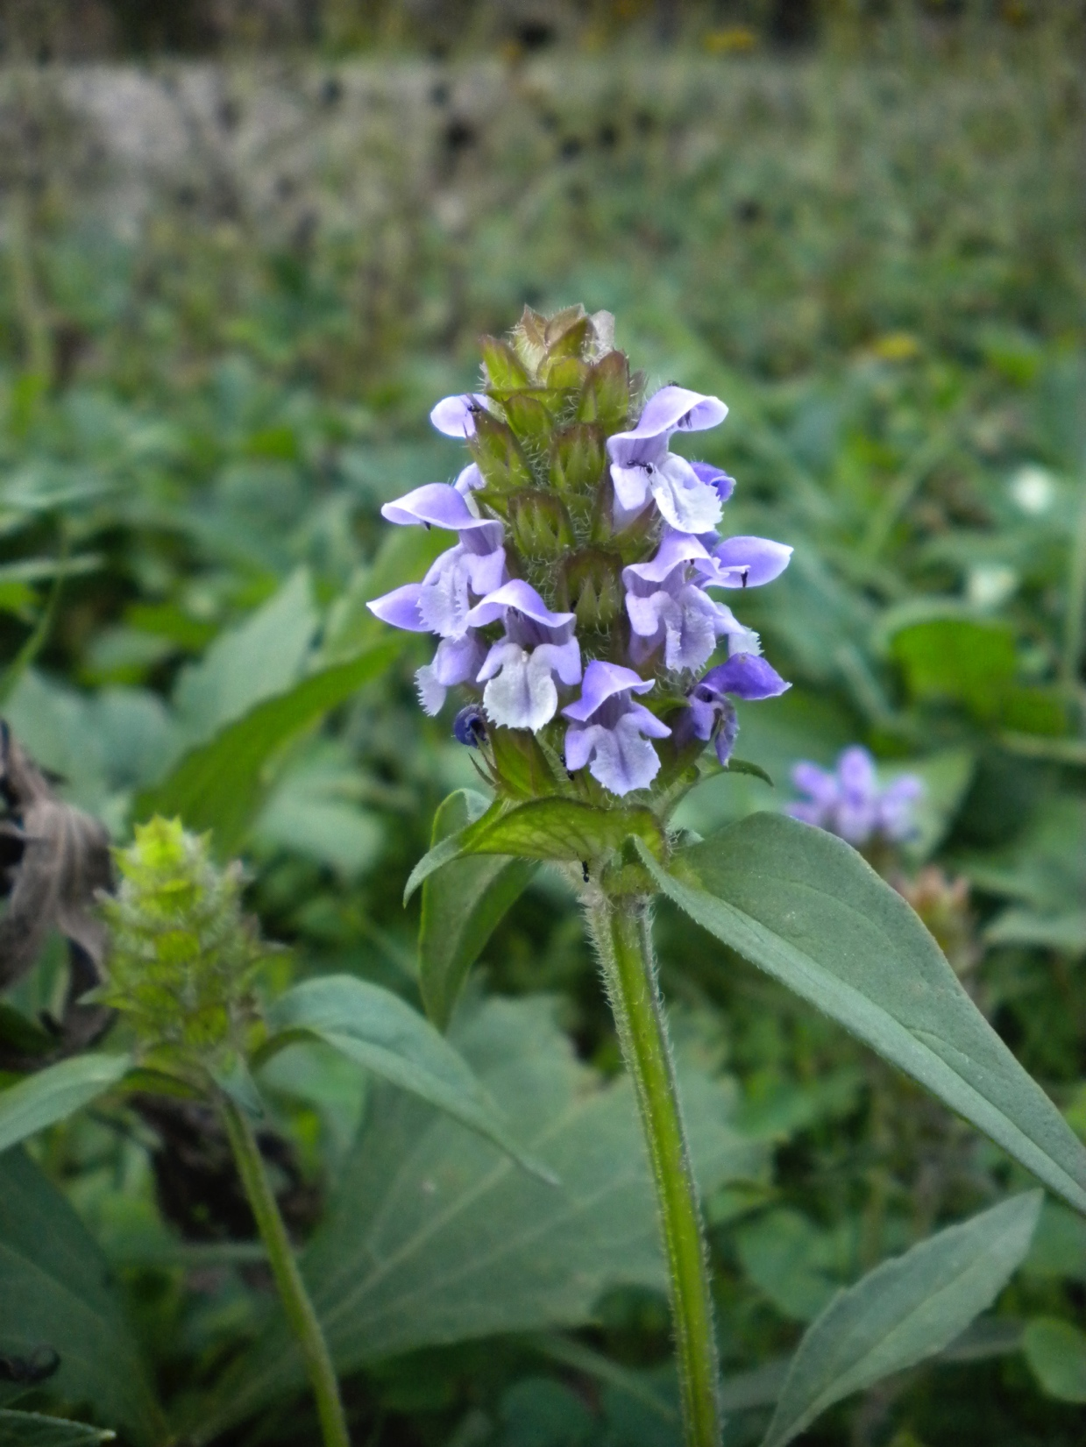

Mint phylogeny working group
The mint family (Lamiaceae), with approximately 236 genera and 7200 species, is the sixth largest family of flowering plants, and has major economic and cultural importance worldwide.
Ross Mounce
P Murray-Rust
Collaborators
http://lamiaceae.myspecies.info/content/lamiaceae

Slide 4
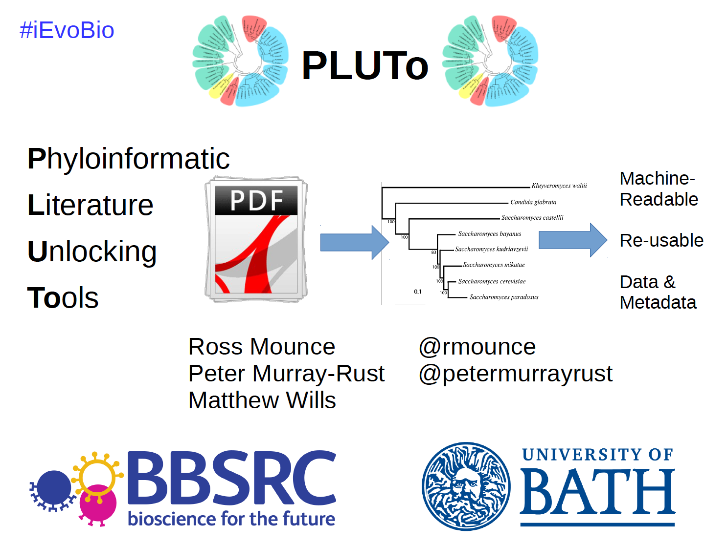
http://www.slideshare.net/rossmounce/the-pluto-project-ievobio-2014

Slide 5
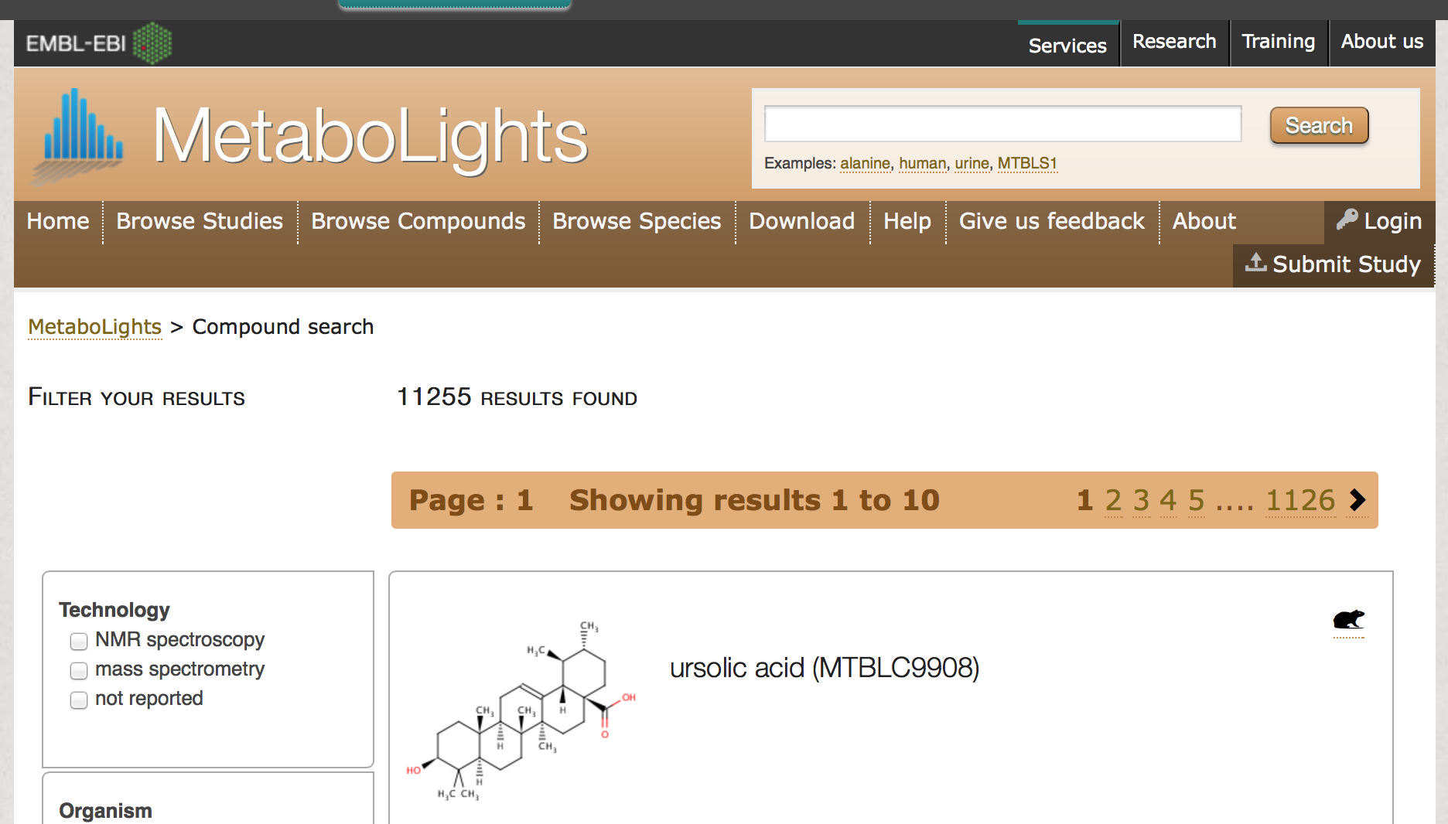
PMR is collaborating with the European Bioinformatics Institute to liberate all metabolic information from journals

Slide 6

Publishers destroy structured information (LaTeX, Word) into PDF …
Characters (NOT words or higher structure)
WORD is simply 4 characters, NO spaces
Paths (NOT circles, squares …) “Vectors”
… They / their APIs then destroy it further
into Pixels (e.g. PNG ☹ or JPG ☹☹)
Content Mine will read 10,000 PNGs a day and
try to recover the science.

Slide 7
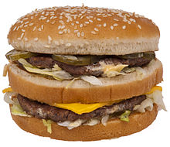
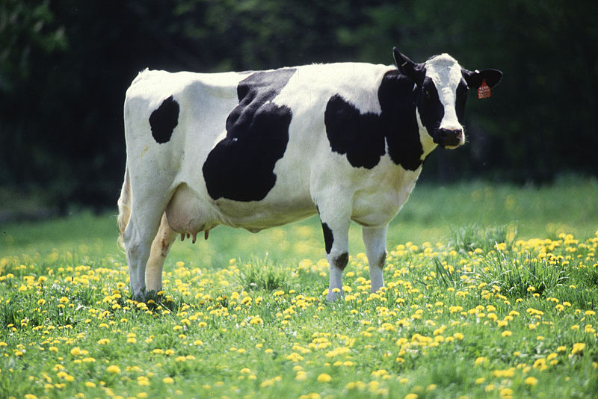
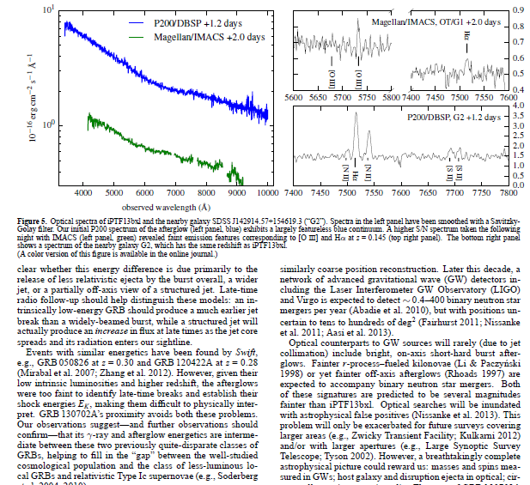
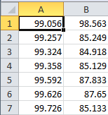

But we can now turn PDFs into Science
We can’t turn a hamburger into a cow
Pixel => Path => Shape => Char => Word => Para => Document => SCIENCE

Slide 8
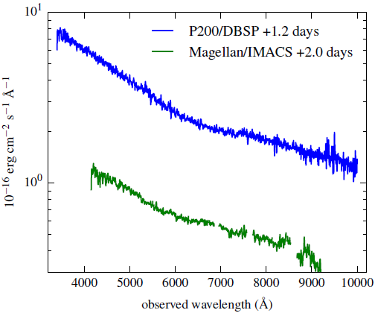
TITLES
VECTOR PDF
DATA!!
2000+ points
UNITS
TICKS
SCALE
QUANTITY

Slide 9
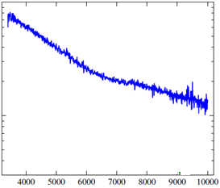
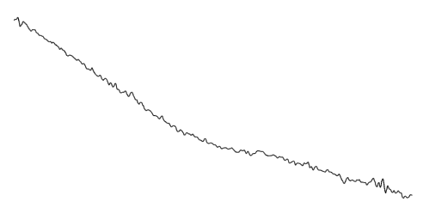
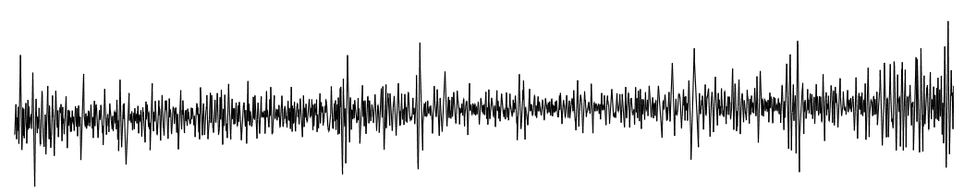

Dumb PDF
Automatic
extraction
CSV
Smoothing Gaussian Filter
Semantic
Spectrum
2nd Derivative

Slide 10
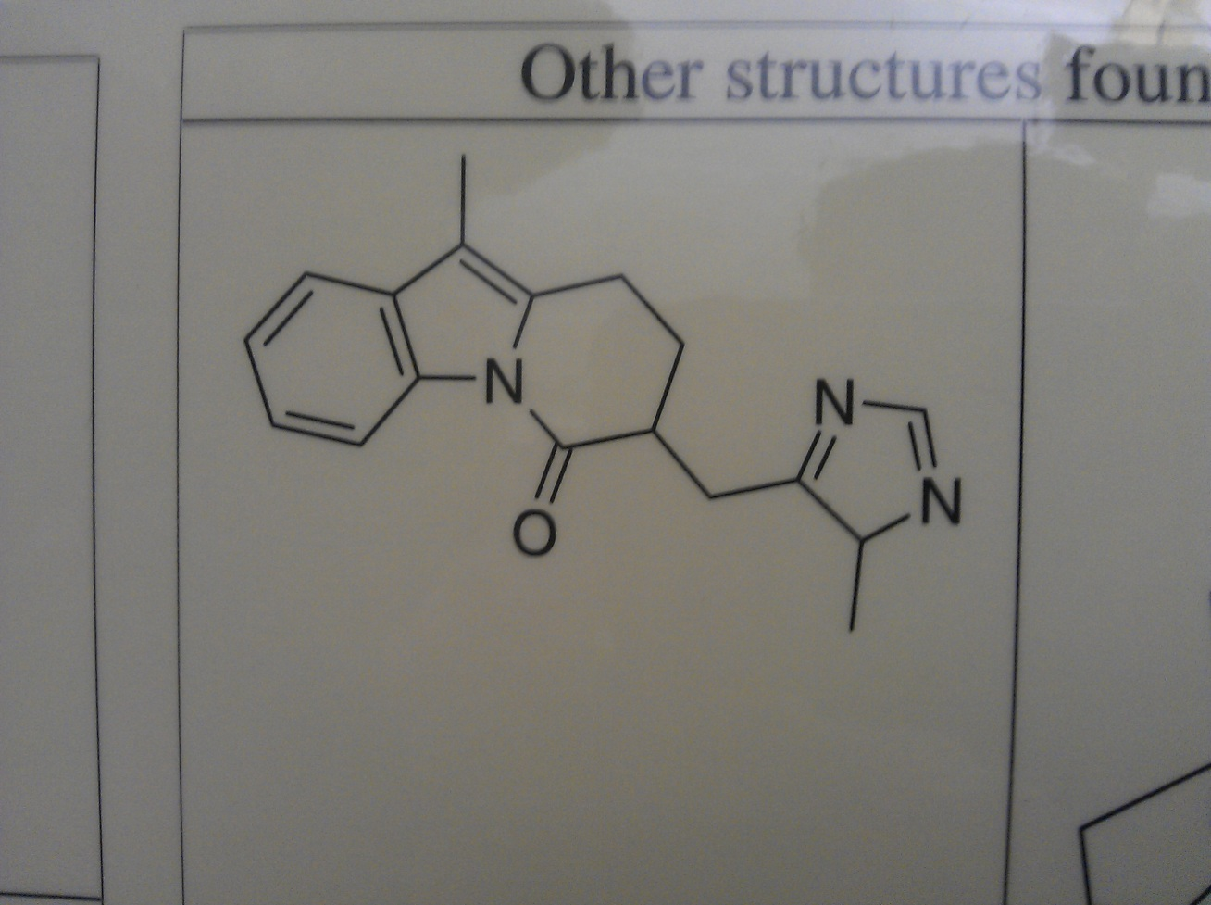
Chemical Computer Vision
Raw Mobile photo; problems:
Shadows, contrast, noise, skew, clipping

Slide 11
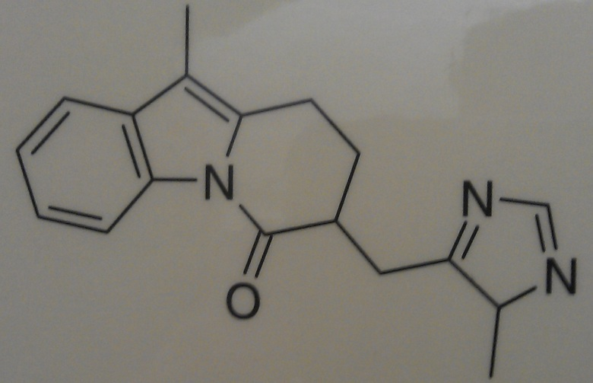
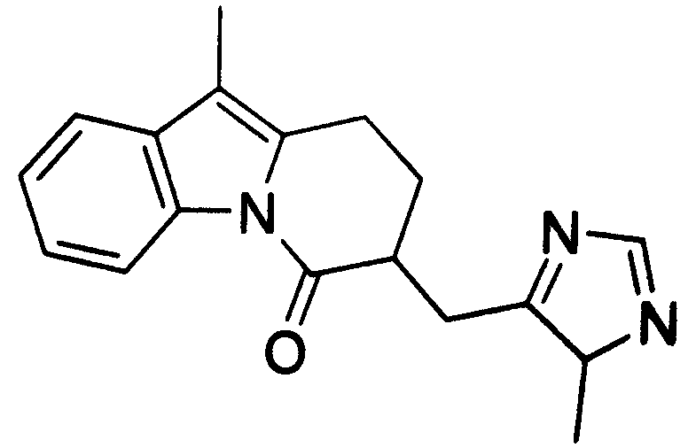
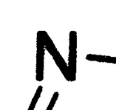
Binarization (pixels = 0,1)
Irregular edges

Slide 12
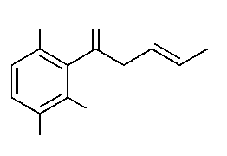
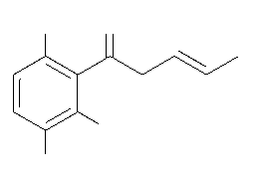
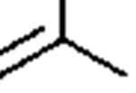

Thinning: thick lines to 1-pixel

Slide 13
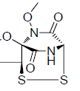
Chemical Optical Character Recognition
Small alphabet, clean typefaces, clear boundaries make this relatively tractable. Problems are “I” “O” etc.

Slide 14
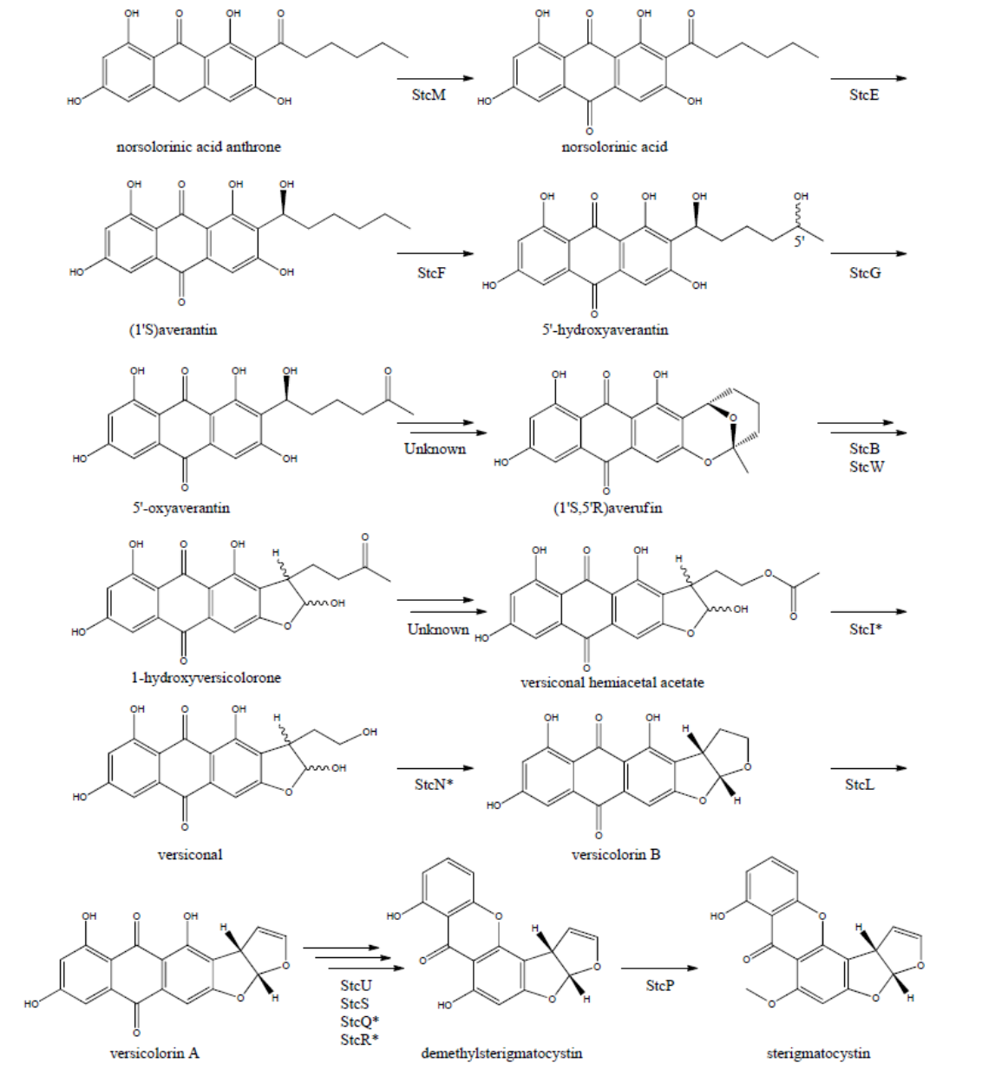
AMI https://bitbucket.org/petermr/xhtml2stm/wiki/Home
AMI reads the complete diagram, recognizes the paths and generates the molecules. Then she creates a stop-fram animation showing how the 12 reactions lead into each other
CLICK HERE FOR ANIMATION
(may be browser dependent)
Example reaction scheme, taken from MDPI Metabolites 2012, 2, 100-133; page 8, CC-BY:

Slide 15
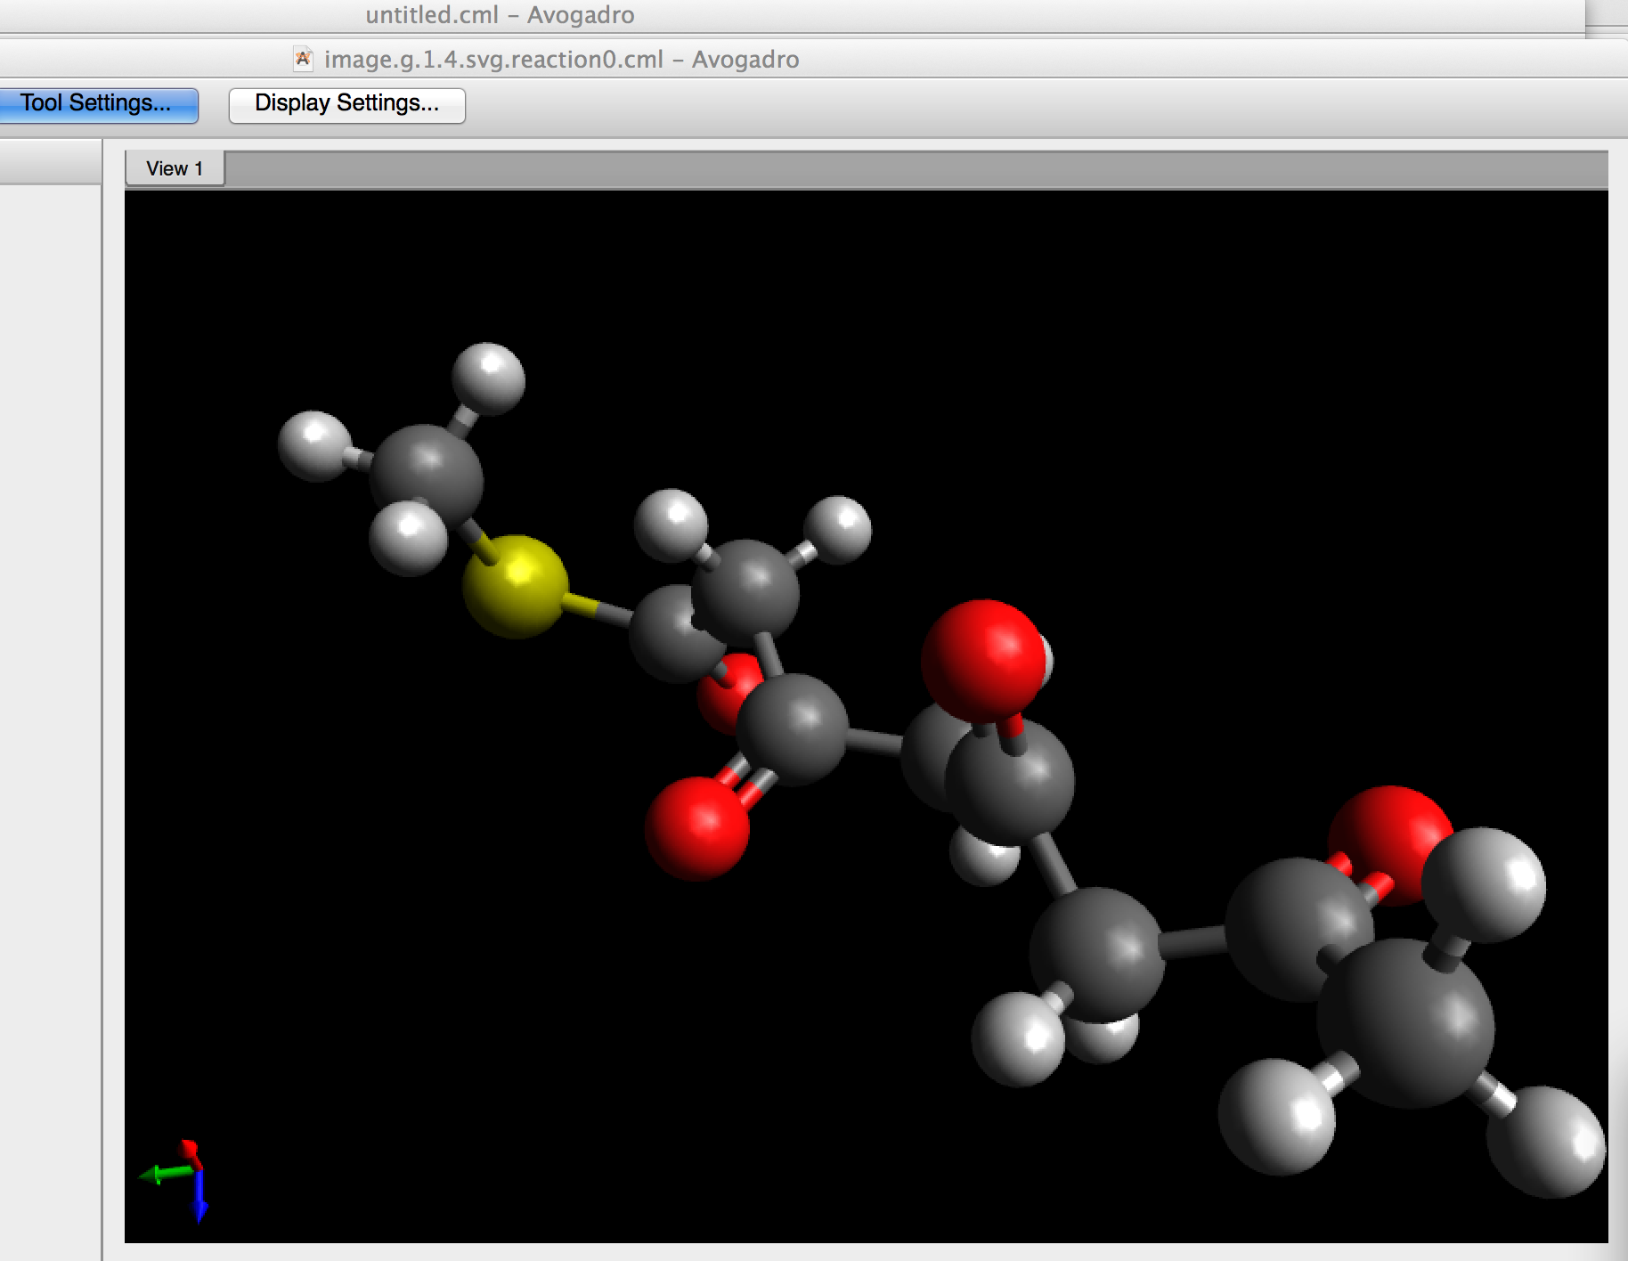
AMI Demo
https://bitbucket.org/AndyHowlett/ami2-poc
ami2-poc -i example
-v org.xmlcml.xhtml2stm.visitor.chem.ChemVisitor
May take time to start if not connected to web
Output in
./example/target/output/reactionsexample
Look at: image.g.1.4.svg.reaction0.cml in Avogadro
http://www.mdpi.com/2218-1989/2/1/39/pdf

Slide 16
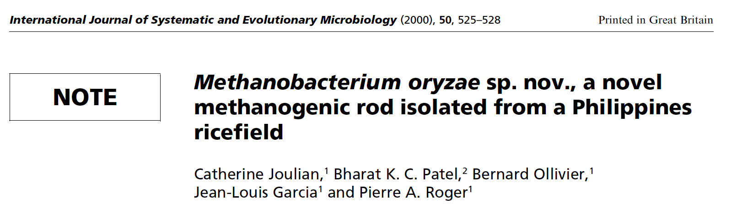
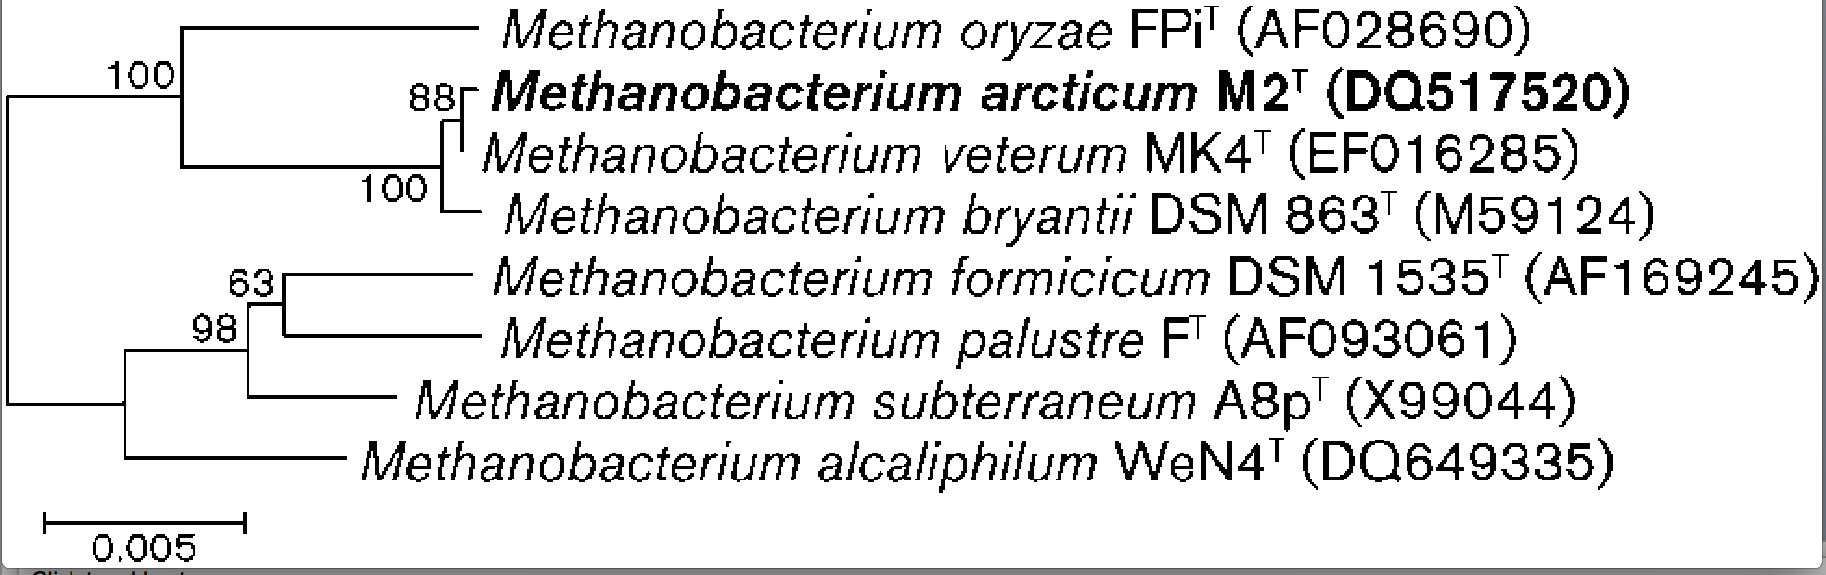
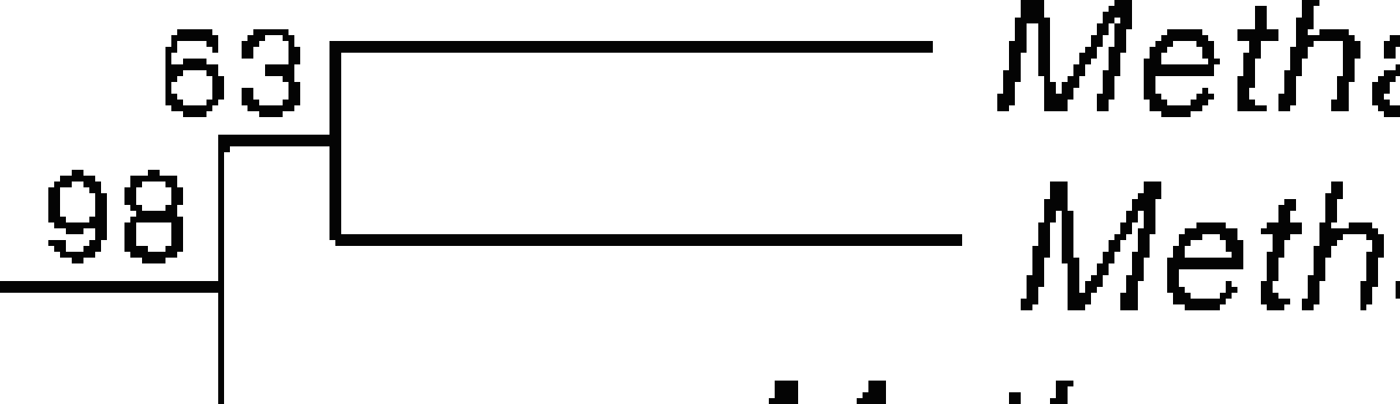
NEW Bacteria must have a phylogenetic tree
Length
_________
Binomial Name
Culture/Strain
GENBANK ID
Weight
Evolution
Rate
Note Jaggy and
broken pixels

Slide 17
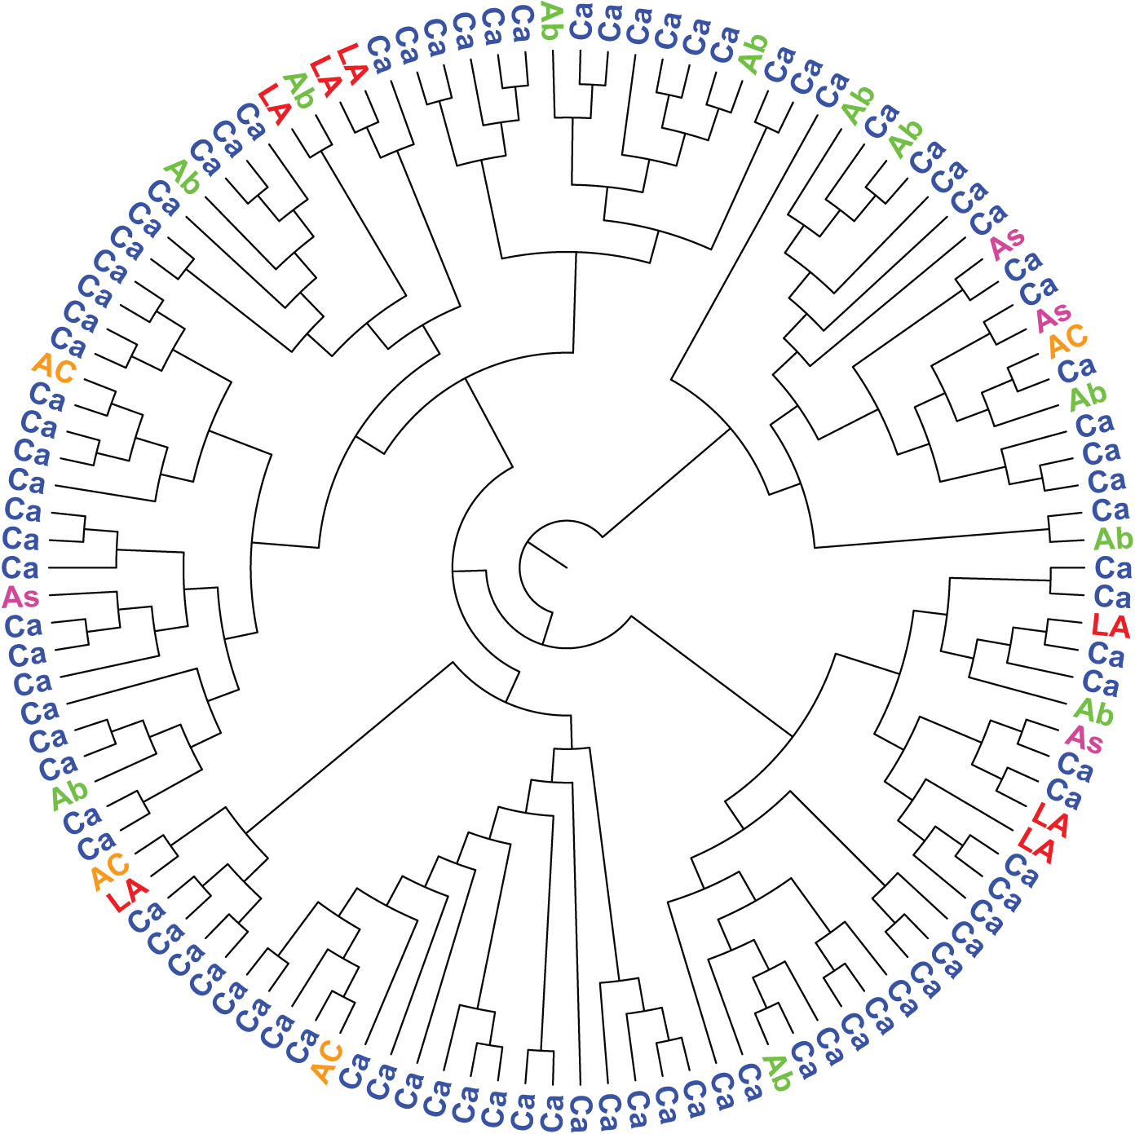
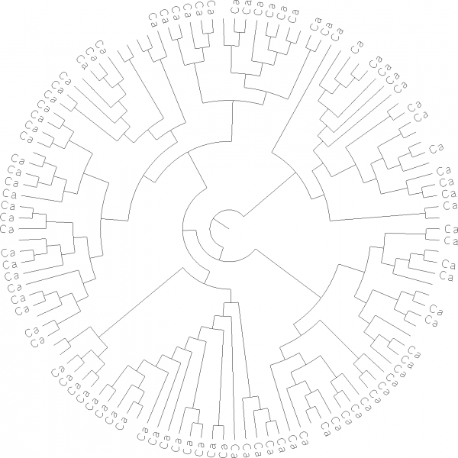
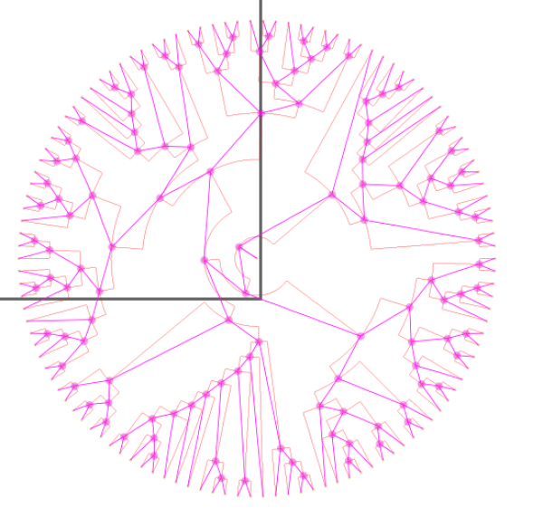
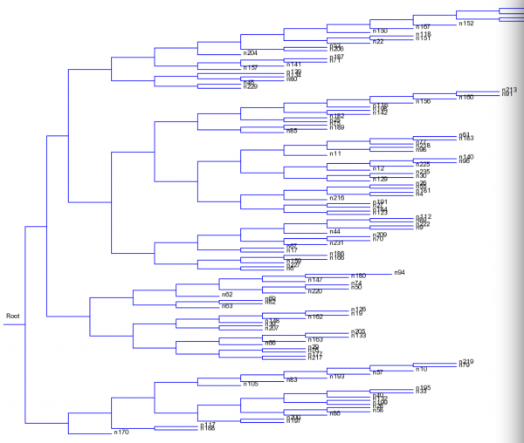
Thinning
Topology
https://blogs.ch.cam.ac.uk/pmr/2014/06/25/content-mining-we-can-now-mine-images-of-phylogenetic-trees-and-more/ for story of extraction
Serialization
Newick

Slide 18
Display your own tree
Cut and paste…
((n122,((n121,n205),((n39,(n84,((((n35,n98),n191),n22),n17))),((n10,n182),((((n232,n76),n68),(n109,n30)),(n73,(n106,n58))))))),((((((n103,n86),(n218,(n215,n157))),((n164,n143),((n190,((n108,n177),(n192,n220))),((n233,n187),n41)))),((((n59,n184),((n134,n200),(n137,(n212,((n92,n209),n29))))),(n88,(n102,n161))),((((n70,n140),(n18,n188)),(n49,((n123,n132),(n219,n198)))),(((n37,(n65,n46)),(n135,(n11,(n113,n142)))),(n210,((n69,(n216,n36)),(n231,n160))))))),(((n107,n43),((n149,n199),n74)),(((n101,(n19,n54)),n96),(n7,((n139,n5),((n170,(n25,n75)),(n146,(n154,(n194,(((n14,n116),n112),(n126,n222))))))))))),(((((n165,(n168,n128)),n129),((n114,n181),(n48,n118))),((n158,(n91,(n33,n213))),(n87,n235))),((n197,(n175,n117)),(n196,((n171,(n163,n227)),((n53,n131),n159)))))));
View with http://www.unc.edu/~bdmorris/treelib-js/demo.html or
http://www.trex.uqam.ca/index.php?action=newick&project=trex

Slide 19
Questions and comments
Technical and/or scientific, please
Politics can wait till Charles Oppenheim presentation
Thanks:
Andy Howlett, Dept Chemistry, Cambridge
Mark Williamson, Dept Chemistry, Cambridge
Ross Mounce, Biology, University of Bath

