Slide 1


The Content Mine
Peter Murray-Rust[*]
University of Cambridge, Open Knowledge,
& Shuttleworth Fellow
OKFest, Berlin, 2014-07-15, DE
[*] and Michelle Brook, Jenny Molloy, Ross Mounce, Richard Smith-Unna, Mark MacGillivray, Emanuel Toliv

Slide 2
Liberating facts for humanity*
Public science 500,000,000,000 USD per year
85% of medical research is wasted (bad design, lost data, non-communication)
ContentMine will liberate 100,000,000 facts per year from scientific literature
Crawl, Scrape, Extract, Republish
Open Data CC 0, Open Standards, Open Source
COLLABORATIVE, any data-rich discipline
[*] Closed data means people die

Slide 3
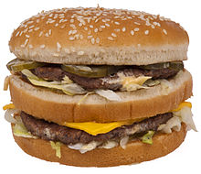
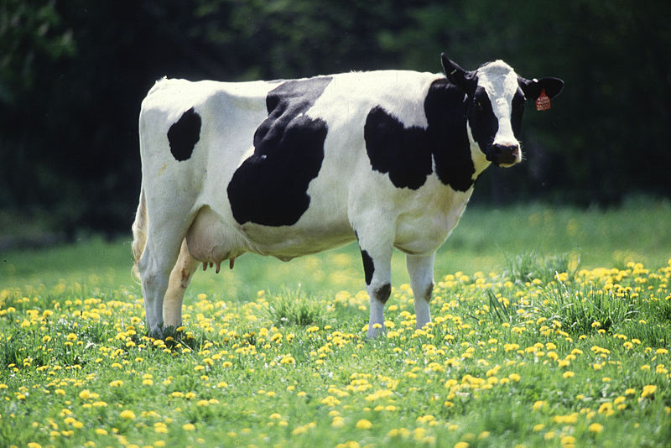
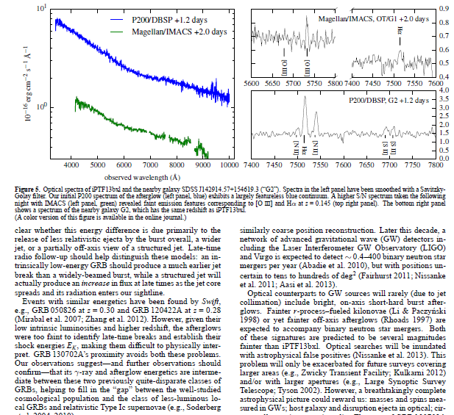
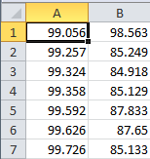

But we can now turn PDFs into Science
We can’t turn a hamburger into a cow

Slide 4
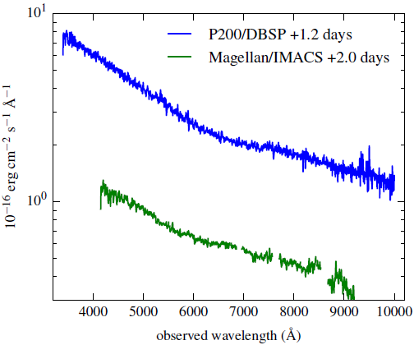
TITLES
DATA!!
2000+ points
UNITS
TICKS
SCALE
QUANTITY

Slide 5
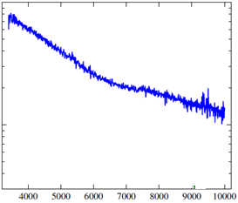
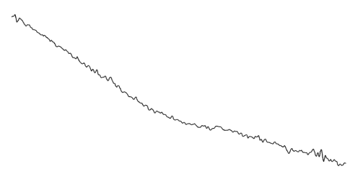
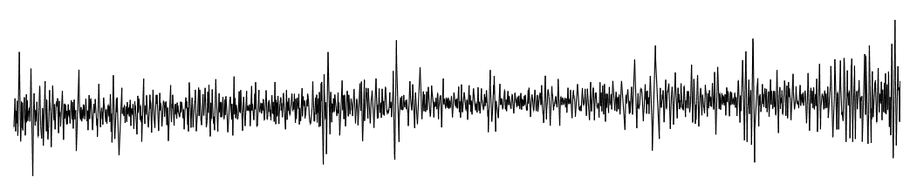

Dumb PDF
Automatic
extraction
CSV
Smoothing Gaussian Filter
Semantic
Spectrum
2nd Derivative

Slide 6
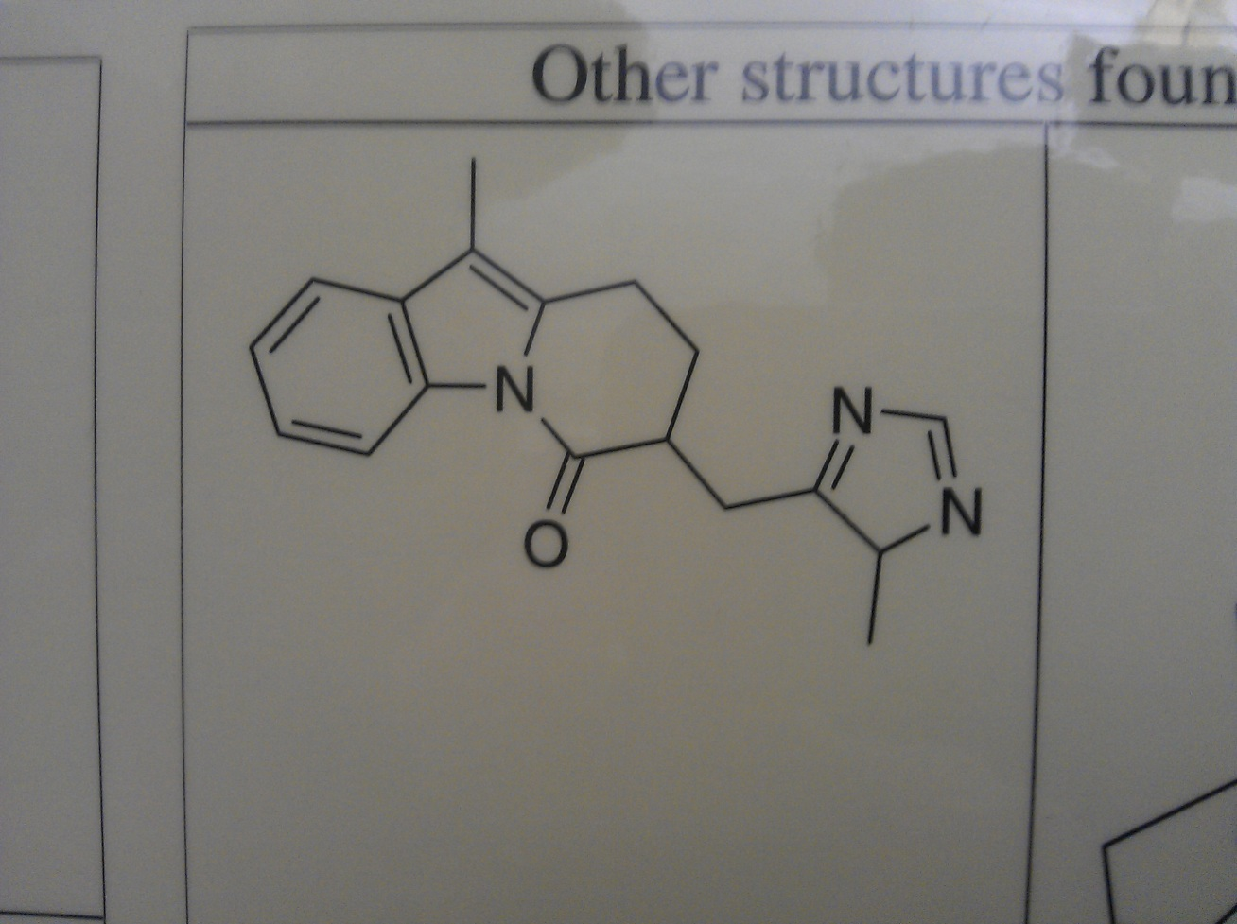
Chemical Computer Vision
1 sec to turn this into semantic science

Slide 7

PROPERTIES (Name-Value-Units-Error)
Name
Value
Units
V
U
N
V
U
N
N
V
E
U
N
V
E
U
Note CML supports value ranges and errors

Slide 8
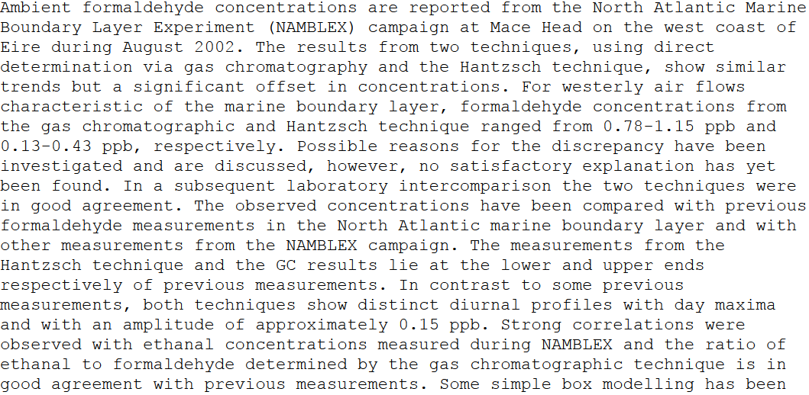
“nuggets” in a scientific paper
places
project
Value ranges
quantity
units
chemical
Humans aren’t designed to mine this … ☹

Slide 9
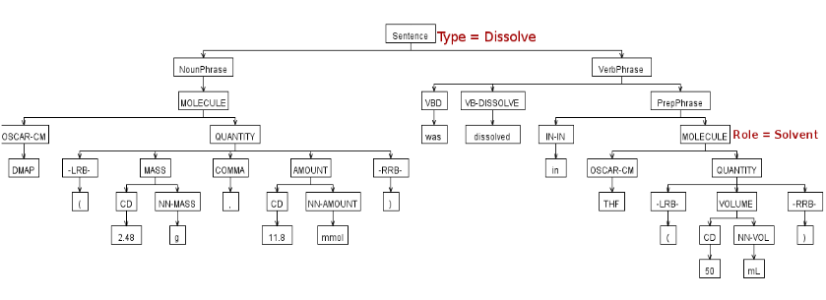
Parsing chemical sentences

Slide 10
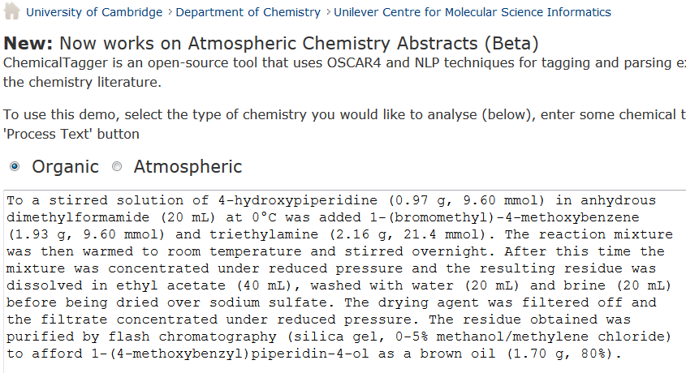
http://wwmm.ch.cam.ac.uk/chemicaltagger
Typical
Typical chemical synthesis

Slide 11
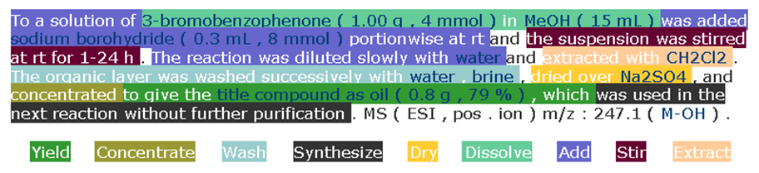
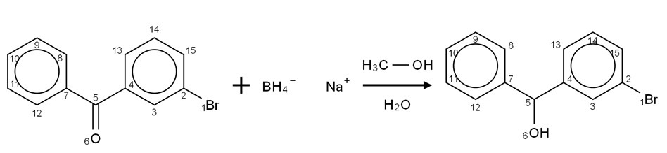
Open Content Mining of FACTs
Machines can interpret chemical reactions
We have done 500,000 patents. There are > 3,000,000 reactions/year. Added value > 1B Eur.

Slide 12
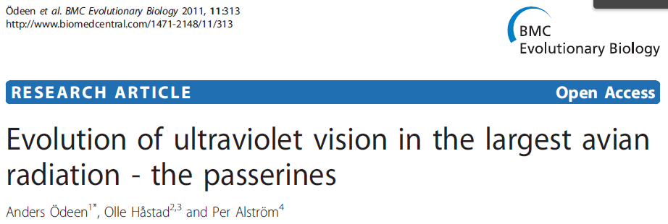
PDF ☹
AMI
HTML ☺
Evolution of ultraviolet vision in the largest avian radiation - the passerines
Anders Ödeen ^{1*} , Olle Håstad ^{2,3} and Per Alström ⁴
Styles , ^{superscripts}
And diåcritics
preserved!

Slide 13

PDF ☹
Turdus iliacus
Taeniopygia guttata
Serinus canaria
Lanius excubitor
Melopsittacus undulatus
Pavo cristatus
Sturnus vulgaris
Dolichonyx oryzivorus
Ficedula hypoleuca
Vaccinium myrtillus
Falco tinnunculus
Turdus
Pomatostomus
Leothrix
Amytornis
Acanthisitta
Orthonyx x 2
Malurus
Cnemophilus x 4
Philesturnus x 2
Motacilla x 2
Toxorhampus x 2

Slide 14
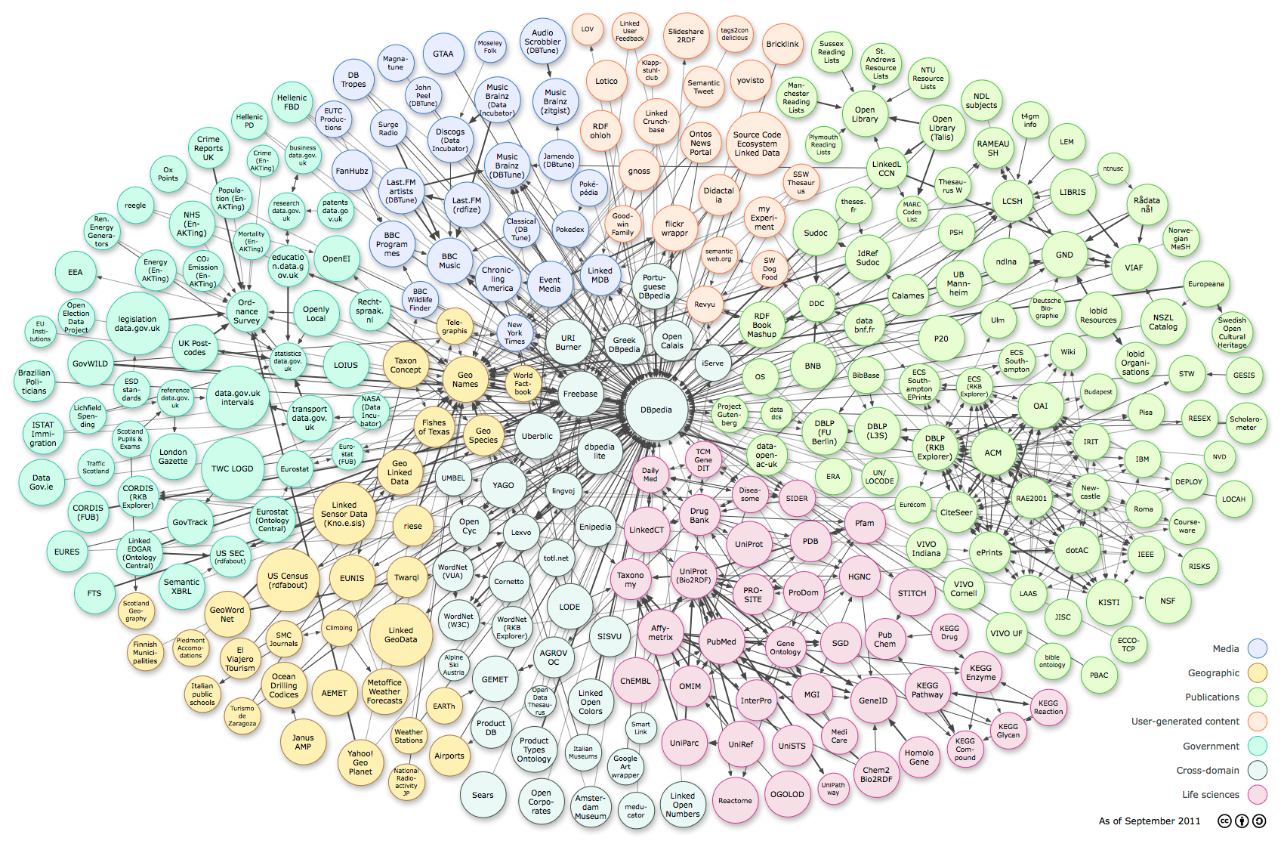
Linked Open Data – the world’s knowledge
RDF
triples
Music,
Art
Literature
Social
DBPedia
Knowledge
bases
Lib
GOV.uk
Comp
PDB
GOV
BIO
Ontologies
very little physical science ☹
http://upload.wikimedia.org/wikipedia/commons/3/34/LOD_Cloud_Diagram_as_of_September_2011.png

Slide 15
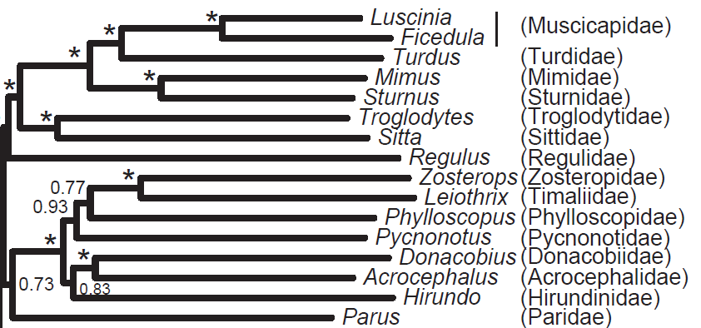
AMI
Acanthisittidae
Acanthizidae
Acrocephalidae
Callaeidae
Campephagidae
Cnemophilidae
Corvidae
Acanthisitta
Acrocephalus
Ailuroedus
Ailuroedus
Amytornis
Camptostoma
0.84
0.91
0.93
0.95
23.12
34.54
37.21
38.55
NexML
HTML
Posterior
probability
AMI can MEASURE
Branch lengths!
Genus
Family

Slide 16
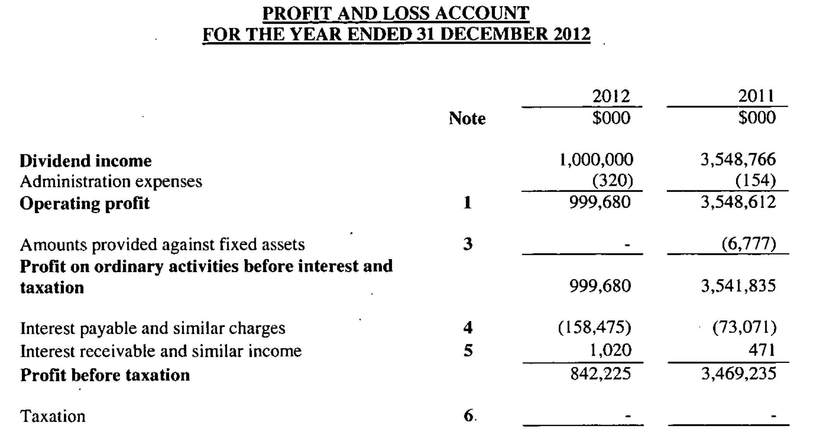
We can do any data…

Slide 17
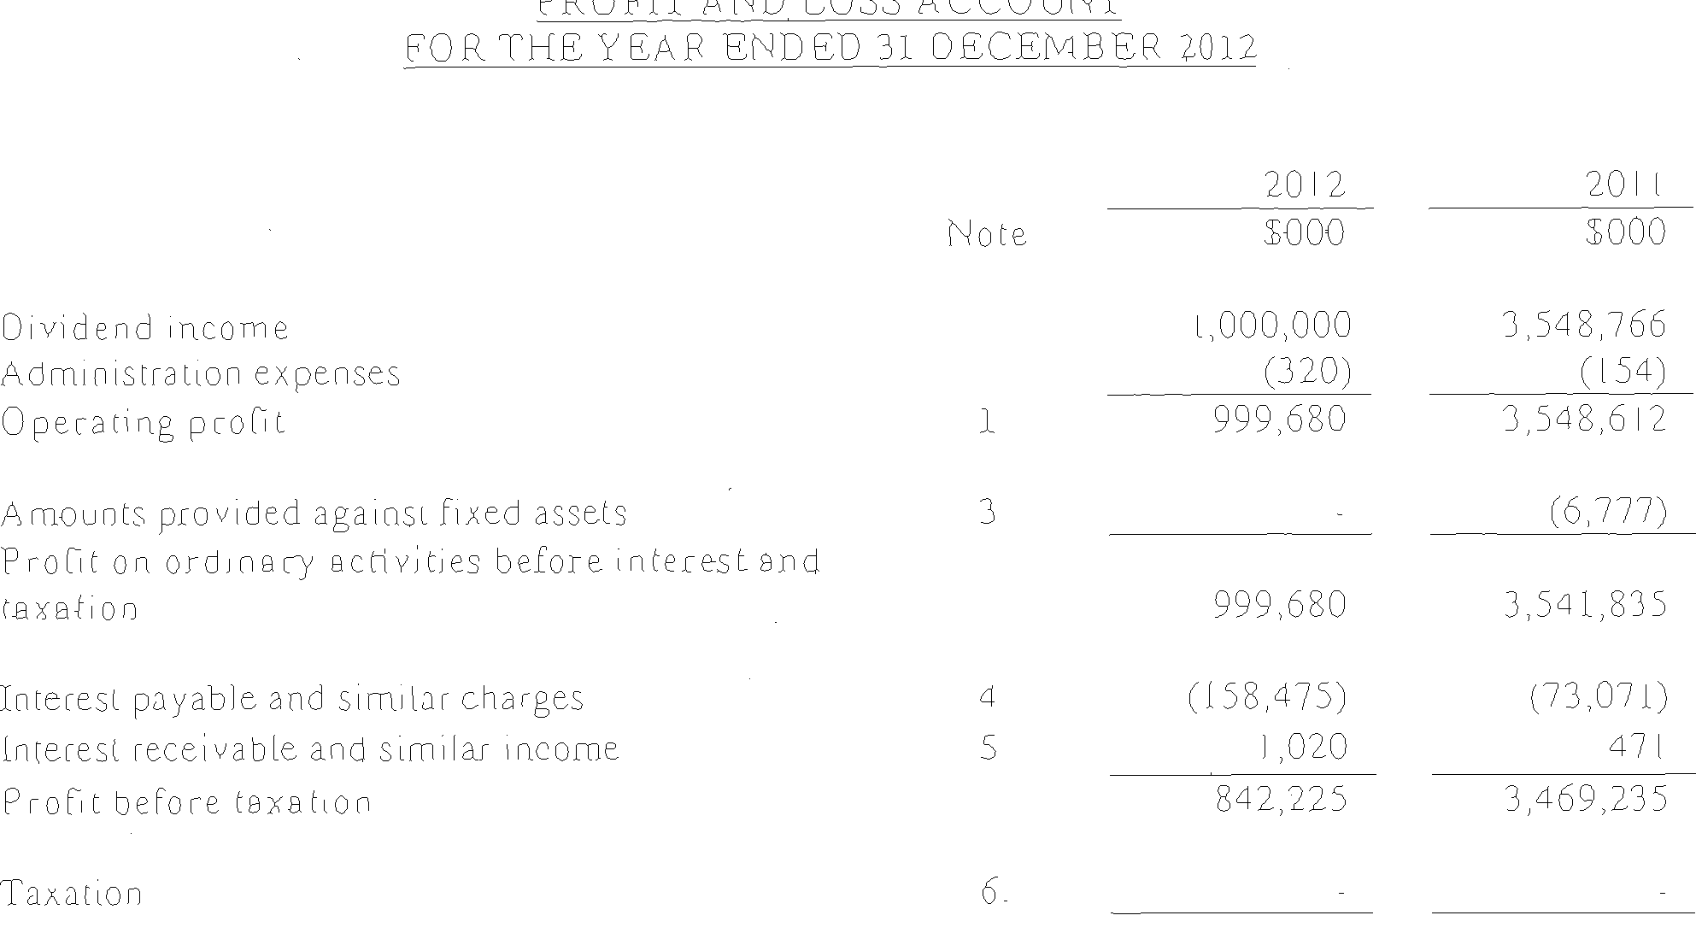
… pixel analysis …

